Slide 1
A Tour through the Linux Filesystem
Dr. Charles J. Antonelli
Research Systems Group
LSA Information Technology
The University of Michigan
2012

Slide 2
Roadmap
UNIX Filesystem History
Linux Filesystem Theory
Linux Filesystem Practicum

Slide 3
The UNIX Filesystem

Slide 4
Filesystem Concepts
Filesystems organize file data on permanent media
Filesystems create and associate file data and metadata
Filesystems provide secure, scalable, efficient permanent storage

Slide 5
The UNIX Filesystem
In the beginning, there were two
  UNIX™ File System (1971)¹
  Berkeley Fast File System (1983)²

Slide 6
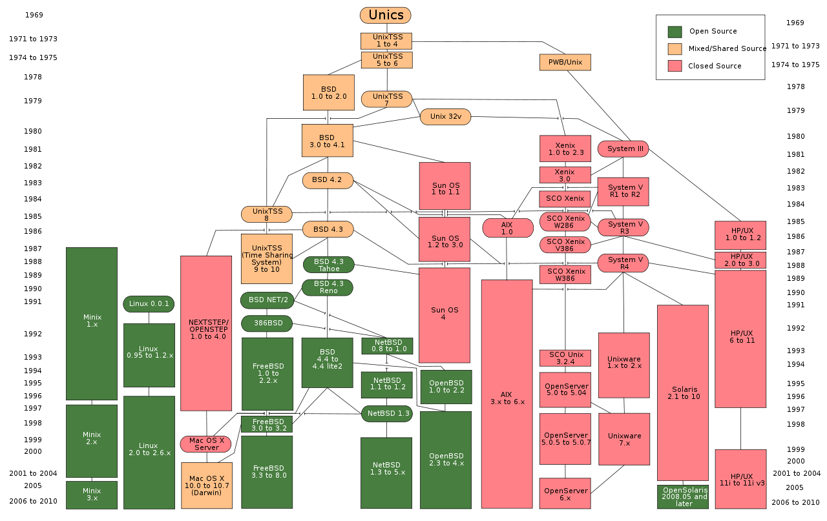
After that, things got complicated
http://en.wikipedia.org/wiki/Berkeley_Software_Distribution

Slide 7
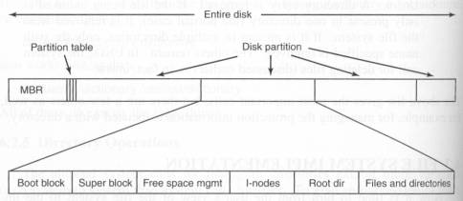
UNIX™ File System Disk Layout
Stolen from “A Fast File System For UNIX,” Presented by Zhifei Wang

Slide 8
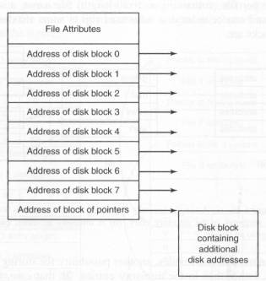
UNIX™ Inodes
Inodes (“Index nodes”):
  File ownership information
  Time Stamps for last modification/access
  Array of pointers to data blocks of the underlying file
Stolen from “A Fast File System For UNIX,” Presented by Zhifei Wang

Slide 9
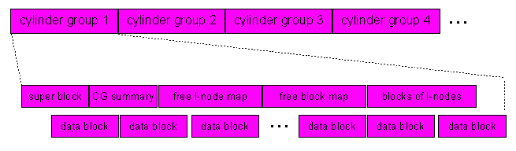
Berkeley Fast File System
Addresses performance issues by dividing a disk partition into one or more cylinder groups
Excerpted from “A Fast File System For UNIX,” Presented by Zhifei Wang

Slide 10
UNIX Filesystem Concepts
A (regular) file is a linear array of bytes that can be read or written starting at any byte offset in the file
The size of the file offset determines the absolute maximum size of any file:
Offset size, bits | Maximum file size, bytes
16 | 2¹⁶ | 65,536
32 | 2³² | 4,294,967,296
64 | 2⁶⁴ | 1.84e+19
128 | 2¹²⁸ | 3.40e+38
Notes:
1 yottabyte = 10^24

Slide 11
UNIX Filesystem Concepts
File names are stored in a file called a directory
Directories may refer to other directories as well as to files
A hierarchy of these directories is called a filesystem
Each filesystem tree (a connected graph with no cycles) has a single topmost root directory
Hardware devices are represented as special files
A UNIX mantra: everything is a file
Notes:
Nice thing about a tree

Slide 12
UNIX Filesystem Concepts
The root of one filesystem may be mounted on a mount point of another filesystem
The user sees one aggregated filesystem with one root, while the operating system manages several logical filesystems, each on a different device
A filesystem device may be physical permanent storage, a portion of same, an aggregation of same (a logical volume), a remote filesystem, physical volatile storage, or a file stored in another filesystem

Slide 13
Absolute vs. relative path names
A file is accessed using its path name
Absolute path name
  /dir1/dir2/…/dirn/filename
  /opt/moab/etc/moab.cfg
Relative path name
  current-working-directory/filename
  moab.cfg
Every process maintains a notion of a current working directory
  Initialized at login from /etc/passwd home directory field
  Changed via chdir() system call

Slide 14
UNIX Filesystem Implementation
An inode (index node) contains bookkeeping information about each file. Inode numbers are unique to a filesystem
A hard link is a directory entry which contains the target file’s inode
A symbolic link is a directory entry which contains the inode of a special file containing the path name to the target file

Slide 15
Directories
A special file which maps names to inode numbers
There are always 2 hard links
  . (dot) is self-referential
  .. (dotdot) refers to the parent directory
File permissions are stored in the inode, and not the directory

Slide 16
Directories
A hard link results in two (or more) directory entries that point to the same inode
  Can’t hard link directories
  Can’t cross filesystem boundary
  Identical permissions for different links
A soft link is a separate directory entry whose file contains a pathname
  Can soft link directories
    Now it’s a filesystem graph
  Can cross filesystem boundary
  Separate permissions for different links
  “Dangling softlink” if pointed-to file is deleted

Slide 17
File Permissions I
Three permission bits, aka mode bits
  Files: Read, Write, Execute
  Directories: List, Modify, Search
Three user classes
  User (File Owner), File Group, Other

Slide 18
File Permissions, examples
  -rwxr-xr-x cja lsait
  file read, write, and execute rights for the owner, read and execute for others
  -rwsr-x--x cja lsait
  same permissions as above, but on exec() the process will run with cja’s credentials
  drwxr-x--x cja lsait
  list, modify, and search for the owner, list and search for group, and execute only for others

Slide 19
File Permissions II
Three special bits:
  Setuid
    Executable has file owner’s user id, not invoker’s
  Setgid
    Executable has file group’s group id, not invoker’s
  Sticky
    Directory: only owner of the directory or of a file it contains can delete or rename the file

Slide 20
File Permissions, intermezzo
Given
  -rw-r--r-x cja lsait
  What rights would drhey have to this file?

Slide 21
UNIX Filesystem
The UNIX filesystem buffer cache improves performance while maintaining “UNIX semantics”
  Write changes seen by subsequent readers
  File reads obviate disk reads if the data are already buffered
  File writes are buffered but not immediately written to disk
  Metadata writes are ordered and written synchronously to enable fsck to function correctly

Slide 22
UNIX Filesystem
This buffering is a potential source of file system inconsistency, since the filesystem state on disk can differ from the in-memory filesystem state
  If the operating system crashes, you will lose the in-memory state
The fsck utility restores disk filesystem consistency
  But the time taken is proportional to the filesystem size, regardless of activity

Slide 23
Linux Filesystems

Slide 24
Create an ext4 filesystem
ssh student@ci.lsait.lsa.umich.edu
mkdir uniqname; cd uniqname
dd if=/dev/zero of=mydev bs=`expr 1024 \* 1024` count=100
mkfs -F -t ext4 mydev
mkdir mymnt
sudo mount mydev mymnt
dumpe2fs mydev

Slide 25

Phasers on stun, please, Mr. Sulu!

Slide 26
Linux ext4
Fourth extended filesystem
  Minix (pre-1992)
  ext (1992)
  ext2 (1993)
  ext3 (2001)
  ext4 (2008)

Slide 27
Minix fs
Toy filesystem, used for teaching
14-character file names
16-bit file offsets
  => 64 MB maximum file size

Slide 28
ext
First Linux filesystem to use VFS API
255-character file names
32-bit file offsets
  => 2 GB maximum file size

Slide 29
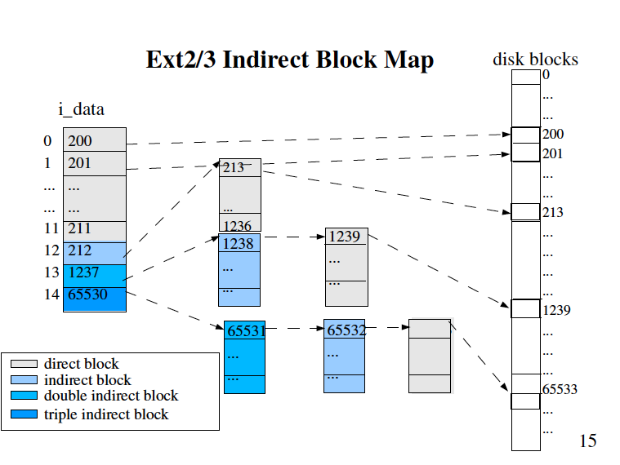
Linux block mapping
Cao et al, Ottawa Linux Symposium, 2005.

Slide 30
ext2
Re-implementation of ext
  With ideas from Berkeley FFS
255-character file names
64-bit file offsets
  => 2⁶⁴ GB theoretical maximum file size
    Really 16 GB and up, depends on file system block size and block pointer size

Slide 31
ext3
Journaling
  Data and/or metadata are written to the journal before being committed
  After a crash, the journal is replayed at boot to restore filesystem consistency
  => replay time depends on level of activity in a filesystem and not its size

Slide 32
ext3
Journaling levels
  Journal: data and metadata journaled (slowest, safest)
  Ordered: metadata journaled, data writes completed before entry committed to journal, à la fsck (faster, safer, default)
  Writeback: metadata journaled, data writes unsynchronized (fastest, riskiest)
/home/cja/mydev on /home/cja/mymnt type ext4
(rw,relatime,seclabel,user_xattr,acl,barrier=1,data=ordered)
Notes:
writeback,noatime,barrier=0 reported to yield 30% performance improvement
http://blog.smartlogicsolutions.com/2009/06/04/mount-options-to-improve-ext4-file-system-performance/
relatime
Update inode access times relative to modify or change time.
Access time is only updated if the previous access time was ear‐
lier than the current modify or change time. (Similar to noat‐
ime, but doesn't break mutt or other applications that need to
know if a file has been read since the last time it was modi‐
fied.)
Since Linux 2.6.30, the kernel defaults to the behavior provided
by this option (unless noatime was specified), and the stricta‐
time option is required to obtain traditional semantics. In
addition, since Linux 2.6.30, the file's last access time is
always updated if it is more than 1 day old.

Slide 33
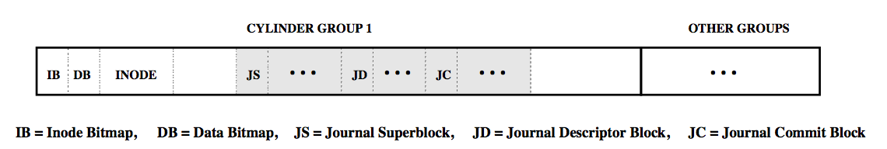
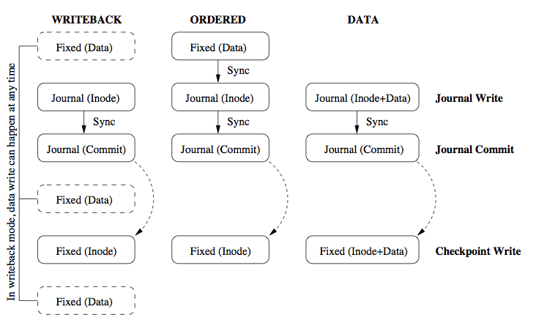
ext3
Prabhakaran et al 2005, Proc. USENIX Annual Conference

Slide 34
Compare journaling performance
cd ~/uniqname/mymnt
time for f in `seq 1 100`; do for g in `seq 1 100`; do mkdir $f.$g; done done; time for f in `seq 1 100`; do for g in `seq 1 100`; do rmdir $f.$g; done done
cd ..
sudo umount mymnt
sudo mount mydev mymnt -o data=writeback,noatime,barrier=0
cd mymnt
time for f in `seq 1 100`; do for g in `seq 1 100`; do mkdir $f.$g; done done; time for f in `seq 1 100`; do for g in `seq 1 100`; do rmdir $f.$g; done done

Slide 35
ext3
Access control lists
  Access may be controlled for arbitrary users and groups
    No longer limited to user,group,other
  Set for files and directories
    Directories may have default ACLs
    ACLs are inherited
  Discretionary

Slide 36
Manipulate ACLs
cd ~/uniqname/mymnt
mkdir foo; cd foo; echo bar>bar; ls -la # notice mode bits end with .
getfacl bar # no acls on bar, just mode bits
setfacl -m u:cja:r bar # set an acl on a file
getfacl bar # user cja has read rights
echo baz>baz # create a file
getfacl baz # user cja has no read rights
ls –l # mode bits with acls end with +
setfacl -d -m u:tcpdump:rx . # assign default acl
getfacl . # see what it looks like
echo quux>quux # create a file
getfacl quux # user cja has read rights
mkdir qqsv # make a subdirectory
getfacl qqsv # it inherits the default rights
cd qqsv # enter the new subdirectory
echo foo>foo # create another file
getfacl foo # user cja has read rights

Slide 37
ext3
HTree indexing of directory names
  Linear search suffers O(n) performance
  B-trees allow O(log₂n) search/insert/delete but need balancing and require complex algorithms
  HTrees have similar benefits but simpler to implement
    Hash, high fanout, constant depth
    No balancing required
Notes:
Htrees are special cases of B-Trees that (a) have two levels and (b) don’t require balancing.

Slide 38
ext3
File system online growth
  Can increase (and decrease) filesystem size without reboot
Backwards-compatible with ext2
  ext3 can mount ext2 filesystems
  ext2 forward compatible in some cases
Notes:
Htrees are special cases of B-Trees that (a) have two levels and (b) don’t require balancing.

Slide 39
Resize a filesystem
cd ~/uniqname
sudo umount mymnt
cat mydev mydev >bigdev
sudo mount bigdev mymnt
df -kh mymnt
… verify filesystem is still 100 MB in size
sudo umount mymnt
e2fsck -f bigdev
resize2fs bigdev
sudo mount bigdev mymnt
df -kh mymnt

Slide 40
ext4
1 EB maximum filesystem size
16 TB maximum file size
64,000 maximum directory entries
Extents for contiguous allocation
  128 MB extent with 4 KB block size
Backwards-compatible with ext3 & ext2
  Ext3 forwards-compatible in some cases

Slide 41
ext4
Persistent pre-allocation
  Pre-allocate contiguous space
  Media streaming, databases
Nanosecond-granularity timestamps
  Date-of-creation timestamp, filesystem only
relatime option
  Only updates atime if old atime older than mtime or ctime (can check is file was read after being written without atime cost)
Several other enhancements
  Journal checksums, online defragmentation, faster fsck, multi-block & delayed allocation

Slide 42
References
Maurice Bach, The Design of the UNIX Operating System, ISBN 978-0132017992, Prentice Hall, 1986.
Dennis M. Ritchie, Ken Thompson, “The UNIX Time Sharing System,” Communications of the ACM, Vol. 17 Issue 7, pp. 365-375, July 1974. http://dl.acm.org/citation.cfm?id=361061
Marshall K. McKusick, William N. Joy, Samuel J. Leffler, and Robert S. Fabry, “A Fast File System for UNIX,” ACM Transactions on Computer Systems, Vol. 2, No. 3, pp. 181-197, August 1984. http://dl.acm.org/citation.cfm?id=990
http://en.wikipedia.org/wiki/Berkeley_Software_Distribution
http://en.wikipedia.org/wiki/Ext4 et al
http://kernel.org/doc/Documentation/filesystems/ext4.txt
Vijayan Prabhakaran, Andrea C. Arpaci-Dusseau, and Remzi H. Arpaci-Dusseau, “Analysis and Evolution of Journaling File Systems,” Proc. USENIX Annual Technical Conference, 2005.
http://kerneltrap.org/node/14148
http://en.wikipedia.org/wiki/Filesystem_Hierarchy_Standard
Sandberg, R., Goldberg, D., Kleiman, S., Walsh, D., and B. Lyon, "Design and Implementation of the Sun Network Filesystem," Proc. 1985 Summer USENIX Technical Conference.
Sun Microsystems, Inc., "NFS: Network File System Protocol Specification", RFC 1094, March 1989. http://www.ietf.org/rfc/rfc1094.txt
Pawlowski, B., Juszczak, C., Staubach, P., Smith, C., Lebel, D., and D. Hitz, "NFS Version 3 Design and Implementation", Proc. USENIX 1994 Summer Technical Conference.

