Slide 1
High Performance
Computing: Technologies and Opportunities
Dr. Charles J Antonelli
LSAIT ARS
May, 2013

Slide 2
ES13 Mechanics
Welcome! Please sign in
  If registered, check the box next to your name
  If walk-in, please write your name, email, standing, unit, and department
Please drop from sessions for which you registered by do not plan to attend – this makes room for folks on the wait list
Please attend sessions that interest you, even if you are on the wait list

Slide 3
Goals
High-level introduction to high-performance computing
Overview of high-performance computing resources, including XSEDE and Flux
Demonstrations of high-performance computing on GPUs and Flux

Slide 4
Introductions
Name and department
Area of research
What are you hoping to learn today?

Slide 5
Roadmap
High Performance Computing Overview
CPUs and GPUs
XSEDE
Flux
  Architecture & Mechanics
  Batch Operations & Scheduling

Slide 6
High Performance Computing

Slide 7

High Performance Computing
https://www.xsede.org/nics-kraken
Notes:
Kraken – Cray XT5: 9,408 compute nodes, 12 cores each, 112,896 cores total, 1.3 GB/core

Slide 8
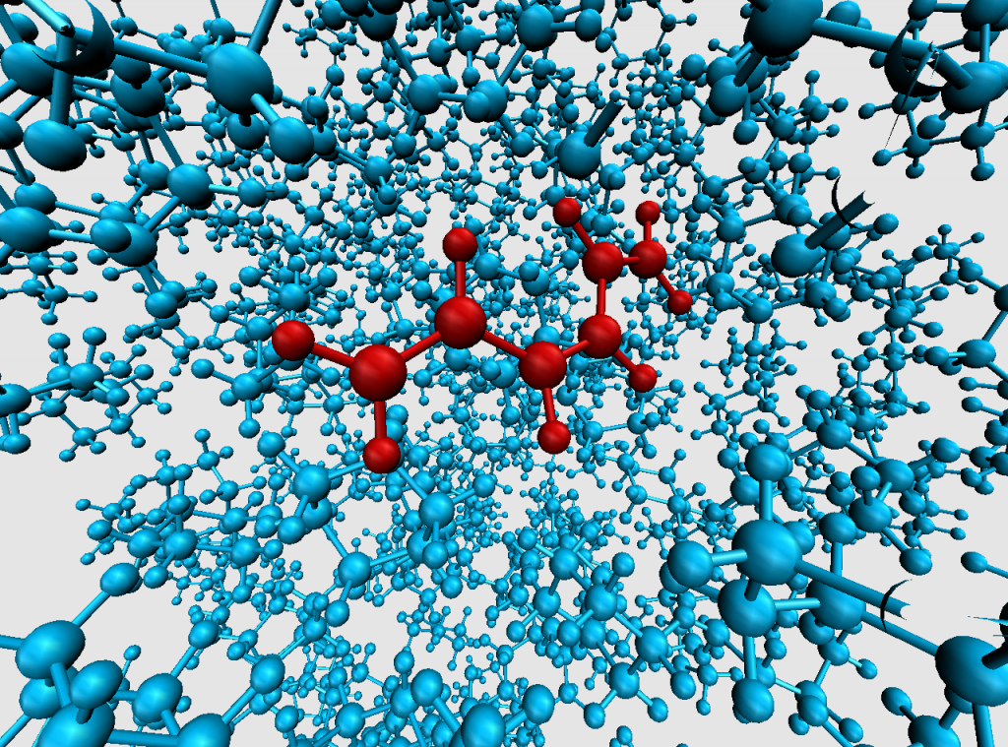
High Performance Computing
Image courtesy of Frank Vazquez, Surma Talapatra, and Eitan Geva.
http://arc.research.umich.edu/
Notes:
The Sension Group in U-M's Chemistry Dept. uses ultrafast laser techniques to probe molecular dynamics in liquid solution in real time. Their observation that isomerization in alkane solvents is faster than in alcohol solvents contradicted the trend predicted by conventional theory. Calculations by the Geva group based on simulations carried out on FLUX were able to reproduce the experimental trend and trace it back to the inherently different molecular structures of alcohols and alkanes not taken into account by previous models (as demonstrated here). Image courtesy of Frank Vazquez, Surma Talapatra, and Eitan Geva.

Slide 9
Node
P
RAM
Process
Processor
Local disk

Slide 10
High Performance Computing
“Computing at scale”
Computing cluster
  Collection of powerful computers (nodes), interconnected by a high-performance network, connected to large amounts of high-speed permanent storage
Parallel code
  Application whose components run concurrently on the cluster’s nodes

Slide 11
Coarse-grained parallelism
Notes:
Lots of experimentation with connectivity models in 80s and 90s
Note these nodes don’t have uniform connectivity

Slide 12
Programming Models (1)
Coarse-grained parallelism
The parallel application consists of several processes running on different nodes and communicating with each other over the network
  Used when the data are too large to fit on a single node, and simple synchronization is adequate
  “Message-passing”
  Implemented using software libraries
    MPI (Message Passing Interface)

Slide 13
Fine-grained parallelism
RAM
Cores
Local disk
Notes:
With the end of Moore’s law (chip density doubles every 18 months, true for 20 years), we now build multicore systems
One implication is increased emphasis on parallel software

Slide 14
Programming Models (2)
Fine-grained parallelism
The parallel application consists of a single process containing several parallel threads that communicate with each other using synchronization primitives
  Used when the data can fit into a single process, and the communications overhead of the message-passing model is intolerable
  “Shared-memory parallelism” or “multi-threaded parallelism”
  Implemented using compilers and software libraries
    OpenMP (Open Multi-Processing)
Notes:
Of course, you can combine the two models in a single parallel application

Slide 15
Advantages of HPC
More scalable than your laptop
Cheaper than a mainframe
Buy or rent only what you need
COTS hardware, software, expertise

Slide 16
Why HPC
More scalable than your laptop
Cheaper than the mainframe
Buy or rent only what you need
COTS hardware, software, expertise

Slide 17
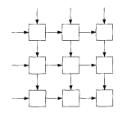
Good parallel
Embarrassingly parallel
  Folding@home, RSA Challenges, password cracking, …
  http://en.wikipedia.org/wiki/List_of_distributed_computing_projects
Regular structures
  Equal size, stride, processing
  Pipelines

Slide 18
Less good parallel
Serial algorithms
  Those that don’t parallelize easily
Irregular data & communications structures
  E.g., surface/subsurface water hydrology modeling
Tightly-coupled algorithms
Unbalanced algorithms
  Master/worker algorithms, where the worker load is uneven

Slide 19

Amdahl’s Law
If you enhance a fraction f of a computation
by a speedup S, the overall speedup is:

Slide 20
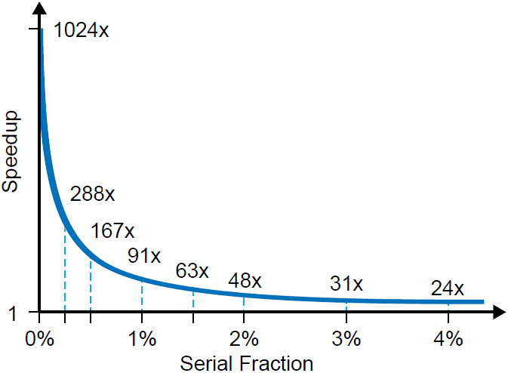
Amdahl’s Law

Slide 21
CPUs and GPUs

Slide 22
CPU
Central processing unit
Executes serially instructions stored in memory
A CPU may contain a handful of cores
Focus is on executing instructions as quickly as possible
  Aggressive caching (L1, L2)
  Pipelined architecture
  Optimized execution strategies
Notes:
Speculative execution

Slide 23
GPU
Graphics processing unit
Parallel throughput architecture
  Focus is on executing many GPU cores slowly, rather than a single CPU very quickly
Simpler processor
Hundreds of cores in a single GPU
“Single-Instruction Multiple-Data”
Ideal for embarrassingly parallel graphics problems
  e.g., 3D projection, where each pixel is rendered independently
Notes:
Similarly for Xeon Phi

Slide 24
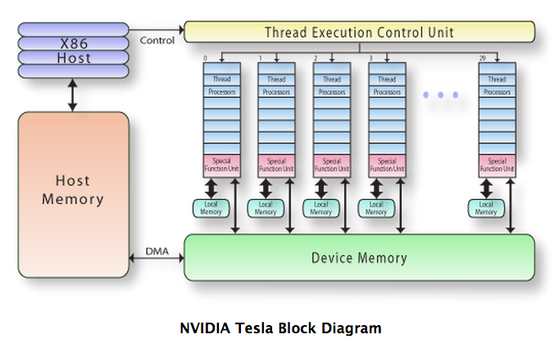
High Performance Computing
http://www.pgroup.com/lit/articles/insider/v2n1a5.htm

Slide 25
GPGPU
General-purpose computing on graphics processing units
Use of GPU for computation in applications traditionally handled by CPUs
Application a good fit for GPU when
  Embarrassingly parallel
  Computationally intensive
  Minimal dependencies between data elements
Not so good when
  Extensive data transfer from CPU to GPU memory are required
  When data are accessed irregularly

Slide 26
Programming models
CUDA
  Nvidia proprietary
  Architectural and programming framework
  C/C++ and extensions
  Compilers and software libraries
  Generations of GPUs: Fermi, Tesla, Kepler
OpenCL
  Open standard competitor to CUDA

Slide 27
GPU-enabled applications
Application writers provide GPGPU support
  Amber
  GAMESS
  MATLAB
  Mathematica
  …
  See list at http://www.nvidia.com/docs/IO/123576/nv-applications-catalog-lowres.pdf

Slide 28
Demonstration
Task: Compare CPU / GPU performance in MATLAB
Demonstrated on the Statistics Department & LSA CUDA and Visualization Workstation
Notes:
ssh visualize01.stat.lsa.umich.edu
~smeyer/deviceQuery
matlab –nodisplay
igpu

Slide 29
Recommended Session
Introduction to the CUDA GPU and Visualization Workstation Available to LSA
Presenter: Seth Meyer
Thursday, 5/9, 1:00 pm – 3:00 pm
429 West Hall
1085 South University, Central Campus

Slide 30
Further Study
Virtual School of Computational Science and Engineering (VSCSE)
  Data Intensive Summer School (July 8-10, 2013)
  Proven Algorithmic Techniques for Many-Core Processors (July 29 – August 2, 2013)
https://www.xsede.org/virtual-school-summer-courses
http://www.vscse.org/
Notes:
Concrete steps:
Attend Seth’s talk
Sign up for Data Intensive workshop, maybe Algorithmic Techniques
If in LSA, experiment with GPU support on visualize01.stat.lsa.umich.edu

Slide 31
XSEDE

Slide 32
XSEDE
Extreme Science and Engineering Discovery Environment
  Follow-on to TeraGrid
“XSEDE is a single virtual system that scientists can use to interactively share computing resources, data and expertise. People around the world use these resources and services — things like supercomputers, collections of data and new tools — to improve our planet.”
https://www.xsede.org/

Slide 33
XSEDE
National-scale collection of resources:
  13 High Performance Computing (loosely- and tightly-coupled parallelism, GPCPU)
  2 High Throughput Computing (embarrassingly parallel)
  2 Visualization
  10 Storage
  Gateways
https://www.xsede.org/resources/overview

Slide 34
XSEDE
In 2012
  Between 250 and 300 million SUs consumed in the XSEDE virtual system per month
    A Service Unit = 1 core-hour, normalized
  About 2 million SUs consumed by U-M researchers per month

Slide 35
XSEDE
Allocations required for use
  Startup
    Short application, rolling review cycle, ~200,000 SU limits
  Education
    For academic or training courses
  Research
    Proposal, reviewed quarterly, millions of SUs awarded
  https://www.xsede.org/active-xsede-allocations

Slide 36
XSEDE
Lots of resources available https://www.xsede.org/
  User Portal
  Getting Started guide
  User Guides
  Publications
  User groups
  Education & Training
  Campus Champions

Slide 37
XSEDE
U-M Campus Champion
Brock Palen
CAEN HPC
brockp@umich.edu
Serves as advocate & local XSEDE support, e.g.,
  Help size requests and select resources
  Help test resources
  Training
  Application support
  Move XSEDE support problems forward
Notes:
You can get a startup alloc in two weeks

Slide 38
Recommended Session
Increasing Your Computing Power with XSEDE
Presenter: August Evrard
Friday, 5/10, 10:00 am – 11:00 am
Gallery Lab, 100 Hatcher Graduate Library
913 South University, Central Campus
Notes:
Concrete steps:
Attend August’s session
If you have an HPC application, get touch with Brock to obtain a startup (or educational or research!) allocation

Slide 39
Flux Architecture

Slide 40
Flux
Flux is a university-wide shared computational discovery / high-performance computing service.
Interdisciplinary
  Provided by Advanced Research Computing at U-M (ARC)
  Operated by CAEN HPC
  Hardware procurement, software licensing, billing support by U-M ITS
  Used across campus
Collaborative since 2010
  Advanced Research Computing at U-M (ARC)
  College of Engineering’s IT Group (CAEN)
  Information and Technology Services
  Medical School
  College of Literature, Science, and the Arts
  School of Information
http://arc.research.umich.edu/resources-services/flux/
Notes:
ARC: Advanced Research Computing (neé ORCI)

Slide 41
The Flux cluster
Login nodes
Compute nodes
Data transfer
node
Storage
…

Slide 42
A Flux node
48 GB RAM
12 Intel cores
Local disk
Ethernet
InfiniBand

Slide 43
A Flux BigMem node
1 TB RAM
40 Intel cores
Local disk
Ethernet
InfiniBand

Slide 44
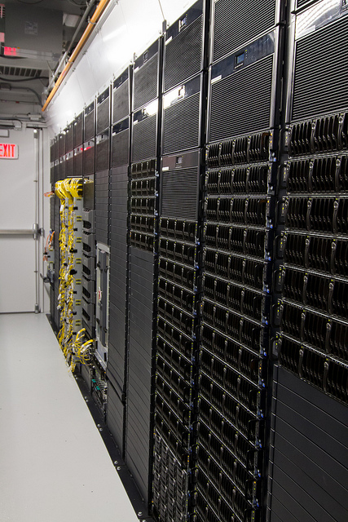
Flux hardware
8,016 Intel cores 200 Intel BigMem cores
632 Flux nodes 5 Flux BigMem nodes
48/64 GB RAM/node 1 TB RAM/ BigMem node
4 GB RAM/core (average) 25 GB RAM/BigMem core
4X Infiniband network (interconnects all nodes)
  40 Gbps, <2 us latency
  Latency an order of magnitude less than Ethernet
Lustre Filesystem
  Scalable, high-performance, open
  Supports MPI-IO for MPI jobs
  Mounted on all login and compute nodes

Slide 45
Flux software
Licensed & open source software:
  Abacus, Java, Mason, Mathematica, Matlab,
  R, STATA SE, …
  http://cac.engin.umich.edu/resources/software/index.html
Software development (C, C++, Fortran)
  Intel, PGI, GNU compilers

Slide 46
Flux data
Lustre filesystem mounted on /scratch on all login, compute, and transfer nodes
  640TB of short-term storage for batch jobs
  Large, fast, short-term
NFS filesystems mounted on /home and /home2 on all nodes
  80 GB of storage per user for development & testing
  Small, slow, short-term

Slide 47
Globus Online
Features
  High-speed data transfer, much faster than SCP or SFTP
  Reliable & persistent
  Minimal client software: Mac OS X, Linux, Windows
GridFTP Endpoints
  Gateways through which data flow
  Exist for XSEDE, OSG, …
  UMich: umich#flux, umich#nyx
  Add your own server endpoint: contact flux-support
  Add your own client endpoint!
More information
  http://cac.engin.umich.edu/resources/loginnodes/globus.html

Slide 48
Flux Mechanics

Slide 49
Using Flux
Three basic requirements to use Flux:
  A Flux account
  A Flux allocation
  An MToken (or a Software Token)

Slide 50
Using Flux
A Flux account
    Allows login to the Flux login nodes
    Develop, compile, and test code
    Available to members of U-M community, free
    Get an account by visiting http://arc.research.umich.edu/resources-services/flux/managing-a-flux-project/

Slide 51
Using Flux
A Flux allocation
    Allows you to run jobs on the compute nodes
    Current rates:
      $18 per core-month for Standard Flux
      $24.35 per core-month for BigMem Flux
      $8 cost-sharing per core month for LSA, Engineering, and Medical School
      Details at http://arc.research.umich.edu/resources-services/flux/flux-costing/
    To inquire about Flux allocations please email flux-support@umich.edu

Slide 52

Using Flux
An MToken (or a Software Token)
    Required for access to the login nodes
      Improves cluster security by requiring a second means of proving your identity
    You can use either an MToken or an application for your mobile device (called a Software Token) for this
    Information on obtaining and using these tokens at http://cac.engin.umich.edu/resources/loginnodes/twofactor.html

Slide 53
Logging in to Flux
ssh flux-login.engin.umich.edu
  MToken (or Software Token) required
You will be randomly connected a Flux login node
  Currently flux-login1 or flux-login2
Firewalls restrict access to flux-login.
To connect successfully, either
  Physically connect your ssh client platform to the U-M campus wired network, or
  Use VPN software on your client platform, or
  Use ssh to login to an ITS login node, and ssh to flux-login from there

Slide 54
Demonstration
Task: Use the R multicore package
The multicore package allows you to use multiple cores on the same node when writing R scripts
Notes:
module load R
cp ~cja/sample-code.tar.gz .
tar –zxvf sample-code.tar.gz
cd ~/sample-code
Examine lab3.pbs and lab3.R

Slide 55
Demonstration
Task: compile and execute simple programs on the Flux login node
Copy sample code to your login directory:
cd
  cp ~brockp/cac-intro-code.tar.gz .
  tar -xvzf cac-intro-code.tar.gz
  cd ./cac-intro-code
Examine, compile & execute helloworld.f90:
  ifort -O3 -ipo -no-prec-div -xHost -o f90hello helloworld.f90
  ./f90hello
Examine, compile & execute helloworld.c:
  icc -O3 -ipo -no-prec-div -xHost -o chello helloworld.c
  ./chello
Examine, compile & execute MPI parallel code:
  mpicc -O3 -ipo -no-prec-div -xHost -o c_ex01 c_ex01.c
  mpirun -np 2 ./c_ex01

Slide 56
Flux Batch Operations

Slide 57
Portable Batch System
All production runs are run on the compute nodes using the Portable Batch System (PBS)
PBS manages all aspects of cluster job execution except job scheduling
  Flux uses the Torque implementation of PBS
  Flux uses the Moab scheduler for job scheduling
  Torque and Moab work together to control access to the compute nodes
PBS puts jobs into queues
  Flux has a single queue, named flux

Slide 58
Cluster workflow
You create a batch script and submit it to PBS
PBS schedules your job, and it enters the flux queue
When its turn arrives, your job will execute the batch script
Your script has access to any applications or data stored on the Flux cluster
When your job completes, anything it sent to standard output and error are saved and returned to you
You can check on the status of your job at any time, or delete it if it’s not doing what you want
A short time after your job completes, it disappears

Slide 59
Demonstration
Task: Run an MPI job on 8 cores
Sample code uses MPI_Scatter/Gather to send chunks of a data buffer to all worker cores for processing
Notes:
cd ~/cac-intro-code
Examine c_ex05
make c_ex05
Examine file run, change #PBS -M, -A, -l
qsub run

Slide 60

The Batch Scheduler
If there is competition for resources, two things help determine when you run:
    How long you have waited for the resource
    How much of the resource you have used so far
  Smaller jobs fit in the gaps (“backfill”)
Cores
Time

Slide 61
Flux Resources
http://www.youtube.com/user/UMCoECAC
  UMCoECAC’s YouTube channel
http://orci.research.umich.edu/resources-services/flux/
  U-M Office of Research Cyberinfrastructure Flux summary page
  http://cac.engin.umich.edu/
  Getting an account, basic overview (use menu on left to drill down)
http://cac.engin.umich.edu/started
  How to get started at the CAC, plus cluster news, RSS feed and outages
http://www.engin.umich.edu/caen/hpc
  XSEDE information, Flux in grant applications, startup & retention offers
  http://cac.engin.umich.edu/ Resources | Systems | Flux | PBS
    Detailed PBS information for Flux use
  For assistance: flux-support@umich.edu
  Read by a team of people
  Cannot help with programming questions, but can help with operational Flux and basic usage questions
Notes:
Concrete steps:
Get a Flux account
If in LSA, use free lsa_flux allocation, else get an allocation
flux-support@umich.edu, unit support staff will help

Slide 62
Wrap-up

Slide 63
Further Study
CSCAR/ARC Python Workshop (week of June 12, 2013)
Sign up for news and events on the Advanced Research Computing web page at http://arc.research.umich.edu/news-events/

Slide 64
Any Questions?
Charles J. Antonelli
LSAIT Advocacy and Research Support
cja@umich.edu
http://www.umich.edu/~cja
734 763 0607

Slide 65
References
http://cac.engin.umich.edu/resources/software/R.html
http://cac.engin.umich.edu/resources/software/matlab.html
CAC supported Flux software, http://cac.engin.umich.edu/resources/software/index.html, (accessed August 2011)
J. L. Gustafson, “Reevaluating Amdahl’s Law,” chapter for book, Supercomputers and Artificial Intelligence, edited by Kai Hwang, 1988. http://www.scl.ameslab.gov/Publications/Gus/AmdahlsLaw/Amdahls.html (accessed November 2011).
Mark D. Hill and Michael R. Marty, “Amdahl’s Law in the Multicore Era,” IEEE Computer, vol. 41, no. 7, pp. 33-38, July 2008. http://research.cs.wisc.edu/multifacet/papers/ieeecomputer08_amdahl_multicore.pdf (accessed November 2011).
InfiniBand, http://en.wikipedia.org/wiki/InfiniBand (accessed August 2011).
Intel C and C++ Compiler 1.1 User and Reference Guide, http://software.intel.com/sites/products/documentation/hpc/compilerpro/en-us/cpp/lin/compiler_c/index.htm (accessed August 2011).
Intel Fortran Compiler 11.1 User and Reference Guide,http://software.intel.com/sites/products/documentation/hpc/compilerpro/en-us/fortran/lin/compiler_f/index.htm (accessed August 2011).
Lustre file system, http://wiki.lustre.org/index.php/Main_Page (accessed August 2011).
Torque User’s Manual, http://www.clusterresources.com/torquedocs21/usersmanual.shtml (accessed August 2011).
Jurg van Vliet & Flvia Paginelli, Programming Amazon EC2,’Reilly Media, 2011. ISBN 978-1-449-39368-7.

Slide 66
Extra
Task: Run an interactive job
  Enter this command (all on one line):
  qsub –I -V -l procs=2
  -l walltime=15:00 -A FluxTraining_flux -l qos=flux -q flux
  When your job starts, you’ll get an interactive shell
  Copy and paste the batch commands from the “run” file, one at a time, into this shell
  Experiment with other commands
  After fifteen minutes, your interactive shell will be killed

Slide 67
Extra
Other above-campus
  Amazon EC2
  Microsoft Azure
  IBM Smartcloud
  …

