Slide 1
Lecture 6
Nontariff Barriers
Econ 340

Slide 2
Outline: Nontariff Barriers
What Are NTBs?
Quotas
  Effects Equivalent to Tariffs
  Who Gets the Rents
Other NTBs
  Tariff-Rate Quotas
  Voluntary Export Restraints (VERs)
  Variable Levies
  Government Procurement Regulations
  Customs Procedures
  Standards
  Unfair Trade Laws
  Export taxes
Subsidies

Slide 3
What Are NTBs?
What Are They?
  Any institutional or policy arrangement that interferes with trade, other than tariffs
  Term NTB is also used more broadly to include policies that artificially expand trade
    e.g., Export subsidy
  Sometimes called “Nontariff Measures” (NTMs)
Main Types of NTB
  See outline above

Slide 4
Outline: Nontariff Barriers
What Are NTBs?
Quotas
  Effects Equivalent to Tariffs
  Who Gets the Rents
Other NTBs
  Tariff-Rate Quotas
  Voluntary Export Restraints (VERs)
  Variable Levies
  Government Procurement Regulations
  Customs Procedures
  Standards
  Unfair Trade Laws
  Export taxes
Subsidies
We’ll go through some of these individually

Slide 5
Outline: Nontariff Barriers
What Are NTBs?
Quotas
  Effects Equivalent to Tariffs
  Who Gets the Rents
Other NTBs
  Tariff-Rate Quotas
  Voluntary Export Restraints (VERs)
  Variable Levies
  Government Procurement Regulations
  Customs Procedures
  Standards
  Unfair Trade Laws
  Export taxes
Subsidies

Slide 6
Quotas
Definition: An import quota is a direct restriction on the quantity of an import
  E.g., US might limit the imports of steel to some number of tons per year
  Until Jan 1, 2005, US and EU had elaborate import quotas on many textile and apparel products from developing countries
  We still have quotas on many agricultural products, e.g., sugar, cheddar cheese, dried milk, etc

Slide 7
Quotas
Effects of a quota
  If permitted quantity is above what would be imported anyway, then no effect at all. (True only with perfect competition)
  Otherwise, quota creates scarcity and raises price
  Quota raises domestic price above world price
    For market to clear, domestic price must rise to the point that desired imports equal the quota
    See this with supply and demand
    But first note example of US quota on sugar..

Slide 8
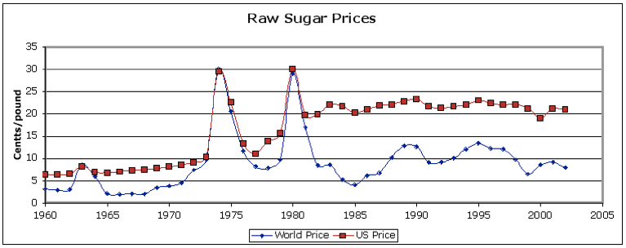
Note that US price stayed mostly above the world price, and was more stable
But when world price spiked, then US price was
  just equal to the world price,
  not above as it would have been with a tariff
http://public.wsu.edu/~hallagan/EconS327/weeks/week5/Sugar/Sugarquota301.html

Slide 9
Effects of a Quota: Small Country
P
S
Suppose quota limits imports to this amount
P_{a}
Quota
P_{W}
D
Q_{S}⁰
Q_{D}⁰
Q

Slide 10
Effects of a Quota: Small Country
P
S
Suppose quota limits imports to this amount
P_{a}
Quota
which is less than initial imports
P_{W}
D
Quota
Q_{S}⁰
Q_{D}⁰
Q

Slide 11
Effects of a Quota: Small Country
P
S
Then price must rise until D-S=Quota
P_{a}
P_{W}
D
Quota
Q_{S}⁰
Q_{D}⁰
Q

Slide 12
Effects of a Quota: Small Country
P
S
Thus price is…
P_{a}
P_{Q}
“Tariff Equivalent”
Quota
P_{W}
D
Q_{S}⁰
Q_{D}⁰
Q

Slide 13
Effects of a Quota: Small Country
P
S
…and quantities are
P_{a}
P_{Q}
Tariff Equivalent
P_{W}
Quota
D
Q_{S}⁰
Q_{S}¹
Q_{D}¹
Q_{D}⁰
Q

Slide 14
Effects of a Quota: Small Country
P
S
Effects on Welfare
P_{a}
Same as tariff, except c
P_{Q}
Tariff Equivalent
a
c
b
d
P_{W}
Quota
D
Q_{S}⁰
Q_{S}¹
Q_{D}¹
Q_{D}⁰
Q

Slide 15
Effects of a Quota: Small Country
P
S
Results
  Suppliers gain area +a
  Demanders lose area −(a+b+c+d)
  Somebody gets area c, but who?
P_{Q}
a
b
c
d
P_{W}
D
Q
Area c is called “quota rents”
  It is the profit from buying at world price, P_{W}, and selling at higher domestic price, P_{Q}

Slide 16
Effects of a Quota: Small Country
Who gets quota rents?
Depends on how quota is administered:
  First-come, first-served: Rents go to whoever gets there before quota is exhausted
  Sell (or “auction”) import licenses: Rents go to government as revenue from sale of licenses
  Give away import licenses to domestic people or firms: those people or firms then get the rents
  Give away licenses to foreign firms or governments: foreigners get the rents
Most common is the last: Give away to foreigners in proportion to their historical exports

Slide 17
Effects of a Quota: Rent Seeking
“Rent Seeking”
  Defined as the use of resources in effort to get rents
  Examples
    Faster (thus more costly) transport to win race to border for 1st-come-1st-served quota
    Lobbying legislators to get quota allocations
    Inefficient production intended to get quota allocations based on market shares

Slide 18
Effects of a Quota
Effects of quota compared to tariff
  Effects on price and quantity at a given time are the same
    Hence “tariff equivalent”
  Effect on welfare is different if quota rents are lost to rent seeking and/or accrue to foreigners:
    In that case, importing country loses more from quota than from equivalent tariff
What if country is large?
  Picture is also same as for tariff
  But if quota rent is lost or goes to foreigners, importing country cannot gain

Slide 19
Effects of Quota: Large Country
(if Rent given to foreigners)
Summary:
Domestic Country:
Suppliers gain +a’
Demanders lose −(a’+b’+c’+d’)
Net effect on country = −(b’+c’+d’)
Foreign Country:
License holders gain +(c’+e’)
(Suppliers/Demanders also lose)
P
S
a’
b’
c’
d’
e’
D
Q

Slide 20
Effects of a Quota
Other effects of a quota
  Quality upgrading
    Limited to a fixed quantity, foreign exporters seek higher value by improving quality and charging higher price
  Like a tariff, quota may induce foreign firms to produce here
  Unlike a tariff, the quota becomes more restrictive if foreign supply increases or world price drops

Slide 21
Effects of a Fall in World Price
P
S
With Tariff, Domestic Price Would Fall to P_{T}′
P_{a}
P_{Q}
Tariff Equivalent
P_{T}′
P_{W}
Grows
P_{W}′
Quota
D
Q_{S}⁰
Q_{S}¹
Q_{D}¹
Q_{D}⁰
Q

Slide 22
Effects of a Fall in World Price
Many things do not change:
  Domestic price
  Domestic quantity supplied
  Domestic quantity demanded
  Quantity of imports (fixed by quota)
What does change?
  Tariff equivalent increases
  Rents from quota increase

Slide 23
Effects of a Rise in World Price
If the rise is small, this is just the reverse of what happened with a fall in world price
But if the rise in world price is large enough, then
  The quota ceases to be binding
  Tariff equivalent of quota becomes, and stays, zero
  Domestic price becomes
    Equal to world price, and
    Rises with it
This last is what we saw in the graph of the price of sugar

Slide 24
http://public.wsu.edu/~hallagan/EconS327/weeks/week5/Sugar/Sugarquota301.html

Slide 25
Effects of a Rise in World Price
P
S
P_{a}
P_{Q}’=
P_{W}′
P_{Q}
P_{W}
Quota
D
Q_{S}⁰
Q_{S}¹
Q_{D}¹
Q_{D}⁰
Q

Slide 26
Outline: Nontariff Barriers
What Are NTBs?
Quotas
  Effects Equivalent to Tariffs
  Who Gets the Rents
Other NTBs
  Tariff-Rate Quotas
  Voluntary Export Restraints (VERs)
  Variable Levies
  Government Procurement Regulations
  Customs Procedures
  Standards
  Unfair Trade Laws
  Export taxes
Subsidies

Slide 27
Other NTBs:
Tariff-Rate Quota (TRQ)
This is two tariffs, separated by a quota
  Low (or zero) tariff applies to imports below the quota
  High tariff applies to imports above the quota
Tariff
Used by US on many agricultural products
Effect is like
  a low tariff,
  a quota,
  or a high tariff,
depending on levels of supply and demand
Imports
Quota

Slide 28
Other NTBs:
Tariff-Rate Quota (TRQ)
This is what Trump used against imports of solar panels and washing machines

Slide 29
Other NTBs:
Voluntary Export Restraint (VER)
Restriction of exports
  At request of importing country
  Usually specified as maximum quantity
This was the major form of protection for the US auto industry in the 1980s: US persuaded Japan to limit exports of cars to US
Illegal since 1995 under WTO rules
  But how to enforce
  There were examples in 2012 that look like VERs
  Now the US has gotten S. Korea to limit its exports of steel
  It look like VERs are back, but may not be called that
Effect is exactly like a quota allocated to foreigners

Slide 30
Other NTBs:
Variable Levies
A tariff that is changed as necessary to keep domestic price at a specified level
These are used extensively by the European Union as part of its Common Agricultural Policy (CAP)
Effects are same as a tariff, except for behavior over time

Slide 31
Other NTBs: Government Procurement Regulations
Government favors domestic suppliers in buying goods and services
  Buys only from domestic firms,
or
  Buys from domestic firms unless imports are, say, 10% cheaper
US used to have a “Buy American” law
  Some say we need it again, but would violate WTO
Effect is like a tariff, except that loss to demander is now loss to government and thus taxpayer

Slide 32
Other NTBs: Government Procurement Regulations
“Buy American” was part of the Stimulus Package of the US in 2009
  Congress would have imposed broad restrictions
  Obama got them to restrict only when not contrary to US commitments under trade agreements
  Even so, result was broadly restrictive, because purchasers were not sure of rules, so avoided imports
  Result was also that other countries included similar provisions in their stimulus packages
  See reading by Hufbauer and Schott.
“Buy American” was said in President Trump’s Inauguration Speech, Jan 20, 2017

Slide 33
Other NTBs: Government Procurement Regulations
Not just in US. There is an increasing use of “Buy Local” requirements by US and other governments
  See Economist, “Buying local is more expensive than it looks”
  The share of imports covered by buy-local requirements has increased five-fold since 2009
  But… they increases costs, just like tariffs, without any tariff revenue

Slide 34
Other NTBs:
Customs Procedures
All countries have customs procedures for maintaining border security and collecting tariffs
They become NTBs when
  Excessive difficulty, or red tape, limits imports
  Rules impose artificially high valuation for ad valorem tariffs

Slide 35
Other NTBs:
Standards
All countries also have standards, for
  Health and safety (e.g., no lead paint)
  Compatibility (e.g., 110 volt appliances)
They become NTBs when biased against imports in
  Substance of the requirement
  Procedures for certifying compliance

Slide 36
Other NTBs:
Unfair Trade Laws
The (legal) threat and use of
  Anti-Dumping Duties
  Countervailing Duties
We’ll say more about this later, in lecture about U.S. Trade Policies
These are NTBs if
  “Unfair trade” is actually normal trade (it usually is)
  The threat of action discourages trade, even when duties are not levied (the “chilling effect”)

Slide 37
Other NTBs:
Unfair Trade Laws
Use of these laws is increasing rapidly by other countries. See Lindsey and Ikenson
  In 1990s, antidumping use increased 50% over the ‘80s.
  Developing country AD cases:
    7 in 1980-87
    Over 700 in 1995-2000
  Leading users of AD (1995-2000)
    US (323), EU (143) (out of 976 total)
  Targets of AD cases (1995-2000, per year):
    Leading: China (179), Japan (78), US (65)
    Developed countries 355; Developing countries 656

Slide 38
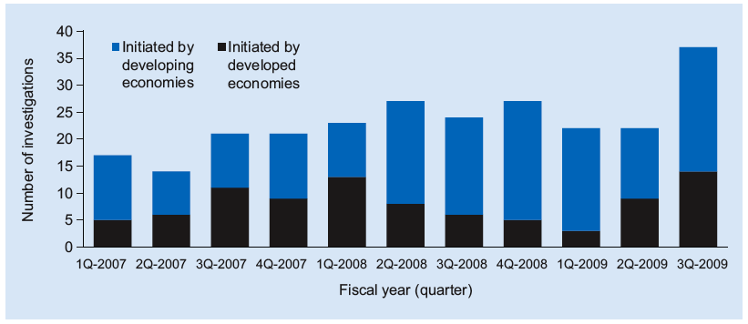
Other NTBs:
Unfair Trade Laws
Somewhat more recently:
Newly Initiated Antidumping Investigations, 1Q 2007–3Q 2009
Source: Global Antidumping Database.
Notes:
Source: “The Pattern of Antidumping and Other Types of Contingent Protection,” Chad Bown, PREMNotes #144, World Bank, October 2009.

Slide 39
Other NTBs: Temporary Trade Barriers (AD, CVD, etc.)
Notes:
Source: Bown, Chad P. (2014) Temporary Trade Barriers Database, The World Bank. Available at http://econ.worldbank.org/ttbd/, June.

Slide 40
Other NTBs:
Export Taxes
Simply a tax on exports, analogous to tariff on imports
  Effects are similar
  Not common, until recently, because countries think exports are good
  Became common in mid-2008, as high world prices for agriculture led food exporters to protect their own consumers
  Also used recently by China on certain minerals used in high-tech devices

Slide 41
Other NTBs:
Effects of Export Tax – Small Country
P
D
S
P_{W}
Tax
P_{W}-t
Q

Slide 42
Outline: Nontariff Barriers
What Are NTBs?
Quotas
  Effects Equivalent to Tariffs
  Who Gets the Rents
Other NTBs
  Tariff-Rate Quotas
  Voluntary Export Restraints (VERs)
  Variable Levies
  Government Procurement Regulations
  Customs Procedures
  Standards
  Unfair Trade Laws
  Export taxes
Subsidies

Slide 43
Subsidies
Government assistance to producers
  Export subsidy: paid only for exports
  Domestic subsidy: paid for all production (but still increases exports or reduces imports)
Effect on the subsidizing country
  In competitive industries, country loses
  Subsidies usually are intended to benefit producers, not country
  In non-competitive industries, result may be different (recall Boeing-Airbus example)

Slide 44
Effects of a Subsidy on Foreign Countries
Effect, if country is large, is to reduce the world price of the exported good
Subsidy expands supply in subsidizing country (which is part of S_{W}⁰)
World Market
P_{W}
S_{W}⁰
S_{W}¹
P_{W}⁰
P_{W}¹
D_{W}
Q_{W}

Slide 45
Effects of a Subsidy on Foreign Countries
Effects on other countries depend direction of their trade:
  If they import the good, they gain
  If they export the good, they lose
  See this in the following figures…

Slide 46
Effects of Export Subsidy: on Foreign Importer
P
S
Effects on Welfare
Suppliers lose Demanders gain Country gains +(b+c+d)
P_{W}⁰
a
c
b
d
P_{W}¹
D
Q_{S}¹
Q_{S}⁰
Q_{D}⁰
Q_{D}¹
Q

Slide 47
Effects of Export Subsidy: on Foreign Exporter
P
Effects on Welfare
S
Suppliers lose Demanders gain Country loses −c
P_{W}⁰
a
c
b
d
P_{W}¹
D
Q_{S}⁰
Q_{S}¹
Q_{D}¹
Q_{D}⁰
Q

Slide 48
Effects of a Subsidy on Foreign Countries
In both cases
  Foreign suppliers lose
  Foreign demanders gain
  Net effect on countries depends on
    Whether they are net importers or exporters
    Thus whether price change is improvement or worsening of their terms of trade
Optimal policy response for foreign countries
  Importers: Write “thank-you note” (Krugman)
  Exporters: Not much they can do

Slide 49
Subsidies: Are They Used?
YES!!
US, EU, Japan all have large subsidies on many agricultural products
These reduce world prices and hurt producers of these products in developing countries
Examples of US subsidies and whom they hurt:
  Corn: Mexico
  Sugar: Caribbean countries
  Cotton: Certain African countries

Slide 50
Next Time
Reasons for Protection
If tariffs are such a bad idea, why are they used?

