Slide 1
Lecture 14
Pegging the Exchange Rate
Econ 340

Slide 2
Lecture 14 Outline:
Pegging the Exchange Rate
How It’s Done
  Market Intervention
  Bands of Fluctuation
  Hybrids of Pegged and Floating
  The Gold Standard
Who Pegs?
Mechanics of Intervention
  Reserves
  Money Supply
  Sterilization
Effects of Pegging
Chinese Currency Manipulation

Slide 3
How It’s Done
What “Pegging” Means
  To “fix” the exchange rate by intervening in the market
  It does not mean just fixing it by law – making it illegal to exchange the currency at other than the official rate
    Countries do that too, but that is not pegging, and it does not entirely work: gives rise to “black market”
  “Intervention” means
    Buying or selling foreign currency, so as to
    Make up the difference between the market’s supply and demand
    Normally done by the central bank of the pegging country

Slide 4
How It’s Done
Example: If the Fed were to peg the $ to the € at rate E* (Note: it does not do this!)
E = $/€
E
Fed buys the extra €
S€
S€
E*
OR
E*
Fed sells the needed €
D€
D€
Q€
Q€

Slide 5
How It’s Done
What “Pegging” Means
  In practice, pegs are never exact
  Central banks
    Set a “par value” (= “central value”)
    Intervene only if rate moves some distance (e.g., 1%) above or below this par value
    This range of movement is called an “exchange rate band”
  We will ignore this complication in drawing the market, and pretend that they peg the rate exactly

Slide 6
How It’s Done
Hybrids of Pegged and Freely Floating Exchange Rates
  Managed Float
    Intervene to influence the rate
    But do not announce a target rate or par value
    And do not necessarily keep the rate constant
  “Dirty Float” = same as Managed Float

Slide 7
How It’s Done
Hybrids of Pegged and Freely Floating Exchange Rates
  “Leaning Against the Wind”
    Particular form of managed float that
      Does not try to alter the level of the exchange rate, but
      Does try to slow its rate of change
    Purpose: to dampen fluctuations

Slide 8
How It’s Done
Hybrids of Pegged and Freely Floating Exchange Rates
  Crawling Peg
    A pegged rate with a par value that moves
      Slowly
      and
      Predictably
    Example: Country might announce that the par value will appreciate by 0.01% each week as long as central bank is buying foreign exchange, and vice versa
  Note: All of these hybrids still do require intervention in the exchange market

Slide 9
How It’s Done
The Gold Standard
  Common in 19th century, but ended 1914.
  Countries
    Defined their currencies in terms of gold
    Stood ready to buy and sell gold at their official rate
  Result was like pegged exchange rates, except that the pegging was to gold.
  “Rules” of the Gold Standard
    Fix price of gold in terms of your own currency
    Keep money supply equal gold supply (or proportional to it)
    Be ready to redeem currency in terms of gold and allow gold (and thus money) to flow internationally
  Implication of the gold standard: Changes in money supply (gold) equilibrate the markets

Slide 10
Lecture 14 Outline:
Pegging the Exchange Rate
How It’s Done
  Market Intervention
  Bands of Fluctuation
  Hybrids of Pegged and Floating
  The Gold Standard
Who Pegs?
Mechanics of Intervention
  Reserves
  Money Supply
  Sterilization
Effects of Pegging
Chinese Currency Manipulation

Slide 11
Who Pegs?
US?
  No
  But we did have a pegged exchange rate until 1973
    (Strictly speaking, it was other countries that pegged to us, not us to them)
    In fact, from the late 1940s until 1973, virtually all countries pegged to the US dollar (exceptions were Canada, which sometimes floated, and several former colonies that pegged to the British pound or French franc)

Slide 12
Who Pegs?
Europe?
  No: the euro floats freely
  Before the euro, but after 1973,
    Countries did not peg to currencies outside Europe
    But they often did try to peg to each other
  Denmark now pegs to the euro
  Other EU countries outside the euro (UK, Sweden) and countries outside the EU (Switzerland, Norway) all have floating exchange rates

Slide 13
Who Pegs?
Other Developed Countries?
  No: Canada, Japan, Australia, New Zealand, S. Korea all have floating rates

Slide 14
Who Pegs?
Developing Countries?
  They are mixed
  A sample (from IMF, 2008):
    Argentina: pegged (to US dollar)
    Brazil: float
    Bulgaria: currency board (pegged to euro)
    China pegged to dollar until summer 05, and July 08 to July 2010; now sometimes says it pegs to basket of currencies
    Costa Rica: crawling peg
    India: managed float
    Egypt: managed float
    Nepal: pegged (to India’s rupee)
Notes:
From IMF: De Facto Classification of Exchange Rate Arrangements
http://www.imf.org/external/np/mfd/er/2006/eng/0706.htm

Slide 15
Lecture 14 Outline:
Pegging the Exchange Rate
How It’s Done
  Market Intervention
  Bands of Fluctuation
  Hybrids of Pegged and Floating
  The Gold Standard
Who Pegs?
Mechanics of Intervention
  Reserves
  Money Supply
  Sterilization
Effects of Pegging
Chinese Currency Manipulation

Slide 16
Mechanics of Intervention
Always: Buy or sell foreign currency in exchange for domestic currency
This has two effects, if nothing else is done:
  Changes the level of reserves of foreign currency
  Changes the level of the country’s own domestic money supply in circulation

Slide 17
Mechanics of Intervention
Change in Central Bank’s Reserves of Foreign Currency
  What they buy is added to reserves
  What they sell is subtracted from reserves

Slide 18
Mechanics of Intervention
Change in Country’s Domestic Money Supply
  When US Central Bank (CB) buys € with $, those $ go into circulation
    This adds to the US money supply
    (Actually, it adds even more, due to “money multiplier” you learned about in Econ 102)
  When CB sells € for $, those $ come out of circulation
    Reducing the money supply
    Similar to Gold Standard

Slide 19
Mechanics of Intervention
Sterilization
  However, Central Bank has the option of preventing this change in the money supply by “sterilization”
  Sterilization = Use of offsetting open market operations to keep the money supply unchanged
  Example: To sterilize a $1 m. purchase of foreign currency, CB would sell $1 m.-worth of bonds
    This takes the $1 m. back out of circulation
  Sterilization is a policy choice
    Central Bank can do it, or not, as it sees fit
    Some central banks have said they lack the tools to sterilize
    Most, if they intervene in the exchange market, do sterilize, thus preventing gold-standard-like adjustment

Slide 20
Lecture 14 Outline:
Pegging the Exchange Rate
How It’s Done
  Market Intervention
  Bands of Fluctuation
  Hybrids of Pegged and Floating
  The Gold Standard
Who Pegs?
Mechanics of Intervention
  Reserves
  Money Supply
  Sterilization
Effects of Pegging
Chinese Currency Manipulation

Slide 21
Effects of Pegging
Case I: Dollar Over-valued
  In this case (unlike PPP), “overvalued” means the dollar is being pegged at a rate that is above (i.e., appreciated relative to) the market-clearing rate
    Which means that the actual exchange rate, E, the price of foreign currency, is below the market-clearing rate, E₀
  At the overvalued exchange rate, there is excess demand for foreign currency, which CB must provide by selling out of reserves. Thus reserves fall.
  If it does not sterilize, then the money supply also shrinks
  If it does sterilize, then it buys bonds

Slide 22
Effects of Pegging
Peg if $ Overvalued
E = $/€
S€
Effects of Pegging if $ Overvalued:
  Reserves (of €) fall
  & if intervention is not sterilized,
  Money supply (of $) falls
Market-clearing rate
E₀
E*
Pegged rate
Fed sells €
D€
In exchange for $
Q€

Slide 23
Effects of Pegging
Further implication of an overvalued peg
  If it continues, central bank must eventually run out of reserves
  This, as we’ll see, causes a Crisis
    Exchange-rate crisis, or
    Financial crisis

Slide 24
Effects of Pegging
Case II: Dollar Under-valued
  In this case, “undervalued” means the dollar is being pegged at a rate that is below (i.e., depreciated relative to) the market-clearing rate
    Which means that E, the price of foreign currency, is above the market-clearing rate, E₀
  At undervalued rate, there is excess supply of foreign currency, which CB must take out of the market by buying and adding to reserves
  If it does not sterilize, then the money supply grows
  If it does sterilize, then it sells bonds

Slide 25
Effects of Pegging
Peg if $ Undervalued
E = $/€
Fed buys €
S€
Effects of Pegging if $ Undervalued:
  Reserves (of €) rise
  & if intervention is not sterilized,
  Money supply (of $) rises
with $
E*
E₀
D€
Q€

Slide 26
Effects of Pegging
Further implication of an undervalued peg
  Nothing critically important
  If it continues, Central Bank piles up more and more reserves, but there is no limit on its ability to do that
  Result: No crisis
  However, if it does not sterilize, then money supply grows too, and this may cause inflation

Slide 27
Effects of Pegging
Note the asymmetry:
  Overvalued peg leads to crisis
  Undervalued peg does not

Slide 28
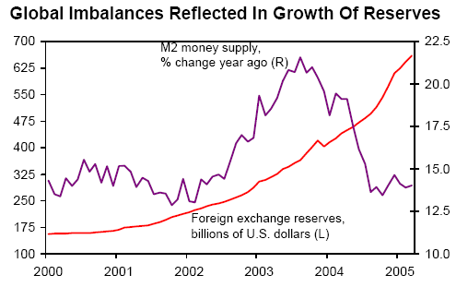
Effects of Pegging
Example of Undervalued Peg: China
Note that China was not sterilizing
Source PNC Financial Services Group
Notes:
Source: Economics Division, PNC Financial Services Group. Visit our web site at http://www.econ.pncbank.com

Slide 29
Effects of Pegging
A Special Case: The US Dollar
  Most countries that peg their currencies, peg them to the US dollar
  That means that their reserves are dollar-denominated assets, mostly US gov’t bonds
  If they keep their currencies undervalued, then that means the dollar is overvalued
    But the overvalued dollar need not lead to crisis
    Others want, need, or at least choose, to hold our dollars

Slide 30
Effects of Pegging
A Special Case: The US Dollar (see Ferguson)
  Most of US foreign borrowing is being met by foreign central banks
  That means they are holding reserves, a result of buying dollars to
    Keep their currency down
    Keep the US dollar up
    Or just to have dollars available in case of crisis
  We benefit from the high dollar: we can buy cheap goods and services
  But we borrow in dollars in order to do it
    If others were to stop lending, then the dollar would fall and so would the value of our debt, which they hold!
    Thus it is “their problem,” not ours!

Slide 31
Effects of Pegging
A Special Case: The US Dollar vs Chinese Renminbi (see Levy)
  Many US policymakers disagree: Thus US has pressured China to appreciate the yuan
    Why? To make it easier to sell US goods
    Congress threatens trade barriers against China
      Might have once been legal under Section 421, special “China safeguard” negotiated with China’s WTO accession, but that has now expired.
      Instead Trump is using tariffs on China for other reasons

Slide 32
Effects of Pegging
A Special Case: The US Dollar vs Chinese Renminbi (see Levy)
  Levy argues
    Tariffs against China won’t work
      We’ll just switch to importing from other low-cost countries
      US trade deficit (due to our low saving) will be unchanged
    To really have an effect and send a message, we should: Reduce government spending!

Slide 33
China’s Exchange Rate, US$/Yuan, 2000-2019
The exchange rate did not change at all between 2000 and 2005
Notes:
China currency.xlsx
From IMF, IFS

Slide 34
And reserves more than quadrupled!
Notes:
See China Currency.xlsx

Slide 35
Effects of Pegging
A Special Case: The US Dollar vs Chinese Renminbi
  It is clear from the two graphs that
    China was pegging their currency to the US dollar in 2000-2005
    To do so they were buying dollars and thus accumulating almost $1 trillion of reserves

Slide 36
Effects of Pegging
Example: To see the effects on US of China pegging versus floating,
  Consider the Chinese foreign exchange market (for $)
  Suppose the US economy expands, increasing US imports from China.
  What will happen if
    The renminbi floats?
    Or, instead, if
    The renminbi is pegged to the US dollar?
  We’ll look at China’s market for foreign exchange, where their foreign currency is the dollar

Slide 37
Effects of US Expansion on China if Renminbi is Floating
US expansion if renminbi is floating
Effects of US expansion:
  S$ shifts right (more US imports from China)
  Yuan appreciates (¥/$ falls)
  No change in China’s reserves or money supply
  Rising ¥ reduces US imports and increases US exports
E = ¥/$
S$
S’$
E₀
E₁
D$
Q$

Slide 38
Effects of US Expansion on China if Renminbi is Pegged
US expansion if renminbi is pegged
E = ¥/$
Effects of US expansion:
  S$ shifts right (more US imports from China)
  Yuan stays constant (no further effect on US trade)
  People’s Bank of China buys more $
    Reserves rise faster
    Money supply expands faster if not sterilized
  May cause inflation in China
S$
ΔR’
S’$
ΔR
E*
D$
Q$

Slide 39
Effects of Pegging
Implication of Example:
  Something always changes in the exchange market when changes occur for trade, capital flows, or other transactions
    Exchange rate changes if floating
    Reserves (and maybe money supply) change if pegged

Slide 40
Lecture 14 Outline:
Pegging the Exchange Rate
How It’s Done
  Market Intervention
  Bands of Fluctuation
  Hybrids of Pegged and Floating
  The Gold Standard
Who Pegs?
Mechanics of Intervention
  Reserves
  Money Supply
  Sterilization
Effects of Pegging
Chinese Currency Manipulation

Slide 41
Chinese Currency Manipulation
We saw in the graphs above that China was intervening in 2000-2005 to keep the value of its currency down
This led policy makers in the US to complain, and in 2005 China let its currency rise

Slide 42
China’s Exchange Rate, US$/Yuan, 2000-2019
The yuan appreciated steadily between 2005 and 2008
Notes:
China currency.xlsx
From IMF, IFS

Slide 43
Chinese Currency Manipulation
But China’s reserves continued to rise, indicating that it was still buying dollars.

Slide 44
Reserves continued to rise, to almost $2 trillion
Notes:
See China Currency.xlsx

Slide 45
Chinese Currency Manipulation
The financial crisis of 2008 slowed down both
  The appreciation of the renminbi, and
  The growth of reserves

Slide 46
China’s Exchange Rate, US$/Yuan, 2000-2019
The yuan stopped rising in 2008, then rose slowly
Notes:
China currency.xlsx
From IMF, IFS

Slide 47
Reserves mostly rose after 2008, to over $4 trillion in 2014
Notes:
See China Currency.xlsx

Slide 48
Chinese Currency Manipulation
The financial crisis of 2008
  Slowed down the appreciation of the renminbi, off and on
  But reserves continued to grow rapidly in most periods until 2014
  China’s purchases of US dollars were still holding down the yuan’s value, or slowing its rise
But all that changed in 2014

Slide 49
China’s Exchange Rate, US$/Yuan, 2000-2019
The yuan reached its peak in 2013, and began to fall in 2015
Notes:
China currency.xlsx
From IMF, IFS

Slide 50
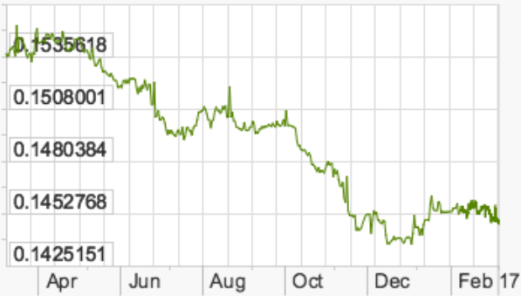
US$/Yuan 2016-17
6.6%

Slide 51
From 2014-16, China’s reserves were falling
Notes:
See China Currency.xlsx

Slide 52
Chinese Currency Manipulation
Conclusion:
  China did intervene extensively 2000-2014,
    Sometimes to keep the yuan from moving,
    Other times to slow its rise
  But since then, until 2017,
    Although the yuan was falling in value until 2017,
    This was in spite of Chinese intervention, not because of it
    They sold close to $1 trillion of reserves, slowing its fall (over $1 trillion as of March 2017)

Slide 53
China’s Exchange Rate, US$/Yuan, 2000-2018
Most recently, the yuan has moved up in 2017, down in 2018/19
Notes:
China currency.xlsx
From IMF, IFS

Slide 54
While reserves have moved little
Notes:
See China Currency.xlsx

Slide 55
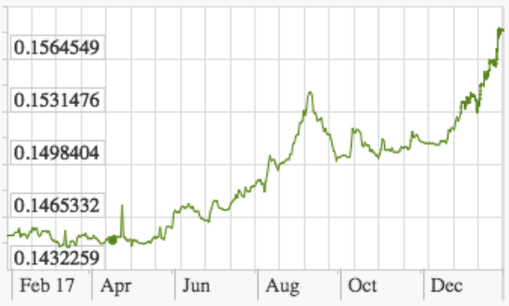
US$/Yuan 2017-18
9.2%

Slide 56
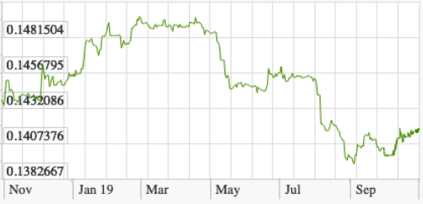
US$/Yuan 2018-19
7.2%

Slide 57
Chinese Currency Manipulation
See Varas
  Varas notes that China fixed its exchange rate from 1995 to 2005, consistent with the graph above
  But she also shows the following graph, which shows the value of the yuan
    Moving first up, then down, in 2000-2005
    Then rising steadily ever since, except for
      A big drop after the 2008 crisis
      And a smaller drop in 2015

Slide 58
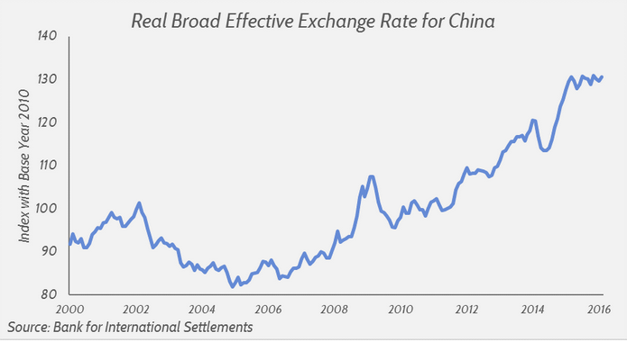
Notes:
From Varas, 2016

Slide 59
Chinese Currency Manipulation
Why does Varas disagree with my graphs?
  Hers is the “Real Broad Effective Exchange Rate”
  Since the renminbi was pegged to the US dollar 2000-2005, it rose and fell with the dollar relative to other currencies
    See the Graph of the Trade-Weighted Dollar from the last lecture

Slide 60
Source: Federal Reserve, “Broad Index” based on a large group of currencies, monthly data
Pegged to dollar, yuan rose and fell with it
Falling relative to dollar as dollar rose, yuan was stable
Notes:
http://www.federalreserve.gov/releases/h10/Summary/indexbc_m.txt
Dollar Index Broad Real 2007.xls

Slide 61
Chinese Currency Manipulation
Conclusion from both Varas and these graphs:
  China did manage its exchange rate and limited its appreciation until fairly recently
  During 2014-16, however, China acted to raise its currency’s value, not to lower it
  And since 2016, it has hardly intervened at all
  It has not, throughout this time span, ever acted deliberately to depreciate the yuan
  Therefore China has not been a currency manipulator

Slide 62
Next Time
International Macroeconomics
  Macro Effects ON the Exchange Market
  Macro Effects OF the Exchange Market
  Macro Effects THROUGH the Exchange Market

