Slide 1
Lecture 18
Preferential Trading Arrangements and the NAFTA
Econ 340
Notes:
Delete Kanter-Jolly
Add Villarreal & Fergusson, Brown

Slide 2
News: Nov 11-17
Currency news -- FT: 11/12 | Canvas | WSJ: 11/13 | Canvas | WSJ: 11/14 | Canvas
  Chile's peso fell nearly 5% to its lowest level in history on Nov 12, responding to widespread protests against the government. Protests were initially prompted by a 3% increase in metro fares that has since been suspended.
  Sweden's krona continues to perform worse than most other major currencies. In response, Sweden's central bank will soon cease using negative interest rates.
  Currencies of Latin America are continuing to depreciate. Chile's peso continued to slide, along with Colombia's peso, and Brazil's real. There are also concerns about the currencies of Argentina, Bolivia, and Mexico.
China removes ban on US chicken -- WSJ: 11/14 | Canvas | AP: 11/14 | Reuters: 11/14
  China banned imports of American poultry in 2015, following an outbreak of avian influenza. The US has now been free of avian influenza for over 2 years.
  As part of the current China-US trade talks, China is now lifting the ban, effective immediately.
  The US is now expected to export $1-2 billion of chicken, including $1 billion of chicken feet.
Trade war effects -- FT: 11/10 | Canvas | FT: 11/12 | Canvas | WSJ: 11/13 | Canvas
  Stock market prices world-wide have done worse for sectors most exposed to the trade war: cars, metals, technology, and telecoms.
  US manufacturing has been hurt more than China's manufacturing. This is seen in the decline in the last year of the PMI (Purchasing Managers Index) in the US, while China's PMI has remained steady.
  Particular markets have been disrupted. Most recently reported were: lobsters and bourbon. US lobster exports to China have been "hammered" by China's 25% tariff (but many lobsters now reach China through Canada). Kentucky bourbon has been hit by the EU's 25% tariff in retaliation for US tariffs on steel and aluminum.

Slide 3
News: Nov 11-17
Currency news
  Chile's peso fell nearly 5% to its lowest level in history on Nov 12, responding to widespread protests against the government. Protests were initially prompted by a 3% increase in metro fares that has since been suspended.
  Sweden's krona continues to perform worse than most other major currencies. In response, Sweden's central bank will soon cease using negative interest rates.
  Currencies of Latin America are continuing to depreciate. Chile's peso continued to slide, along with Colombia's peso, and Brazil's real. There are also concerns about the currencies of Argentina, Bolivia, and Mexico.

Slide 4
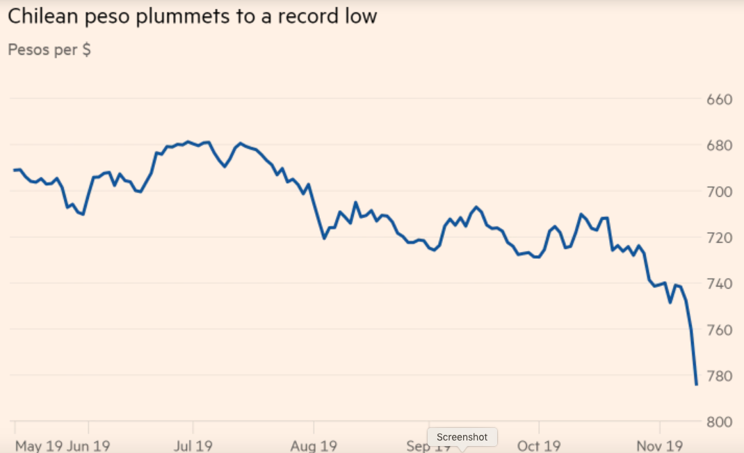

Slide 5
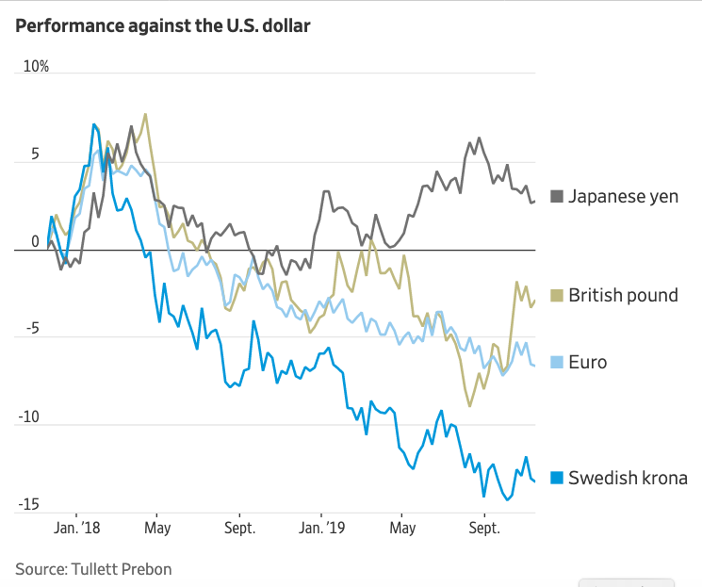

Slide 6
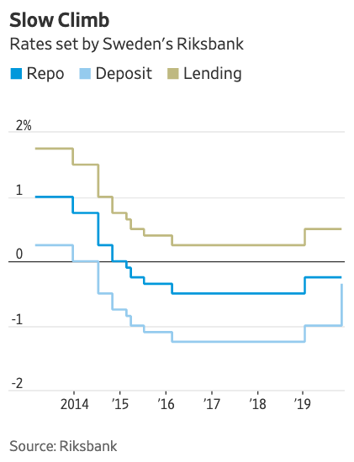

Slide 7
News: Nov 11-17
China removes ban on US chicken
  China banned imports of American poultry in 2015, following an outbreak of avian influenza. The US has now been free of avian influenza for over 2 years.
  As part of the current China-US trade talks, China is now lifting the ban, effective immediately.
  The US is now expected to export $1-2 billion of chicken, including $1 billion of chicken feet.

Slide 8
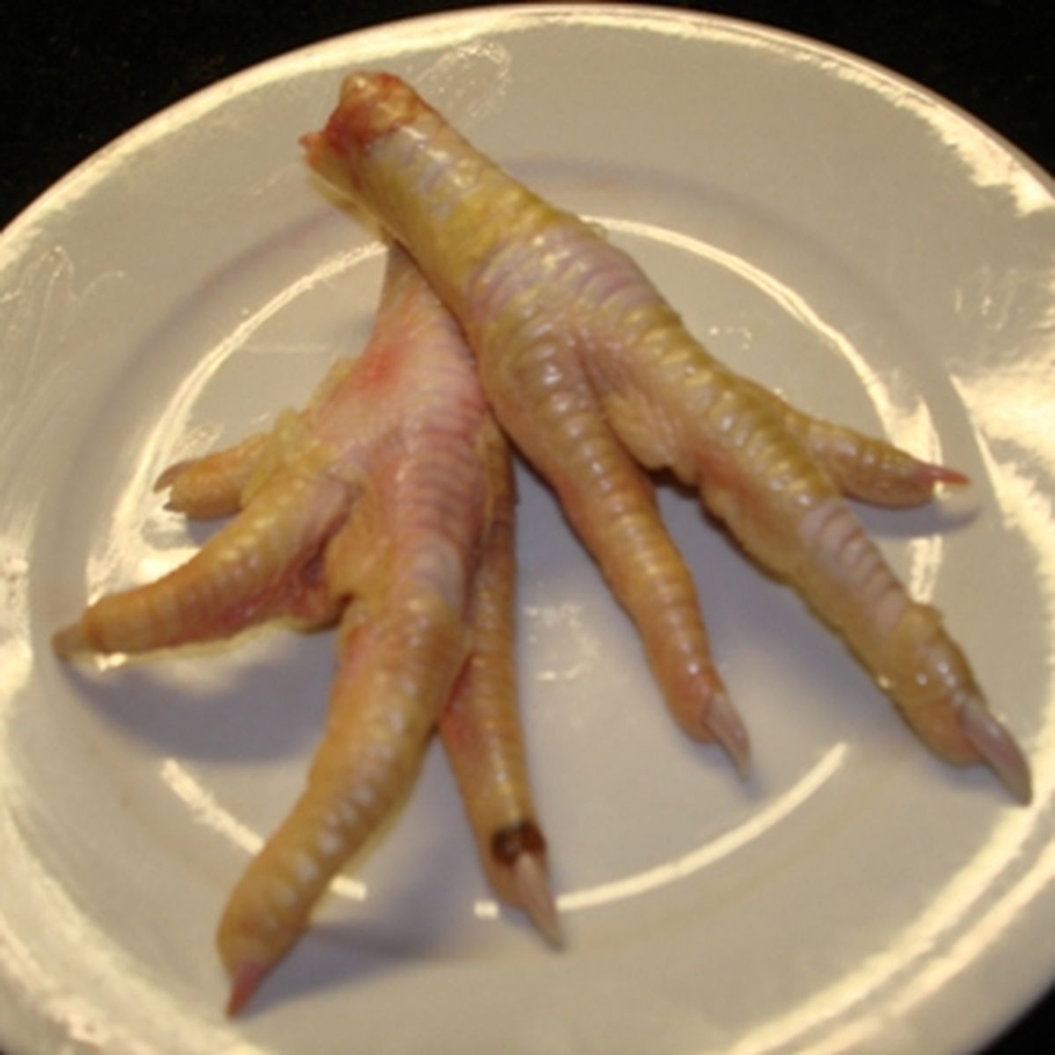

Slide 9
News: Nov 11-17
Trade war effects
  Stock market prices world-wide have done worse for sectors most exposed to the trade war: cars, metals, technology, and telecoms.
  US manufacturing has been hurt more than China's manufacturing. This is seen in the decline in the last year of the PMI (Purchasing Managers Index) in the US, while China's PMI has remained steady.
  Particular markets have been disrupted. Most recently reported were: lobsters and bourbon. US lobster exports to China have been "hammered" by China's 25% tariff (but many lobsters now reach China through Canada). Kentucky bourbon has been hit by the EU's 25% tariff in retaliation for US tariffs on steel and aluminum.

Slide 10
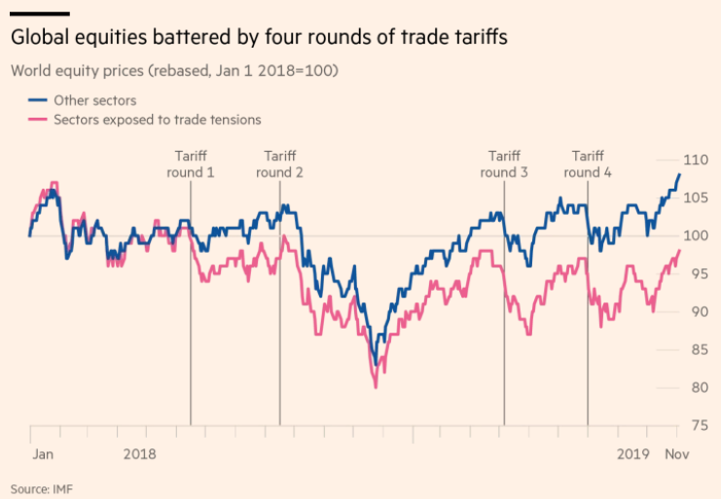

Slide 11
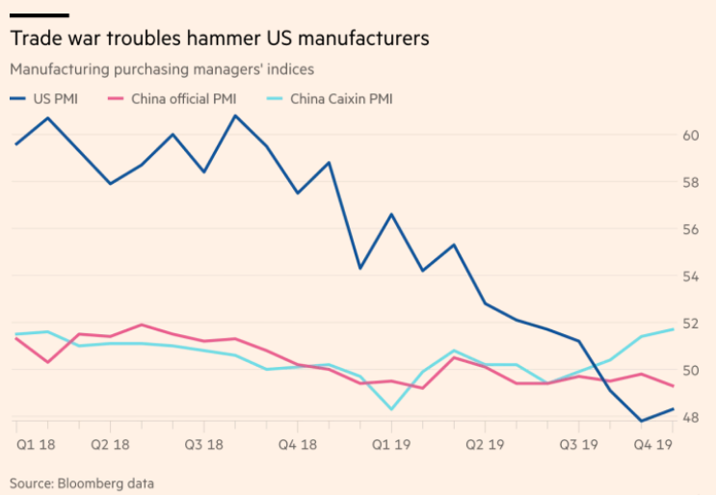

Slide 12

Announcement
John Sweetland gave me several copies of his recent autobiography, to lend to any of you who would like to borrow it.
If you are interested, email me or stop by my office.

Slide 13
Outline: Preferential Trading Arrangements and the NAFTA
What Are PTAs?
Examples
  European Union (EU)
  North American Free Trade Agreement (NAFTA)
Effects of PTAs
  Not the Same as Free Trade
    Trade Creation
    Trade Diversion
  Market Diagram Illustration
NAFTA
  History
  Analysis
  What Happened?
NAFTA Renegotiation and USMCA

Slide 14
What Are PTAs?
A Preferential Trading Arrangement (PTA) is a trade policy that favors one country over another
  Most obvious cases: Charge a lower, or zero, tariff on imports from one country while charging a higher tariff on imports from another
  Also called a Regional Trade Agreement (RTA – the term used by the Gerber textbook and by the WTO) when a group of countries in a region do this with each other
    Term is used even when the countries are not near each other

Slide 15
What Are PTAs?
In WTO (and GATT), the MFN principle would prohibit this
  All members are supposed to be charged a country’s MFN (Most Favored Nation) tariff
  However, some exceptions are explicitly permitted in rules of GATT & WTO

Slide 16
Outline: Preferential Trading Arrangements and the NAFTA
What Are PTAs?
Examples
  European Union (EU)
  North American Free Trade Agreement (NAFTA)
Effects of PTAs
  Not the Same as Free Trade
    Trade Creation
    Trade Diversion
  Market Diagram Illustration
NAFTA
  History
  Analysis
  What Happened?
NAFTA Renegotiation and USMCA

Slide 17
Examples of Legal PTAs
Permitted by WTO:
Free Trade Areas (FTAs)
  Members have zero tariffs against each other on essentially everything (also Customs Unions and Common Markets, which include FTAs)
GSP = Generalized System of Preferences
  Developed countries have lower (not usually zero) tariffs on some goods from developing countries

Slide 18
Examples of Legal PTAs
Permitted by WTO:
Also
  Anti Dumping Duties (higher tariff against some than against others)
  Countervailing Duties (ditto)
  Note: “safeguards” tariffs are also permitted,
    But they are not normally PTAs; they are supposed to be nondiscriminatory

Slide 19
Examples of PTAs
Variations on FTAs
  FTA:
    Two or more countries set zero tariffs on all (or almost all) imports from each other
    Keeping their old (presumably different) tariffs against outside countries
    Must include “rules of origin” (ROOs)
      ROO = criteria that must be met, regarding location of production, for a good to cross a border tariff-free within the FTA
      Otherwise, all trade would enter through lowest-tariff country

Slide 20
Examples of PTAs
Variations on FTAs
  Customs Union (CU)
    = FTA + Common External Tariffs (on each good)
    (no need for ROOs)
  Common Market
    = CU + free movement of factors (capital and labor) among members

Slide 21
Examples of PTAs
European Union (EU)
  A Customs Union
    Originally among 6 countries (France, Germany, Italy, Belgium, Netherlands, Luxembourg)
    Called, then, the “European Economic Community” (EEC)
  Later
    Became a Common Market
    Grew intermittently to 15 countries
      then, to 25 in 2004, to 27 in 2007
      and, in 2013, to 28 (adding Croatia)
    Changed name
      First to “European Community” (EC)
      Then later to “European Union”

Slide 22
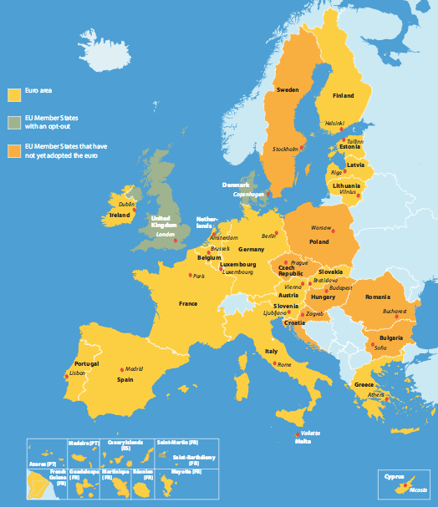
EU Members
Austria
Belgium Bulgaria Croatia Czech Repub.
Cyprus Denmark
Estonia
Finland
France
Germany
Greece Hungary
Ireland
Italy
Latvia
Lithuania
Luxembourg
Malta
Netherlands Poland
Portugal Romania
Slovakia
Slovenia
Spain Sweden U.K.
Notes:
http://europa.eu/european-union/about-eu/money/euro_en

Slide 23
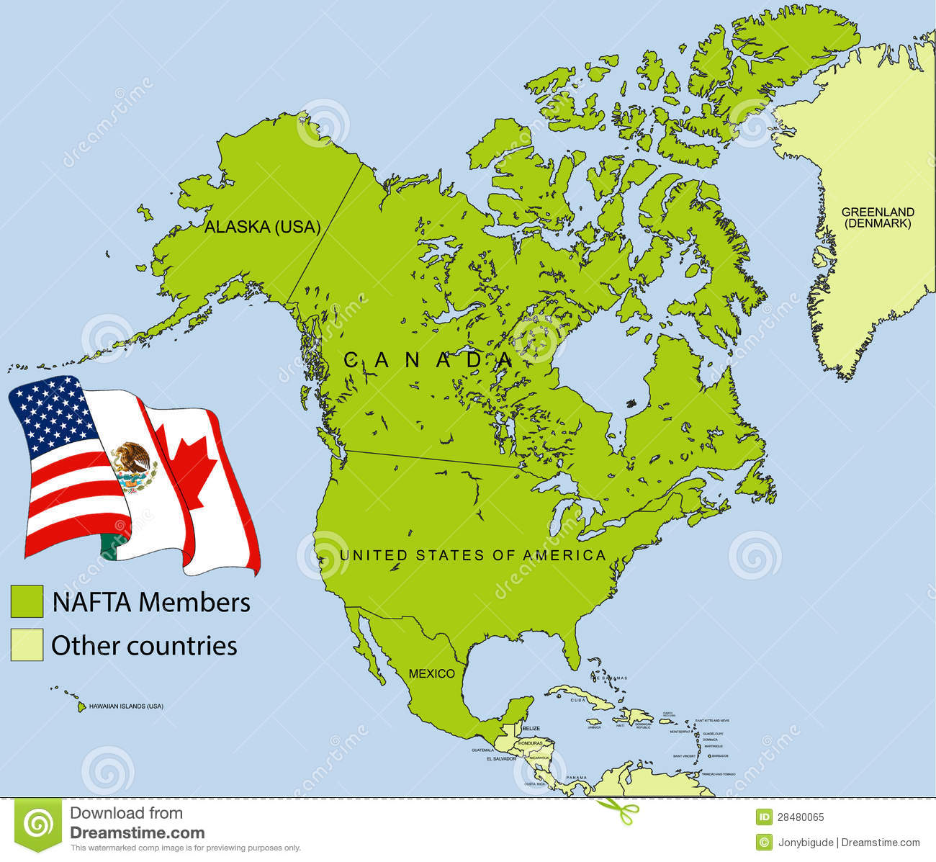
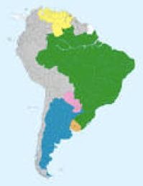
Examples of PTAs
North American Free Trade Area (NAFTA)
  US, Canada, Mexico
  Started in 1994
  More on this later
Mercosur
  Customs union in South America
  Includes Brazil, Argentina, Paraguay, Uruguay, Venezuela

Slide 24
Examples of PTAs
US also now has smaller FTAs:
  With Israel (since 1985)
  2-country FTAs with Australia, Bahrain, Chile, Jordan, Morocco, Oman, Peru, Singapore
  A contentious FTA was CAFTA (Central American Free Trade Agreement), approved 2005
  Somewhat recently, 3 more (Colombia, Panama, and S. Korea)
    Negotiated 2007
    Approved late 2011
    Went into effect in 2012
  US was to be part of TPP under Obama, but no longer.
There are more than 400 FTAs and similar arrangements that have been notified to the WTO

Slide 25
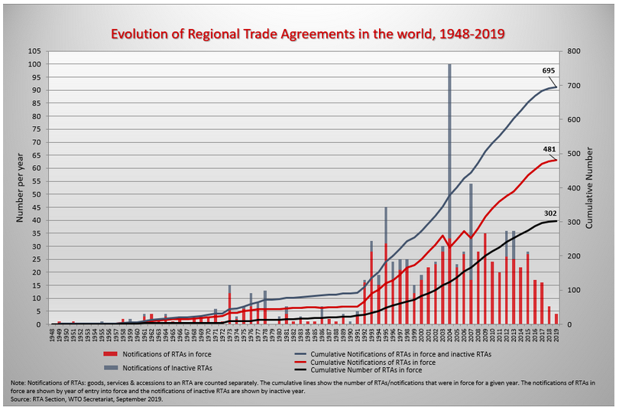
Regional Trade Agreements (RTAs) Notified to GATT/WTO
Notes:
http://www.wto.org/english/tratop_e/region_e/regfac_e.htm

Slide 33
Clicker Question
In which of the following are tariffs on trade among members mostly zero?
  Free trade agreement
  Customs union
  Common market
  All of the above
  None of the above
✓

Slide 34
Clicker Question
In which of the following do labor and capital flow freely among members?
  Free trade agreement
  Customs union
  Common market
  All of the above
  None of the above
✓

Slide 35
Clicker Question
Which of the following pairs of countries are included within a customs union?
  Argentina and Brazil
  China and Japan
  Mexico and Canada
  Russia and the European Union
  US and South Korea
✓

Slide 36
Outline: Preferential Trading Arrangements and the NAFTA
What Are PTAs?
Examples
  European Union (EU)
  North American Free Trade Agreement (NAFTA)
Effects of PTAs
  Not the Same as Free Trade
    Trade Creation
    Trade Diversion
  Market Diagram Illustration
NAFTA
  History
  Analysis
  What Happened?
NAFTA Renegotiation and USMCA

Slide 37
Effects of PTAs
They are NOT the same as multilateral free trade, when a country eliminates tariffs against all other countries
  The name “free trade area” is misleading
  It is likely that countries outside a PTA will lose from it
  Even the members of the PTA may lose from it!

Slide 38
Effects of PTAs
Two main effects of a PTA
  Trade Creation
    = Importing from the partner what you would otherwise produce at home
  Trade Diversion
    = Importing from the partner what you would otherwise import from another (“third”) country

Slide 39
Effects of PTAs
Welfare effects of one country reducing its tariff on a good from a partner country:
  Importing country
    Gains from trade creation
    Loses from trade diversion (we’ll see why shortly)
  Partner country gains regardless
  Rest of world
    Loses from trade diversion
    Not much affected by trade creation

Slide 40
Effects of PTAs
Reasons
  Trade creation is much like true free trade
    At zero tariff, import from partner only if its cost is lower
    Thus resources are used more efficiently
  Trade diversion is not like true free trade
    What was imported from 3rd country, not partner, when both paid the same tariff, must have cost more in the partner than in the 3rd country
    Switching to the partner is a switch to a higher cost source for the good

Slide 41
Effects of PTAs
With trade diversion, importing country is paying more for the good
  The importing person is not paying more, since the person doesn’t pay a tariff on imports from the partner
  But the importing country got to keep the tariff revenue on imports from 3rd countries
    Thus the price a person paid on import from 3rd country was higher than the price the country paid

Slide 42
Effects of PTAs
Example
  Suppose that, before NAFTA
    The US imported sugar subject to a 25% tariff
    The cost of sugar was
      $8 in Haiti
      $9 in Mexico
    US sugar importers would pay, with the tariff,
      1.25×8=$10.00 from Haiti
      1.25×9=$11.25 from Mexico
    So they buy from Haiti
      The importers pay $10.00
      The US government keeps $2.00 of that
      So the US as a country pays only $8.00

Slide 43
Effects of PTAs
Example
  Now with NAFTA
    the tariff on sugar from Mexico becomes zero
    US sugar importers would pay,
      1.25×8=$10.00 from Haiti
      $9.00 from Mexico
    So they buy from Mexico
      The importers pay $9.00
      The US government gets nothing
      So the US as a country pays $9.00

Slide 44
Effects of PTAs
EXAMPLE: | Without NAFTA | With NAFTA
a. Price in Haiti | $8 | $8
b. Price in Mexico | $9 | $9
c. Tariff on Haiti | 25% | 25%
d. Tariff on Mexico | 25% | 0%
e. Price from Haiti [(1+c)×a] | $10.00 | $10.00
f. Price from Mexico [(1+d) ×b] | $11.25 | $9.00
g. Imports come from | Haiti | Mexico
h. Importers pay | $10.00 | $9.00
i. Government gets | $2.00 | 0
j. Country’s net cost [h−i] | $8.00 | $9.00
Trade Diversion
US Loss from Trade Diversion

Slide 45
Outline: Preferential Trading Arrangements and the NAFTA
What Are PTAs?
Examples
  European Union (EU)
  North American Free Trade Agreement (NAFTA)
Effects of PTAs
  Not the Same as Free Trade
    Trade Creation
    Trade Diversion
  Market Diagram Illustration
NAFTA
  History
  Analysis
  What Happened?
NAFTA Renegotiation and USMCA

Slide 46
Effects of PTAs
Market-diagram Illustration
  Suppose Country A can import a good from either Country B or Country C at prices
  P_{C} < P_{B}
  And Country A has a tariff greater than the price difference:
  t > (P_{B} − P_{C})
  What happens when Country A forms a PTA with high-cost Country B, lowering its tariff to zero on imports from Country B?

Slide 47
Effects of PTAs
Before FTA
Market in Country A
P
P_{C}+t < P_{B}+t, so
S^{A}
P_{B}+t
A imports from C
P_{C}+t
With FTA
P_{B}
P_{B}< P_{C}+t, so
P_{C}
A imports from B
D^{A}
Q

Slide 48
Effects of PTAs
Market in Country A
FTA of Country A and Country B:
P
S^{A}
Trade Creation
P_{C}+t
a
c
Welfare effects
Producers lose −a
Consumers gain +(a+b+c+d)
Gov’t loses −(c+e)
Net +(b+d)−e
P_{B}
b
d
e
P_{C}
D^{A}
Q
Trade Diversion

Slide 49
Effects of PTAs
Market in Country A
FTA of Country A and Country B:
P
S^{A}
Trade Creation
P_{C}+t
a
c
Implication:
Country A can lose from the FTA in this market, if
e > (b+d)
(as it is in this picture)
P_{B}
b
d
e
P_{C}
D^{A}
Q
Trade Diversion

Slide 50
Clicker Question
Which of the following would be an example of trade diversion due to NAFTA (which includes only US, Canada, and Mexico)?
  US continues to buy lumber from Canada
  Mexico buys corn from the US instead of from its own farmers
  Japan buys more cars from the US
  Canada buys machine tools from the US instead of from Germany
  None of the above (none are trade diversion)
✓

Slide 51
Clicker Question
The graph is like the one above, but P_{C} is higher, at P’_{C}. Which of these effects of the FTA is not larger than when P_{C} was lower?
  Demander gain
  Supplier loss
  Trade creation
  Trade diversion
  Net benefit from FTA
P
S^{A}
P’_{C}+t
P_{C}+t
✓
P_{B}
P’_{C}
P_{C}
D^{A}
Q

Slide 52
Clicker Question
In the graph, country A initially levies tariff t on both countries B and C. Then it forms a FTA with only country B. Using the numbered quantities at the bottom, how much is trade diversion?
  1
  2
  3
  4
  2+4
Market in Country A
P
P_{B}+t
S^{A}
✓
P_{C}+t
P_{B}
P_{C}
The amount 3 was imported from C before the FTA and is imported from B after. Trade creation is 2+4.
D^{A}
Q
1
2
3
4

Slide 53
Clicker Question
Same graph and situation. Using the areas labeled with letters, what is the net welfare effect on country A?
  +a+b+c+d
  +b+d
  –b–c–d+h
  +b+d–h
  +(b+c+d)–(g+h+i)
Market in Country A
P
P_{B}+t
S^{A}
✓
P_{C}+t
a
c
d
P_{B}
b
e
g
h
i
P_{C}
f
Demanders gain +(a+b+c+d)
Suppliers lose –a
Gov’t loses –(c+h)
D^{A}
Q

Slide 54
Outline: Preferential Trading Arrangements and the NAFTA
What Are PTAs?
Examples
  European Union (EU)
  North American Free Trade Agreement (NAFTA)
Effects of PTAs
  Not the Same as Free Trade
    Trade Creation
    Trade Diversion
  Market Diagram Illustration
NAFTA
  History
  Analysis
  What Happened?
NAFTA Renegotiation and USMCA
Skip this, to slide 68

Slide 55
NAFTA - History
Before NAFTA, US had
  US-Canada Auto Pact
    Signed 1965
    Free trade between US and Canada in cars and car parts
  US-Canada FTA
    1989
    Prompted by
      US frustration with multilateral negotiations
      Canadian frustration with US AD and CVD policies

Slide 56
NAFTA - History
Before NAFTA,
  Mexico had
    High tariffs, like most developing countries
    Had begun to reduce them in 1980s
    Even after reductions, Mexican tariffs were much higher than US tariffs
  Maquiladora Arrangements with Mexico
    Low tariffs on US imports from Mexico of goods processed there from US inputs
    Initially restricted to border region

Slide 57
NAFTA - History
NAFTA Negotiations
  Done by Bush (Sr.) administration, 1991-2
  Extended US-Canada FTA to include Mexico
  Covered many issues in addition to trade
    Investment
    Intellectual Property
    Services
  Agreement was reached under Bush, but was not yet approved by Congress before 1993

Slide 58
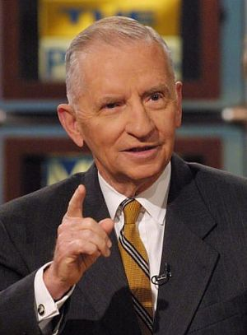
NAFTA - History
NAFTA Debate (around 1992 US election)
  Those opposed
    Labor unions (feared lost jobs and lower wages)
    Some environmental groups (feared dirty industries)
    Ross Perot (ran for president)
      Feared firms would move to Mexico:
      “Great sucking sound”
    Some Democrats

Slide 59
NAFTA - History
NAFTA Debate (around 1992 US election)
  Those in favor
    Bush (Sr.) administration
    Clinton (Bill) (but with reservations about labor and environment)
    Most of the business community
    Most economists (Not all)

Slide 60
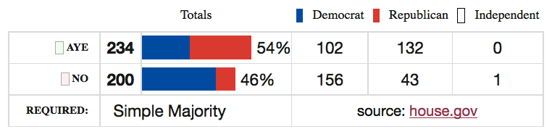
NAFTA - History
After Clinton won election
  Clinton negotiated Side Agreements on Labor and Environment
  NAFTA was approved (very narrowly) by Congress Nov 1993

Slide 61
NAFTA - History
Jan 1, 1994: NAFTA took effect
What happened?
  Not much, at first
  Then, almost a year later, the “Peso Crisis”

Slide 62
NAFTA - History
Peso Crisis (also called “Tequila Crisis”)
  Mexico’s exchange rate had been pegged
  Resisted depreciation during 1994 due to Mexican presidential election in late ‘94
    Two assassinations in also 1994 disrupted Mexico
  Late 1994 (after Mexican election)
    Crisis hit
    Peso devalued
  Devaluation had devastating effects on the Mexican economy

Slide 63
Outline: Preferential Trading Arrangements and the NAFTA
What Are PTAs?
Examples
  European Union (EU)
  North American Free Trade Agreement (NAFTA)
Effects of PTAs
  Not the Same as Free Trade
    Trade Creation
    Trade Diversion
  Market Diagram Illustration
NAFTA
  History
  Analysis
  What Happened?
NAFTA Renegotiation and USMCA

Slide 64
NAFTA - Analysis
Before NAFTA
  Many studies examined likely effects
  Some, from both sides of the debate, used spurious analysis to support their views
    Example: All imports from Mexico are viewed as costing jobs
    On the positive side, advocates of NAFTA did the same with US exports, presumed to rise a lot because of Mexico’s high tariffs
    Brown reading notes one study that overstated the benefits and understated the costs

Slide 65
NAFTA - Analysis
Before NAFTA
  Best academic studies (including “Michigan Model”) predicted
    Positive, but very small, benefit to the US
    Negligible disruption of US labor markets
    Positive, somewhat larger, benefit to Mexico
    Significant disruption in some Mexican markets
  Nobody predicted Peso Crisis

Slide 66
NAFTA - Analysis
Reasons for small predicted effects on US
  US MFN tariffs were already very low
  Much trade with Mexico was already at even lower tariffs, under Maquiladora system
  US trade with Mexico was big, but not all that big, compared to size of US economy

Slide 67
NAFTA - Analysis
The issue that raised concern
  Mexican wages were only about 1/10 of US wages
  Seemed obvious to many (e.g., Ross Perot) that employers would move to Mexico
Answer
  Mexican wages were low for a reason: low productivity
  If this had not been true, jobs would already have moved, given our already low tariffs

Slide 68
Outline: Preferential Trading Arrangements and the NAFTA
What Are PTAs?
Examples
  European Union (EU)
  North American Free Trade Agreement (NAFTA)
Effects of PTAs
  Not the Same as Free Trade
    Trade Creation
    Trade Diversion
  Market Diagram Illustration
NAFTA
  History
  Analysis
  What Happened?
NAFTA Renegotiation and USMCA

Slide 69
NAFTA – What Happened
Peso Dropped One Year After
NAFTA
Mexico Exchange Rate
Peso Crisis
Quarterly 1988-2004
0.5
0.4
$/peso
0.3
0.2
0.1
0
Q1 1988
Q2 1989
Q3 1990
Q4 1991
Q1 1993
Q2 1994
Q3 1995
Q4 1996
Q1 1998
Q2 1999
Q3 2000
Q4 2001
Q1 2003
Q2 2004
Notes:
Source of data in slide and following: IMF IFS online

Slide 70
NAFTA: What Happened - Mexico Reserves Dropped at Once
NAFTA
Peso Crisis

Slide 71
NAFTA: What Happened - Mexico
GDP Fell after Peso Crisis
NAFTA
Mexico Real GDP
Peso Crisis
1993=100
160
140
120
100
80
60
40
20
0
Q1 1988
Q2 1989
Q3 1990
Q4 1991
Q1 1993
Q2 1994
Q3 1995
Q4 1996
Q1 1998
Q2 1999
Q3 2000
Q4 2001
Q1 2003
Q2 2004

Slide 72
NAFTA: What Happened - Mexico
Imports Fell after Crisis
NAFTA
Peso Crisis

Slide 73
NAFTA: What Happened - Mexico
Wages Fell after Crisis
NAFTA
Peso Crisis

Slide 74
NAFTA: What Happened - Mexico Real Wages Plummeted!
NAFTA
Peso Crisis

Slide 75
NAFTA: What Happened - US Unemployment: No effect (or fell)
NAFTA
Peso Crisis

Slide 76
NAFTA: What Happened - US Trade: Continued growth
NAFTA
Peso Crisis

Slide 77
NAFTA: What Happened - US
Real Wage: No Change
NAFTA
Peso Crisis

Slide 78
NAFTA: What Happened
Trade Grew, More To US than From
NAFTA
Peso Crisis

Slide 79
NAFTA: What Happened
Skipped to here from slide 43
Posen (see reading) says
  “For every 100 jobs US manufacturers created in Mexican manufacturing, they added nearly 250 jobs at their larger US home operations”
  Unemployment in US was actually lower after NAFTA than before (until the 2008 financial crisis)
  Fears of Mexican farmers crossing border into US haven’t happened:
    border apprehensions have fallen since 2000,
    as have most estimates of illegal immigration
  Critics say NAFTA cost 45,000 jobs a year.
    That may be true
    But this is only 0.1% of normal job turnover in the US, where 4m-6m workers leave or lose jobs per month)

Slide 80
NAFTA: What Happened
Villarreal & Fergusson (see reading) say
  “In reality, NAFTA did not cause the huge job losses feared by the critics or the large economic gains predicted by supporters.”
  “The net overall effect of NAFTA on the U.S. economy appears to have been relatively modest, primarily because trade with Canada and Mexico accounts for a small percentage of U.S. GDP.”
  “However, there were worker and firm adjustment costs as the three countries adjusted to more open trade and investment among their economies.”

Slide 81
NAFTA: What Happened
DeLong (see reading) notes that
  The shift from manufacturing to services is just one of many such shifts that have happened in history
    From hunter-gatherers to agriculture
      And then horses, fertilizer, mechanization
    From agriculture to manufacturing
  Estimates of any jobs lost (shifted really) due to NAFTA were a tiny fraction of US employment
  The decline in US manufacturing employment did not start, or even speed up, with NAFTA

Slide 82
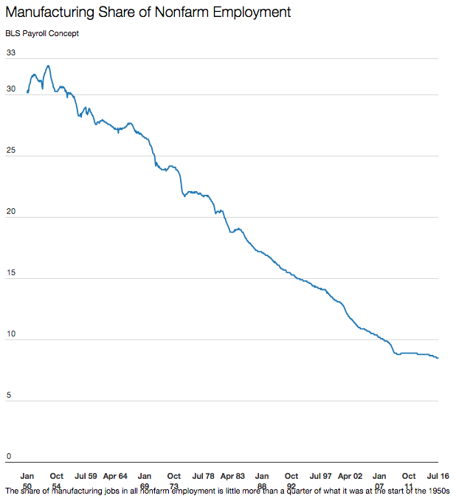
NAFTA
Jan 1950
Jul 2016

Slide 83
NAFTA: What Should Happen?
During 2008 primary campaign, Obama (& Clinton) argued for “renegotiating NAFTA”
  Early on, said NAFTA was “devastating” and “a big mistake”
  Obama later said only that he would “open up a dialogue” with Canada and Mexico
  Wanted stronger agreements on labor and environmental standards
After 2008
  Obama administration did not tamper with NAFTA
  NAFTA was not an issue in the 2012 campaign
  Did negotiate TPP=Trans-Pacific Partnership, FTA that included Canada and Mexico

Slide 84
NAFTA: What Should Happen?
Faux (see reading) says
  NAFTA has
    Caused a larger wage gap between US and Mexico
    Turned US bilateral trade surplus into deficit
    Driven 2 million Mexican farmers off the land (due to US subsidies)
    Caused illegal immigration from Mexico to double
  Reason: Mexico is “run by a small elite of crony capitalists” who were strengthened by NAFTA
  Argues for a deal that would
    Create a “fund for investment in Mexico” (like what EU did for Spain, Portugal, Ireland, Greece)
    In exchange, require “guarantees for free trade unions, enforceable minimum wages, and an increase in education and other social spending”

Slide 85
NAFTA: What Should Happen?
Donald Trump, before election
  Trump opposed NAFTA as early as 1993
    “The Mexicans want it, and that doesn't sound good to me.”
  Called NAFTA “The single worst trade deal ever approved in this country”
Donald Trump, after election
  Called for renegotiation of NAFTA, as promised
  May 18, 2017, Trump formally launched renegotiation
  Aug 16, 2017, negotiations began

Slide 86
Clicker Question
How has the US share of employment in manufacturing changed before and after NAFTA?
  It rose before NAFTA and fell after
  It fell before NAFTA and rose after
  It rose both before and after NAFTA
  It fell both before and after NAFTA
  It was constant over time before NAFTA and fell after
✓

Slide 87
Outline: Preferential Trading Arrangements and the NAFTA
What Are PTAs?
Examples
  European Union (EU)
  North American Free Trade Agreement (NAFTA)
Effects of PTAs
  Not the Same as Free Trade
    Trade Creation
    Trade Diversion
  Market Diagram Illustration
NAFTA
  History
  Analysis
  What Happened?
NAFTA Renegotiation and USMCA

Slide 88
NAFTA Renegotiation Issues
Trade imbalances: Trump wants deficits to fall
Rules of origin: tighten them
Dispute mechanisms: keep or remove
  Chapter 11: Investor-State Dispute Settlement (ISDS)
  Chapter 19: Dumping and CVD
Dairy and poultry (Canada’s policies)
Sunset clause
New issues (digital trade, state-owned enterprises, labor standards)

Slide 89
Clicker Question
Which of the following is not being asked for by the US in the NAFTA renegotiation?
  That Mexico reduce its trade surplus with the US
  That Mexico pay for a wall between the US and Mexico
  That Canada reduce its tariff on imported dairy
  That any agreement have a “sunset clause”
  That more North American content be required for cars to be imported tariff-free into the US
✓

Slide 90
Clicker Question
Why did the NAFTA not require free trade within North America in energy? (This is from the Schultz and Aspe reading, not lecture)
  Because the NAFTA countries did not then produce energy products
  Because Ross Perot, an oil company executive, would have objected.
  Because the oil sector in Mexico at that time was state owned.
  Because that would have violated the rules of the GATT.
  Because Republicans owned the US oil companies.
✓

Slide 91
USMCA
Outcome of the Renegotiation
  May 18, 2017: Renegotiation began
  Aug 27, 2018: Agreement reached between US and Mexico
  Sep 30, 2018: Agreement reached with Canada to join USMCA
USMCA = U.S.-Mexico-Canada (Trade) Agreement

Slide 92
USMCA
Features of USMCA
  Auto rules of origin
    Required North American content raised from 62.5% to 75%
    40-45% content must be from labor paid $16/hr or more (but does not rise with inflation)

Slide 93
USMCA
Features of USMCA
  New rules (similar to TPP) on
    Intellectual property
    Environment
    Labor
    Financial services
    Digital trade

Slide 94
USMCA
Features of USMCA
  Sunset clause? Not exactly
    Revisit deal after 6 years
      If happy, extend for 10 more
      If not, new negotiations

Slide 95
USMCA
Features of USMCA
  Canadian dairy
    Canada will increase permitted imports of dairy from US, to 3.6% of its market
    Canada to cease selling some dairy ingredients abroad at low prices and will tax exports over over some threshold

Slide 96
USMCA
Features of USMCA
  Currencies
    Commitment to “refrain from competitive devaluations and targeting exchange rates”

Slide 97
USMCA
Features of USMCA
  Trade with China
    Countries must inform US 3 months before beginning trade negotiations with any “non-market economy” (i.e., China)
    If agreement with such economy is reached, US can terminate USMCA with six months notice.

Slide 98
USMCA
Features of USMCA
  Chapter 19
    Keeps this dispute settlement system for trade remedies such as anti-dumping
    Does not apply them to “national-security-based” tariffs

Slide 99
USMCA
Features of USMCA
  Chapter 11 (ISDS)
    Removes this for disputes between US and Canada
    Keeps it for disputes with Mexico

Slide 100
USMCA
“Side letter” of USMCA
  Promise to shield Canada Mexico from future “national-security-based” tariffs (i.e., cars) (not enforceable)

Slide 101
USMCA
NOT a Feature of USMCA
  Removal of US recent tariffs on steel and aluminum from Canada and Mexico
  But these were eventually removed anyway, May 17, 2019

Slide 102
USMCA
Prospects for approval
  Must be approved by all three legislatures
    Canada: Dairy will resist, but approval assured
    Mexico: Ratified June 19, 2019
    US: Contentious, Democrats in House want changes

Slide 103
USMCA
Importance of USMCA
  Trump: “It’s not NAFTA redone, it’s a brand-new deal”
  NYT: “a consequential set of revisions”
  Economist: “a modest revision”, “inferior to the agreement it replaces”
  Bown: deal to “result in less trade, not more”

Slide 104
Clicker Question
Once the USMCA is fully in place, how much of a car imported to the US from Mexico with zero tariff can be made in China?
  None
  10%
  25%
  37.5%
  50%
The required North-American content will rise to 75% (from 62.5%)
✓

Slide 105
Clicker Question
What country’s past currency manipulation was the reason for including this as a feature of USMCA?
  Canada
  China
  Mexico
  US
  All of the above except US
✓

Slide 106
Clicker Question
Which of the following is not an issue included in the USMCA?
  Intellectual property
  Environment
  Labor
  Aircraft
  Digital trade
✓

Slide 107
Next Time
International Policies for Economic Development: Trade
  The Issues
  Washington Consensus
  Pros and cons of free trade for developing countries
  Policy recommendations

Slide 108
Clicker questions on skipped slides.

Slide 109
Clicker Question
Under what US president was the NAFTA approved in Congress?
  Ronald Reagan
  George H. W. Bush
  Bill Clinton
  George W. Bush
  Barak Obama
✓

Slide 110
Clicker Question
When did the Peso Crisis happen, compared to the NAFTA?
  One year before
  One month before
  One week after
  One year after
  Two years after
✓

Slide 111
Clicker Question
What happened to real wages in the US and Mexico over the years after the NAFTA?
  Wages rose a lot in Mexico and fell a lot in the US
  Wages fell a lot in Mexico and rose a lot in the US
  Wages changed very little in both countries
  Wages changed little in Mexico and fell a lot in the US
  Wages changed little in the US and fell a lot in Mexico
✓

