Slide 1
Lecture 23
Environment, Labor Standards, and Trade
Econ 340
Notes:
Add Porter

Slide 2
News: Dec 2-8
Trump puts metals tariffs on Argentina and Brazil -- WSJ: 12/2 | Canvas | NYT: 12/2 | Canvas | FT: 12/2 | Canvas | WP: 12/2 | Canvas
  Trump says he will levy tariffs on steel and aluminum from Argentina and Brazil. His reason is his claim that they are manipulating their currencies.
  Trump's tariffs on steel and aluminum were levied on the EU and many others, but Brazil and Argentina were exempted until now due to an agreement negotiated with them in 2018 to limit their exports.
  A contributing reason may be that the US trade war with China has led to China shifting its purchases of agricultural products away from the US and toward these two countries.
Trump threatens tariff on France in retaliation against their digital tax -- WSJ: 12/3 | Canvas | FT: 12/2 | Canvas
  Trump says he will put a 100% tariff on various luxury goods from France, in retaliation for their tax on digital commerce, which he says unfairly hurts American firms.
  The Digital Services Tax takes 3% of revenues made in France by digital companies such as Google, Apple, Facebook, and Amazon. Though it applies to French and other European firms as well as US firms, the market is clearly dominated by the US firms.
  The OECD is working on a broader effort to address the unfairness of international and digital taxation, and France's President Macron promised Trump to remove his tax once an OECD agreement has been reached.
OPEC and its allies agree to cut oil production -- WSJ: 12/6 | Canvas | NYT: 12/6 | Canvas
  The Organization of Petrolium Exporting Countries (OPEC), meeting with other oil exporters including especially Russia, agreed to cut oil output next year by 40% more than previously agreed. The aim is to raise the world price of oil.
  The burden of the cuts is expected to be shared by ten oil producers that are not members of OPEC, in addition to OPEC itself. Observers are not confident that they will actually succeed in reducing output, since the strong incentive for each country to produce more.
  Saudi Arabia is most interested in raising the price of oil, because it plans soon to sell shares in the state oil company, Aramco, and it wants to get a high price for those shares.

Slide 3
News: Dec 2-8
Trump puts metals tariffs on Argentina and Brazil
  Trump says he will levy tariffs on steel and aluminum from Argentina and Brazil. His reason is his claim that they are manipulating their currencies.
  Trump's tariffs on steel and aluminum were levied on the EU and many others, but Brazil and Argentina were exempted until now due to an agreement negotiated with them in 2018 to limit their exports.
  A contributing reason may be that the US trade war with China has led to China shifting its purchases of agricultural products away from the US and toward these two countries.

Slide 4
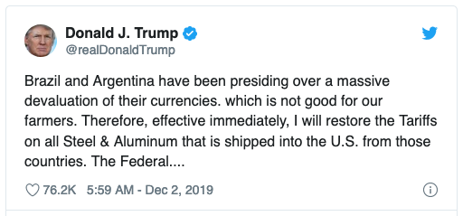

Slide 5
News: Dec 2-8
Trump threatens tariffs on France in retaliation against their digital tax
  Trump says he will put a 100% tariff on various luxury goods from France, in retaliation for their tax on digital commerce, which he says unfairly hurts American firms.
  The Digital Services Tax takes 3% of revenues made in France by digital companies such as Google, Apple, Facebook, and Amazon. Though it applies to French and other European firms as well as US firms, the market is clearly dominated by the US firms.
  The OECD is working on a broader effort to address the unfairness of international and digital taxation, and France's President Macron promised Trump to remove his tax once an OECD agreement has been reached.

Slide 6
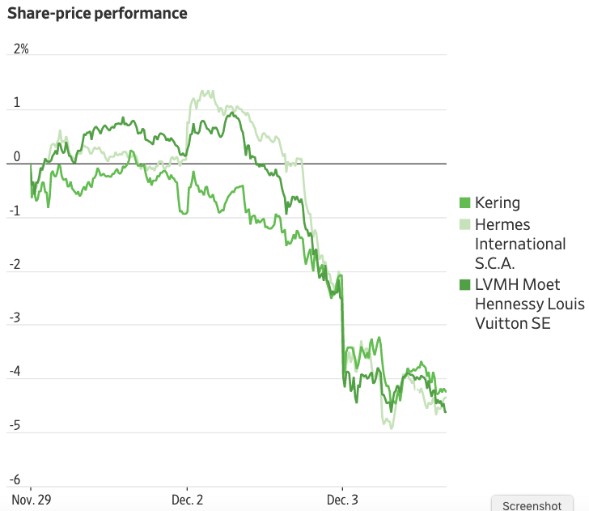

Slide 7
News: Dec 2-8
OPEC and its allies agree to cut oil production
  The Organization of Petroleum Exporting Countries (OPEC), meeting with other oil exporters including especially Russia, agreed to cut oil output next year by 40% more than previously agreed. The aim is to raise the world price of oil.
  The burden of the cuts is expected to be shared by ten oil producers that are not members of OPEC, in addition to OPEC itself. Observers are not confident that they will actually succeed in reducing output, since the strong incentive for each country to produce more.
  Saudi Arabia is most interested in raising the price of oil, because it plans soon to sell shares in the state oil company, Aramco, and it wants to get a high price for those shares.

Slide 8
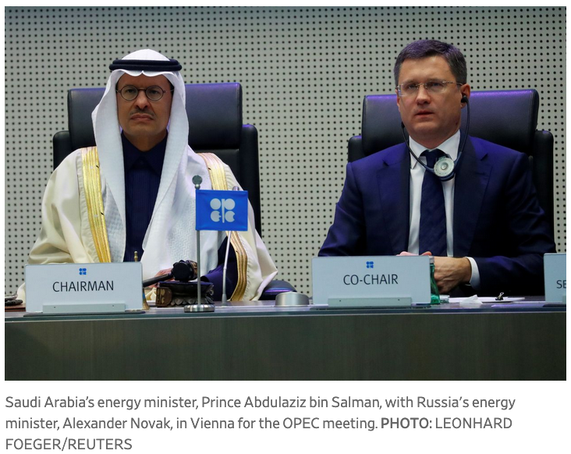

Slide 9
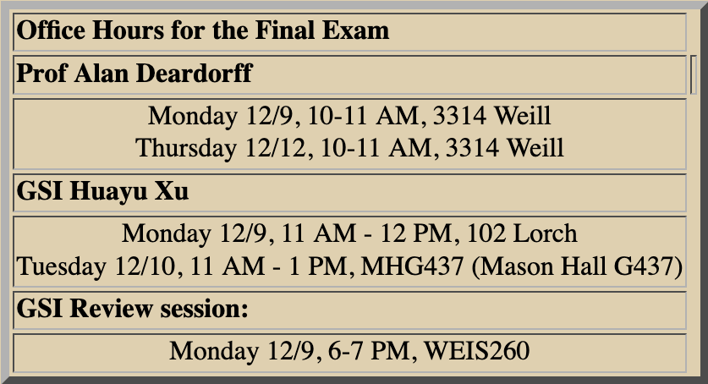

Slide 10
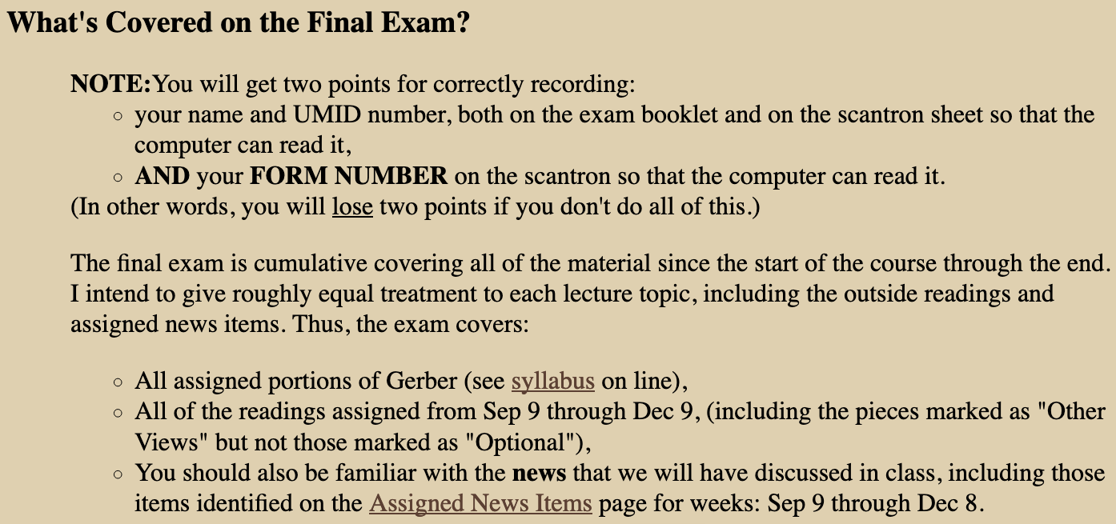
Note: Does not cover slides on NAFTA History that we jumped over in Lecture 18

Slide 11
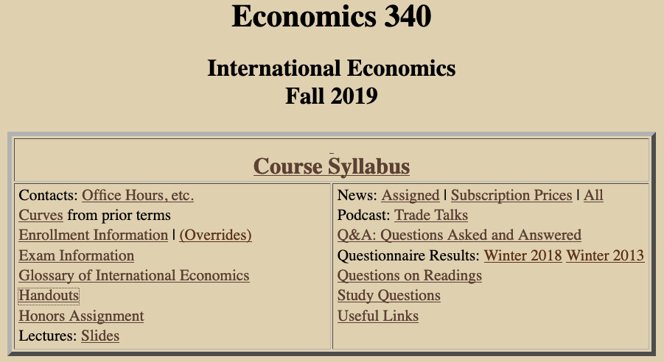

Slide 12
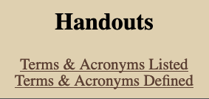

Slide 13
Outline: Environment, Labor Standards, and Trade
The Issues
Environment
  Examples
  Policies
  International Problems
  Role of the WTO
Labor Standards
  Fundamental ILO Conventions
  United States Role
  Issues

Slide 14
The Issues
Environment
  Does trade hurt the environment?
  Does international competition weaken environmental laws?
Labor Standards
  Does trade hurt workers?
  Does international competition weaken labor standards?
Role of the WTO in both
  Do WTO rules
    Limit countries’ abilities to raise standards?
    Or lead them to reduce standards (“race to the bottom”)?
  Should trade policy be used to improve standards?
  Should trade policy be used if countries’ standards or policies differ?

Slide 15
Outline: Environment, Labor Standards, and Trade
The Issues
Environment
  Examples
  Policies
  International Problems
  Role of the WTO
Labor Standards
  Fundamental ILO Conventions
  United States Role
  Issues

Slide 16
Environment
The problem: Externalities
  Externality is: Cost or benefit of an activity that is not borne by the actor.
  Examples: Pollution, global warming, destruction of species
The issues:
  How should externalities be dealt with?
  Is doing this made harder or easier by trade and trade policy, or by the WTO?

Slide 17
Outline: Environment, Labor Standards, and Trade
The Issues
Environment
  Examples
  Policies
  International Problems
  Role of the WTO
Labor Standards
  Fundamental ILO Conventions
  United States Role
  Issues

Slide 18
Environment: Examples
Pollution along the Mexican border
  Caused by production, for export to U.S.
  Stimulated by
    Maquiladoras (Firms given special tariff treatment on processing for U.S. firms)
    NAFTA

Slide 19
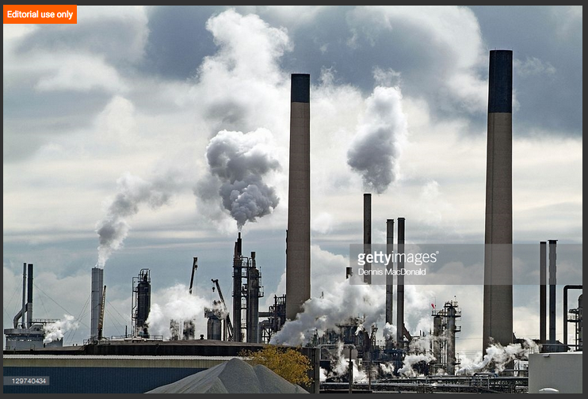
Notes:
https://www.gettyimages.com/detail/photo/chemical-industry-plants-spew-air-pollution-high-res-stock-photography/129740434

Slide 20
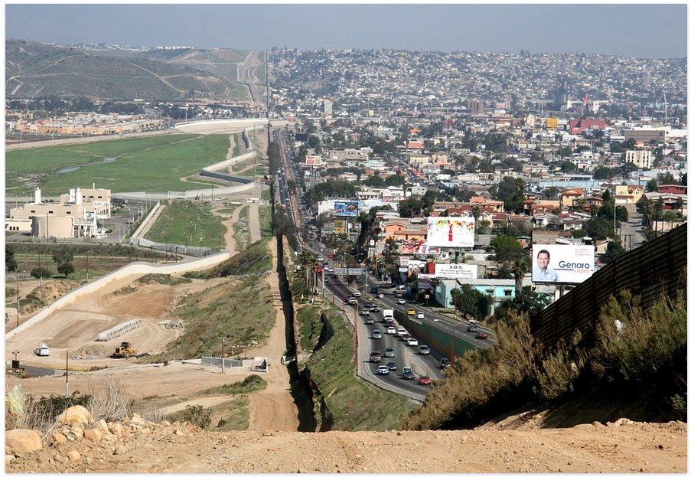
Notes:
http://geo-mexico.com/?tag=border

Slide 21
Environment: Examples
Pollution along the Mexican border
  Caused by production, for export to U.S.
  Stimulated by
    Maquiladoras (Firms given special tariff treatment on processing for U.S. firms)
    NAFTA
U.S. laws struck down by GATT / WTO
  Tuna-dolphin case
  Shrimp-turtle case
US laws banned imports
… hurts these
Struck Down by GATT/WTO!
Fishing for these…

Slide 22
Outline: Environment, Labor Standards, and Trade
The Issues
Environment
  Examples
  Policies
  International Problems
  Role of the WTO
Labor Standards
  Fundamental ILO Conventions
  United States Role
  Issues

Slide 23
Environment: Policies
How to deal with a negative externality
  Regulate: Prohibit or limit activity
  Tax: Make activity more costly
    By setting tax equal to cost to others, government can “internalize” the externality.
  Hybrid: Tradable licenses
    Number of licenses set by regulation
    Market determines who uses licenses
    = “cap and trade”

Slide 24
Environment: Policies
What is the “Optimal” level of a negative externality?
  It is not zero!
  It is found by equating
    marginal benefit (of reducing externality) to
    marginal cost (of reducing externality)

Slide 25
Environment: Policies
What is the “Optimal” level of a negative externality?
$
Marginal cost …
Marginal benefit …
… of reducing pollution
Optimal pollution
Zero pollution

Slide 26
Environment: More Examples
Air pollution
Water pollution
Acid rain
CO₂ emission (global warming)
Destruction of rain forest
Destruction of species
  Endangered (sea turtles)
  Favored (dolphin)
Overuse of natural resources (over-fishing)

Slide 27
Clicker Question
What is an “externality”?
  A cost of production that occurs outside of a country, due to offshoring.
  The amount a firm must pay in interest if it borrows to finance investment.
  The harm done to consumers of exported products such as cigarettes.
  The negative effect of imports on domestic employment.
  A cost or benefit of an activity that is not borne by the actor.
✓

Slide 28
Clicker Question
What is the optimal level of a air pollution?
  The level that would occur if markets were free.
  The level beyond which the harm from pollution would increase.
  The level beyond which the harm from pollution would decrease.
  The level at which there is no pollution.
  The level at which the marginal benefit from reducing pollution equals the marginal cost.
✓

Slide 29
Outline: Environment, Labor Standards, and Trade
The Issues
Environment
  Examples
  Policies
  International Problems
  Role of the WTO
Labor Standards
  Fundamental ILO Conventions
  United States Role
  Issues

Slide 30
Environment: International Problems
Cross-border Externalities
  Contrast with local externalities
    Local government has ability and incentive to act
  Cross-border: No incentive to incur a local cost in order to limit harm to foreigners.
  Need international agreement
  Example:
    CFCs (Chloroflorocarbons) that caused the hole in the ozone.
    Dealt with by Montreal Protocol (1987)

Slide 31
Environment: International Problems
Effects on Competitiveness
  Pollution tax raises costs of
    Exporters
    Import-competitors
  If foreign firms are not taxed, this is viewed as unfair
  Countries with weak regulations become “pollution havens”
    But Jones says there is little evidence that this happens – it’s not worth it
  “Race to the bottom”: Countries compete by lowering their environmental standards
  Solution (?): International agreement for all to tax equally
    Called “harmonization”

Slide 32
Environment: International Problems
Differences in Optimal Policy
  Optimal policy may depend on a country’s income
  Poor countries can’t afford strict regulations
  The environment is “income elastic” or a “superior good” – that is, countries demand more of it as their incomes rise.
  Thus taxes on local pollution should not be the same

Slide 33
Environment: International Problems
Example: Internal memo by Larry Summers when at World Bank:
[He goes on to give several reasons.]
“ ‘Dirty’ Industries: Just between you and me, shouldn’t the World Bank be encouraging MORE migration of the dirty industries to LDCs?”

Slide 34
Clicker Question
What agreement dealt with CFCs (chloroflorocarbons), and why?
  The Montreal Protocol, because CFCs were destroying ozone.
  NAFTA, because CFCs cause lung cancer.
  The Plaza Accord, because CFCs were causing Legionnaires’ disease.
  The Doha Disagreement, because CFCs are a substitute for petroleum.
  The Paris Agreement, because CFCs contribute to climate change.
✓

Slide 35
Clicker Question
Why might a country be reluctant to levy a pollution tax on its producers in order to clean its own air if other countries do not do the same?
  It raises the cost of production for export.
  It reduces the competitiveness of local producers who compete with imports.
  It’s not fair.
  It encourages producers to relocate abroad.
  All of the above.
✓

Slide 36
Outline: Environment, Labor Standards, and Trade
The Issues
Environment
  Examples
  Policies
  International Problems
  Role of the WTO
Labor Standards
  Fundamental ILO Conventions
  United States Role
  Issues

Slide 37
Environment: Role of the WTO
Does WTO permit limits on imports for environmental reasons?
  Yes, if the imports themselves would do damage inside importing country.
  No, for damage done abroad.
  Any policy must not discriminate.
  May not limit imports based on process by which they were produced.

Slide 38
Policy Options
Use WTO (These options are not in fact permitted, and they are not good ideas)
  Treat environmental violations as trade violations
    Some environmentalists would like this, because the WTO has “teeth”
  Define environmentally harmful production of exported goods as “unfair,” and permit AD & CVD

Slide 39
Policy Options
Carbon Tariff
  If some but not all countries
    use carbon tax or cap-and-trade to raise price of carbon
    to fight global climate change
  Then many would advocate a carbon tariff on imports of goods from non-participating countries
  Problem:
    Benefits (to world) of reducing carbon may be the same
    But the costs (to the country) are not

Slide 40
Policy Options
Carbon Tariff: Arguments for and against
  Krugman is for
    Failure to use them will cause consumer substitution toward cheaper products made in countries that do not tax or restrict carbon emissions
    [Economist 2018: “carbon leakage” – the possibility that places with laxer climate policies will produce commodities more cheaply]
    Should be legal under WTO, like “border tax adjustments” used when countries taxation systems differ
  China (per Reuters) is against
    Calls carbon tariffs “protectionist”
    Predicts use of carbon tariffs would cause trade war
    Says not legal under WTO
Notes:
Economist quote: November 29, 2018, in “Decarbonising industry: How to get the carbon out of industry”

Slide 41
Clicker Question
Why might Larry Summers have argued that dirty industries should be located in poor countries?
  It would be less costly for them to clean their air than for rich countries.
  He believes that international policies should be most beneficial for those who can pay for them.
  Larry Summers is a jerk.
  Poor countries value the income from those industries more, relative to clean air.
  Wind speeds tend to be higher in poor countries and will blow away the pollution.
✓

Slide 42
Clicker Question
Why have environmentalists been critical of the WTO?
  The WTO requires that countries permit imports that will foul the environment.
  International trade contributes to global warming.
  Policies intended to help the environment have been struck down by the WTO.
  WTO disputes are handled in Switzerland, whose environmental policies are weak.
  The WTO opposes the Convention on International Trade in Endangered Species.
✓

Slide 43
Outline: Environment, Labor Standards, and Trade
The Issues
Environment
  Examples
  Policies
  International Problems
  Role of the WTO
Labor Standards
  Fundamental ILO Conventions
  United States Role
  Issues

Slide 44
Labor Standards
What are they?
  Formal list of “conventions” (190) and “recommendations” (206) regarding treatment and conditions of labor, established by
  The ILO = International Labour Organization
  These include 8
  “Fundamental ILO Conventions”
      Numbers in parentheses below: numbers of countries that have ratified the conventions (as of 11/27/2019) out of 187 members
Notes:
http://www.ilo.org/public/english/standards/relm/country.htm

Slide 45
Labor Standards:
Fundamental ILO Conventions
Freedom of Association
  Right to Organize (155)
  Right to Collective Bargaining (167)
Abolition of Forced Labor
  Forced Labor (178)
  Abolition of Forced Labor (175*)
Notes:
1a: http://www.ilo.org/dyn/normlex/en/f?p=1000:11300:0::NO:11300:P11300_INSTRUMENT_ID:312232
1b: http://www.ilo.org/dyn/normlex/en/f?p=1000:11300:0::NO:11300:P11300_INSTRUMENT_ID:312243
2a: http://www.ilo.org/dyn/normlex/en/f?p=1000:11300:0::NO:11300:P11300_INSTRUMENT_ID:312174
2b: http://www.ilo.org/dyn/normlex/en/f?p=1000:11300:0::NO:11300:P11300_INSTRUMENT_ID:312250

Slide 46
Labor Standards:
Fundamental ILO Conventions
Equality
  Discrimination (175)
  Equal Remuneration (173)
Elimination of Child Labor
  Minimum Age (172)
  Worst Forms of Child Labor (186*)
Notes:
3a: http://www.ilo.org/dyn/normlex/en/f?p=1000:11300:0::NO:11300:P11300_INSTRUMENT_ID:312256
3b: http://www.ilo.org/dyn/normlex/en/f?p=1000:11300:0::NO:11300:P11300_INSTRUMENT_ID:312245
4a: http://www.ilo.org/dyn/normlex/en/f?p=1000:11300:0::NO:11300:P11300_INSTRUMENT_ID:312283
4b: http://www.ilo.org/dyn/normlex/en/f?p=1000:11300:0::NO:11300:P11300_INSTRUMENT_ID:312327

Slide 47
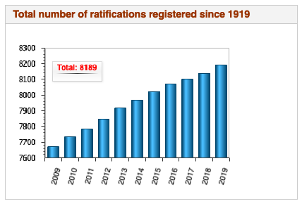
Notes:
http://www.ilo.org/dyn/normlex/en/f?p=NORMLEXPUB:1:0::NO:::

Slide 48
Outline: Environment, Labor Standards, and Trade
The Issues
Environment
  Examples
  Policies
  International Problems
  Role of the WTO
Labor Standards
  Fundamental ILO Conventions
  United States Role
  Issues

Slide 49
Labor Standards:
Fundamental ILO Conventions
*Fundamental Conventions ratified by U.S.:
ONLY:
  Abolition of Forced Labor
  Worst Forms of Child Labor
Notes:
http://www.ilo.org/dyn/normlex/en/f?p=1000:12001:0::NO:::

Slide 50
Labor Standards:
Fundamental ILO Conventions
United States
  Has not ratified many of the conventions
  But… in spite of that, US enforces many labor standards through its trade laws

Slide 51
Labor Standards:
Found in U.S. Trade Law
Freedom of Association
Right to Organize and Bargain Collectively
Forced Labor
Minimum Age for Employment
Acceptable Conditions of Work
(not “Fundamental” in ILO)
  Minimum wage
  Hours of work
  Safety and Health
  Enforcement

Slide 52
U.S. Labor Standards
US pushes labor standards in trade agreements
  Side agreement in NAFTA & was included in TPP
  Now included in USMCA
  Purpose is to
    Improve labor conditions abroad
    Protect labor standards in the US
  Do they work? No, says Porter

Slide 53
U.S. Labor Standards
Porter:
  US labor standards are
    Among the lowest in OECD countries
    Weaker than in EU
    Also weak in US:
      Unions
      Safety net
  Could a trade agreement help?
    Porter says yes: the TTIP with EU could harmonize labor standards in US up to EU levels
    (But TTIP is now unlikely, post-Trump.)
    (TTIP = Trans-Atlantic Trade and Investment Partnership, proposed FTA of US and EU)

Slide 54
Clicker Question
Which of the following is not one of the eight core labor standards of the ILO?
  Abolition of forced labor
  Minimum wage
  Right to collective bargaining
  Nondiscrimination
  Right to organize
✓

Slide 55
Clicker Question
Why is the article by Porter critical of US labor standards?
  They are weaker than those of the EU.
  Unions in the US have less power than abroad.
  Compared to other rich countries, the safety net for US workers is weak.
  All of the above.
  None of the above.
✓

Slide 56
Outline: Environment, Labor Standards, and Trade
The Issues
Environment
  Examples
  Policies
  International Problems
  Role of the WTO
Labor Standards
  Fundamental ILO Conventions
  United States Role
  Issues

Slide 57
Labor Standards: Issues
Should labor standards be promoted?
Of course?
Yes, but only if it will help the people involved, the workers themselves
What if the true purpose is to help workers in rich countries?

Slide 58
Labor Standards: Issues
Effect of labor standards:
w = wage
S
D
L = labor

Slide 59
Labor Standards: Issues
Effect of labor standards: Minimum wage
w
And creates unemployment
S
Raises wage
Does labor benefit?
Yes, if still employed
No if not
D
But lowers employment
L

Slide 60
Labor Standards: Issues
Effect of labor standards:
Legislating Better conditions
Raises costs of employers, thus lowers the benefit of hiring labor. Thus shifts demand curve down.
w
S
Lowers wage
Does labor benefit?
Yes, if still employed and conditions worth the fall in wage
No if not
D
D′
And lowers employment
L

Slide 61
Labor Standards: Issues
Should trade policies be used for labor standards?
NO, say
  Trade economists
  Trade lawyers
  Developing countries (even some of their labor unions)
  MNEs (who would pay the cost)
  Most Republicans
    But this is (weakly) a part of USMCA

Slide 62
Labor Standards: Issues
Should trade policies be used for labor standards?
YES, say
  Most Democrats
  US labor unions
  Many NGOs
  (NGO=non-governmental organization)

Slide 63
Labor Standards: Issues
Should trade policies be used for labor standards?
PRO (assuming standards themselves are good):
  Trade is the only tool we have (ILO is “toothless”)
  WTO already does this in TRIPs (why help corporations and not labor?)
  It is wrong to benefit from abuse of labor

Slide 64
Labor Standards: Issues
Should trade policies be used for labor standards?
CON:
  Slippery slope to enforcing harmful labor standards
  Trade restrictions make countries poorer, hurting their workers
  Trade restrictions cost everybody
  Incentive for protectionist claims of low labor standards

Slide 65
Labor Standards: Issues
Are trade policies used to enforce labor standards?
No, not in the WTO in the way some would like (by limiting imports from weak-standard places)
But US is including them in FTAs.

Slide 66
Labor Standards: Issues
What to do when labor standards are violated
Example: Fires in garment factories in Bangladesh and Pakistan (see Bhagwati)
Stop buying the brands who manufactured there?
  No. That just destroys the jobs of poor-country garment workers.
Hold local governments responsible?
  Yes. They need pressure to enforce labor standards.

Slide 67
Labor Standards: Issues
UM response to Bangladesh fire (from University Record, 4/12/14):
  President Mary Sue Coleman announced Tuesday that U-M will adopt the recommendation of the President's Advisory Committee on Labor Standards and Human Rights that all U-M licensees either sign and abide by a worker safety initiative called the Accord on Fire and Building Safety in Bangladesh or demonstrate that they have an equivalent safety plan.
  Accord on Fire and Building Safety in Bangladesh
    calls for public reporting, independent fire and building safety inspectors at factories, and a commitment to workers in improving factory safety practices.

Slide 68
Clicker Question
Who benefits from a law requiring improved standards for workers in factories?
  The firms that own the factories.
  Those workers who are laid off from factories where they were mistreated.
  Those workers who value the improved conditions more than any loss of wages.
  Those who buy the products of the factories, the prices of which will fall
  Nobody. Legislated labor standards only cause inefficiency.
✓

Slide 69
Clicker Question
Why should the WTO not permit countries to use tariffs against imports from countries that have low labor standards?
  Tariffs would cause deadweight loss to the importing countries.
  This would encourage industries to claim low standards just to get protection.
  Such tariffs would likely lead to a trade war.
  Low labor standards are beneficial to the countries that have them.
  Strong labor standards are adequately enforced already by the International Labor Organization.
✓

Slide 70
Clicker Question
Why should the WTO permit countries to use tariffs against imports from countries that have low labor standards?
  The ILO is toothless.
  The WTO already protects owners of capital and should do the same for labor.
  Low labor standards give producers a cost advantage, similar to dumping.
  By championing workers, the WTO would make globalization more popular.
  Only then could the United States be induced to improve its own labor standards.
✓

Slide 71
Clicker Question
Which of the following might the graph below represent?
  A minimum wage
  An incentive for more workers to seek jobs
  A rise in employers’ the cost of making the workplace safe
  Union negotiation of a wage agreement
  Migration of workers out of the country
✓
w
S
D
D′
L

Slide 72
Next Time, and After That
Last Class, Wed Dec 11
  Review
Final Exam: Fri, Dec 13, 1:30-3:30 PM

