Slide 1
Class 1
The State of Play in International Trade and Trade Policy I:
Trade Wars by
Alan V. Deardorff
University of Michigan
2024
PubPol/Econ 541

Slide 2
Announcements
Next class (Wednesday) I’ll start by asking you for recent News, then discuss it and what I’ve noticed myself.
  After that, every Monday if class
Note that if I don’t get through all my slides, you should view them later. (But not the Aug 26 class.)
Office hours:
  Feel free to enter even if others are there
  If you want a private meeting, email me to schedule

Slide 3
Trade Wars
Notes:
Pinn, Ingram, “Ingram Pinn’s illustration of the week: Trading tariffs,” Financial Times, June 22, 2018.
https://www.ft.com/content/c56ebb64-7579-11e8-b326-75a27d27ea5f

Slide 4
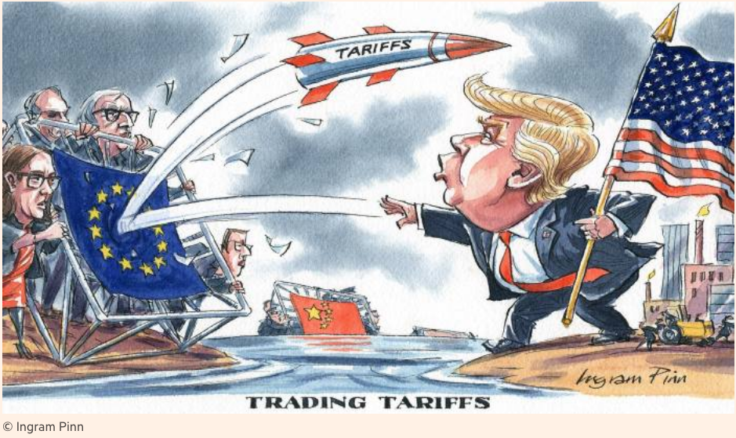
Notes:
Pinn, Ingram, “Ingram Pinn’s illustration of the week: Trading tariffs,” Financial Times, June 22, 2018.
https://www.ft.com/content/c56ebb64-7579-11e8-b326-75a27d27ea5f

Slide 5
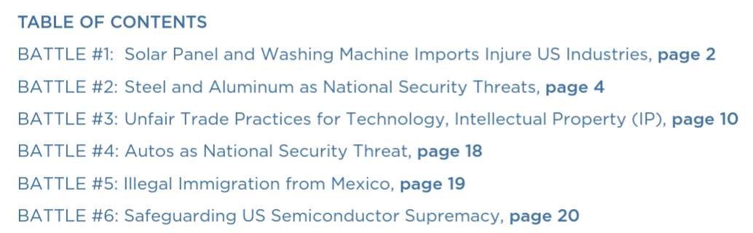
Bown, Chad P. and Melina Kolb, "Trump's Trade War Timeline
We’ll focus on these three only
Notes:
Pinn, Ingram, “Ingram Pinn’s illustration of the week: Trading tariffs,” Financial Times, June 22, 2018.
https://www.ft.com/content/c56ebb64-7579-11e8-b326-75a27d27ea5f

Slide 6
Pause for Discussion

Slide 7
  Questions on Bown & Kolb
With what countries is/was the US engaged in a trade war?
What have been the legal bases (within the US) for tariffs and threats of tariffs?
What is the current status of the trade war with China?
To what extent has President Biden reversed the tariffs begun by Trump?
What main new actions have happened under Biden?

Slide 8
Trade Wars, 2018-2021
Outline
  Battles in the Trade Wars
    (Washing Machines & Solar Panels)
    Steel & Aluminum
    US-China Trade War (re Intellectual Property)
    (Cars)
    (Mexico migration)
    Semiconductors

Slide 9
  Steel & Aluminum
National Security
  Section 232 of US trade law
  Tariffs on imports that “threaten national security”
  “National security” is not defined
  Legality in WTO is unclear
    But WTO panel report ruled against US

Slide 10
  Steel & Aluminum
National Security
  Mar 1, 2018: Trump levies tariffs
    25% on steel, 10% on aluminum
    Against all countries
      A few removed shortly thereafter
      Remained in place on EU, China, Canada, Mexico, and others
    Retaliation by all
    (Tariffs on Canada & Mexico were later removed)

Slide 11
  Steel & Aluminum
US-EU and other
  Negotiations began under Biden May 17, 2021
  US lifts some tariffs but keeps them on over-quota quantities (“tariff-rate quota”) and partners remove retaliatory tariffs on US:
    EU: Oct 31, 2021
    Japan: Feb 7, 2022
    UK: Mar 22, 2022
    Ukraine: May 9, 2022
  WTO panel rules on Trump’s tariffs (“inconsistent”)

Slide 12
Pause for Discussion

Slide 13
  Questions on
  Reuters, “Biden extends …”
How high were the tariffs before the suspension?
When were they suspended and against whom?
What were the tariffs replaced with?
How are non-EU exports treated?

Slide 14
  Questions on
  Rampell, “The terrible lesson …”
What policy action prompted this article (not mentioned in the headline)?
What effect does this say tariffs on steel have on jobs in the US, and why?
Will this policy, only on exports from China, be as costly? What other policy is mentioned that would be more so?
What policy has Trump said he will enact if reelected, and how has Biden responded?

Slide 15
  US-China Trade War
Legal basis for US tariffs on China was mostly on intellectual property
  IP includes patents, trademarks, copyrights, and trade secrets
  US (and others) claim that China
    Steals technology secrets
    Forces investors to turn over technologies in joint ventures

Slide 16
  US-China Trade War
USTR (United States Trade Representative) under Trump
  Initiated investigation of China’s IP practices
  Under Section 301 of US trade law – Unfair trade practices
  This is not something permitted by the WTO

Slide 17
  US-China Trade War
March 22, 2018: Report found unfair trade practices
  IP violations (see above)
  Also subsidies to firms and state-owned enterprises (SOEs) to trade unfairly
Trump announced tariffs on up to $60 billion of China’s exports to US

Slide 18
  US-China Trade War
US and China levied tariffs on each other
  Three times in 2018, twice in 2019
    Trump either added new tariffs on China exports or raised them
    Each time, China responded with more tariffs on US exports
  Threat of more in December 2019 was suspended by the “Phase One” US-China Trade Deal

Slide 19
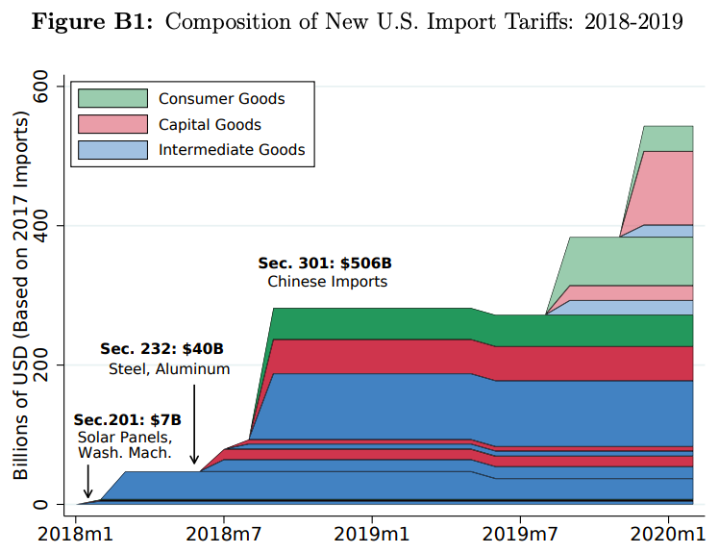
Trump Tariffs, 2018
Source: Flaan & Pierce 2020
Notes:
Flaan and Pierce 2020
https://www.federalreserve.gov/econres/feds/files/2019086pap.pdf

Slide 20
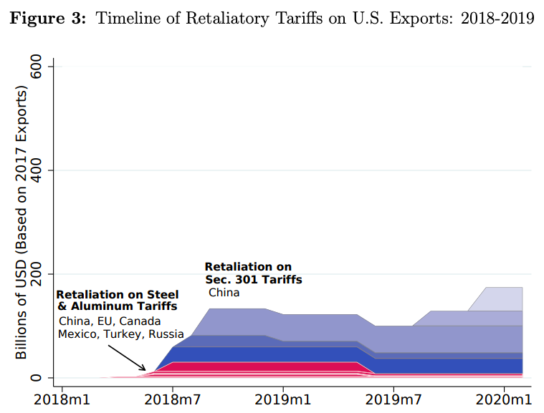
Source: Flaan & Pierce 2020
Notes:
Flaan and Pierce 2020
https://www.federalreserve.gov/econres/feds/files/2019086pap.pdf

Slide 21
  US-China Trade War
Phase One Deal
  In anticipation, Trump called off December 2019 tariffs
  Agreement signed January 15, 2020
Content of Deal:
  China to buy $200 billion more US exports
  US to reduce a few tariffs on China
  China to stop forcing foreign companies to transfer technology
  Most tariffs remain in place by both, and China did not address subsidies and SOEs

Slide 22
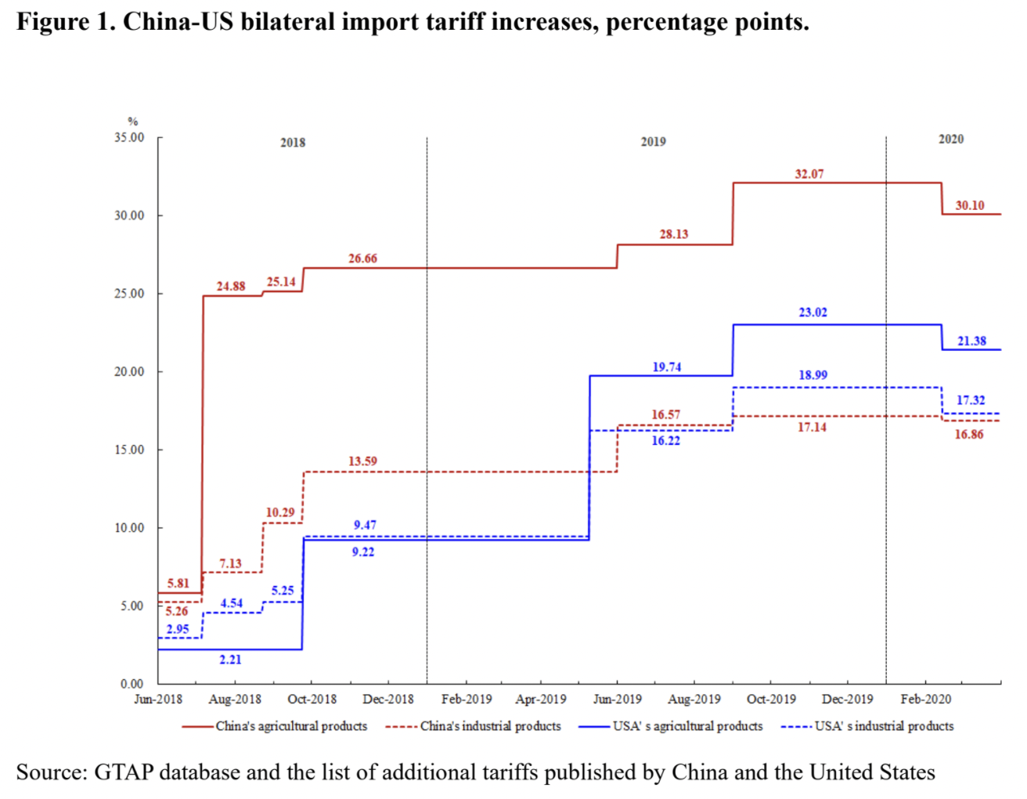
Phase One Agreement Reductions Jan 2020
US tariffs on China
Agriculture
Industrial
China tariffs on US
Agriculture
Industrial
Source: Zheng et al. Oct 2021
Notes:
Zheng, Jian, Shudong Zhou, Xingzi Li, Antonio Domingos Padula, Will Martin, “Effects of Eliminating the US-China Trade War Tariffs,” 27 October 2021

Slide 23
  US-China Trade War
Effects of the trade war
      Economist, “New research counts the costs of the Sino-American trade war,” The Economist, January 1, 2022.
  Tariffs rose:
    US on China 3% to 19%
    China on US 8% to 21%
  Compared to Smoot-Hawley tariffs of 1930
    Covered more trade as share of GDP
    Caused smaller harm to GDP (“effects muffled by complex supply chains”)
  US prices of imports rose by 90% of tariffs
  Reduced US manufacturing employment by 1.4%
Notes:
Economist, “New research counts the costs of the Sino-American trade war,” The Economist, January 1, 2022. [3p].
https://www.economist.com/finance-and-economics/2022/01/01/new-research-counts-the-costs-of-the-sino-american-trade-war

Slide 24
  US-China Trade War
Other effects of the trade war
  With higher tariffs, exporters are re-packaging to keep values under the “de minimis” threshold
    Into US, imports under $800 pay no tariff
    See Economist, “Artful dodging: America’s tariff wall on Chinese imports looks increasingly like Swiss cheese,” Feb 26, 2022 (Not assigned)
What happened to trade?
  US imports from China: the following is from unassigned reading by Bown (2022)
  US exports to China: the following is from optional reading, Bown and Wang (2023)
Notes:
Economist, “New research counts the costs of the Sino-American trade war,” The Economist, January 1, 2022. [3p].
https://www.economist.com/finance-and-economics/2022/01/01/new-research-counts-the-costs-of-the-sino-american-trade-war

Slide 25
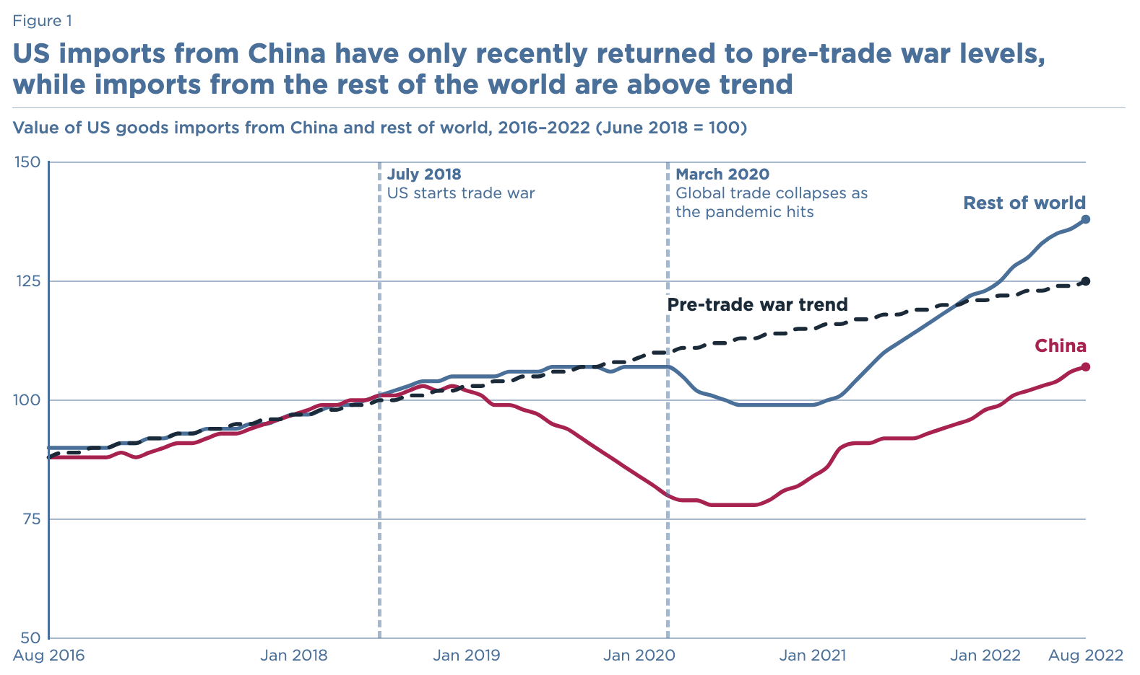
Source: Bown, 2022
Notes:
Bown, Chad P., “Four years into the trade war, are the US and China decoupling?,” Realtime Economics, Peterson Institute of International Economics, October 20,, 2022.
https://www.piie.com/blogs/realtime-economics/four-years-trade-war-are-us-and-china-decoupling

Slide 26
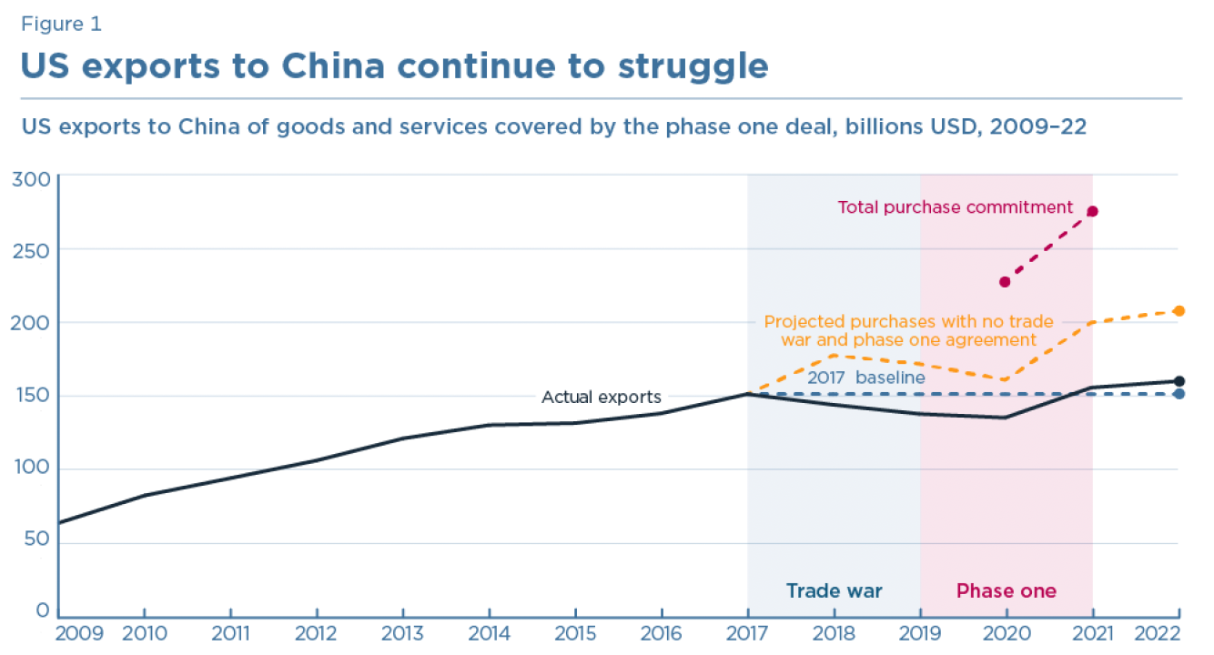
Source: Bown and Wang, 2023
Notes:
Bown, Chad P. and Yilin Wang, "Five Years Into the Trade War, China Continues Its Slow Decoupling From US Exports," Realtime Economics, Peterson Institute of International Economics, March 16, 2023.
https://www.piie.com/blogs/realtime-economics/five-years-trade-war-china-continues-its-slow-decoupling-us-exports

Slide 27
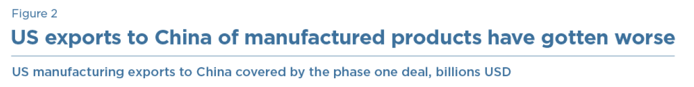
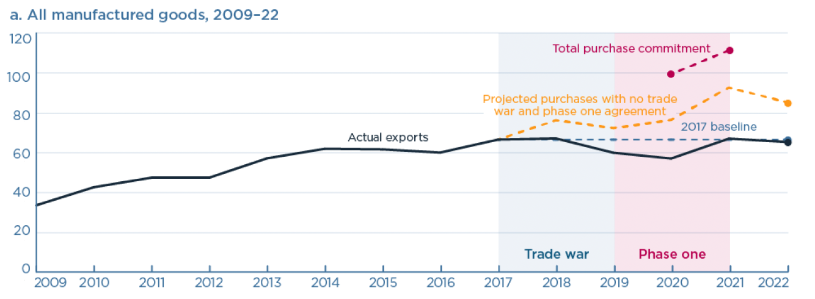
Source: Bown and Wang, 2023
Notes:
Bown, Chad P. and Yilin Wang, "Five Years Into the Trade War, China Continues Its Slow Decoupling From US Exports," Realtime Economics, Peterson Institute of International Economics, March 16, 2023.
https://www.piie.com/blogs/realtime-economics/five-years-trade-war-china-continues-its-slow-decoupling-us-exports

Slide 28
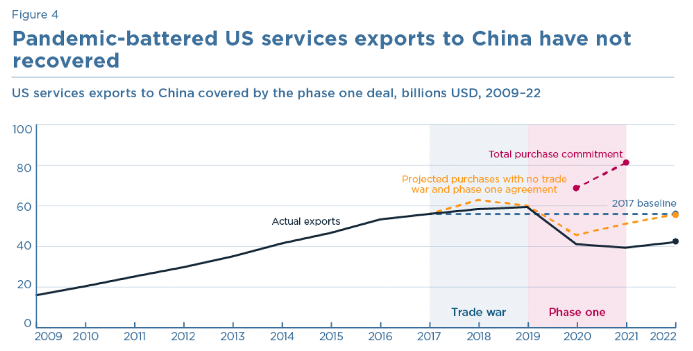
Source: Bown and Wang, 2023
Notes:
Bown, Chad P. and Yilin Wang, "Five Years Into the Trade War, China Continues Its Slow Decoupling From US Exports," Realtime Economics, Peterson Institute of International Economics, March 16, 2023.
https://www.piie.com/blogs/realtime-economics/five-years-trade-war-china-continues-its-slow-decoupling-us-exports

Slide 29
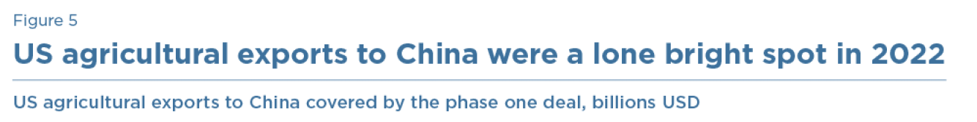
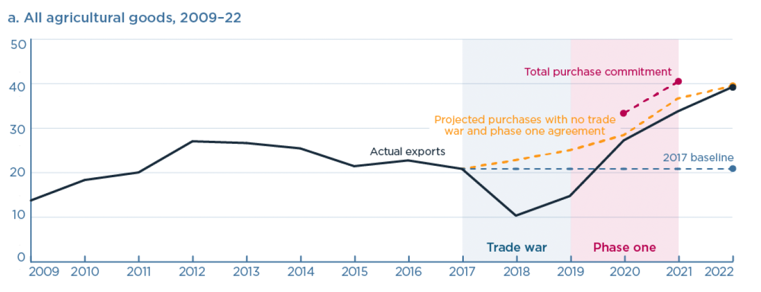
Source: Bown and Wang, 2023
Notes:
Bown, Chad P. and Yilin Wang, "Five Years Into the Trade War, China Continues Its Slow Decoupling From US Exports," Realtime Economics, Peterson Institute of International Economics, March 16, 2023.
https://www.piie.com/blogs/realtime-economics/five-years-trade-war-china-continues-its-slow-decoupling-us-exports

Slide 30
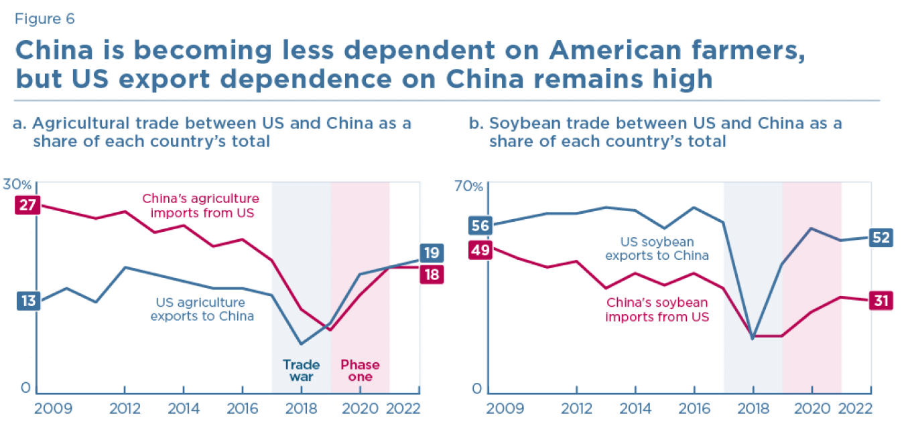
Source: Bown and Wang, 2023
Notes:
Bown, Chad P. and Yilin Wang, "Five Years Into the Trade War, China Continues Its Slow Decoupling From US Exports," Realtime Economics, Peterson Institute of International Economics, March 16, 2023.
https://www.piie.com/blogs/realtime-economics/five-years-trade-war-china-continues-its-slow-decoupling-us-exports

Slide 31
  US-China Trade War
Recent changes
  Biden has NOT reduced Trump’s tariffs on China
  In May 2024, Biden raised tariffs on some products from China (see next table)
  EU also announced high tariffs on Electric vehicles from China
  US announced tariffs on China exports via Mexico
Notes:
Economist, “New research counts the costs of the Sino-American trade war,” The Economist, January 1, 2022. [3p].
https://www.economist.com/finance-and-economics/2022/01/01/new-research-counts-the-costs-of-the-sino-american-trade-war

Slide 32
  US-China Trade War
Biden raised tariffs on goods from China:
On | From | To | When
Steel and aluminum, certain products | 0-7.5% | 25% | 2024
Semiconductors | 25% | 50% | 2025
Electric vehicles | 25% | 100% | 2024
Batteries, etc. | 25% | 100% | 2024
Solar cells | 25% | 50% | 2024
Ship-to-shore cranes | 0% | 25% | 2024
Syringes and needles | 0% | 50% | 2024
Certain PPE | 0-7.5% | 25% | 2024
Rubber medical & surgical gloves | 7.5% | 25% | 2026
Notes:
Economist, “New research counts the costs of the Sino-American trade war,” The Economist, January 1, 2022. [3p].
https://www.economist.com/finance-and-economics/2022/01/01/new-research-counts-the-costs-of-the-sino-american-trade-war

Slide 33
Pause for Discussion

Slide 34
  Questions on Swanson,
  “Contentious U.S.-China…”
Is China’s economy bigger or smaller than the US economy?
Where does China stand as a trading partner of the US?
Does China make cars?
Is the US eager to export all products to China?

Slide 35
  Questions on White House,
  “FACT SHEET: President …”
What actions by China are these new tariffs a response to, and under what US law?
What is the main evidence cited to China’s actions?
How do these policies by Biden differ from those of Trump and Republicans?
Are all the new tariffs in high-technology sectors?

Slide 36
  Questions on Foroohar,
  “Not all American tariffs …”
How do Biden’s and Trump’s tariff differ, according to this?
Why does the author dismiss standard economic analyses of trade?
What other reasons does the author give to justify Biden’s tariffs on China?
In what sense mentioned here does the US rely on China for energy?

Slide 37
  Questions on Bounds et al.,
  “EU to hit Chinese electric …”
On what basis is the EU imposing higher tariffs on China’s EVs?
When are the tariffs to go into effect? Is it possible that they won’t?
How large is China’s tariff on imported EVs? How large was the EU’s tariff on EVs before?
By how much has China’s share of EU EVs increased since 2020?

Slide 38
  Questions on Williams,
  “US targets Chinese steel…”
The tariff on steel from China was already 25%. What is different here?
What are the political and economic reasons for doing this?
What percentages of steel and aluminum from Mexico will be subject to these tariffs?

Slide 39
  Semiconductors
As early as 2016 (under Obama), the US was taking actions to “Safeguard US Semiconductor Supremacy”
US placed Chinese companies on its “Entity List”
  2016: ZTE, a partially state-owned technology company that specializes in telecommunication
  2019: Huawei, the world's largest supplier of telecommunications network equipment
  2020: SMIC, a semiconductor foundry company

Slide 40
  Semiconductors
2022
  Aug 9: US passes CHIPS Act
    “invests $280 billion to bolster US semiconductor capacity, catalyze R&D, and create regional high-tech hubs and a bigger, more inclusive STEM workforce.” (per McKinsey & Co)
  Aug 31: US Imposes New Controls on Advanced Chip Exports
  Sep 16: US Redefines National Security
    “maintain as large a lead as possible in foundational technologies”
  Oct &: New export controls
Notes:
McKinsey & Co, “” The CHIPS and Science Act: Here’s what’s in it,” October 4, 2022.
https://www.mckinsey.com/industries/public-sector/our-insights/the-chips-and-science-act-heres-whats-in-it

Slide 41
  Semiconductors
2023
  Mar 8: Netherlands Joins US Export Controls
  Mar 31: Japan Restricts Chipmaking Equipment Exports
  May 21: China Bans Some Chips from US-Based Micron
  Jul 4: China limits exports of gallium and germanium, critical to manufacturing semiconductors
  Sep 1: US, Japan, & Netherlands require permit to export high-end chip-making machines made by Dutch company, ASML

Slide 42
  Semiconductors
2024
  May 14: Biden raises tariffs on semiconductors from China (see above)

Slide 43
Pause for Discussion

Slide 44
  Questions on Mozur & Liu,
  “With Ban on Micron…”
What was China’s claimed basis for blocking purchases of chips from Micron?
What actions had the US taken previously that might have motivated this?
What actions had China taken previously in this area?

Slide 45
  Questions on Sohn et al.,
  “China’s Export Curb …”
Who is China targeting with its new restrictions on exports of gallium and germanium?
What are the aims of China and the US?
What steps does South Korea say it will pursue to deal with this?
Does China have a natural monopoly on these materials?

