Slide 1
Class 2
The State of Play in International Trade and Trade Policy II:
Other by
Alan V. Deardorff
University of Michigan
2024
PubPol/Econ 541

Slide 2
Announcements
I’ve extended to availability of the Getting-to-know-you survey through this Friday. If you haven’t filled it out, please do.
Quiz 1 due Friday midnight.
  Accepted until Saturday midnight with penalty
  Covers material from last Wednesday and today only.

Slide 3
Pause for News

Slide 4
State of Play: Other
Outline
  Background from KOM
  Brexit
  China Trade Actions
  Russia Sanctions
  Other Disputes, Actions, and Events

Slide 5
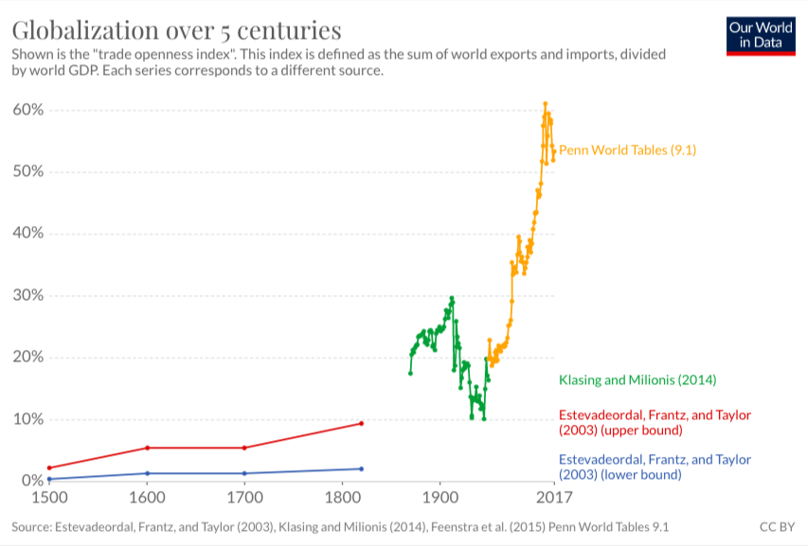
World Trade Growth
Notes:
Our World in Data
https://ourworldindata.org/trade-and-globalization

Slide 6
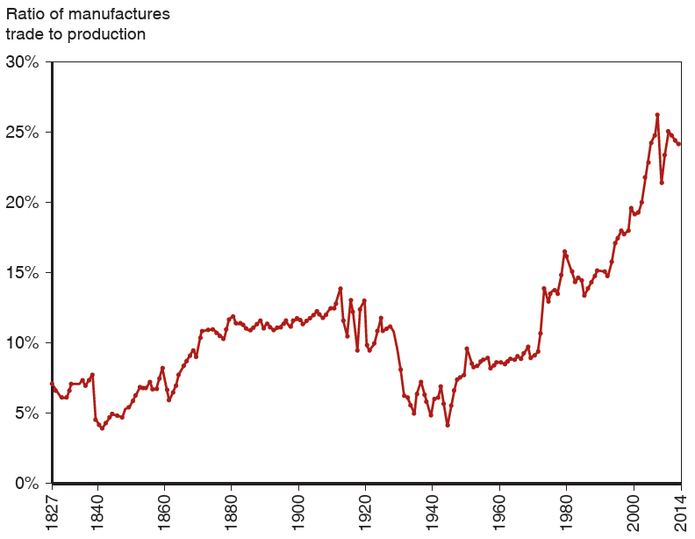
Figure 2.5 The Fall and Rise of World Trade
The ratio of world exports to world G D P rose in the decades before World War
but fell sharply in the face of wars and protectionism. It didn’t return to 1913 levels until the 1970s but has since reached new heights.
Source: Michel Fouquin and Jules Hugot, “Trade Globalisation in the Last Two Centuries,” Voxeu (September 2016).
From KOM
Notes:
The graph plots ratio of manufactures trade to production versus year. The plot generally rises from (18 27, 7%) to (20 14, 22%). A significant drop occurs from (18 39, 8%) to (18 40, 4.5%), before a rise to (18 60, 8.5%). The plot then significantly drops from (19 10, 13%), to (19 50, 4%), before a rise back to (19 55, 8%). The graph displays fluctuating behavior with high and lows in the intermediate points. All values are estimated.

Slide 7
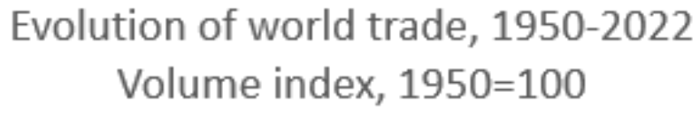
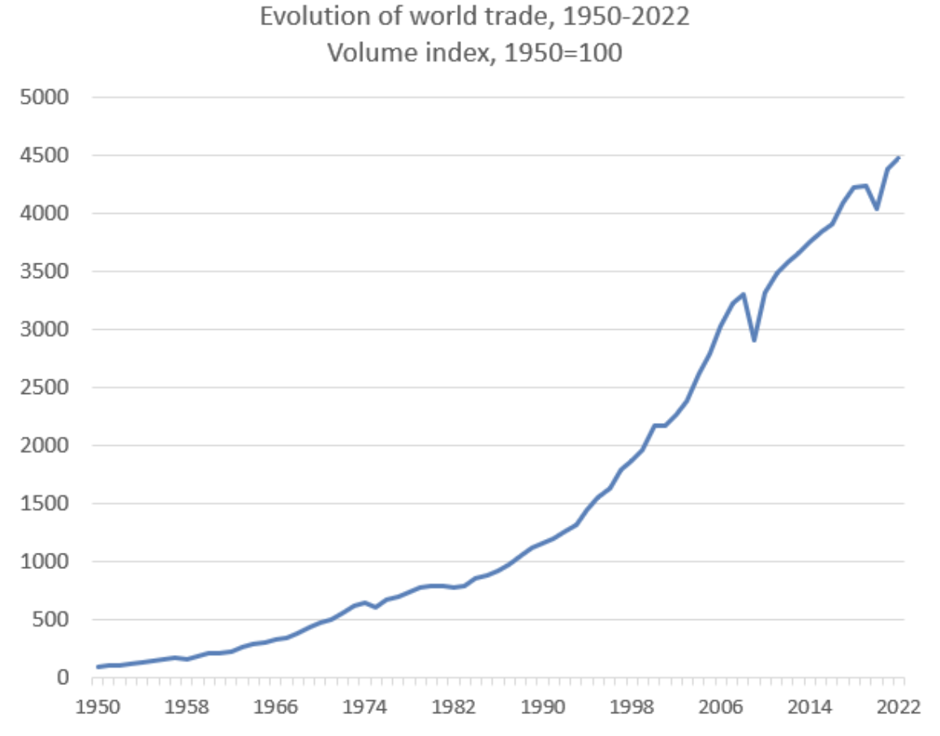
Evolution of World Trade, 1950-2022
Volume index, 1950=100
Source: WTO
Notes:
https://www.wto.org/english/res_e/statis_e/trade_evolution_e/evolution_trade_wto_e.htm

Slide 8

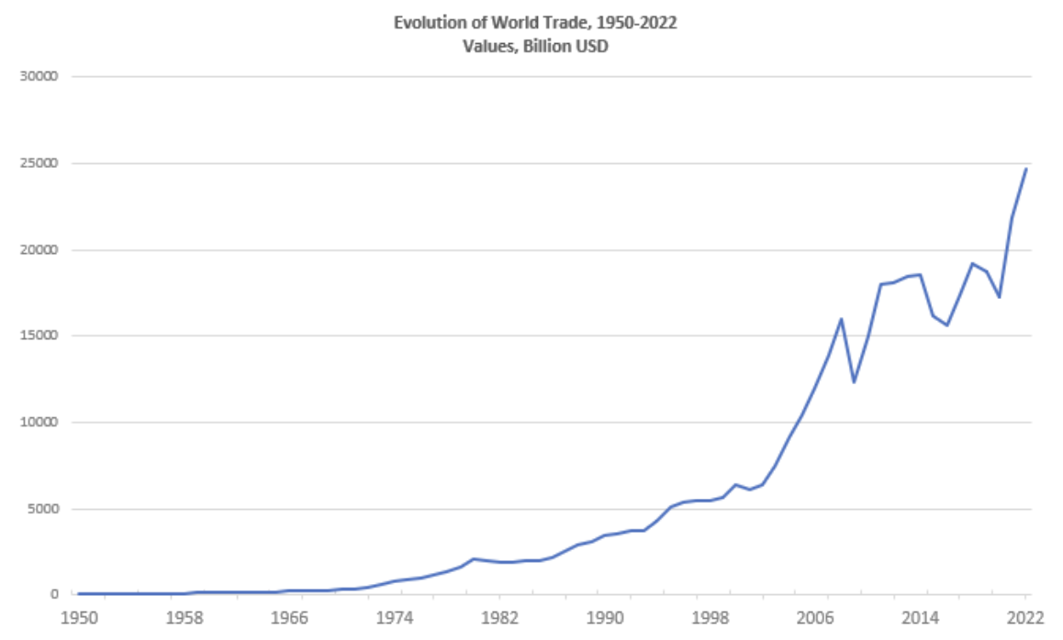
Evolution of World Trade, 1950-2022
Values, Billion USD
Source: WTO
Notes:
https://www.wto.org/english/res_e/statis_e/trade_evolution_e/evolution_trade_wto_e.htm

Slide 9
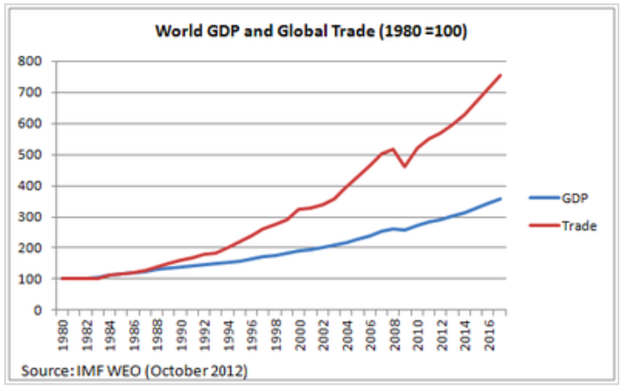
World Trade Growth
Notes:
https://g2reports.weebly.com/reports.html

Slide 10
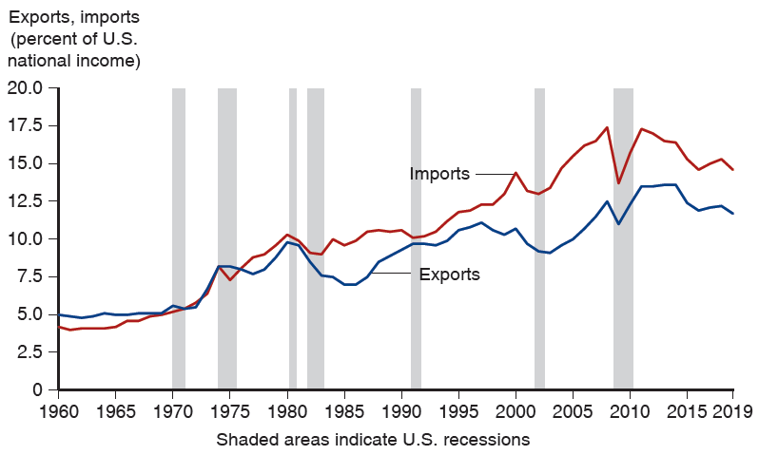
Figure 1.1 Exports and Imports as a Percentage of U.S. National Income
(Shaded areas indicate U.S. recessions.) Both imports and exports have risen as a share of the U.S. economy, but imports have risen more.
Source: U.S. Bureau of Economic Analysis,
research.stlouisfed.org
From KOM
Notes:
https://research.stlouisfed.org/
The graph depicts exports and imports as a percentage of U S national income versus year, from 19 60 to 20 19. 7 shaded areas indicate U S recessions. The plot for exports generally rises from (19 60, 5.0) to (20 19, 12.0). A significant drop occurs from (20 07, 12.0) to (20 09, 10.5), before a rise to (20 11, 13.0). The plot for imports generally rises from (19 60, 4.0) to (20 19, 14.5). A significant drop in the imports plot occurs from (20 07, 17.3), to (20 09, 13.0), before a rise back to (20 11, 17.0). The shaded areas for U S recessions, by years, are as follows. 19 70 to 19 72, 19 74 to 19 76, 19 80 to 19 81, 19 82 to 19 83, 19 91 to 19 92, 20 03 to 20 04, and 20 08 to 20 11. All values are estimated.

Slide 11
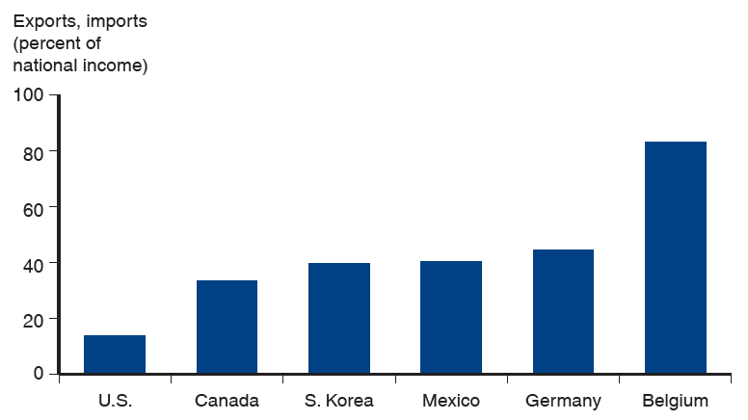
Figure 1.2 Average of Exports and Imports as Percentages of National Income in 2018
International trade is even more important to most other countries than it is to the United States.
Source: World Bank
From KOM
Notes:
The graph depicts exports and imports as a percentage of national income for the following 6 countries. U S, 15%. Canada, 33%. South Korea, 42%. Mexico 43%. Germany, 45%. Belgium, 87%. All values are estimated.

Slide 12
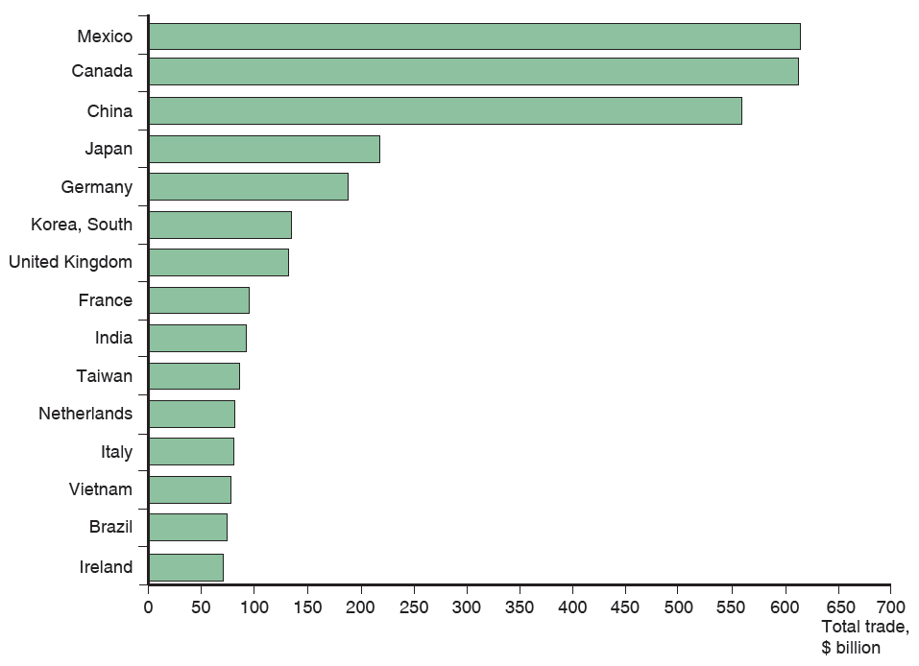
Figure 2.1 Total U.S. Trade with Major Partners, 2019
U.S. trade—measured as the sum of imports and exports—is mostly with 15 major partners.
Source: U.S. Department of Commerce.
From KOM
Notes:
The horizontal bar graph lists countries versus total trade in billions of dollars. The list provides total trade, in billions of dollars, for each country as follows. China, 620. Canada, 610. Mexico, 570. Japan, 240. Germany, 19 0. South Korea, 165. United Kingdom, 160. France, 100. India, 90. Taiwan, 80. Netherlands, 78. Italy, 75. Vietnam, 70. Brazil, 65. Ireland, 60. All values are estimated.

Slide 13
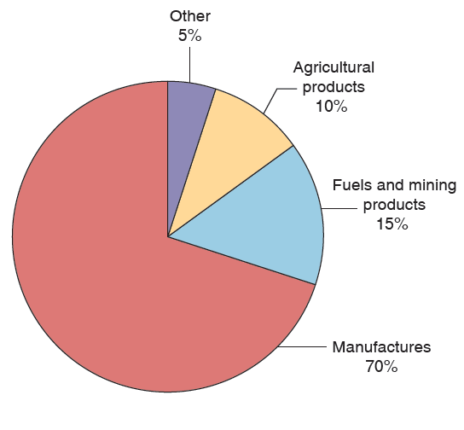
Figure 2.6 The Composition of World Trade, 2017
Most world trade is in manufactured goods, but minerals—mainly oil—remain important.
Source: World Trade Organization.
From KOM

Slide 14
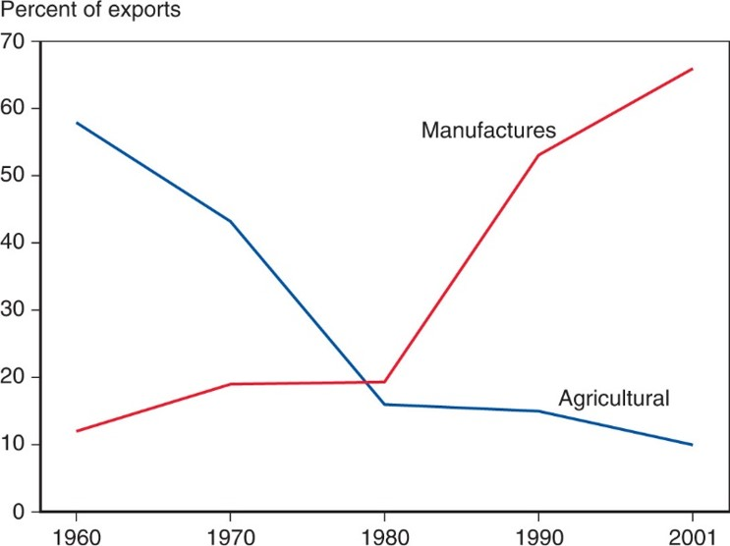
Figure 2.7 The Changing Composition of Developing-Country Exports
Over the past 50 years, the exports of developing countries have shifted toward manufactures.
Source: United Nations Council on Trade and Development.
From KOM
Notes:
The graph plots the percent of exports versus year, from 19 60 to 20 01. The plot for manufactures rises gradually from (19 60, 12) to (19 80, 18) and then rises steeply to (20 01, 68). The plot for agricultural falls steeply from (19 60, 58) to (19 80, 14) and then falls less steeply to (20 01, 10). The graphs intersect at (19 79, 18). All values are estimated.

Slide 15
Pause for Discussion

Slide 16
  Questions from KOM
How much has trade grown? why?
Who gains from trade?
What does the amount of trade between two countries depend on?
Why is the gravity model useful?
Do national borders interfere with trade?
Why is trade in services growing?

Slide 17
Brexit
Brexit Timeline
  Jun 23, 2016: Referendum
    UK votes to leave EU (Vote: 52-48)
    Leave:
      England, Wales
      Old people
      People opposed to immigration from EU
    Remain:
      Scotland, Northern Ireland
      Young people
      London
Notes:
Walker, Nigel, ” Brexit timeline: events leading to the UK’s exit from the European Union,” House of Commons Library, June 10, 2020.
https://commonslibrary.parliament.uk/research-briefings/cbp-7960/

Slide 18
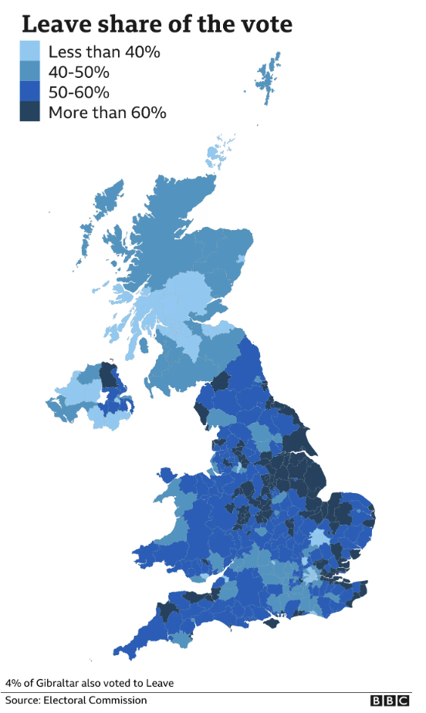
Notes:
“EU referendum: The result in maps and charts,” BBC News, June 8, 2021.
https://www.bbc.com/news/uk-politics-36616028

Slide 19
Brexit
Brexit Timeline
  Jun 23, 2016: Referendum
    UK votes to leave EU (Vote: 52-48)
  Mar 29, 2017: EU exit provision triggered
    UK PM initiates 2-year exit process
  2019: Several extensions asked and given
  Jan 31, 2020: UK leaves EU
    Transition period (policies unchanged) thru 2020
  Dec 31, 2020: Transition period ends
Notes:
Walker, Nigel, ” Brexit timeline: events leading to the UK’s exit from the European Union,” House of Commons Library, June 10, 2020.
https://commonslibrary.parliament.uk/research-briefings/cbp-7960/

Slide 20
Brexit
The Brexit Agreement
  Reached Dec 24, 2020
    EU Ambassadors approved Dec 28
    UK MPs approved Dec 30
    Signed Dec 30
    Effective provisionally Jan 1, 2021
    Entered into force May 1, 2021, after ratification
  Title: “Trade and Cooperation Agreement”

Slide 21
Brexit
The Brexit Agreement
  Features:
    Free Trade Agreement for goods, but with rules of origin (no longer customs union)
    Some limited mutual market access for services
  Not included:
    Free movement of persons
    UK subject to European Court of Justice
    UK subject to EU regulations

Slide 22
Brexit
Northern Ireland (N.I.) Protocol
  Part of the Brexit Withdrawal Agreement from Dec 24, 2020
  Avoids hard border between N.I. (part of UK) and Ireland (EU member country) by
    Keeping N.I. in EU customs union
    Adding customs checks, etc., between N.I. and Great Britain (the rest of UK: England, Scotland, Wales)
  Reason: To avoid re-igniting the “Troubles”

Slide 23
Brexit
The N.I. Protocol Was Contentious
  Trade within UK between N.I. and Great Britain was costly and cumbersome
    Had to pass through customs checks
    These often included checks for satisfying EU regulations (health & safety, etc.)
  PM Johnson in June 2022 (before he stepped down) submitted a bill to “rip up” the Protocol

Slide 24
Brexit
PM Rishi Sunak negotiated Windsor Framework with EU
  Replaced N.I. Protocol
  Signed March 24, 2023
  Created “green lanes” for goods that will not cross the border into Ireland
    For “trusted traders”
    Require minimal (but not zero) checks
  “Red lanes” for goods destined for Ireland still have full controls

Slide 25
Brexit
Other features of Windsor Framework
  Scrapped bans on parcels, pets, sausages, plants, and seed potatoes.
  Made medicines approved by the UK freely available in Northern Ireland.
  Jurisdiction of the ECJ (European Court of Justice) now only applies to EU laws.
  “Stormont brake”:
    Allows Northern Ireland Assembly (Stormont) to ask UK to veto EU rules

Slide 26
Brexit
Public Opinion
  2016: Vote to leave: 52%
  2023 Poll: Up to 60% wish that Britain had remained in the EU
Notes:
Economist, "Buyers’ Remorse: As Britons Grow More Unhappy With Brexit, What Happens Next?" the Economist, Jun 27, 2023.
https://www.economist.com/britain/2023/06/27/as-britons-grow-more-unhappy-with-brexit-what-happens-next

Slide 27
Pause for Discussion

Slide 28
  Questions on Brexit (Kirkegaard)
What UK objectives are mentioned here as having been achieved by the Brexit agreement?
What aspects of UK-EU interactions will be adversely affected by the agreement?
What is the relevance of
  “rules of origin”?
  “minimal processing requirements”?

Slide 29
  Questions on Colchester and Luhnow. “As Britain Gears…”
What adverse effects of Brexit on the UK are mentioned here? What part of the population thinks Brexit worth the costs?
Which party caused Brexit?
Why doesn’t the Labor Party argue to reverse Brexit. Was its leader, Keir Starmer, in favor of it?
If it wanted to, could the UK just re-enter the EU on the same terms as before?

Slide 30
China Trade Actions
China responded to Australia’s 2020 call for inquiry into origins of Covid-19
  Massively curbed imports of
    Timber, coal, lobsters, barley, wine and other products
    Due to “concerns about trade practices and pest infestations”
  Australia’s exports suffered briefly but recovered
    Exporters found other markets
  China has now removed tariff on Australian wine

Slide 31
China Trade Actions
In August 2022, in response to US House Speaker Nancy Pelosi visiting Taiwan
  China
    Blocked imports from hundreds of Taiwanese food producers
    Suspended exports of natural sand
  This was a “huge expansion” compared to China’s earlier uses of economic levers

Slide 32
China Trade Actions
China actions:
  Export controls on 2 metals (gallium and germanium) for advanced tech
  “Unreliable entities list” of companies undermining China’s interests
  Export control law and anti-sanctions law
  Ban of semiconductors from American chipmaker Micron
  Proposed ban on exports of ingot-casting technology used in making solar-panel wafers
  Export controls on aviation equipment & technology
Notes:
Economist, "The Dragon Shows Its Claws: China hits back against Western sanctions", the Economist, July 23, 2023.
https://www.economist.com/business/2023/07/23e /china-hits-back-against-western-sanctions

Slide 33
Pause for Discussion

Slide 34
  Questions on White,
  “China bans export of rare …”
Is China banning the export of rare earths?
Why is it doing this?
What has the US done to China that is mentioned here?
How important is China in the rare earths industry?
How has the market for rare earths changed and is likely to change?

Slide 35
  Questions on Winning,
  “China to Lift Tariffs …”
When and why did China raise tariffs on Australian wine?
How did Australia’s wine trade respond?
What prompted this removal of the tariffs?
Do other frictions between China and Australia remain? Is China dropping other trade policies against Australia that started at the same time?

Slide 36
  Questions on Huang,
  “China to Impose Export …”
When will these new controls go into effect?
What products do they cover?
Is this a ban on exports or a tax on exports?
Is it targeted at US?

Slide 37
Russia Sanctions
Russia’s invasion of Ukraine on Feb 24, 2022 prompted economic responses
  Economic sanctions by governments
    On financial linkages
    On trade
  Private companies said they would stop dealing with Russia
Notes:
Walker, Nigel, ” Brexit timeline: events leading to the UK’s exit from the European Union,” House of Commons Library, June 10, 2020.
https://commonslibrary.parliament.uk/research-briefings/cbp-7960/

Slide 38
Russia Sanctions, Gov’t
Sample financial sanctions
  Several Russian banks removed from the Swift international payments system
  Cut off many Russian banks from transactions and operations
Sample trade sanctions
  Banned or reduced imports of oil and other energy
  Imposed price cap on permitted oil exports
  Revoked Russia’s most favored nation status for tariffs
Notes:
Walker, Nigel, ” Brexit timeline: events leading to the UK’s exit from the European Union,” House of Commons Library, June 10, 2020.
https://commonslibrary.parliament.uk/research-briefings/cbp-7960/

Slide 39
Russia Sanctions, Gov’t
Countries
Australia | Iceland | Singapore
Bahamas | Italy | Switzerland
Canada | Japan | Taiwan
EU | New Zealand | UK
Finland | Norway | US
France | Poland
Germany | S Korea
Source: Funakoshi et al, “Updated July 7, 2022” but includes from July 29
Notes:
Funakoshi, Minami, Hugh Lawson, and Kannaki Deka, “Tracking sanctions against Russia,” Reuters, March 9, 2022, updated July 7, 2022..
https://graphics.reuters.com/UKRAINE-CRISIS/SANCTIONS/byvrjenzmve/

Slide 40
Russia Sanctions, Gov’t
Countries announcing they will not use sanctions against Russia:
NOT using sanctions
India | Feb 24
Mexico | Mar 1
Brazil | Mar 1
China | Mar 2
Argentina | Mar 4
Indonesia | Mar 9
Turkey | Mar 13
S Africa | Mar 17
Serbia | Apr 21
Source: Bown
Notes:
Bown, Chad P. “Russia's war on Ukraine: A sanctions timeline,” Realtime Economic Issues Watch, Peterson Institute for International Economics, March 14, 20202, last updated July 18, 2022. [4p]
https://www.piie.com/blogs/realtime-economic-issues-watch/russias-war-ukraine-sanctions-timeline

Slide 41
Pause for Discussion

Slide 42
  Questions on Bown,
  “A sanctions timeline”
What prompted the sanctions to start and when?
What were the most recent actions reported here, and by whom?
How useful did you find the interactive timeline on the Bown website?

Slide 43
  Questions on Sanger et al.,
  “U.S. expands sanctions …”
Are the new sanctions targeted directly at US trade with Russia?
Has China participated in sanctions against Russia?
What did President Biden expect the original sanctions (in 2022) to do? Did they?
How important is China for Russia’s imports of machine tools and microelectronics?

Slide 44
Other Disputes, Actions, and Events
EU carbon tariff
Shipping disruptions
Forced labor import ban
EU deforestation import ban
Vietnam market-economy status
EU-MERCOSUR FTA

Slide 45
Pause for Discussion

Slide 46
EU carbon tariff

Slide 47
  Questions on Hancock & Dempsey:
  “Aluminium Companies …”
What is CBAM?
What is the loophole that aluminum producers are complaining about?
What are some other concerns, and might they apply more broadly than aluminum?
Will CBAM go into effect, and if so when and how?

Slide 48
CBAM
I asked Google, “Did CBAM go into effect?”
  It’s AI answerd: “Yes, the European Union's Carbon Border Adjustment Mechanism (CBAM) entered into its transitional phase on October 1, 2023. The full implementation of CBAM is scheduled to begin on January 1, 2026.
  No mention of July 11.

Slide 49
  Questions on Mooney:
  “US examines carbon pricing …”
What is said to be the purpose of any policy?
Is this a response to any policy by US trading partners?
What products are of most concern? Which political party in the US is calling for this?
How does the US compare to others in the carbon intensity of our production?
Does China have any policy to limit carbon emissions?

Slide 50
Shipping disruptions

Slide 51
  Questions on FT Editors:
  “Global trade shudders…”
What is interfering with shipping through the Red Sea?
Why does this raise the cost of shipping?
What is limiting traffic through the Panama Canal? Does this say why this is happening?
Are these disruptions as bad as the pandemic?

Slide 52
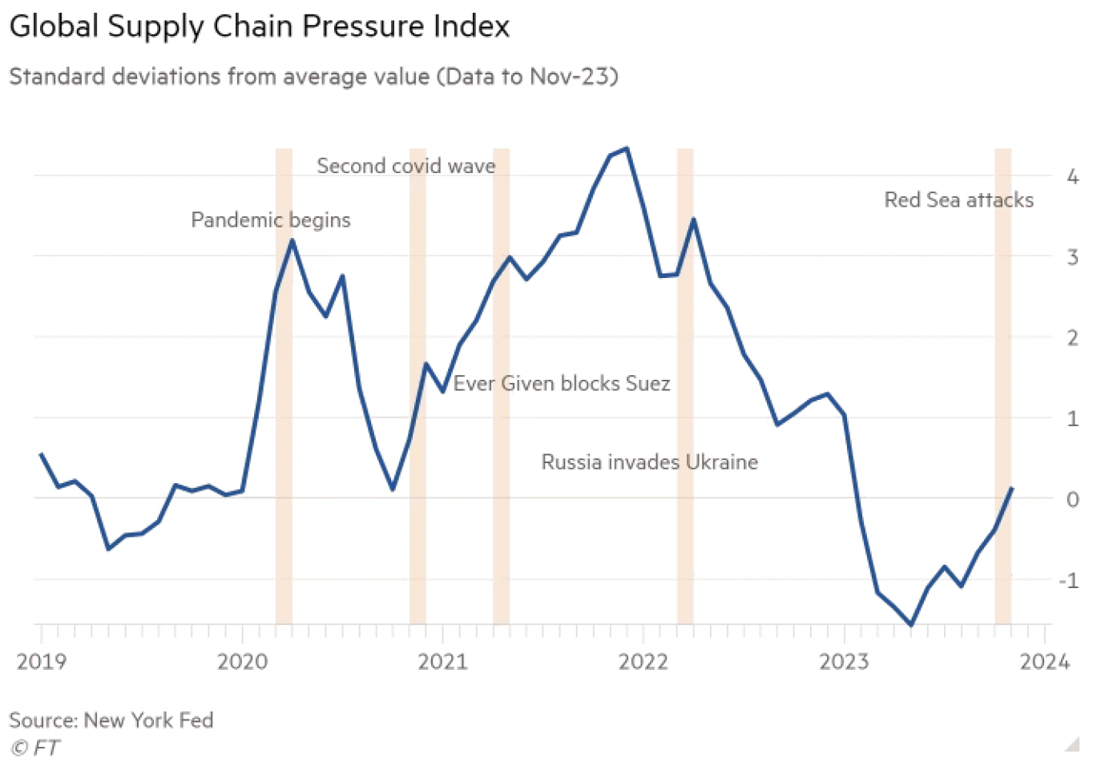

Slide 53
Forced labor import ban

Slide 54
  Questions on Swanson:
  “U.S. Bans Imports From 3 …”
What US law caused this list to be created, and when?
How many Chinese companies are on the list, and when were most of them added?
Where in China does it use policies that the US regards as forced labor?

Slide 55
EU deforestation import ban

Slide 56
  Questions on Economist:
  “The forest for the trees”
What does the EU’s new “deforestation regulation” do?
When does it go into effect?
Why is this a problem, and for whom?
What challenge does this create for supply chains?
Is the EU helping with this problem?
Is there an alternative approach to this problem?

Slide 57
Vietnam market-economy status

Slide 58
  Questions on Lakshmi:
  “US rejects Vietnam’s bid …”
Does this explain how market-economy status matters?
What does Vietnam do that this says should deprive it of market-economy status?
Is it only the US that classifies Vietnam as a non-market economy?
Who in the US made this decision, and on what basis?
Was this a partisan issue in the US?

Slide 59
EU-MERCOSUR FTA

Slide 60
  Questions on Pooler et al.:
  “EU inches closer to trade deal …”
How many countries will be in this FTA?
When was agreement reached “in principle” to do this?
What countries in the EU currently object to this? Are they enough to stop it?
What are some of the concerns in the EU?
What are some of the concerns in the MERCOSUR countries?

