Slide 1
Class 5
Exchange Rates by
Alan V. Deardorff
University of Michigan
2024
PubPol/Econ 541

Slide 2
Pause for News

Slide 3
News
Trump on currency use:
  “Many countries are leaving the dollar. You’re not going to leave the dollar with me. I’ll say, ‘You leave the dollar, you’re not doing business with the United States, because we’re going to put 100 percent tariff on your goods, sir. We would like very much to get back to the dollar immediately. Thank you very much.’ It’s so easy.”
  Quoted in NYT by Krugman from Sep 7 Trump rally.

Slide 4
Quiz 2
Quiz results:
Mean | 7.66 | 7.83
Median | 7.5 | 8
Max | 10 | 9
Min | 5 | 6
Standard deviation | 1.37 | 0.85

Slide 5
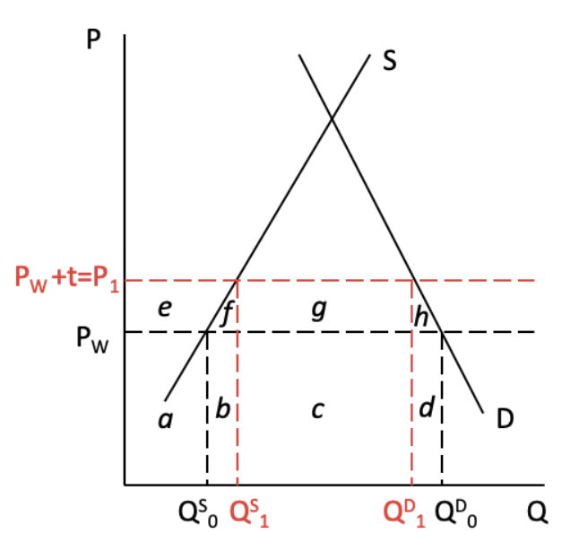
Quiz 2
Question 9:
Suppliers’ revenue = price times quantity, PQ.
Change due to tariff is e+f+b
Almost all answered just e, which is the change in producer surplus, or profit, not revenue.

Slide 6
Outline
Exchange markets: What they are
Supply and Demand
Two Simple Theories
Pegged Exchange Rates

Slide 7
Exchange Market
Exchange rate is
  Price of one currency in terms of another
    E.g., $/£ or £/$

Slide 8
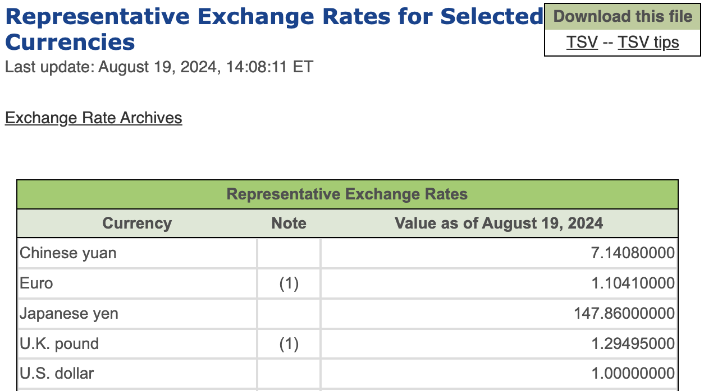
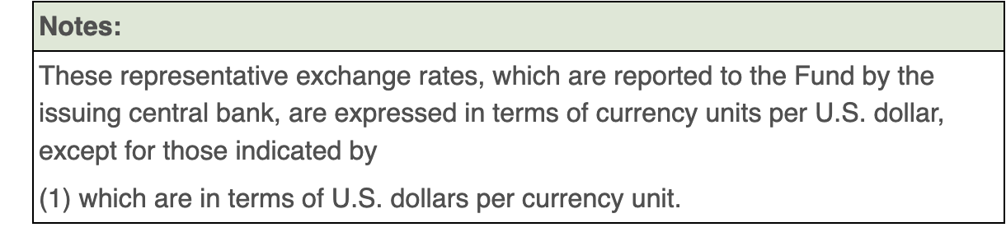
Notes:
https://www.imf.org/external/np/fin/data/rms_rep.aspx

Slide 9
Pause for Discussion

Slide 10
  Questions on KOM, Ch 14
Is an exchange rate the price of one country’s goods in terms of another’s, or the price of one country’s assets in terms of another’s?
On what transactions are reported rates based?
What hours of the day are the exchange markets open?

Slide 11
Exchange Market
Types of exchange rate
  Spot
    For exchange of currencies today
  Forward
    Contracts for exchange of currencies 30, 60, 90 etc. days from the present
    Both payment and receipt happen then, not now
  Futures –
    Like forward market, but for specific calendar dates in future

Slide 12
Exchange Market
Types of exchange rate, continued
  Bilateral
    For exchange of 2 currencies
  Trade weighted
    For one currency relative to multiple others
    An average, or index
  Real
    Adjusted for inflation, both at home and abroad

Slide 13
US Exchange Rate
Rose because US had lower inflation than others
Source: Federal Reserve
Notes:
https://www.federalreserve.gov/releases/h10/summary/jrxwtfb_nm.htm
Jun 12, 2023
Presentations/OLLI/Trade Deficits & Exchange Rates/Dollar Index Broad.xlsx

Slide 14
US Exchange Rate
Dollar rose due to Volker Interest rate rise, fighting inflation.
Caused severe recession in US.
Source: Federal Reserve
Notes:
https://www.federalreserve.gov/releases/h10/summary/jrxwtfb_nm.htm
Jun 12, 2023
Presentations/OLLI/Trade Deficits & Exchange Rates/Dollar Index Broad.xlsx

Slide 15
Exchange Market
Who uses the exchange market
  Traders in both goods and services
    Also travelers (but that’s trade)
  International borrowing, lending, and asset trade
  Speculators
    Buyers or sellers who hope to profit from future exchange-rate change
  Hedgers
  Arbitragers

Slide 16
Pause for Discussion

Slide 17
  More Questions from KOM
What is “arbitrage” in the foreign exchange market?
What is “hedging” in the foreign exchange market?
What role does the US dollar play in international finance?

Slide 18
Supply and Demand for Foreign Exchange
Questions:
Who demands €?
Who supplies €?
Market Model:
E ($/€)
S€
E₀
D€
Q€

Slide 19
Exchange Market
Traders respond to
  Prices of goods
    Rise in home prices causes currency to fall
Capital movements respond to
  Interest rates
    Rise in home interest rate causes currency to rise
  Expectations
    Expectation of any change causes that change

Slide 20
Two Simple Theories
Asset Theory
  Simple: E is whatever it is expected to be
    If it were not, its expected change would drive capital flows that would swamp the market
  Works best in short run (but not useful)
PPP = Purchasing Power Parity
  Exchange rate reflects the prices of goods
  See Big Mac Index
  Works best in long run

Slide 21
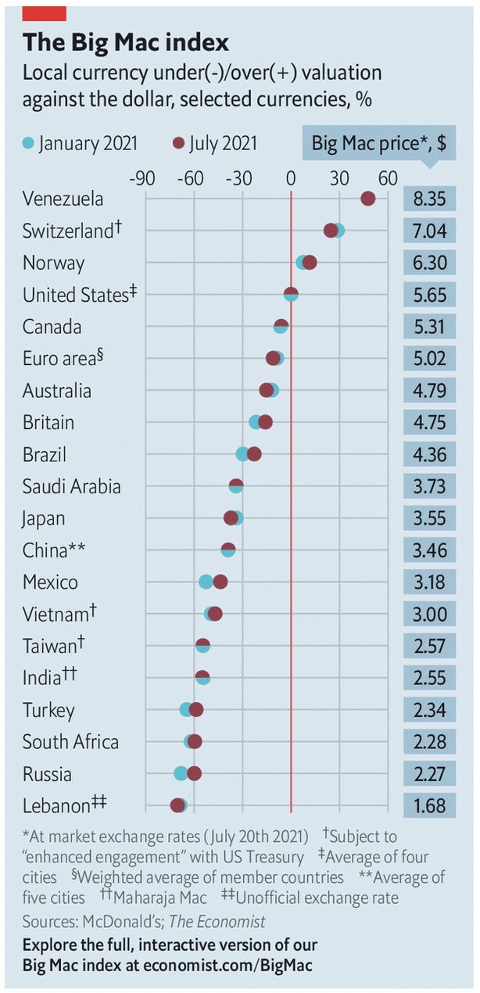
From July 2021
Notes:
Economist, “The Big Mac index: What the Big Mac index says about the dollar and the dong,” The Economist, July 24, 2021.
https://www.economist.com/finance-and-economics/2021/07/24/what-the-big-mac-index-says-about-the-dollar-and-the-dong

Slide 22
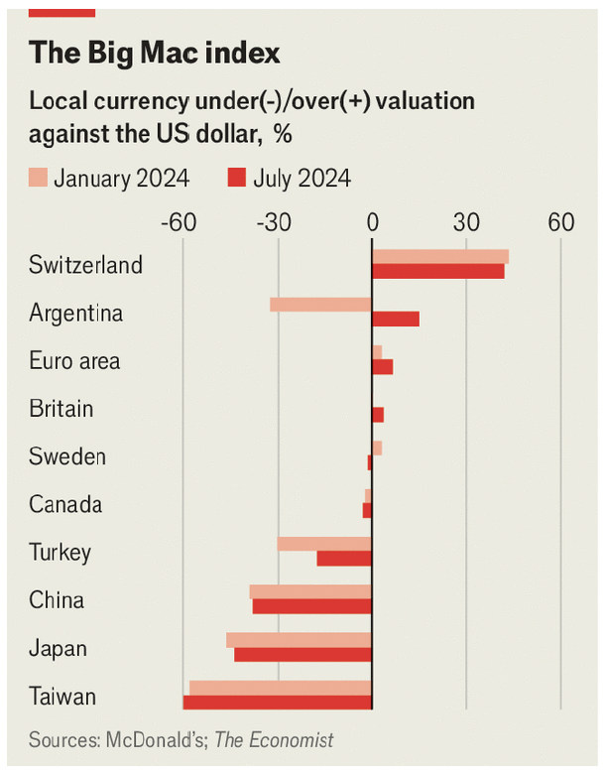
From August 2024
Notes:
Economist, “Burgernomics: The Big Mac index: where to buy a cheap hamburger,” The Economist, August 7, 2024
https://www.economist.com/finance-and-economics/2024/08/07/the-big-mac-index-where-to-buy-a-cheap-hamburger

Slide 23
Pause for Discussion

Slide 24
  Questions on Economist,
  “Big Mac index”
On what basis does this article rank countries?
Why does this article focus on the Vietnamese currency, the dong?
What criteria does the US Treasury use to identify an undervalued currency?
Is Vietnam’s poverty relevant to this?

Slide 25
  Questions on Economist,
  “Burgernomics”
Why is the Big Mac hamburger a good choice to measuring PPP, if one needs to do it with only a single good?
What currencies are most under- and over-valued among those reported here?
Why has Argentina’s position changed so much since January?
Is this a good measure of PPP? What would be better, and why not use it?

Slide 26
Pegged Exchange Rates
Bretton-Woods System
  Successor to the Gold Standard
  Most currencies pegged to US $
How to peg
  Need “reserves” of foreign currency
  Use them to buy or sell own currency as needed
Does it work? Yes and no

Slide 27
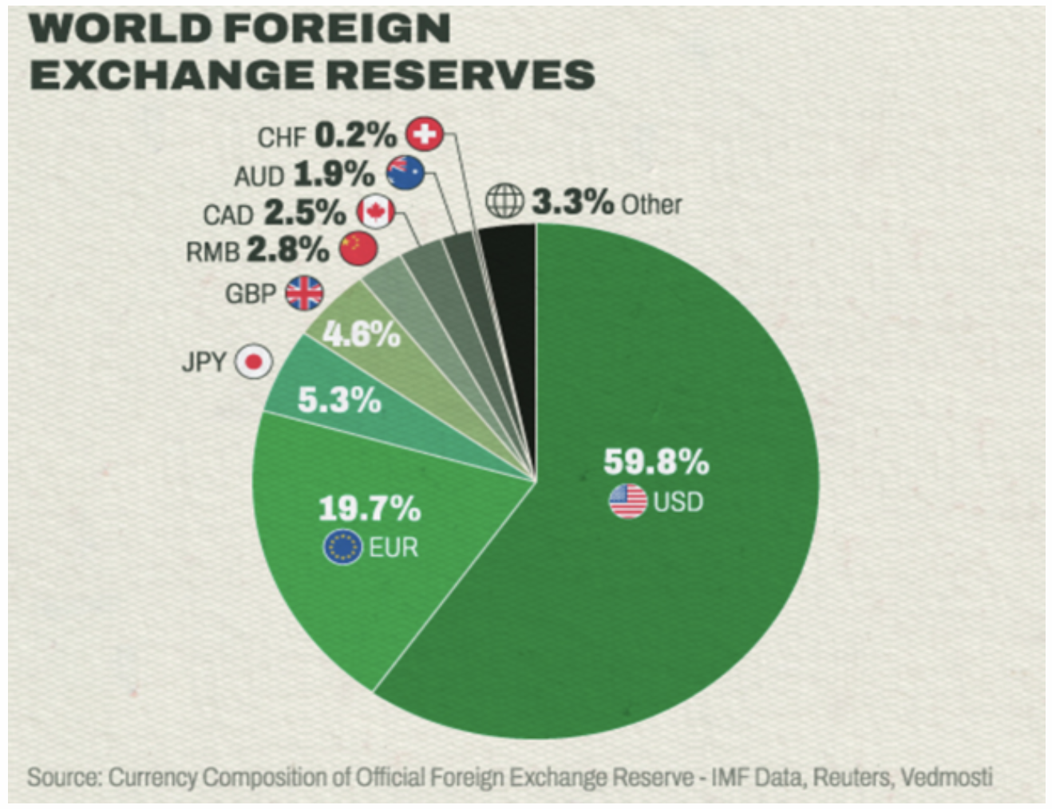
Notes:
Mehta, Pushpendra, “The US dollar’s dominance in global trade and finance is steadily declining,” CTNFile. March 29, 2023.
https://ctmfile.com/story/the-us-dollars-dominance-in-global-trade-and-finance-is-steadily-declining

Slide 28
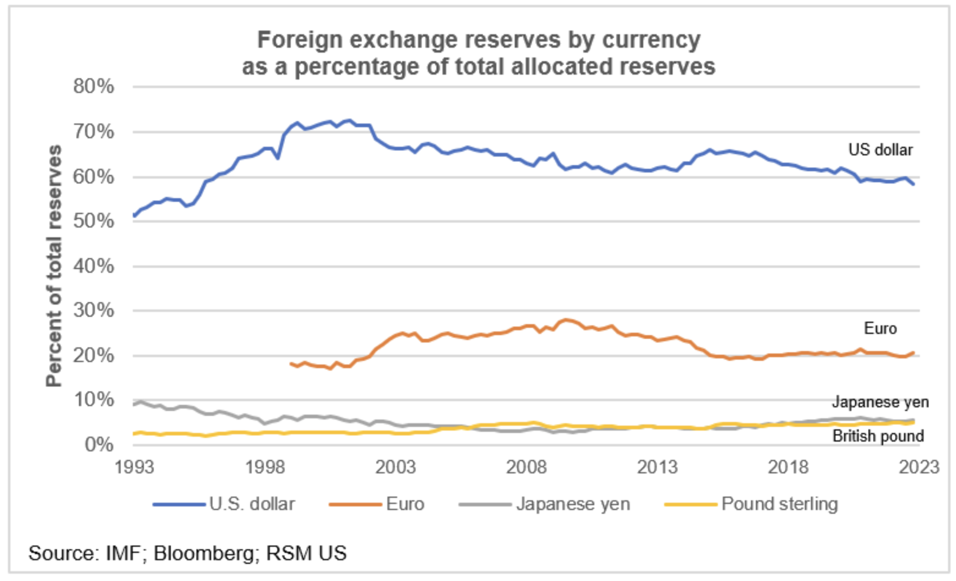
Notes:
Joseph Brusuelas, “Why the dollar remains the world’s reserve currency, and will stay that way,” The Real Economy Blog, April 17, 2023.
https://realeconomy.rsmus.com/why-the-dollar-remains-the-worlds-reserve-currency/

Slide 29
Pause for Discussion

Slide 30
  Questions on Economist, “…Bretton Woods…”
What names and characteristics describe the three international monetary regimes that the Economist article describes, the last of which may be coming to an end?
Why did the world not shift to using dollars, euros, and renminbi more equally for transactions and reserves?
Why is currency stability so hard to achieve?

Slide 31
  Questions on McDougall,
  “US Dollar to Maintain…”
Why do central banks hold foreign-currency reserves?
Has holding of US dollar reserves by central banks declined over time, and what is expected in the near and farther future?
Who is mentioned as wanting reduced reliance on the dollar?
What currency is most likely to expand being held?

Slide 32
  Questions on Eichengreen,
  “The fate of dollar …”
How did Biden’s policies in his first term effect the dollar, and why?
What does the author expect from a second Biden term?
How did Trump’s election effect the dollar in 2016?
Why might the dollar rise in a Trump second term?
Why might the dollar fall in a Trump second term?

Slide 33
Some Recent Exchange Rate Movements
Most from X-rates.com
Most are US $ per country currency
Showing
  Major currencies last year and this
  This year only for currencies of current students in the course
If you have comments on yours, I’d welcome them

Slide 34
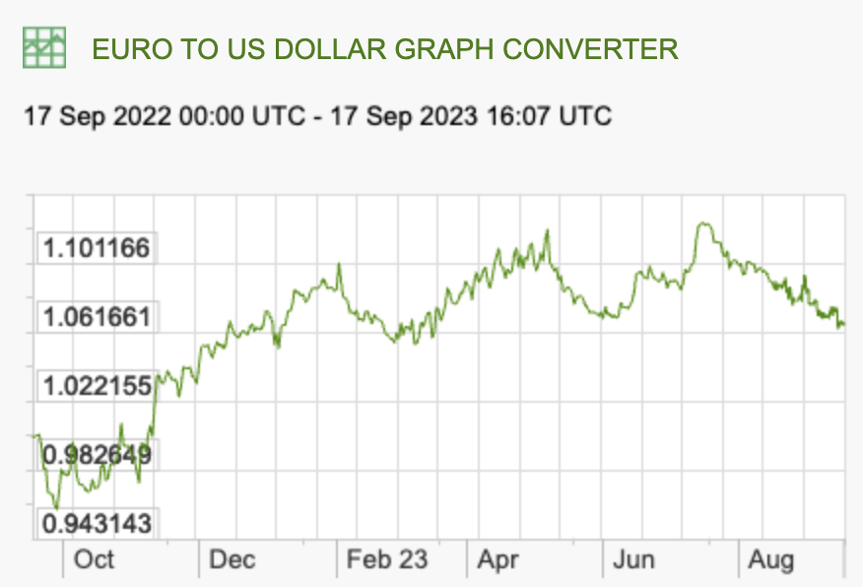
Recent Rate Movements: Euro
Last Year:
Source: X-rates.com
Notes:
https://www.x-rates.com/graph/?from=RUB&to=USD&amount=1

Slide 35
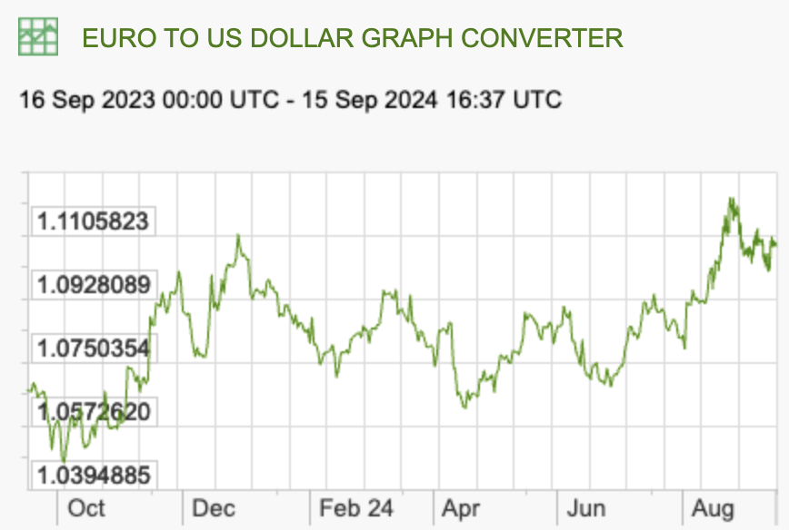
Recent Rate Movements: Euro
This Year:
Source: X-rates.com
Notes:
https://www.x-rates.com/graph/?from=RUB&to=USD&amount=1

Slide 36
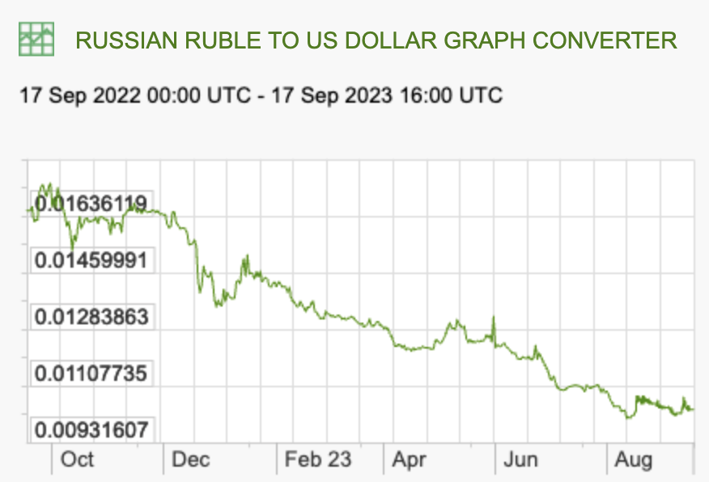
Recent Rate Movements: Russia
Last Year:
Source: X-rates.com
Notes:
https://www.x-rates.com/graph/?from=RUB&to=USD&amount=1

Slide 37
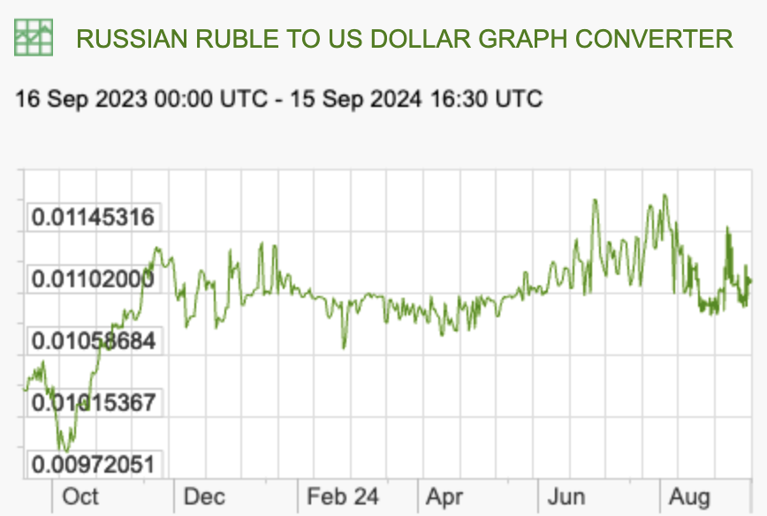
Recent Rate Movements: Russia
This Year:
Source: X-rates.com
Notes:
https://www.x-rates.com/graph/?from=RUB&to=USD&amount=1

Slide 38
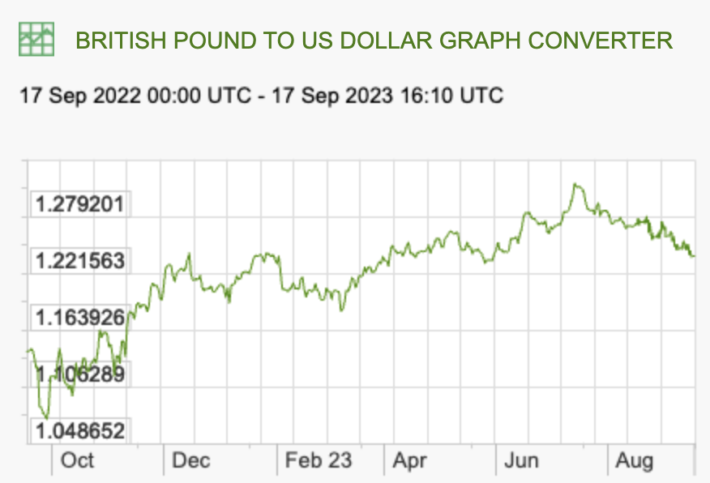
Recent Rate Movements: UK
Last Year:
Source: X-rates.com
Notes:
https://www.x-rates.com/graph/?from=RUB&to=USD&amount=1

Slide 39
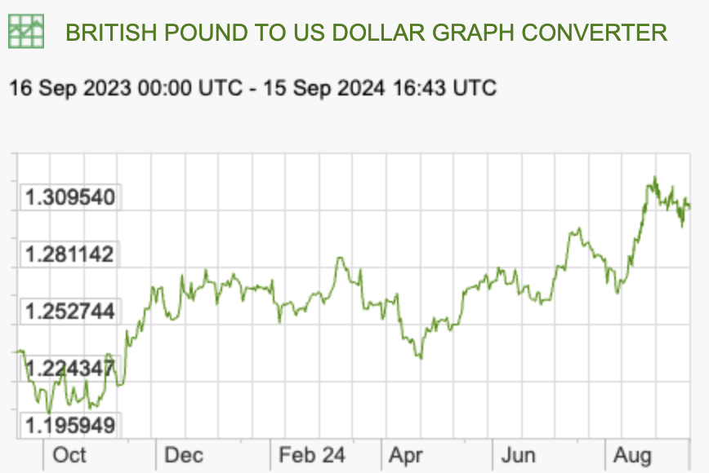
Recent Rate Movements: UK
This Year:
Source: X-rates.com
Notes:
https://www.x-rates.com/graph/?from=RUB&to=USD&amount=1

Slide 40
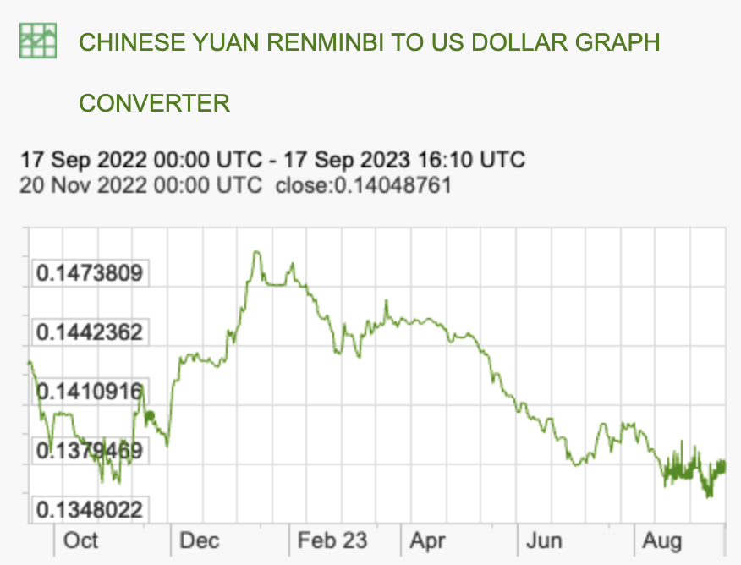
Recent Rate Movements: China
Last Year:
Source: X-rates.com
Notes:
https://www.x-rates.com/graph/?from=RUB&to=USD&amount=1

Slide 41
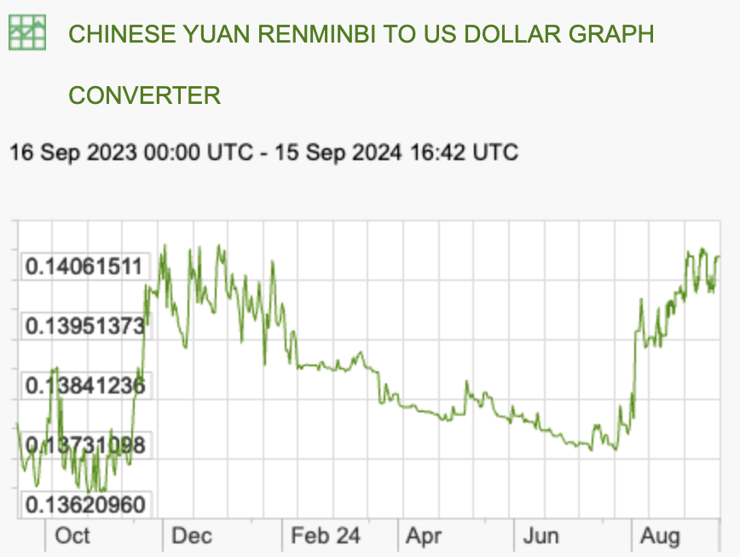
Recent Rate Movements: China
This Year:
Source: X-rates.com
Notes:
https://www.x-rates.com/graph/?from=RUB&to=USD&amount=1

Slide 42
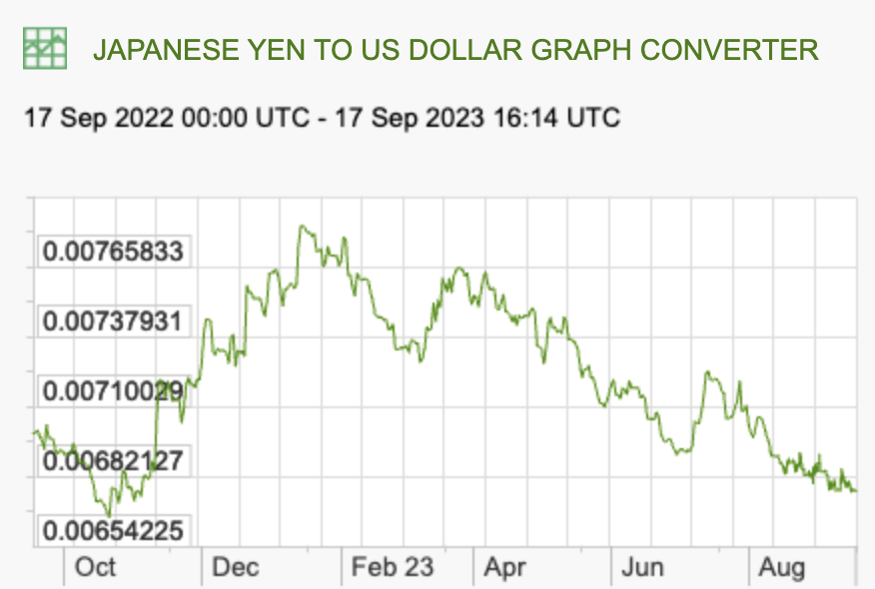
Recent Rate Movements: Japan
Last Year:
Source: X-rates.com
Notes:
https://www.x-rates.com/graph/?from=RUB&to=USD&amount=1

Slide 43
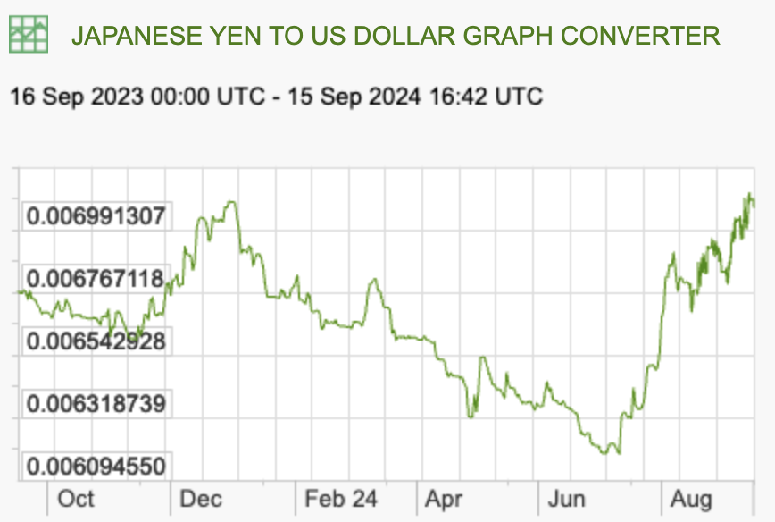
Recent Rate Movements: Japan
This Year:
Source: X-rates.com
Notes:
https://www.x-rates.com/graph/?from=RUB&to=USD&amount=1

Slide 44
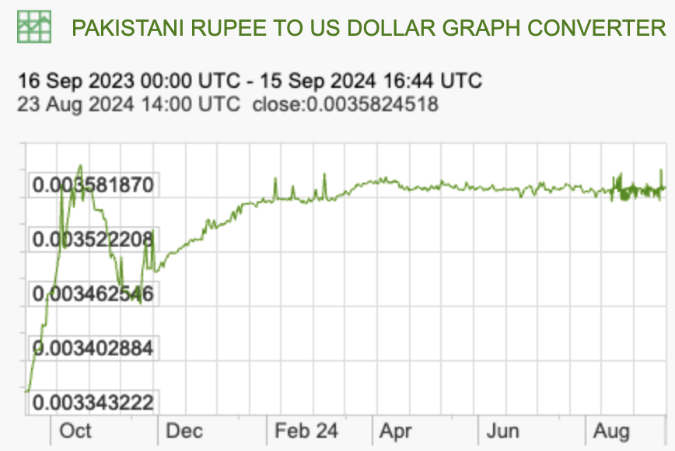
Recent Rate Movements: Pakistan
This Year:
Source: X-rates.com
Notes:
https://www.x-rates.com/graph/?from=RUB&to=USD&amount=1

Slide 45
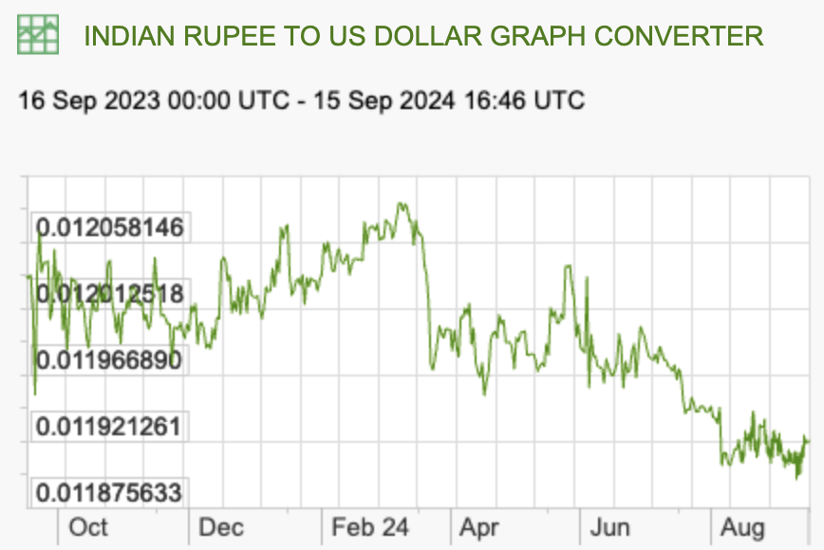
Recent Rate Movements: India
This Year:
Source: X-rates.com
Notes:
https://www.x-rates.com/graph/?from=RUB&to=USD&amount=1

Slide 46
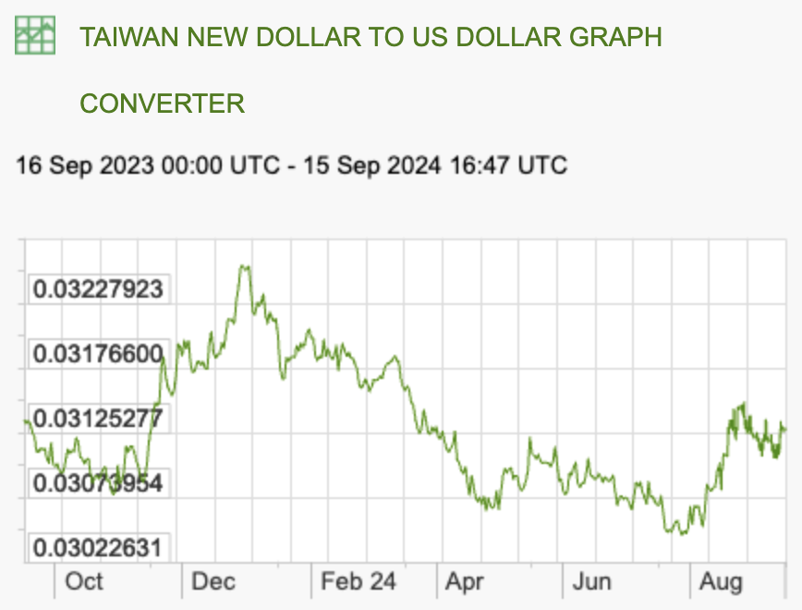
Recent Rate Movements: Taiwan
This Year:
Source: X-rates.com
Notes:
https://www.x-rates.com/graph/?from=RUB&to=USD&amount=1

Slide 47
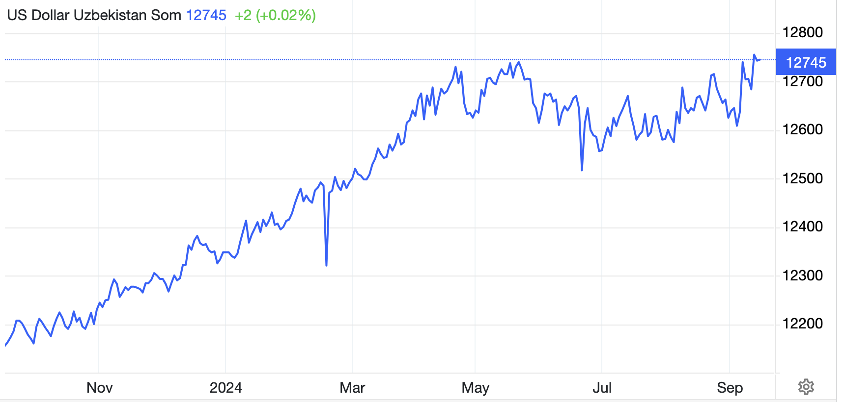
Recent Rate Movements: Uzbekistan
This Year:
Note: This is Som/$, not $/Som
Source: Trading Economics
Notes:
https://tradingeconomics.com/uzbekistan/currency

