Slide 1
Class 6
International Transactions and the Trade Balance by
Alan V. Deardorff
University of Michigan
2024
PubPol/Econ 541

Slide 2
Announcements
Papers
  Monday was the drop/add deadline, so I’ll be doing the paper assignments soon
  Group assignments will be in Canvas: Files / Paper Assignments
  Assignments will also be there, and on website under Paper Assignments
  First paper is due Wed, Oct 2, 8:30 AM in Canvas
  The groups will be set in Canvas; turn in once per group

Slide 3
Outline
A Bit of Macroeconomics
The Balance of Payments Accounts
Surpluses and Deficits
They Add to Zero
What a Deficit Means
The Assumption of Balanced Trade

Slide 4
A Bit of Macroeconomics
From KOM:
  Y = C + I + G + (X – M)
  Where
    Y = GDP = Gross Domestic Product
    C = Consumption
    I = Investment
    G = Government purchases
    X = Exports
    M = Imports

Slide 5
A Bit of Macroeconomics
GDP measures
  The economy’s output of goods and services
  Essentially the same as National Income
    Wages, salaries, interest, rent, and profits
    =GDP since production generates income
  GDP is positively related to, but not the same as
    Employment
    Welfare
    Happiness
  And there are problems even with measuring output. E.g., it misses all that we produce in our homes

Slide 6
The Balance of Payments Accounts
Recording International Transactions
  Credits versus debits
    Credits correspond to payments that would flow into the country
      Exports
      Borrowing from foreigners
      Collection of interest and dividends from foreigners
    Debits correspond to payments that would flow out of the country
      Imports, etc.
This use of the words “credit” and “debit” is specific to the international accounts. It is NOT the same as their use in accounting or in other contexts.

Slide 7
The Balance of Payments Accounts
Recording International Transactions
  Current versus Financial Accounts
    Financial account is (only) changes in holding of assets by one country in another
    Current account is all other international transactions:
      Trade (both goods and services)
      Income payments (wages, interest, & dividends)
      Transfers (Gifts, remittances, and foreign aid)

Slide 8
Table 13.2 U.S. Balance of Payments Accounts for 2019 (Billions of Dollars) (1 of 2)
Current Account | Blank | Blank
(1) | Exports and current transfer receipts Of which: | 3,805.94
 | Goods | 1,652.44
 | Services | 875.83
 | Income receipts (primary income) | 1,135.69
 | Current transfer receipts (secondary income) | 141.98
(2) | Imports and current transfer payments Of which: | 4,286.16
 | Goods | 2,516.77
 | Services | 588.36
 | Income receipts (primary income) | 899.35
 | Current transfer receipts (secondary income) | 281.69
 | Balance on current account left bracket left parenthesis 1 right parenthesis minus left parenthesis 2 right parenthesis right bracket | negative 480.22
(3) | Capital Account | negative 6.24
Credits
Debits
Source: U.S. Department of Commerce, Bureau of Economic Analysis, June 196, 2020, release. Totals may differ from sums because of rounding.
?
Notes:
KOM, 2022

Slide 9
Table 13.2 U.S. Balance of Payments Accounts for 2019 (Billions of Dollars) (2 of 2)
Financial Account | Blank | Blank
(4) | Net U.S. acquisition of financial assets, excluding financial derivatives Of which: | 440.75
Blank | Official reserve assets | 4.66
Blank | Other assets | 436.09
(5) | Net U.S. incurrence of liabilities, excluding financial derivatives Of which: | 797.96
Blank | Official reserve assets | 61.63
Blank | Other assets | 736.33
(6) | Financial derivatives, other than reserves, net | negative 38.34
Blank | Net financial flows Left bracket left parenthesis 4 right parenthesis minus left parenthesis 5 right parenthesis minus left parenthesis 6 right parenthesis right bracket | negative 395.54
Statistical Discrepancy | Blank | 90.92
Blank | [Net financial flows less sum of current and capital accounts] | Blank
Debits
These are both changes from end of last year to end of this year.
Credits
Source: U.S. Department of Commerce, Bureau of Economic Analysis, June 196, 2020, release. Totals may differ from sums because of rounding.
Notes:
KOM, 2022

Slide 10
Pause for Discussion

Slide 11
  Questions on KOM
What’s the difference between GNP and GDP?
Why does GNP (or GDP) only include consumption of final goods, not firms’ purchases of intermediate inputs?
Why are imports subtracted from C+I+G+X–M in calculating GDP? Is it because imports cause unemployment?

Slide 12
  More Questions on KOM
What distinguishes credits and debits in the balance of payments?
What distinguishes the current account from the financial account?
For which categories of transactions did credits exceed debits for the United States in 2019 (the year reported in KOM)?
  Trade in goods
  Trade in services
  Investment (i.e., “primary income”)
  Transfer payments (i.e., “secondary income”)
  Changes in asset holdings

Slide 13
The Balance of Payments Accounts
Accounts |  |  |  | Credits | Debits
 | Current Account
 |  | Exports |  | +
 |  |  | Goods
 |  |  | Services (including investment income rcvd)
 |  | Imports |  |  | –
 |  |  | Goods
 |  |  | Services (including investment income paid)
 |  | Transfers |  | + (in) | – (out)
 | Financial Account
 |  | Change in US assets held abroad |  |  | –
 |  | Change in foreign holdings of assets in US |  | +
Balance on Current Account: Credits minus Debits
Balance on Financial Account: Credits minus Debits

Slide 14
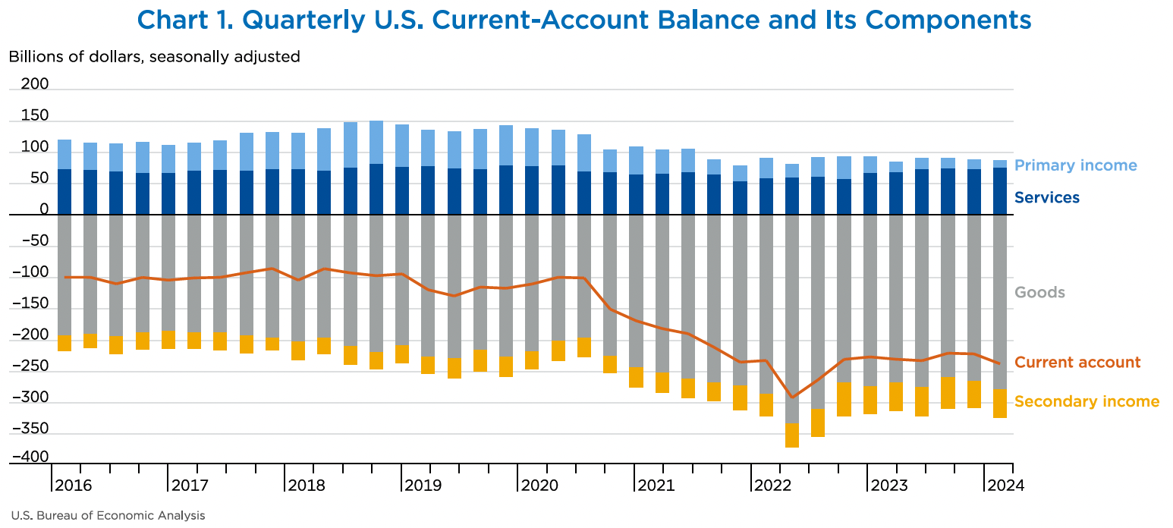
Notes:
Berg, Elliot, Jr., "A Look at the U.S. International Transactions, First Quarter 2024," Survey of Current Business, Bureau of Economic Analysis, July 10, 2024.
https://apps.bea.gov/scb/issues/2024/07-july/pdf/0724-quarterly-international-transactions.pdf

Slide 15
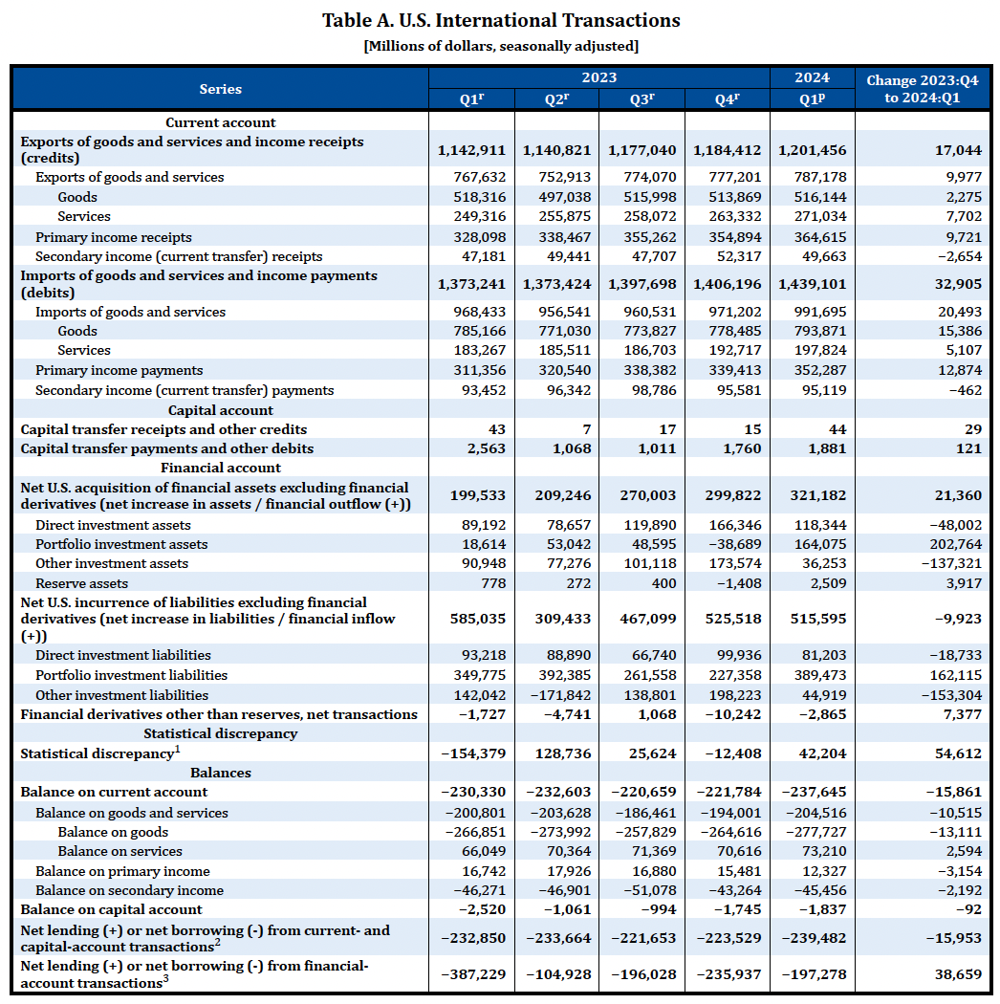
Note that Bal on CA is –230,330
= 1,142,911 – 1,373,241
These are all debits and therefore negative.
Ignore this. It’s small.
These are also debits and therefore negative.
Really, errors and omissions
Notes:
Berg, Elliot, Jr., "A Look at the U.S. International Transactions, First Quarter 2024," Survey of Current Business, Bureau of Economic Analysis, July 10, 2024.
https://apps.bea.gov/scb/issues/2024/07-july/pdf/0724-quarterly-international-transactions.pdf

Slide 16
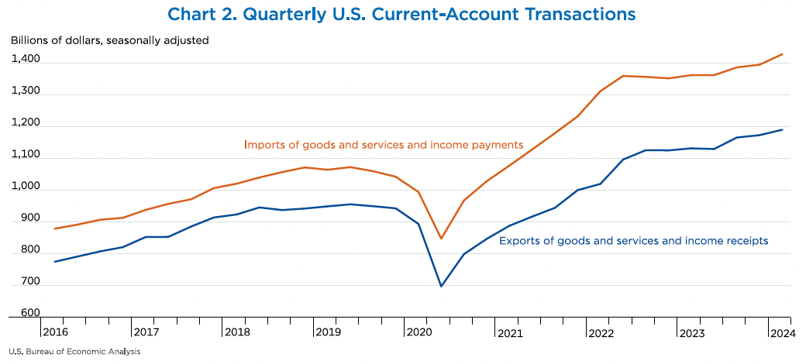
Trade War
Covid-19 Pandemic
Notes:
Berg, Elliot, Jr., "A Look at the U.S. International Transactions, First Quarter 2024," Survey of Current Business, Bureau of Economic Analysis, July 10, 2024.
https://apps.bea.gov/scb/issues/2024/07-july/pdf/0724-quarterly-international-transactions.pdf

Slide 17
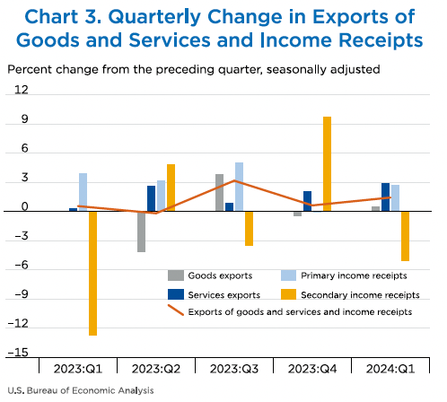
Notes:
Berg, Elliot, Jr., "A Look at the U.S. International Transactions, First Quarter 2024," Survey of Current Business, Bureau of Economic Analysis, July 10, 2024.
https://apps.bea.gov/scb/issues/2024/07-july/pdf/0724-quarterly-international-transactions.pdf

Slide 18
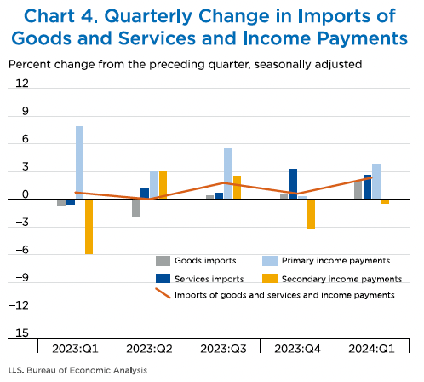
Notes:
Berg, Elliot, Jr., "A Look at the U.S. International Transactions, First Quarter 2024," Survey of Current Business, Bureau of Economic Analysis, July 10, 2024.
https://apps.bea.gov/scb/issues/2024/07-july/pdf/0724-quarterly-international-transactions.pdf

Slide 19
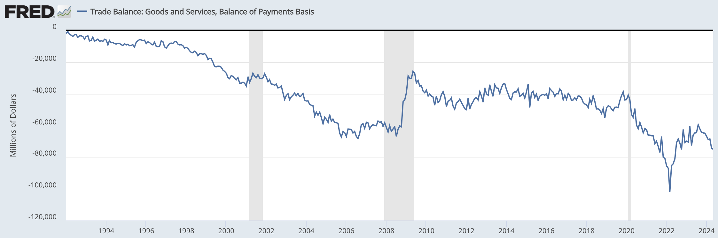
US Trade Balance = Exports minus Imports
Clinton
Bush
Obama
Trump
Biden
Note the zero. This whole thing is negative – a trade deficit! – and getting mostly larger since 1992.
Recessions
Notes:
FRED,
https://fred.stlouisfed.org/series/BOPGSTB
Jukly 29, 2024

Slide 20
The US Trade Deficit
Grew from about $2 billion in 1992 to almost $70 billion in 2006
Shrank in the recessions of 2001 & 2008, but not 2020
Grew for Trump’s first two years, then fell, then rose even more
Under Biden, it grew to record levels, then fell back

Slide 21
Pause for Discussion

Slide 22
  Questions on Berg,
  Survey of Current Business
What mostly happened to current account transactions in the first quarter of 2024 compared to the quarter before? (The most recent change in the BEA table, is in its far-right column.)
What happened to financial transactions?

Slide 23
Surpluses and Deficits
For any subset of transactions
  “Surplus” is credits > debits
  “Deficit” is debits > credits
Common “balances”:
  Balance of Merchandise Trade (i.e., goods)
  Balance on Goods and Services
  Balance on Current Account
  Balance on Financial Account
    = Financial inflows minus financial outflows

Slide 24
They Add to Zero
If all transaction were captured perfectly, then all would add to zero
  ∑ credits = ∑ debits
Thus
  Balance on Current Account
  +
  Balance on Financial Account
  = 0
(If they don’t, there must be errors, hence “statistical discrepancy”)

Slide 25
They Add to Zero
Why?
  Every actual transaction has two parts, and these cancel each other
    Example: I buy a book for $10 from the UK
      That’s a US debit of $10
      If the seller does nothing (keeps the $10 cash), it’s an increase in that foreigner’s holdings of US assets (the $10 bill), a US credit
      The seller may instead do many other things with the $10, but each of them would result in either a $10 US credit or reversing a $10 US debit

Slide 26
They Add to Zero
Examples:
Buy a US export (US credit in trade account)
Pay interest on debt to US (US credit in primary income)
Give to US charity (US credit in secondary income)
Deposit in US bank (US credit in financial account)
Borrow less from NY bank (reverse US debit in financial account)
Sell for £ to someone who uses $10 for one of above
Why?
  Every actual transaction has two parts, and these cancel each other
    Example: I buy a book for $10 from the UK
      That’s a US debit of $10
      If the seller does nothing (keeps the $10 cash), it’s an increase in that foreigner’s holdings of US assets (the $10 bill), a US credit
      The seller may instead do many other things with the $10, but each of them would result in either a $10 US credit or reversing a $10 US debit

Slide 27
They Add to Zero
Implication
  A trade (or current account) deficit must be accompanied by
    Financial account surplus
    Thus net capital inflow
How does it happen?
  Credits correspond to supply of foreign exchange
  Debits correspond to demand for foreign exchange
  So exchange-market equilibrium
    Implies supply = demand
    Implies credits = debits

Slide 28
What a Deficit Means
Recall (from macroeconomics) the definition of GDP
  GDP = Y = C + I + G + (X – M)
    (C + I + G) equals expenditure, E
    (X–M) equals trade surplus
  So:
  X – M = Y – E
  Trade surplus equals
  Income minus expenditure

Slide 29
What a Deficit Means
Interpretations of a trade deficit
    (as the US has had for decades)
  We are spending more than our income
  We are consuming (and investing in) more goods that we are producing
  We are borrowing from (or selling assets to) foreigners

Slide 30
What a Deficit Means
Another Interpretation
  With T = net taxes, then Y–T is “disposable income”
  Rearrange: Y = C + I + G + (X – M)
  Y – C – G – I = (X – M)
  (Y – T – C) + (T – G) – I = (X – M)
  Private savings + Government saving – I = (X – M)
  Total Saving – Investment = (X – M)
  Thus
  X – M = S – I

Slide 31
What a Deficit Does Not Mean
That foreign trade barriers are hurting our exports
That other countries are engaged in unfair trade
That our firms are not competitive
That we are losing jobs to other countries
That we need to restrict trade
(But note: many disagree, including Trump and the two optional readings: Scott and Mokhiber, and Buffet)

Slide 32
Pause for Discussion

Slide 33
  More Questions on KOM
Why must credits and debits exactly offset if measured accurately?
KOM defines a country’s current account surplus as its exports minus its imports. Why is this also said to equal “net foreign investment”?
What are, and what are not, the implications of a trade deficit? For jobs? Debt? Trade barriers? Competitiveness?

Slide 34
What a Deficit Means
Is a trade (or current account) deficit good or bad?
  It depends

Slide 35
Pause for Discussion

Slide 36
  Questions from Obstfeld
Is a country with a trade deficit losing from trade?
What determines a country’s bilateral deficits and surpluses?
Why does the fact that the US was at full employment matter for the discussion in Obstfeld?

Slide 37
What a Deficit Means
Many trade sceptics, such as Scott, associate trade deficits with lost jobs.
  In other work (not assigned) Scott "measures” the lost jobs by comparing
    The jobs producing US exports
    to
    The jobs the US would need to produce US imports here
  By this measure, “jobs lost” are sometimes more than the unemployed

Slide 38
Balanced Trade
In this course we will assume either
  Trade is balanced, or
  The trade imbalance does not change
Why?
  Because the trade imbalance depends
    On macroeconomic factors, such as monetary and fiscal policies
    Not on the trade policies will are studying

Slide 39
  Questions from Krugman
What does Krugman say is the source of Russia’s trade surplus?
What does he say is the source of China’s trade surplus?
Why does he say that the surpluses are good for other countries?
Why (according to him) are dictators more likely to have these problems?

Slide 40
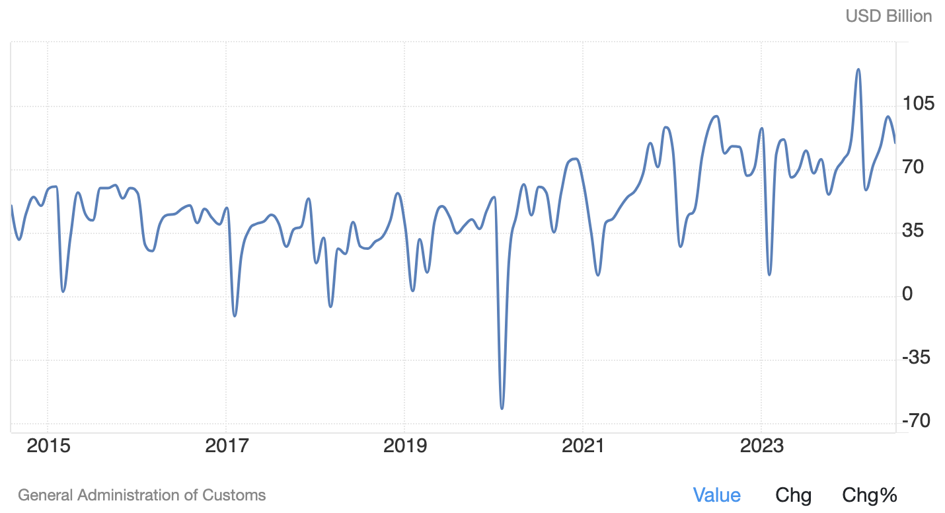
China’s Trade Surplus
Record surplus. (See Bradsher)
Note that the surplus dips each February. Why, do you suppose?

Slide 41
  Questions from Pettis.
  “No, trade surpluses aren’t…”
According to this, what is needed for trade in accordance with comparative advantage to be beneficial to both countries?
In his 2-good example, why is Germany able to export both goods?
What, according to him, is the reason for China’s trade surplus?
Does China say that it wants to keep wages and incomes low?

Slide 42
  Questions from Bradsher.
  “China Record Trade Surplus…”
Did both exports and imports rise in China, producing this record surplus?
Is China exporting more because other countries are reducing their tariffs on China?
What has happened in China to account for this change?
Is it only the US that is concerned about this?
Why do other countries object to this, if they are getting cheap imports from China?

