Slide 1
Classes 7, 8
Policies and Institutions: International by
Alan V. Deardorff
University of Michigan
2023
PubPol/Econ 541

Slide 2
Pause for News

Slide 3
Quiz Scores
 | Q1 | Q2 | Q3
Mean | 7.66 | 7.83 | 7.83
Median | 7.5 | 8 | 8
Max | 10 | 9 | 10
Min | 5 | 6 | 5
Standard deviation | 1.37 | 0.85 | 1.26

Slide 4
Announcement
Papers
  Avoid “spurious specificity”
    Nothing here is known exactly
    So don’t report more than a few (3?) significant digits
    Eg, “$162 million”
      NOT “$161,629,418
      NOT “$161.629 million”

Slide 5
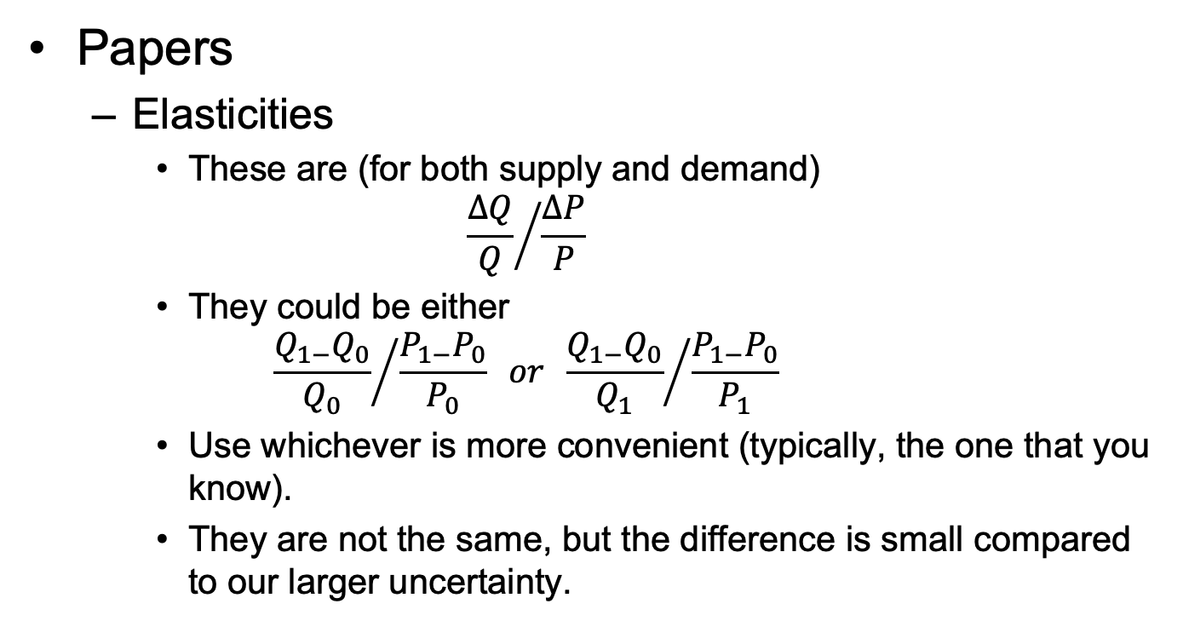
Announcement
Papers
  Elasticities
    These are (for both supply and demand)
    $${\frac{∆Q}{Q}}/{\frac{∆P}{P}}$$
    They could be either
    $${\frac{Q_{1−}Q_{0}}{Q_{0}}}/{\frac{P_{1−}P_{0}}{P_{0}}} or {\frac{Q_{1−}Q_{0}}{Q_{1}}}/{\frac{P_{1−}P_{0}}{P_{1}}}$$
    Use whichever is more convenient (typically, the one that you know).
    They are not the same, but the difference is small compared to our larger uncertainty.

Slide 6
Outline (for 2 classes)
The Problem
History
GATT
WTO
Issues
Other Institutions

Slide 7
The Problem
Countries think they can benefit themselves at the expense of others by using tariffs or other import protection
But they also know that if all do, they all will lose
It’s a classic Prisoners’ Dilemma

Slide 8
The Problem of Trade Warfare
 | Japan
US |  | Free Trade |  | Protection
Free Trade |  |  | 10 |  | 20
 |  | 10 |  | –10
Protection |  |  | –10 |  | –5
 |  | 20 |  | –5
(Nash) Equilibrium

Slide 9
The Outcome
Equilibrium: All countries use tariffs, and all are worse off
The solution: Cooperation
  Bilateral
    Pairs of countries agree to reduce tariffs on each other
    They worry that partners will later do better deals with others
    So they promise “Most Favored Nation” (MFN) treatment
      = Promise partners the best they do later for others
    The also need a penalty if countries violate the agreement
  Multilateral: GATT, and later WTO
    Both had MFN as a core requirement

Slide 10
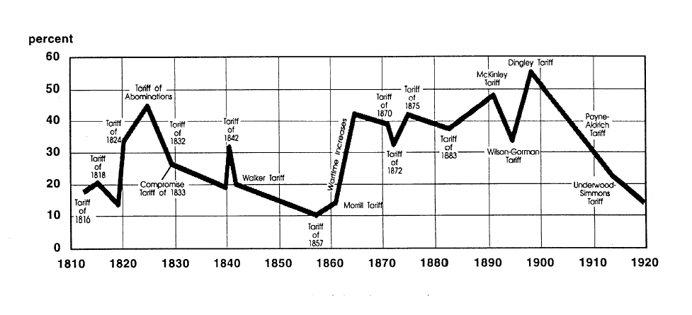
US tariff history: 1810-1920
Today
landandfreedoml.org
Notes:
Source: landandfreedom.org

Slide 11
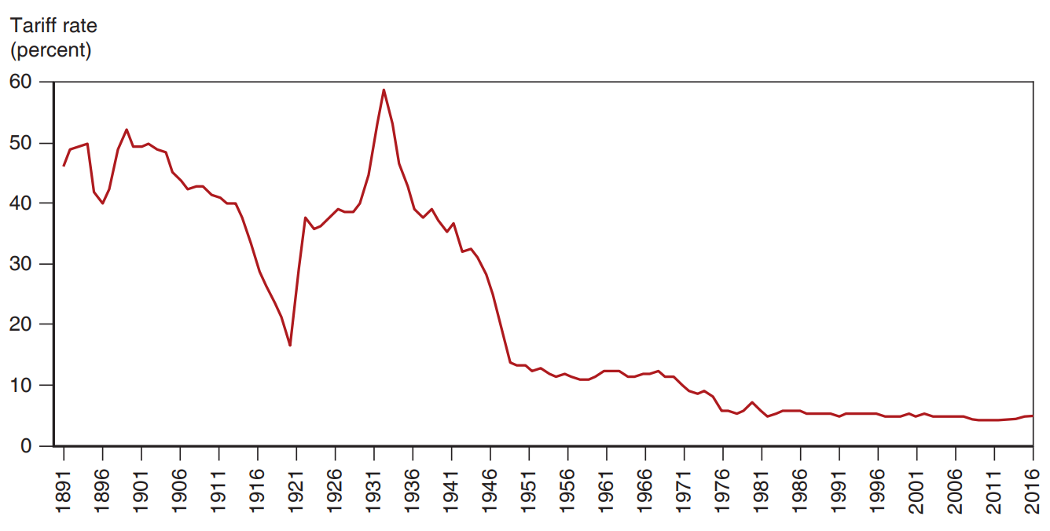
Figure 10.5 The U.S. Tariff Rate
Smoot-Hawley Tariff
1934 Reciprocal Trade Agreements Act
1947 GATT
1995 WTO
After rising sharply at the beginning of the 1930s, the average tariff rate of the United States has steadily declined until the eve of the U.S.-China trade war.
Notes:
KOM, Chapter 10. The tariff rate in percent for the U S is plotted versus year, 18 91 to 20 16. From 18 91 to 19 12, the tariff rate gradually declines from 48% to 40%. In 19 21, a large dip to 15% occurs and then in 19 32 the tariff rate rises to a peak of 59%. Until 19 48, the rate drops rapidly to 12%. From 19 48 to 20 16, the rate declines gradually, with a tariff rate of 4% in 20 16. All values are estimated.

Slide 12
History
Before 1934
  Massive use of tariffs
    Especially by US
    Often used for government revenue
    Also for protection of North-east manufacturers
  1930: Smoot-Hawley Tariff
    Result of “logrolling” in Congress
    Prompted retaliation by others
    Worsened (did not cause) the Great Depression

Slide 13
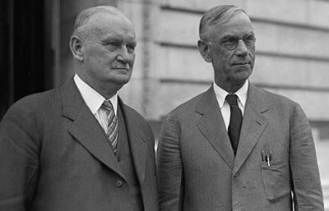
Hawley
Smoot

Slide 14
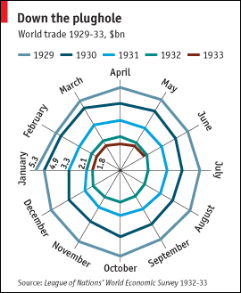
Kindleberger Spiral
Source: Economist, “The battle of Smoot-Hawley,” December 18, 2008.

Slide 15
History
1934: Reciprocal Trade Agreements Act
  US Congress authorized President to negotiate bilateral tariff reductions
  Used MFN to spread tariff cuts to, and from, multiple countries

Slide 16
History
1947: General Agreement on Tariffs and Trade (GATT)
  Accompanied (but was not part of) the Bretton Woods negotiations that created
    IMF
    World Bank
  Meant as temporary until International Trade Organization (ITO) would be ratified.
    GATT was adopted via Protocol of Provisional Application
    ITO failed (in US)
  GATT became the rules for ~50 years by default

Slide 17
Pause for Discussion

Slide 18
  Questions on KOM
What reasons may motivate countries to use tariffs on imports?
By how much were US tariffs reduced from the 1930s to just after World War II, just before the GATT? How was this accomplished?
What do KOM mean by the “levers” and the “ratchets”?

Slide 19
GATT
What GATT did
  Set rules for countries to follow in their trade policies
    Still does, as part of WTO
  Included weak enforcement of rules
  Hosted “Rounds” of multilateral negotiations

Slide 20
GATT Negotiations
Rounds of GATT Multilateral Trade Negotiations
No. | Years | Name | Accomplishments
1-5 | 1947-61 |  | Reduced tariffs
6 | 1964-67 | Kennedy | Tariffs + anti-dumping
7 | 1973-79 | Tokyo | Tariffs + NTBs
8 | 1986-94 | Uruguay | Tariffs, NTBs, Services, Intellectual Property, Textiles, Ag., Dispute Settlement, Created WTO
9 | 2001-15 | Doha | FAILED: Doha Development Agenda

Slide 21
GATT Negotiations
How negotiations took place
  Tariffs:
    In early rounds, tariff cuts were negotiated between “principal supplier” country and “principal demander” country
      Cuts extended to all other members (MFN)
      Large countries dominated this process
    In more recent rounds, negotiations started with a formula for tariff cuts, then negotiated exceptions

Slide 22
GATT Negotiations
Swiss Formula:
Z = AX/(A+X)
    X = initial tariff rate
    A = coefficient and maximum tariff rate
    Z = resulting lower tariff rate
  Proposed by Switzerland in Tokyo Round
  Reduces high tariffs more than low tariffs
Swiss Formula with A=16:
Old tariff: | 5 | 10 | 20 | 50
New tariff: | 3.8 | 6.2 | 8.9 | 12.1

Slide 23
Pause for Discussion

Slide 24
  Questions on Jackson
What is the date of the Jackson book?
Was it written before or after:
  The expansion of world trade?
  The appearance of global supply chains?
  The creation of the WTO?
  The creation of the internet / web?
  The proliferation of Free Trade Agreements?

Slide 25
WTO
World Trade Organization
  Created by Uruguay Round, in 1994
  Went into effect Jan 1, 1995
  Members as of 2024: 166
    Latest: Comoros and Timor-Leste in 2024
  Led by Director General
    Position last filled Feb 2021, after some controversy
    Little power

Slide 26
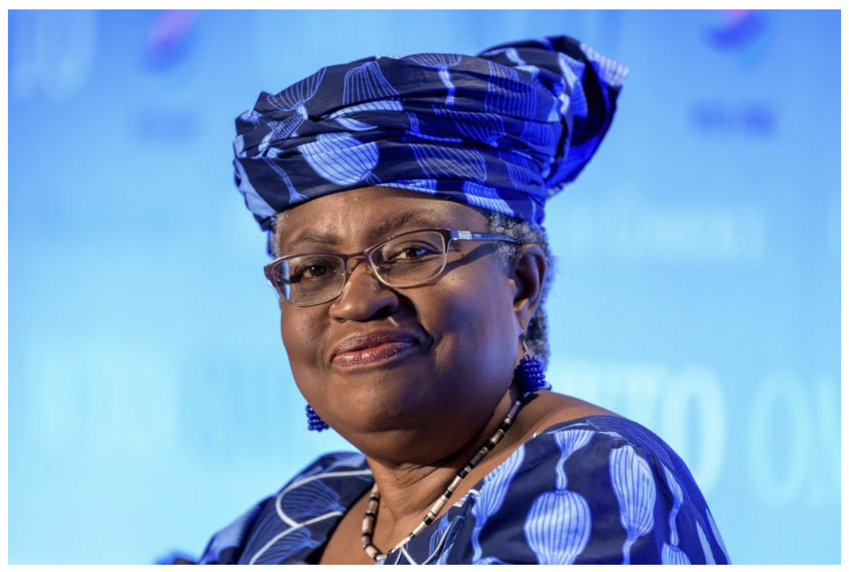
WTO Appoints Nigeria’s Ngozi Okonjo-Iweala as First Female Leader, Feb 15, 2021
Notes:
Norman, Laurence. “WTO Appoints Nigeria’s Ngozi Okonjo-Iweala as First Female Leader,” Wall Street Journal, February 15, 2021.

Slide 27
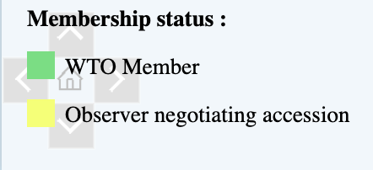
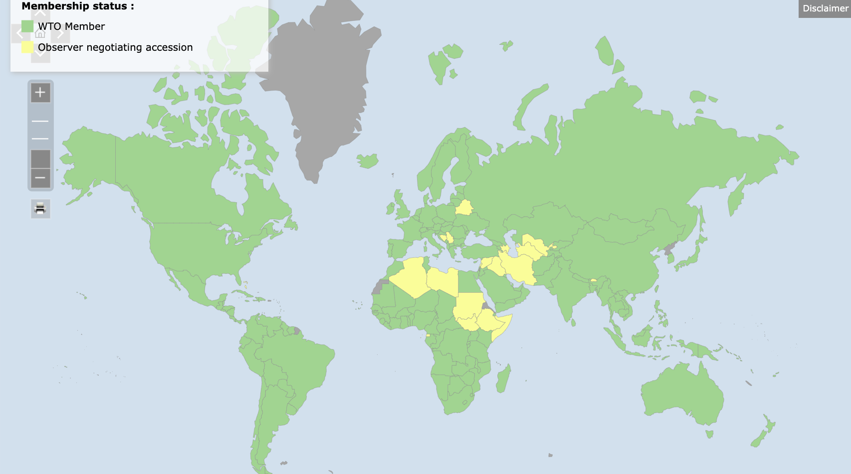
WTO
Notes:
https://www.wto.org/english/thewto_e/whatis_e/tif_e/org6_e.htm

Slide 28
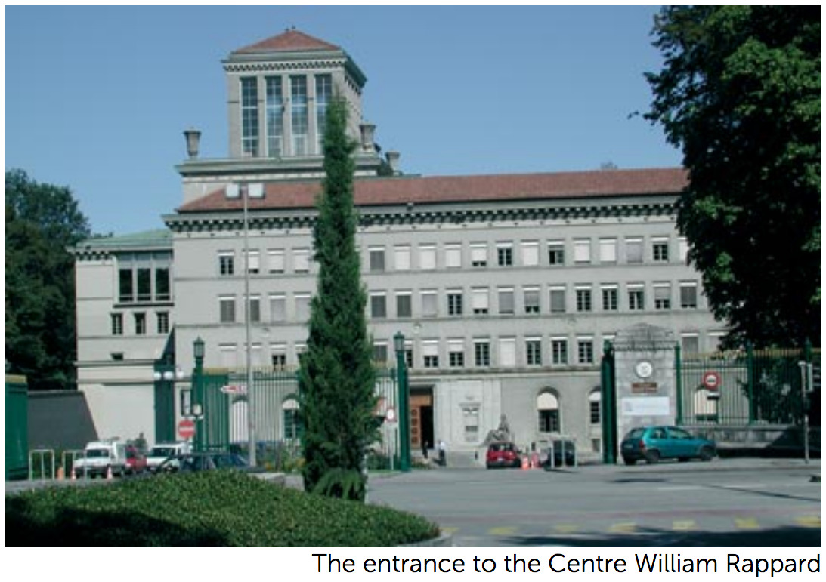

Slide 29
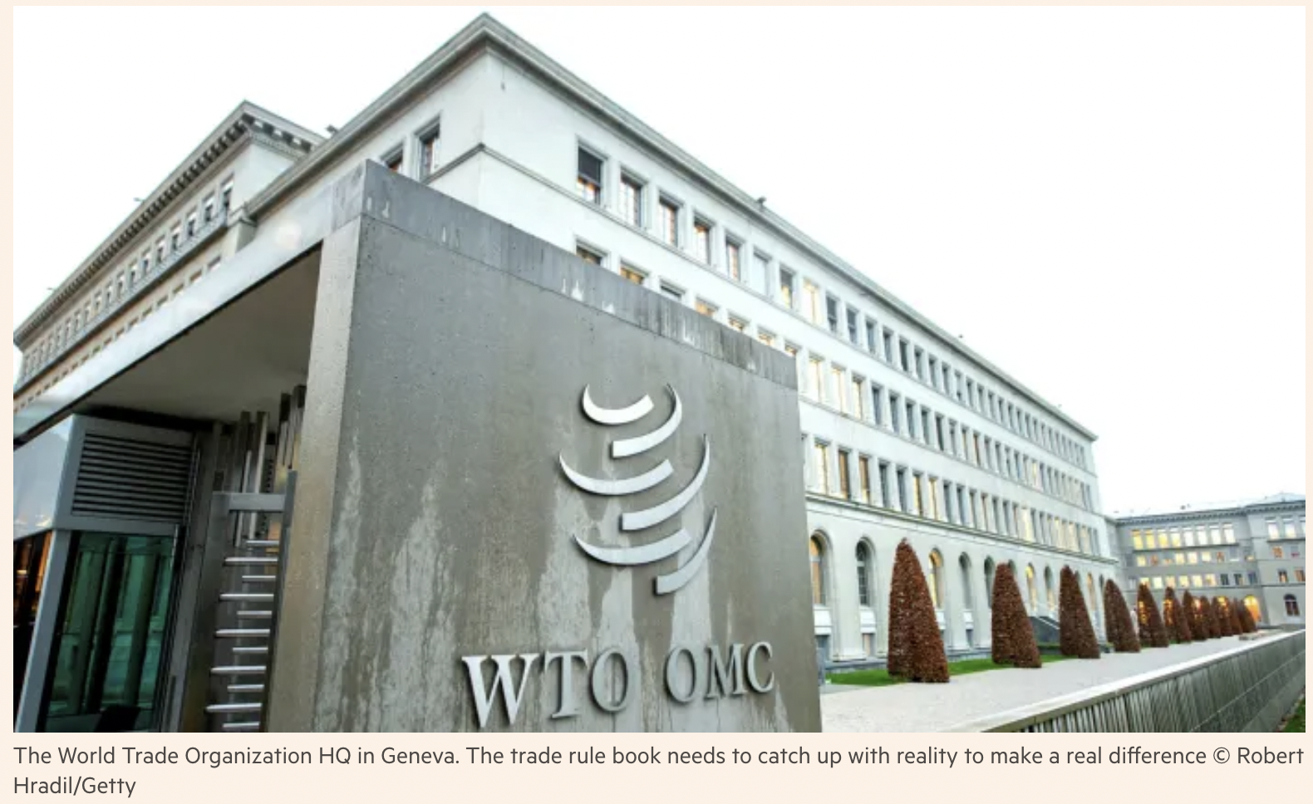
Notes:
https://www.ft.com/content/c22f1d52-b824-4c6d-8a5e-860fe9eb97d3

Slide 30
WTO
How it works
  Decides by “consensus”
    = “no member present objecting”
    Otherwise fraction (2/3 or 3/4) of all members
  In practice, major countries decide
  Ministerial meetings intended every two years
2 Fundamental principles
  MFN = Most Favored Nation
  National Treatment.
    Imports treated same as domestic once inside

Slide 31
Pause for Discussion

Slide 32
  Discussion Question
What do you think the world of trade would be like today now if we hadn’t had the GATT/WTO?

Slide 33
WTO
Three parts:
  GATT = General Agreement on Tariffs and Trade
  GATS = General Agreement on Trade in Services
  TRIPs = Trade-Related Aspects of Intellectual Property Rights
Functions (see below)

Slide 34
WTO Functions
Functional Outline of the World Trade Organization
Communication
Constraints
Exceptions
Dispute Settlement

Slide 35
WTO Functions
Communication | Ministerials
 | Negotiating Rounds
 | Working Groups
 | Trade Policy Review Mechanism
 | Councils and Committees
Trade Ministers (USTR, etc.) Meet “Every” Two Years
Tariff Reductions; Changes in Rules

Slide 36
WTO Functions
National Treatment for Service Firms (only in some industries)
Constraints | Tariff Bindings
 | Customs Valuation
 | Product Regulations
 | Quantitative Restrictions
 | Subsidies
 | Foreign Direct Investment (TRIMS)
 | Services (GATS)
 | Intellectual Property (TRIPs)
Countries negotiate and commit to maximum tariffs
Enforce Patents, Copyrights, Trademarks

Slide 37
WTO Functions
Most commonly used
Exceptions | Anti-Dumping
 | Countervailing Duties
 | Safeguards
 | Balance of Payments Protection
 | Preferential Trade Agreements
Permitted; not required
Allows NAFTA, EU, etc.

Slide 38
WTO Functions
Standing Committee that reviews most cases
Dispute Settlement | Consultation
 | Panel Recommendation
 | Appellate Body
 | Remedy | Implementation
 |  | Compensation
 |  | Retaliation
3-person Panel Decides Case
The Ultimate Remedy: Permit Tariffs

Slide 39
Pause for Discussion

Slide 40
  Questions on Jackson
Jackson lists 11 important achievements of the Uruguay Round in its creation of the WTO. Are any of them flawed or incomplete in his view or others’?
What are the two principles that promote nondiscrimination? Are there exceptions to these principles?
Does the WTO permit export subsidies? Why or why not?

Slide 41
WTO Early Issues
Seattle Ministerial – December 1999
  Intended to start a new Round
  Protesters flocked to Seattle, with objections
    Labor issues
    Environmental issues
    Corporate dominance
    Lack of transparency, democracy

Slide 42
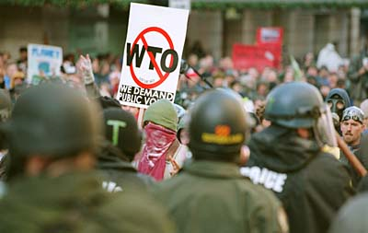

Slide 43
WTO Early Issues
Doha Round
  Began at WTO Ministerial at Doha, Qatar, Fall 2001 (after Sep 11)
  Emphasis on development:
  Cancún Ministerial Sep 2003
    Meeting ended without agreement: Failure!
  December 2015: Nairobi Ministerial meeting
    Ended without reaffirming intent to complete the Doha Round
    Implicitly, admitted Round had ended in failure

Slide 44
WTO Early Issues
WTO has also succeeded in negotiating “plurilateral agreements”
  These are agreements the members can sign or not, and are only binding on those who do
  Agreements that have been negotiated:
    Information Technology Agreement (1995 with update 2015)
    Financial Services Agreement
    Basic Telecommunication Services Agreement
    Anti-Counterfeiting Trade Agreement

Slide 45
WTO Ministerials
December 2013: Bali Ministerial salvaged a limited agreement, mainly on Trade Facilitation
December 2015: Nairobi Ministerial agreed on several commitments, including
  Abolished export subsidies on farm exports.
December 2017: Buenos Aries Ministerial met but accomplished essentially nothing (note: Trump)
[Missed meeting in 2019; not sure why – Trump?]
June 12-17, 2022: Geneva, Switzerland
  Originally planned for Nur-Sultan, Kazakhstan, June 8-11, 2020.
  Put on hold due to COVID-19,
  Then rescheduled for Geneva

Slide 46
WTO Ministerials
Feb 26-Mar 2, 2024, in Abu Dhabi, UAE
  Failed to achieve:
    Agreement to limit fisheries subsidies and overfishing
    Deal on agriculture to regulate “public stockholding”
  Progress made on
    Investment facilitation for development: text but not “path forward”
    Dispute settlement. Blocked
      By BRICS countries, according to US
      By US according to EU
  Successes
    Another 2-year extension of e-commerce moratorium
    TRIPs waiver extension rejected (success for US but not most others)
    Plurilateral agreement on domestic services regulation, agreed in 2021 now to go into effect
    2 new members achieved accession (Comoros and Timor-Leste).

Slide 47
Pause for Discussion

Slide 48
  Questions on Denamiel et al., “Insight into the 13th …”
Where and when was this meeting held?
On what were negotiations attempted but failed?
On what did they succeed?
Does and did the WTO deal with industrial policy subsidies?

Slide 49
WTO Disputes
There have been 627 disputes brought to the WTO since its creation in 1995 (as of 9/14/24)
Two of the more notable were
  EU ban on hormone treated beef (ruled by WTO to have no scientific basis)
  US shrimp-turtle import prohibition (struck down by WTO)

Slide 50
WTO Disputes
Boeing-Airbus
  Both countries lost cases against the other
  Settled bilaterally June 2021
COOL dispute (Country of Origin Labeling)
  US requires it on meat
  Canada and Mexico objected
  US lost and Congress repealed its law
China’s “Market-economy status” for anti-dumping cases
  China lost

Slide 51
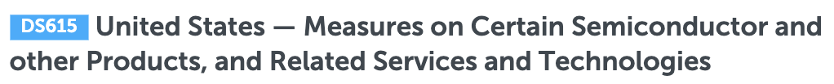
WTO Disputes
Semiconductors
  December 12, 2022, China filed a complaint against the US:
    In response to “sweeping export controls” on chips
  US says
    “these targeted actions relate to national security”
    “WTO is not the appropriate forum to discuss issues related to national security”
  Status of case: “In consultations” (still in 9/24)

Slide 52
Trump and the WTO
Oct 25, 2017, on Fox interview with Lou Dobbs:
  “The WTO, World Trade Organization, was set up for the benefit for everybody but us.”
  “we lose the lawsuits, almost all of the lawsuits … within the WTO”
In fact, like other countries, US
  Wins most of the cases it brings
  Loses most the cases brought against it
Since 1995, in all cases, complainant has won 90%
  As complainant, US has won 91%
  As respondent, US has lost 89%

Slide 53
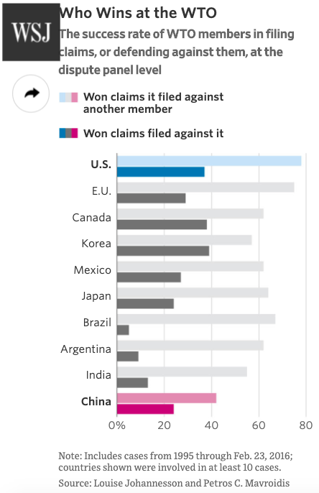
Source: Schlesinger
Notes:
Schlesinger, Jacob M., “How China Swallowed the WTO,” Wall Street Journal, November 2, 2017.
https://www.wsj.com/articles/how-china-swallowed-the-wto-1509551308

Slide 54
US and the WTO
National-Security Tariffs (on steel, aluminum)
    Cases brought by EU and many others
    EU, Canada, & Mexico cases settled by negotiation
    Other cases status: panel composed
How did WTO rule?
    Panel report in December 2022 found against the US
      Said action was not “in time of war or other international emergency”
    US appealed (but has blocked the Appellate Body)
WTO provision:
  Article XXI: “[n]othing in this Agreement shall be construed . . . to prevent any contracting party from taking any action which it considers necessary for the protection of its essential security interests . . . taken in time of war or other emergency in international relations[.]”

Slide 55
US and the WTO
National-Security Tariffs (on steel, aluminum)
    Cases brought by EU and many others
    EU, Canada, & Mexico cases settled by negotiation
    Other cases status: panel composed
How did WTO rule?
    Panel report in December 2022 found against the US
      Said action was not “in time of war or other international emergency”
    US appealed (but has blocked the Appellate Body)
WTO provision:
  Article XXI: “[n]othing in this Agreement shall be construed . . . to prevent any contracting party from taking any action which it considers necessary for the protection of its essential security interests . . . taken in time of war or other emergency in international relations[.]”

Slide 56
US and the WTO
Dispute Settlement Body (DSB)
  Lacks a quorum since Dec 11, 2019
  Trump blocked all new appointments
Without DSB no case can finish if it is appealed
Other countries formed an alternative mechanism
  See below and Kugler and Morgan reading

Slide 57
US and the WTO
Trade war with China
  Tariffs levied under US Section 301 not consistent with GATT/WTO
  WTO panel ruled against US Sep 15, 2020
    Panel: “Trump’s tariffs violated several global rules” (NYT)
  US appealed but case cannot be completed
  Even without that, would WTO permission for China to levy tariffs be meaningful?

Slide 58
US and the WTO
Lighthizer (NYT 9/15/2020)
    Trump’s USTR
  “This panel report confirms what the Trump administration has been saying for four years: The W.T.O. is completely inadequate to stop China’s harmful technology practices”
  “Although the panel did not dispute the extensive evidence submitted by the United States of intellectual property theft by China, its decision shows that the W.T.O. provides no remedy for such misconduct.”

Slide 59
Biden and the WTO
Biden’s “Trade Policy Agenda” (see next class):
  2021 included:
    “Reengage and be a leader in international organizations, including the World Trade Organization”
  2023 includes:
    “The United States is also stepping up engagement in multilateral institutions and international organizations, such as the World Trade Organization.
  2024 includes:
    “At the World Trade Organization (WTO), building on the progress made at the Thirteenth Ministerial Conference, Ambassador Tai is working with other WTO Members to reform the organization to restore transparency, rebuild its ability to address emerging challenges, and make the dispute settlement system more effective.”
Notes:
Baschuk, Bryce, “Biden Picks Up Where Trump Left Off in Hard-Line Stances at WTO, Bloomberg, Feb 22, 2021.
https://www.bloomberg.com/news/articles/2021-02-22/biden-picks-up-where-trump-left-off-in-hard-line-stances-at-wto

Slide 60
Fixing the WTO
Does the WTO need fixing?
  Trump thought so (or just kill it)
  Biden shares concerns about Appellate Body
  New DG Okonjo-Iweala said WTO hadn’t helped in the pandemic
    It permits trade restrictions to protect health
    It requires they be reported, but often they aren’t

Slide 61
Fixing the WTO
Does the WTO need fixing?
  “Intellectual property rules are too rigid, and protect pandemic profiteers over the poor”
    Some want to drop patents for vaccines. But DG O-I does not
  Rodrik critiques (of both WTO and FTAs)
    With tariffs reduced under GATT, WTO shifted from resisting import protection to promoting interests of exporters
    GATS and TRIPs agreements were results of big business lobbying

Slide 62
Pause for Discussion

Slide 63
  Questions on Rodrik
  [NOTE: Much of Rodrik critique is about FTAs, not WTO, so I’ll have questions on that later.]
How does Rodrik change the political economy of trade policy?
Why are the welfare effects different?
What groups of companies does Rodrik criticize specifically?

Slide 64
Fixing the WTO
A temporary fix for the broken Appellate Body: MPIA
  A large group of WTO member countries agreed to handle appeals separately from the WTO

Slide 65
Parties to the MPIA:
The following WTO members are parties to the MPIA: Australia; Benin; Brazil; Canada; China; Chile; Colombia; Costa Rica; Ecuador; European Union; Guatemala; Hong Kong, China; Iceland; Japan; Macao, China; Mexico; Montenegro; New Zealand; Nicaragua; Norway; Pakistan; Peru; Philippines; Singapore; Switzerland; Ukraine and Uruguay.
Notes:
Geneva Trade Platform, “Multi-Party Interim Appeal Arbitration Arrangement (MPIA),” Geneva Graduate Institute, Konrad Adenauer Stiftung, undated. [4p]
https://wtoplurilaterals.info/plural_initiative/the-mpia/#:~:text=Known%20as%20the%20Multiparty%20Interim,and%20staffed%20WTO%20Appellate%20Body

Slide 66
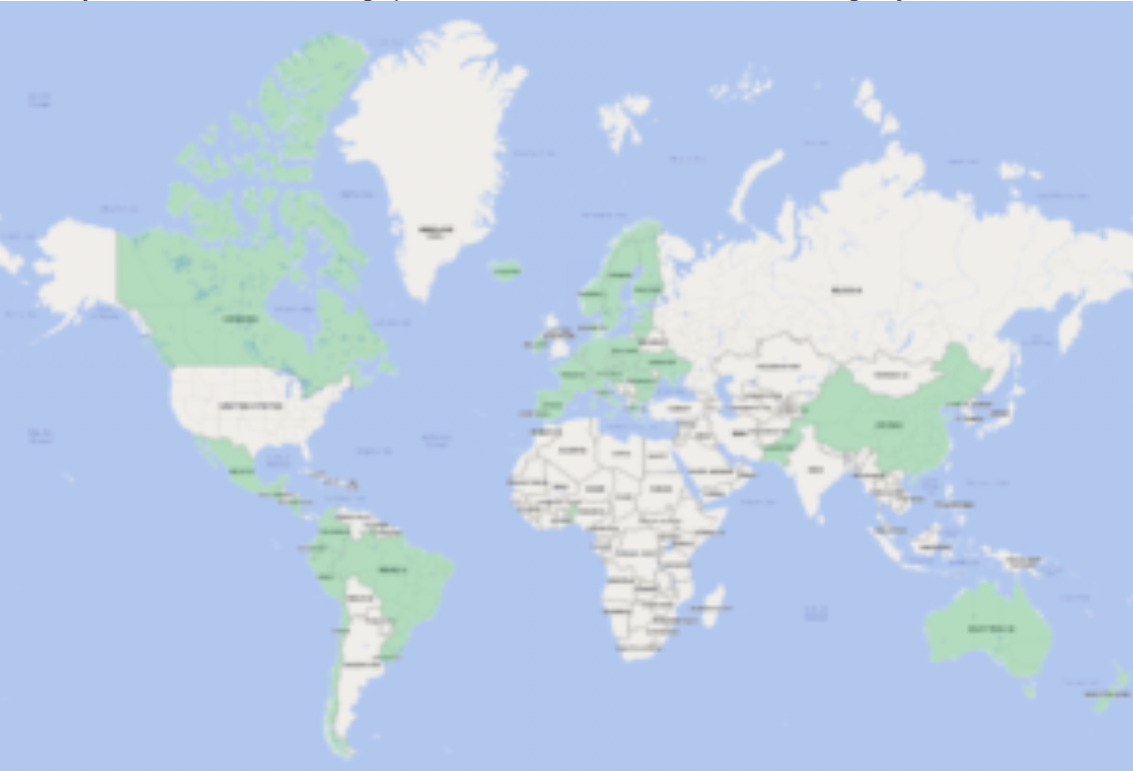
Also Japan & Philippines
Notes:
Geneva Trade Platform, “Multi-Party Interim Appeal Arbitration Arrangement (MPIA),” Geneva Graduate Institute, Konrad Adenauer Stiftung, undated. [4p]
https://wtoplurilaterals.info/plural_initiative/the-mpia/#:~:text=Known%20as%20the%20Multiparty%20Interim,and%20staffed%20WTO%20Appellate%20Body

Slide 67
  Questions on Kugler & Moran, “The MPIA: A Viable …”
When did the Appellate Body cease to function, and why?
What does MPIA stand for, when was it agreed, and how many members does it now have? Are US and China members?
Why is the MPIA not likely to “succeed the Appellate Body”?
How is the US handling trade disputes?

Slide 68
Other International Institutions
IMF (International Monetary Fund)
World Bank (International Bank for Reconstruction and Development)
G-7, G-8, G-20
OECD (Organization for Economic Cooperation and Development)
EU (European Union)

Slide 69
Other International Institutions
United Nations
  UNCTAD (United Nations Conference on Trade and Development)
  ILO (International Labor Organization)
  WIPO (World Intellectual Property Organization)
FTAs (Free Trade Agreements)
  USMCA (United States Mexico Canada Agreement)
  CPTPP (Comprehensive and Progressive Agreement for Trans-Pacific Partnership)
  RCEP (Regional Comprehensive Economic Partnership)
  Many others …

Slide 70
Major Economic Institutions Compared
 | Members | Budget $ mil |  | Employees |  | from Countries
UN | 193 | 3,400 |  | 125,436
IMF | 190 | 1,411 |  | 2,400 |  | Over 190
World Bank | 189 | 2,851 |  | 18,946 |  | Over 170
WTO | 166 | 217 |  | Over 600 |  | Around 80

Slide 71
IMF
IMF = International Monetary Fund
  Created at Bretton Woods 1944
  Original purpose
    To prevent international financial crises by
      Overseeing exchange rates pegged to the US dollar
      Providing resources to central banks to assist in exchange-rate management
    Current purpose
      No longer pegged exchange rates
      “Promote financial stability and monetary cooperation”
Notes:
https://www.imf.org/en/About/Factsheets/IMF-at-a-Glance

Slide 72
IMF
Things the IMF does
  Loans to countries in financial distress
    Conditional on agreeing to “undertake certain policy actions” (“Policy conditionality”)
      Ceilings on external debt, government wage bill
      Improve tax administration, fiscal transparency, anti-corruption
    Charges interest rate based on the SDR interest rate (see below) plus a margin that is currently 100 basis points (1%)
Notes:
https://www.imf.org/en/About/Factsheets/IMF-at-a-Glance

Slide 73
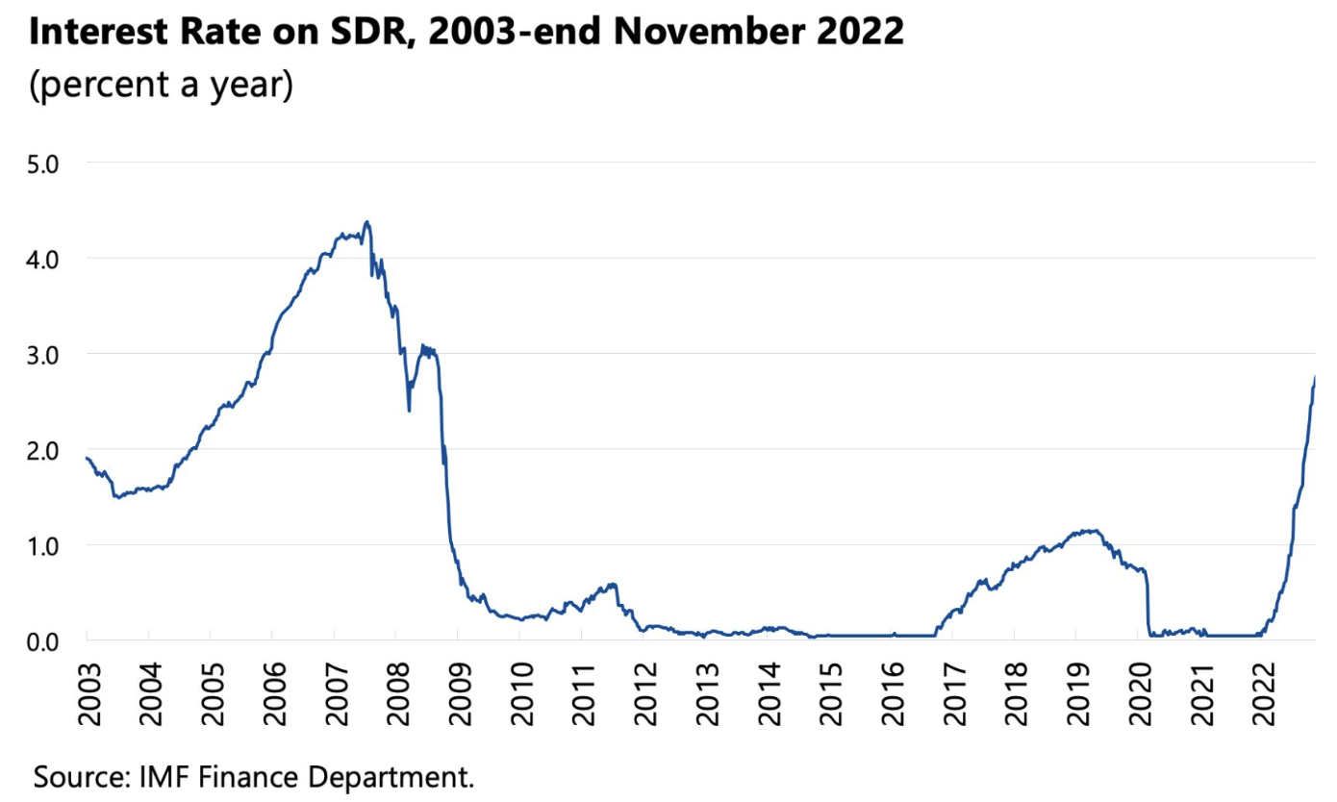
IMF
Notes:
https://www.imf.org/en/About/Factsheets/Sheets/2023/special-drawing-rights-sdr

Slide 74
IMF
SDRs
  SDR = Special Drawing Right
  A “supplementary international reserve asset”
    Created in 1969 in failed attempt to preserve the system of pegged exchange rates
    Additional SDRs can be created by the IMF and allocated to members
    “Not a currency, but an asset that can be exchanged for currency when needed”
    Value is a basket of world currencies
Notes:
https://www.imf.org/en/About/Factsheets/IMF-at-a-Glance

Slide 75
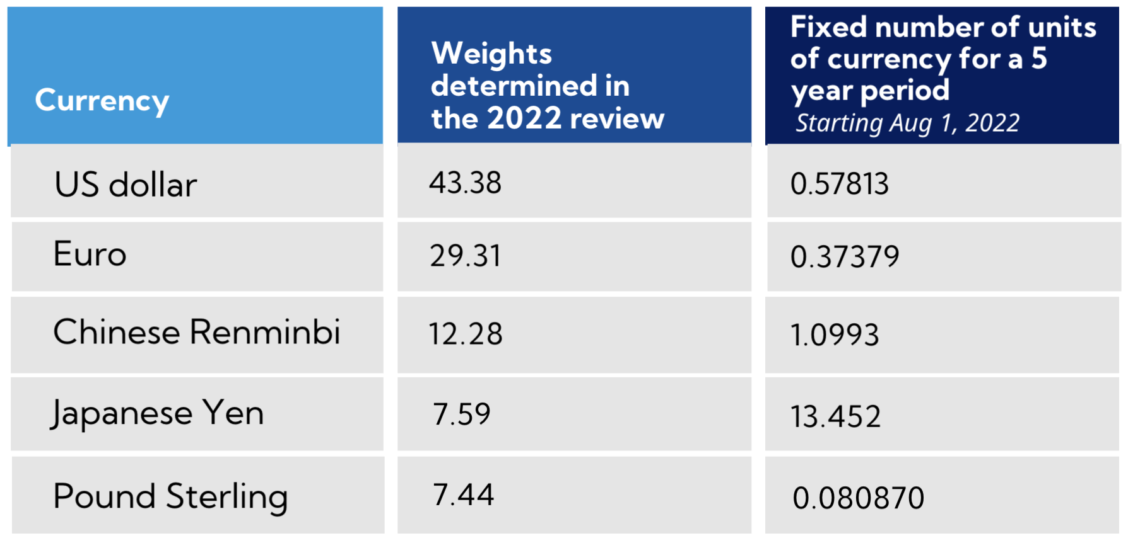
SDR
Notes:
https://www.imf.org/en/About/Factsheets/Sheets/2023/special-drawing-rights-sdr

Slide 76
World Bank
World Bank Group
  Original purpose
    To assist war-destroyed countries to recover from WWII
  Current purpose
    To assist developing countries with
      Loans
      Policy advice
      Assistance

Slide 77
World Bank
World Bank Institutions:
  International Bank for Reconstruction and Development
  International Development Association
  International Finance Corporation
  Multilateral Investment Guarantee Agency
  International Centre for Settlement of Investment Disputes

Slide 78
World Bank
World Bank Aims
  Reduce the share of the global population that lives in extreme poverty to 3 percent.
  Increase the incomes of the poorest 40 percent of people in every country.

Slide 79
Groups, G7, etc.
G7: US, Canada, Japan, Britain, France, Germany, and Italy (plus the EU)
  Began annual meetings of heads of state in 1976
  Added Russia, forming G8, in 1998, but expelled Russia in 2013 after Crimea
  Discusses economic and political issues
  Meetings are informal and take no mandatory decisions

Slide 80
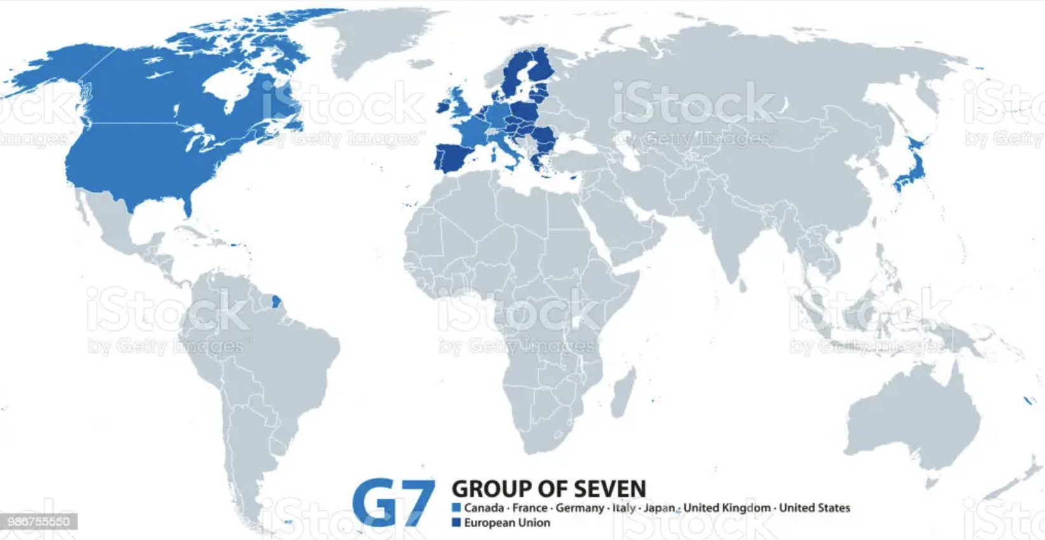
G7 accounts for 27% of global GDP in 2022

Slide 81
Groups, G7, etc.
G20: G7 plus 13 others, both major developed and developing countries
  Founded 1999 with only finance ministers, it began head-of-state meetings after financial crisis of 2008
  “Summit on Financial Markets and the World Economy”
  Today, G7 deals more with politics, G20 with economics
Notes:
https://time.com/5657375/what-is-g7/

Slide 82
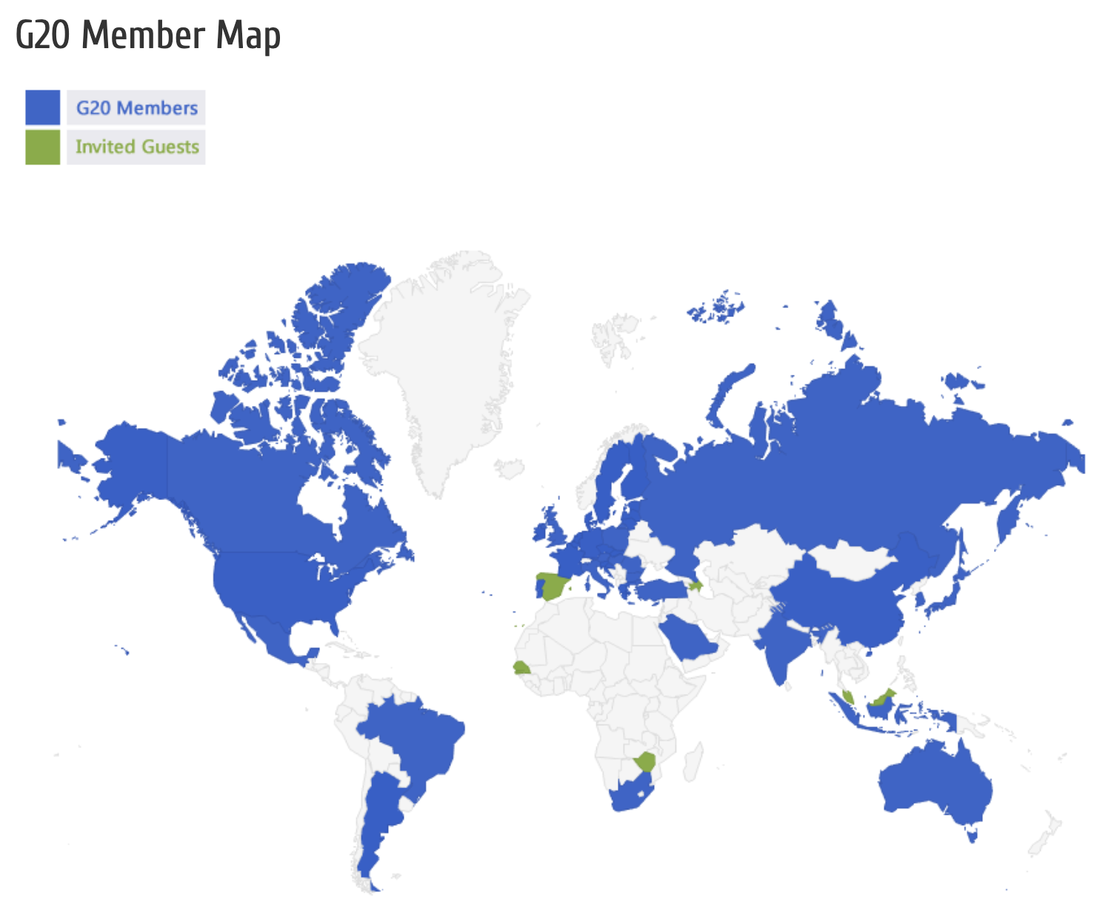
G20 accounted for 80% of global GDP in 2022
(2015)

Slide 83
OECD
OECD = Organization for Economic Cooperation and Development
  38 member countries
  Economist calls it a “rich-country think tank”
  “provides governments a setting in which to discuss, develop and perfect economic and social policy”
Notes:
https://www.imf.org/en/About/Factsheets/IMF-at-a-Glance

Slide 84
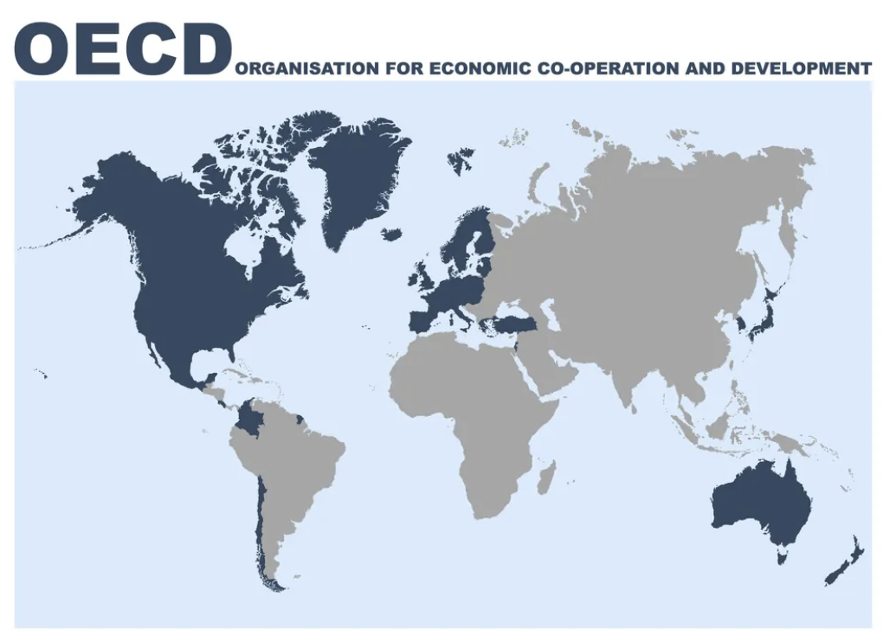

Slide 85
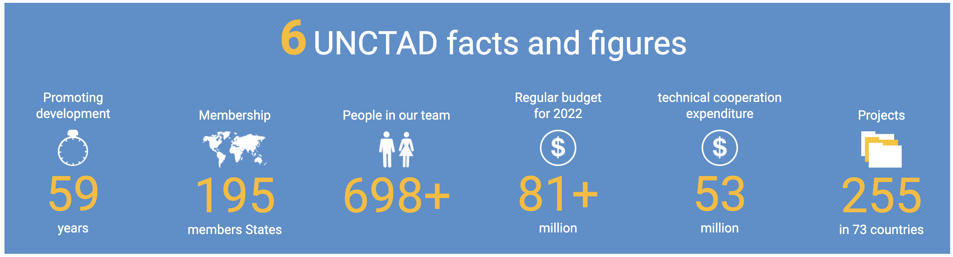
United Nations Economic Orgs
UNCTAD = United Nations Conference on Trade and Development
  Supports “developing countries to access the benefits of a globalized economy more fairly and effectively.”
Notes:
https://unctad.org/about

Slide 86
United Nations Economic Orgs
ILO = International Labor Organization
  Created 1919 by Treaty of Versailles
  Tripartite: governments, employers and workers
  Sets labor standards, develops policies, and devises programs promoting decent work
  Has no power to enforce, but only shame
Notes:
https://unctad.org/about

Slide 87
Fundamental ILO Conventions
Freedom of Association
  Right to Organize (157)
  Right to Collective Bargaining (168)
Abolition of Forced Labor
  Forced Labor (180)
  Abolition of Forced Labor (178*)
Equality
  Discrimination (174)
  Equal Remuneration (175)
Elimination of Child Labor
  Minimum Age (175)
  Worst Forms of Child Labor (187*)
(# countries ratifying)
* USA ratified
Notes:
https://unctad.org/about

Slide 88
United Nations Economic Orgs
WIPO = World Intellectual Property Organization
  Global forum for intellectual property policy, services, information and cooperation.
  IP includes
    Patents
    Copyrights
    Trademarks
    Trade secrets
Has no power to enforce
Notes:
https://unctad.org/about

