Slide 1
Class 11
Non-tariff Barriers by
Alan V. Deardorff
University of Michigan
2024
PubPol/Econ 541

Slide 2
Pause for News

Slide 3
Quiz and Papers
Papers
  Grades ranged from 11 to 15 (out of 15)
  Comments
Quiz:
 | Q3 | Q4 | Q5
Mean | 7.76 | 8.72 | 9.08
Median | 8 | 9 | 9
Max | 10 | 10 | 10
Min | 5 | 6.5 | 8
Standard deviation | 1.26 | 0.96 | 0.79

Slide 4
Announcement
Next Monday, Oct 14: Fall Study Break
  We won’t have class, as I’ll be out of town
  If you wish, read and listen to optional assignments on trade and
    Women
    Environment
    Developing countries
    Human rights
    Black and disadvantaged workers
Note that
  There is a quiz due this week, Oct 11
  There is NO quiz due Oct 18.

Slide 5
Outline
Types of NTBs and NTMs
Quota Analysis
  Perfect Competition
    Small country
    Large country
  Monopoly
TRQs
Other NTBs
Empirics (Feenstra)

Slide 6
NTBs
Types of NTBs (Non-tariff barriers)
    Or NTMs (Non-tariff measures, slightly more general)
  Quotas
  TRQs (Tariff-Rate Quotas)
  VERs (Voluntary Export Restraints)
  Variable Levies
  Procurement Requirements
  Subsidies
  Local Content Requirements
  Export Credits
  Red Tape
  Standards
  Customs Valuation Procedures
  Tax Treatments

Slide 7
NTBs
Also: “Administered Protection”
    Defined as use of tariffs under procedures that may also have “damping” effect on trade
  Safeguard tariffs (aka Escape Clause in US, Section 201)
    Levied against injurious imports
  Anti-dumping duties
    Levied against dumped imports
  CVDs (Countervailing duties)
    Levied against subsidized imports
  US Section 232
    Levied against imports threatening national security
  US Section 301
    Used against foreign “unfair practices”
    Not usually tariffs, since the concern is exports, but Trump did

Slide 8
Pause for Discussion

Slide 9
  Questions
Jackson:
Countries are not allowed under the GATT/WTO to use quotas. How do they get away with it?
Why is the EU’s variable levy legal under the GATT/WTO? And why does Jackson nonetheless object to it?
KOM:
How do the welfare effects of a VER compare to those of a tariff?
Why does a local content requirement raise the price of inputs to producers?

Slide 10
Outline
Types of NTBs and NTMs
Quota Analysis
  Perfect Competition
    Small country
    Large country
  Monopoly
TRQs
Other NTBs
Empirics (Feenstra)

Slide 11
Quota analysis: Small country
Assumptions throughout (same as tariff)
  Markets perfectly competitive (but later monopoly)
  Product homogeneous
  Markets in equilibrium
  There are no “distortions” (externalities, etc.)
  Supply and demand curves linear
    Just for simplicity
  Model is partial equilibrium
  Model is static
  Trade is free and frictionless, except for quota

Slide 12
Small country
Special assumption for small country case
  World price is given (country too small to influence it)
  More correctly: country’s supply and demand in that industry are too small to influence the world price

Slide 13
Quota under Perfect Competition
Small country
Quota sets a maximum quantity of imports, not price
  Price must adjust to whatever level reduces excess demand to the permitted quantity
  If excess demand (i.e., desired imports) is already less than the quota, then quota has no effect. It is not “binding.”
    (That won’t always be true with imperfect competition, as we’ll see later)

Slide 14
Small country quota
P
Effects of a binding quota, starting from free trade
  Price rises
    (by t_{eq} = “tariff equivalent of quota”)
  Quantity supplied rises
  Quantity demanded falls
  Quantity of imports falls (to M_{Q})
  Tariff revenue?
    No
    Instead there is “quota rent”
    t_{eq}×M_{Q}
S
P_{aut}
P₁
t_{eq}
Rent
P₀=P_{W}
M_{Q}=M₁
D
S₀
S₁
D₁
D₀
Q
M₀
Import Quota M_{Q}

Slide 15
Perfect Competition
Small country
Who gets the quota rent? Depends on how the rights to import under the quota are allocated
  First-come, first-served
    Whoever wins the race to the border
  Import licenses sold by home government
    Government revenue, just like tariff
  Import licenses granted to domestic people or firms
    They get the rents, which stay in the country
  Import licenses granted to foreign people, firms, or government
    Foreigners get the rents
Most common

Slide 16
Small country quota,
Rents domestic
P
Welfare effects of a quota, starting from free trade with quota rights domestic
  Suppliers gain +a
  Demanders Lose −(a+b+c+d)
  Rents +c
  Country loses −(b+d)
S
P_{aut}
P₁
t_{eq}
a
c
b
d
P₀=P_{W}
D
M_{Q}=M₁
“Dead Weight Loss” =
(Same as tariff)
S₀
S₁
D₁
D₀
Q
M₀
Import Quota M_{Q}

Slide 17
Small country quota,
Rents foreign
P
Welfare effects of a quota, starting from free trade with quota rights foreign
Home:
  Suppliers gain +a
  Demanders Lose −(a+b+c+d)
  Country loses −(b+c+d)
Foreign:
  Rents +c
World: −(b+d)
S
P_{aut}
P₁
t_{eq}
a
c
b
d
P₀=P_{W}
D
M_{Q}=M₁
S₀
S₁
D₁
D₀
Q
M₀
(Worse than tariff for Home)
Import Quota M_{Q}
(Still Dead-weight loss for world)

Slide 18
Pause for Discussion

Slide 19
  Questions
  (not asked about readings)
If you were a (home) producer, would you prefer being protected with a tariff or a quota?
If you were a (home) consumer, which would you prefer?
Why do governments tend to give quota rights to foreigners?
In what ways, aside from the rents, do tariffs and quotas differ?

Slide 20
Outline
Types of NTBs and NTMs
Quota Analysis
  Perfect Competition
    Small country
    Large country
  Monopoly
TRQs
Other NTBs
Empirics (Feenstra)

Slide 21
Large country quota, Rents foreign
Welfare effects of a large-country quota with rents allocated to foreign
Home:
  Private sector (S&D) loses −(a+b)
  Country must lose −(a+b)
Foreign
  Private sector (S&D) loses −(c+d)
  Quota rents +(a+c)
  Country may gain or lose: +a−d
World loses −(b+d)
World Market
Home is Importer
Foreign (*) is Exporter
P
XS*
P₁
a
b
t_{eq}
c
d
P*₁
MD
M_{Q}
M₁=X*₁
M₀=X*₀
M,X*
Now area a is a transfer from home to foreign, reflecting an improved terms of trade for foreign.

Slide 22
Pause for Discussion

Slide 23
  Questions
  (not asked about readings)
Why does large-country quota with rents to foreigners improve the foreign terms of trade?

Slide 24
Outline
Types of NTBs and NTMs
Quota Analysis
  Perfect Competition
    Small country
    Large country
  Monopoly
TRQs
Other NTBs
Empirics (Feenstra)

Slide 25
Monopoly, Small Country
Assumptions
  Product homogeneous
  World price is given (country too small to influence it)
  Home market has only a single producer
    Firm has increasing marginal cost
    Without trade, firm is a monopoly
    With free trade firm has no market power, as it takes world price as given

Slide 26
Monopoly, Small Country
We’ll skip the analysis unless you are interested
For more, see
  Skipped slides here, and/or
  KOM Appendix to Chapter 9
We’ll go straight the the results

Slide 27
Monopoly in a closed economy
P
Recall
  Monopolist cares about marginal revenue
  Selects quantity Q_{M} where MR=MC
  Then charges the price P_{M} at which this quantity is demanded
MC
P_{M}
D
MR
Q_{M}
Q

Slide 28
Monopoly in Free Trade
P
The firm can’t charge above P_{W}
It produces Q_{F}
where MC = P_{W}
Since D_{F}>Q_{F}, the country imports
(Had P_{W} been enough higher, the firm and country would export.)
MC
P_{M}
P_{W}
D
MR
Q_{F}
Q_{M}
D_{F}
Q
M_{F}

Slide 29
Monopoly with Tariff
P
Now the firm can charge up to P_{W} +t, and it will, as long as P_{W} +t < P_{M}
It produces Q_{T} where MC = P_{W} +t
If D_{T}>Q_{T}, the country imports M_{T}
(If t were higher, imports would be zero and we’re back to monopoly.)
MC
P_{M}
P_{W}+t
P_{W}
D
MR
Q_{F}
Q_{M}
Q_{T}
D_{T}
D_{F}
Q
M_{T}

Slide 30
Monopoly with Quota
A quota M_{Q} means that for prices above P_{W}, demand faced by the monopolist is reduced (shifted left) by M_{Q}.
To D’
And marginal revenue becomes MR’
P
D’
MR’
P_{W}
D
M_{Q}
Q

Slide 31
Monopoly with Quota:
M_{Q} = M_{T}
P
Now the firm can charge a higher price, and it will
It produces Q_{Q} where MC = MR’
and charges price P_{Q}.
Result: Imports are the same as under the tariff, but price is higher and quantity lower.
The quota has given back to the firm some monopoly power.
MC
P_{M}
P_{Q}
MR’
P_{T}=P_{W}+t
P_{W}
D
Q_{F}
Q_{M}
Q_{T}
D_{T}
D_{F}
Q
M_{T}
Q_{Q}

Slide 32
Non-binding Quota under Monopoly
P
Here free trade imports are M_{F}
Set quota Q_{M} > M_{F}
Demand becomes D_{Q}
  Equals D for P < P_{W}
  Equals D–Q_{M} for P > P_{W}
Marginal revenue is MR_{Q}
Output (at MR_{Q}=MC) is Q_{Q}
Price is P_{Q} > P_{W}
Result: Non-binding quota can raise price under imperfect competition.
D
D_{Q}
P_{Q}
MC
Q_{M}
P_{W}
MR_{Q}
M_{F}
Q_{Q}
Q_{F}
D_{F}
Q

Slide 33
Monopoly, Small Country
Results
  With perfect competition
    Quota set equal to imports under tariff raises price by same as tariff.
  With monopoly
    Quota set equal to imports under tariff raises price by more than the tariff would have.
    Even a quota set to more than free-trade imports (which would be expected to be a “non-binding quota), may raise price.
    Reason: Quota limits how much buyers can shift to imports if monopolist raises price.

Slide 34
Pause for Discussion

Slide 35
  Questions
  (not asked about readings)
Why does a large country using a quota (with rents given to foreigners) not benefit from an improvement in its terms of trade?
Why does a monopolist benefit more from a quota than a tariff, if the quantity of imports is the same?
How can a non-binding quota raise price?

Slide 36
Outline
Types of NTBs and NTMs
Quota Analysis
  Perfect Competition
    Small country
    Large country
  Monopoly
TRQs
Other NTBs
Empirics (Feenstra)

Slide 37
Tariff-Rate Quotas (TRQs)
Definition
  Low (or zero) tariff on imports below some set quantity, M_{trq}
  High(er) tariff on imports above M_{trq}

Slide 38
Tariff-Rate Quotas (TRQs)
Effect depends on levels of domestic supply and demand, thus
  Excess demand, or
  Demand for imports
Depending on level of demand for imports, It is like
  a low tariff,
  a quota,
  or a high tariff,
Tariff
Imports
M_{trq}

Slide 39
Tariff-Rate Quotas (TRQs)
Used by
  US for years on some agricultural products
  Trump on Korean steel
  US to settle other trade disagreements
  Used most recently to “remove” Trump’s tariffs on steel and aluminum
    Tariff still in place for imports over quota
    Note the different welfare effects
      Depending on whether quota is binding or not
  See Beattie

Slide 40
Pause for Discussion

Slide 41
  Questions on Beattie,
  “Mind your TRQs”
Why are TRQs inefficient and harmful?
Who benefits most from a TRQ, and why?
What was tariffication? When was it done?
How was China hurt by TRQs in a case they took to the WTO in 2015?

Slide 42
US TRQ on Steel from EU
Biden negotiated with EU to replace Trump’s 25% tariff on steel with a TRQ, beginning in 2022.
  “An historically-based volume of EU steel products will enter the U.S. market without any tariffs.”
  “The initial quota will be 3.3 million metric tons and calculated on a quarterly basis.”
  “Up to 4% of any unused quota in a quarter can roll over into the next quarter.”
  Imports above the quota are still subject to 25% tariff.

Slide 43
US TRQ on Steel from EU
How is the TRQ administered?
  According to one source: “The TRQs on steel will be administered quarterly, and is a first-come, first-served system.”
    Per Tom Lee, “Details of the U.S.-EU Aluminum and Steel Tariff Rate Quota System,” November 9, 2021.
Has the TRQ been binding?
  Apparently yes, for some of the largest EU steel exporters
  See data on next slide for “hot rolled sheet” (there are similar tables for many other steel products).
Notes:
Tom Lee, “Details of the U.S.-EU Aluminum and Steel Tariff Rate Quota System,” American Action. Forum, November 9, 2021.
https://www.americanactionforum.org/research/details-of-the-u-s-eu-aluminum-and-steel-tariff-rate-quota-system/

Slide 44
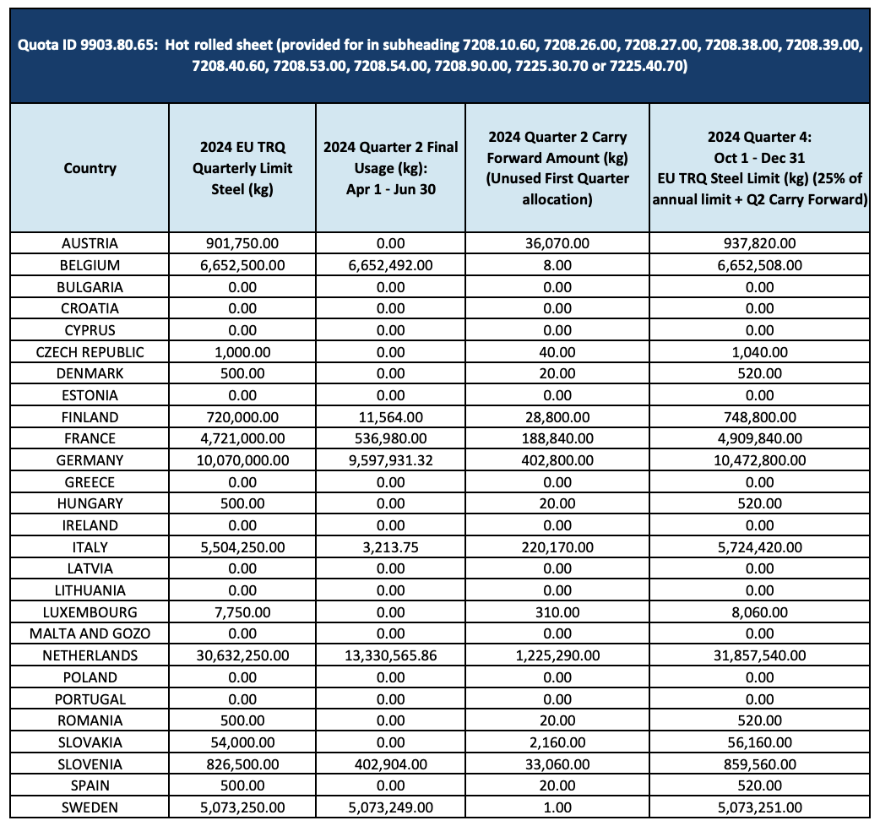
Notes:
https://www.cbp.gov/sites/default/files/2024-09/eu_steel_trq_q2_usage_q4_limits_2024.pdf

Slide 45
US TRQ on Steel from EU
Of countries with quotas of 500,000 kgs or more in 2024, Q2:
Countries that used almost all of their quotas:
Belgium | 100% of | 6,652,500 kg
Germany | 95.3% of | 10,070,000 kg
Sweden | 100% of | 5,073,250 kg
Countries that used only part of of their quotas:
Austria | 0% of | 901,750 kg
Finland | 1.6% of | 720,000 kg
France | 11.3% of | 4,721,000 kg
Italy | 0.05% of | 5,504,250 kg
Netherlands | 43.5% of | 30,632,250 kg
Slovenia | 48.7% of | 826,500 kg

Slide 46
Outline
Types of NTBs and NTMs
Quota Analysis
  Perfect Competition
    Small country
    Large country
  Monopoly
TRQs
Other NTBs (see list from earlier)
Empirics (Feenstra)

Slide 47
NTBs
Types of NTBs (Non-tariff barriers)
    Or NTMs (Non-tariff measures)
  Quotas
  TRQs (Tariff-Rate Quotas)
  VERs (Voluntary Export Restraints)
  Variable Levy
  Procurement Requirements
  Subsidies
  Local Content Requirements
  Export Credits
  Red Tape
  Standards
  Customs Valuation Procedures
  Tax Treatments

Slide 48
Other NTBs: VERs
World Market
Home is Importer
Foreign (*) is Exporter
Voluntary Export Restraint has exporter limiting exports at request of importing country
Effect is just like a quota with rents given to foreigners
Rents go to foreigners
Foreign country may gain
P
XS*_{VER}
XS*
P_{VER}
P_{W}
MD
M₀=X*₀
M,X*

Slide 49
Other NTBs: Variable Levy
World Market
Home is Importer
Foreign (*) is Exporter
Importer uses a tariff (levy) but changes it to maintain a target domestic price, P^{V}
Notice how the size of the levy will change as
  Demand shifts right or left
  Supply shifts right or left
Welfare effects are all exactly like a simple tariff.
P
XS*
P^{V}
levy
MD
M₀=X*₀
M,X*

Slide 50
Other NTBs:
Procurement Requirements
World Market
Home is Importer
Foreign (*) is Exporter
Government limits its own purchases of imports
If government buys less than home production, then no effect, as private buyers just import more
If government buys all home production, then
  Home price rises (to government)
  Foreign price falls (to private importers)
Home buyers and sellers both gain but government loses more.
P
XS*
P_{W}
P’_{W}
MD
MD’
M₀=X*₀
M,X*

Slide 51
Other NTMs:
Export Subsidy
(We’ll see more detail in last class, Dec 4)
Export subsidy gives $s to sellers for each unit exported, so exporters get a higher price than foreign buyers pay
Like large-country tariff, it
  Raises home price
  Helps suppliers
  Hurts demanders
Unlike large-country tariff, it
  Costs the government
  Cannot benefit country
(That last may change with imperfect competition.)
World Market
Home is Exporter
Foreign (*) is Importer
P
XS
P’_{D}
P_{W}
s
P’_{W}
MD*
MD’
M₀=X*₀
M,X*

Slide 52
Pause for Discussion

Slide 53
  Questions on Deardorff
Suppose we are a small country and that foreign producers of imports to our country become more efficient, so that their costs fall. How will the effects of this change on the price and quantity of imports differ depending on whether we restrict imports with
  A tariff
  A quota
  A VER
  A variable levy
  A government procurement regulation
If the import demand curve shifts to the right, how will a variable levy, a tariff, and a quota respond differently?

Slide 54
  Questions on
  KOM on Export Subsidy
Why is a tariff needed to accompany an export subsidy?
Why does an export subsidy raise the price of the good inside the exporting country?
Can an export subsidy benefit the country that uses it (in the perfectly competitive model of the text)? Why or why not?

Slide 55
Outline
Types of NTBs and NTMs
Quota Analysis
  Perfect Competition
    Small country
    Large country
  Monopoly
TRQs
Other NTBs
Empirics (Feenstra)

Slide 56
The Size of These Effects
See Feenstra
  Uses analysis like this one to measure effects of protection
  Sectors with high US protection in 1985:
    Automobiles (VERs)
    Dairy
    Steel
    Sugar
    Textiles and Apparel
    (All these had quotas and/or other NTBs as well as tariffs.)

Slide 57
The Size of These Effects
See Feenstra
  For 1985, U.S. average tariffs caused dead-weight loss (DWL) for U.S. of
  DWL = $1.2-3.4 billion per year
  Sounds like a lot! But U.S. 1985 GDP was $4,181 b. So
  DWL = 0.03% of GDP
TINY!

Slide 58
The Size of These Effects
Why was the loss from tariffs so small?
  Most U.S. tariffs were (& are) small
  But note, this is only the DWL
  The transfer from consumers, to producers and to government, is much larger
P
S
P_{W}+t
P_{W}
D
Q

Slide 59
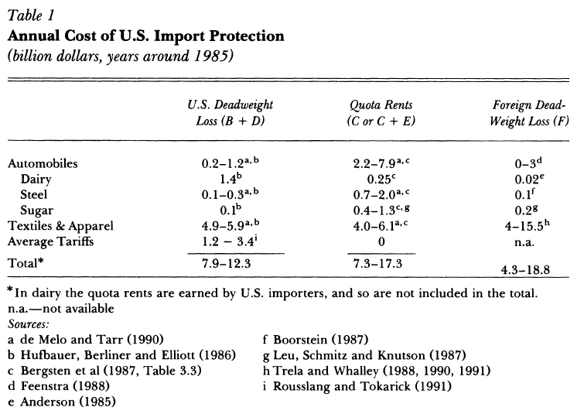
Notes:
Feenstra, Robert C., “How Costly Is Protectionism?” Journal of Economic Perspectives 6, Summer 1992, pp. 159-178

Slide 60
Pause for Discussion

Slide 61
  Questions on Feenstra,
  “How Costly Is Protectionism?”
How much more do consumers lose from protection than the country loses? Who gets the difference?
If foreign firms respond to a quota by “upgrading” their product, how can that be bad?
Why might foreign firms respond to protection by investing in the U.S.? What are the welfare effects if they do?

Slide 62
  Questions on Economist,
  “Buying local”
Why is buying local seen as “sensible – wholesome even”?
Why does the Economist disagree?
Is the use of buy-local rules becoming more common?
What are some examples of these rules that have been used? article disagree?

