Slide 1
Class 14
Why Countries Restrict Trade by
Alan V. Deardorff
University of Michigan
2024
PubPol/Econ 541

Slide 2
Pause for News

Slide 3
Announcements
Note that Paper 2 is due Nov 6. Confer with your team soon and look at the assignment, so that you can ask any questions.

Slide 4
Outline
Multiple reasons
Second best use of tariffs
Political economy
Why are trade barriers so low?
Recent uses of protection

Slide 5
Pause for Discussion

Slide 6
  Questions on KOM
What benefits from free trade are not captured in the partial equilibrium model?
The textbook mentions only two arguments against free trade: terms of trade and market failure. Can you think of others?

Slide 7
Outline
Multiple reasons
Second best use of tariffs
Political economy
Why are trade barriers so low?
Recent uses of protection

Slide 8
Multiple Reasons
See my Glossary:
    Lists: Arguments for Protection
    I list 26, and our examples later suggest more

Slide 9
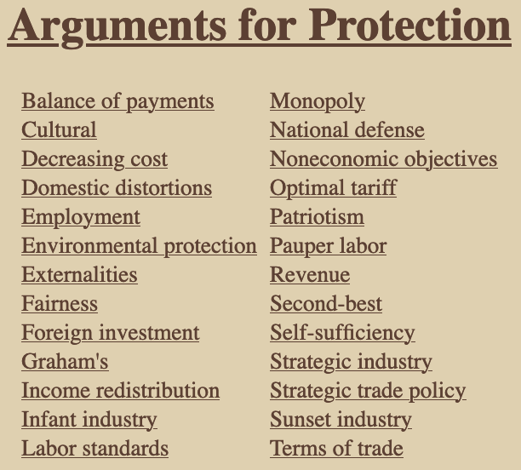

Slide 10
Multiple Reasons
Details on just a few
  Cultural: Sustain a distinctive culture that would be undermined by imports
  Foreign investment: Use tariff to induce foreign companies to invest instead of export
  Infant industry: Let new industry “learn by doing” behind tariff wall
  Patriotism: Support our own producers

Slide 11
Pause for Discussion

Slide 12
  Questions (not asked before)
Which of these seem to have motivated Trump’s tariffs?
  From his presidency?
  From his current plans
Do any of these seem to have motivated Biden’s tariffs?
Which look like they may be legal under GATT/WTO?

Slide 13
Outline
Multiple reasons
Second best use of tariffs
Political economy
Why are trade barriers so low?
Recent uses of protection

Slide 14
Second best use of tariffs
First, why do economists expect undistorted markets to do well?
  In general, the recipe for maximizing benefit net of cost is to increase any useful activity up to the point that
    Marginal Benefit equals Marginal Cost
  To the extent that
      Supply curves measure marginal cost (MC), and
      Demand curves measure marginal benefit (MB),
    Then market price equates these
    And maximize net benefit

Slide 15
Second best use of tariffs
But what if the curves don’t measure these?
  Then we say there are “distortions” and market price is not optimal.
  The harm done by a tariff is an example of this.

Slide 16
Second best use of tariffs
Our model says tariffs hurt if all else is perfect. What if there are
  Market failures?
  Distortions?
  Externalities?
  Imperfect competition?
  Etc.

Slide 17
Second best use of tariffs
Answer
  A tariff can offset some distortions and therefore may raise welfare
  But there is always another policy that will do better
    Reason: A tariff creates two distortions (see our triangles of dead-weight loss)
    One may offset a distortion, but the other makes things worse
  Hence tariff is “second best”

Slide 18
Second best use of tariffs
Example
  Suppose production yields a “positive externality”
    Production provides a benefit not captured (or charged for) by producers
  A tariff stimulates production and so generates more of the externality – That’s good!
  For example, European farms make countryside attractive to tourists

Slide 19
Small country with positive externality
P
S
= Marginal cost of firms
= Marginal private cost
P_{aut}
MC–E = MSC
This is the marginal social cost of the good.
That is, the marginal cost to society, not just to the firm.
P₀=P_{W}
D
E
S₀
D₀
Q
Positive Externality, E

Slide 20
Small country tariff with positive externality
P
Welfare effects of a tariff, if set equal to E, starting from free trade:
  Suppliers gain +a
  Demanders lose −(a+b+c+d)
  Government gains +c
  Externality benefit +(b+e)
  Country gain or loss +e −d
S
P_{aut}
MC–E
P₁=P_{W}+t
t=E
a
c
b
d
P₀=P_{W}
e
D
E
S₀
S₁
D₁
D₀
Q
Specific Tariff t=E

Slide 21
Second best use of tariffs
Result
  Tariff raises welfare if e > d
  That is, if
    the benefit of increased externality exceeds
    the demand-distortion loss of the tariff

Slide 22
Second best use of tariffs
But there’s a better policy: subsidize supply:
  That leaves demanders facing world price
  Lets suppliers be paid P_{W}+E
Causes only one distortion, of supply, and
  That is beneficial because
    It corrects the distortion of the externality
    Without also distorting demand

Slide 23
Small country production subsidy with positive externality
P
Welfare effects of a subsidy, if set equal to E, starting from free trade
  Suppliers gain +a
  Demanders lose 0
  Government loses –(a+b)
  Externality benefit +(b+e)
  Country gains +e
S
P_{aut}
MC–E
s=E
a
c
b
d
P₀=P_{W}
e
D
E
But note that:
Tariff creates revenue
Subsidy costs the gov’t
S₀
S₁
D₁
D₀
Q
Production subsidy s=E

Slide 24
Second best use of tariffs
In general, most distortions (market failures) distort only supply or demand
A tariff can only correct one by hurting the other
A more direct policy – tax or subsidy on distorted behavior – will be “first best”
  Except for budget implications

Slide 25
Pause for Discussion

Slide 26
  Questions on KOM
How does the theory of the second best provide reasons that tariffs may be beneficial?
How does it also provide reasons why tariffs are not the best policy in such cases?

Slide 27
Outline
Multiple reasons
Second best use of tariffs
Political economy
Why are trade barriers so low?
Recent uses of protection

Slide 28
Political Economy of Tariffs
Explains policies based on features of the political process
  Allow for
    Voting
    Lobbying
    Other forms of political pressure by interest groups
  But also allow policymakers to care about economic well-being as in our models

Slide 29
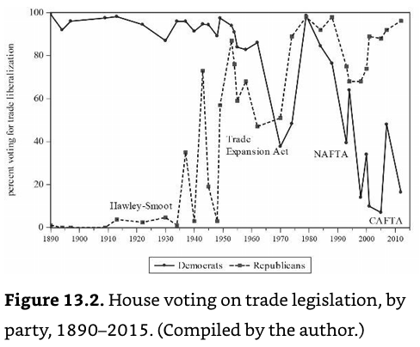
Democrats
Votes for freer trade
Republicans
Source: Irwin, p. 788
Notes:
Irwin, Doug, Clashing Over Commerce

Slide 30
Political Economy
Politics of tariffs in US 2024 election
  See Ponnuru
  Trump promises new tariffs
    “End our gaping trade deficits”
    “Bring back millions of American jobs”
    “Bring trillions and trillions of dollars pouring into the United States Treasury from foreign countries”
  Biden did not, but he was aggressive on other trade-related policies
    China policies
    IRA subsidy conditions
    Favors unions, who are protectionist
  Harris says little, but likely similar to Biden

Slide 31
Political Economy
Politics of tariffs in US 2024 election
  Trumps “tariffs have become an item of bipartisan consensus.”
  But public is more positive on trade than the politicians, and also more than they were 10 years ago
    “Gallup finds that Americans are more likely to consider trade an opportunity, and less likely to consider it a threat, than they were 10 years ago.”
    “That’s especially true among Democrats.”

Slide 32
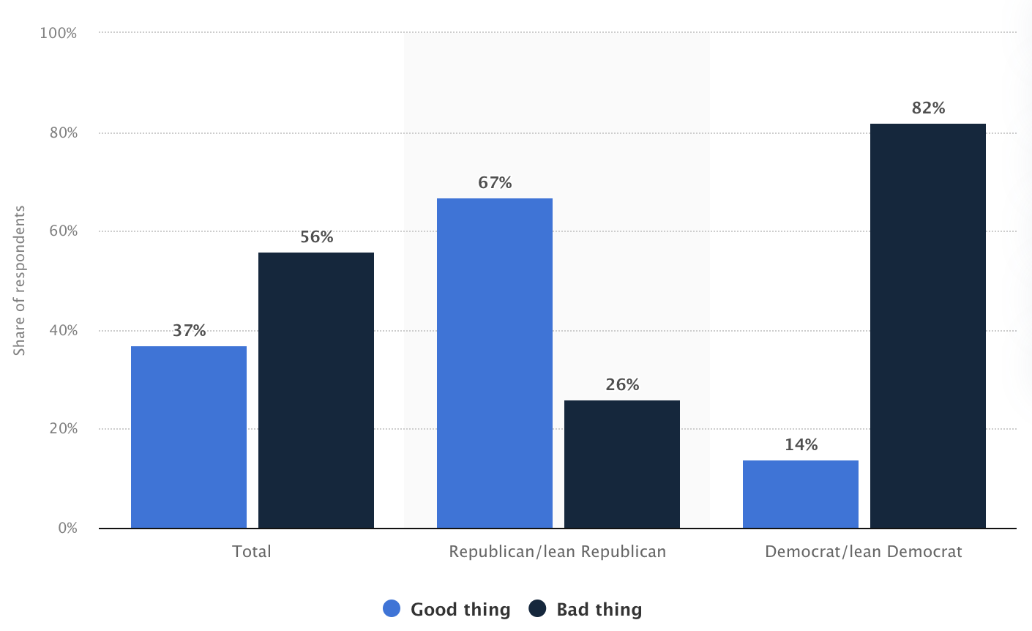
Share of people in the United States who think increased tariffs between the United States and its trading partners is a good thing for the country in 2019, by party
Notes:
https://www.statista.com/statistics/913391/share-americans-support-raising-tariffs-steel-aluminum-party/

Slide 33
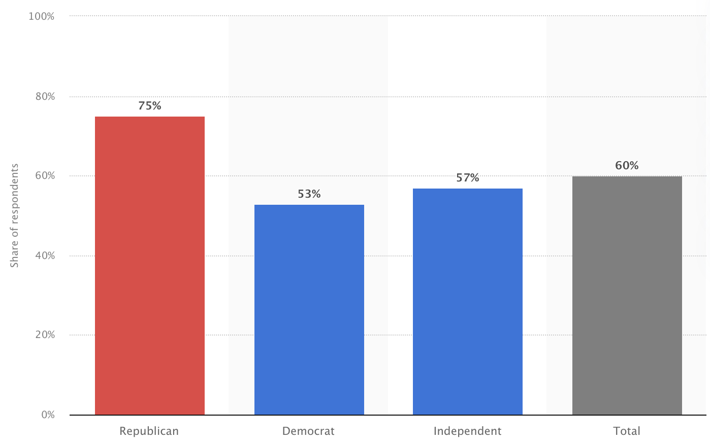
Share of Americans who think there should be tariffs imposed between the United States and its trading partners in 2021, by party
Notes:
https://www.statista.com/statistics/913391/share-americans-support-raising-tariffs-steel-aluminum-party/

Slide 34
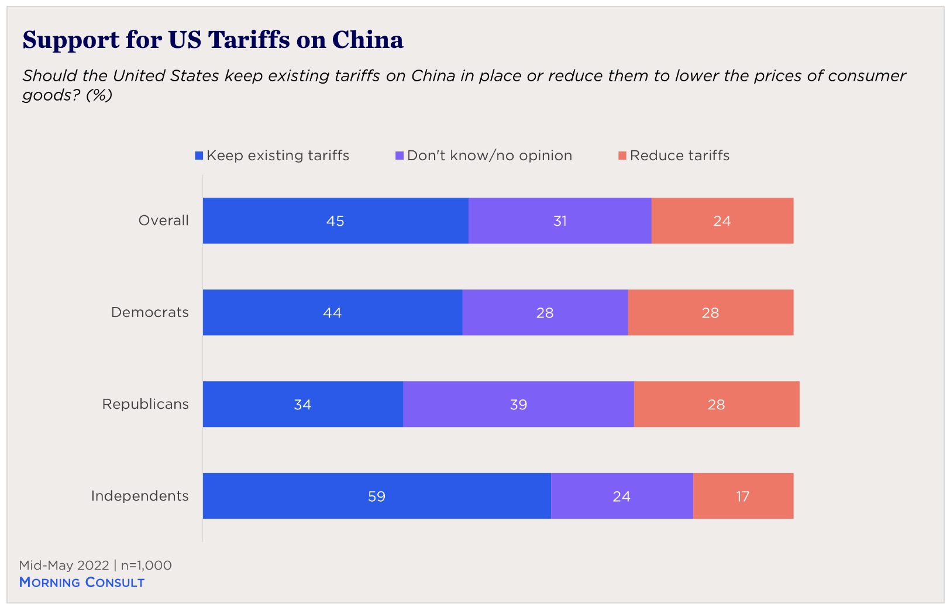
(from poll Mid-May 2022)
Notes:
Phillip Meng, “Free Trade with Exceptions: Public Opinion and Industrial Policy,” The Chicago Council on Global Affairs, January 25, 2023.
https://globalaffairs.org/commentary-and-analysis/blogs/free-trade-exceptions-public-opinion-and-industrial-policy

Slide 35
Pause for Discussion

Slide 36
  Questions on KOM
What is the “median voter theory,” and why does it seem not to explain protection?

Slide 37
  Questions on Baldwin & Magee “Is Trade Policy for Sale?”
By what mechanisms do theorists suggest that political contributions result in votes for and against trade liberalization?
Do businesses and labor groups in the US tend to contribute in favor of protection or free trade?
What were the three Congressional votes studied by Baldwin and Magee? Which side – labor or business – had the greater effect on the voting?

Slide 38
  Questions on Baldwin & Magee “Is Trade Policy for Sale?”
What do they estimate as the “price” of one congressional vote against NAFTA or the WTO?
Were campaign contributions the only thing that mattered for congressional votes on these trade issues?

Slide 39
  Questions on Ponnuru,
  “The Politics of Trade Favor …”
Does Trump promise more tariffs?
What does he claim tariffs will do?
  Why are two of his claims contradictory?
  And why are all proven wrong by experience?
Why do politicians favor tariffs?
Will there be lots of new tariffs?

Slide 40
Outline
Multiple reasons
Second best use of tariffs
Political economy
Why are trade barriers so low?
Recent uses of protection

Slide 41
Why Aren’t Tariffs Higher?
Magee lists 6 possible reasons why tariffs are not higher:
  Politicians are not responsive to lobbying efforts
  Welfare costs of tariffs are higher than traditionally measured
  The GATT was successful in reducing trade barriers
  Free riding by firms hinders lobby organization
  Users of imported goods lobby against tariffs
  Protection is given, but by non-tariff barriers, which are high
Magee’s view of the evidence
  #1, 5 not important
  #2, 3, 4 play a small role
  #6 is most important: actual protection is much higher than tariffs
✗
✓
✓
✓
✗
✓✓✓

Slide 42
Pause for Discussion

Slide 43
  Questions on Magee
  “Why Are Trade Barriers So Low?”
Does the main “political economy” model for explaining tariffs say that politicians care only about campaign contributions?
Why does Magee give only partial credit to GATT negotiations in explaining the fall of tariffs since the 1930s?

Slide 44
  Questions on Magee
  “Why Are Trade Barriers So Low?”
How do the following terms or concepts figure in explanations for why trade barriers are low:
  free riding;
  peace;
  imported inputs;
  non-tariff barriers?

Slide 45
Outline
Multiple reasons
Second best use of tariffs
Political economy
Why are trade barriers so low?
Recent uses of protection

Slide 46
Recent uses of protection
Some examples from earlier (not in this year’s readings):
  India considers tariffs on China after border conflict
  Pakistan to “halt trade with India” after actions on Kashmir
  Japan uses export controls on S Korea after Korea seeks compensation for forced labor in WWII
  US bars arms exports to Hong Kong after China reduces Hong Kong independence

Slide 47
Recent uses of protection
More from earlier:
  China puts tariffs on Australian barley after Australia seeks inquiry on origins of coronavirus.
  US may stop cocoa imports from Ivory Coast for using child labor.
  China blocked meat imports from Canada after Canada arrested daughter of Huawei founder.
  China had a ban (and has now lifted it) on US chicken due to outbreak of avian flu.

Slide 48
Recent uses of protection
From two years ago:
  US banned avocados from Mexico due to verbal threat made to US inspector in Mexico.
  US threatened tariffs on countries using a digital services tax.
  China suspended imports of many food products from Taiwan in response to Nancy Pelosi visit.

Slide 49
Recent uses of protection
From last year:
  Mexico banned GM corn
  India regulates imports of laptops
From this year:
  EU bans imports from areas with deforestation

Slide 50
Recent uses of protection
Message from much of this:
Countries often restrict trade to hurt other countries that they are angry at.

Slide 51
Pause for Discussion

Slide 52
  Questions on Krugman
  “Two Cheers for Carbon Tariffs”
Why would Krugman favor a carbon tariff even if it were as economically harmful as a tariff usually is?
Why does he discuss the economics of the value added tax?
A carbon tariff set equal to a domestic carbon tax makes sense, but what if the domestic policy is regulation, not tax?
Why does he give only two cheers, not the usual three?

