Slide 1
Class 23
Dumping and
Anti-Dumping Policy by
Alan V. Deardorff
University of Michigan
2024
PubPol/Econ 541

Slide 2
Announcements
Course Evaluations
  Please do them when they become available
Quiz:
 | Q9 | Q10 | Q11
Mean | 6.58 | 6.58 | 7.94
Median | 6.5 | 6.25 | 8.5
Max | 9.5 | 10 | 10
Min | 5 | 5 | 5
Standard deviation | 1.18 | 1.32 | 1.47

Slide 3
Pause for Discussion

Slide 4
  Questions on Jackson
Under what circumstances are imports regarded as “dumped”?
What is the “dumping margin”?

Slide 5
Dumping and Anti-Dumping
Dumping is defined as exporting for a price below a “fair price,” defined as
  EITHER
  What the exporter charges in its home market,
  OR
  Cost
Anti-dumping duties (ADD) are permitted by the GATT/WTO if set equal to (or below)
  The dumping margin: the difference between fair price and the export price

Slide 6
Outline
Why firms dump
  Predation? No
  Protected home market
  Interface problem
  Other reasons
Procedures and data
Anti-dumping issues
Economic effects of anti-dumping duties

Slide 7
Outline
Why firms dump
  Predation? No
  Protected home market
  Interface problem
  Other reasons
Procedures and data
Anti-dumping issues
Economic effects of anti-dumping duties

Slide 8
Predation
Defined as selling at low price in order to
  Drive competitors out of business
  AND THEN
  Charge monopoly price

Slide 9
Predation
Does predation happen?
  Within economies yes. (e.g., Microsoft Explorer)
  Internationally? Rarely if ever
    Dumping is usually alleged against multiple firms and sometimes multiple countries
    Later monopoly pricing is therefore very unlikely

Slide 10
Outline
Why firms dump
  Predation? No
  Protected home market
  Interface problem
  Other reasons
Procedures and data
Anti-dumping issues
Economic effects of anti-dumping duties

Slide 11
Protected Home Market
Does a tariff cause dumping?
  It raises the home price above the world price
  If home firm also exports at the world price, then that would be dumping
  But with perfect competition, no home firm would export, since it gets a higher price at home.
So a protected home market only causes dumping with imperfect competition
We’ll look at a case of a single home firm, thus a monopoly in the home market

Slide 12
Marginal Revenue of a Monopoly protected by a Tariff
The usual MR curve for a monopolist in a closed economy is is mostly not relevant for a firm facing
  a world price P_{W} at which it can export and
  an upper limit P_{W}+t on what it can charge in the home market.
MRT (marginal revenue in presence of a tariff) is
  P_{W}+t for sales up to Q₁
  MR for sales between Q₁ and Q₂ (sales along demand curve)
  P_{W} for sales above Q₂ (exports above Q₃)
P
MRT
P_{W}+t
MRT
MRT
P_{W}
D
MR
Q₁
Q₂
Q₃
Q

Slide 13
Recall Monopoly with Tariff
P
Here the world price is low enough that the monopolist does not export.
It can sell up to D_{T} at price P_{W}+t, so that is its marginal revenue. Equating that to MC, it produces only Q_{T} and demanders import the rest.
It is not exporting, and therefore not dumping.
MC
P_{M}
MRT
P_{W}+t
P_{W}
D
MR
Q_{F}
Q_{M}
Q_{T}
D_{T}
D_{F}
Q
M_{T}

Slide 14
Monopoly with Small Tariff
P
But suppose P_{W} is higher
Again the firm can sell up to D_{T} at price P_{W}+t,
But now it can also sell more at price P_{W} which is above its MC. Its marginal revenue from exporting is P_{W}, so it produces Q_{T} where P_{W}=MC
It is charging P_{W}+t at home and P_{W} abroad, so it is dumping.
MC
P_{M}
P_{W}+t
P_{W}
MRT
D
MR
Q_{F}
Q_{M}
D_{T}
Q_{T}
Q
X_{T}
= Dumped exports

Slide 15
Monopoly with Medium Tariff
P
With a somewhat higher tariff, the firm charges an even higher price at home, sells less there but exports more.
Again it is charging P_{W}+t at home and P_{W} abroad, so it is dumping.
Note that it is now selling domestically at more than the closed-economy monopoly price.
P_{W}+t
MC
P_{M}
P_{W}
MRT
D
MR
Q_{F}
D_{T}
Q_{M}
Q_{T}
Q
X_{T}
= Dumped exports

Slide 16
Monopoly with High Tariff
P
With an even higher tariff, the firm would lose profit if it charged P_{W}+t at home.
Instead it charges P_{Mt} equating marginal revenue to marginal cost.
But the relevant marginal cost for sales at home is not MC, but rather P_{W}, since that is the opportunity cost of selling at home instead of exporting.
Again it is charging P_{Mt} at home and P_{W} abroad, so it is dumping.
P_{W}+t
P_{Mt}
MC
P_{M}
P_{W}
MRT
D
MR
Q_{F}
D_{T}
Q_{M}
Q_{T}
Q
X_{T}
= Dumped exports

Slide 17
Pause for Discussion

Slide 18
  Questions (not asked before)
Why will a tariff not cause dumping (by price definition) if markets are perfectly competitive?
If dumping is due to a protected home market, to what extent is it harmful to the
  Importing country?
  Exporting country?

Slide 19
Outline
Why firms dump
  Predation? No
  Protected home market
  Interface problem
  Other reasons
Procedures and data
Anti-dumping issues
Economic effects of anti-dumping duties

Slide 20
The Interface Problem
Countries with different cultures and institutions may encounter frictions at the border as a result.
Example from the Jackson text:
    Japan: Worker tenure; mostly debt financing
    US: No worker tenure; more equity financing
  Leads to differences in fixed costs (F) and variable costs (V), even when total costs are same

Slide 21
The Interface Problem
Costs |  | Japan |  | US
 |  | F | V | F | V
 | Plant | 20 |  | 20
 | Debt service | 90 |  | 50
 | Dividends |  | 10 |  | 50
 | Labor | 240 |  |  | 240
 | Materials |  | 240 |  | 240
Total cost |  | 600 |  | 600
 | Fixed | 350 |  | 70
 | Variable |  | 250 |  | 530
100

Slide 22
The Interface Problem
Costs |  | Japan |  | US
 |  | F | V | F | V
 | Plant | 20 |  | 20
 | Debt service | 90 |  | 50
 | Dividends |  | 10 |  | 50
 | Labor | 240 |  |  | 240
 | Materials |  | 240 |  | 240
Total cost |  | 600 |  | 600
 | Fixed | 350 |  | 70
 | Variable |  | 250 |  | 530
100
At prices 250<P<530: Japan produces; US shuts down
To US, looks like P<MC

Slide 23
The Interface Problem
Japan-US
  Differences in normal behavior lead naturally to conflict and misunderstanding
  This was Jackson’s example

Slide 24
The Interface Problem
China-Other
  China’s political system differs from the democracies of other major traders
    Much greater use of state-owned firms
    Communist Party plays a role even in private firms
  Others see subsidies where China sees national interest

Slide 25
The Interface Problem
EU-US
  Recall semiconductor conflict
    EU
      Has carbon price and carbon tariff to encourage green production
      Bans subsidies by member nations
    US
      No carbon tax, as it is not politically viable
      Prefers subsidies for green production

Slide 26
Outline
Why firms dump
  Predation? No
  Protected home market
  Interface problem
  Other reasons
Procedures and data
Anti-dumping issues
Economic effects of anti-dumping duties

Slide 27
Other Reasons for Dumping
Below-average-cost dumping
  Temporary weak demand (recession)
  World excess supply
Below-marginal-cost dumping
  Producer learning
  Consumer learning
Other thoughts?

Slide 28
Pause for Discussion

Slide 29
  Questions on Deardorff, (“Economic Perspectives…”)
Why might an exporter dump, based on the below-cost definition? Who is harmed in these cases (answer may depend on which of several reasons apply)?
How common is “predatory dumping”, and why?

Slide 30
Outline
Why firms dump
  Predation? No
  Protected home market
  Interface problem
  Other reasons
Procedures and data
Anti-dumping issues
Economic effects of anti-dumping duties

Slide 31
US Procedures for ADD
File in both Commerce (ITA) and USITC
< 45 days: Preliminary injury determination by USITC
< 160 days: Preliminary dumping margin by ITA
(if yes, action at the border)
< 235 days: Final margin
< 280 Days: Final injury
Throughout: Settlement is possible!
Notes:
https://www.trade.gov/statutory-time-frame-adcvd-investigations

Slide 32
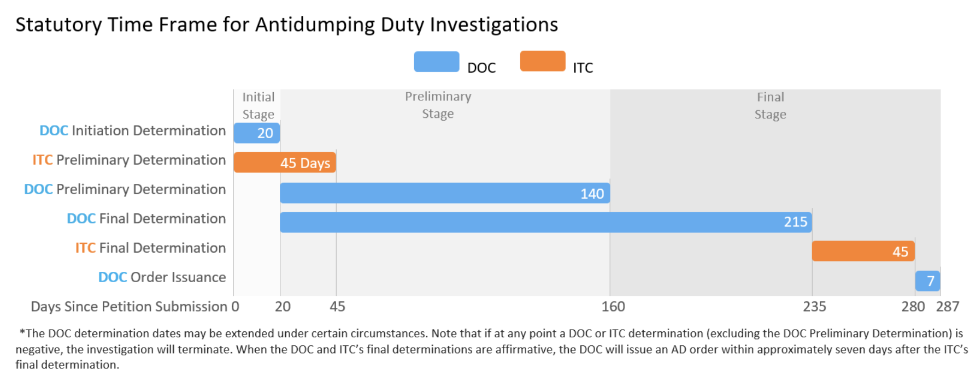
Notes:
https://www.trade.gov/statutory-time-frame-adcvd-investigations

Slide 33
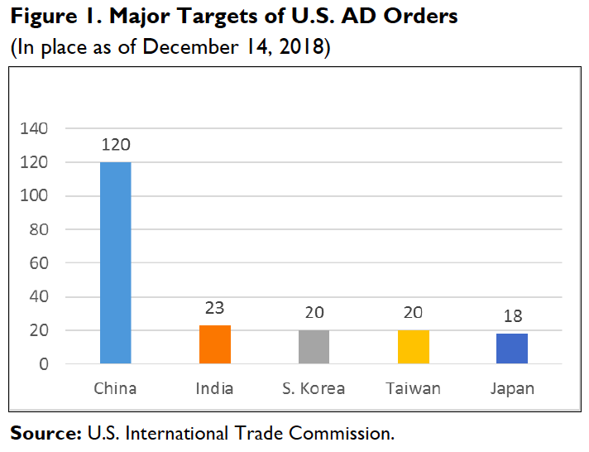
Notes:
Morrison, Wayne M., “China’s Status as a Nonmarket Economy (NME),” In Focus, Congressional Research Service, updated January 10, 2019.
https://www.google.com/url?sa=t&rct=j&q=&esrc=s&source=web&cd=12&ved=2ahUKEwjnjMbC-p7kAhVQI6wKHXeyBQAQFjALegQIABAC&url=https%3A%2F%2Ffas.org%2Fsgp%2Fcrs%2Frow%2FIF10385.pdf&usg=AOvVaw3spsQhEn0dqvQIFOq86KAD

Slide 34
Source: WTO
Notes:
https://www.wto.org/english/tratop_e/adp_e/adp_e.htm

Slide 35
Top targets of anti-dumping investigations, 1995-2019
 | Exporter
1 | China | 1392
2 | Korea, Republic of | 447
3 | Chinese Taipei | 315
4 | United States | 298
5 | India | 241
6 | Thailand | 238
7 | Japan | 230
8 | Indonesia | 218
9 | Russian Federation | 173
10 | Malaysia | 165
11 | Brazil | 159
12 | European Union | 133
13 | Germany | 119
14 | Turkey | 103
15 | Ukraine | 94
Source: WTO
Notes:
https://www.wto.org/english/tratop_e/adp_e/adp_e.htm

Slide 36
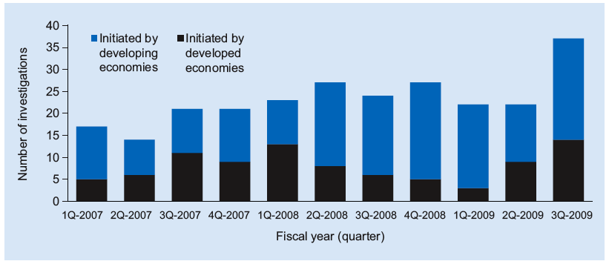
Newly Initiated Antidumping Investigations, 1Q 2007–3Q 2009
Source: Global Antidumping Database.
Notes:
Source: “The Pattern of Antidumping and Other Types of Contingent Protection,” Chad Bown, PREMNotes #144, World Bank, October 2009.

Slide 37
Outline
Why firms dump
  Predation? No
  Protected home market
  Interface problem
  Other reasons
Procedures and data
Anti-dumping issues
Economic effects of anti-dumping duties

Slide 38
Anti-Dumping Issues
Cumulation
Margins analysis
Lesser-Duty Rule
Nonmarket economies

Slide 39
Pause for Discussion

Slide 40
  Questions on Jackson
Does “cumulation” make it more or less likely that a country whose exports are dumped will face an anti-dumping duty?
Does “margins analysis” make it more or less likely that a country whose exports are dumped will face an anti-dumping duty?

Slide 41
Anti-Dumping Issues
Cumulation
Margins analysis
Lesser-Duty Rule
Nonmarket economies

Slide 42
Pause for Discussion

Slide 43
  Questions on Jackson
What is the level of the injury test in dumping cases?
If dumping and injury are both found, what determines the size of the anti-dumping duty? Must it then be applied? Are the rules any different in the EU than in the US?

Slide 44
  Questions on Jackson (cont.)
What is the “lesser-duty rule”? In what countries is it applied, and in what countries is it not applied?
Suppose an anti-dumping duty will cause harm to some in an economy that is greater than the benefit to the protected industry.
  Can authorities therefore choose not levy the duty?
  For those who can decline to levy the duty, what must be true in order for them to do so?

Slide 45
  Questions on EC, DG-Trade
Who decides on anti-dumping in the EU?
Do the criteria for anti-dumping measures differ from those of the US?
What forms do EU anti-dumping measures take, and for how long?
What is the size of an anti-dumping duty in the EU?

Slide 46
  Questions on Jakob,
  “Lesser Duty Rule…”
What does Jakob view as “fair competition”?
What is the “lesser-duty rule”?
  In what countries is it applied, and in what countries is it not applied?
  In those that apply it, how often has the smaller injury margin been used?
In what countries can an anti-dumping duty be denied based on other interests of the country?
  What is the “proportionality test” for this?

Slide 47
Anti-Dumping Issues
Cumulation
Margins analysis
Lesser-Duty Rule
Nonmarket economies

Slide 48
Nonmarket-economy status
In most cases, the ”fair price” is found from the exporting country’s own market
  The price of the good, or
  The cost of producing it there
If exporter is a “nonmarket economy” then those prices are not meaningful
  Instead, fair price may be inferred from data of an otherwise comparable market economy
  This typically finds a much higher price and therefore a
    Larger dumping margin
    Larger anti-dumping duty
This was contentious when China objected to being labelled as nonmarket, but they lost their case in WTO

Slide 49
Pause for Discussion

Slide 50
  Questions on Hayashi,
  “U.S. Downgrades Russia…”
Can you tell from this why nonmarket status is important?
Why is the change unlikely to have much effect on Russia-US trade right now?
On what basis does the US justify this change?
What other countries have nonmarket status in the US?
How many countries, other than Russia, have been moved from market status to nonmarket status?

Slide 51
  Questions on Leahy et al.,
  “China launches anti-dumping …”
Did the pork producers in China request this investigation?
What is presumed to be the motive for this investigation, according to this?
What evidence is mentioned here that EU pork was being dumped in China?
Will the EU tariffs on Chinese EVs necessarily go into effect?
Are other anti-dumping cases mentioned here?
Though it is not mentioned here, does it look like China could have instead used a safeguards tariff?

Slide 52
Outline
Why firms dump
  Predation? No
  Protected home market
  Interface problem
  Other reasons
Procedures and data
Anti-dumping issues
Economic Effects of ADD

Slide 53
Economic Effects of ADD
Effects of an Anti-Dumping duty depend on how the dumping firm responds
  It may keep its exporting price unchanged
  It may readjust its prices in the presence of the duty
  It may not dump (perhaps to forestall the ADD): change its pricing policy to charge the same price in both markets
      Note that this may happen even without dumping ever being alleged

Slide 54
Effects of ADD
Model
  Single firm at home (thus monopoly in autarky)
  Faces downward sloping demand from abroad
  Protected by prohibitive tariff, so that it can charge a lower price for export than at home
  Uses monopoly pricing (MC=MR) in both markets separately
  Assumes firm’s marginal cost is constant and same for both markets

Slide 55
Dumping Equilibrium
Cty A
Dom Mkt
Cty B
MD
Cty B
Dom Mkt
P
P
P
S^{B}
P^{Baut}
P₁^{A}
P^{Baut}
P₁^{B}
MR^{A}
D^{A}
P₁^{B}
MD^{B}
MC
D^{B}
MR^{B}
Q
Q
Q
Consider an equilibrium with a single firm at home (A) that can also export to a foreign market, B, whose home supply and demand lead to the import demand curve MD^{B} shown
Assume Country A’s domestic market is protected by a prohibitive tariff
As drawn, P₁^{A} > P₁^{B} so the firm is dumping

Slide 56
1. ADD Effects with unchanged export price
Cty A
Dom Mkt
Cty B
MD
Cty B
Dom Mkt
P
P
P
S^{B}
P^{Baut}
P₁^{A}
P^{Baut}
ADD=t
P₂^{B}
MR^{A}
D^{A}
P₁^{B}
P₁^{B}
MD^{B}
MC
D^{B}
MR^{B}
Q
Q
Q
With P₁^{B} fixed, ADD raises price to demanders like any other tariff, and imports fall
Note welfare effects

Slide 57
1. ADD Effects with unchanged export price
Cty A
Dom Mkt
Cty B
MD
Cty B
Dom Mkt
P
P
P
S^{B}
P^{Baut}
P₁^{A}
P^{Baut}
ADD=t
P₂^{B}
a
c
b
d
MR^{A}
D^{A}
P₁^{B}
f
P₁^{B}
e
MD^{B}
MC
D^{B}
MR^{B}
Q
Q
Q
Welfare Effects of ADD in Dumping Country, A’s firm:
Lost profit –(e+f)
Cty B –(e+f)
Welfare Effects of ADD in Importing Country, B:
Suppliers gain +a
Demanders lose –(a+b+c+d)
A’s gov’t +c
Cty A –(b+d)

Slide 58
2. ADD Effects with changed export price
Cty A
Dom Mkt
Cty B
MD
Cty B
Dom Mkt
P
P
P
S^{B}
P^{Baut}
P₁^{A}
P^{Baut}
ADD
MR^{A}
P₁^{B}
P₁^{B}
D^{A}
MD^{B}
MC
D^{B}
MR^{B}
Q
Q
Q
If P₁^{A} and P₁^{B} can readjust, P₁^{A} will not change

Slide 59
2. ADD Effects with changed export price
Cty A
Dom Mkt
Cty B
MD
Cty B
Dom Mkt
P
P
P
S^{B}
P₁^{A}
ADD
P₂^{B} + t
MR^{A}
P₂^{B}
P₁^{B}
D^{A}
MC
MR^{B}
Q
Note welfare effects
Q
Q
MR^{B} – t
MD^{B} – t
If P₁^{A} and P₁^{B} can readjust, P₁^{A} will not change
ADD, set equal to P₁^{A} – P₁^{B}, acts as downward shift in demand (and MR) for the exporting firm
Effect is to lower export price but by less than tariff

Slide 60
2. ADD Effects with changed export price
Cty A
Dom Mkt
Cty B
MD
Cty B
Dom Mkt
P
P
P
S^{B}
P^{Baut}
P₁^{A}
ADD
g
P₂^{B} + t
a
c
P₂^{B}
P₁^{B}
e
MR^{A}
D^{A}
f
MD^{B}
MC
i
b
d
h
D^{B}
MR^{B}
Q
Q
Q
MR^{B} – t
MD^{B} – t
Welfare Effects of ADD in Dumping Country, A’s firm:
Lost profit on lost sales –(f+g)
Lost profit on kept sales –(h+i)
Cty B (firm) –(f+g+h+i)
Welfare Effects of ADD in Importing Country, B:
Suppliers gain +a
Demanders lose –(a+b+c+d)
A’s gov’t +(c+e)
Cty A e–(b+d)
Net gain if e > (b+d)

Slide 61
2. ADD Effects with changed export price
Cty A
Dom Mkt
Cty B
MD
Cty B
Dom Mkt
P
P
P
S^{B}
P^{Baut}
P₁^{A}
ADD
g
P₂^{B}
a
c
P₂^{B}
P₁^{B}
e
MR^{A}
D^{A}
f
MD^{B}
MC
i
b
d
h
D^{B}
MR^{B}
Q
Q
Q
MR^{B} – t
MD^{B} – t
Welfare Effects of ADD for world:
Note that (h+i) = e
So world loses (f+g) + (b+d)
Welfare Effects of ADD in Dumping Country, A’s firm:
Lost profit on lost sales –(f+g)
Lost profit on kept sales –(h+i)
Cty B (firm) –(f+g+h+i)
Welfare Effects of ADD in Importing Country, B:
Suppliers gain +a
Demanders lose –(a+b+c+d)
A’s gov’t +(c+e)
Cty A e–(b+d)
Net gain if e > (b+d)

Slide 62
3. Not-Dumping Equilibrium
Cty A
Dom Mkt
Cty B
MD
Cty B
Dom Mkt
P
P
P
S^{B}
P₁^{A}
D^{A}+MD^{B}
P₂
P₂
P₁^{B}
MR^{A}
D^{A}
P₁^{B}
MD^{B}
MC
D^{B}
MR^{A+B}
Q
Q
Q
Now firm combines the two markets, now facing single demand curve D^{A}+MD^{B}
Corresponding MR curve, MR^{A+B},
Determines price P₂ charged in both markets
Result: Price falls at home and rises abroad
Note welfare effects

Slide 63
3. Not-Dumping Equilibrium
Cty A
Dom Mkt
Cty B
MD
Cty B
Dom Mkt
P
P
P
S^{B}
e
P₁^{A}
D^{A}+MD^{B}
P₂
P₂
P₁^{B}
a
c
MR^{A}
D^{A}
P₁^{B}
MD^{B}
b
d
MC
D^{B}
MR^{A+B}
Q
Q
Q
Welfare Effects of No-Dumping in Exporting Country, A:
Demanders gain e
Firm loses ?
Cty A ?
Welfare Effects of No-Dumping in Importing Country, B:
Suppliers gain +a
Demanders lose –(a+b+c+d)
Cty A –(b+c+d)

Slide 64
Summary of ADD Effects
If export price unchanged
  Exporter sells less and loses profit
  Importer has same effects as usual small-country tariff
    Suppliers gain
    Demanders lose
    Government gains
    Dead-weight loss

Slide 65
Summary of ADD Effects
If exporter resets price to maximize profit (and ADD is unchanged)
  Exporter lowers price, but by less than tariff
  Exporter loses profit, but loses less than if price unchanged
  Importer has same effects as usual large-country tariff
    Suppliers gain, demanders lose, government gains
    Country may gain
    Terms of trade improves

Slide 66
Summary of ADD Effects
If exporter sets a single price for home and exporter (so as not to dump)
  Home price falls, export price rises
  Exporter profit falls
  Importing country does not use tariff (ADD)
  Importing country welfare:
    Suppliers gain
    Demanders lose more
    Government gains nothing
    Terms of trade worsens

Slide 67
Pause for Discussion

Slide 68
  Questions (Not asked before)
Of the three cases considered here, which seems most likely to you?
  No change in dumper’s prices
  Dumper’s export price changes
  Dumper changes both prices in order not to dump
Might the dumper simply raise the export price to equal its home price?

