Slide 1
Class 24
Economic Sanctions by
Alan V. Deardorff
University of Michigan
2024
PubPol/Econ 541

Slide 2
Pause for News

Slide 3
Announcements
Quiz 12
  Due Friday midnight, Dec 6 as always
  Covers Dumping only
Quiz 13
  Due a week from this Friday, Dec 13
  Will cover today (Sanctions) and Wednesday (Subsidies)
Note that I’ll only count your best 10 quizzes

Slide 4
Announcements
Last class: Monday Dec 9
  No assignments
  I’ll present my recent talk on Trump and Tariffs
  Plus any Q&A from you
Paper 3
  Your assigned group picks (already picked, I hope) topic
  Due next Wednesday, December11, 8:30 AM

Slide 5
Outline
What are sanctions?
Who has used them, and why?
What effects do they have?
Do they work?
Effects of Russia sanctions

Slide 6
What economic sanctions are
From my Glossary:
  Sanctions are “coercive measures used by a nation or group of nations against another as a penalty for violating international law or international norms”
  Most apply to economic transactions or assets, and thus are “economic sanctions”
From Masters:
  “the withdrawal of customary trade and financial relations for foreign- and security-policy purposes”

Slide 7
What economic sanctions are
Types of sanctions
  Primary: When a a government prohibits its own people and firms from doing business with a target country
  Secondary: When a a government prohibits people and firms of third countries from doing business with a target country
    Also called “extraterritorial”.
    US uses these, but many governments object to these
  Smart: sanctions that “aim to minimize the suffering of innocent civilians”

Slide 8
What economic sanctions are
Forms of sanctions (per Masters)
  *Travel bans
  *Asset freezes
  *Arms embargoes
  Capital restraints
  Foreign aid reductions
  Trade restrictions
Other forms (per Haass)
  Negative votes in international financial institutions
  Withdrawal of diplomatic relations
  Visa denials
  Cancellation of air links
  *Most common types of UN sanctions, per Masters (2019)
Notes:
Masters, Jonathan, “What Are Economic Sanctions?” Backgrounder, Council on Foreign Relations, August 12, 2019. 12 pp.
https://www.cfr.org/backgrounder/what-are-economic-sanctions

Slide 9
What economic sanctions are
Purposes of sanctions (per Masters)
  counterterrorism,
  counternarcotics,
  nonproliferation,
  democracy and human rights promotion,
  conflict resolution, and
  cybersecurity.
Other purposes (per Haass)
  Discourage WMDs
  Thwart drug trafficking
  Discourage armed aggression
  Promote market access
  Protect environment
  Replace governments
Notes:
Masters, Jonathan, “What Are Economic Sanctions?” Backgrounder, Council on Foreign Relations, August 12, 2019. 12 pp.
https://www.cfr.org/backgrounder/what-are-economic-sanctions

Slide 10
Sanctions Regimes
Masters (2019) identifies 3 regimes of sanctions:
  United Nations
    Decided by Security Council
  European Union (but called “restrictive measures”)
    Requires unanimous consent by member states
    Member states are free to impose harsher ones
  United States
    Originate in either executive or legislative branch
    “US uses [them] more than any other country”
Notes:
Masters, Jonathan, “What Are Economic Sanctions?” Backgrounder, Council on Foreign Relations, August 12, 2019. 12 pp.
https://www.cfr.org/backgrounder/what-are-economic-sanctions

Slide 11
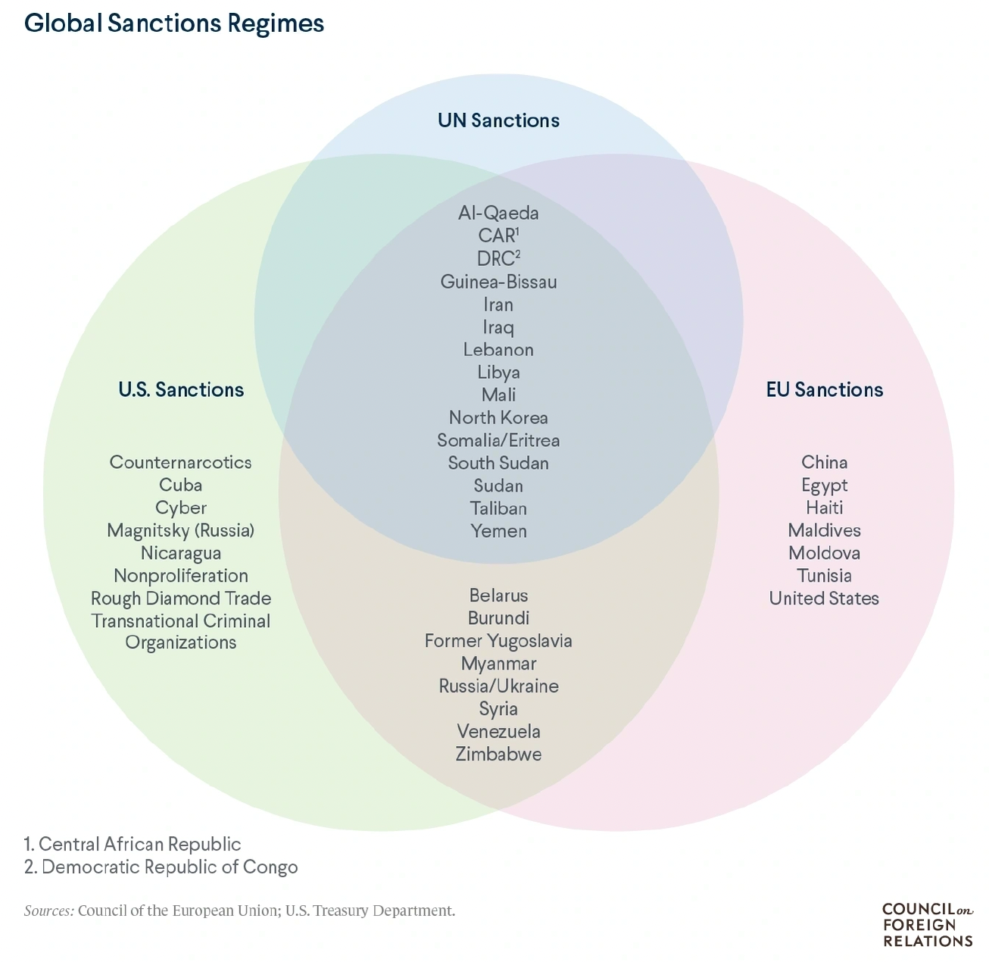
Source: Masters (2019)
Notes:
Masters, Jonathan, “What Are Economic Sanctions?” Backgrounder, Council on Foreign Relations, August 12, 2019. 12 pp.
https://www.cfr.org/backgrounder/what-are-economic-sanctions

Slide 12
Sanctions Regimes
Sanctions used by others
  China on
    Australia 2020
    Lithuania 2021
    Taiwan 2022

Slide 13
Pause for Discussion

Slide 14
  Questions on Masters, “What Are Economic Sanctions?
Are trade restrictions among the most used forms of sanctions by the UN?
Does this say that sanctions work?
Why is the US best positioned to use sanctions, and why might their use undermine that position?

Slide 15
  Questions on Haass,
  “Too Much of a Bad Thing”
Why are economic sanctions so popular?
Overall, does Haass favor the use of sanctions?
He argues for comparing costs and benefits with those of alternatives. What alternatives does he mention?

Slide 16
Sanctions History
After World War I:
  Sanctions were envisioned as alternative to war
  League of Nations tried to oversee their use
  Used in 1935 against Mussolini’s invasion of Ethiopia by Italy
    Sanctions implemented by 52 states, but not by US and Germany
    Failed to stop Italy’s conquest of Ethiopia
  Used against Japan 1939-41, prompting attack on
    European colonies in Southeast Asia
    US (Pearl Harbor)
Notes:
Mulder, Nicholas, “The Sanctions Weapon,” Finance and Development, June 2022, pp. 20-23. 4 pp.
https://www.imf.org/en/Publications/fandd/issues/2022/06/the-sanctions-weapon-mulder

Slide 17
Sanctions History
After World War II:
  UN and Western sanctions against Rhodesia (now Zimbabwe)
  UN against apartheid-era South Africa
  US against Cuba and Iran
Notes:
Mulder, Nicholas, “The Sanctions Weapon,” Finance and Development, June 2022, pp. 20-23. 4 pp.
https://www.imf.org/en/Publications/fandd/issues/2022/06/the-sanctions-weapon-mulder

Slide 18
Do Sanctions Work?
Elliott [optional reading]
  Writing in 1997, she reports that US sanctions since 1970 have
    Achieved foreign policy objectives only 13% of the time\
    Cost US $15-19 billion annually in potential exports
    Cost >200,000 jobs in (high-wage) export sector
  Conclusion: “unilateral economic sanctions are decreasingly useful yet increasingly costly”

Slide 19
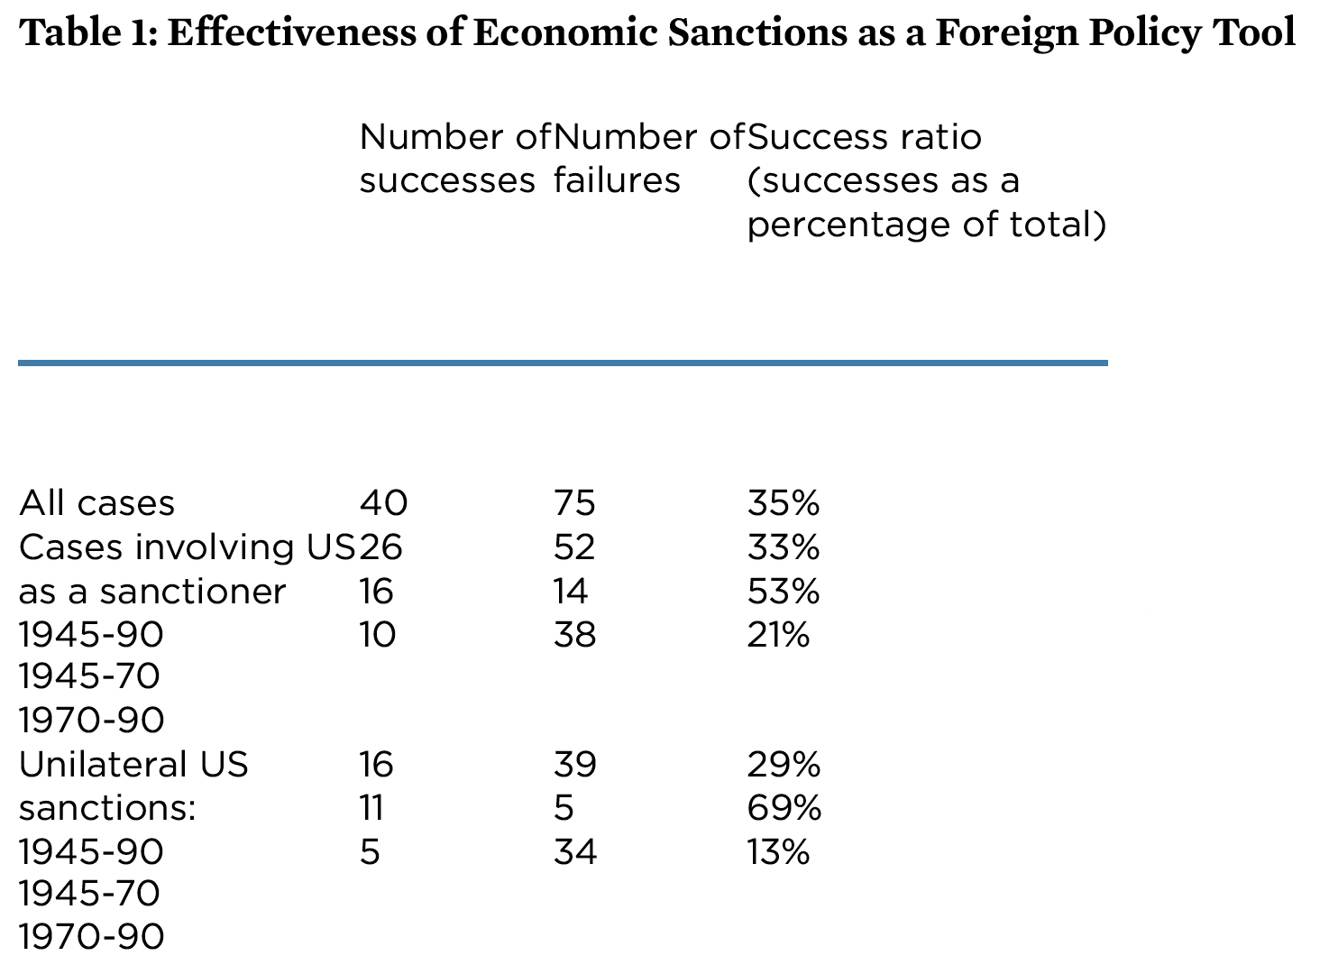
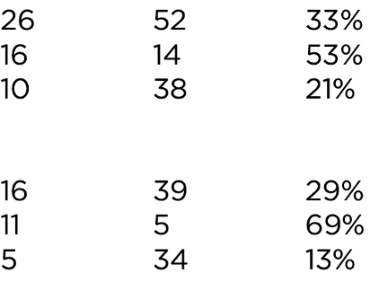
Source: Elliott (1997)
Notes:
Elliott, Kimberly Ann, “Evidence on the Costs and Benefits of Economic Sanctions,” Speech given before the Subcommittee on Trade Committee on Ways and Means United States House of Representatives Washington, DC, October 23, 1997, Peterson Institute for International Economics. 6 pp.
https://www.piie.com/commentary/testimonies/evidence-costs-and-benefits-economic-sanctions
[Original had data too high. I moved it down.]

Slide 20
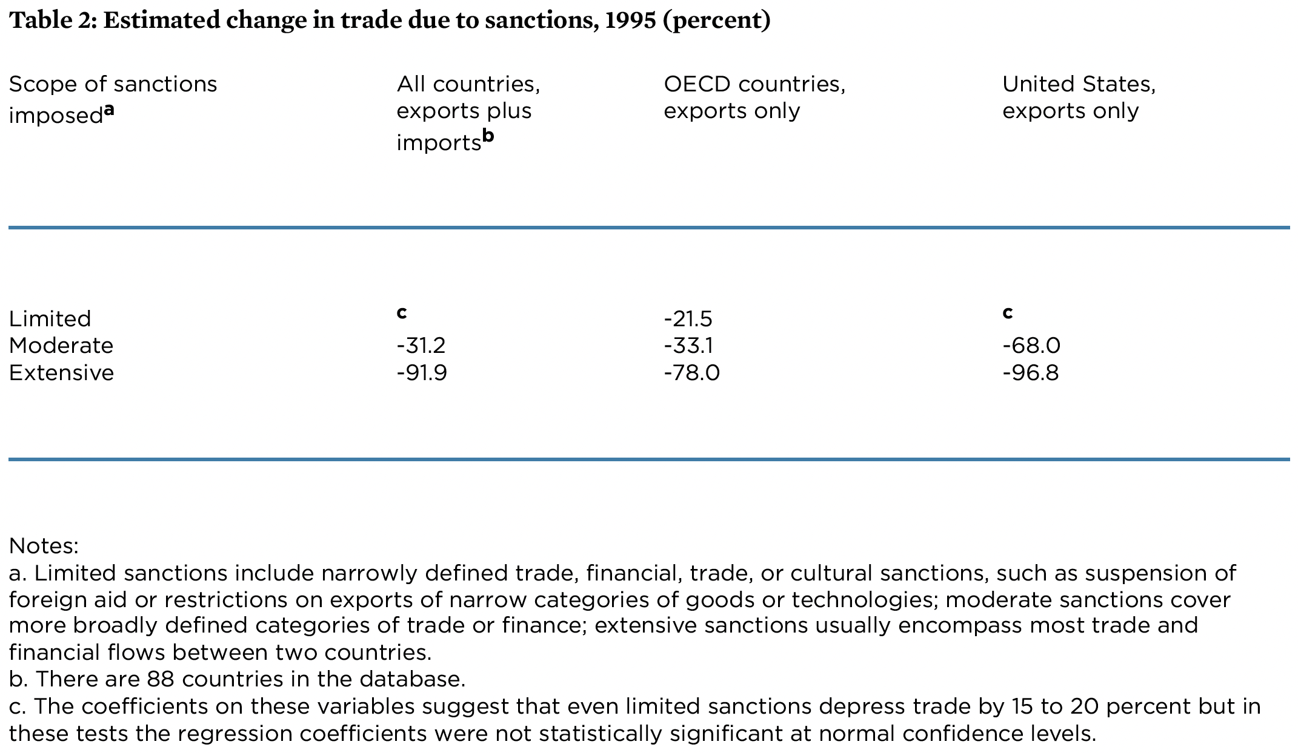
Source: Elliott (1997)
Notes:
Elliott, Kimberly Ann, “Evidence on the Costs and Benefits of Economic Sanctions,” Speech given before the Subcommittee on Trade Committee on Ways and Means United States House of Representatives Washington, DC, October 23, 1997, Peterson Institute for International Economics. 6 pp.
https://www.piie.com/commentary/testimonies/evidence-costs-and-benefits-economic-sanctions

Slide 21
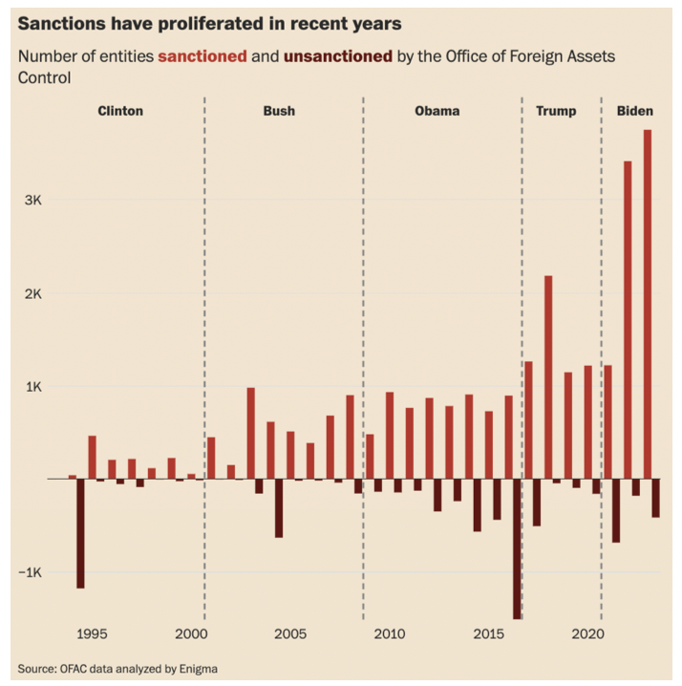
Notes:
Stein, Jeff and Federica Cocco, “How four U.S. presidents unleashed economic warfare across the globe,” Washington Post, July 25, 2024.
https://www.washingtonpost.com/business/interactive/2024/us-sanction-countries-work/

Slide 22
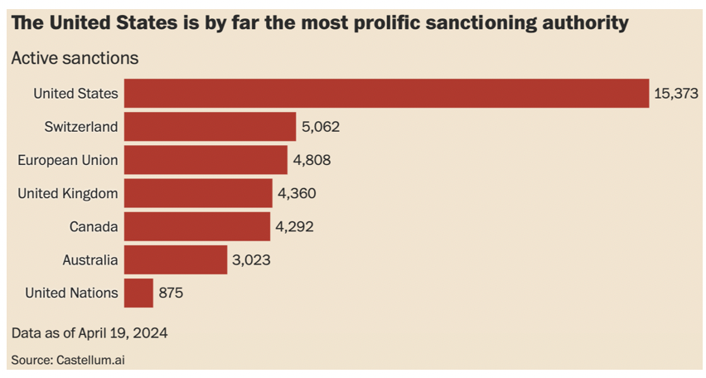
Notes:
Stein, Jeff and Federica Cocco, “How four U.S. presidents unleashed economic warfare across the globe,” Washington Post, July 25, 2024.
https://www.washingtonpost.com/business/interactive/2024/us-sanction-countries-work/

Slide 23
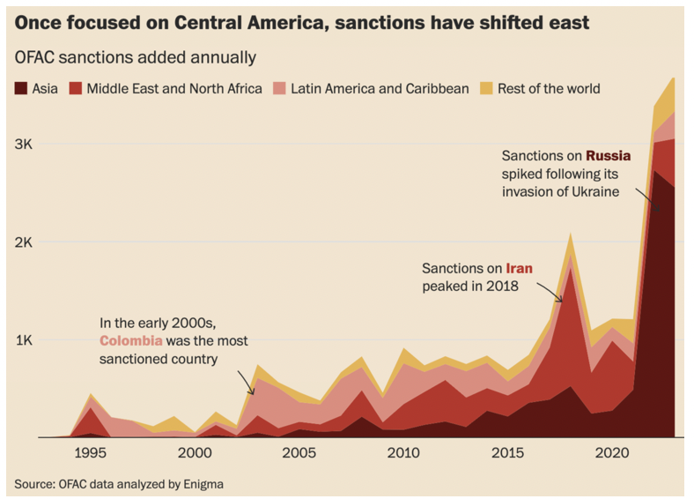
Notes:
Stein, Jeff and Federica Cocco, “How four U.S. presidents unleashed economic warfare across the globe,” Washington Post, July 25, 2024.
https://www.washingtonpost.com/business/interactive/2024/us-sanction-countries-work/

Slide 24
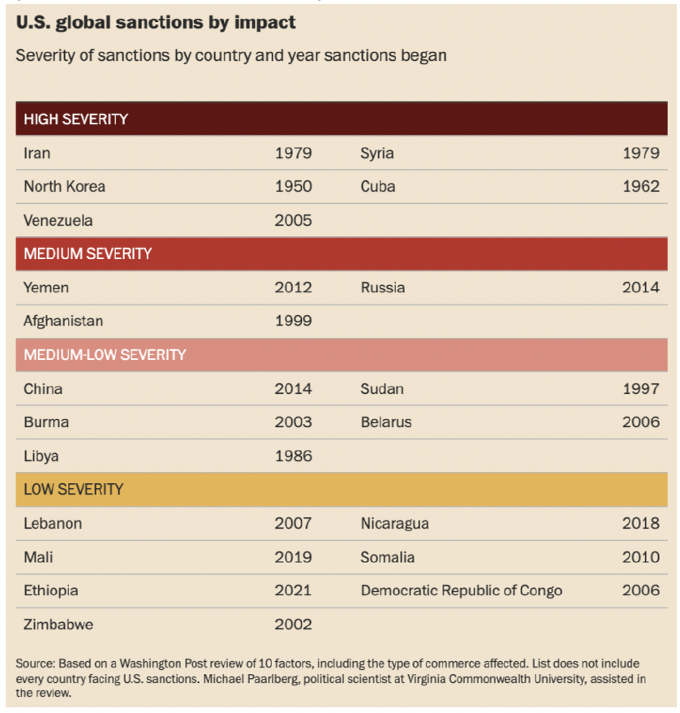
Notes:
Stein, Jeff and Federica Cocco, “How four U.S. presidents unleashed economic warfare across the globe,” Washington Post, July 25, 2024.
https://www.washingtonpost.com/business/interactive/2024/us-sanction-countries-work/

Slide 25
Pause for Discussion

Slide 26
  Questions on Rodriguez,
  “The harm that sanctions do …”
What percentages of countries and the world economy are subject to sanctions now? What were those percentages in the 1990s?
What measures of living conditions are mentioned as being made worse by sanctions?
What is the “main channel” through which sanctions have their effects, and how does this matter?
How big is the hit on GDP estimated to be in one study?

Slide 27
Effects of Russia sanctions
Russia sanctions began with Russia’s Feb 24, 2022, invasion of Ukraine
  Recall what we saw Sep 6:
Economic sanctions by governments
  Financial linkages
  Trade
Notes:
https://www.reuters.com/markets/europe/heineken-exits-russia-with-one-euro-sale-operations-2023-08-25/

Slide 28
Russia Sanctions
Russia’s invasion of Ukraine on Feb 24, 2022 prompted economic responses
  Economic sanctions by governments
    On financial linkages
    On trade
  Private companies said they would stop dealing with Russia
Notes:
Walker, Nigel, ” Brexit timeline: events leading to the UK’s exit from the European Union,” House of Commons Library, June 10, 2020.
https://commonslibrary.parliament.uk/research-briefings/cbp-7960/

Slide 29
Russia Sanctions, Gov’t
Sample financial sanctions
  Several Russian banks removed from the Swift international payments system
  Cut off many Russian banks from transactions and operations
Sample trade sanctions
  Banned or reduced imports of oil and other energy
  Imposed price cap on permitted oil exports
  Revoked Russia’s most favored nation status for tariffs
Notes:
Walker, Nigel, ” Brexit timeline: events leading to the UK’s exit from the European Union,” House of Commons Library, June 10, 2020.
https://commonslibrary.parliament.uk/research-briefings/cbp-7960/

Slide 30
Russia Sanctions, Gov’t
Countries
Australia | Iceland | Singapore
Bahamas | Italy | Switzerland
Canada | Japan | Taiwan
EU | New Zealand | UK
Finland | Norway | US
France | Poland
Germany | S Korea
Source: Funakoshi et al, “Updated July 7, 2022” but includes from July 29
Notes:
Funakoshi, Minami, Hugh Lawson, and Kannaki Deka, “Tracking sanctions against Russia,” Reuters, March 9, 2022, updated July 7, 2022..
https://graphics.reuters.com/UKRAINE-CRISIS/SANCTIONS/byvrjenzmve/

Slide 31
Russia Sanctions, Gov’t
Countries announcing they would not use sanctions against Russia:
NOT using sanctions
India | Feb 24
Mexico | Mar 1
Brazil | Mar 1
China | Mar 2
Argentina | Mar 4
Indonesia | Mar 9
Turkey | Mar 13
S Africa | Mar 17
Serbia | Apr 21
Source: Bown
Notes:
Bown, Chad P. “Russia's war on Ukraine: A sanctions timeline,” Realtime Economic Issues Watch, Peterson Institute for International Economics, March 14, 20202, last updated July 18, 2022. [4p]
https://www.piie.com/blogs/realtime-economic-issues-watch/russias-war-ukraine-sanctions-timeline

Slide 32
Effects of Russia sanctions
Russia sanctions began with Russia’s Feb 24, 2022, invasion of Ukraine
  Recall what we saw Sep 6:
Economic sanctions by governments
  Financial linkages
  Trade
Private companies said they would stop dealing with Russia
  Many have found it hard to do this.
  Only on Aug 25, 2023 did I hear (on NPR) that Heineken had just succeeded in selling its Russia operations for 1 euro
Notes:
https://www.reuters.com/markets/europe/heineken-exits-russia-with-one-euro-sale-operations-2023-08-25/

Slide 33
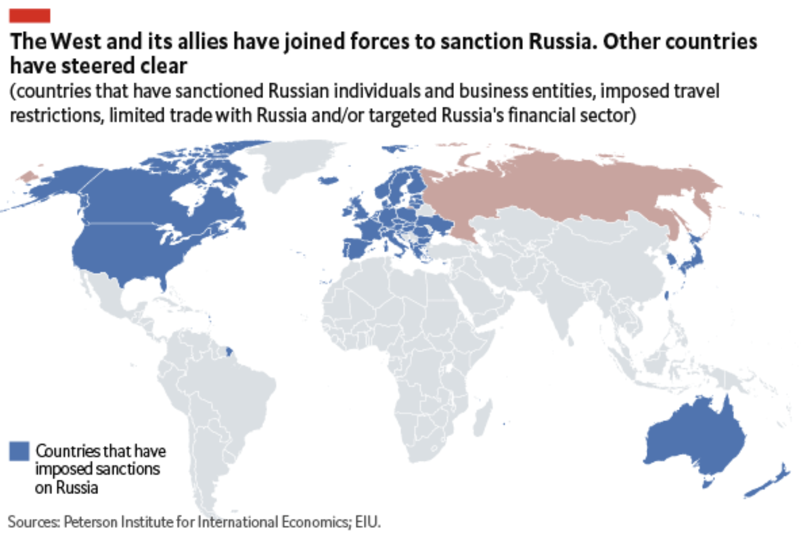
Source: Economist Intelligence Unit, April 13, 2022

Slide 34
Effects of Russia Sanctions
Per Mulder, June 2022
  Today’s sanctions have greater effects than seen before, due to
    More integrated global economy
    Russia’s importance as exporter of
      Grain
      Oil
  “…globalization has thereby increased the economic costs of using sanctions against large, highly integrated economies.”

Slide 35
Pause for Discussion

Slide 36
  Questions on Mulder,
  “The Sanctions Weapon”
How many governments imposed sanctions on Russia, and from which continents?
Why does the author view sanctions as more problematic today than previously?
What “policy adjustments” does he suggest?

Slide 37
  Questions on Alderman,
  “Leave Russia? A Year Later…”
Many companies announced last year that they were leaving Russia. Have they?
What fraction are still there?
What has Russia done to keep them from leaving?

Slide 38

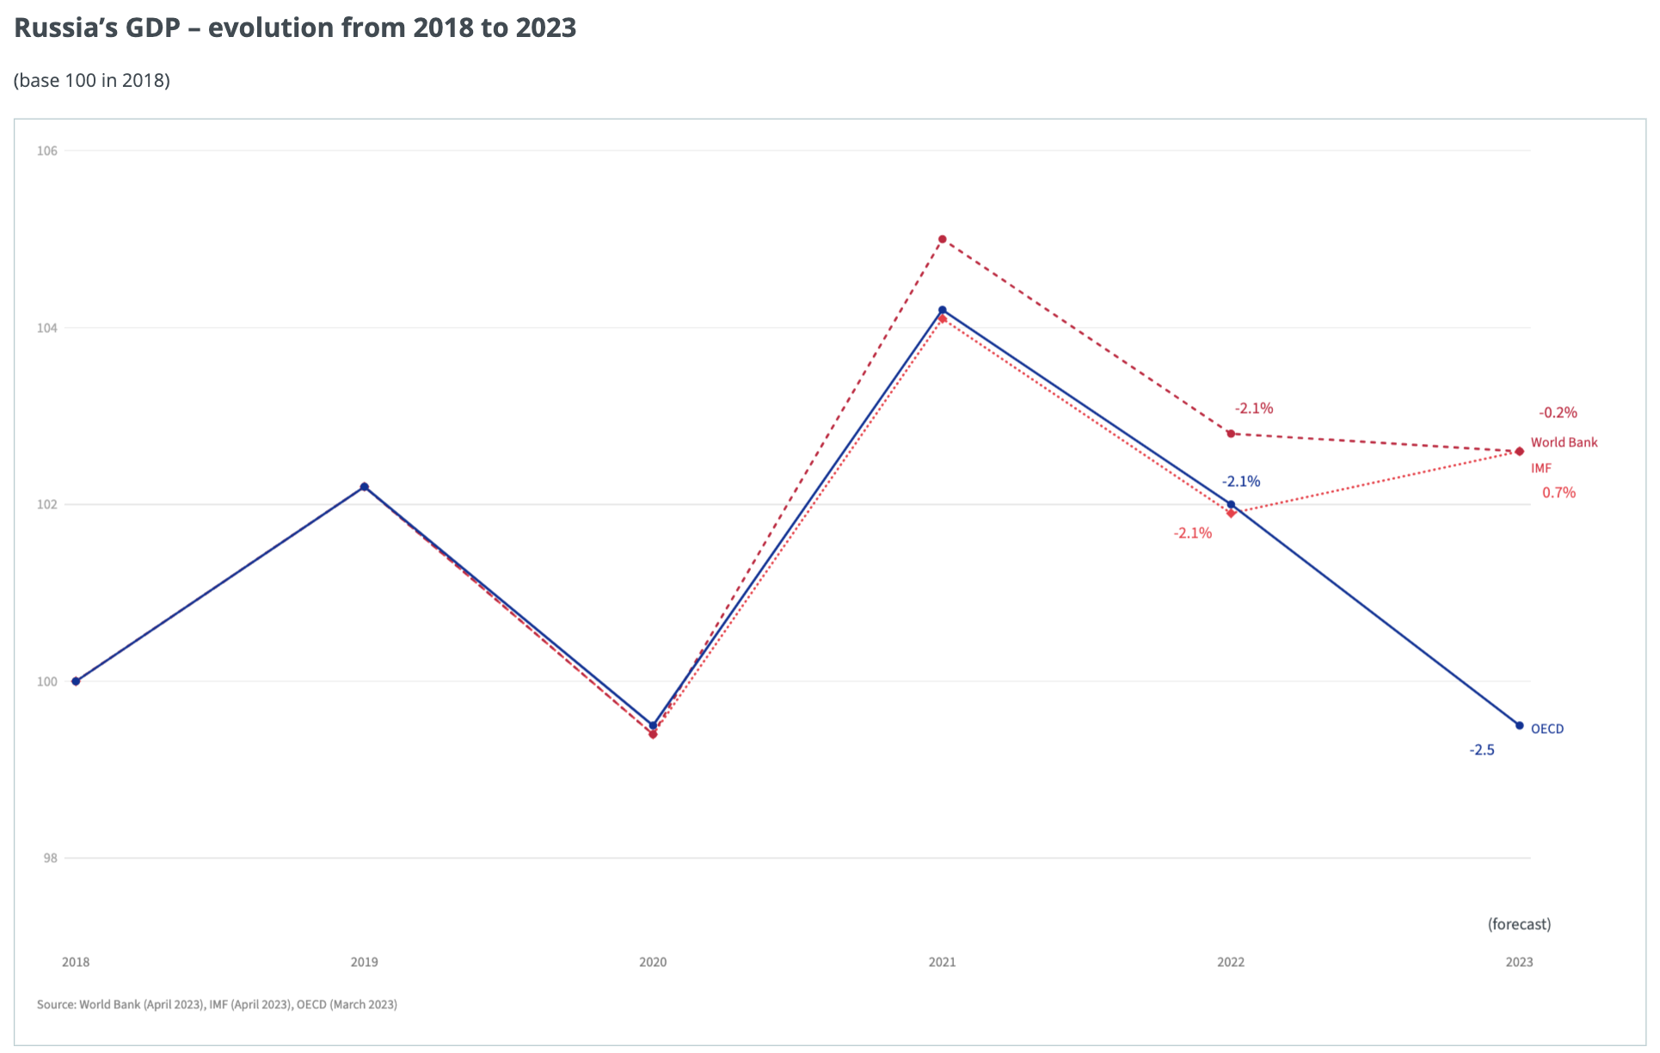
  Effects of Russia Sanctions
Message: Sanctions/war have hurt Russia’s GDP
Sources: IMF, WB, OECD, via European Council
Notes:
European Council, Infographic - Impact of sanctions on the Russian economy
https://www.consilium.europa.eu/en/infographics/impact-sanctions-russian-economy/

Slide 39
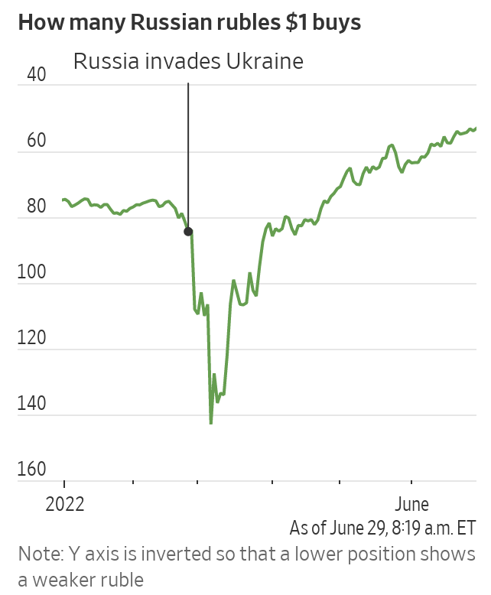
Russia’s Surprising Economic Headache: A Strong Ruble
Messages:
Ruble first fell, then rose
Rise was a “headache”
Wall Street Journal
June 29, 2022
Why “headache”?
Ruble rose 42% against $.
This reduces ruble value of oil exports, denominated in $.
Notes:
McCabe, Caitlin and Kate Vtorygina, “Russia’s Surprising Economic Headache: A Strong Ruble,” Wall Street Journal, June 29, 2022.
https://www.wsj.com/articles/russias-surprising-economic-headache-a-strong-ruble-11656530936

Slide 40
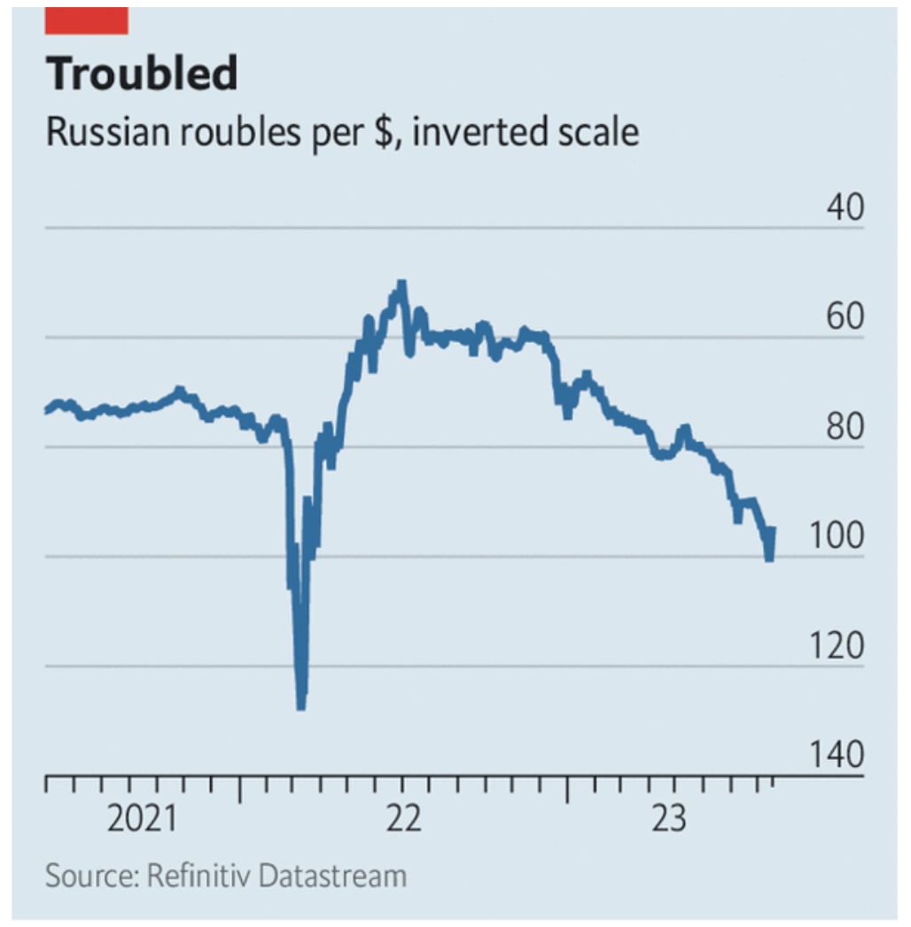
Messages:
Ruble then fell again, but not as much
Source: Economist, August 14, 2023

Slide 41
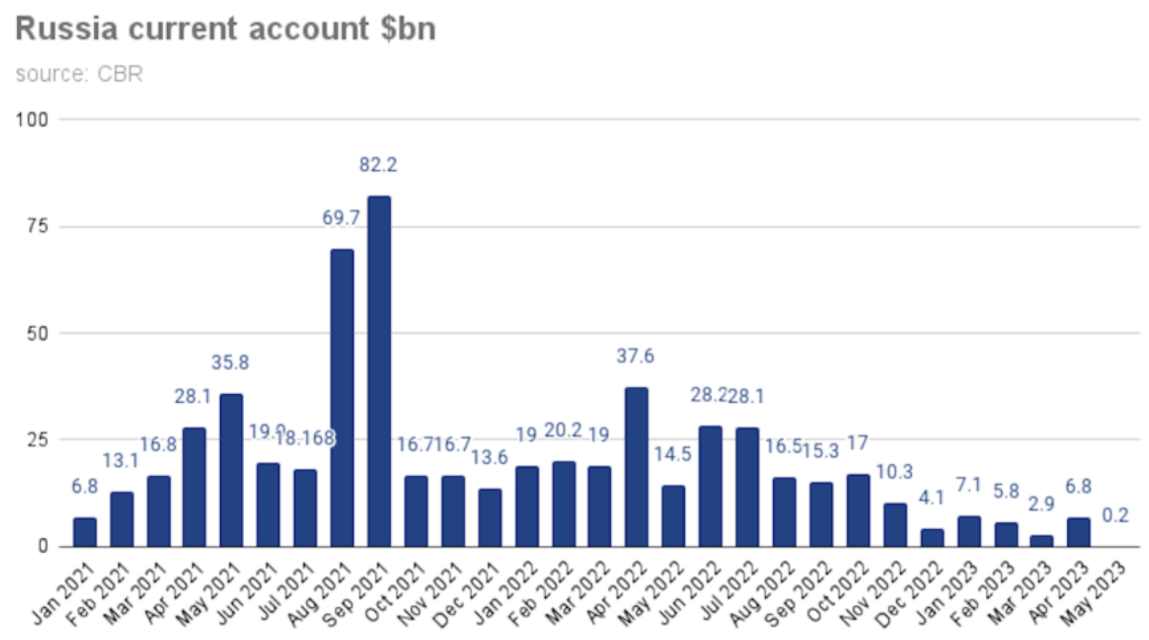
Message: Current account surplus first rose, then fell
Source: BNE Intellinews, June 14, 2023
Notes:
“Russia’s current account surplus slashed in 5M23,” BNE Intellinews, June 14, 2023
https://intellinews.com/karins-to-step-down-as-latvian-prime-minister-288127/?source=baltic-states

Slide 42
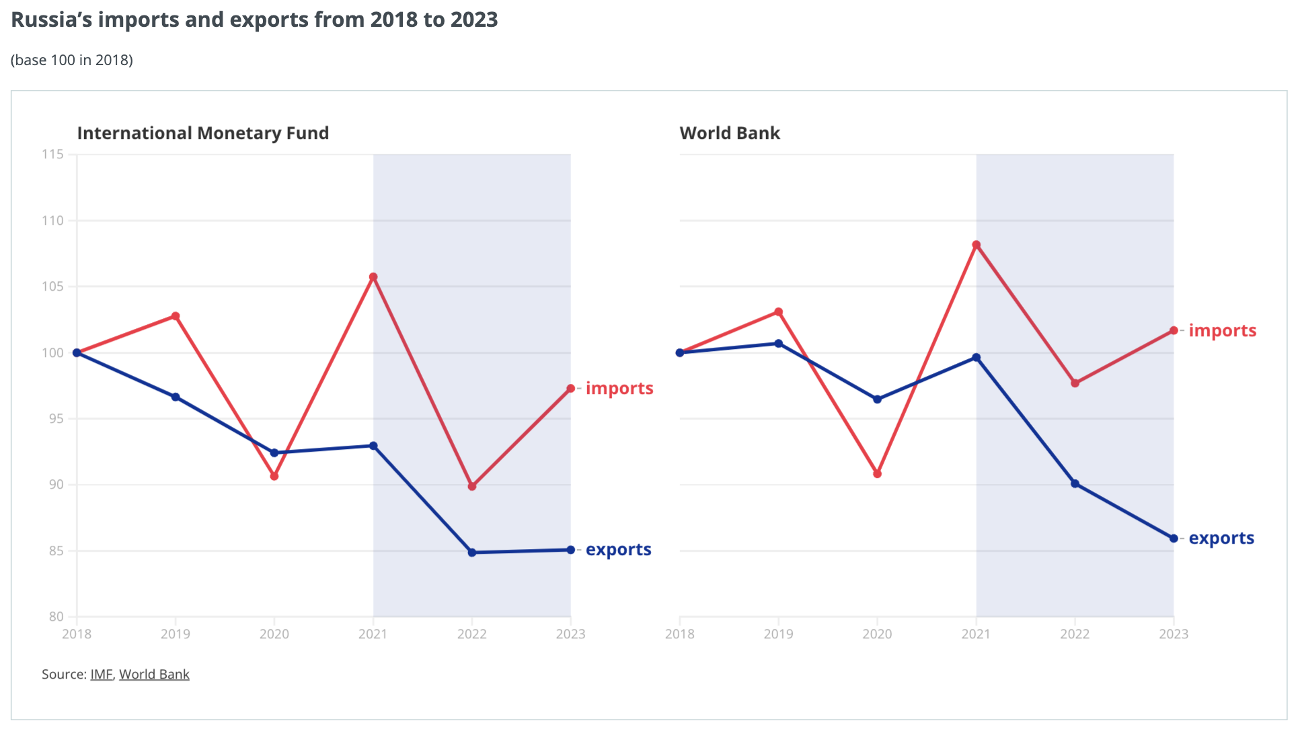
  Effects of Russia Sanctions
Messages:
Data disagree, but
Exports fell while imprts did not
Source: IMF, WB, via European Council
Notes:
European Council, Infographic - Impact of sanctions on the Russian economy
https://www.consilium.europa.eu/en/infographics/impact-sanctions-russian-economy/

Slide 43
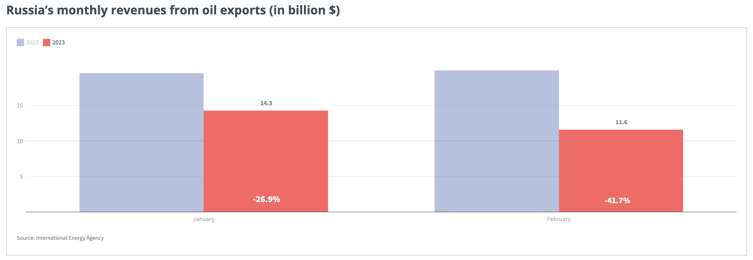
  Effects of Russia Sanctions
Message: Oil revenue fell
Source: International Energy Agency
Notes:
European Council, Infographic - Impact of sanctions on the Russian economy
https://www.consilium.europa.eu/en/infographics/impact-sanctions-russian-economy/

Slide 44
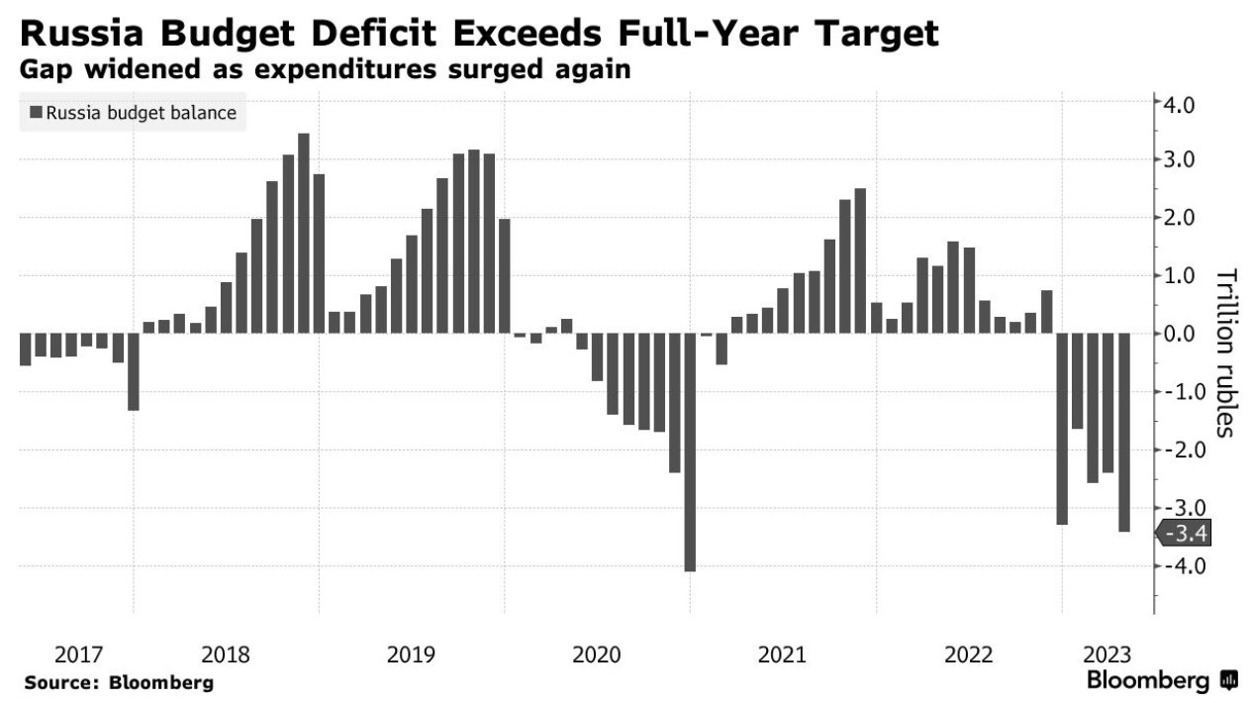
  Effects of Russia Sanctions
Message: Budget moved up and down. Message unclear.
Source: Bloomberg, July 7, 2023
Notes:
Alberto Nardelli, “EU Says Cost of Sanctions Will Hit Russia Harder Over Time,” July 7, 2023.
https://www.bloomberg.com/news/articles/2023-07-07/eu-says-high-cost-of-sanctions-on-russia-will-grow-for-years#xj4y7vzkg

Slide 45
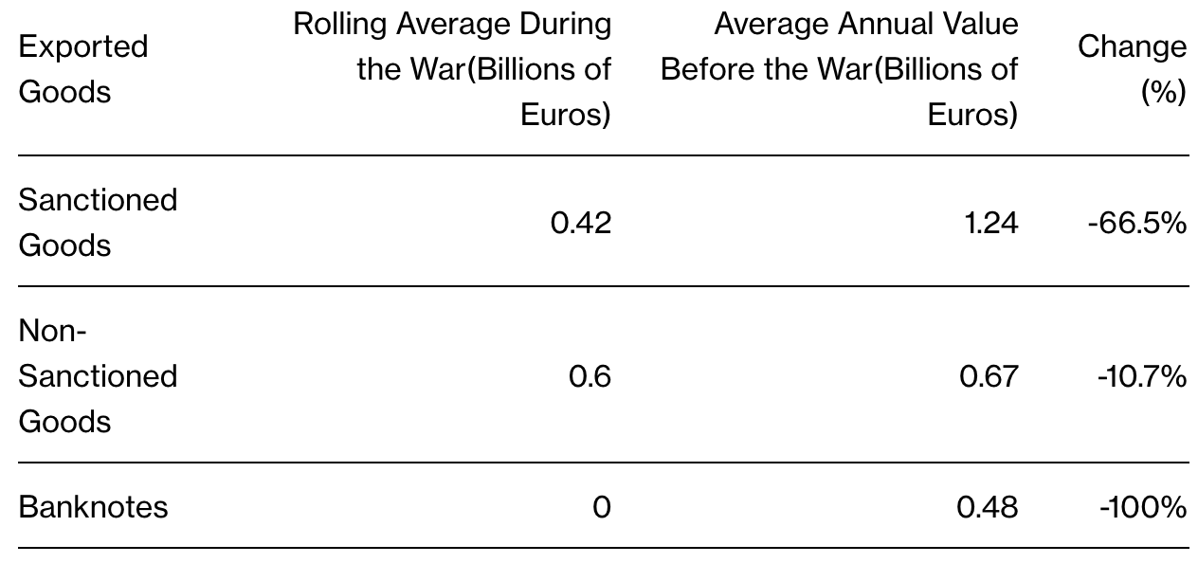
  Effects of Russia Sanctions
Message: Exports of sanctioned goods fells much more than non-sanctioned
Source: Bloomberg, July 7, 2023
Notes:
Alberto Nardelli, “EU Says Cost of Sanctions Will Hit Russia Harder Over Time,” July 7, 2023.
https://www.bloomberg.com/news/articles/2023-07-07/eu-says-high-cost-of-sanctions-on-russia-will-grow-for-years#xj4y7vzkg

Slide 46
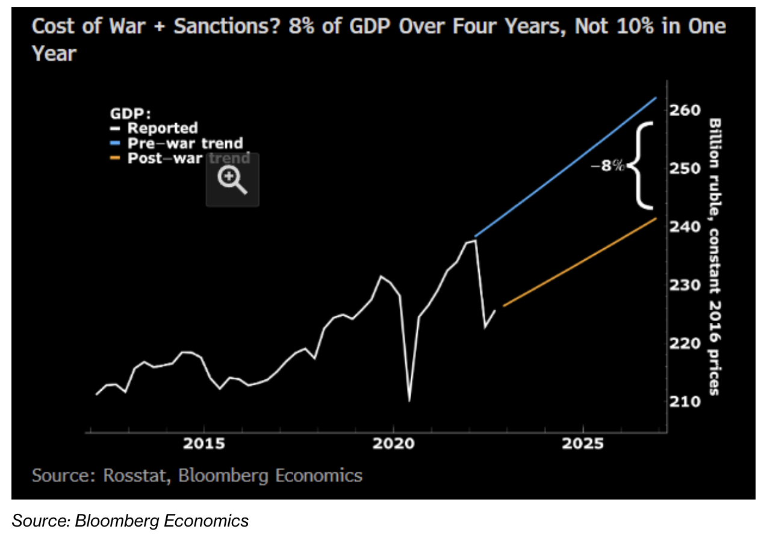
  Effects of Russia Sanctions
Message: War & sanctions reduced GDP by 8%
Source: Bloomberg, July 7, 2023
Notes:
Alberto Nardelli, “EU Says Cost of Sanctions Will Hit Russia Harder Over Time,” July 7, 2023.
https://www.bloomberg.com/news/articles/2023-07-07/eu-says-high-cost-of-sanctions-on-russia-will-grow-for-years#xj4y7vzkg

Slide 47
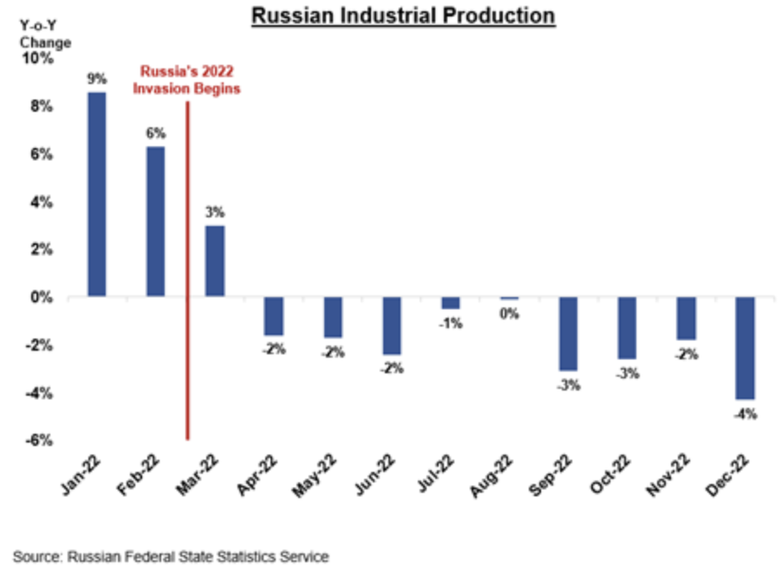
  Effects of Russia Sanctions
Message: Industrial production, which had been growing, has now been falling
Source: US Treasury, Feb 24, 2023
Notes:
“FACT SHEET: Disrupting and Degrading – One Year of U.S. Sanctions on Russia and Its Enablers,” US Department of Treasury, February 24, 2023.
https://home.treasury.gov/news/press-releases/jy1298

Slide 48
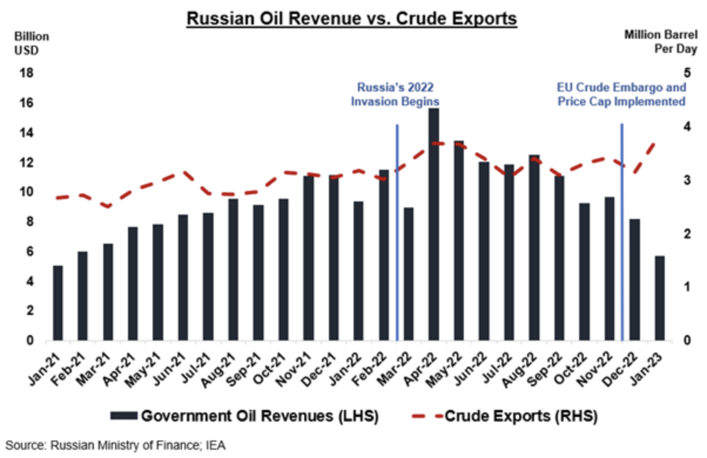
  Effects of Russia Sanctions
Message: Oil revenue first rose, but fell after price cap.
Source: US Treasury, Feb 24, 2023
Notes:
“FACT SHEET: Disrupting and Degrading – One Year of U.S. Sanctions on Russia and Its Enablers,” US Department of Treasury, February 24, 2023.
https://home.treasury.gov/news/press-releases/jy1298

Slide 49
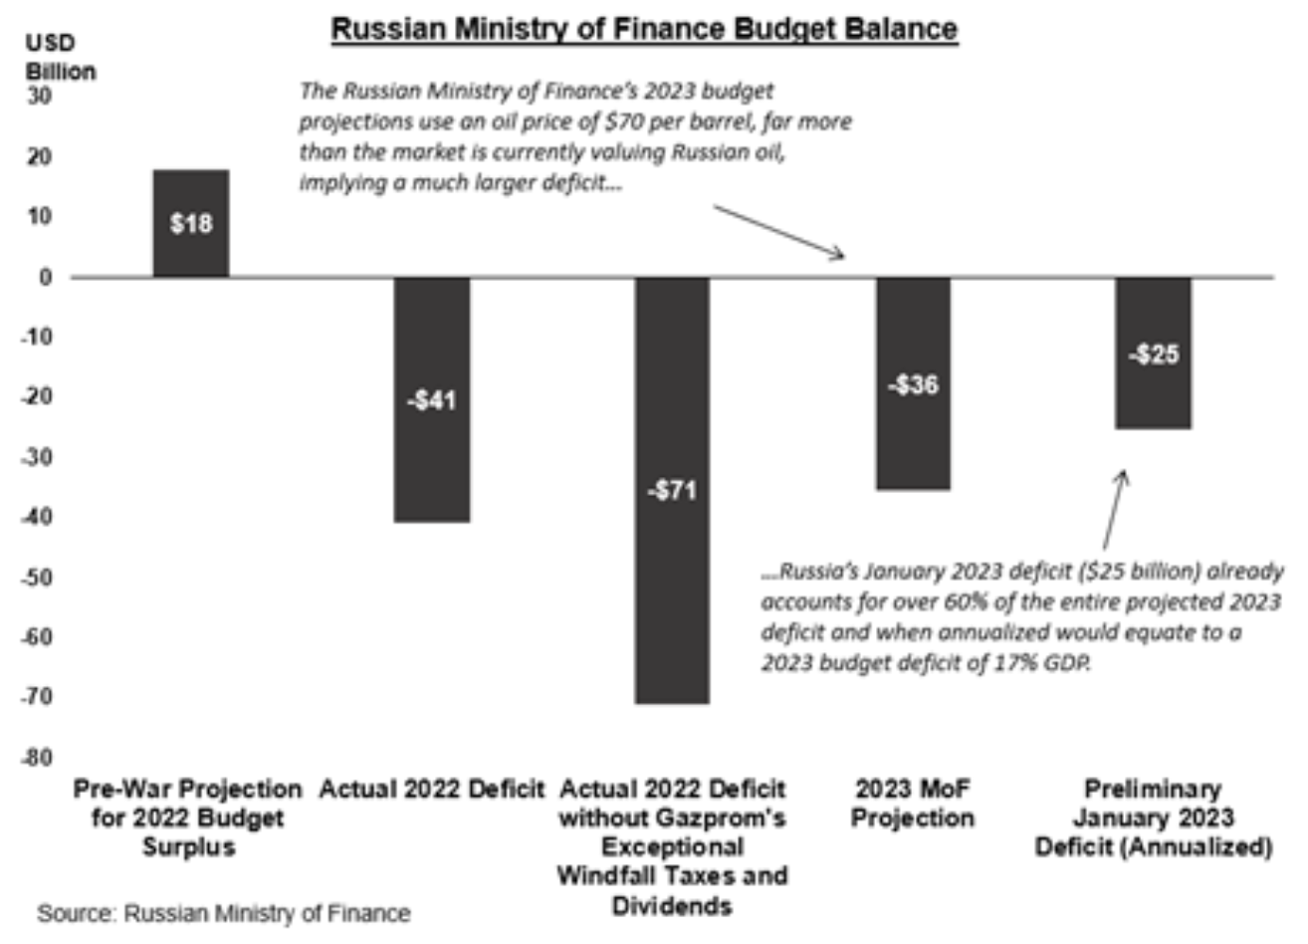
  Effects of Russia Sanctions
Message: Pre-war surplus turned to deficit
Source: US Treasury, Feb 24, 2023
Notes:
“FACT SHEET: Disrupting and Degrading – One Year of U.S. Sanctions on Russia and Its Enablers,” US Department of Treasury, February 24, 2023.
https://home.treasury.gov/news/press-releases/jy1298

Slide 50
Pause for Discussion

Slide 51
  Questions on Kantchev,
  “How Sanctioned Western Goods …”
What is being called the “Eurasian roundabout”?
What countries are said to be involved?
What is the evidence that this is happening?
What can be done about it?

Slide 52
  Questions on Bounds,
  “EU prepares tariffs on Russian …”
What are some of the products that the EU may levy new tariffs on from Russia?
Why were some products not previously covered by the EU sanctions?
Have other countries imposed tariffs on imports from Russia?
Can the European Commission by itself decide to levy these tariffs?

Slide 53
  Questions on Belton & Stein,
  “Russia financial system shaken …”
What “new sanctions” are mentioned?
What signs are mentioned here that Russia’s “financial system is shaken”?
What are “secondary sanctions”?
How do sanctions on Russia compare to economic sanctions that have been used oon others previously?
Have sanctions stopped Russia from building up its war capabilities?

