Slide 1
Class 25
Final Class by
Alan V. Deardorff
University of Michigan
2024
PubPol/Econ 541

Slide 2
Announcements
Paper #3
  Is due this Wednesday (no class), 8:30 AM, Dec 11
  I am still available to answer questions
    At today’s office hour 10-11
    By email
    Meet with your group by zoom

Slide 3
Announcements
Quiz #12
 | Q10 | Q11 | Q12
Mean | 6.58 | 8.06 | 7.97
Median | 6.25 | 8.5 | 8.5
Max | 10 | 10 | 9.5
Min | 5 | 5 | 5
Standard deviation | 1.32 | 1.50 | 1.41

Slide 4
Quiz #13
  Available since last week.
  Due by this Friday 12/13 midnight,
  Accepted until Saturday 12/14 midnight with 1 point penalty
  Covers material from Monday and Wednesday last week (Sanctions, Subsidies and Countervailing Duties)

Slide 5
Course evaluations
  Please do them
  As of today, only 4 of 20 had been done
  Due tomorrow

Slide 6
Tariffs and Their Effects
With Revisions 11/24 +
Alan V. Deardorff
University of Michigan
Presentation to Economic Dinner Group
November 18, 2024

Slide 7
Outline
US Tariff History
Trump I Tariffs
Trump II Tariff Proposals
Tariff Effects in General
Effects of Trump II Tariffs

Slide 8
US Tariff History

Slide 9
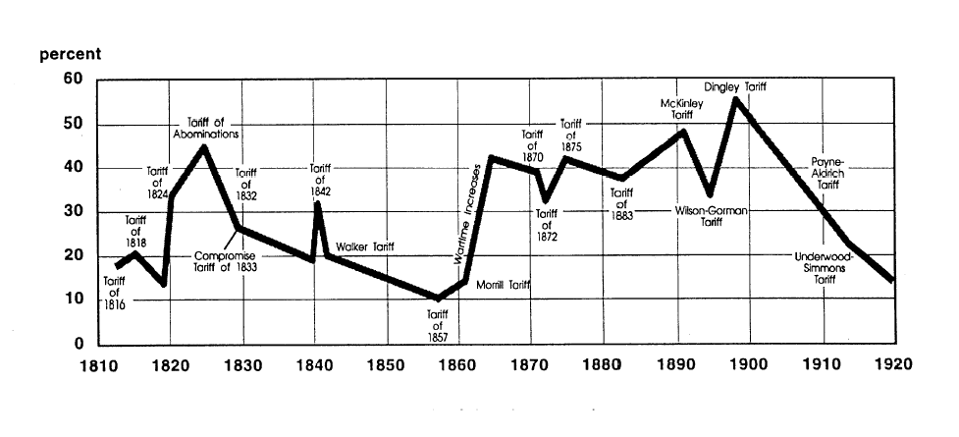
US Tariff History, 1810-1920
Today, pre-Trump
Notes:
Source: Don’t know

Slide 10
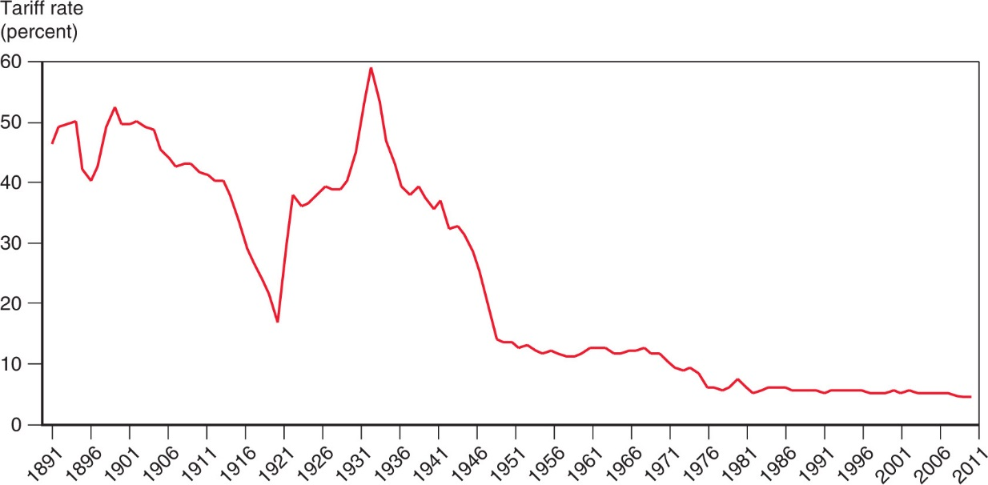
US Tariff History, 1891-2011
Smoot-Hawley Tariff
1934 Reciprocal Trade Agreements Act
1947 GATT
1995 WTO

Slide 11
Trump I Tariffs and the Trade War

Slide 12
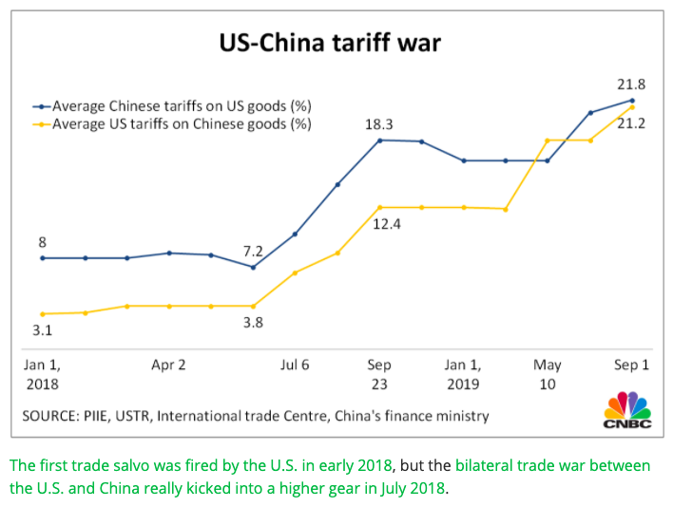
US-China Tariff War – Tariff Rates
Source: CNBC.com
Notes:
SEPTEMBER 18, 2019 | Yen Nee Lee, CNBC.com
http://nbr.com/2019/09/18/these-4-charts-show-how-us-china-trade-has-changed-during-the-tariff-dispute/

Slide 13
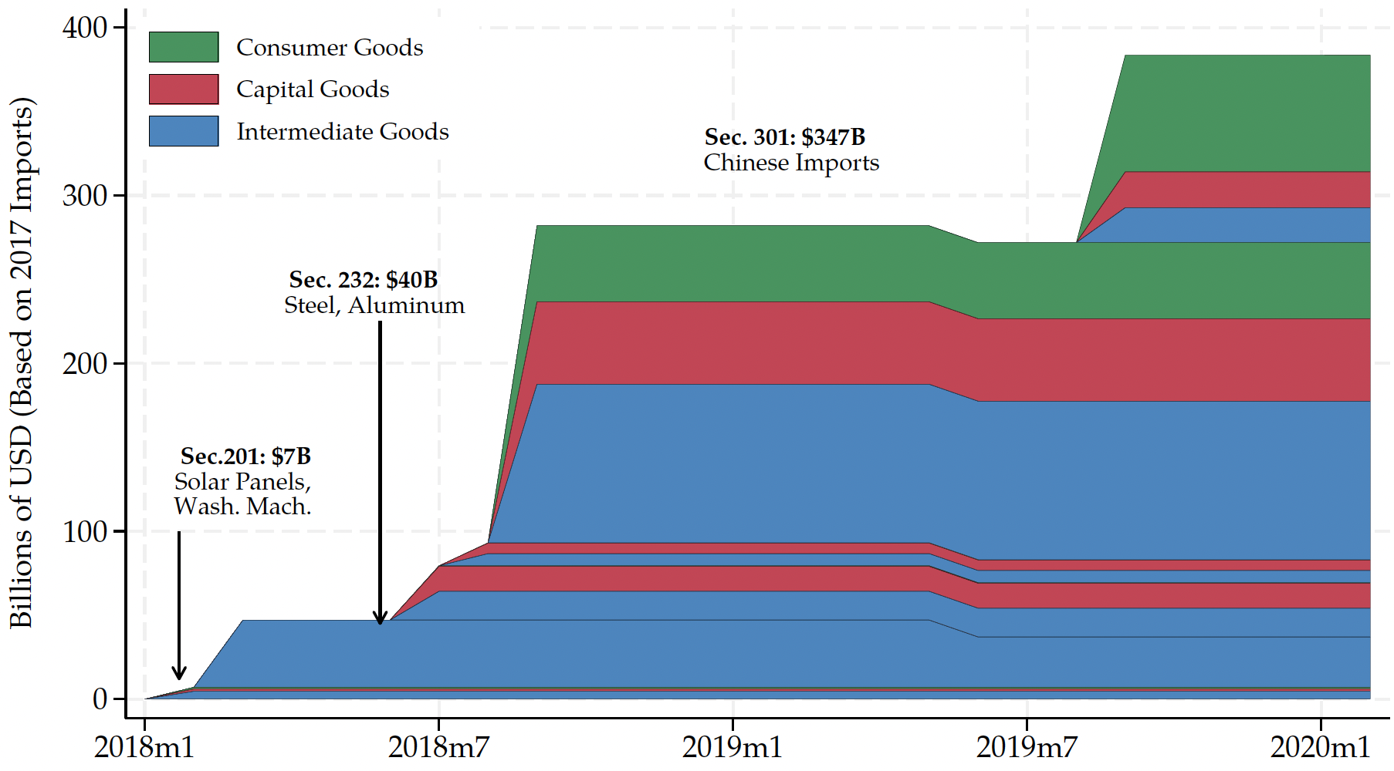
Trump I Tariffs - US Imports Covered
US imports from China in 2017, per World Bank:
$480 billion
Source: Flaaen & Pierce 2020
Notes:
SEPTEMBER 18, 2019 | Yen Nee Lee, CNBC.com
http://nbr.com/2019/09/18/these-4-charts-show-how-us-china-trade-has-changed-during-the-tariff-dispute/

Slide 14
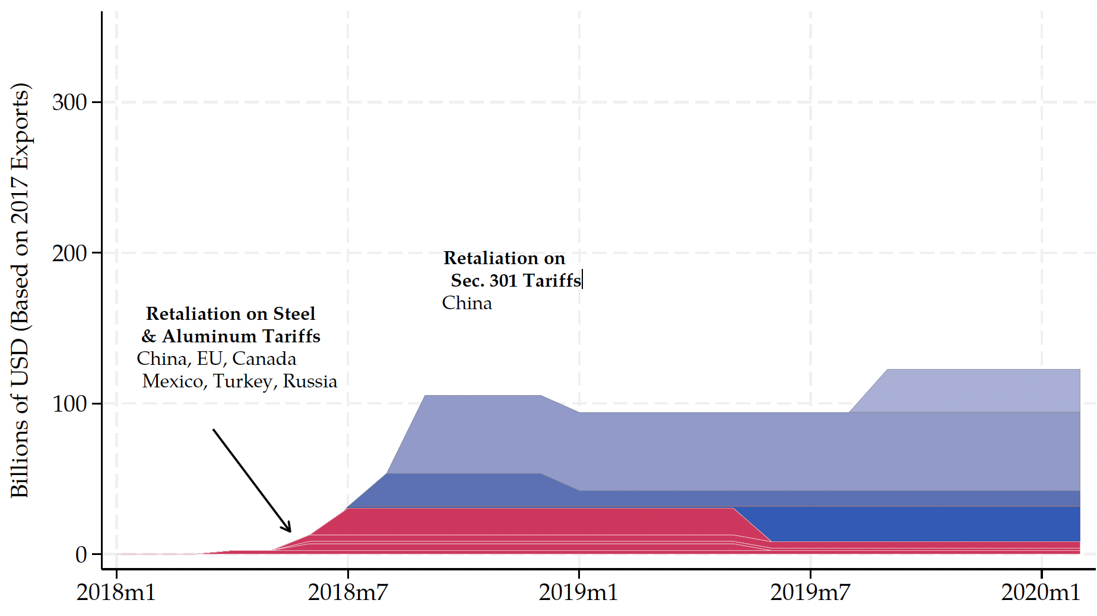
Trump I Tariff Retaliation - US Exports Covered
US exports to China in 2017, per World Bank:
$154 billion
Source: Flaaen & Pierce 2020
Notes:
SEPTEMBER 18, 2019 | Yen Nee Lee, CNBC.com
http://nbr.com/2019/09/18/these-4-charts-show-how-us-china-trade-has-changed-during-the-tariff-dispute/

Slide 15
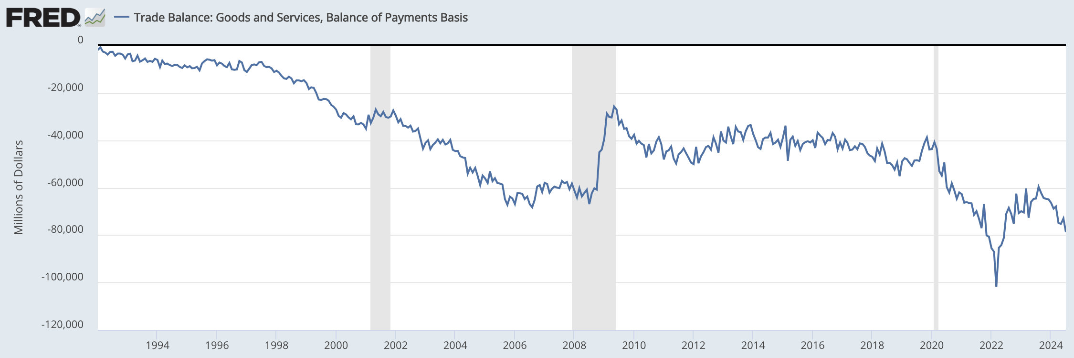
US Trade Balance = Exports minus Imports
Clinton
Bush
Obama
Trump
Biden
Note the zero. This whole thing is negative – a trade deficit! – and getting mostly larger since 1992.
Recessions
Notes:
FRED,
https://fred.stlouisfed.org/series/BOPGSTB
Sep 30, 2024

Slide 16
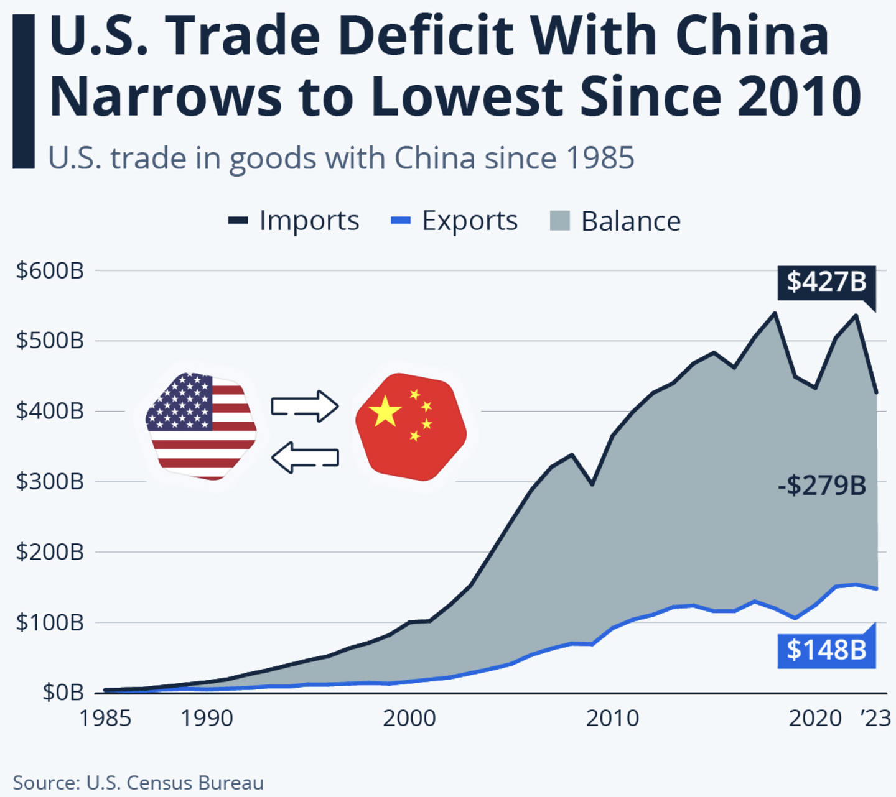
US Trade Balance with China
Notes:
Richter, “Is the U.S. Pulling Away From China Economically?” statista, 11/4/24
https://www.statista.com/chart/17982/us-trade-in-goods-with-china-since-1985/

Slide 17
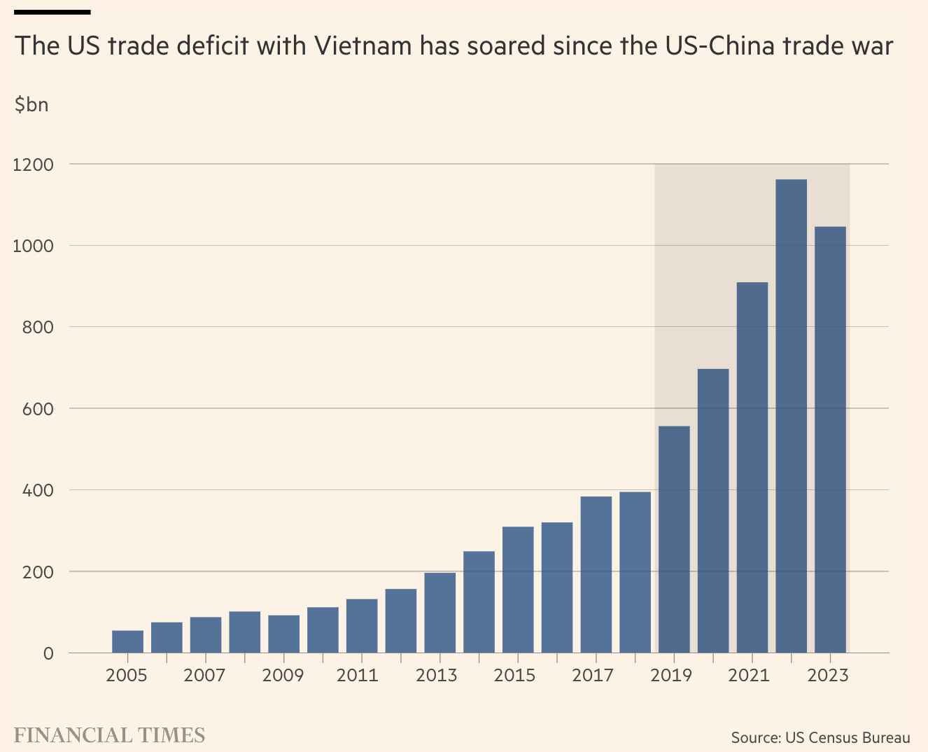
US Trade Balance with Vietnam
Notes:
Lakshmi, “Why Vietnam risks ending up a big loser from Trump’s tariffs,” FT, 11/17/24
https://www.ft.com/content/4f9f11dd-2278-49a6-9e70-b87916667fbe

Slide 18

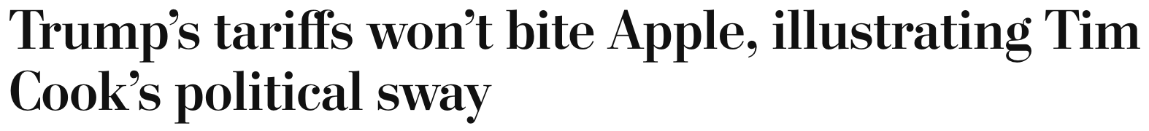
Trump Tariff Exemptions
September 18, 2018:
  “Clearly Tim Cook has been effective in his developing a relationship with the current administration, and this is probably one of the best examples of the fruits of that labor.”

Slide 19
Trump Tariff Exemptions
Both the metals tariffs and the China tariffs permitted certain products and product categories to be exempted, through an application process to Commerce (metals) and USTR (China), if certain criteria are satisfied.
  Whether tariffs would impose significant harm on American business interests
  Whether substitute products were available outside China
  Whether the products were “strategically important” to China”

Slide 20
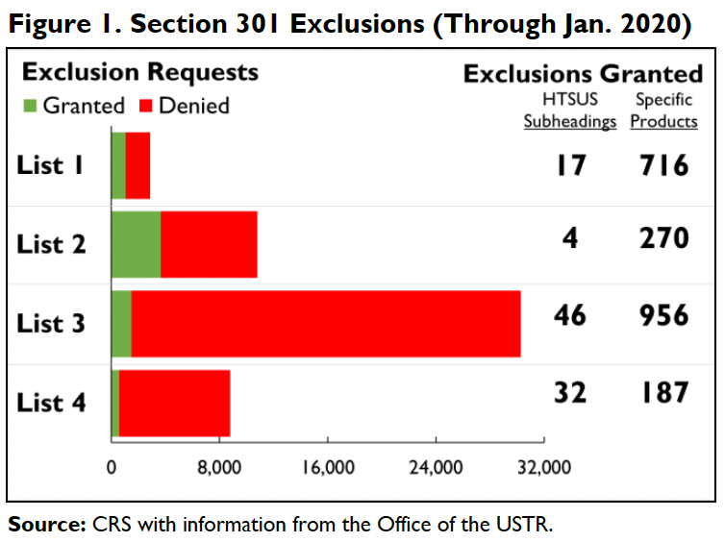
Trump Tariff Exemptions
Notes:
Andres B. Schwarzenberg, “Section 301 Tariff Exclusions on U.S. Imports from China,” Congressional ioal Research Service, May 13, 2024
https://crsreports.congress.gov/product/pdf/IF/IF11582

Slide 21
Trump Tariff Exemptions
Requests for exemption
  Metals tariffs: “Commerce Department received nearly 500,000 exclusion requests”
  China tariffs: USTR “fielded more than 50,000 requests”
“He has also suggested targeting particular companies or industries.”
Lobbying Congress on trade issues increased once Mr. Trump took office
Biden maintained Trump’s tariffs, but it has
  gradually wound down the exclusions for China tariffs
  continued to grant them for tariffs on steel and aluminum.
Notes:
Swanson, “Trump’s Trade Agenda Could Benefit Friends and Punish Rivals,” NYT, 11/24/24
https://nytimes.com/2024/11/23/us/politics/trump-tariff-exemptions.html

Slide 22
Trump Tariff Exemptions
Trump administration’s decisions on exclusions were mysterious and arbitrary.
  Tariff exemptions were given to Bibles but not to textbooks,
  to salmon but not to pollock,
  to children’s car seats but not to baby cribs.
  The decisions were not subject to appeal.”
Notes:
Swanson, “Trump’s Trade Agenda Could Benefit Friends and Punish Rivals,” NYT, 11/24/24
https://nytimes.com/2024/11/23/us/politics/trump-tariff-exemptions.html

Slide 23
Trump Tariff Exemptions
Issues with the exemptions
  “Firms hiring lobbyists were less likely to have steel tariff exemptions approved.”
  Study found:
    Contributions to Republicans made China exemptions more likely
    Contributions to Democrats made China exemptions less likely
    Author quoted as saying the exclusion process was a very effective spoils system”
  Renewal of exemptions were uncertain and came late enough to create uncertainty.
Notes:
Keynes, Soumaya, “Your guide to how to dodge a tariff,” FT, 11/15/24
https://www.ft.com/content/f9e4cc47-5b70-4beb-85df-a49a9f03181c
Armstrong, Dan, “Politically Connected Corporations Received More Exemptions from U.S. Tariffs on Chinese Imports, Study Finds,” Lehigh News, October 8,, 2024
https://www2.lehigh.edu/news/politically-connected-corporations-received-more-exemptions-from-us-tariffs-on-chinese-imports
Swanson, “Trump’s Trade Agenda Could Benefit Friends and Punish Rivals,” NYT, 11/24/24
https://nytimes.com/2024/11/23/us/politics/trump-tariff-exemptions.html
Ben Unglesbee, “Biden administration extends China tariff exclusions — again,” SupplyChainDive, January 4, 2024.
https://www.supplychaindive.com/news/biden-administration-extends-china-tariff-exclusions-May-2024/703510/

Slide 24
Trump II Tariffs

Slide 25
Trump II Tariff Plans
“To me the most beautiful word in the dictionary is ‘tariff’”
Has said he will
  Place a tariff of 10% or 20% on all imports from all countries.
  Place even higher tariffs (60%) on imports from China.
  Raise our tariffs on countries to match what they charge on our exports.
    “Reciprocal Trade Act”
    (And lower those where they charge less?)
  Raise tariffs on countries that don’t use the US dollar for international transactions.
  Place tariffs on Mexico, violating his own USMCA trade agreement
    25% on everything if they don’t stop US immigration
    100% on cars to get production in US
Notes:
McCormick, “Trump Calls Tariffs the ‘Most Beautiful Word’,” WSJ, 10/14/24
https://www.wsj.com/livecoverage/harris-trump-election-10-16-2024/card/trump-calls-tariffs-the-most-beautiful-word--YMVPAupw4EjBRp6yobOy
Swanson, “Harris and Trump Embrace Tariffs, Though Their Approaches Differ,” New York Times, Aug 27, 2024.
https://www.nytimes.com/2024/08/27/us/politics/trump-harris-tariffs.html
Toomey, “About Trump’s ‘Reciprocal’ Tariffs,” WSJ, 10/27/24
https://www.wsj.com/opinion/about-trumps-reciprocal-tariffs-he-wants-to-raise-taxes-and-thinks-im-the-stupid-one-5dc3c56c?mod=itp_wsj
Krugman, “Donald Trump on the Dollar, in His Own Words. NYT, 9/9/24
https://www.nytimes.com/2024/09/09/opinion/trump-tariffs-reserve-currency.html
Economist, “Donald Trump is poised to smash Mexico with tariffs,” 11/7/24
https://www.economist.com/the-americas/2024/11/07/donald-trump-is-poised-to-smash-mexico-with-tariffs
Ewing, “Trump’s Tariffs Could Deal a Blow to Mexico’s Car Factories,” NYT, 11/12/24
https://www.nytimes.com/2024/11/12/business/economy/trump-mexico-trade-tariffs-car-factories.html

Slide 26
Trump II Tariff Plans
More recently:
  Nov 26: New tariffs unless they stop people and drugs crossing border
    25% on Mexico and Canada
    Extra 10% on China
  Nov 30: 100% Tariffs on Brics if they undermine the US dollar
    Brics = Brazil, Russia, India, China and South Africa
      Expanded to include Iran, United Arab Emirates, Egypt and Ethiopia
    A proposal for a Brics currency was introduced at last year’s summit in South Africa.
Notes:
McCormick, “Trump Calls Tariffs the ‘Most Beautiful Word’,” WSJ, 10/14/24
https://www.wsj.com/livecoverage/harris-trump-election-10-16-2024/card/trump-calls-tariffs-the-most-beautiful-word--YMVPAupw4EjBRp6yobOy
Swanson, “Harris and Trump Embrace Tariffs, Though Their Approaches Differ,” New York Times, Aug 27, 2024.
https://www.nytimes.com/2024/08/27/us/politics/trump-harris-tariffs.html
Toomey, “About Trump’s ‘Reciprocal’ Tariffs,” WSJ, 10/27/24
https://www.wsj.com/opinion/about-trumps-reciprocal-tariffs-he-wants-to-raise-taxes-and-thinks-im-the-stupid-one-5dc3c56c?mod=itp_wsj
Krugman, “Donald Trump on the Dollar, in His Own Words. NYT, 9/9/24
https://www.nytimes.com/2024/09/09/opinion/trump-tariffs-reserve-currency.html
Economist, “Donald Trump is poised to smash Mexico with tariffs,” 11/7/24
https://www.economist.com/the-americas/2024/11/07/donald-trump-is-poised-to-smash-mexico-with-tariffs
Ewing, “Trump’s Tariffs Could Deal a Blow to Mexico’s Car Factories,” NYT, 11/12/24
https://www.nytimes.com/2024/11/12/business/economy/trump-mexico-trade-tariffs-car-factories.html

Slide 27
Trump II Tariff Plans
What will Trump actually do?
  Beattie in FT 11/18/24: “trade policy in his first administration emerged from fierce internal battles like a victorious but bloodied rat crawling out of a sack of rodent corpses, with Trump’s caprice determining which idea survived.”
  He will surely do some of the things on this list
  But not on everybody. He’ll use the threat to negotiate ”deals”
    For the benefit of the country (?)
    For the benefit of himself (!)
Notes:
McCormick, “Trump Calls Tariffs the ‘Most Beautiful Word’,” WSJ, 10/14/24
https://www.wsj.com/livecoverage/harris-trump-election-10-16-2024/card/trump-calls-tariffs-the-most-beautiful-word--YMVPAupw4EjBRp6yobOy
Swanson, “Harris and Trump Embrace Tariffs, Though Their Approaches Differ,” New York Times, Aug 27, 2024.
https://www.nytimes.com/2024/08/27/us/politics/trump-harris-tariffs.html
Toomey, “About Trump’s ‘Reciprocal’ Tariffs,” WSJ, 10/27/24
https://www.wsj.com/opinion/about-trumps-reciprocal-tariffs-he-wants-to-raise-taxes-and-thinks-im-the-stupid-one-5dc3c56c?mod=itp_wsj
Krugman, “Donald Trump on the Dollar, in His Own Words. NYT, 9/9/24
https://www.nytimes.com/2024/09/09/opinion/trump-tariffs-reserve-currency.html
Economist, “Donald Trump is poised to smash Mexico with tariffs,” 11/7/24
https://www.economist.com/the-americas/2024/11/07/donald-trump-is-poised-to-smash-mexico-with-tariffs
Ewing, “Trump’s Tariffs Could Deal a Blow to Mexico’s Car Factories,” NYT, 11/12/24
https://www.nytimes.com/2024/11/12/business/economy/trump-mexico-trade-tariffs-car-factories.html
Beattie, “Where Trump will go with his plans on trade,” FT, 11/18/24
https://www.ft.com/content/afab0fab-524b-4845-addd-bcffbe6b0b22

Slide 28
Trump II Tariff Plans
What will Trump be able do?
  The constitution gives power over tariffs only to Congress, not the President
  But Congress has passed laws delegating that power to the President In certain circumstances:
    Section 201 of 1974 Trade Act: Safeguards, used for washing machines
    Section 232 of 1962 Trade Act: National security, used for steel
    Section 301 of 1974 Trade Act: Unfair trade, used for China tariffs
    International Emergency Economic Powers Act of 1977, not used yet
      But threatened against Mexico in 2018 over migration
  For his tariffs on all imports, he may need to get Congress to act, but Beatie in FT disagrees
  Reciprocal Trade Act would have to be by Congress
Notes:
McCormick, “Trump Calls Tariffs the ‘Most Beautiful Word’,” WSJ, 10/14/24
https://www.wsj.com/livecoverage/harris-trump-election-10-16-2024/card/trump-calls-tariffs-the-most-beautiful-word--YMVPAupw4EjBRp6yobOy
Swanson, “Harris and Trump Embrace Tariffs, Though Their Approaches Differ,” New York Times, Aug 27, 2024.
https://www.nytimes.com/2024/08/27/us/politics/trump-harris-tariffs.html
Toomey, “About Trump’s ‘Reciprocal’ Tariffs,” WSJ, 10/27/24
https://www.wsj.com/opinion/about-trumps-reciprocal-tariffs-he-wants-to-raise-taxes-and-thinks-im-the-stupid-one-5dc3c56c?mod=itp_wsj
Krugman, “Donald Trump on the Dollar, in His Own Words. NYT, 9/9/24
https://www.nytimes.com/2024/09/09/opinion/trump-tariffs-reserve-currency.html
Economist, “Donald Trump is poised to smash Mexico with tariffs,” 11/7/24
https://www.economist.com/the-americas/2024/11/07/donald-trump-is-poised-to-smash-mexico-with-tariffs
Ewing, “Trump’s Tariffs Could Deal a Blow to Mexico’s Car Factories,” NYT, 11/12/24
https://www.nytimes.com/2024/11/12/business/economy/trump-mexico-trade-tariffs-car-factories.html
Beattie, “Where Trump will go with his plans on trade,” FT, 11/18/24
https://www.ft.com/content/afab0fab-524b-4845-addd-bcffbe6b0b22

Slide 29
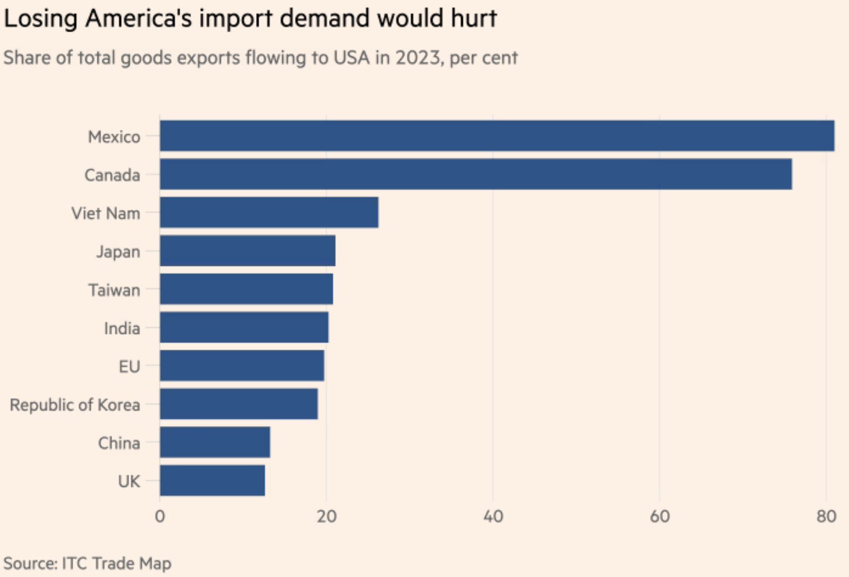
What Countries will Be Hurt?
Source:
Keynes, FT, 11/15/24
Notes:
Keynes, Soumaya, “Your guide to how to dodge a tariff,” FT, 11/15/24
https://www.ft.com/content/f9e4cc47-5b70-4beb-85df-a49a9f03181c

Slide 30
Effects of Tariffs in General

Slide 31
Economic effects of a tariff
A tariff is a tax on imports. It causes
  A rise in the price of the imported good in the importing country
  A fall in the price of the imported good in the exporting country
  The quantity imported to fall
  Revenue for the tariff-levying government
Almost always: the rise at home is much larger than the fall abroad
  That’s especially true if importing country is small
  But it’s also true if importing country is as large as the U.S.
  Example: Trump’s tariffs caused US prices to rise, with hardly any perceptible fall in prices abroad.

Slide 32
Effects of a tariff
The rise in price in the importing country causes
  A rise in price of competing goods produced there
  Benefits to those producers
  Harm to buyers of both the import and the competing goods
    Including producers that use the higher-priced goods as inputs
      Their prices also rise, hurting their buyers
  Employment changes:
    Increase in the protected industry
    Decrease in industries that use the protected product as inputs
  Example: Trump’s 25% tariff on steel
    Helped US steel firms and their workers
    Hurt US auto firms and workers
      and many other industries that use steel

Slide 33
Effects of a tariff
Economists’ cost-benefit analysis quantifies these and shows that
  Unless there are market distortions, the costs of a tariff always exceed the benefits
  Even when distortions give potential for tariff to be net beneficial
    It may be net harmful
    There exists another policy that would be better
  But
    Costs of tariffs are spread over many buyers, and are small for each
    Benefits of tariffs are concentrated for domestic producers and are large for them

Slide 34
Effects of a tariff
Politics of tariffs
  Political forces favor tariffs
  Tariffs were reduced during 1934-1995 only by slow reciprocal negotiation among countries

Slide 35
Effects of a tariff
If a tariff is on exports of only one country (e.g., China), then
  Some imports shift to another country
  Price rises by less, to that other country’s higher cost
  Example: See next slide for Christmas Lights

Slide 36
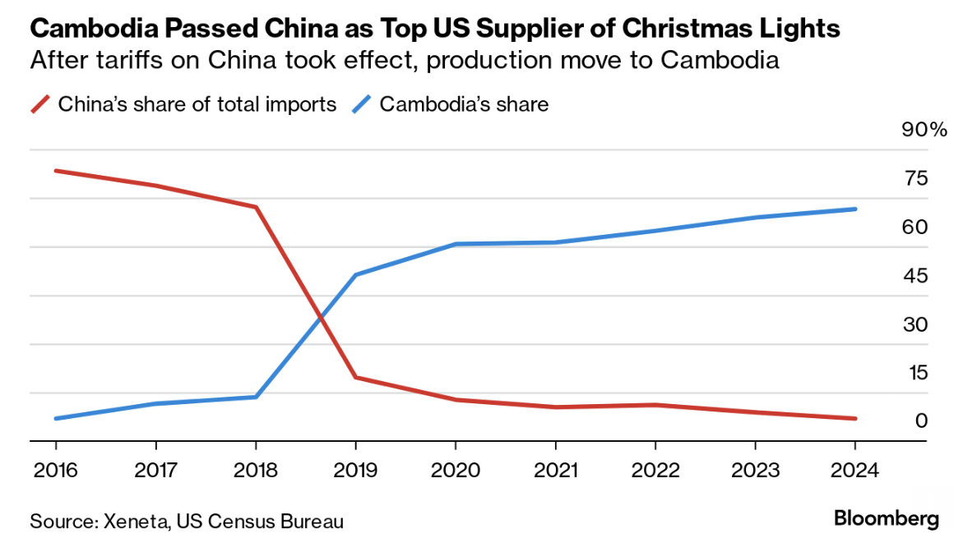
Effects of Trump I on Christmas Lights
A few key things are unclear in the case of Christmas lights that Xeneta analyzed, like whether the production actually moved from China or whether the goods were merely diverted and then packaged in Cambodia by Chinese affiliates.
Notes:
Bloomberg Supply Lines, 11/14/24
https://mail.google.com/mail/u/0/?shva=1#inbox/FMfcgzQXKDfRqwmLlHHMJDDlWNpqbKTq

Slide 37
Effects of a tariff
Do tariffs reduce a trade deficit?
  Trump thinks so, but the US deficit grew under him (see above)
  A trade deficit equals Expenditure minus Income
  There is no reason for tariffs to reduce expenditure
  And unless in a recession, no reason for tariffs to raise income
  So NO!

Slide 38
Effects of a tariff
Government revenue
  Could Trump’s proposed tariffs replace the US income tax?
  NO!
  If imports did not fall (they would!), his tariffs would have collected in 2023:
    60% on US goods imports from China, 0.6✕$0.43tr = $0.26tr
    20% on US goods imports from non-China, 0.2✕$3.40tr = $0.68tr
    Total: $0.94tr
  US federal income tax revenue in 2023 was $2.18tr
  So his tariffs would collect AT MOST less than half of the income tax

Slide 39
Other effects of a tariff
Income distribution
  Tariffs, especially on China, raise prices of the products disproportionately bought by low-income consumers, hurting them more than high-income consumers
Retaliation
  Other countries place tariffs on US exports
  Trade war that started in 2018 continues and gets worse
Corruption
  Historically, tariffs prompted both smuggling and bribes to customs officers
  Today, in the US, those are less likely.
  But requests for exemptions from tariffs may be accompanied by favors or political contributions

Slide 40
Effects of
Trump II Tariffs

Slide 41
Effects of Trump II Tariffs
Source: Warwick McKibbin, Megan Hogan, and Marcus Noland, “The International Economic Implications of a Second Trump Presidency,” Working Paper 24-20, Peterson Institute of International Econnomics, September 2024
  They use a large computer model of both microeconomics and macroeconomics to calculate effects of
    Deportation of 8.3 million unauthorized immigrant workers
    Tariffs
      10% on all imports
      60% on imports from China
    Erosion of Federal Reserve independence
  Results below only for the 2 sets of tariffs
Notes:
Warwick McKibbin, Megan Hogan, and Marcus Noland, “The International Economic Implications of a Second Trump Presidency,” Working Paper 24-20, Peterson Institute of International Econnomics, September 2024.
https://www.piie.com/publications/working-papers/2024/international-economic-implications-second-trump-presidency

Slide 42
Effects of Trump Proposed Tariffs
on GDP

Slide 43
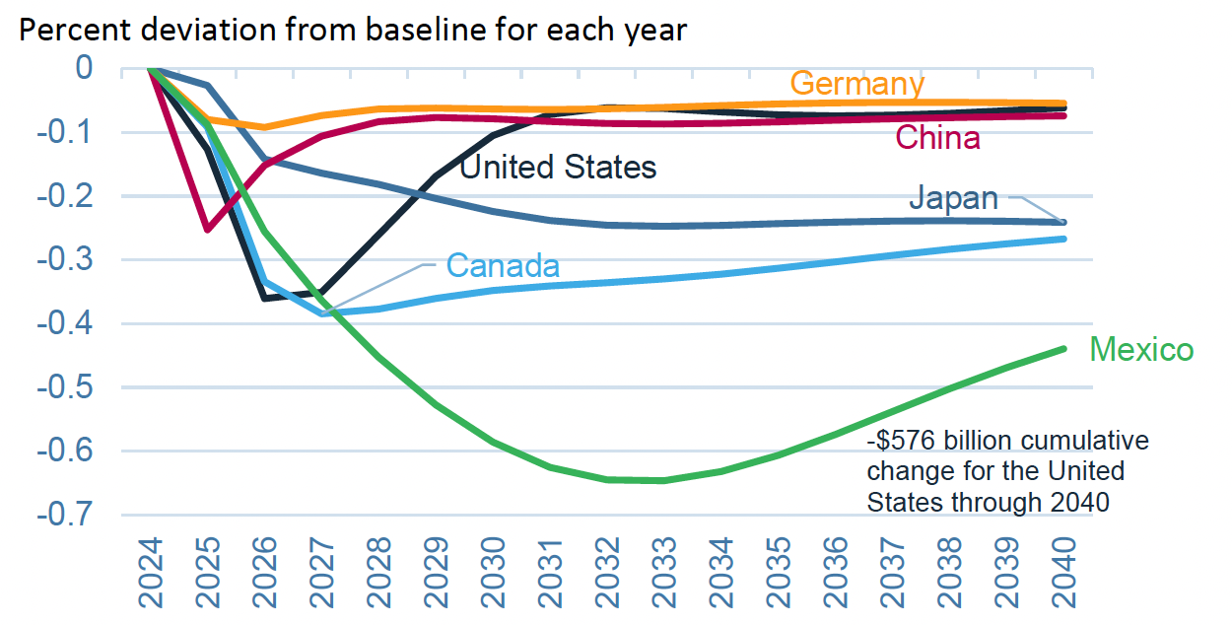
Effects of 10% Tariff on All US Imports
Real GDP
Notes:
Warwick McKibbin, Megan Hogan, and Marcus Noland, “The International Economic Implications of a Second Trump Presidency,” Working Paper 24-20, Peterson Institute of International Econnomics, September 2024.
https://www.piie.com/publications/working-papers/2024/international-economic-implications-second-trump-presidency

Slide 44
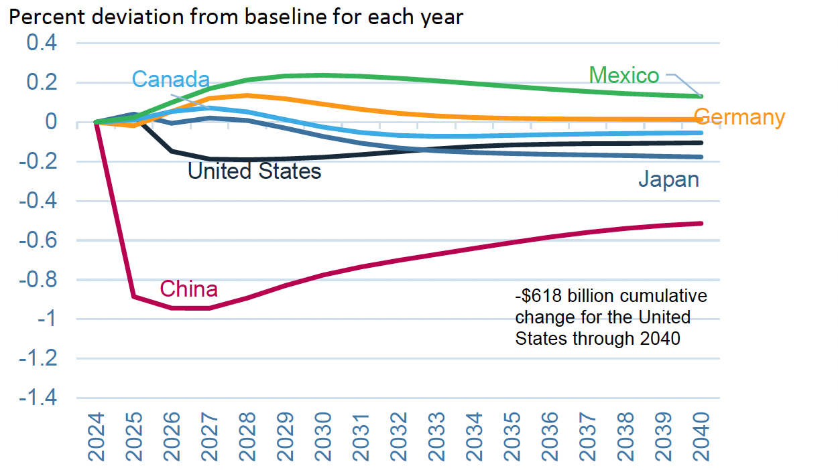
Effects of 60% Tariff on China Exports
Real GDP
Notes:
Warwick McKibbin, Megan Hogan, and Marcus Noland, “The International Economic Implications of a Second Trump Presidency,” Working Paper 24-20, Peterson Institute of International Econnomics, September 2024.
https://www.piie.com/publications/working-papers/2024/international-economic-implications-second-trump-presidency

Slide 45
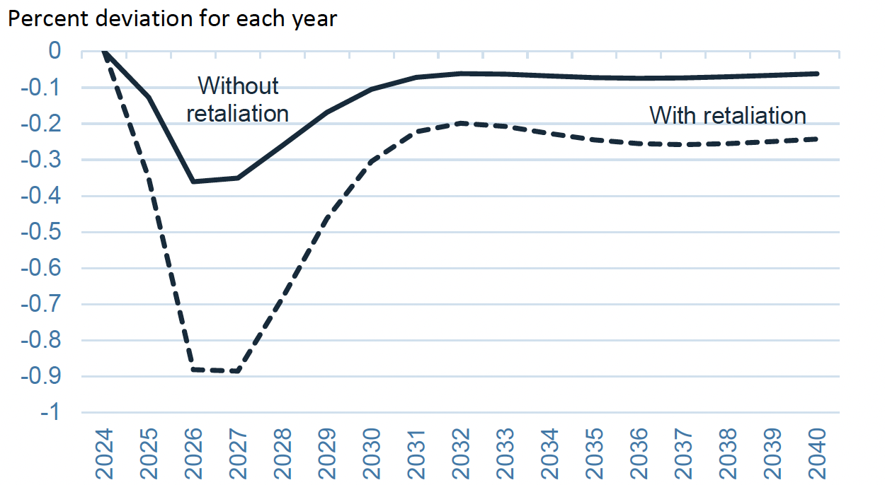
Effects of 10% Tariff on All US Imports
US GDP with and without Retaliation
Notes:
Warwick McKibbin, Megan Hogan, and Marcus Noland, “The International Economic Implications of a Second Trump Presidency,” Working Paper 24-20, Peterson Institute of International Econnomics, September 2024.
https://www.piie.com/publications/working-papers/2024/international-economic-implications-second-trump-presidency

Slide 46
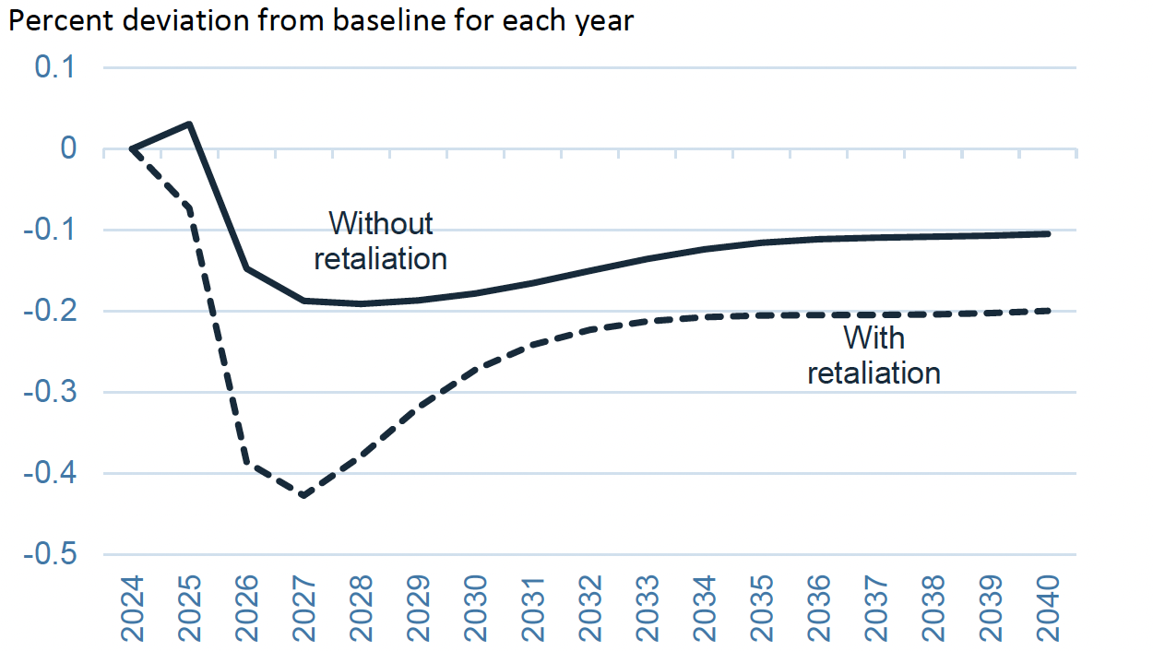
Effects of 60% Tariff on China Exports
US GDP with and without Retaliation
Notes:
Warwick McKibbin, Megan Hogan, and Marcus Noland, “The International Economic Implications of a Second Trump Presidency,” Working Paper 24-20, Peterson Institute of International Econnomics, September 2024.
https://www.piie.com/publications/working-papers/2024/international-economic-implications-second-trump-presidency

Slide 47
Effects of Trump Proposed Tariffs
on Employment

Slide 48
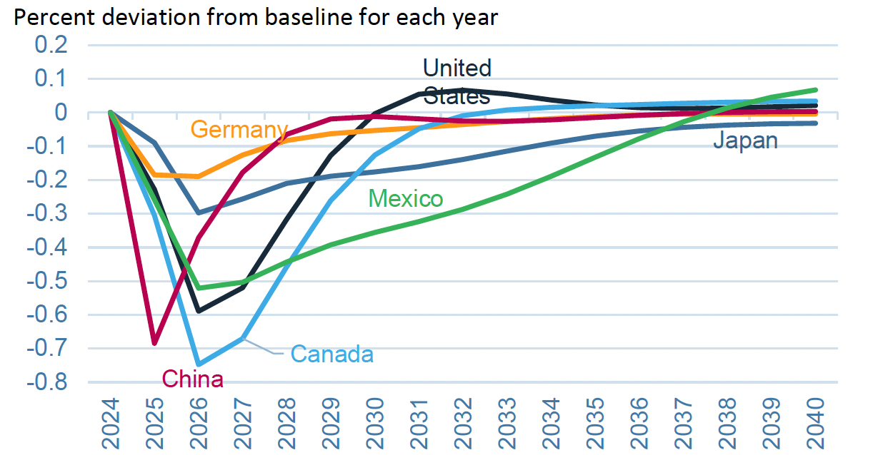
Effects of 10% Tariff on All US Imports
Employment
Notes:
Warwick McKibbin, Megan Hogan, and Marcus Noland, “The International Economic Implications of a Second Trump Presidency,” Working Paper 24-20, Peterson Institute of International Econnomics, September 2024.
https://www.piie.com/publications/working-papers/2024/international-economic-implications-second-trump-presidency

Slide 49
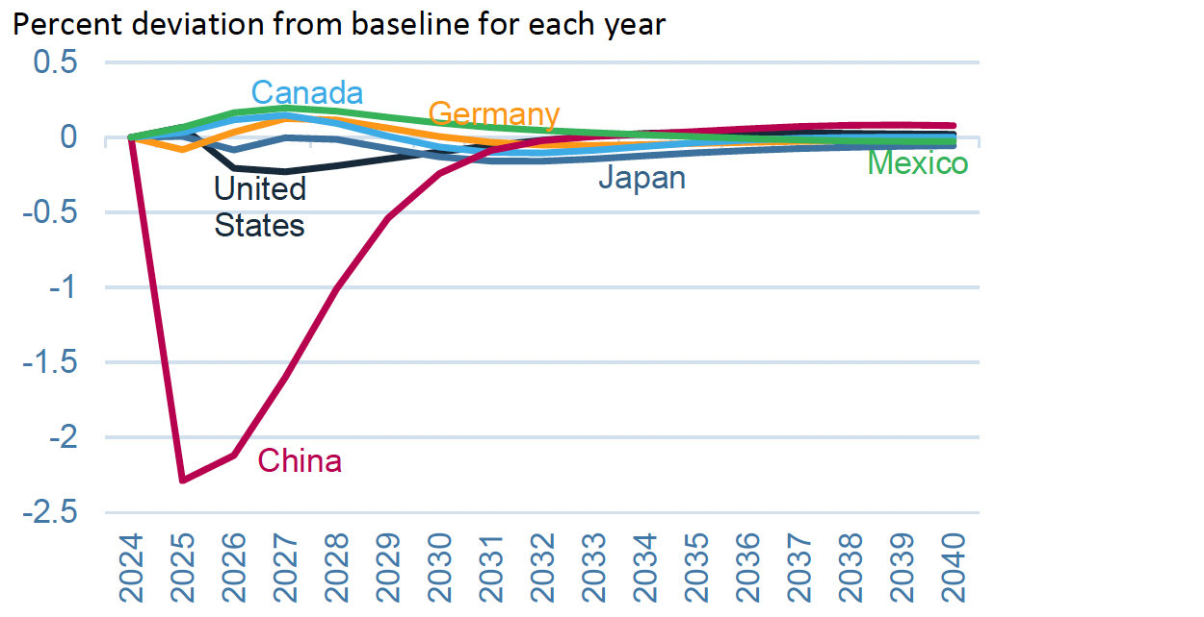
Effects of 60% Tariff on China Exports
Employment
Notes:
Warwick McKibbin, Megan Hogan, and Marcus Noland, “The International Economic Implications of a Second Trump Presidency,” Working Paper 24-20, Peterson Institute of International Econnomics, September 2024.
https://www.piie.com/publications/working-papers/2024/international-economic-implications-second-trump-presidency

Slide 50
Effects of Trump Proposed Tariffs
on Inflation

Slide 51
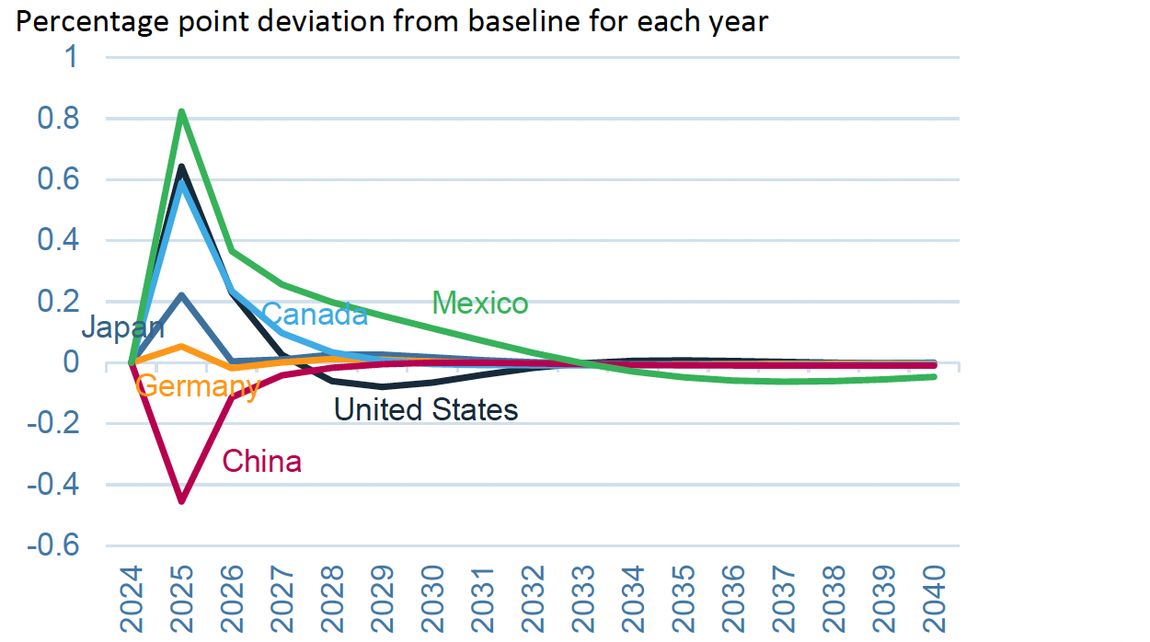
Effects of 10% Tariff on All US Imports
Inflation
Notes:
Warwick McKibbin, Megan Hogan, and Marcus Noland, “The International Economic Implications of a Second Trump Presidency,” Working Paper 24-20, Peterson Institute of International Econnomics, September 2024.
https://www.piie.com/publications/working-papers/2024/international-economic-implications-second-trump-presidency

Slide 52
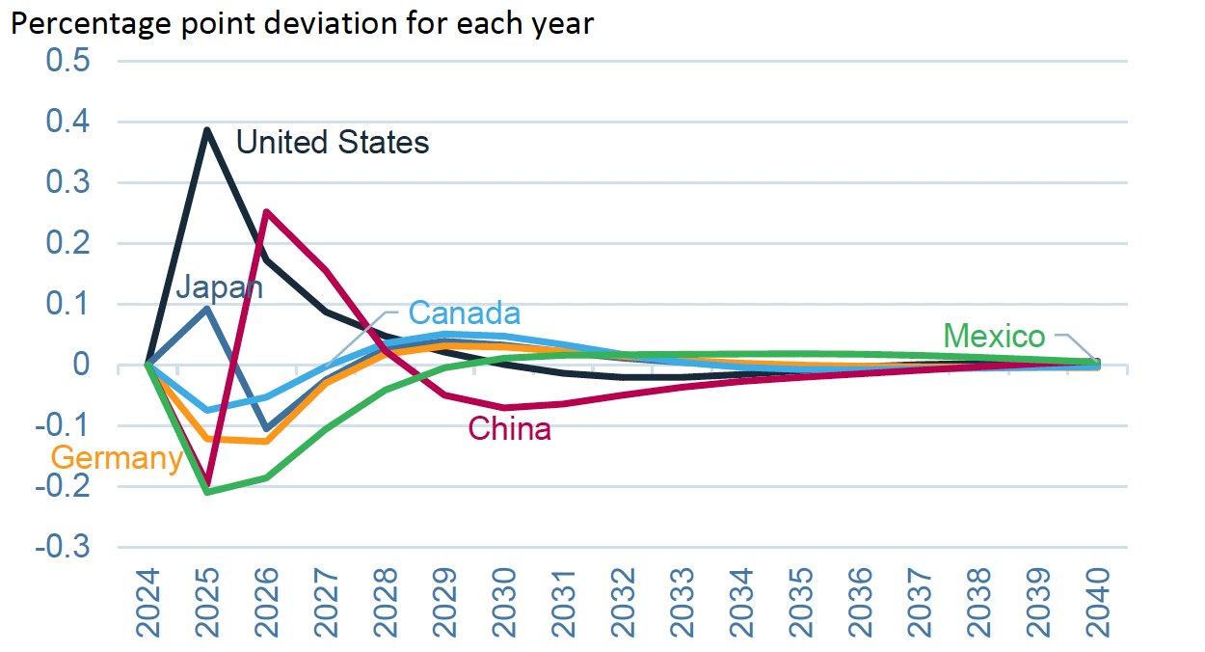
Effects of 60% Tariff on China Exports
Inflation
Notes:
Warwick McKibbin, Megan Hogan, and Marcus Noland, “The International Economic Implications of a Second Trump Presidency,” Working Paper 24-20, Peterson Institute of International Econnomics, September 2024.
https://www.piie.com/publications/working-papers/2024/international-economic-implications-second-trump-presidency

Slide 53
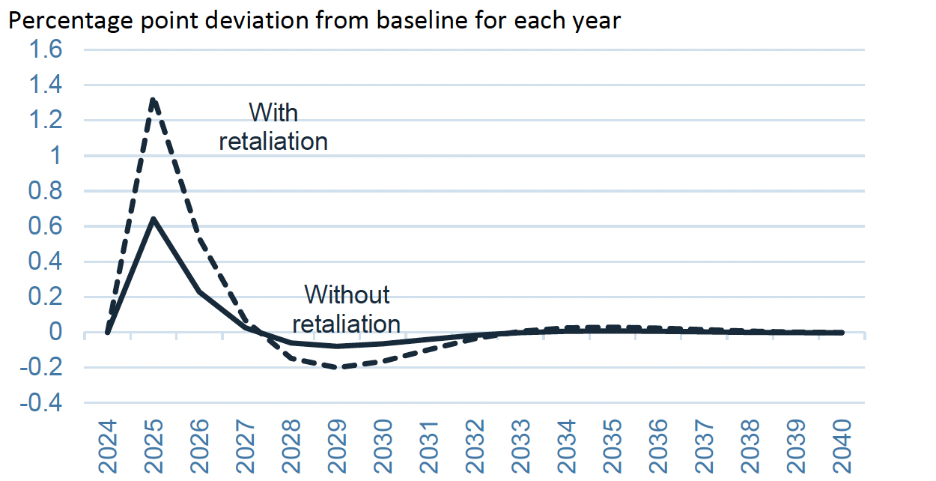
Effects of 10% Tariff on All US Imports
US Inflation with and without Retaliation
Notes:
Warwick McKibbin, Megan Hogan, and Marcus Noland, “The International Economic Implications of a Second Trump Presidency,” Working Paper 24-20, Peterson Institute of International Econnomics, September 2024.
https://www.piie.com/publications/working-papers/2024/international-economic-implications-second-trump-presidency

Slide 54
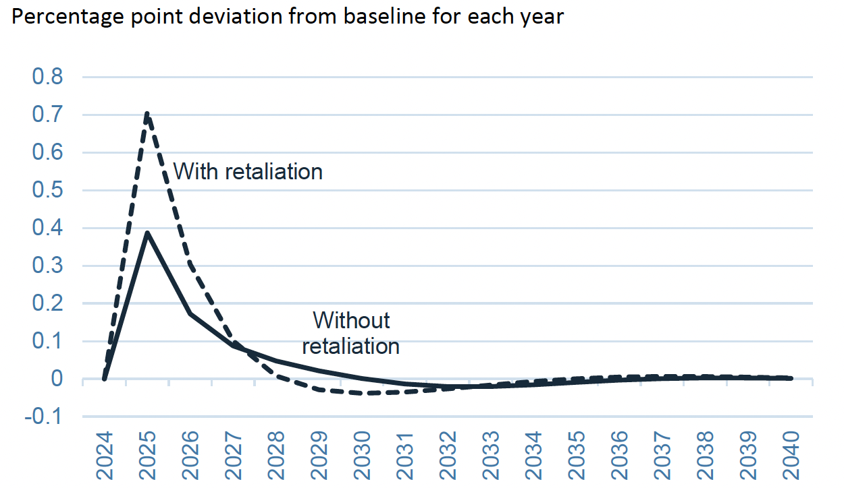
Effects of 60% Tariff on China Exports
US Inflation with and without Retaliation
Notes:
Warwick McKibbin, Megan Hogan, and Marcus Noland, “The International Economic Implications of a Second Trump Presidency,” Working Paper 24-20, Peterson Institute of International Econnomics, September 2024.
https://www.piie.com/publications/working-papers/2024/international-economic-implications-second-trump-presidency

Slide 55
Effects of Trump Proposed Tariffs
on Trade Surplus

Slide 56
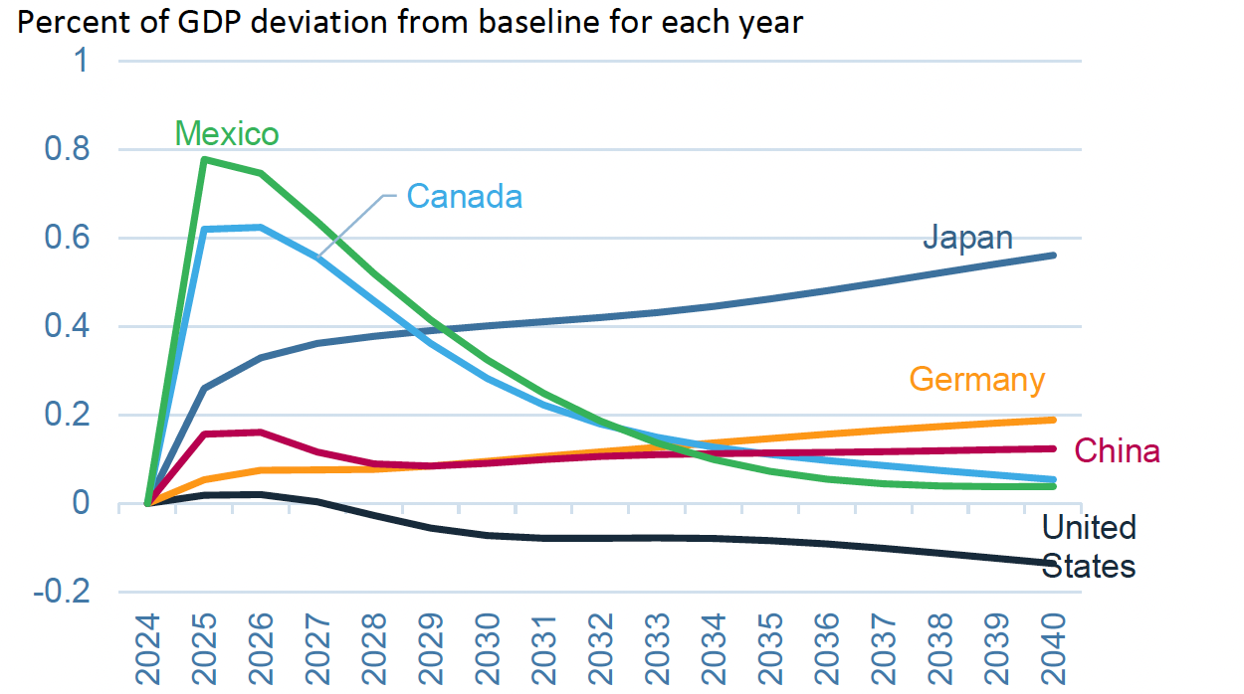
Effects of 10% Tariff on All US Imports
Trade Surplus
Notes:
Warwick McKibbin, Megan Hogan, and Marcus Noland, “The International Economic Implications of a Second Trump Presidency,” Working Paper 24-20, Peterson Institute of International Econnomics, September 2024.
https://www.piie.com/publications/working-papers/2024/international-economic-implications-second-trump-presidency

Slide 57
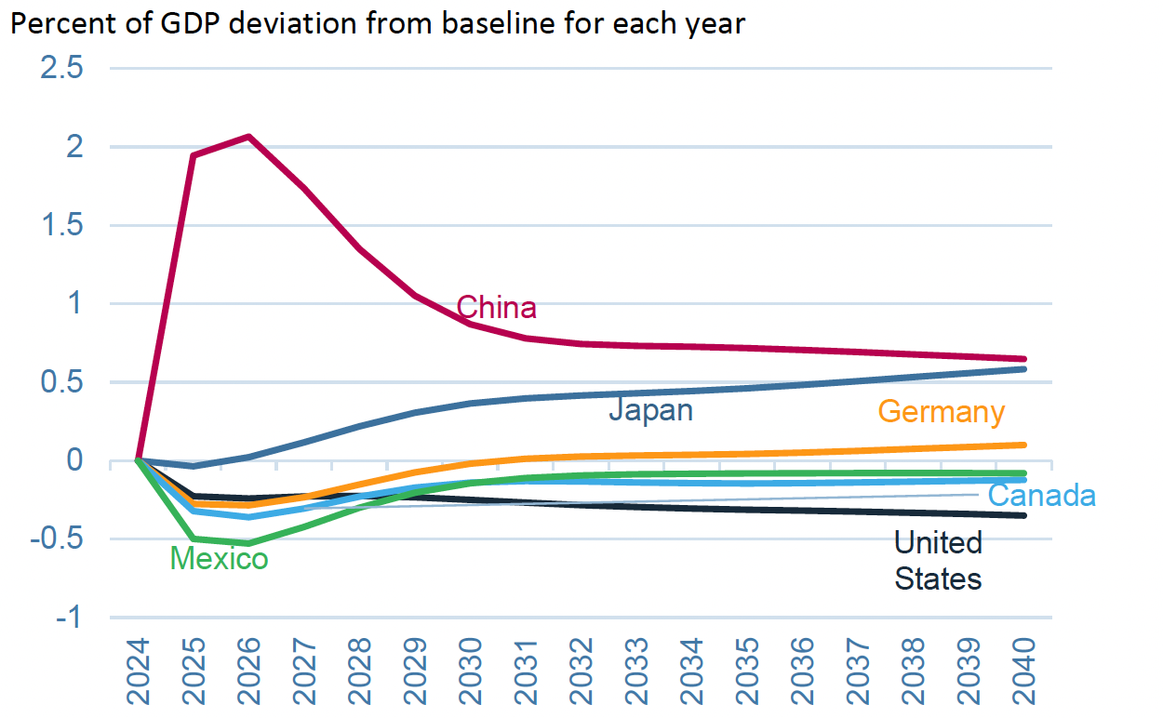
Effects of 60% Tariff on China Exports
Trade Surplus
Notes:
Warwick McKibbin, Megan Hogan, and Marcus Noland, “The International Economic Implications of a Second Trump Presidency,” Working Paper 24-20, Peterson Institute of International Econnomics, September 2024.
https://www.piie.com/publications/working-papers/2024/international-economic-implications-second-trump-presidency

Slide 58
Effects of Trump Proposed Tariffs
on Sectoral
Production

Slide 59
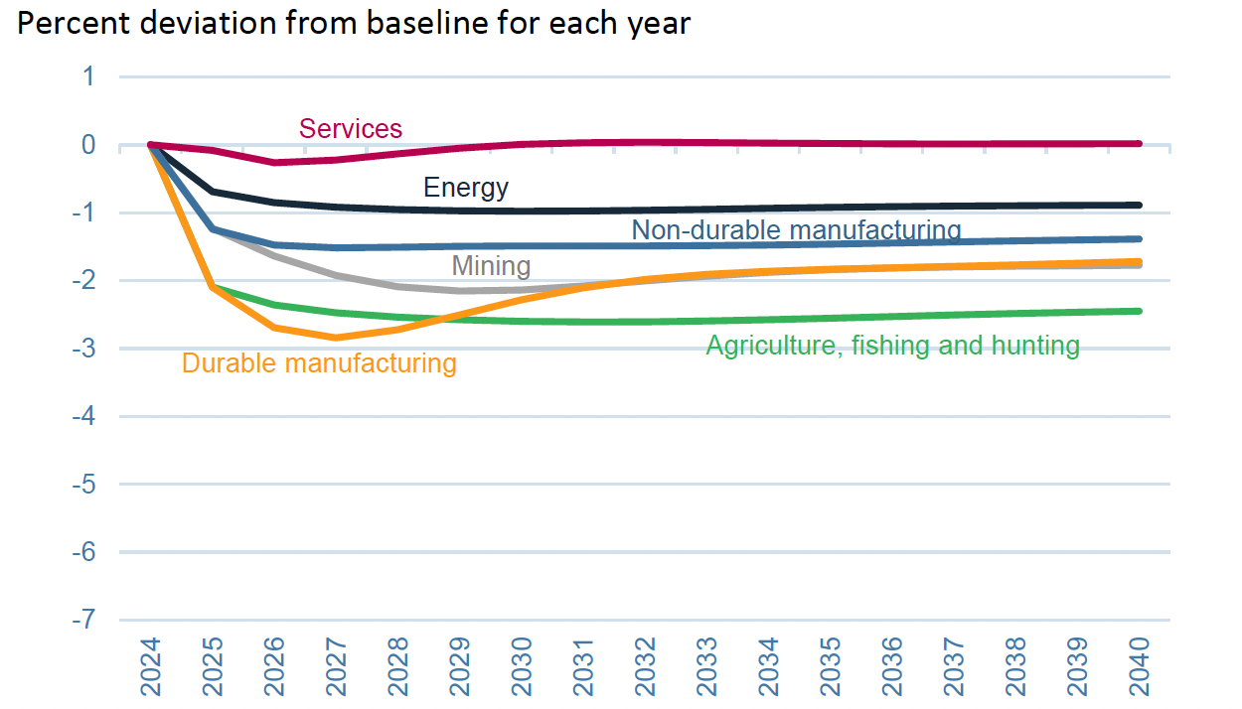
Effects of 10% Tariff on All US Imports
US Sectoral Production
Notes:
Warwick McKibbin, Megan Hogan, and Marcus Noland, “The International Economic Implications of a Second Trump Presidency,” Working Paper 24-20, Peterson Institute of International Econnomics, September 2024.
https://www.piie.com/publications/working-papers/2024/international-economic-implications-second-trump-presidency

Slide 60
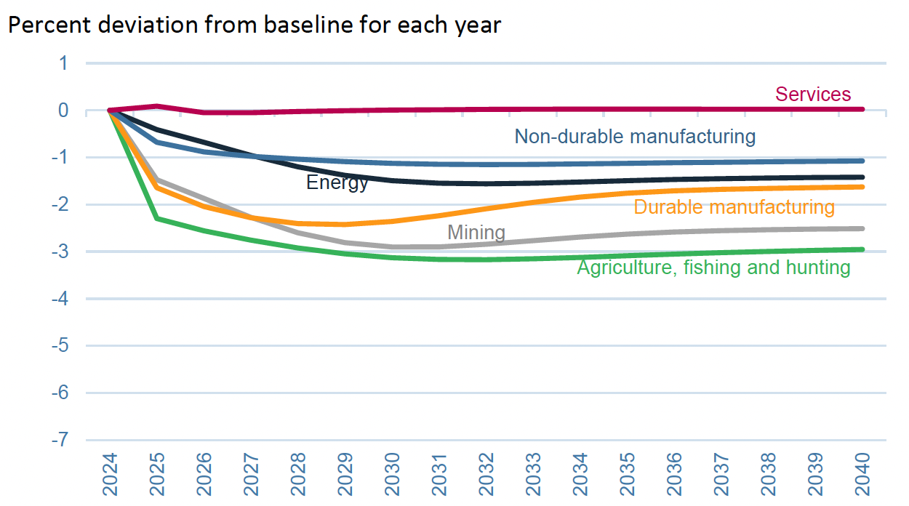
Effects of 60% Tariff on China Exports
US Sectoral Production
Notes:
Warwick McKibbin, Megan Hogan, and Marcus Noland, “The International Economic Implications of a Second Trump Presidency,” Working Paper 24-20, Peterson Institute of International Econnomics, September 2024.
https://www.piie.com/publications/working-papers/2024/international-economic-implications-second-trump-presidency

Slide 61
Effects of Trump Proposed Tariffs
on Sectoral
Employment

Slide 62
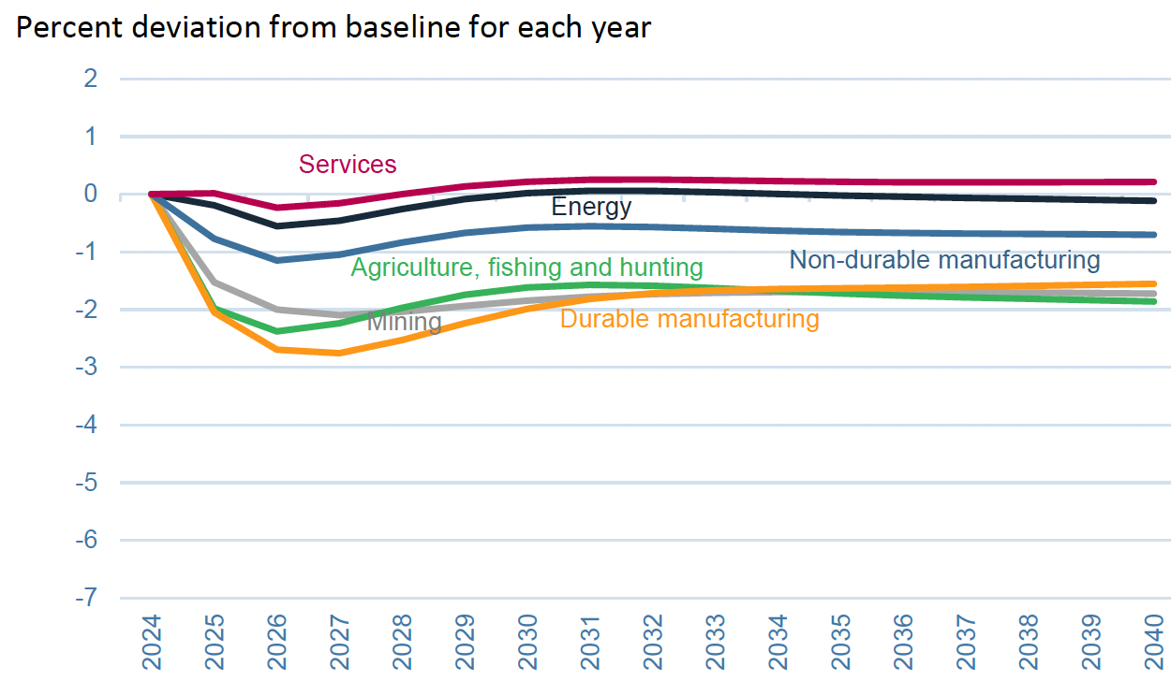
Effects of 10% Tariff on All US Imports
US Sectoral Employment
Notes:
Warwick McKibbin, Megan Hogan, and Marcus Noland, “The International Economic Implications of a Second Trump Presidency,” Working Paper 24-20, Peterson Institute of International Econnomics, September 2024.
https://www.piie.com/publications/working-papers/2024/international-economic-implications-second-trump-presidency

Slide 63
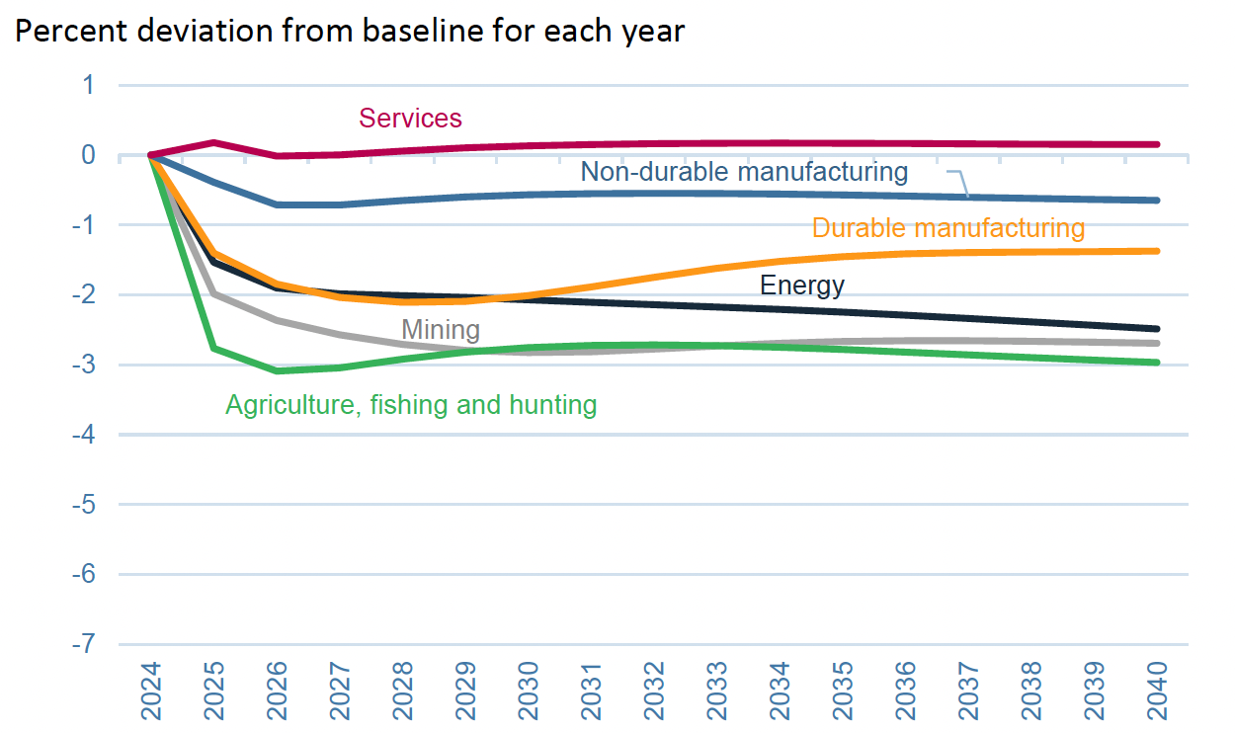
Effects of 60% Tariff on China Exports
US Sectoral Employment
Notes:
Warwick McKibbin, Megan Hogan, and Marcus Noland, “The International Economic Implications of a Second Trump Presidency,” Working Paper 24-20, Peterson Institute of International Econnomics, September 2024.
https://www.piie.com/publications/working-papers/2024/international-economic-implications-second-trump-presidency

Slide 64
Effects of Trump Proposed Tariffs
on Sectoral
Prices

Slide 65
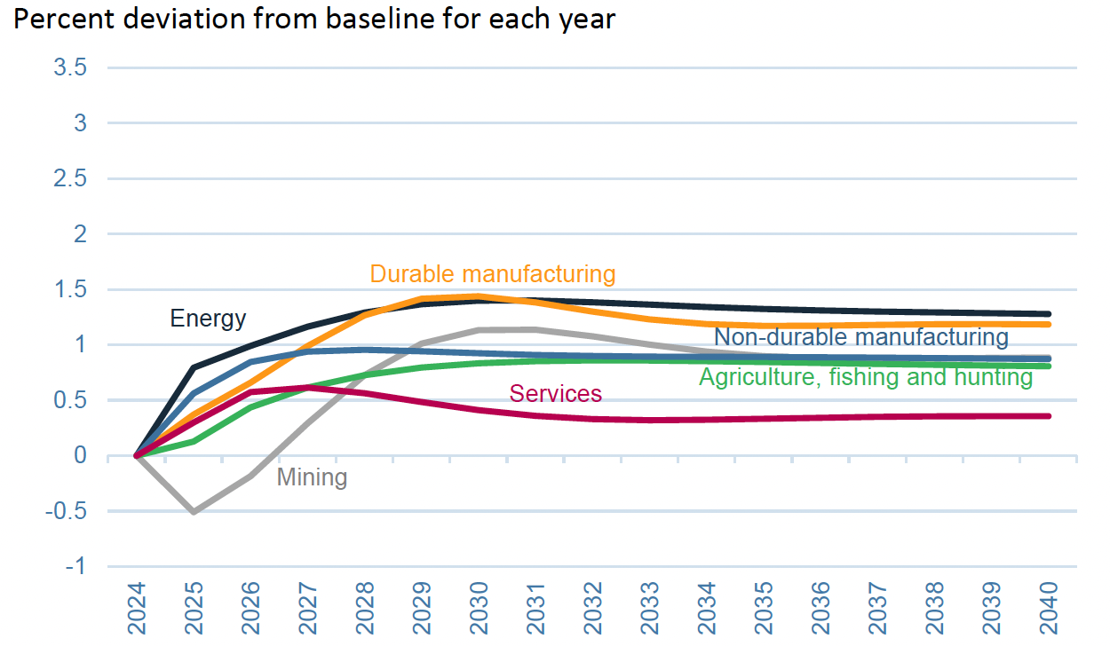
Effects of 10% Tariff on All US Imports
Sectoral Prices
Notes:
Warwick McKibbin, Megan Hogan, and Marcus Noland, “The International Economic Implications of a Second Trump Presidency,” Working Paper 24-20, Peterson Institute of International Econnomics, September 2024.
https://www.piie.com/publications/working-papers/2024/international-economic-implications-second-trump-presidency

Slide 66
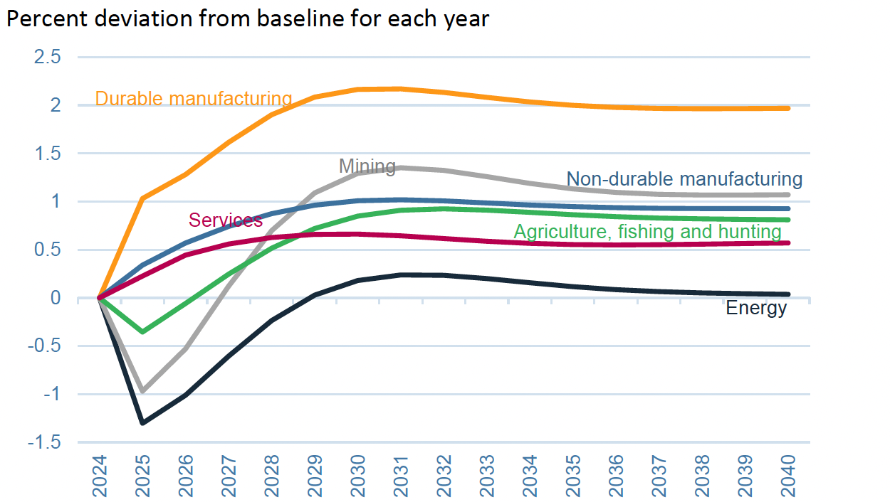
Effects of 60% Tariff on China Exports
US Sectoral Prices
Notes:
Warwick McKibbin, Megan Hogan, and Marcus Noland, “The International Economic Implications of a Second Trump Presidency,” Working Paper 24-20, Peterson Institute of International Econnomics, September 2024.
https://www.piie.com/publications/working-papers/2024/international-economic-implications-second-trump-presidency

Slide 67
Effects of Trump Proposed Tariffs
Which products come from
which countries?
SourceP. Luis Melgar and Rachel Lerman, “See which products Trump’s tariffs could make more expensive,” Washington Post, December 5, 2024.

Slide 68
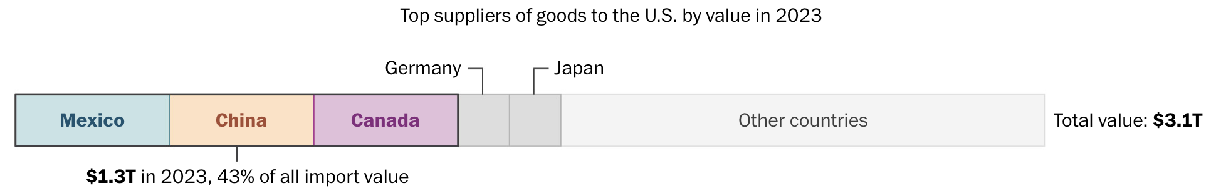
Notes:
Luis Melgar and Rachel Lerman, “See which products Trump’s tariffs could make more expensive,” Washington Post, December 5, 2024.
https://www.washingtonpost.com/business/2024/12/05/trump-china-mexico-canada-tariffs-prices/?utm_campaign=wp_evening_edition&utm_medium=email&utm_source=newsletter&carta-url=https%3A%2F%2Fs2.washingtonpost.com%2Fcar-ln-tr%2F3fd6330%2F67522261e179af1b45e73c5e%2F597273baade4e21a847d94bd%2F27%2F50%2F67522261e179af1b45e73c5e

Slide 69
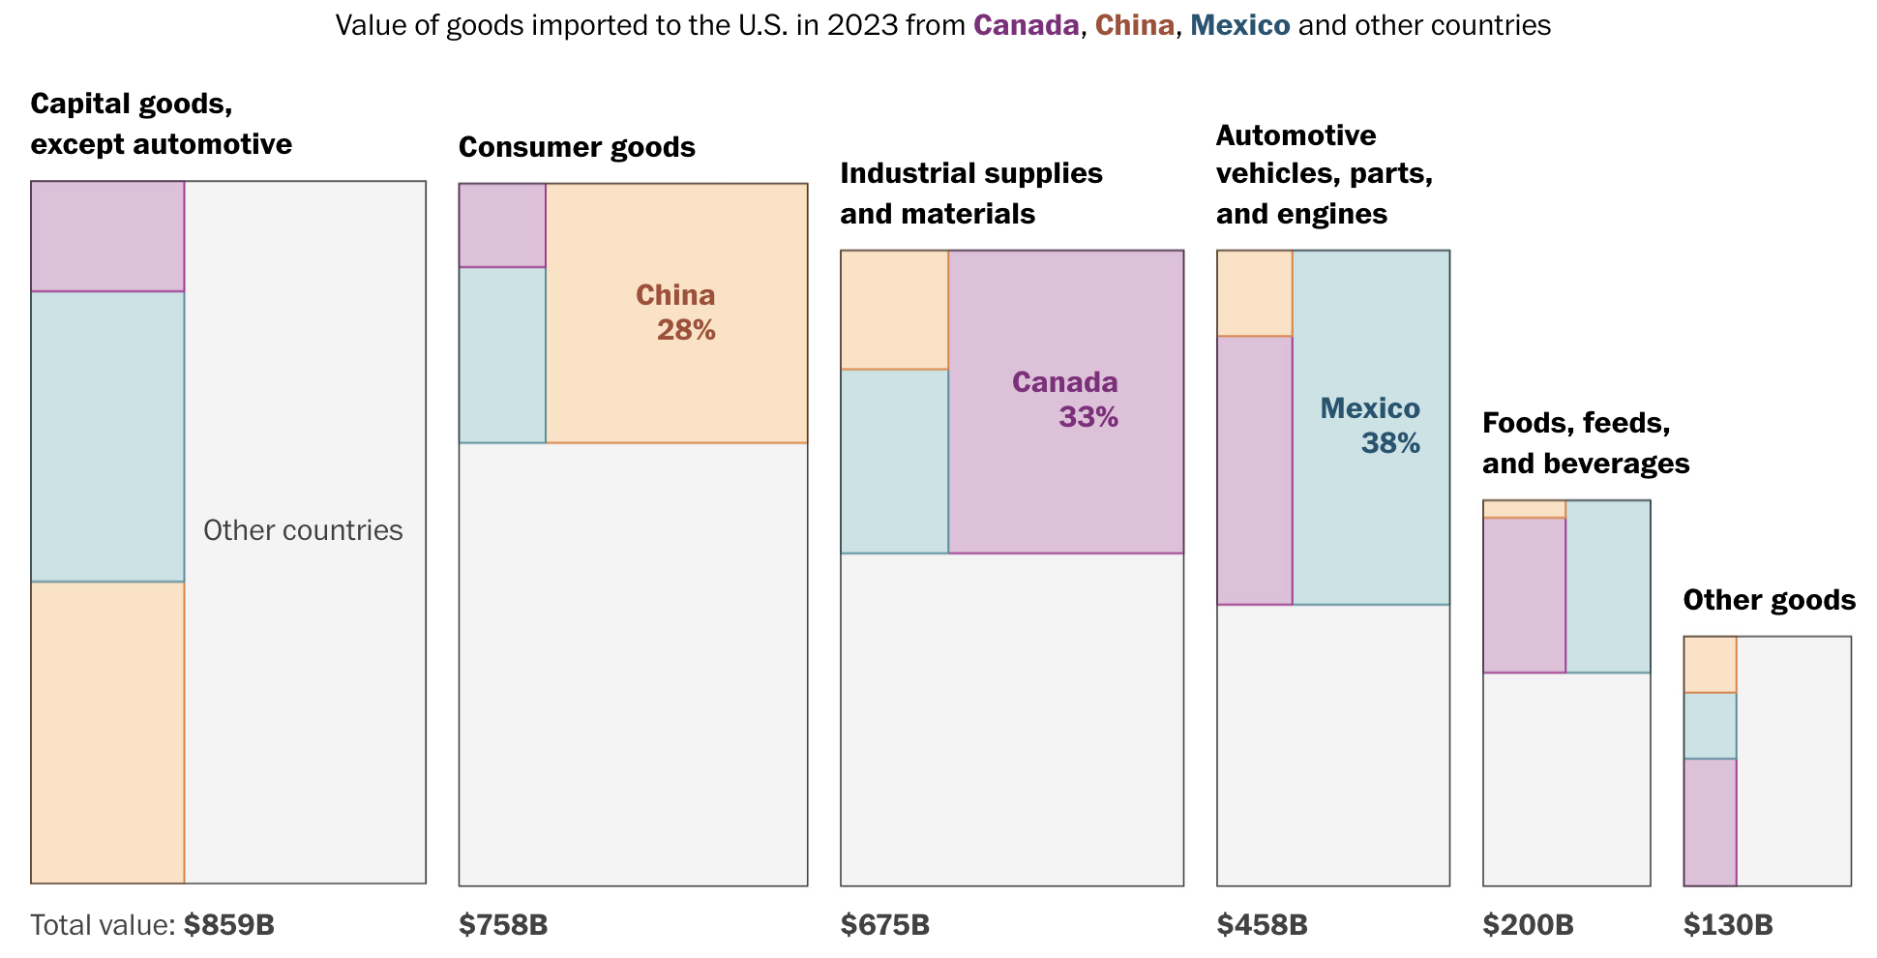
Notes:
Luis Melgar and Rachel Lerman, “See which products Trump’s tariffs could make more expensive,” Washington Post, December 5, 2024.
https://www.washingtonpost.com/business/2024/12/05/trump-china-mexico-canada-tariffs-prices/?utm_campaign=wp_evening_edition&utm_medium=email&utm_source=newsletter&carta-url=https%3A%2F%2Fs2.washingtonpost.com%2Fcar-ln-tr%2F3fd6330%2F67522261e179af1b45e73c5e%2F597273baade4e21a847d94bd%2F27%2F50%2F67522261e179af1b45e73c5e

Slide 70
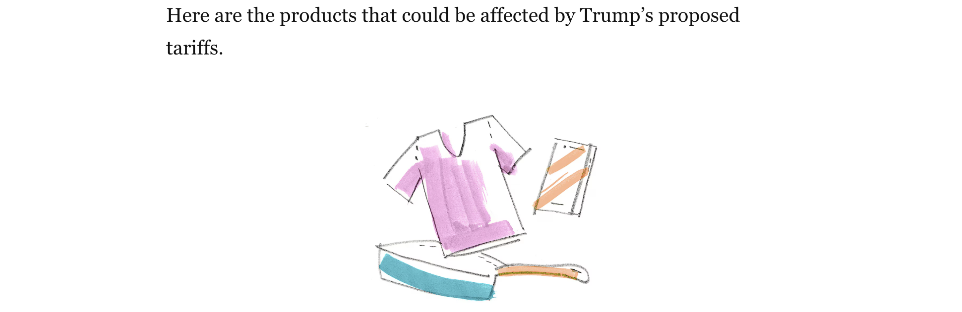
Notes:
Luis Melgar and Rachel Lerman, “See which products Trump’s tariffs could make more expensive,” Washington Post, December 5, 2024.
https://www.washingtonpost.com/business/2024/12/05/trump-china-mexico-canada-tariffs-prices/?utm_campaign=wp_evening_edition&utm_medium=email&utm_source=newsletter&carta-url=https%3A%2F%2Fs2.washingtonpost.com%2Fcar-ln-tr%2F3fd6330%2F67522261e179af1b45e73c5e%2F597273baade4e21a847d94bd%2F27%2F50%2F67522261e179af1b45e73c5e

Slide 71
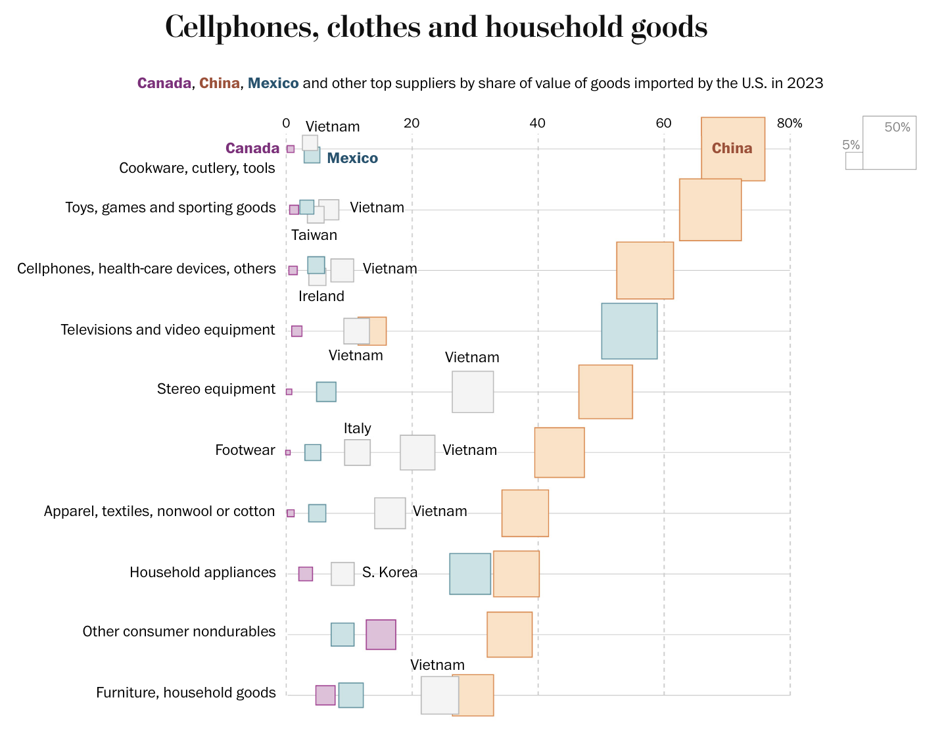
Notes:
Luis Melgar and Rachel Lerman, “See which products Trump’s tariffs could make more expensive,” Washington Post, December 5, 2024.
https://www.washingtonpost.com/business/2024/12/05/trump-china-mexico-canada-tariffs-prices/?utm_campaign=wp_evening_edition&utm_medium=email&utm_source=newsletter&carta-url=https%3A%2F%2Fs2.washingtonpost.com%2Fcar-ln-tr%2F3fd6330%2F67522261e179af1b45e73c5e%2F597273baade4e21a847d94bd%2F27%2F50%2F67522261e179af1b45e73c5e

Slide 72
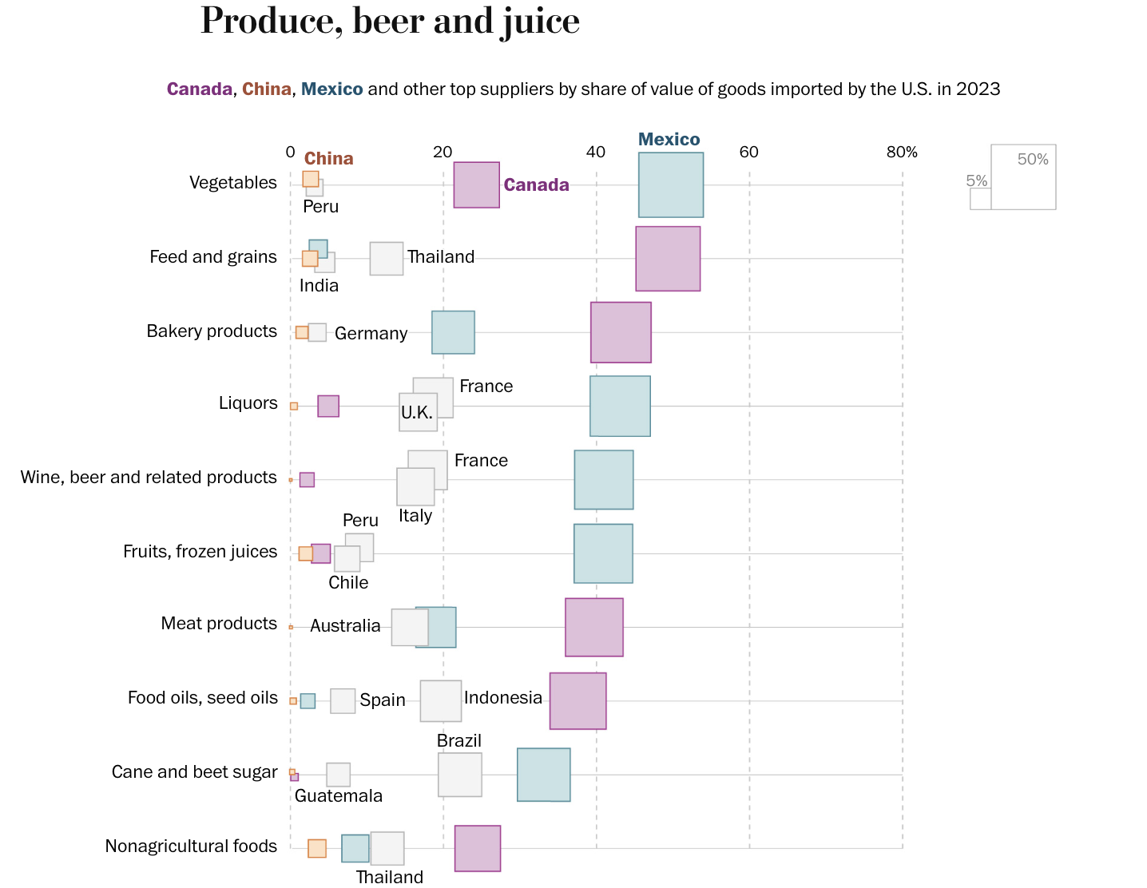
Notes:
Luis Melgar and Rachel Lerman, “See which products Trump’s tariffs could make more expensive,” Washington Post, December 5, 2024.
https://www.washingtonpost.com/business/2024/12/05/trump-china-mexico-canada-tariffs-prices/?utm_campaign=wp_evening_edition&utm_medium=email&utm_source=newsletter&carta-url=https%3A%2F%2Fs2.washingtonpost.com%2Fcar-ln-tr%2F3fd6330%2F67522261e179af1b45e73c5e%2F597273baade4e21a847d94bd%2F27%2F50%2F67522261e179af1b45e73c5e

Slide 73
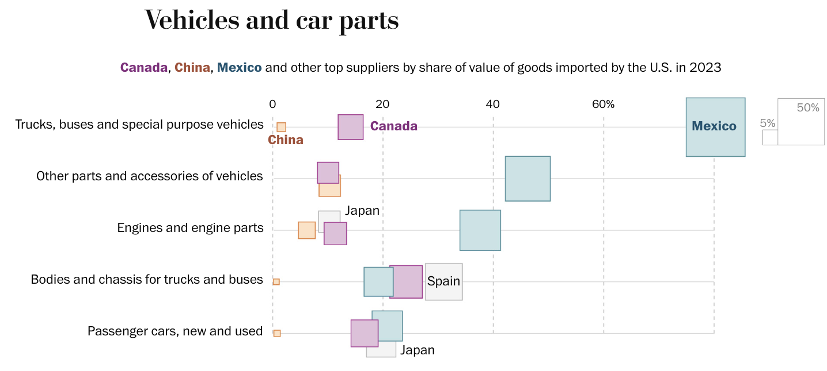
Notes:
Luis Melgar and Rachel Lerman, “See which products Trump’s tariffs could make more expensive,” Washington Post, December 5, 2024.
https://www.washingtonpost.com/business/2024/12/05/trump-china-mexico-canada-tariffs-prices/?utm_campaign=wp_evening_edition&utm_medium=email&utm_source=newsletter&carta-url=https%3A%2F%2Fs2.washingtonpost.com%2Fcar-ln-tr%2F3fd6330%2F67522261e179af1b45e73c5e%2F597273baade4e21a847d94bd%2F27%2F50%2F67522261e179af1b45e73c5e

Slide 74
Thank you!
Questions?
See slides on my website
https://websites.umich.edu/~alandear/presentations/

Slide 75
Notes:
Luis Melgar and Rachel Lerman, “See which products Trump’s tariffs could make more expensive,” Washington Post, December 5, 2024.
https://www.washingtonpost.com/business/2024/12/05/trump-china-mexico-canada-tariffs-prices/?utm_campaign=wp_evening_edition&utm_medium=email&utm_source=newsletter&carta-url=https%3A%2F%2Fs2.washingtonpost.com%2Fcar-ln-tr%2F3fd6330%2F67522261e179af1b45e73c5e%2F597273baade4e21a847d94bd%2F27%2F50%2F67522261e179af1b45e73c5e

