Slide 1
Class 1
The State of Play in International Trade and Trade Policy I:
Trade Wars by
Alan V. Deardorff
University of Michigan
2021
PubPol/Econ 541
Figs: Required and Optional

Slide 2
FROM REQUIRED READINGS

Slide 3
FROM OPTIONAL READINGS

Slide 4
Bown, Chad P. and Yilin Wang, "Five Years Into the Trade War, China Continues Its Slow Decoupling From US Exports,"

Slide 5
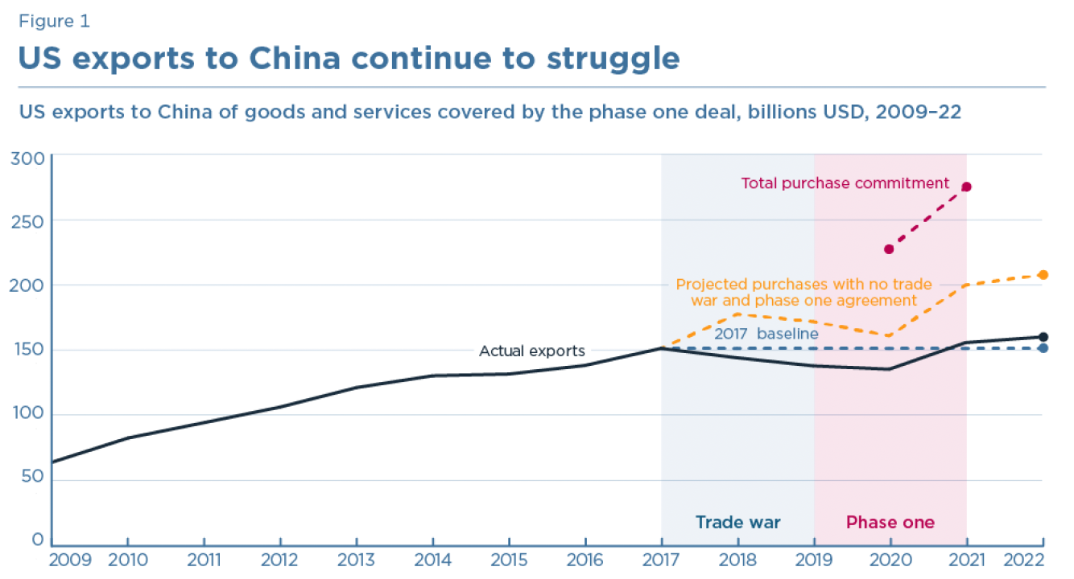

Slide 6
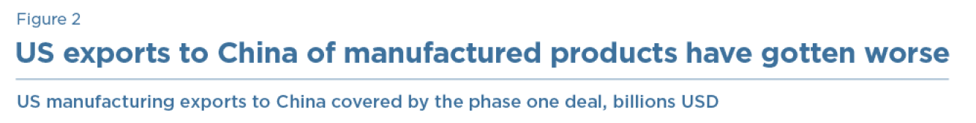
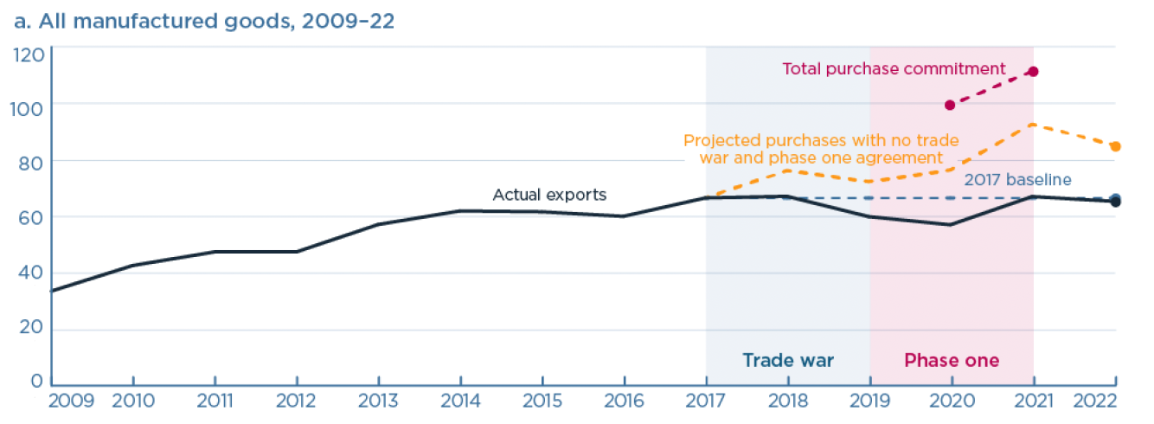

Slide 7
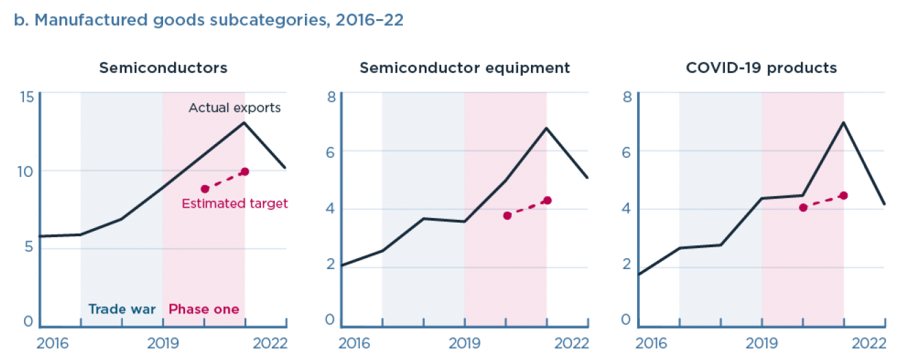
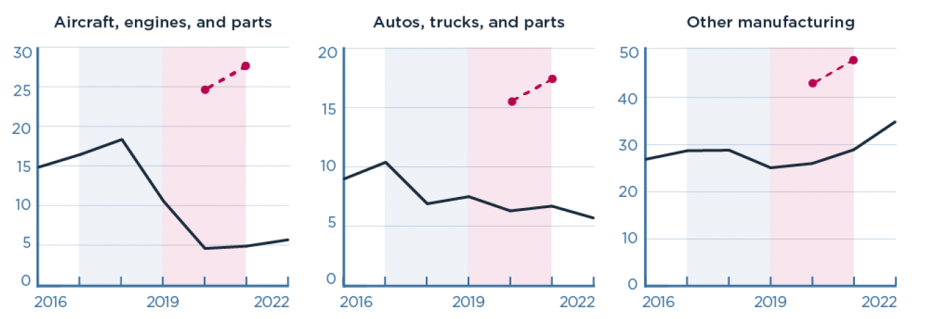

Slide 8
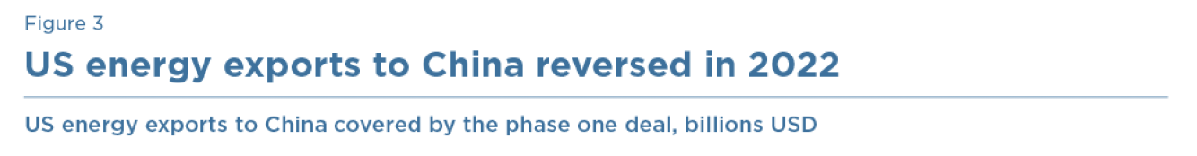
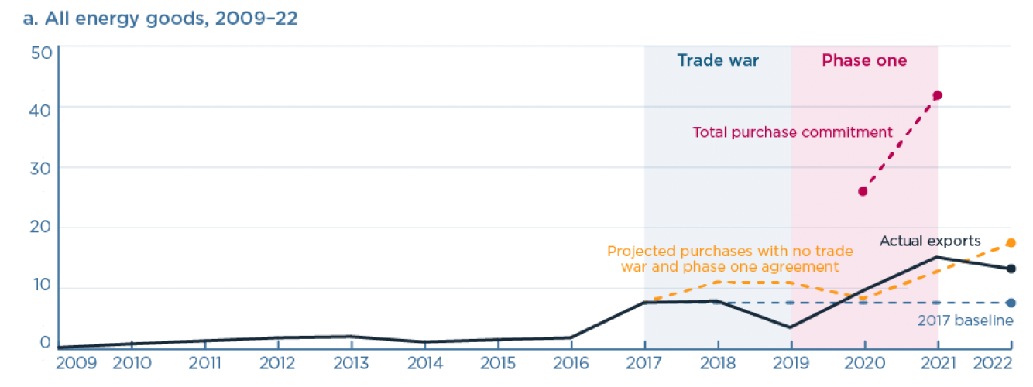

Slide 9
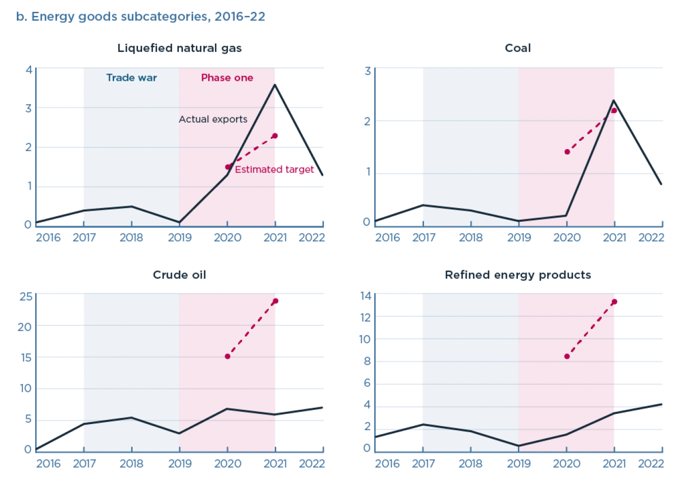

Slide 10
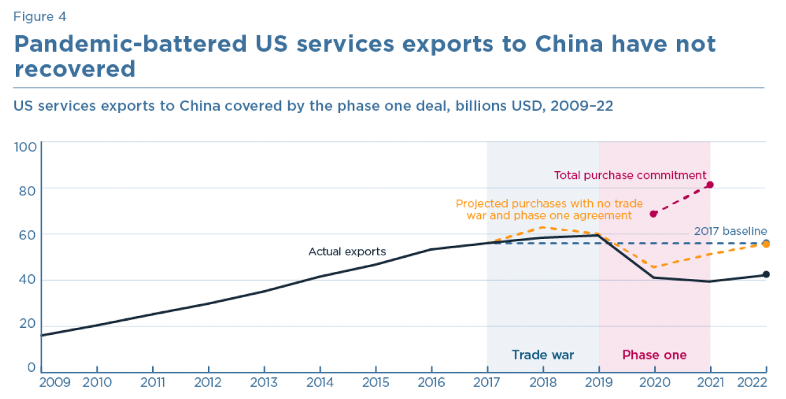

Slide 11
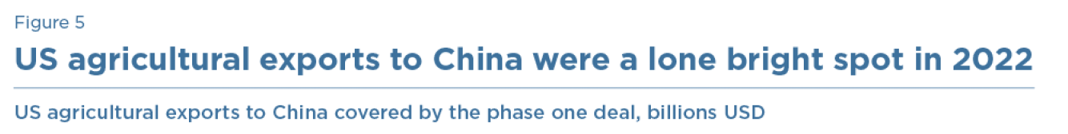
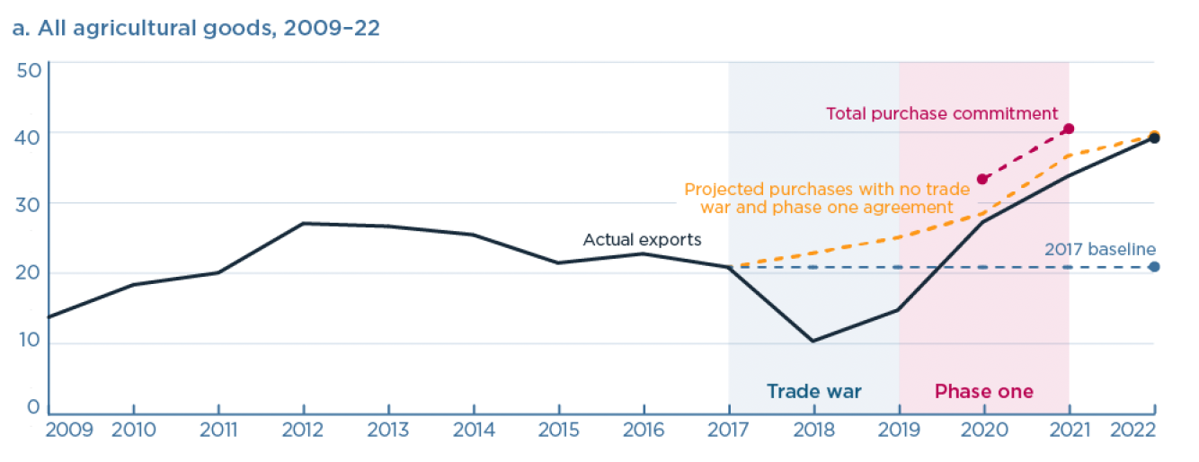

Slide 12
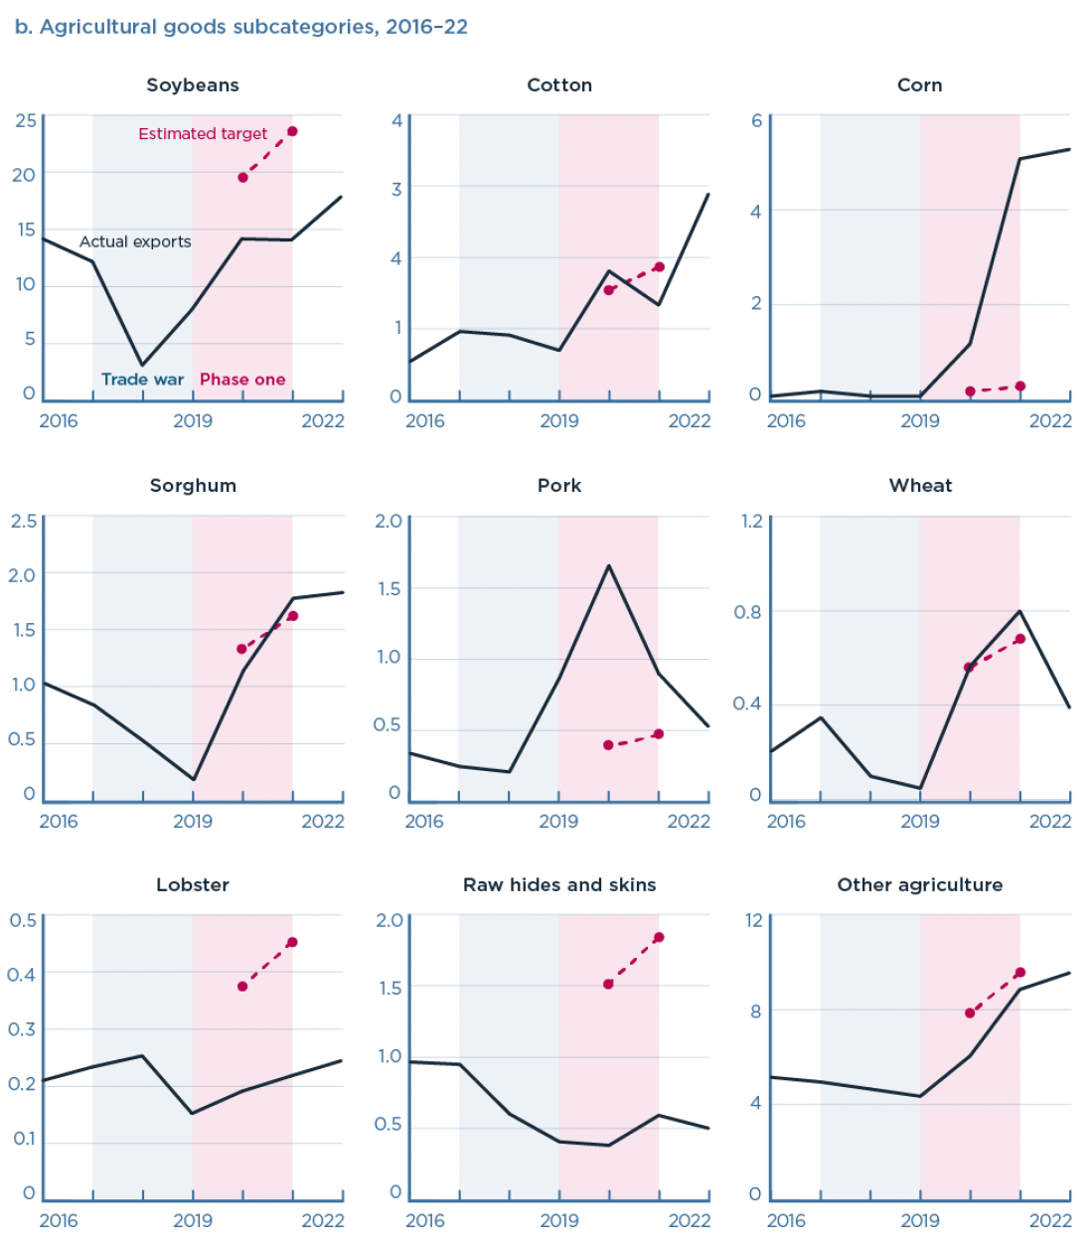

Slide 13
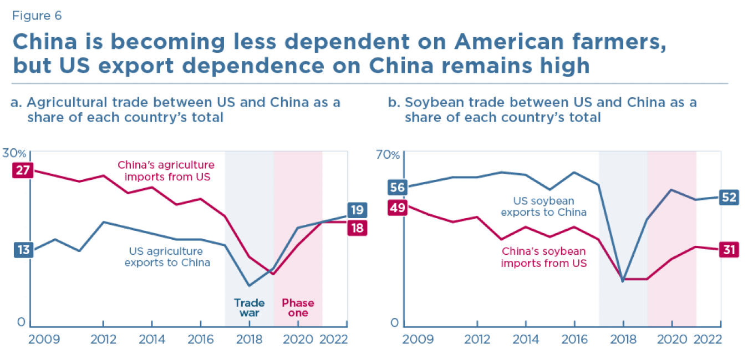

Slide 14
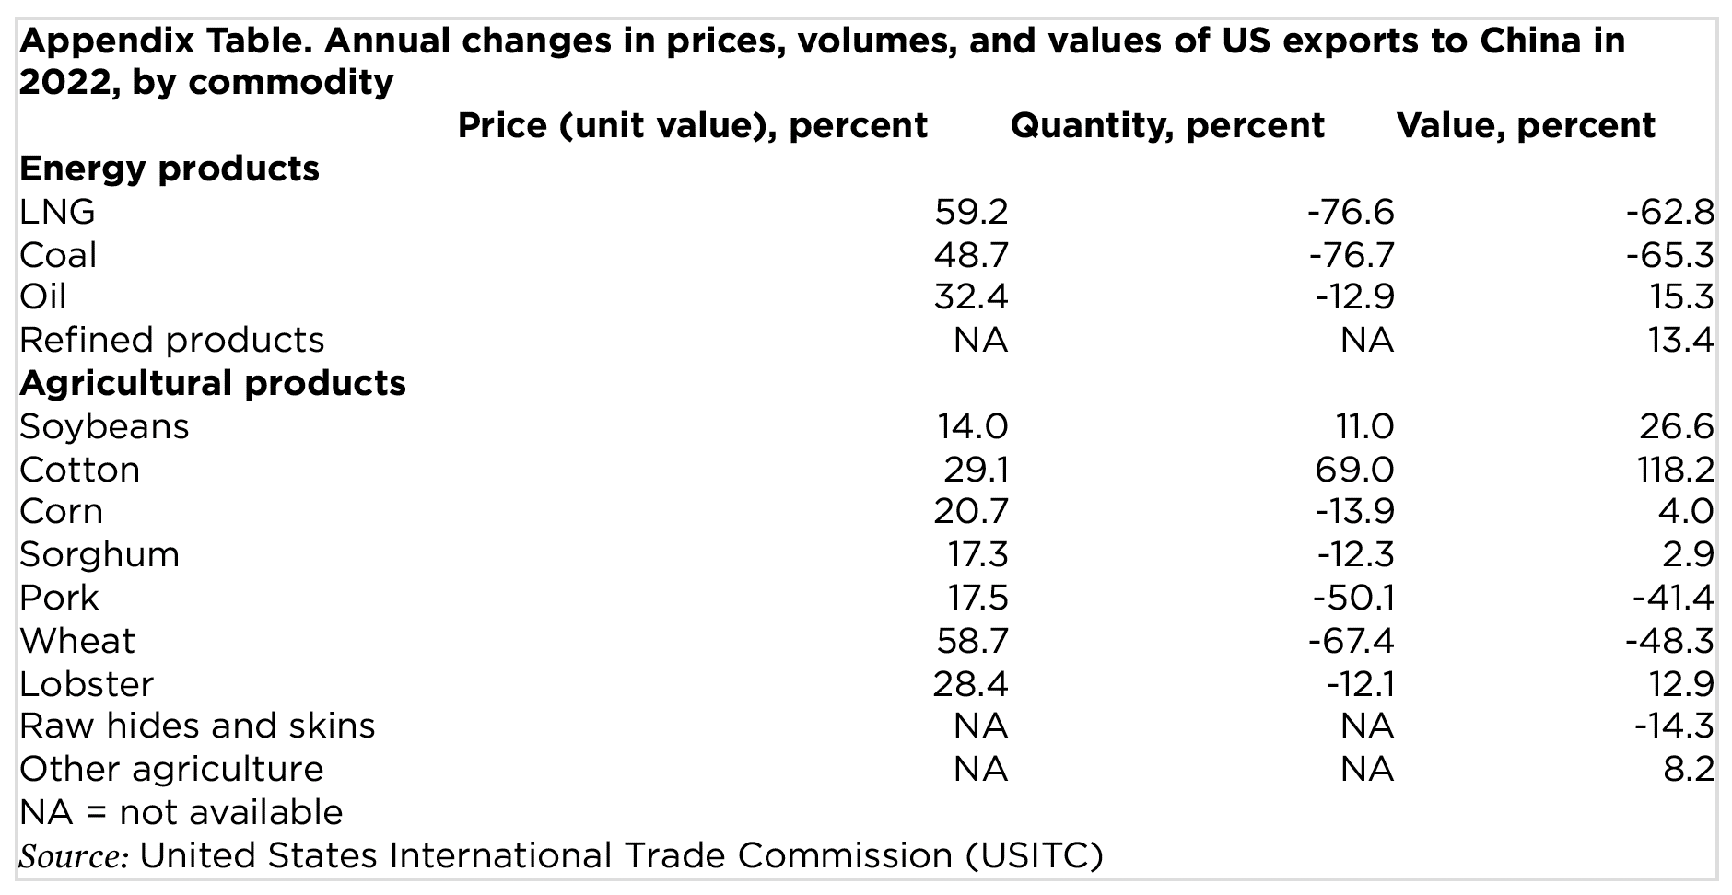

Slide 15
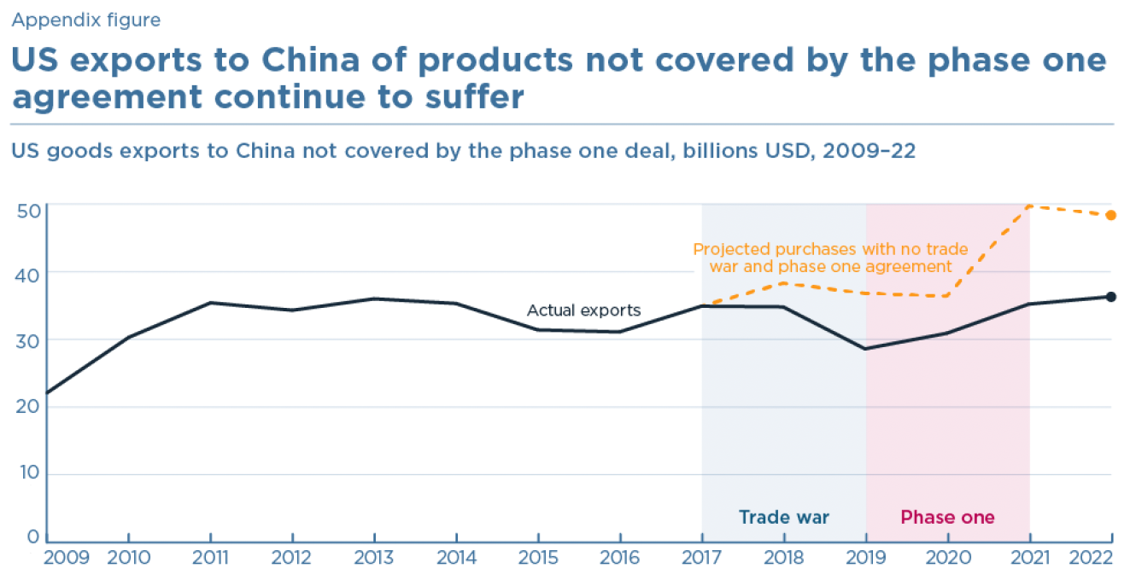

Slide 16
FROM REQUIRED READINGS

Slide 17
Reading

Slide 19
FROM OPTIONAL READINGS

Slide 20
Reading

