Slide 1
Class 2
The State of Play in International Trade and Trade Policy II:
Other by
Alan V. Deardorff
University of Michigan
2023
PubPol/Econ 541

Slide 2
Announcements
Quiz 1 due Friday midnight.
  Accepted until Saturday midnight with penalty
  Covers material from last Wednesday and today only.

Slide 3
Pause for News

Slide 4
State of Play: Other
Outline
  Background from KOM
  Brexit
  China Trade Actions
  Russia Sanctions
  Green Subsidies
  Other Disputes and Actions

Slide 5
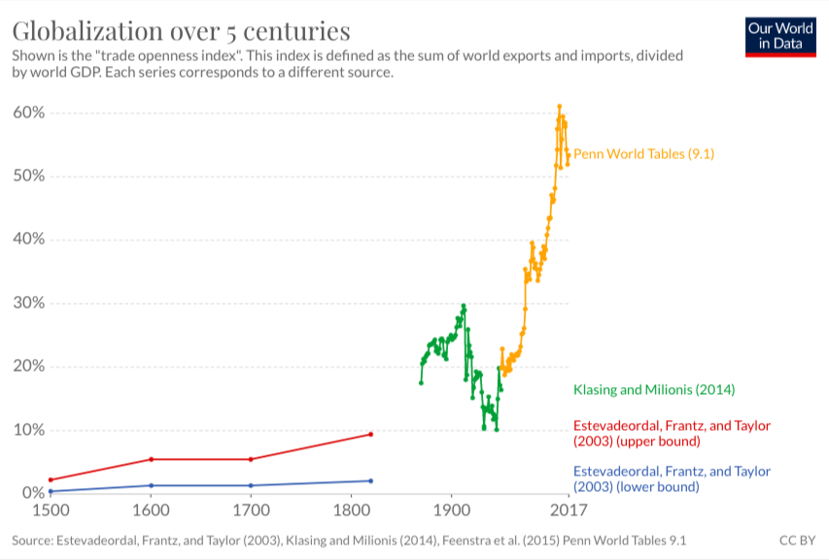
World Trade Growth
Notes:
Our World in Data
https://ourworldindata.org/trade-and-globalization

Slide 6
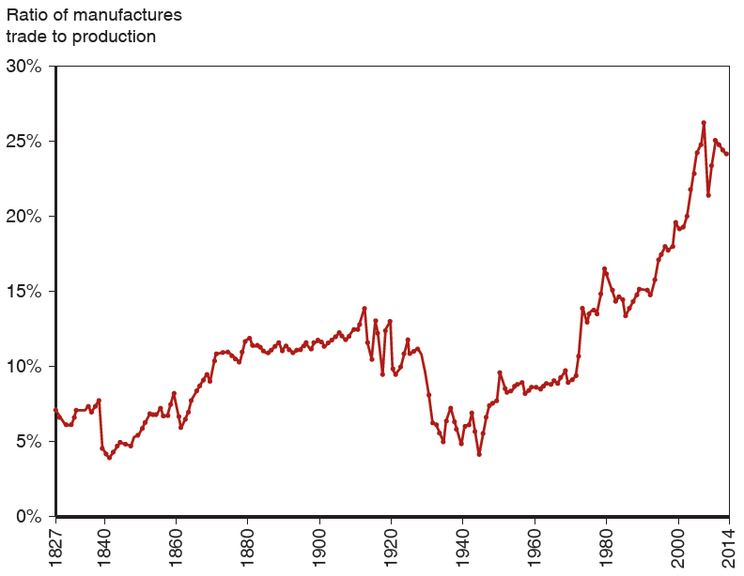
Figure 2.5 The Fall and Rise of World Trade
The ratio of world exports to world G D P rose in the decades before World War
but fell sharply in the face of wars and protectionism. It didn’t return to 1913 levels until the 1970s but has since reached new heights.
Source: Michel Fouquin and Jules Hugot, “Trade Globalisation in the Last Two Centuries,” Voxeu (September 2016).
From KOM
Notes:
The graph plots ratio of manufactures trade to production versus year. The plot generally rises from (18 27, 7%) to (20 14, 22%). A significant drop occurs from (18 39, 8%) to (18 40, 4.5%), before a rise to (18 60, 8.5%). The plot then significantly drops from (19 10, 13%), to (19 50, 4%), before a rise back to (19 55, 8%). The graph displays fluctuating behavior with high and lows in the intermediate points. All values are estimated.

Slide 7
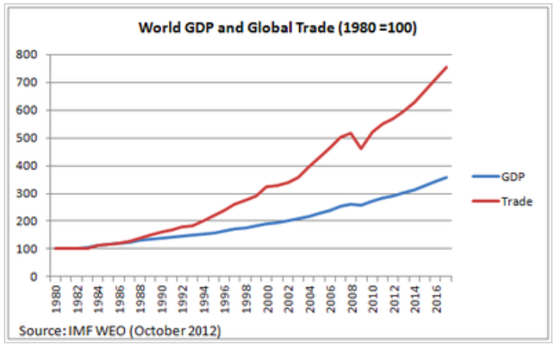
World Trade Growth
Notes:
https://g2reports.weebly.com/reports.html

Slide 8
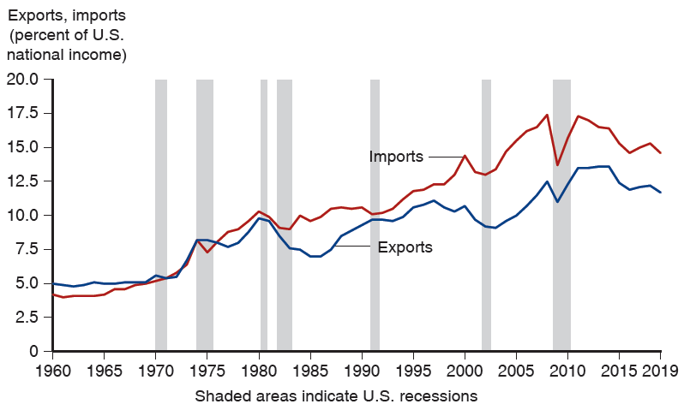
Figure 1.1 Exports and Imports as a Percentage of U.S. National Income
(Shaded areas indicate U.S. recessions.) Both imports and exports have risen as a share of the U.S. economy, but imports have risen more.
Source: U.S. Bureau of Economic Analysis,
research.stlouisfed.org
From KOM
Notes:
https://research.stlouisfed.org/
The graph depicts exports and imports as a percentage of U S national income versus year, from 19 60 to 20 19. 7 shaded areas indicate U S recessions. The plot for exports generally rises from (19 60, 5.0) to (20 19, 12.0). A significant drop occurs from (20 07, 12.0) to (20 09, 10.5), before a rise to (20 11, 13.0). The plot for imports generally rises from (19 60, 4.0) to (20 19, 14.5). A significant drop in the imports plot occurs from (20 07, 17.3), to (20 09, 13.0), before a rise back to (20 11, 17.0). The shaded areas for U S recessions, by years, are as follows. 19 70 to 19 72, 19 74 to 19 76, 19 80 to 19 81, 19 82 to 19 83, 19 91 to 19 92, 20 03 to 20 04, and 20 08 to 20 11. All values are estimated.

Slide 9
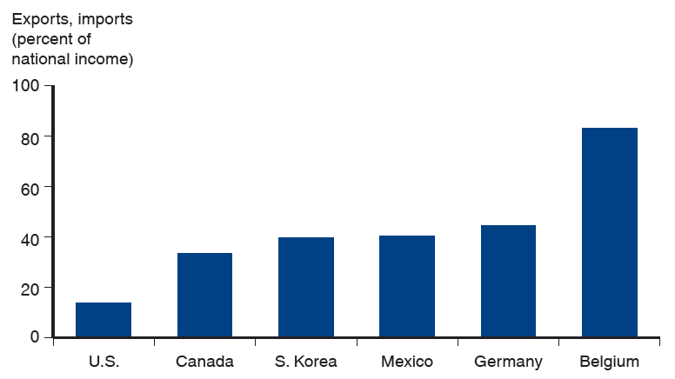
Figure 1.2 Average of Exports and Imports as Percentages of National Income in 2018
International trade is even more important to most other countries than it is to the United States.
Source: World Bank
From KOM
Notes:
The graph depicts exports and imports as a percentage of national income for the following 6 countries. U S, 15%. Canada, 33%. South Korea, 42%. Mexico 43%. Germany, 45%. Belgium, 87%. All values are estimated.

Slide 10
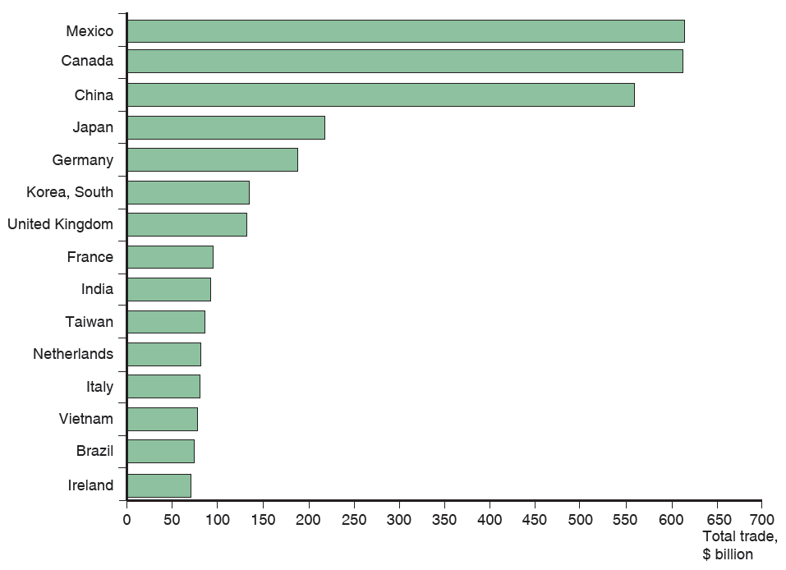
Figure 2.1 Total U.S. Trade with Major Partners, 2019
U.S. trade—measured as the sum of imports and exports—is mostly with 15 major partners.
Source: U.S. Department of Commerce.
From KOM
Notes:
The horizontal bar graph lists countries versus total trade in billions of dollars. The list provides total trade, in billions of dollars, for each country as follows. China, 620. Canada, 610. Mexico, 570. Japan, 240. Germany, 19 0. South Korea, 165. United Kingdom, 160. France, 100. India, 90. Taiwan, 80. Netherlands, 78. Italy, 75. Vietnam, 70. Brazil, 65. Ireland, 60. All values are estimated.

Slide 11
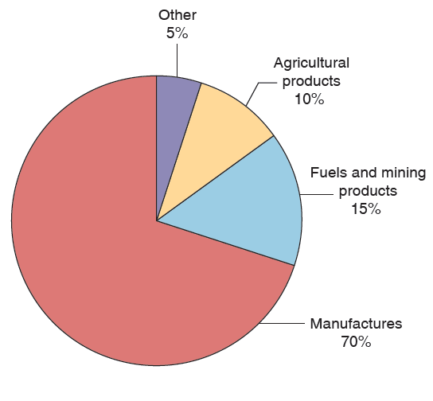
Figure 2.6 The Composition of World Trade, 2017
Most world trade is in manufactured goods, but minerals—mainly oil—remain important.
Source: World Trade Organization.
From KOM

Slide 12
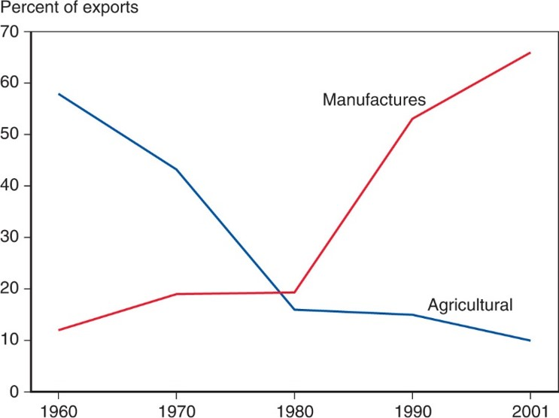
Figure 2.7 The Changing Composition of Developing-Country Exports
Over the past 50 years, the exports of developing countries have shifted toward manufactures.
Source: United Nations Council on Trade and Development.
From KOM
Notes:
The graph plots the percent of exports versus year, from 19 60 to 20 01. The plot for manufactures rises gradually from (19 60, 12) to (19 80, 18) and then rises steeply to (20 01, 68). The plot for agricultural falls steeply from (19 60, 58) to (19 80, 14) and then falls less steeply to (20 01, 10). The graphs intersect at (19 79, 18). All values are estimated.

Slide 13
Pause for Discussion

Slide 14
  Questions from KOM
How much has trade grown? why?
Who gains from trade?
What does the amount of trade between two countries depend on?
Why is the gravity model useful?
Do national borders interfere with trade?
Why is trade in services growing?

Slide 15
Brexit
Brexit Timeline
  Jun 23, 2016: Referendum
    UK votes to leave EU (Vote: 52-48)
    Leave:
      England, Wales
      Old people
      People opposed to immigration from EU
    Remain:
      Scotland, Northern Ireland
      Young people
      London
Notes:
Walker, Nigel, ” Brexit timeline: events leading to the UK’s exit from the European Union,” House of Commons Library, June 10, 2020.
https://commonslibrary.parliament.uk/research-briefings/cbp-7960/

Slide 16
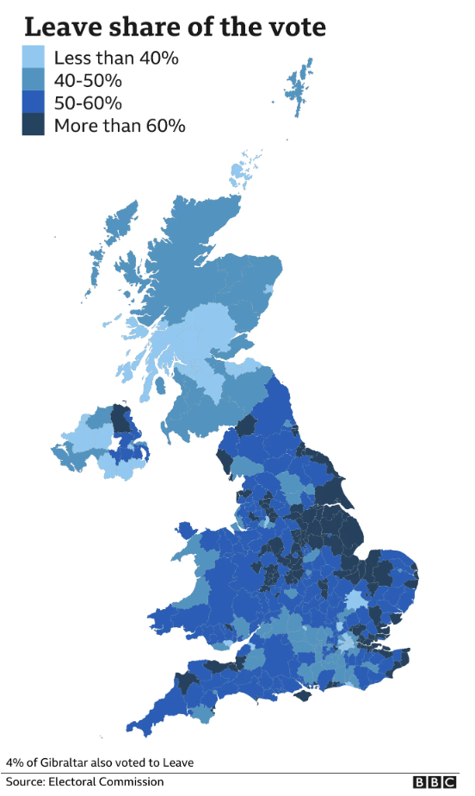
Notes:
“EU referendum: The result in maps and charts,” BBC News, June 8, 2021.
https://www.bbc.com/news/uk-politics-36616028

Slide 17
Brexit
Brexit Timeline
  Jun 23, 2016: Referendum
    UK votes to leave EU (Vote: 52-48)
  Mar 29, 2017: EU exit provision triggered
    UK PM initiates 2-year exit process
  2019: Several extensions asked and given
  Jan 31, 2020: UK leaves EU
    Transition period (policies unchanged) thru 2020
  Dec 31, 2020: Transition period ends
Notes:
Walker, Nigel, ” Brexit timeline: events leading to the UK’s exit from the European Union,” House of Commons Library, June 10, 2020.
https://commonslibrary.parliament.uk/research-briefings/cbp-7960/

Slide 18
Brexit
The Brexit Agreement
  Reached Dec 24, 2020
    EU Ambassadors approved Dec 28
    UK MPs approved Dec 30
    Signed Dec 30
    Effective provisionally Jan 1, 2021
    Entered into force May 1, 2021, after ratification
  Title: “Trade and Cooperation Agreement”

Slide 19
Brexit
The Brexit Agreement
  Features:
    Free Trade Agreement for goods, but with rules of origin (no longer customs union)
    Some limited mutual market access for services
  Not included:
    Free movement of persons
    UK subject to European Court of Justice
    UK subject to EU regulations

Slide 20
Brexit
Northern Ireland (N.I.) Protocol
  Part of the Brexit Withdrawal Agreement from Dec 24, 2020
  Avoids hard border between N.I. (part of UK) and Ireland (EU member country) by
    Keeping N.I. in EU customs union
    Adding customs checks, etc., between N.I. and Great Britain (the rest of UK: England, Scotland, Wales)
  Reason: To avoid re-igniting the “Troubles”

Slide 21
Brexit
The N.I. Protocol Was Contentious
  Trade within UK between N.I. and Great Britain was costly and cumbersome
    Must pass through customs checks
    These often included checks for satisfying EU regulations (health & safety, etc.)
  PM Johnson in June 2022 (before he stepped down) submitted a bill to “rip up” the Protocol

Slide 22
Brexit
PM Rishi Sunak negotiated Windsor Framework with EU
  Replaces N.I. Protocol
  Signed March 24, 2023
  Creates “green lanes” for goods that will not cross the border into Ireland
    For “trusted traders”
    Require minimal (but not zero) checks
  “Red lanes” for goods destined for Ireland still have full controls

Slide 23
Brexit
Other features of Windsor Framework
  Scrapped bans on parcels, pets, sausages, plants, and seed potatoes.
  Made medicines approved by the UK freely available in Northern Ireland.
  Jurisdiction of the ECJ (European Court of Justice) now only applies to EU laws.
  “Stormont brake”:
    Allows Northern Ireland Assembly (Stormont) to ask UK to veto EU rules

Slide 24
Brexit
Public Opinion
  2016: Vote to leave: 52%
  2023 Poll: Up to 60% wish that Britain had remained in the EU
Notes:
Economist, "Buyers’ Remorse: As Britons Grow More Unhappy With Brexit, What Happens Next?" the Economist, Jun 27, 2023.
https://www.economist.com/britain/2023/06/27/as-britons-grow-more-unhappy-with-brexit-what-happens-next

Slide 25
Pause for Discussion

Slide 26
  Questions on Brexit (Kirkegaard)
What UK objectives are mentioned here as having been achieved by the Brexit agreement?
What aspects of UK-EU interactions will be adversely affected by the agreement?
What is the relevance of
  “rules of origin”?
  “minimal processing requirements”?

Slide 27
  Questions on Economist.
  “Brexit and Northern Ireland”
What was disliked in the Northern Ireland Protocol, and by whom especially?
How do “green lanes” help to fix this?
What is the Stormont Brake?
Does this “remove any sense of an Irish Sea border?”

Slide 28
  Questions on Economist.
  “Buyers’ Remorse”
What are some reasons why public opinion in the UK has moved away from favoring Brexit?
Are actions being discussed and taken to “soften” Brexit?
Is the EU eager to make changes?

Slide 29
China Trade Actions
China responded to Australia’s 2020 call for inquiry into origins of Covid-19
  Massively curbed imports of
    Timber, coal, lobsters, barley, wine and other products
    Due to “concerns about trade practices and pest infestations”
  Australia’s exports suffered briefly but recovered
    Exporters found other markets

Slide 30
China Trade Actions
In December 2021, China halted trade with Lithuania in response to Lithuania allowing Taiwan to set up an office there representing “Taiwan” rather than “Taipei”
  Action extends to goods from other countries if they are made with parts from Lithuania
  EU response: December 2022, EU filed a formal complaint at the WTO

Slide 31
China Trade Actions
In August 2022, in response to US House Speaker Nancy Pelosi visiting Taiwan
  China
    Blocked imports from hundreds of Taiwanese food producers
    Suspended exports of natural sand
  This was a “huge expansion” compared to China’s earlier uses of economic levers

Slide 32
China Trade Actions
Assigned Economist article from July 2023 says “
  “in response to new Western sanctions against China,
  ‘new volleys from Beijing are coming thick and fast.’”
Western actions:
  “Blocking “western chip companies [from selling] Chinese customers cutting-edge semiconductors and the machines to make them.”
Notes:
Economist, "The Dragon Shows Its Claws: China hits back against Western sanctions", the Economist, July 23, 2023.
https://www.economist.com/business/2023/07/23e /china-hits-back-against-western-sanctions

Slide 33
China Trade Actions
China actions:
  Export controls on 2 metals (gallium and germanium) for advanced tech
  “Unreliable entities list” of companies undermining China’s interests
  Export control law and anti-sanctions law
  Ban of semiconductors from American chipmaker Micron
  Proposed ban on exports of ingot-casting technology used in making solar-panel wafers
Notes:
Economist, "The Dragon Shows Its Claws: China hits back against Western sanctions", the Economist, July 23, 2023.
https://www.economist.com/business/2023/07/23e /china-hits-back-against-western-sanctions

Slide 34
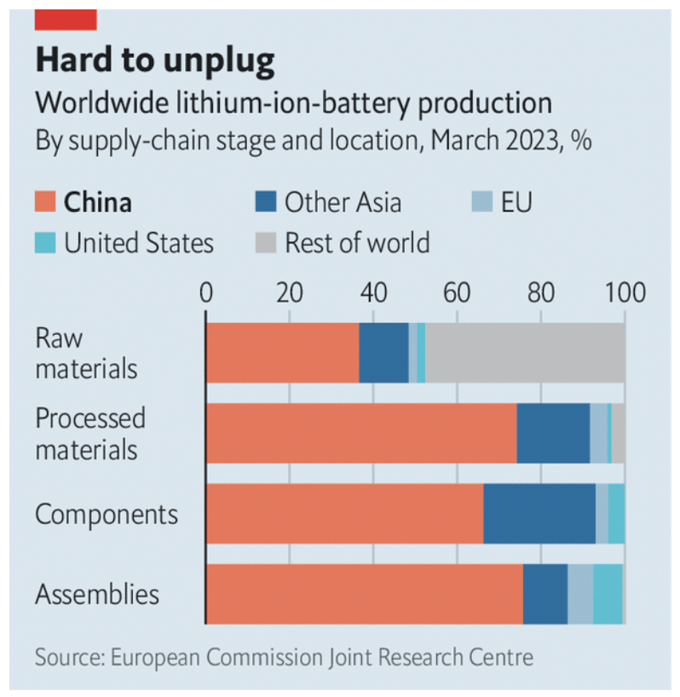
Notes:
Economist, "The Dragon Shows Its Claws: China hits back against Western sanctions", the Economist, July 23, 2023.
https://www.economist.com/business/2023/07/23e /china-hits-back-against-western-sanctions

Slide 35
Pause for Discussion

Slide 36
  Questions on Hille & Langley,
  “China Suspends 2,000…”
Is the blockage said by China to be officially due to the Pelosi visit?
Is sand important?
Does Taiwan’s ruling DPP party favor independence from China?

Slide 37
  Questions on Michaels,
  “EU Sues China in WTO…”
Why did China cut off imports from Lithuania?
Does the EU expect a finding in its favor in the WTO case?
Does China’s action apply only to its imports from Lithuania?

Slide 38
  Questions on Economist,
  “Dragon Shows Its Claws…”
What are some of the Chinese actions mentioned here?
Why is the foreign relations act “hazy”?
Why does China “need to tread carefully”?

Slide 39
Russia Sanctions
Russia’s invasion of Ukraine on Feb 24, 2022 prompted economic responses
  Economic sanctions by governments
    Financial linkages
    Trade
  Private companies said they would stop dealing with Russia
Notes:
Walker, Nigel, ” Brexit timeline: events leading to the UK’s exit from the European Union,” House of Commons Library, June 10, 2020.
https://commonslibrary.parliament.uk/research-briefings/cbp-7960/

Slide 40
Russia Sanctions, Gov’t
Sample financial sanctions
  Several Russian banks removed from the Swift international payments system
  Cut off many Russian banks from transactions and operations
Sample trade sanctions
  Ban or reduced imports of oil and other energy
  Impose price cap on permitted oil exports
  Revoke Russia’s most favored nation status for tariffs
Notes:
Walker, Nigel, ” Brexit timeline: events leading to the UK’s exit from the European Union,” House of Commons Library, June 10, 2020.
https://commonslibrary.parliament.uk/research-briefings/cbp-7960/

Slide 41
Russia Sanctions, Gov’t
Trade sanctions by governments
  Oil and other energy
    Germany puts Nord Stream 2 gas pipeline on hold
    US bans from Russia
    UK to phase out Russian oil by end of 2022
    EU to become independent from Russia by 2030
  EU bans steel imports from Russia
  US restricts exports to Russia, especially technology and military; later also to Belarus; later also luxury goods
  EU and UK impose export restrictions similar to US
  Ban on Russian air carriers by Canada, EU, US, UK
  G-7 to revoke Russia’s most favored nation status
    Permits them to raise tariffs on Russian goods
Notes:
Walker, Nigel, ” Brexit timeline: events leading to the UK’s exit from the European Union,” House of Commons Library, June 10, 2020.
https://commonslibrary.parliament.uk/research-briefings/cbp-7960/

Slide 42
Russia Sanctions, Gov’t
Countries
Australia | Iceland | Singapore
Bahamas | Italy | Switzerland
Canada | Japan | Taiwan
EU | New Zealand | UK
Finland | Norway | US
France | Poland
Germany | S Korea
Source: Funakoshi et al, “Updated July 7, 2022” but includes from July 29
Notes:
Funakoshi, Minami, Hugh Lawson, and Kannaki Deka, “Tracking sanctions against Russia,” Reuters, March 9, 2022, updated July 7, 2022..
https://graphics.reuters.com/UKRAINE-CRISIS/SANCTIONS/byvrjenzmve/

Slide 43
Russia Sanctions, Gov’t
Countries announcing they will not use sanctions against Russia:
NOT using sanctions
India | Feb 24
Mexico | Mar 1
Brazil | Mar 1
China | Mar 2
Argentina | Mar 4
Indonesia | Mar 9
Turkey | Mar 13
S Africa | Mar 17
Serbia | Apr 21
Source: Bown
Notes:
Bown, Chad P. “Russia's war on Ukraine: A sanctions timeline,” Realtime Economic Issues Watch, Peterson Institute for International Economics, March 14, 20202, last updated July 18, 2022. [4p]
https://www.piie.com/blogs/realtime-economic-issues-watch/russias-war-ukraine-sanctions-timeline

Slide 44
Pause for Discussion

Slide 45
  Questions on Bown,
  “A sanctions timeline”
What prompted the sanctions to start and when?
What were the most recent actions reported here, and by whom?
How useful did you find the interactive timeline on the Bown site?

Slide 46
Green Subsidies
The “Green Subsidy War” started with the US Inflation Reduction Act of 2022
  IRA does several things, but mostly it invests government funds in green production
  EU was initially in favor, since US was finally acting against climate change
  But then they saw that it was protectionist

Slide 47
Green Subsidies
Why is the IRA protectionist?
  Consumer tax credit (up to $7,500) for purchase of electric vehicles, conditional on
    Assembled in North America
    Battery components made in North America
    Using battery materials extracted in US or a country with US FTA
  Subsidies for wide range of industries to produce in US, will entice investment from EU.

Slide 48
Green Subsidies
EU’s Proposed Responses:
  Green Deal Industrial Plan
    Offers €250 billion subsidize Europe’s green industries
    Permits member countries to use subsidies for green projects until 2025.
      Members are normally prohibited from using subsidies.
  Critical Raw Materials Act
    Calls for the EU to process at least 40 percent of the raw materials that the car industry needs within its own borders
    How will it do this? That’s not clear to me.

Slide 49
Pause for Discussion

Slide 50
  Questions on WSJ Editors:
  “Green Subsidy War…”
In what sense was the IRA a response to what the EU was doing?
What does the IRA do that the EU objects to?
Do the Wall Street Journal editors approve?

Slide 51
  Questions on Economist:
  “Green Protectionism…”
What two actions is the EU considering to respond to the US subsidies that the Economist mentions, and how does the Economist view them?
Is the EU right to think that US subsidies will hurt the EU?
What does this say the EU can and should do?

Slide 52
Other Disputes and Actions
Disputes
  Japan-South Korea Trade Dispute
  US-Mexico on GM Corn
  EU-China Green Tech
  EU Carbon Tariff
  Japan-Australia LNG
  India laptops
  US-EU cheese beef

Slide 53
Pause for Discussion

Slide 54
  Questions on Davies & Inagaki:
  “Japan and South Korea…”
What were the disputes in 2015 and 2019 about?
What actions had South Korea and Japan taken in the 2019 dispute?
How has this dispute been resolved?

Slide 55
  Questions on Swanson & Qiu:
  “U.S. To Challenge Mexican…”
Has it been legal to grow GM corn in Mexico?
Is GM corn safe?
Is the herbicide that GM corn depends on safe?
Why can the US challenge this ban, and under what international agreement? What will happen if it does?
Is the reason for Mexico’s ban that it disagrees with the science?

Slide 56
  Questions on Bounds & Hancock:
  “Brussels to Curb Imports …”
What imports from China are to be curbed?
How is the curb implemented?
Is it all such imports from China that are targeted?
Is this action permitted by the WTO?
How has China responded to this proposal?

Slide 57
  Questions on Hancock & Dempsey:
  “Aluminium Companies …”
What is CBAM?
What is the loophole that aluminum producers are complaining about?
What are some other concerns, and might they apply more broadly than aluminum?
Will CBAM go into effect, and if so when and how?

Slide 58
  Questions on Lebrun:
  “Japan Accuses Australia …”
Is this a case of either country imposing a trade barrier or otherwise using a trade policy?
Why does Japan care so much about this? Is it just defending the financial needs of its companies?
Does Australia agree that this imposes a hardship on Japan?

Slide 59
  Questions on Roy:
  “Importing Laptops Into India …”
How does this policy discourage imports?
What are the acknowledged motives for this policy?
At whom is the policy aimed?

Slide 60
  Questions on Peterson:
  “The U.S. Has a Beef …”
What is a protected geographical indication?
Does the US reject the legitimacy of these restrictions?
What does the US object to?
What other disputes between the US and EU are mentioned?

