Slide 1
Classes 3, 4
Tariffs and Quotas by
Alan V. Deardorff
University of Michigan
2023
PubPol/Econ 541

Slide 2
Announcements
New optional reading for last week
  Article by Indira Rajaraman, grad-school classmate of mine, now in India, on India’s new laptop policy.
    She says “I think it is important for students in the West to know that good stuff is available in non-Western sources, written in English they can understand, just to alert them to the advantages of not confining themselves to sources like the WSJ which has a few correspondents piping in news about the rest of the world.”

Slide 3
Pause for News

Slide 4
Announcements
I will stay only very briefly in my office hour this morning, as I have a meeting to attend. If you want to see me, either stay after class or come right at 10:00.
Quizzes in general
  Clarify my expectations:
    Feel free to look up anything you like from course or other sources.
    But write your answers yourself and do not work with other students.
    In “short answer” questions, no need to write paragraphs or even sentences if you can convey what I ask for.

Slide 5
Announcements
Quiz 1 Scores
 | Q1
Mean | 7.80
Median | 8
Max | 10
Min | 1
S.D. | 2.19

Slide 6
Pause for Discussion

Slide 7
  Questions from KOM
How do “specific” and “ad valorem” tariffs differ?
An import demand curve is sometimes called a “derived demand curve.” Why?
What is an “effective rate of protection”?

Slide 8
Outline for Today and Wednesday
Tariff by Small country
Tariff by large country
Quotas

Slide 9
Small country
Assumptions throughout
  Markets perfectly competitive (many small buyers and sellers)
  Product homogeneous (all units from all suppliers the same)
  Markets in equilibrium (quantities supplied and demanded equal)
  There are no “distortions” (externalities, etc.)
    This includes no taxes other than tariffs
  Supply and demand curves are straight lines
    Just for simplicity
  Model is partial equilibrium (takes all other prices as given)
  Model is static (time does not play any role)
  Trade is free and frictionless
    No tariffs or quotas other than those we introduce
    No transport costs (for simplicity)

Slide 10
Small country
Special assumption for small country case
  World price is given (country too small to influence it)
  More correctly: country’s supply and demand in that industry too small to influence the world price

Slide 11
Small country, Import Industry
P
Effects of move from autarky to free trade
  Price falls
  Quantity supplied falls
  Quantity demanded rises
  Imports rise
Welfare effects:
  Suppliers lose −a
  Demanders gain +(a+b)
  Country gains +b
S=MC
P_{aut}
a
b
P₀=P_{W}
D=MB
S_{aut} =D_{aut}
S₀
D₀
Q
M₀
The Gain from Trade
Free trade

Slide 12
Welfare Effects
Why a and (a+b)?
Area a
  Loss of “producer surplus”
  Zero to S₀
    Lost revenue
  S₀ to S_{aut}
    Lost profit from P_{aut} above MC
P
S=MC
P_{aut}
a
b
P₀=P_{W}
D=MB
S_{aut} =D_{aut}
S₀
D₀
M₀

Slide 13
Welfare Effects
Area (a+b)
  Gain of “consumer surplus”
  Zero to D_{aut}
    Less expenditure on previous purchase
  D_{aut} to D₀
    Additional units worth more (MB) than price
P
S=MC
P_{aut}
a
b
P₀=P_{W}
D=MB
S_{aut} =D_{aut}
S₀
D₀
M₀

Slide 14
Welfare Effects
Note that these welfare effects are
  Measured in currency, price times quantity
  Loss of producer surplus is what suppliers would be “willing to pay” to avoid the loss
  Gain in consumer surplus is what buyers would be “willing to pay” to get this benefit
This does not tell us about individual buyers and sellers, only them as a group

Slide 15
Small country tariff
Tariff makes importing buyers pay more than the foreign exporters receive
  By size of tariff, % or $
  Difference goes to importing government
Small country means that world price does not change
So domestic price rises above world price by amount of the tariff

Slide 16
Small country tariff
Effects of a tariff, starting from free trade
  Price rises for both the
    Imported good
    Domestically produced good
  Quantity supplied rises
  Quantity demanded falls
  Quantity of imports falls
  Tariff revenue rises from zero
P
S=MC
P_{aut}
P₁=P_{W}+t
t
P₀=P_{W}
M₁
D=MB
S₀
S₁
D₁
D₀
Q
M₀
Specific Tariff t

Slide 17
Small country tariff
WHY?
P
Welfare effects of a tariff, starting from free trade
  Suppliers gain +a
  Demanders Lose −(a+b+c+d)
  Government gains +c
  Country loses −(b+d)
S=MC
WHY?
P_{aut}
P₁=P_{W}+t
t
a
c
b
d
P₀=P_{W}
“Dead Weight Loss” =
M₁
D=MB
S₀
S₁
D₁
D₀
Q
M₀
Specific Tariff t

Slide 18
Small country tariff
P
Welfare effects of a tariff, starting from free trade
  Suppliers gain +a
  Demanders Lose −(a+b+c+d)
  Government gains +c
  Country loses −(b+d)
S=MC
P_{aut}
P₁=P_{W}+t
t
a
c
b
d
P₀=P_{W}
“Dead Weight Loss” =
M₁
D=MB
S₀
S₁
D₁
D₀
Q
M₀
Specific Tariff t

Slide 19
Pause for Discussion

Slide 20
  Questions on Graph
If a price falls, why does the gain to demanders not equal the fall in what they pay? Is it larger than this or smaller?
If a price rises, why is the gain to suppliers not their rise in revenue? Is it larger or smaller?
In what sense does a small country gain by eliminating a tariff? Does anybody in the country lose?

Slide 21
Small country, larger tariff
P
Effects of doubling the tariff
  Price rises by twice as much
  Imports fall by twice as much
  Deadweight loss is 4-times as large!
    (Efficiency loss rises with the square of the tariff)
S=MC
P_{aut}
P₂=P_{W}+2t
P₁=P_{W}+t
P₁=P_{W}+t
t
P₀=P_{W}
M₂
(These are exact only if S and D are straight lines. Approximate otherwise.)
M₁
D=MB
S₀
D₀
S₁
M₀
D₁
Q
Specific Tariffs, t, then 2t

Slide 22
Small country, prohibitive tariff
NOTE: You’ll have to calculate this from supply and demand
P
Welfare effects of a prohibitive tariff, starting from free trade
  Suppliers gain +a
  Demanders Lose −(a+b+d)
  Government gains 0
  Country loses −(b+d)
P_{W}+t_{P} ≠ P₁
S=MC
P₁=
P_{aut}
t_{P}
a
b
d
P₀=P_{W}
“Dead Weight Loss” =
D=MB
S₀
S₁
D₁
D₀
Q
M₀
( M₁=0 )
Specific Tariff t_{P} > P_{aut} − P_{W}

Slide 23
Comparative Statics with Tariff
Fall in World Price
P
S=MC
P_{aut}
P₀=P_{W}+t
Tariff causes same dead-weight loss (with linear S&D)
t
P₁=P’_{W}+t
P_{W}
t
P’_{W}
M₁
D=MB
S₁
S₀
D₀
D₁
Q
M₀

Slide 24
Comparative Statics with Tariff
Fall in World Price
P
Welfare effects of a fall in world price in presence of specific tariff
  Suppliers lose –a
  Demanders gain +(a+b+c+d)
  Government gains +(e+f)
  Country gains +(b+c+d+e+f)
S=MC
P_{aut}
P₀=P_{W}+t
t
a
b
c
d
P₁=P’_{W}+t
P_{W}
t
e
f
P’_{W}
M₁
D=MB
S₁
S₀
D₀
D₁
Q
M₀

Slide 25
Pause for
Your Questions

Slide 26
Pause for Discussion

Slide 27
  Questions on Lahart,
  “The Imperfect Science …”
Why does Lahart say the measurement of harm from tariffs is an “imperfect science”?
Lahart cited an estimate of loss from Trump’s tariffs and retaliation of 1.3% of GDP. Is this big?
What effects of tariffs are missing from the welfare effects of tariffs?

Slide 28
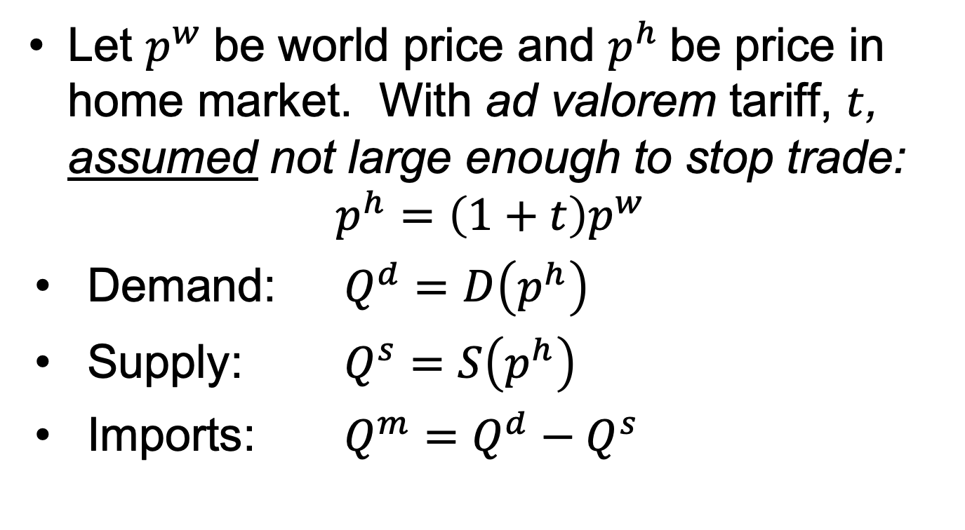
Small Country in Equations
Let $p^{w}$be world price and $p^{h}$be price in home market. With ad valorem tariff, $t$, assumed not large enough to stop trade:
$$p^{h}=\left(1+t\right)p^{w}$$
Demand: $Q^{d}=D\left(p^{h}\right)$
Supply: $Q^{s}=S\left(p^{h}\right)$
Imports: $Q^{m}=Q^{d}−Q^{s}$
NOTE: Used specific tariff in graphs,
ad valorem
in eqns.
Both are for simplicity.

Slide 29
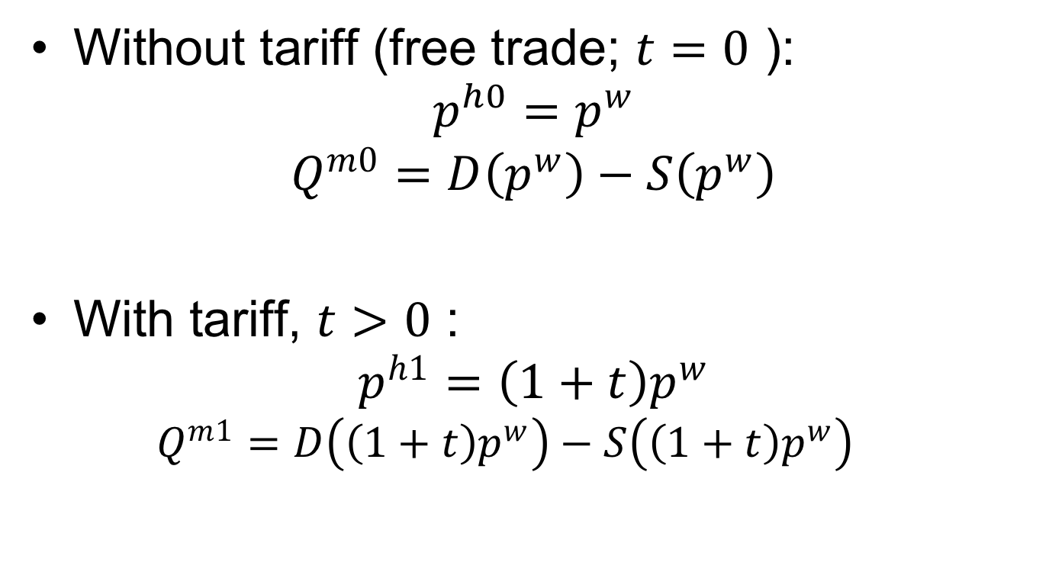
Small Country in Equations
Without tariff (free trade; $t=0$ ):
$$p^{h0}=p^{w}$$
$$Q^{m0}=D\left(p^{w}\right)−S\left(p^{w}\right)$$
With tariff, $t>0$ :
$$p^{h1}=\left(1+t\right)p^{w}$$
  $$Q^{m1}=D\left(\left(1+t\right)p^{w}\right)−S\left(\left(1+t\right)p^{w}\right)$$

Slide 30
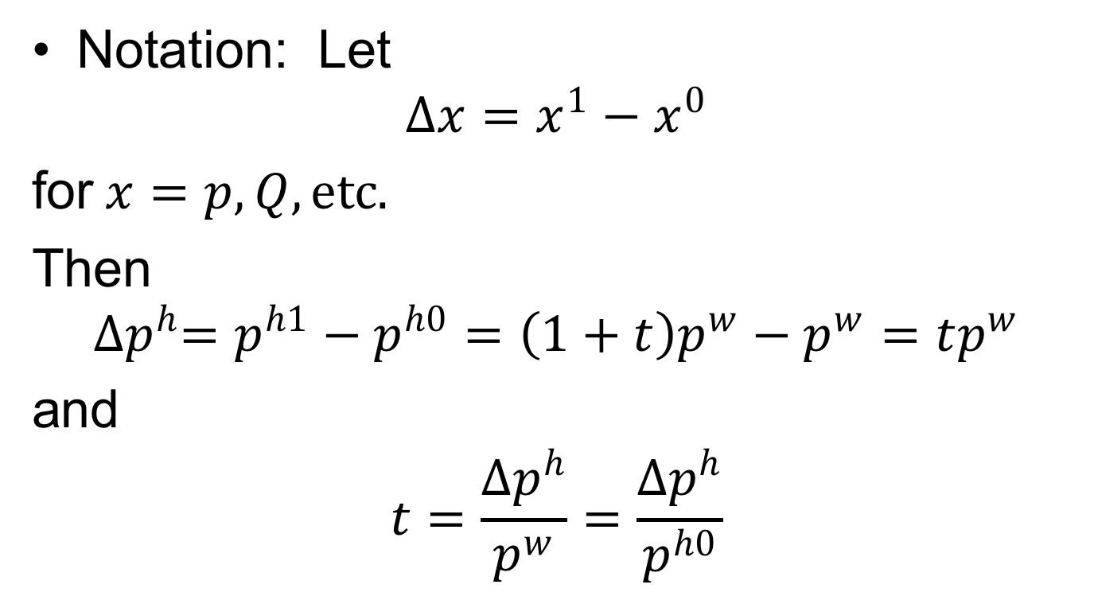
Small Country in Equations
Notation: Let
$$∆x=x^{1}−x^{0}$$
for$x=p, Q, etc.$
Then
$${∆p}^{h}=p^{h1}−p^{h0}=\left(1+t\right)p^{w}−p^{w}=tp^{w}$$
and
$$t=\frac{{∆p}^{h}}{p^{w}}=\frac{{∆p}^{h}}{p^{h0}}$$

Slide 31
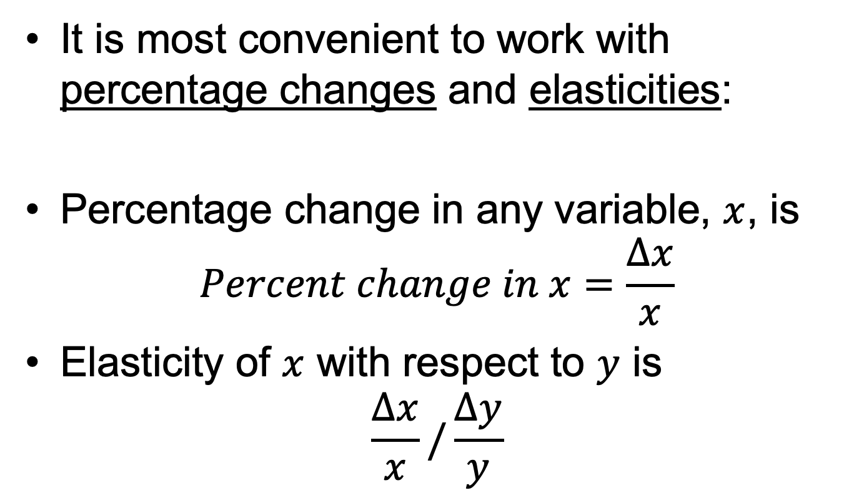
Small Country in Equations
It is most convenient to work with percentage changes and elasticities:
Percentage change in any variable, $x$, is
$$Percent change in x=\frac{∆x}{x}$$
Elasticity of $x$ with respect to $y$ is
$$\frac{∆x}{x}/\frac{∆y}{y}$$

Slide 32
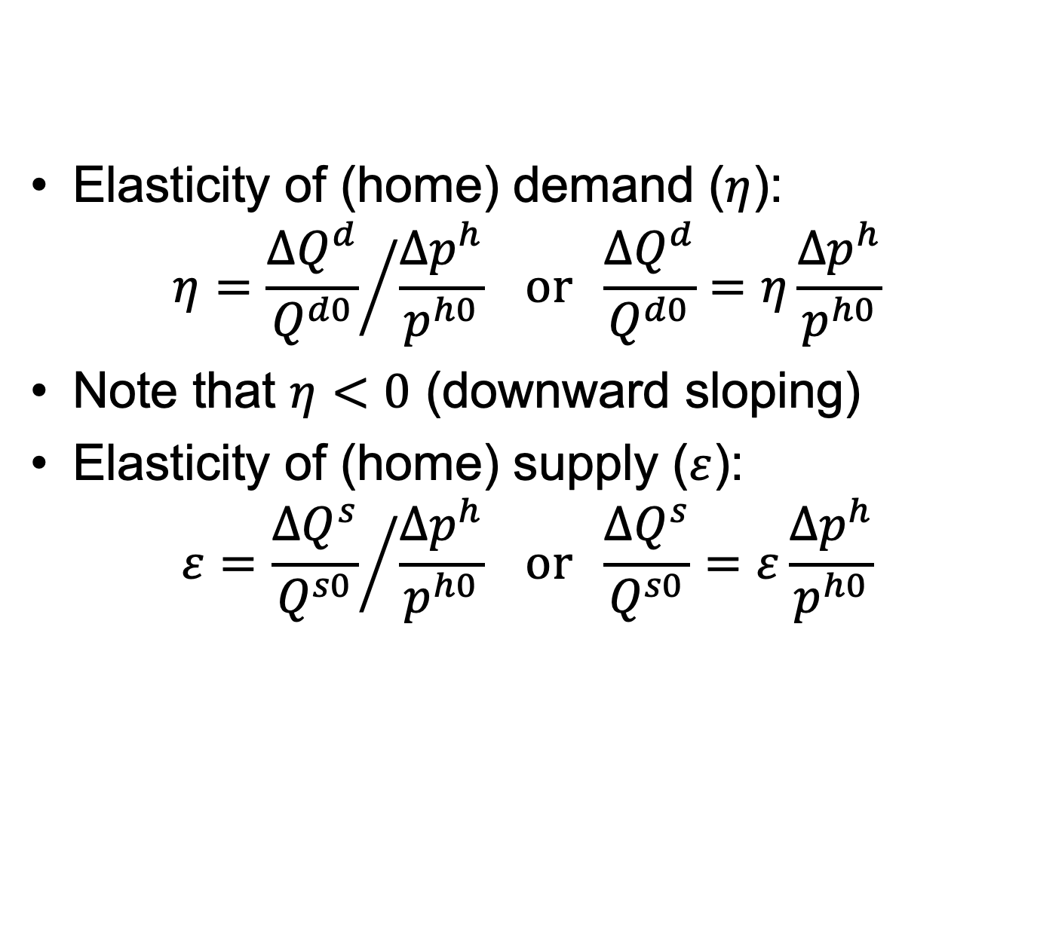
Small Country in Equations
Elasticity of (home) demand ($η$):
$$η={\frac{{∆Q}^{d}}{Q^{d0}}}/{\frac{{∆p}^{h}}{p^{h0}}} or \frac{{∆Q}^{d}}{Q^{d0}}=η\frac{{∆p}^{h}}{p^{h0}}$$
Note that $η<0$ (downward sloping)
Elasticity of (home) supply ($ε$):
$$ε={\frac{{∆Q}^{s}}{Q^{s0}}}/{\frac{{∆p}^{h}}{p^{h0}}} or \frac{{∆Q}^{s}}{Q^{s0}}=ε\frac{{∆p}^{h}}{p^{h0}}$$
When you know the price change, use these to find the quantity change

Slide 33
Small Country in Equations
Notes regarding elasticities:
  They’ll be defined here as changes relative to the free-trade quantities and prices.
  Different, but just as valid, would be changes relative to quantities and prices in the presence of the tariff.
  Answers will differ, but by much less than our uncertainty about the values of elasticities.
  In your calculations, use whichever is most convenient, but be consistent.

Slide 34
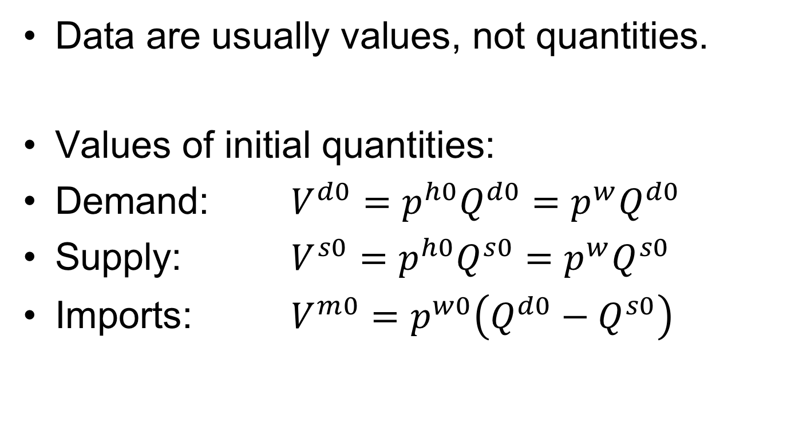
Small Country in Equations
Data are usually values, not quantities.
Values of initial quantities:
Demand: $V^{d0}=p^{h0}Q^{d0}=p^{w}Q^{d0}$
Supply: $V^{s0}=p^{h0}Q^{s0}=p^{w}Q^{s0}$
Imports: $V^{m0}=p^{w0}\left({Q^{d0}−Q}^{s0}\right)$

Slide 35
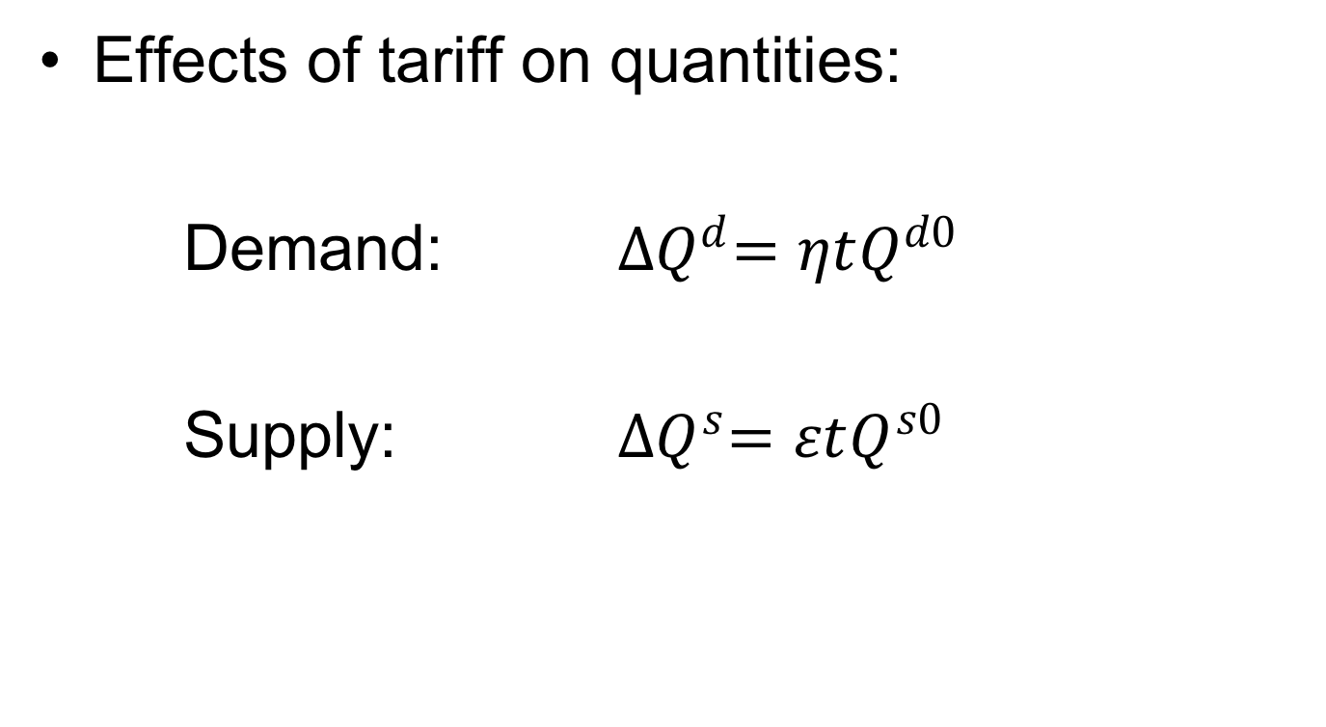
Small Country in Equations
Effects of tariff on quantities:
Demand: ${∆Q}^{d}=ηtQ^{d0}$
Supply: ${∆Q}^{s}=εtQ^{s0}$

Slide 36
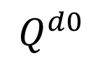
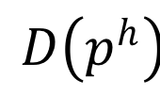
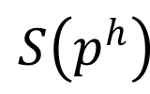
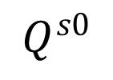
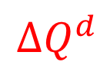
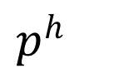

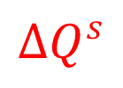
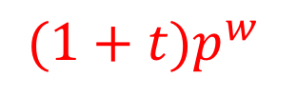


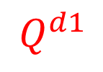

$p^{h}$
$$S\left(p^{h}\right)$$
${(1+t)p}^{w}$
e
$${∆p}^{h}={tp}^{w}$$
a
c
b
d
$p^{w}$
$$D\left(p^{h}\right)$$
$${∆Q}^{s}$$
$${∆Q}^{d}$$
$$Q^{s0}$$
$$Q^{s1}$$
$$Q^{d1}$$
$$Q^{d0}$$
$$Q$$
I’ll use $〈a〉$, $〈abcd〉, etc.$to represent these areas.
≈

Slide 37














Small Country in Equations
Welfare gain of suppliers (producers & upstream):
$WGS=〈a〉$
$=\left(Q^{s0}\right)\left({∆p}^{h}\right)+\frac{1}{2}\left({∆Q}^{s}\right)\left({∆p}^{h}\right)$
$=Q^{s0}{∆p}^{h}+\frac{1}{2}\frac{{∆Q}^{s}}{Q^{s0}}Q^{s0}{∆p}^{h}$
$={\left(1+\frac{1}{2}ε\frac{{∆p}^{h}}{p^{h0}}\right)p^{h0}Q}^{s0}\frac{{∆p}^{h}}{p^{h0}}$
$=\left(1+\frac{1}{2}ε\frac{{∆p}^{h}}{p^{h0}}\right)V^{s0}\frac{{∆p}^{h}}{p^{h0}}$
$=\left(1+\frac{1}{2}εt\right){tV}^{s0}$
$p^{h}$
$$S\left(p^{h}\right)$$
${(1+t)p}^{w}$
$${∆p}^{h}={tp}^{w}$$
a
c
e
b
d
$p^{w}$
$$D\left(p^{h}\right)$$
$${∆Q}^{s}$$
$${∆Q}^{d}$$
$$Q^{s0}$$
$$Q^{s1}$$
$$Q^{d1}$$
$$Q^{d0}$$
$$Q$$

Slide 38
Small Country in Equations
Welfare gain of suppliers (producers & upstream):
$WGS=〈a〉$
$=\left(Q^{s0}\right)\left({∆p}^{h}\right)+\frac{1}{2}\left({∆Q}^{s}\right)\left({∆p}^{h}\right)$
$=Q^{s0}{∆p}^{h}+\frac{1}{2}\frac{{∆Q}^{s}}{Q^{s0}}Q^{s0}{∆p}^{h}$
$={\left(1+\frac{1}{2}ε\frac{{∆p}^{h}}{p^{h0}}\right)p^{h0}Q}^{s0}\frac{{∆p}^{h}}{p^{h0}}$
$=\left(1+\frac{1}{2}ε\frac{{∆p}^{h}}{p^{h0}}\right)V^{s0}\frac{{∆p}^{h}}{p^{h0}}$
$=\left(1+\frac{1}{2}εt\right){tV}^{s0}$
$p^{h}$
$$S\left(p^{h}\right)$$
${(1+t)p}^{w}$
$${∆p}^{h}={tp}^{w}$$
a
c
e
b
d
$p^{w}$
$$D\left(p^{h}\right)$$
$${∆Q}^{s}$$
$${∆Q}^{d}$$
$$Q^{s0}$$
$$Q^{s1}$$
$$Q^{d1}$$
$$Q^{d0}$$
$$Q$$

Slide 39
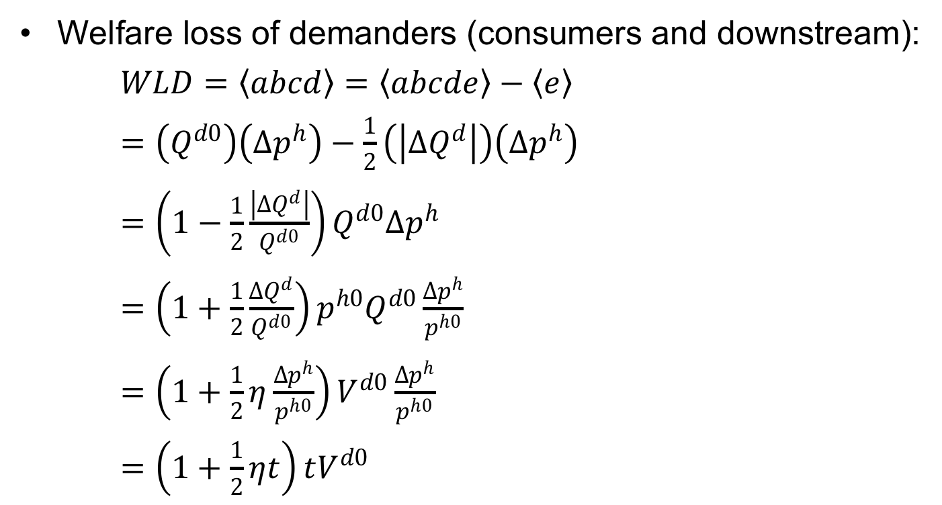
Small Country in Equations
Welfare loss of demanders (consumers and downstream):
$WLD=〈abcd〉=〈abcde〉−〈e〉$
$=\left(Q^{d0}\right)\left({∆p}^{h}\right)−\frac{1}{2}\left(\left|{∆Q}^{d}\right|\right)\left({∆p}^{h}\right)$
$=\left(1−\frac{1}{2}\frac{\left|{∆Q}^{d}\right|}{Q^{d0}}\right)Q^{d0}{∆p}^{h}$
$=\left(1+\frac{1}{2}\frac{{∆Q}^{d}}{Q^{d0}}\right){p^{h0}Q}^{d0}\frac{{∆p}^{h}}{p^{h0}}$
$=\left(1+\frac{1}{2}η\frac{{∆p}^{h}}{p^{h0}}\right)V^{d0}\frac{{∆p}^{h}}{p^{h0}}$
$=\left(1+\frac{1}{2}ηt\right)tV^{d0}$
$p^{h}$
$$S\left(p^{h}\right)$$
${(1+t)p}^{w}$
$${∆p}^{h}={tp}^{w}$$
a
c
e
b
d
$p^{w}$
$$D\left(p^{h}\right)$$
$${∆Q}^{s}$$
$${∆Q}^{d}$$
$$Q^{s0}$$
$$Q^{s1}$$
$$Q^{d1}$$
$$Q^{d0}$$
$$Q$$

Slide 40
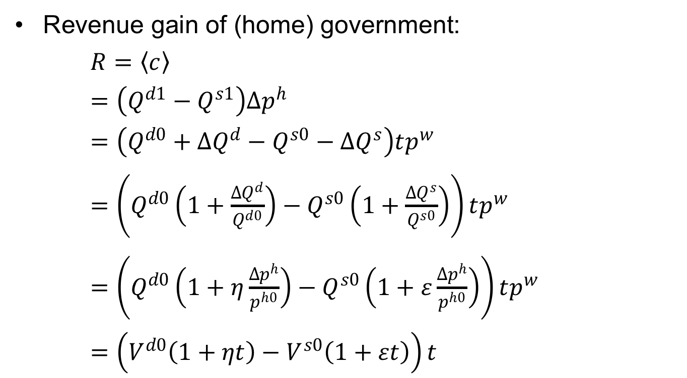
Small Country in Equations
$p^{h}$
$$S\left(p^{h}\right)$$
Revenue gain of (home) government:
$R=〈c〉$
$=\left(Q^{d1}−Q^{s1}\right){∆p}^{h}$
$=\left(Q^{d0}+{∆Q}^{d}−Q^{s0}−{∆Q}^{s}\right)tp^{w}$
$=\left(Q^{d0}\left(1+\frac{{∆Q}^{d}}{Q^{d0}}\right)−Q^{s0}\left(1+\frac{{∆Q}^{s}}{Q^{s0}}\right)\right)tp^{w}$
$=\left(Q^{d0}\left(1+η\frac{{∆p}^{h}}{p^{h0}}\right)−Q^{s0}\left(1+ε\frac{{∆p}^{h}}{p^{h0}}\right)\right)tp^{w}$
$=\left(V^{d0}\left(1+ηt\right)−V^{s0}\left(1+εt\right)\right)t$
${(1+t)p}^{w}$
$${∆p}^{h}={tp}^{w}$$
a
c
e
b
d
$p^{w}$
$$D\left(p^{h}\right)$$
$${∆Q}^{s}$$
$${∆Q}^{d}$$
$$Q^{s0}$$
$$Q^{s1}$$
$$Q^{d1}$$
$$Q^{d0}$$
$$Q$$

Slide 41



Small Country in Equations
$p^{h}$
$$S\left(p^{h}\right)$$
Welfare change for country:
$WCC=−〈abcd〉+〈a〉+〈c〉$
$=WLD−WGS−R$
$$=−\left(1+\frac{1}{2}ηt\right)tV^{d0}+\left(1+\frac{1}{2}εt\right){tV}^{s0}+\left(V^{d0}\left(1+ηt\right)−V^{s0}\left(1+εt\right)\right)t$$
${(1+t)p}^{w}$
$${∆p}^{h}={tp}^{w}$$
a
c
e
b
d
$p^{w}$
$$D\left(p^{h}\right)$$
$${∆Q}^{s}$$
$${∆Q}^{d}$$
$$Q^{s0}$$
$$Q^{s1}$$
$$Q^{d1}$$
$$Q^{d0}$$
$$Q$$
$=−tV^{d0}+{tV}^{s0}−\frac{1}{2}ηt^{2}V^{d0}+\frac{1}{2}εt^{2}V^{s0}+{tV}^{d0}−tV^{s0}$
$$+ηt^{2}V^{d0}−{εt}^{2}V^{s0}$$
$$=−\left[\frac{1}{2}εt^{2}V^{s0}−\frac{1}{2}ηt^{2}V^{d0}\right]$$

Slide 42
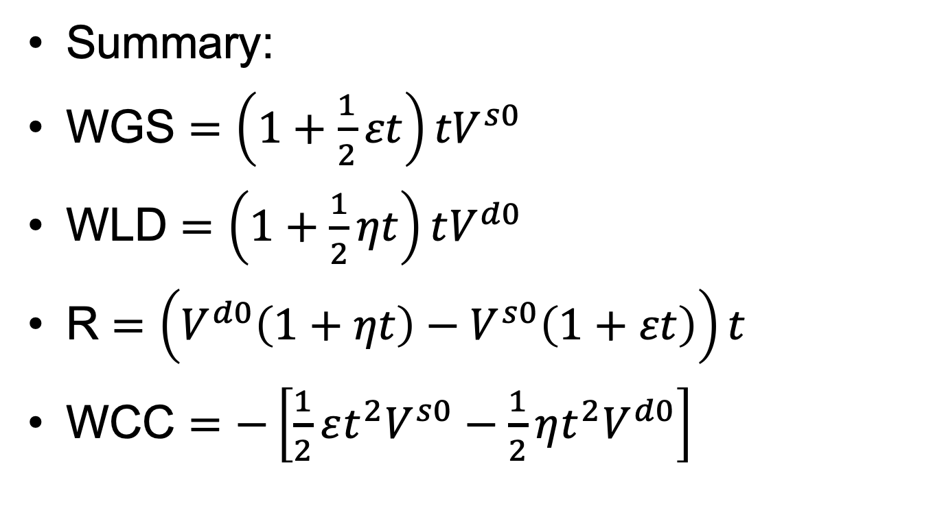
Small Country in Equations
WGS = Welfare Gain of Suppliers
WLD = Welfare Loss of Demanders
R = Government Revenue
WCC = Welfare Change of Country
Summary:
WGS $=\left(1+\frac{1}{2}εt\right){tV}^{s0}$
WLD $=\left(1+\frac{1}{2}ηt\right)tV^{d0}$
R $=\left(V^{d0}\left(1+ηt\right)−V^{s0}\left(1+εt\right)\right)t$
WCC $=−\left[\frac{1}{2}εt^{2}V^{s0}−\frac{1}{2}ηt^{2}V^{d0}\right]$

Slide 43
Pause for Discussion

Slide 44
  Questions on Equations
What information do you need to calculate these welfare effects?
How do the equations change with larger tariffs?
Explain the sources of the “production distortion loss” and the “consumption distortion loss.”
  Why does each occur, and who is it that loses in each case?
  Where do these appear in the equations?

Slide 45
Outline
Tariff by Small country
Tariff by large country
Quotas

Slide 46
Large country
(i.e., Two Countries)
Home
Foreign (*)
P
P*
S
S*
P_{aut}
D*
D
P*_{aut}
Q
Q*
Autarky

Slide 47
Large country
(i.e., Two Countries)
Home
World
Foreign
P
P
P*
S
XS*
S*
P_{aut}
D*
D
P*_{aut}
MD
Q
M₀=X*₀
M,X*
Q*
Free trade

Slide 48
Large country
(i.e., Two Countries)
Home
World
Foreign
P
P
P*
S
XS*
S*
P_{aut}
D*
P_{W0}
P*₀=P_{W0}
P₀=P_{W0}
D
P*_{aut}
MD
S₀
D₀
Q
M₀=X*₀
M,X*
D*₀
S*₀
Q*
M₀
X*₀
Free trade

Slide 49
Large country
(i.e., Two Countries)
Home
World
Foreign
P
P
P*
S
XS*
S*
P₁
D*
P₁
P₀=P_{W0}
t
P*₁
P*₁
D
M₁=X*₁
MD
M₁
X*₁
S₀
D₀
Q
M₀=X*₀
M,X*
D*₀
S*₀
Q*
M₀
X*₀
S₁
D₁
D*₁
S*₁
Specific Tariff, t, by Home
Requires: P=P*+t, MD=XS*

Slide 50
Large country (i.e., Two Countries)
Home
World
Foreign
P
P
P*
S
XS*
S*
P₁
D*
P₁
t
a
c
t
c
P₀=P_{W0}
b
d
f
e
g
i
j
P*₁
e
h
e
P*₁
P*₁
D
MD
S₀
D₀
Q
M₀=X*₀
M,X*
D*₀
S*₀
Q*
S₁
D₁
D*₁
S*₁
Welfare effects of Tariff, t:
Foreign
  Suppliers −(h+i+e+j)
  Demanders +h
  Country −(i+e+j) = −(e+g)
Home
  Suppliers +a
  Demanders –(a+b+c+d)
  Government +(c+e)
  Country +e−(b+d) = e−f
  World: −(f+g) = −(b+d+i+j)
Classes 3, 4: Tariffs and Quotas

Slide 51
Large country, World Market
Welfare effects of a large-country tariff, starting from free trade
Home:
  Private sector (S&D) loses −(a+b)
  Government gains +(a+c)
  Country may gain or lose: +c−b
Foreign
  Private sector (S&D) loses −(c+d)
World loses −(b+d)
World Market
Home is Importer
Foreign (*) is Exporter
P
XS*
P₁
a
b
t
c
d
P*₁
MD
M₁=X*₁
M₀=X*₀
M,X*
“Dead Weight Loss” =

Slide 52
Large country, World Market
Thus large country will gain from tariff if c>b
What is area c?
  The portion of the tariff paid by foreign exporters, who get a lower price
  A transfer from foreign producers to the home government
  The result of improving the home country’s “terms of trade”
World Market
Home is Importer
Foreign (*) is Exporter
P
XS*
P₁
a
b
t
c
d
P*₁
MD
M₁=X*₁
M₀=X*₀
M,X*
“Terms of Trade” ≡ Relative price of exports = P^{X}/P^{M}

Slide 53
Pause for Discussion

Slide 54
  Questions on Large Country
The figure for the world market shows the tariff causing the world price to fall. What in the figure tells you that the Home country is large?
In what sense might a large country gain by using a tariff? Who in the country benefits from that gain?
What reasons are there, if any, for a large country not to levy a tariff?

Slide 55
Large country, “Optimal” tariff
Watch as t rises
Welfare
P
P_{aut}
b
XS*
c
P₁
t
b
P*₁
c
t
MD
P_{aut}*
M₁=X*₁
M₀=X*₀
M,X*
P_{aut}–P_{aut}*

Slide 56
Large country, “Optimal” tariff
Watch as t rises
Welfare
P
P_{aut}
b
XS*
c
P₁
a
b
t
c
d
t
P*₁
MD
P_{aut}*
M₁=X*₁
M₀=X*₀
M,X*
P_{aut}–P_{aut}*

Slide 57
Welfare
P
P_{aut}
b
XS*
c
P₁
t
b
c
t_{opt}
t
P*₁
MD
P_{aut}*
c–b
M₁=X*₁
M₀=X*₀
M,X*
P_{aut}–P_{aut}*
Skipping slides 58-60
How Sizes and Slopes Matter

Slide 58
How Sizes and Slopes Matter
Home
World
Foreign
P
P
P*
S
XS*
S*
P_{aut}
D*
P_{W0}
P*₀=P_{W0}
P₀=P_{W0}
D
P*_{aut}
MD
S₀
D₀
Q
M₀=X*₀
M,X*
D*₀
S*₀
Q*
M₀
X*₀
Free trade
Tariff

Slide 59
How Slopes (Elasticities) Matter
Home
World
Foreign
P
P
P*
S
P_{aut}
XS*
S*
D*
P_{W0}
P*₀=P_{W0}
P₀=P_{W0}
D
P*_{aut}
MD
S₀
D₀
Q
M₀=X*₀
M,X*
D*₀
S*₀
Q*
M₀
X*₀
Free trade
Tariff

Slide 60
How Sizes Matter
Home
World
Foreign
P
P
P*
S
XS*
D*
S*
P_{aut}
P₀=P_{W0}
P*₀=P_{W0}
P_{W0}
P*_{aut}
D
MD
S₀
D₀
Q
M,X*
D*₀
S*₀
Q*
M₀
M₀=X*₀
X*₀
Free trade
Tariff

Slide 61
Pause for Your Questions

Slide 62
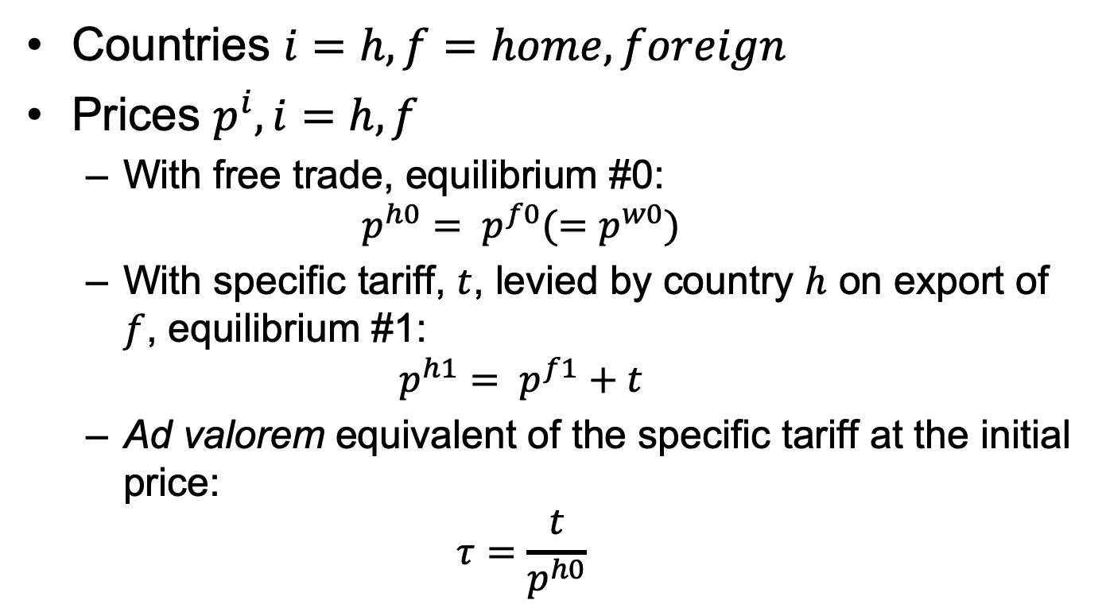
Two-Country in Equations
Countries $i=h, f=home, foreign$
Prices $p^{i}, i=h, f$
  With free trade, equilibrium #0:
  $$p^{h0}= p^{f0}(=p^{w0})$$
  With specific tariff, $t$, levied by country $h$ on export of $f$, equilibrium #1:
  $$p^{h1}= p^{f1}+t$$
  Ad valorem equivalent of the specific tariff at the initial price:
  $$τ=\frac{t}{p^{h0}}$$
Go to Solution
Skipping slides 63-74

Slide 63
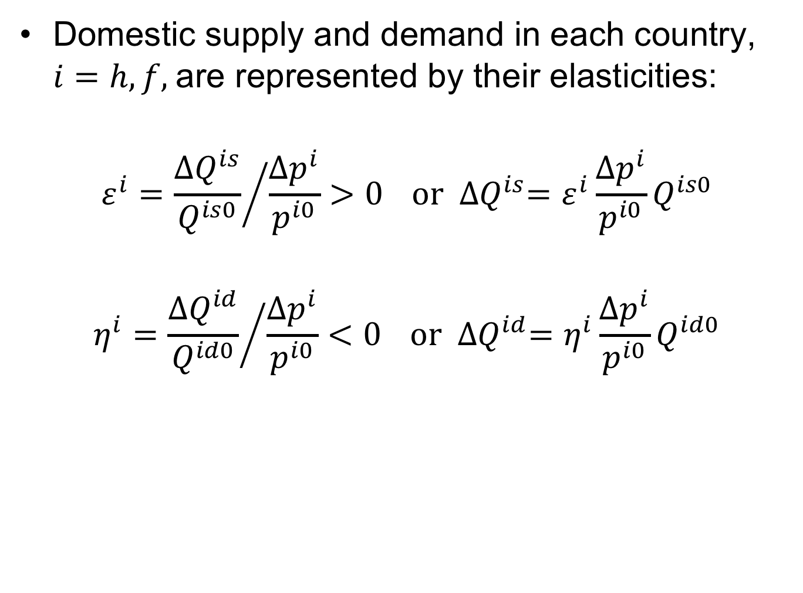
Two-Country in Equations
Domestic supply and demand in each country, $i=h, f,$are represented by their elasticities:
$$ε^{i}={\frac{{∆Q}^{is}}{Q^{is0}}}/{\frac{{∆p}^{i}}{p^{i0}}>0} or {∆Q}^{is}=ε^{i}\frac{{∆p}^{i}}{p^{i0}}Q^{is0}$$
$$η^{i}={\frac{{∆Q}^{id}}{Q^{id0}}}/{\frac{{∆p}^{i}}{p^{i0}}<0} or {∆Q}^{id}=η^{i}\frac{{∆p}^{i}}{p^{i0}}Q^{id0}$$

Slide 64
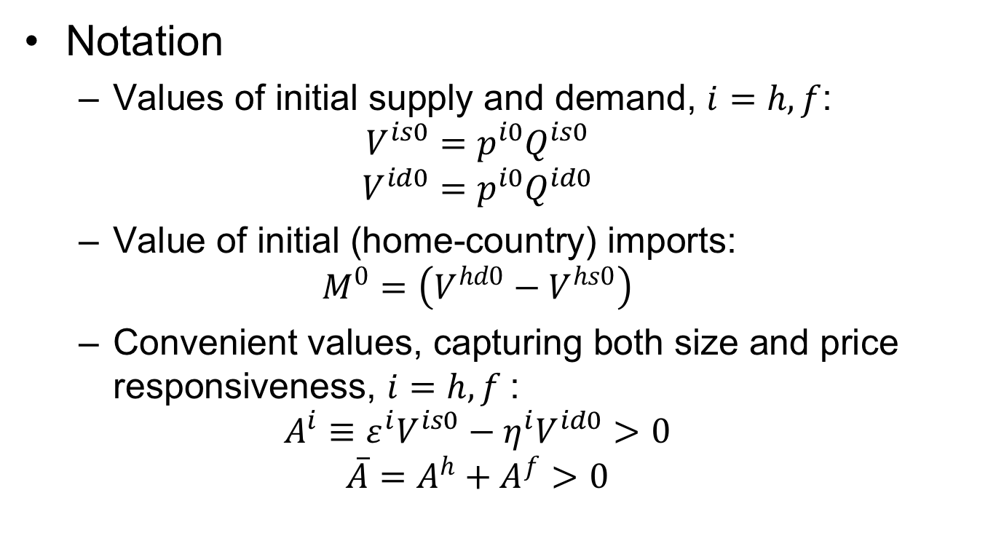
Two-Country in Equations
Notation
  Values of initial supply and demand, $i=h, f$:
  $$V^{is0}=p^{i0}Q^{is0}$$
  $$V^{id0}=p^{i0}Q^{id0}$$
  Value of initial (home-country) imports:
  $$M^{0}=\left(V^{hd0}−V^{hs0}\right)$$
  Convenient values, capturing both size and price responsiveness, $i=h, f$:
  $$A^{i}≡ε^{i}V^{is0}−η^{i}V^{id0}>0$$
  $${\overline{A}=A}^{h}+A^{f}>0$$

Slide 65
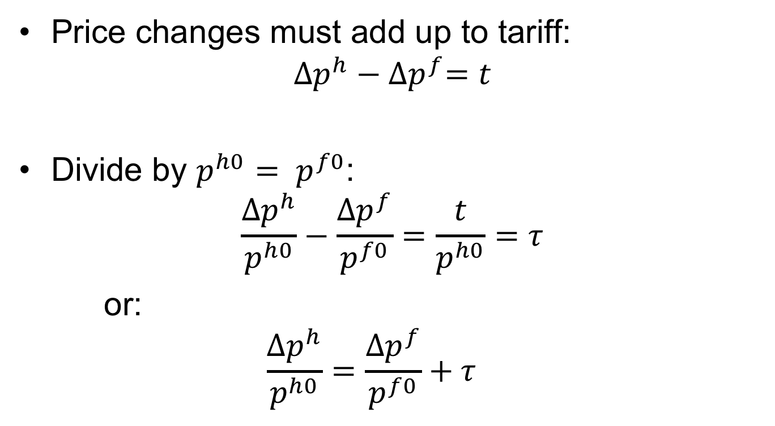
Two-Country in Equations
Price changes must add up to tariff:
$${∆p}^{h}−{∆p}^{f}=t$$
Divide by $p^{h0}= p^{f0}$:
$$\frac{{∆p}^{h}}{p^{h0}}−\frac{{∆p}^{f}}{p^{f0}}=\frac{t}{p^{h0}}=τ$$
or:
  $$\frac{{∆p}^{h}}{p^{h0}}=\frac{{∆p}^{f}}{p^{f0}}+τ$$

Slide 66

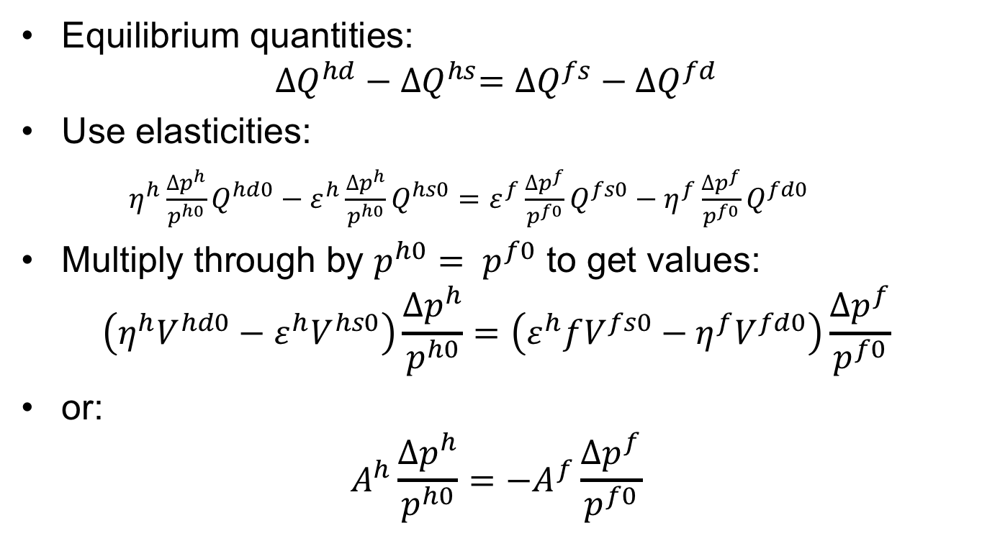
Two-Country in Equations
Equilibrium quantities:
$${∆Q}^{hd}−{∆Q}^{hs}={∆Q}^{fs}−{∆Q}^{fd}$$
Use elasticities:
$η^{h}\frac{{∆p}^{h}}{p^{h0}}Q^{hd0}−ε^{h}\frac{{∆p}^{h}}{p^{h0}}Q^{hs0}=ε^{f}\frac{{∆p}^{f}}{p^{f0}}Q^{fs0}−η^{f}\frac{{∆p}^{f}}{p^{f0}}Q^{fd0}$
Multiply through by $p^{h0}= p^{f0}$ to get values:
$$\left(η^{h}V^{hd0}−ε^{h}V^{hs0}\right)\frac{{∆p}^{h}}{p^{h0}}=\left(ε^{h}fV^{fs0}−η^{f}V^{fd0}\right)\frac{{∆p}^{f}}{p^{f0}}$$
or:
$$A^{h}\frac{{∆p}^{h}}{p^{h0}}={−A}^{f}\frac{{∆p}^{f}}{p^{f0}}$$
$$A^{h}$$

Slide 67
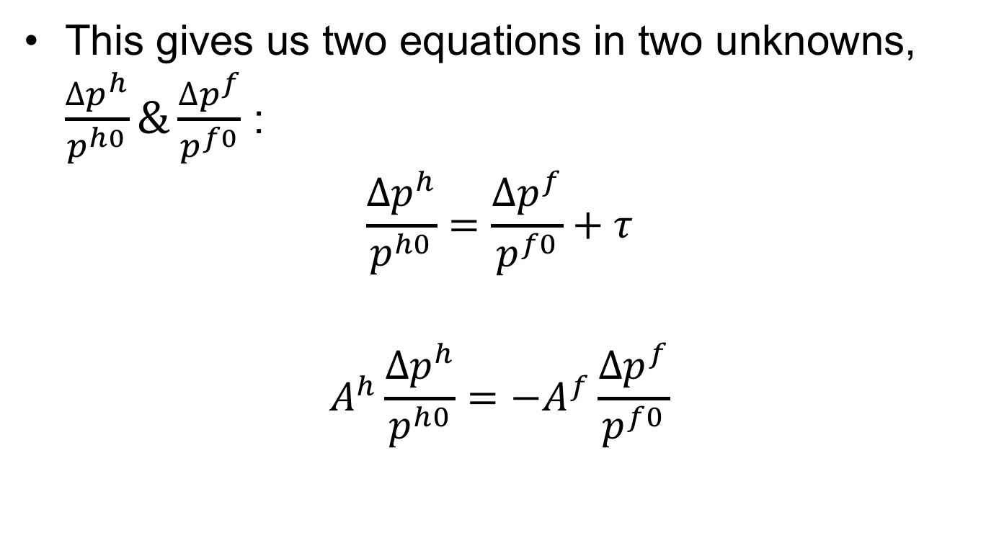
Two-Country in Equations
This gives us two equations in two unknowns, $\frac{{∆p}^{h}}{p^{h0}}\&\frac{{∆p}^{f}}{p^{f0}}$ :
$$\frac{{∆p}^{h}}{p^{h0}}=\frac{{∆p}^{f}}{p^{f0}}+τ$$
$$A^{h}\frac{{∆p}^{h}}{p^{h0}}={−A}^{f}\frac{{∆p}^{f}}{p^{f0}}$$

Slide 68
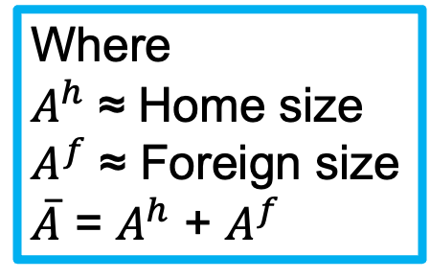
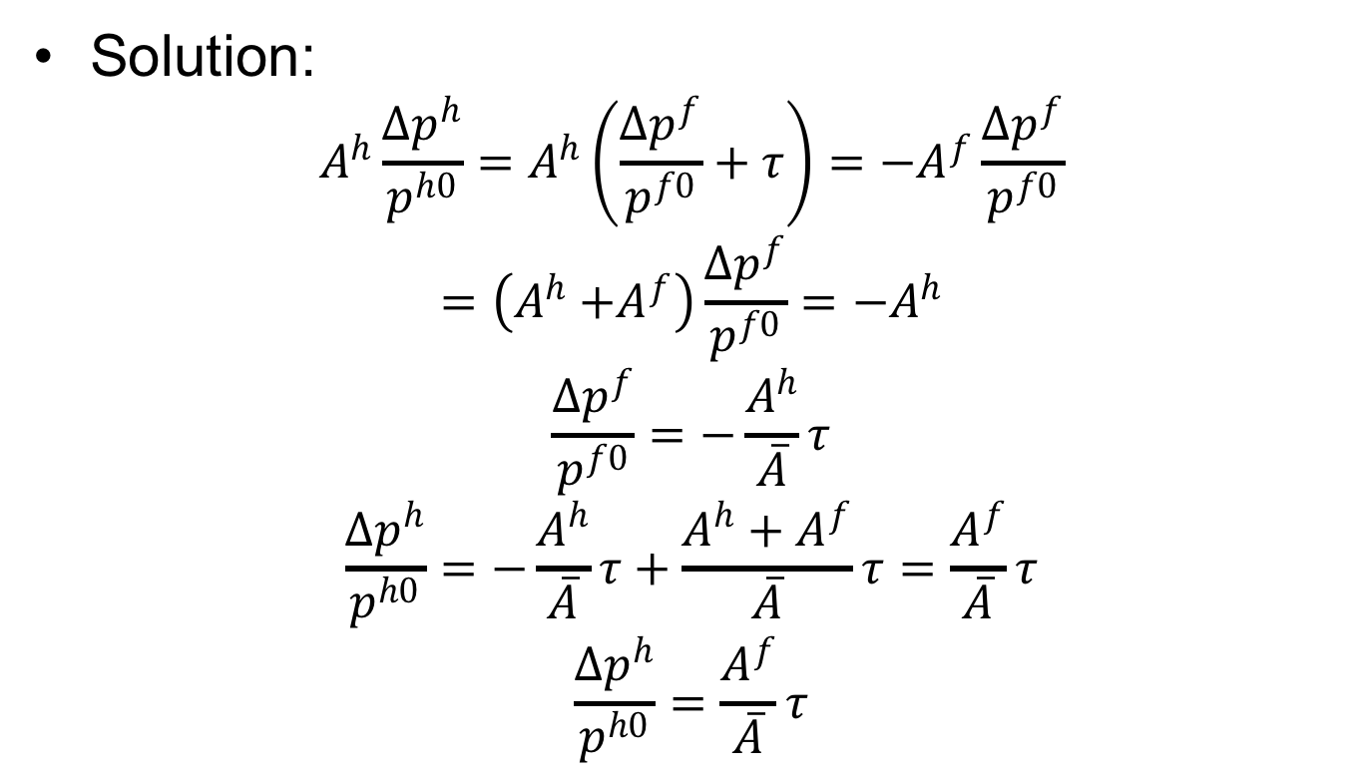
Two-Country in Equations
Solution:
$$A^{h}\frac{{∆p}^{h}}{p^{h0}}=A^{h}\left(\frac{{∆p}^{f}}{p^{f0}}+τ\right)={−A}^{f}\frac{{∆p}^{f}}{p^{f0}}$$
$$=\left(A^{h}{+A}^{f}\right)\frac{{∆p}^{f}}{p^{f0}}=−A^{h}$$
$$\frac{{∆p}^{f}}{p^{f0}}=−\frac{A^{h}}{\overline{A}}τ$$
$$\frac{{∆p}^{h}}{p^{h0}}=−\frac{A^{h}}{\overline{A}}τ+\frac{A^{h}+A^{f}}{\overline{A}}τ=\frac{A^{f}}{\overline{A}}τ$$
$$\frac{{∆p}^{h}}{p^{h0}}=\frac{A^{f}}{\overline{A}}τ$$
Where
$A^{h}$ ≈ Home size
$A^{f}$ ≈ Foreign size
$\overline{A}$ = $A^{h}$ + $A^{f}$

Slide 69
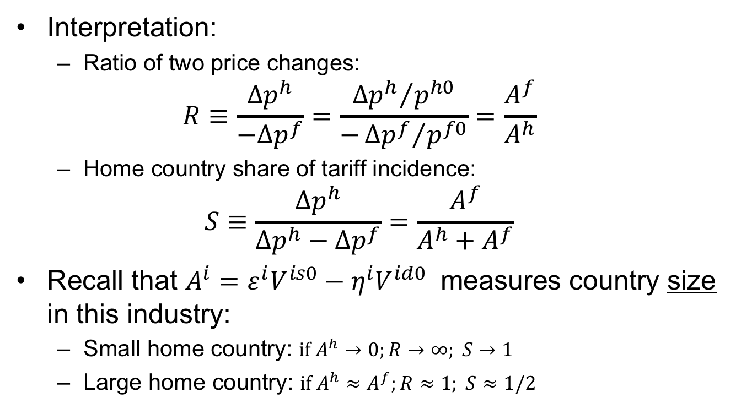
Two-Country in Equations
Interpretation:
  Ratio of two price changes:
  $$R≡\frac{{∆p}^{h}}{−{∆p}^{f}}=\frac{{{∆p}^{h}}/{p^{h0}}}{−{{∆p}^{f}}/{p^{f0}}}=\frac{A^{f}}{A^{h}}$$
  Home country share of tariff incidence:
  $$S≡\frac{{∆p}^{h}}{{∆p}^{h}−{∆p}^{f}}=\frac{A^{f}}{A^{h}+A^{f}}$$
Recall that $A^{i}=ε^{i}V^{is0}−η^{i}V^{id0}$ measures country size in this industry:
  Small home country: $if A^{h}→0;R→∞; S→1$
  Large home country: ${if A}^{h}≈A^{f};R≈1; S≈1/2$

Slide 70
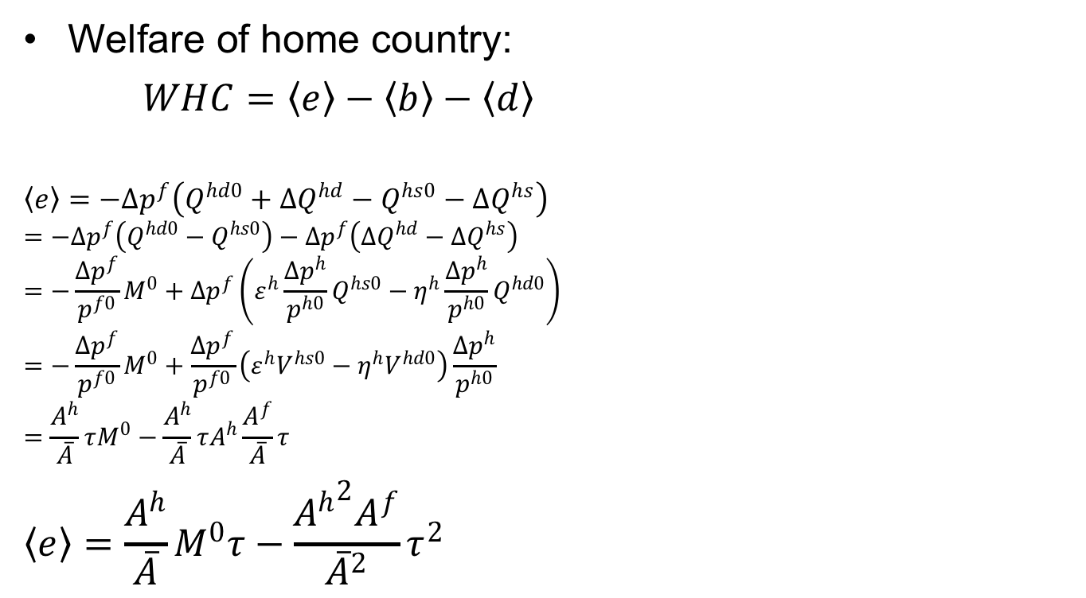
Two-Country in Equations
Home
P^{h}
S^{h}
Welfare of home country:
$WHC=〈e〉−〈b〉−〈d〉$
$$〈e〉=−{∆p}^{f}\left(Q^{hd0}+{∆Q}^{hd}−Q^{hs0}−{∆Q}^{hs}\right)$$
$$=−{∆p}^{f}\left(Q^{hd0}−Q^{hs0}\right)−{∆p}^{f}\left({∆Q}^{hd}−{∆Q}^{hs}\right)$$
$$=−\frac{{∆p}^{f}}{p^{f0}}M^{0}+{∆p}^{f}\left(ε^{h}\frac{{∆p}^{h}}{p^{h0}}Q^{hs0}−η^{h}\frac{{∆p}^{h}}{p^{h0}}Q^{hd0}\right)$$
$$=−\frac{{∆p}^{f}}{p^{f0}}M^{0}+\frac{{∆p}^{f}}{p^{f0}}\left(ε^{h}V^{hs0}−η^{h}V^{hd0}\right)\frac{{∆p}^{h}}{p^{h0}}$$
$$=\frac{A^{h}}{\overline{A}}τM^{0}−\frac{A^{h}}{\overline{A}}τA^{h}\frac{A^{f}}{\overline{A}}τ$$
$$〈e〉=\frac{A^{h}}{\overline{A}}M^{0}τ−\frac{{A^{h}}^{2}A^{f}}{{\overline{A}}^{2}}τ^{2}$$
P^{h1}
t
a
c
b
d
P^{h0}=P^{f0}
e
P^{f1}
Q^{hs0}
Q^{hd0}

Slide 71

Two-Country in Equations
Home
P^{h}
S^{h}
Welfare of home country:
$WHC=〈e〉−〈b〉−〈d〉$
$$〈b〉+〈d〉={∆p}^{h}\left({∆Q}^{hs}−{∆Q}^{hd}\right)/2$$
$$=\frac{{∆p}^{h}}{2p^{h0}}\left(ε^{h}\frac{{∆p}^{h}}{p^{h0}}{p^{h0}Q}^{hs0}−η^{h}\frac{{∆p}^{h}}{p^{h0}}{p^{h0}Q}^{hd0}\right)$$
$$=\frac{{∆p}^{h}}{2p^{h0}}\left(ε^{h}V^{hs0}−η^{h}V^{hd0}\right)\frac{{∆p}^{h}}{p^{h0}}$$
$=\frac{1}{2}A^{h}{\left(\frac{{∆p}^{h}}{p^{h0}}\right)}^{2}$ $=\frac{1}{2}A^{h}{\left(\frac{A^{f}}{\overline{A}}τ\right)}^{2}$
$$〈b〉+〈d〉=\frac{{{A^{h}A}^{f}}^{2}}{{2\overline{A}}^{2}}τ^{2}$$
P^{h1}
t
a
c
b
d
P^{h0}=P^{f0}
e
P^{f1}
Q^{hs0}
Q^{hd0}

Slide 72


Welfare of Home Country
$WHC=〈e〉−\left(〈b〉+〈d〉\right)=\left[\frac{A^{h}}{\overline{A}}M^{0}τ−\frac{{A^{h}}^{2}A^{f}}{{\overline{A}}^{2}}τ^{2}\right]−\frac{{{A^{h}A}^{f}}^{2}}{{2\overline{A}}^{2}}τ^{2}$
Welfare
P
P_{aut}
b
XS*
c
P₁
a
b
t
c
d
$τ$_{opt}
$τ$
P*₁
MD
c–b
P_{aut}*
M₁=X*₁
M₀=X*₀
M,X*
P_{aut}–P_{aut}*

Slide 73
Two-Country in Equations
Other effects can be calculated similarly from the areas in the figure:
Home
World
Foreign
P^{h}
P
P^{f}
S^{h}
XS*
S^{f}
P^{h1}
D^{f}
P^{h1}
t
a
c
t
c
b
d
f
P^{h0}=P^{f0}
e
g
i
j
e
h
e
P^{f1}
P^{f1}
P^{f1}
D^{h}
MD
Q^{hs0}
Q^{hd0}
Q^{h}
M₀=X*₀
M,X*
Q^{fs0}
Q^{fd0}
Q^{f}

Slide 74
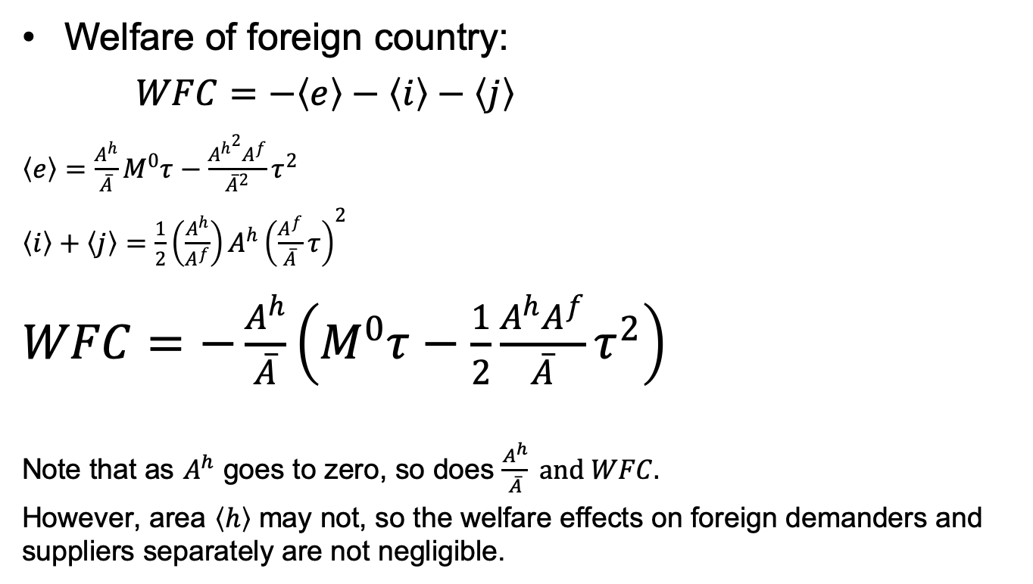
Two-Country in Equations
Foreign
P^{f}
Welfare of foreign country:
$WFC=−〈e〉−〈i〉−〈j〉$
$〈e〉=\frac{A^{h}}{\overline{A}}M^{0}τ−\frac{{A^{h}}^{2}A^{f}}{{\overline{A}}^{2}}τ^{2}$
$〈i〉+〈j〉=\frac{1}{2}\left(\frac{A^{h}}{A^{f}}\right)A^{h}{\left(\frac{A^{f}}{\overline{A}}τ\right)}^{2}$
$WFC=−\frac{A^{h}}{\overline{A}}\left(M^{0}τ−\frac{1}{2}\frac{A^{h}A^{f}}{\overline{A}}τ^{2}\right)$
Note that as $A^{h}$ goes to zero, so does $\frac{A^{h}}{\overline{A}} and WFC.$
However, area $〈h〉$ may not, so the welfare effects on foreign demanders and suppliers separately are not negligible.
S^{f}
D^{f}
P^{h0}=P^{f0}
i
j
h
e
P^{f1}
Q^{fs0}
Q^{fd0}
Q^{f}

Slide 75


Two-Country in Equations
Solution:
$$\frac{{∆p}^{f}}{p^{f0}}=−\frac{A^{h}}{\overline{A}}τ$$
$$\frac{{∆p}^{h}}{p^{h0}}=\frac{A^{f}}{\overline{A}}τ$$
Where
$A^{h}$ ≈ Home size
$A^{f}$ ≈ Foreign size
$\overline{A}$ = $A^{h}$ + $A^{f}$

Slide 76
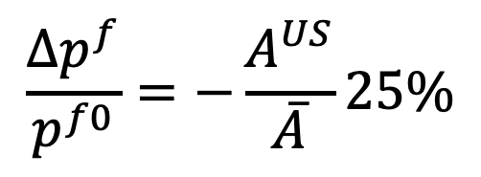

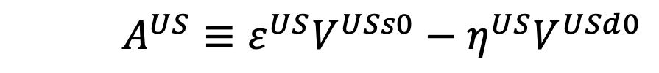
Is the US a Large Country?
Consider Trump’s 25% tariff on steel
So
  Foreign price of steel should fall by 25% times the US share of the world market
  US price of steel should rise by 25% of the foreign share of the world market
$$\frac{{∆p}^{f}}{p^{f0}}=−\frac{A^{US}}{\overline{A}}25\%$$
$A^{US}≡ε^{US}V^{USs0}−η^{US}V^{USd0}$
${\overline{A}=A}^{US}+A^{f}$

Slide 77
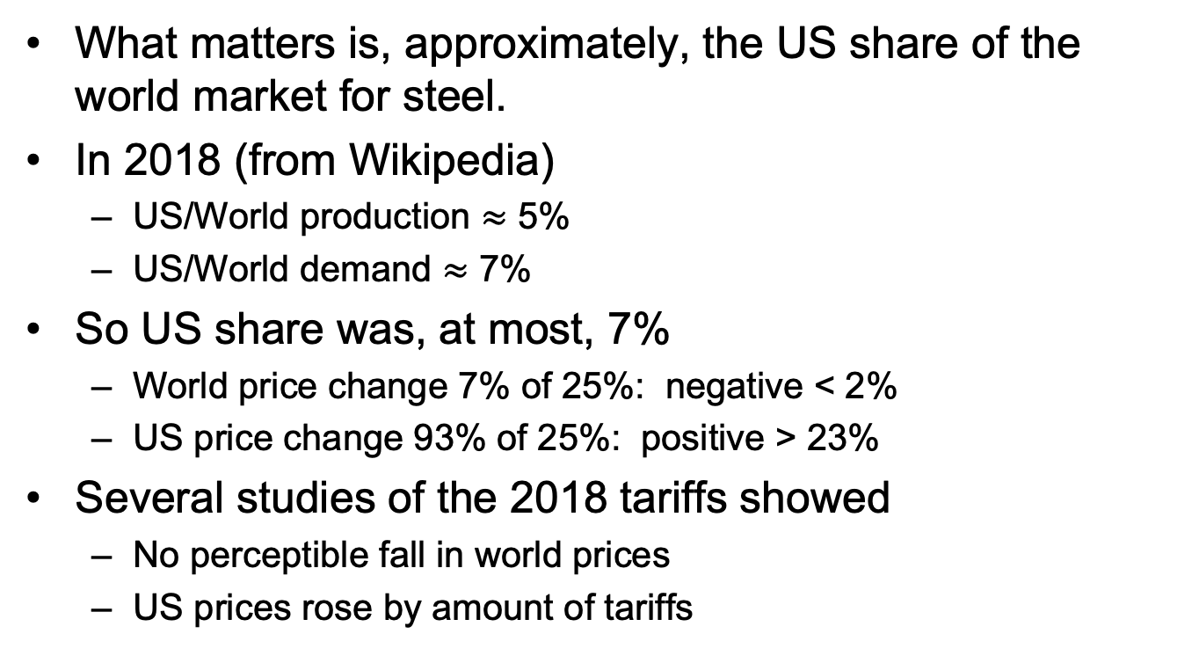
Is the US a Large Country?
What matters is, approximately, the US share of the world market for steel.
In 2018 (from Wikipedia)
  US/World production $≈$ 5%
  US/World demand $≈$ 7%
So US share was, at most, 7%
  World price change 7% of 25%: negative < 2%
  US price change 93% of 25%: positive > 23%
Several studies of the 2018 tariffs showed
  No perceptible fall in world prices
  US prices rose by amount of tariffs

Slide 78
Pause for Discussion

Slide 79
  Questions Martin,
  “US Importers Bore Cost…”
By how much did prices of items subject to tariffs rise?
How much did this mean for individual items?
How much did imports decline from China?
Has USTR under Biden responded?

Slide 80
Pause for Your Questions

Slide 81
Outline
Tariff by Small country
Tariff by large country
Quotas

Slide 82
Quotas
Quota puts upper limit on quantity of imports
Analysis is exactly the same as a tariff, except
  Policy sets quantity of imports
  Price difference is determined by the market (supply & demand)
  Price difference is called “tariff equivalent” of the quota
Welfare analysis of quota is the same as tariff, except
  “Quota rent” instead of tariff revenue
Who gets the quota rent?
  Depends on how quota is administered
  Most commonly, goes to foreigners

Slide 83
Small country quota
(with rents to foreigners)
P
Welfare effects of a quota,q, starting from free trade
  Suppliers gain +a
  Demanders Lose −(a+b+c+d)
  Government gains nothing
  Country loses −(b+c+d)
S
P_{aut}
P₁=P_{W}+t^{eq}
t^{eq}
a
c
b
d
P₀=P_{W}
Foreign gains quota rent +c
  But this is negligible for world, since country is small
D
q =M₁
S₀
S₁
D₁
D₀
Q
M₀
World dead-weight loss is still b+d
Quota q

Slide 84
Large country quota
(with rents to foreigners)
Welfare effects of a large-country quota, starting from free trade
Home:
  Private sector (S&D) loses −(a+b)
  Government gains 0
  Country must lose: −(a+b)
Foreign:
  Private sector (S&D) loses −(c+d)
  Foreigners gain rents +(a+c)
  Country may gain or lose +a−d
World loses −(b+d)
World Market
Home is Importer
Foreign (*) is Exporter
P
XS*
P₁
a
b
t^{eq}
c
d
P*₁
MD
Q=M₁=X*₁
M₀=X*₀
M,X*
“Dead Weight Loss” =

Slide 85
Pause for Discussion

Slide 86
  Questions on Quotas from Deardorff “Nontariff …”
How might quotas be administered; what happens to the quota rents in each case?
How is an import quota equivalent to a tariff? How is it not?
With a fixed and binding import quota, how will the domestic price and the tariff-equivalent of the quota change if curves shift?

