Slide 1
Class 5
Exchange Rates by
Alan V. Deardorff
University of Michigan
2021
PubPol/Econ 541
Figs: Required and Optional

Slide 2
FROM REQUIRED READINGS

Slide 3
Economist, “The Big Mac index:…”

Slide 4
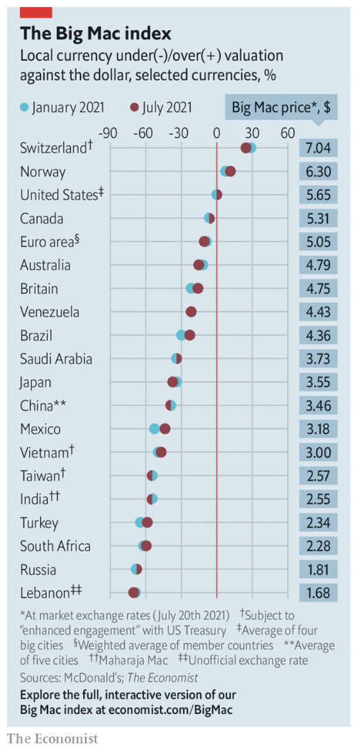

Slide 5
McDougall, Mary, "US Dollar to Maintain Dominance Over Next Decade, Say Central Banks," Financial Times, June 27, 2023.

Slide 6
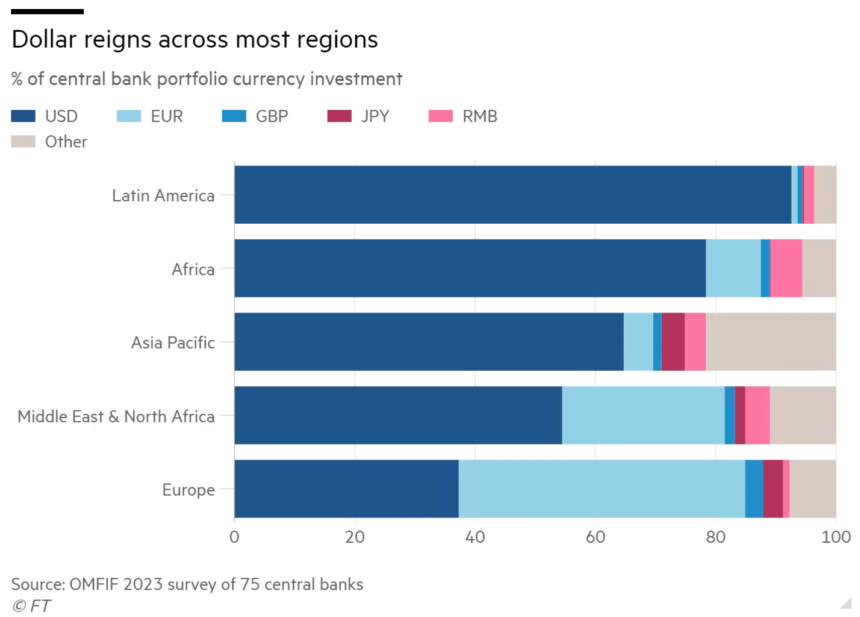

Slide 7
FROM OPTIONAL READINGS

Slide 8
Economist, "Patty-purchasing power: The dollar is now better value, says the Big Mac index," the Economist, August 3, 2023.

Slide 9
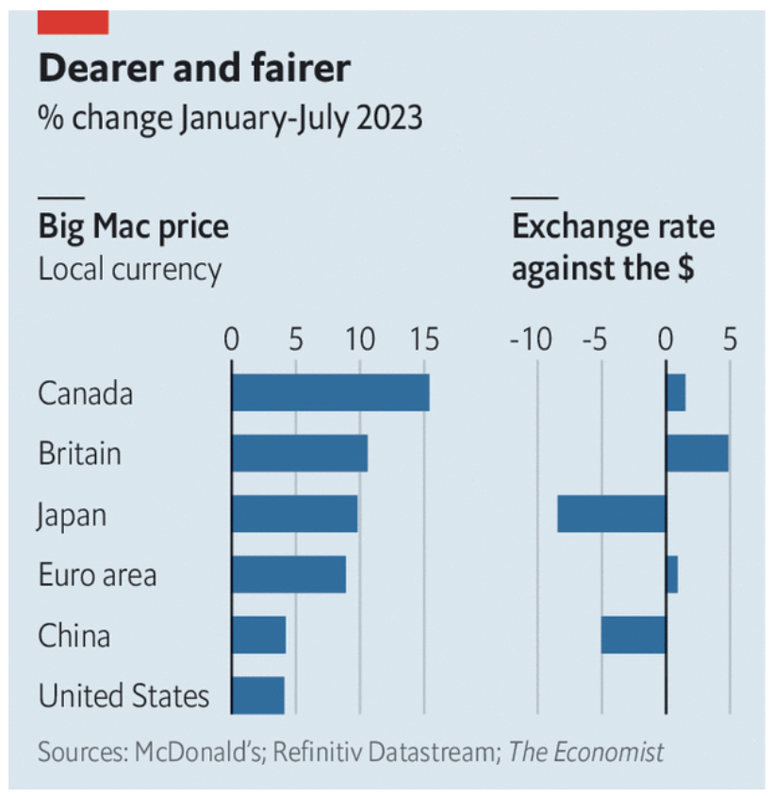

Slide 10
Reading

