Slide 1
Class 6
International Transactions and the Trade Balance by
Alan V. Deardorff
University of Michigan
2020
PubPol/Econ 541

Slide 2
FROM REQUIRED READINGS

Slide 3
Berg, Elliot, Jr., "A Look at the U.S. International Transactions Fourth Quarter and Year 2022," Survey of Current Business, Bureau of Economic Analysis, April 11, 2023.

Slide 4
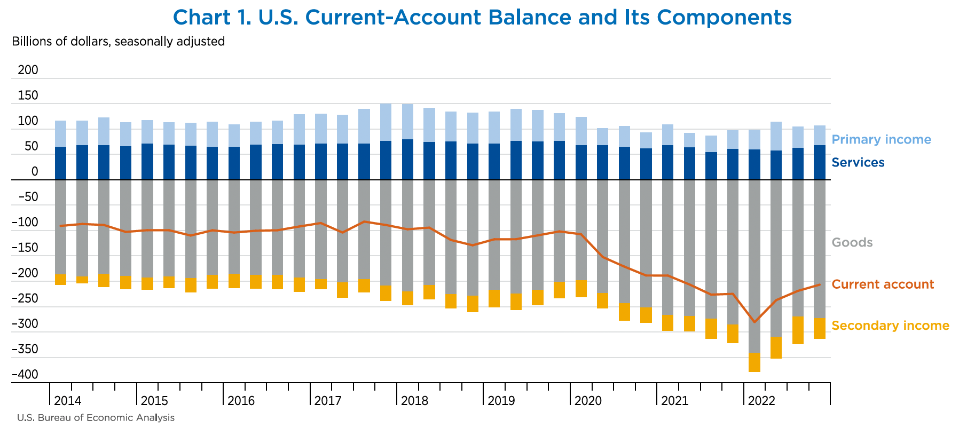
Notes:
Berg, Elliot, Jr., "A Look at the U.S. International Transactions Fourth Quarter and Year 2022," Survey of Current Business, Bureau of Economic Analysis, April 11, 2023. [15p]
https://apps.bea.gov/scb/issues/2023/04-April/0423-quarterly-International-transactions.htm

Slide 5
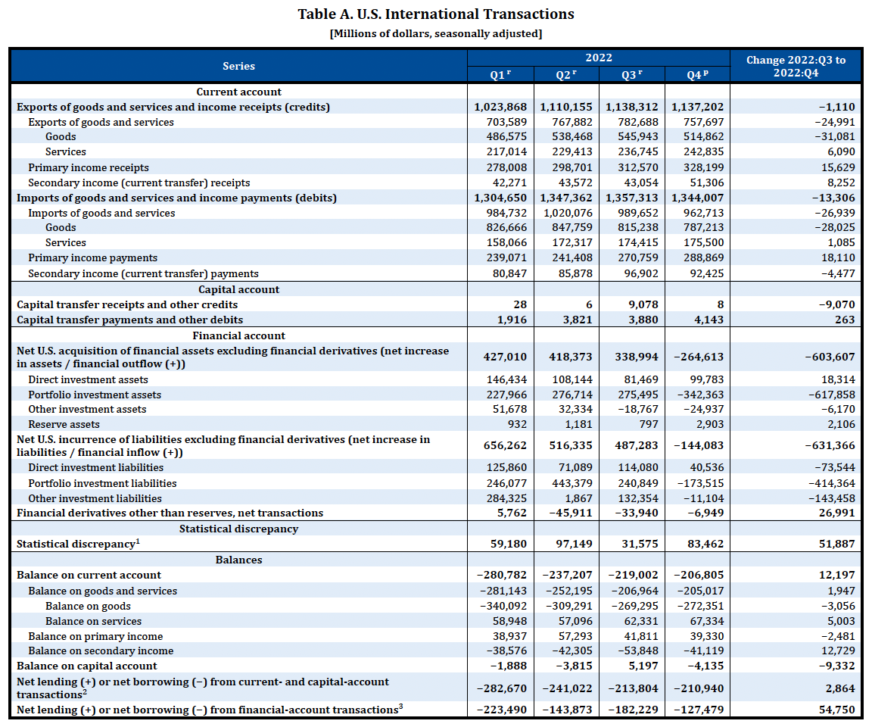
Notes:
Berg, Elliot, Jr., "A Look at the U.S. International Transactions Fourth Quarter and Year 2022," Survey of Current Business, Bureau of Economic Analysis, April 11, 2023. [15p]
https://apps.bea.gov/scb/issues/2023/04-April/0423-quarterly-International-transactions.htm

Slide 6
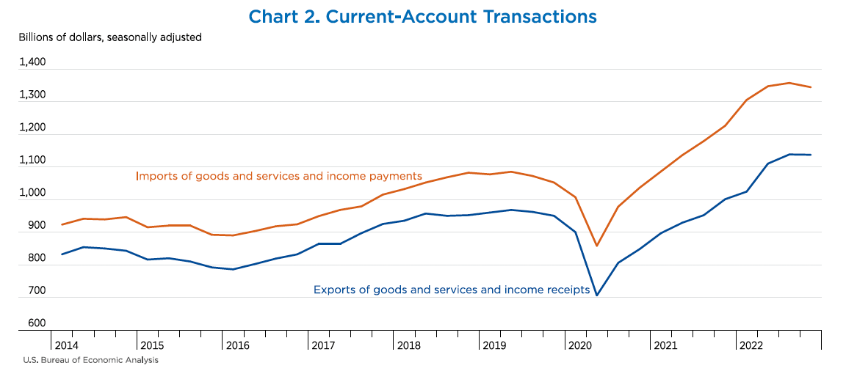
Notes:
Berg, Elliot, Jr., "A Look at the U.S. International Transactions Fourth Quarter and Year 2022," Survey of Current Business, Bureau of Economic Analysis, April 11, 2023. [15p]
https://apps.bea.gov/scb/issues/2023/04-April/0423-quarterly-International-transactions.htm

Slide 7
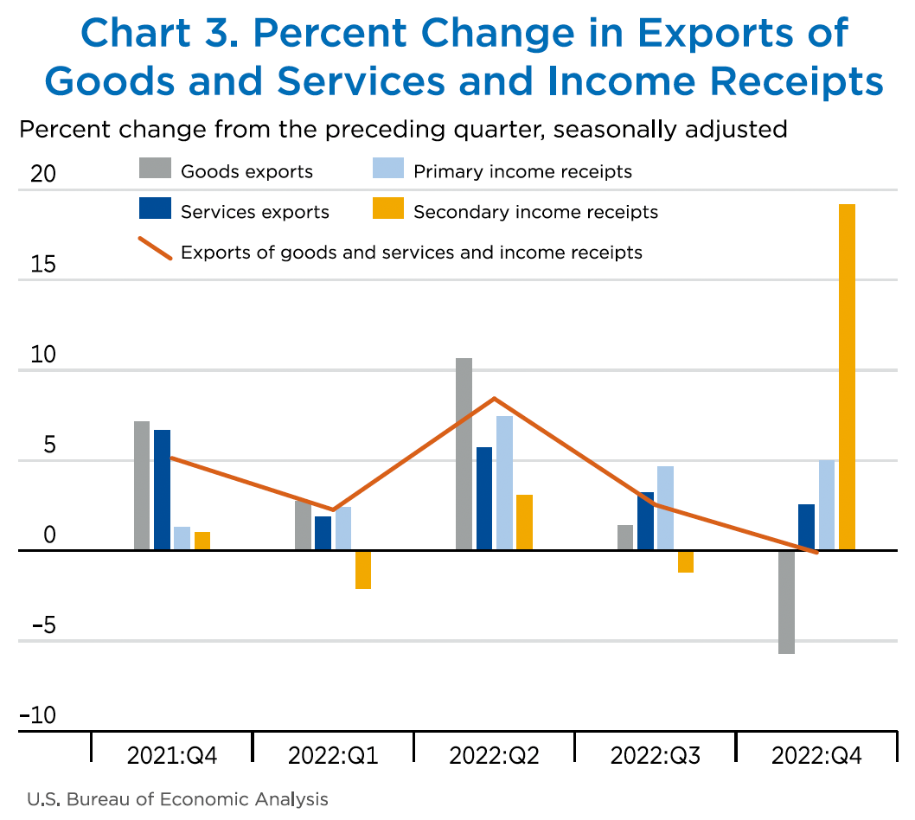
Notes:
Berg, Elliot, Jr., "A Look at the U.S. International Transactions Fourth Quarter and Year 2022," Survey of Current Business, Bureau of Economic Analysis, April 11, 2023. [15p]
https://apps.bea.gov/scb/issues/2023/04-April/0423-quarterly-International-transactions.htm

Slide 8
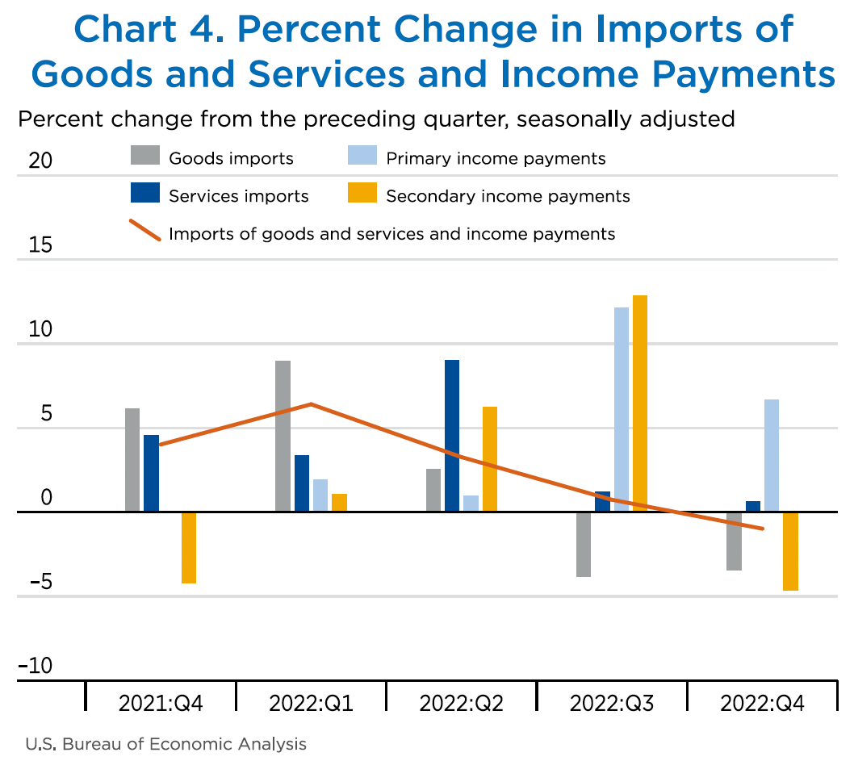
Notes:
Berg, Elliot, Jr., "A Look at the U.S. International Transactions Fourth Quarter and Year 2022," Survey of Current Business, Bureau of Economic Analysis, April 11, 2023. [15p]
https://apps.bea.gov/scb/issues/2023/04-April/0423-quarterly-International-transactions.htm

Slide 9
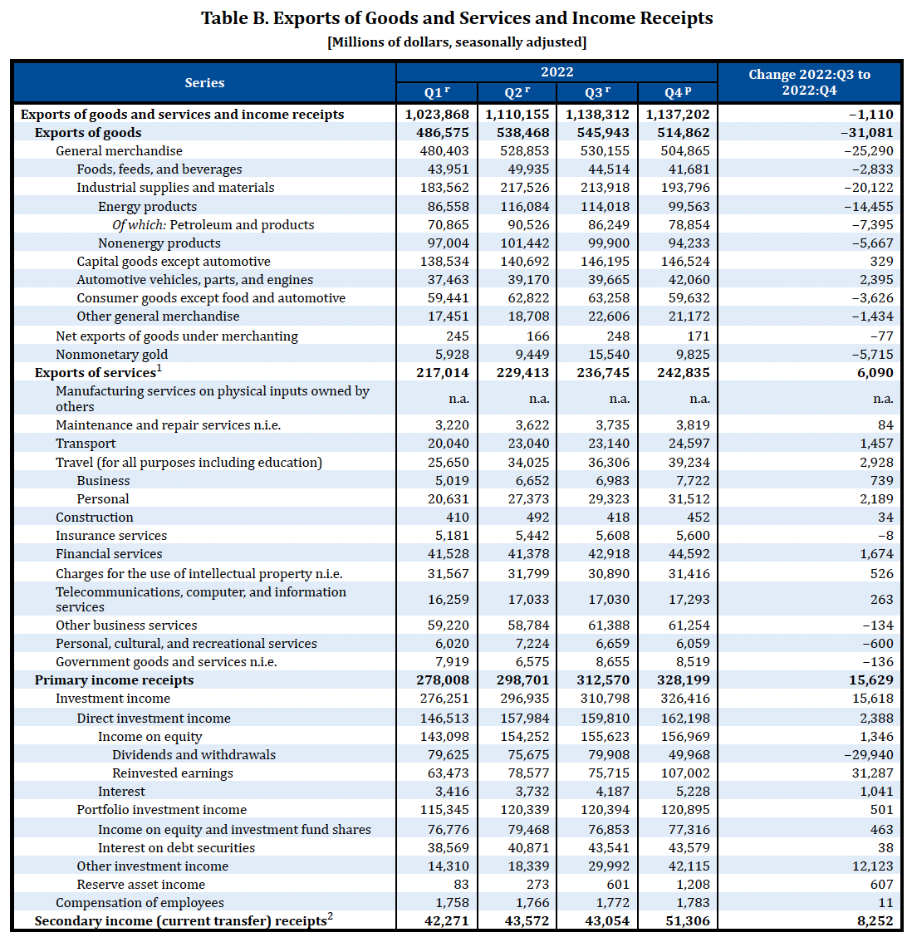
Notes:
Berg, Elliot, Jr., "A Look at the U.S. International Transactions Fourth Quarter and Year 2022," Survey of Current Business, Bureau of Economic Analysis, April 11, 2023. [15p]
https://apps.bea.gov/scb/issues/2023/04-April/0423-quarterly-International-transactions.htm

Slide 10
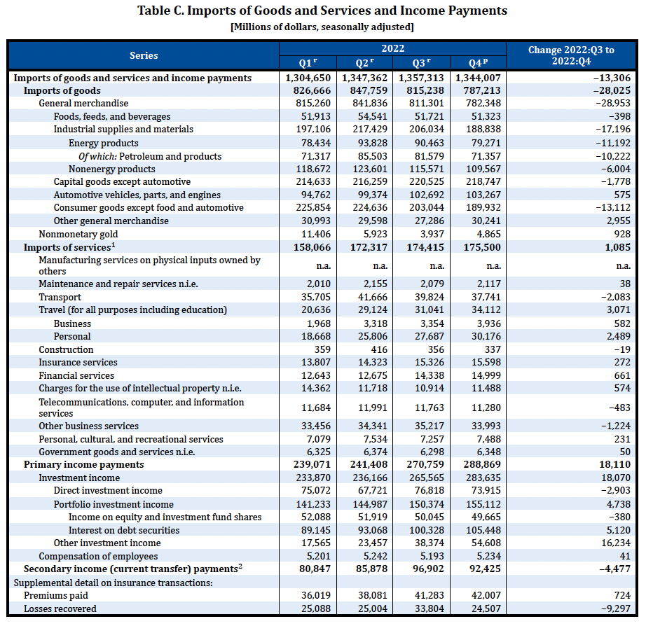
Notes:
Berg, Elliot, Jr., "A Look at the U.S. International Transactions Fourth Quarter and Year 2022," Survey of Current Business, Bureau of Economic Analysis, April 11, 2023. [15p]
https://apps.bea.gov/scb/issues/2023/04-April/0423-quarterly-International-transactions.htm

Slide 11
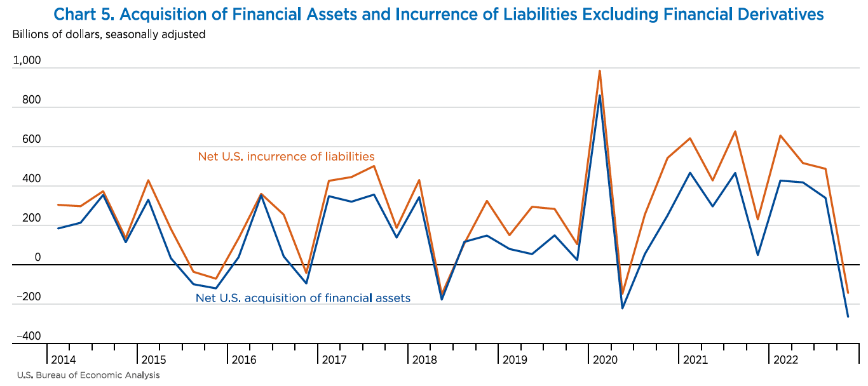
Notes:
Berg, Elliot, Jr., "A Look at the U.S. International Transactions Fourth Quarter and Year 2022," Survey of Current Business, Bureau of Economic Analysis, April 11, 2023. [15p]
https://apps.bea.gov/scb/issues/2023/04-April/0423-quarterly-International-transactions.htm

Slide 12
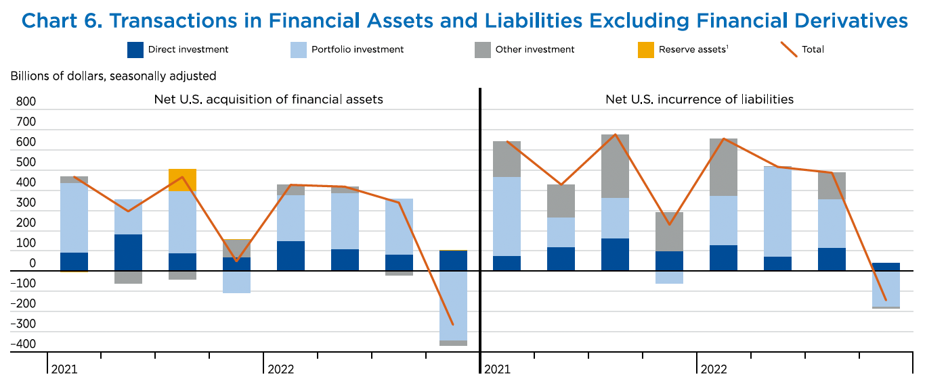
Notes:
Berg, Elliot, Jr., "A Look at the U.S. International Transactions Fourth Quarter and Year 2022," Survey of Current Business, Bureau of Economic Analysis, April 11, 2023. [15p]
https://apps.bea.gov/scb/issues/2023/04-April/0423-quarterly-International-transactions.htm

Slide 13
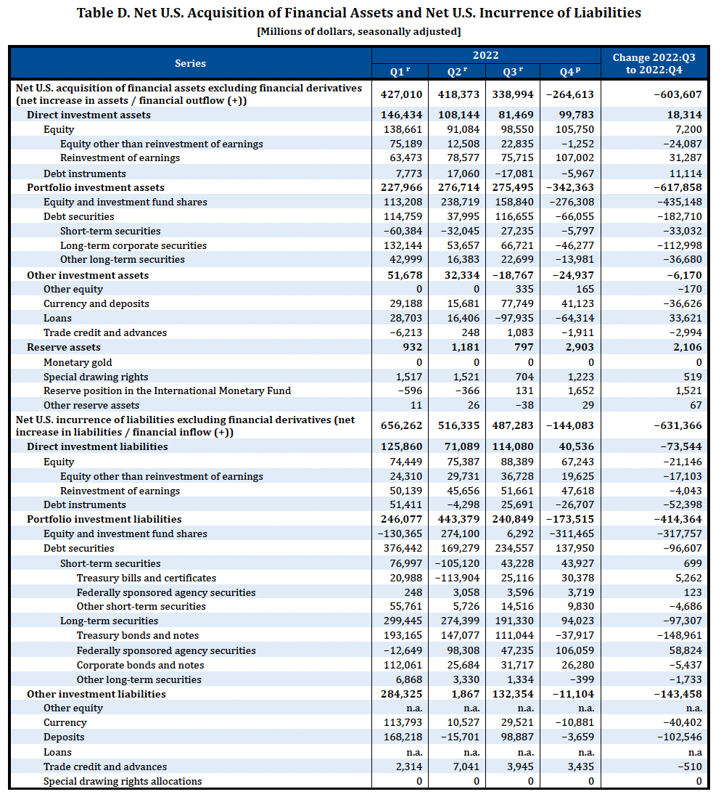
Notes:
Berg, Elliot, Jr., "A Look at the U.S. International Transactions Fourth Quarter and Year 2022," Survey of Current Business, Bureau of Economic Analysis, April 11, 2023. [15p]
https://apps.bea.gov/scb/issues/2023/04-April/0423-quarterly-International-transactions.htm

Slide 14
Scott, Robert E., “U.S. trade deficit hits record highs in 2021,” Working Economics Blog, Economic Policy Institute, February 15, 2022.

Slide 15
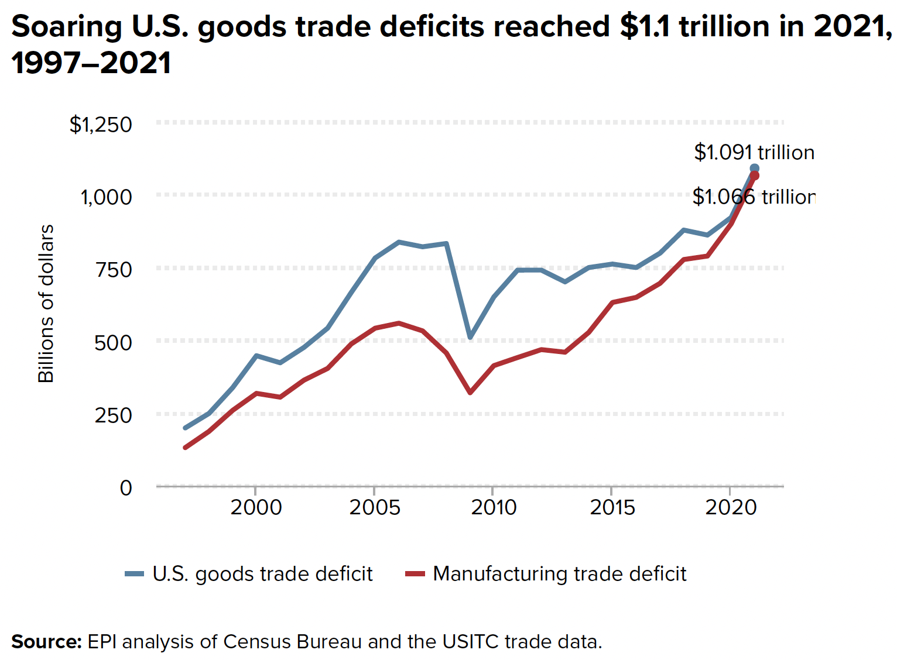
Notes:
Scott, Robert E., “U.S. trade deficits hits record highs in 2021,” Working Economics Blog, Economic Policy Institute, February 15, 2022. [3p].
https://www.epi.org/blog/u-s-trade-deficits-hit-record-highs-in-2021-more-effective-trade-industrial-and-currency-policies-are-needed-to-create-more-domestic-manufacturing-jobs/

Slide 16
FROM OPTIONAL READINGS

Slide 17
Scott, Robert E. and Zane Mokhibert, “Growing China trade deficit cost 3.7 million American jobs between 2001 and 2018,” Report, Economic Policy Institute, January 30, 2020.

Slide 18
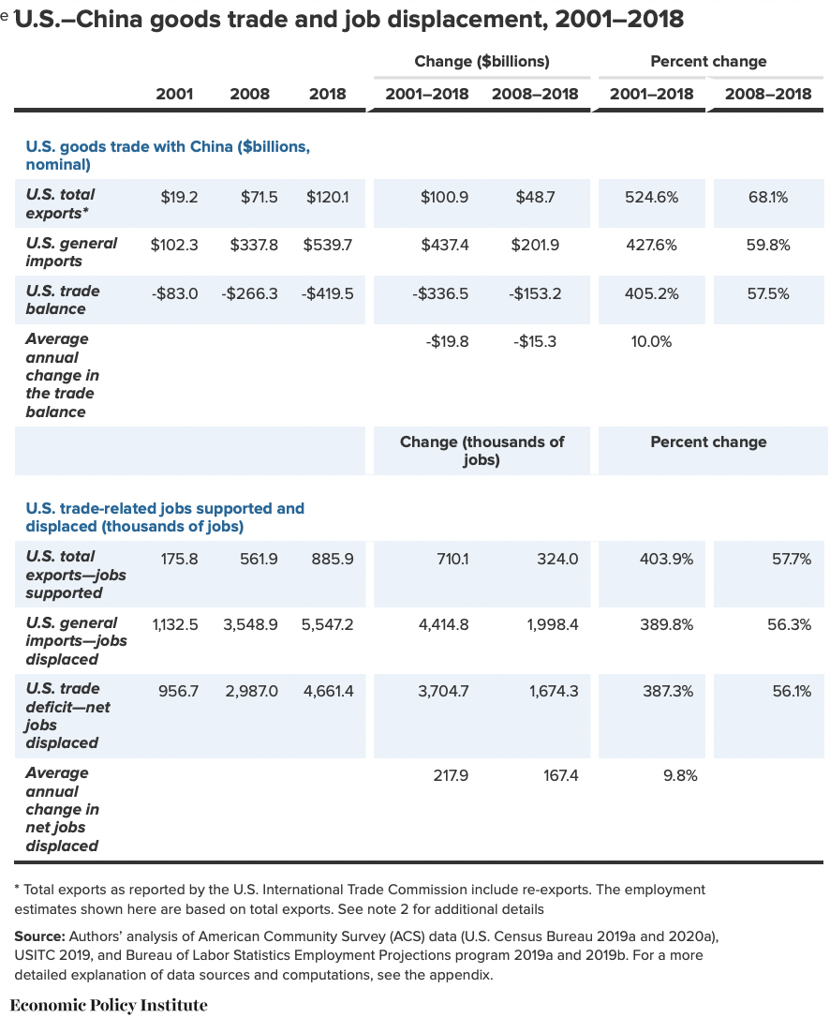
Notes:
Scott, Robert E. and Zane Mokhibert, “Growing China trade deficit cost 3.7 million American jobs between 2001 and 2018,” Report, Economic Policy Institute, January 30, 2020. [85 pp] Read only pp. 1-9]
https://files.epi.org/pdf/181374.pdf

Slide 19
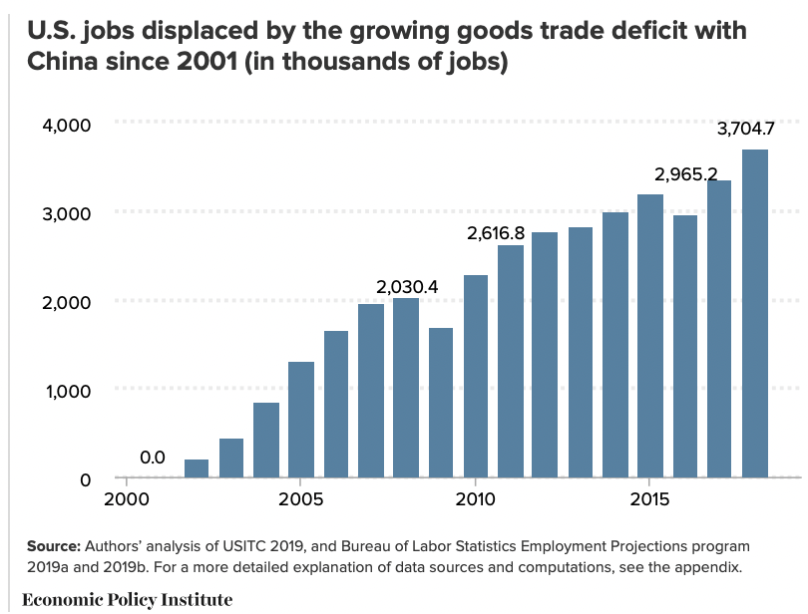
Notes:
Scott, Robert E. and Zane Mokhibert, “Growing China trade deficit cost 3.7 million American jobs between 2001 and 2018,” Report, Economic Policy Institute, January 30, 2020. [85 pp] Read only pp. 1-9]
https://files.epi.org/pdf/181374.pdf

Slide 20
FROM REQUIRED READINGS

Slide 21
Reading

Slide 22
FROM OPTIONAL READINGS

Slide 23
Reading

