Slide 1
Class 9
Policies and Institutions: National, United States by
Alan V. Deardorff
University of Michigan
2023
PubPol/Econ 541

Slide 2
FROM REQUIRED READINGS

Slide 3
Economist, "Trade Mission: Taking Stock of America’s Flagship Trade Programme for Africa," the Economist, February 9, 2023.

Slide 4
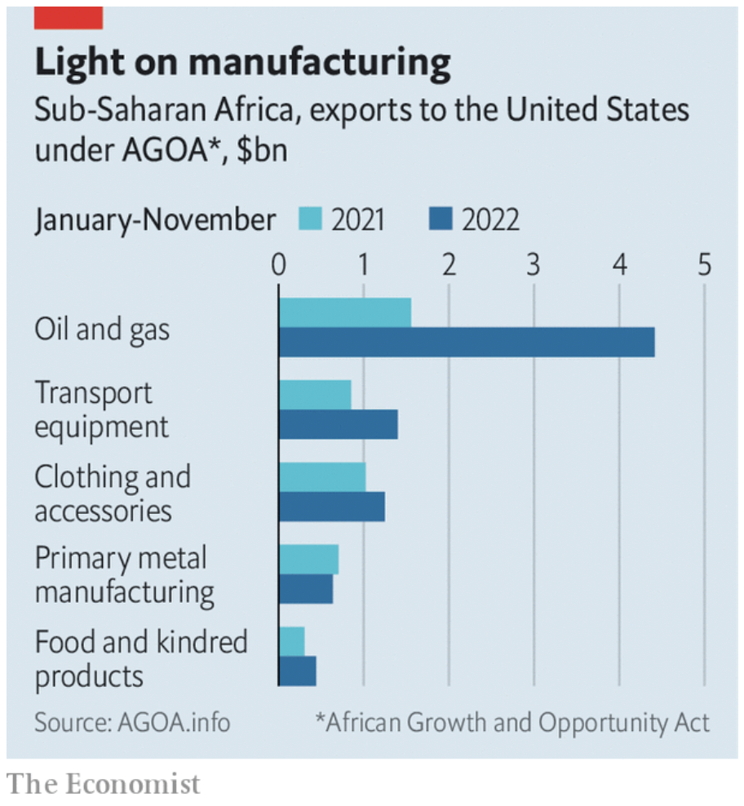

Slide 5
FROM OPTIONAL READINGS

Slide 6
Zumbrun, Josh, “The $67 Billion Tariff Dodge That’s Undermining U.S. Trade Policy,”

Slide 7
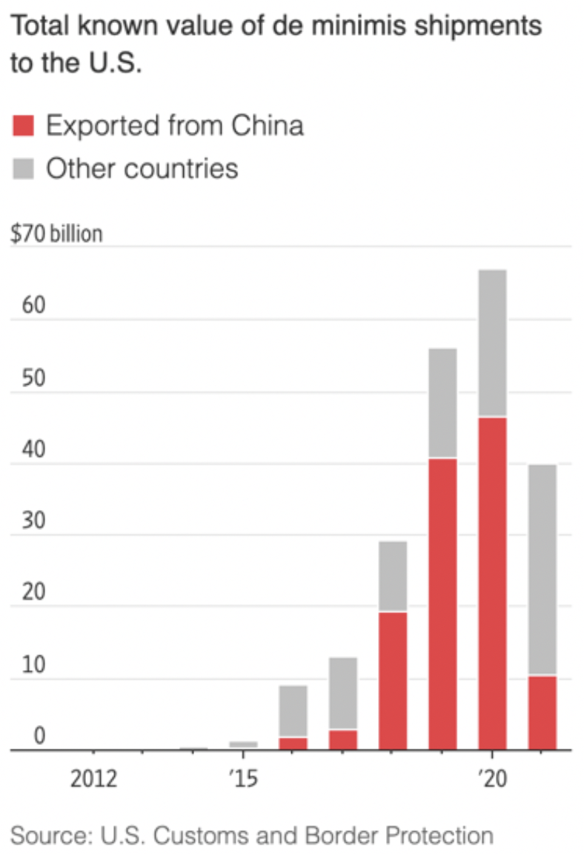
Notes:
Zumbrun, Josh, “The $67 Billion Tariff Dodge That’s Undermining U.S. Trade Policy,” Wall Street Journal, April 25, 2022. [6p]. https://www.wsj.com/articles/the-67-billion-tariff-dodge-thats-undermining-u-s-trade-policy-di-minimis-rule-customs-tourists-11650897161

Slide 8
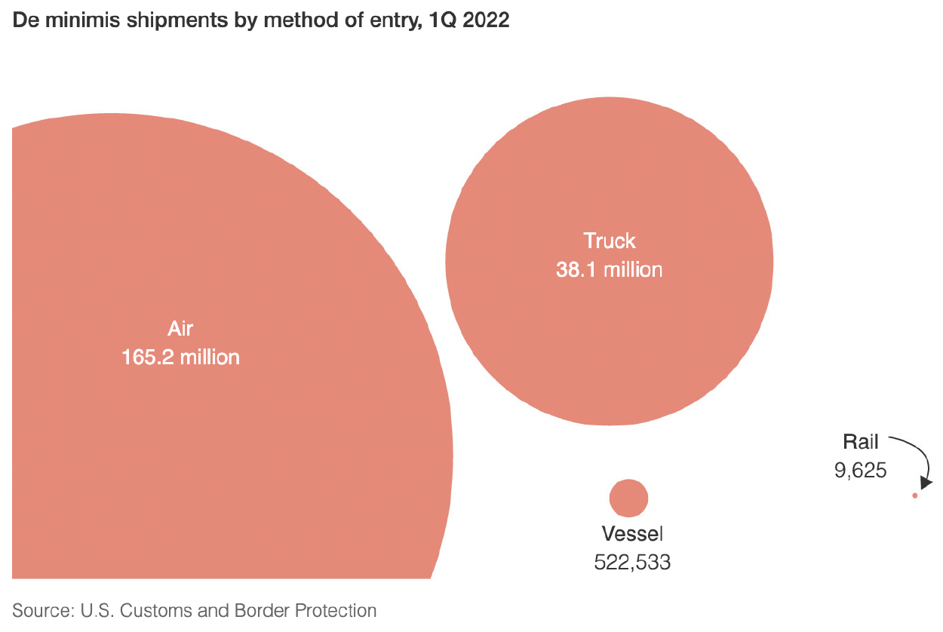

Slide 9
Rampell, Catherine, "What Women’s Underwear Tells Us About Our Trade System,"

Slide 10
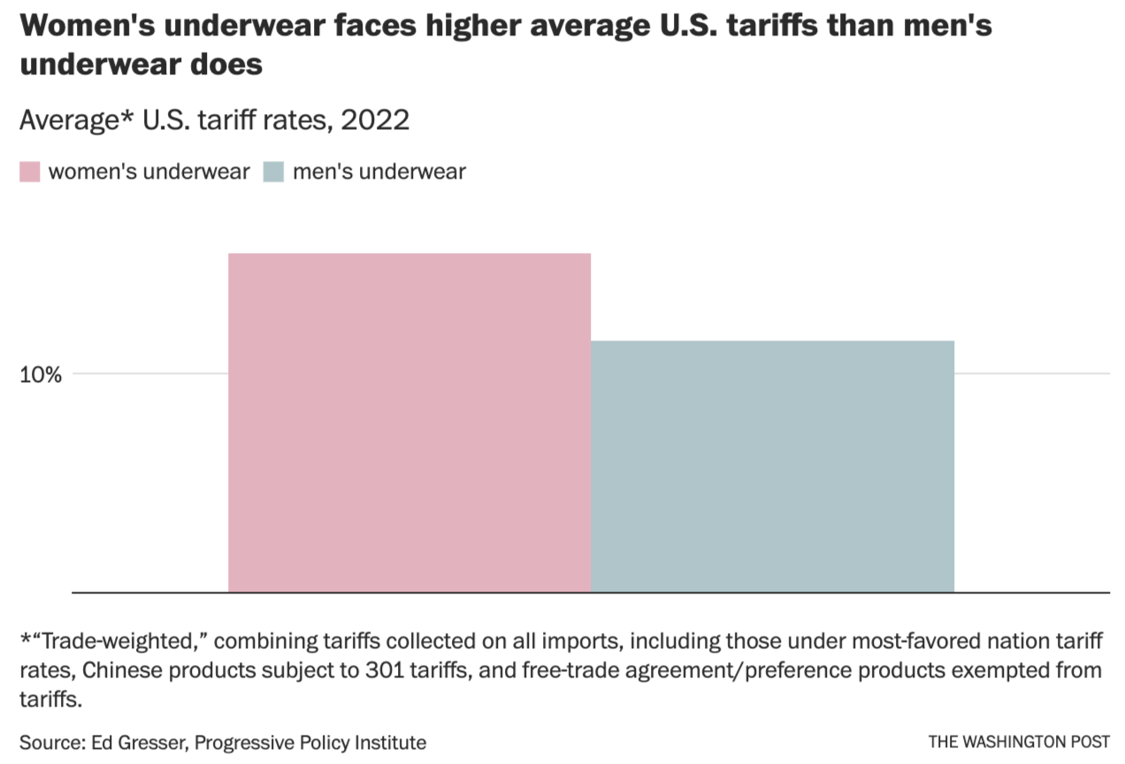
Notes:
https://www.washingtonpost.com/opinions/2023/02/09/women-underwear-tariffs-equality-valentines-day/

Slide 11
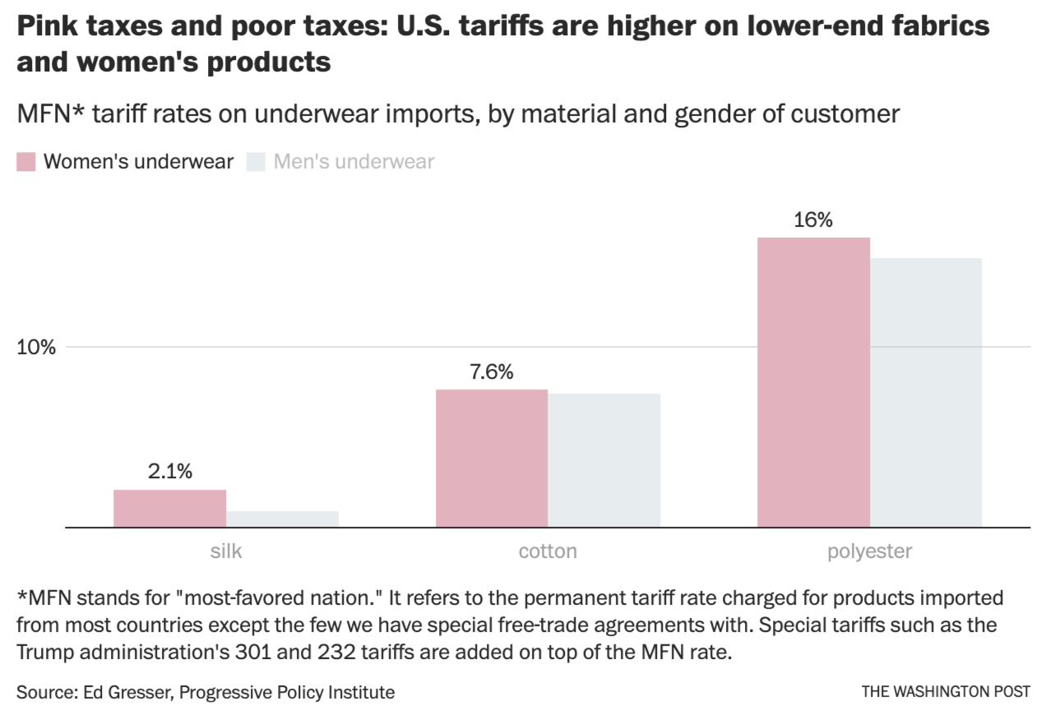
Notes:
https://www.washingtonpost.com/opinions/2023/02/09/women-underwear-tariffs-equality-valentines-day/

Slide 12
Notes:
Jones, Lin, et al., “The Year in Trade 2020,” USITC, September 2021.
https://www.usitc.gov/publications/332/pub5228.pdf

