Slide 1
Class 9
Policies and Institutions: National, United States by
Alan V. Deardorff
University of Michigan
2023
PubPol/Econ 541

Slide 2
Pause for News

Slide 3
Quiz Scores
 | Q2 | Q3 | Q4
Mean | 6.67 | 7.10 | 8.97
Median | 6.5 | 7 | 9
Max | 10 | 10 | 10
Min | 4 | 3.5 | 7.5
S.D. | 1.98 | 1.85 | 0.95

Slide 4
Announcements
More on Papers
  Linear supply and demand are fine
  Results in table, with just discussion in text and conclusion
  Agriculture, alternative crops: just say a little
  Ratio of output to employment: use data on production and employment
  Always: be careful and explicit of units of measurement

Slide 5
Pause for Discussion

Slide 6
  Questions on Jackson, Ch 3
Should (according to Jackson), and do, international institutions like the WTO interfere with the sovereignty of its member states?

Slide 7
Outline
Parts of the US Government that Handle Trade
Main Features of US Trade Policies
  Tariffs, Quotas, VERs
  Escape Clause
  Unfair Trade Laws
  Section 301
  Section 332
  Trade Adjustment Assistance
  Fast Track
  GSP
US Trade Policy under Trump and Biden

Slide 8

US Trade Institutions
US does NOT have a “ministry” or “department” of international trade
Most other countries do; e.g. …
  Canada: Department of International Trade
  Japan: Ministry of Economy, Trade and Industry (METI) (Used to be MITI)
  EU: Directorate General Trade
    Trade Commissioner:
    Valdis Dombrovskis
    since Aug 26, 2020

Slide 9
US Trade Institutions
In US, responsibility for trade issues is spread over many entities
  Congress
  USTR
  Commerce Department (& ITA within it)
  US International Trade Commission (USITC)
  Export-Import Bank
  and several others
Obama said as President that he sought to consolidate many of these in a single agency
  He never did

Slide 10
US Trade Institutions
USTR = United States Trade Representative
  Cabinet-level official of US government
  Handles negotiations on trade issues with
    Other governments
    WTO
  Drafts trade legislation for Congress
  Does NOT set or implement trade policies

Slide 11
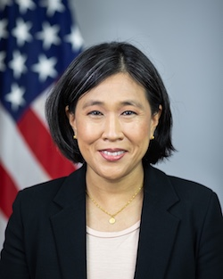
US Trade Institutions
Biden’s USTR is
Katherine Tai
  Harvard Law
  Fluent in Mandarin
  Worked in USTR office 2007-2014
  Chief Trade Counsel for House Ways & Means from 2017

Slide 12
US Trade Institutions
Congress
  Sets tariffs and other trade policies (thus approves trade agreements)
  Two committees are responsible
    House: Ways and Means
    Senate: Finance
  Why these?
    Because trade policy was originally about collecting revenue

Slide 13
US Trade Institutions
Administrative Agencies
  ITA = International Trade Administration
    Part of Department of Commerce
    Main Function: Determines “fairness” in unfair trade cases
      Are imports “dumped”?
      Are they “subsidized”?
    Orientation of ITA: very much favors US businesses

Slide 14
US Trade Institutions
Administrative Agencies
  ITC = USITC = United States International Trade Commission
    Independent agency
      Commissioners (6) are nominated by President and confirmed by Senate
      After that they are on their own
    Main Function: To determine “injury” in cases of
      Anti-Dumping
      Countervailing duties (subsidies)
      Safeguards (a.k.a., Escape Clause)

Slide 15
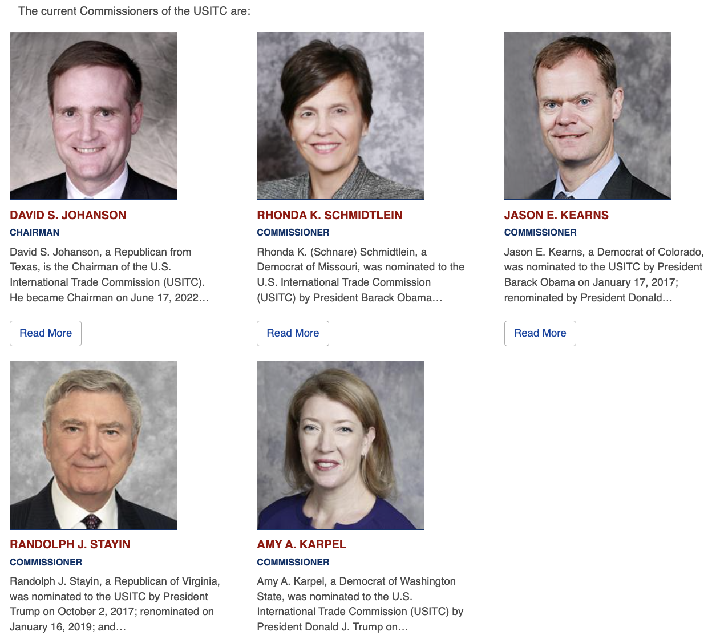
USITC Commissioners
Commissioners
  Serve 9-yr terms
  No more than 3 of one party
    (3 are now Democrats)
  Chair and vice chair from different parties
Staff ~365
Notes:
https://www.usitc.gov/commissioner_bios

Slide 16
US Trade Institutions
Export-Import Bank
  Official export credit agency of the US
  Assists foreign purchasers of US exports
    With loans
    Loan guarantees
    Etc.
  Was target of Tea Party in 2015 as “crony capitalism”
    Was prevented July, 2015 to May 2019, from funding projects of over $10 million

Slide 17
Pause for Discussion

Slide 18
  Questions on Jackson, Ch 3
To what part of the US government does the US constitution assign responsibility for commercial policy?
  What does this imply for the procedures by which the US enters into trade agreements?
Can the US federal government enter into international agreements that constrain the US states?
  Does the same apply to other negotiating units’ (e.g., Canada, the EU) abilities to commit their sub-units?
What units of the US government have responsibilities for aspects of US trade policies?

Slide 19
Features of US Trade Policies
Tariffs
  Column 2: Tariffs left over from pre-1934
    They apply only to N. Korea and Cuba
    But maybe now Russia
  Column 1: Tariffs applied to almost all countries
    MFN rates for WTO members and others
    Negotiated mostly zero rates for FTA members

Slide 20
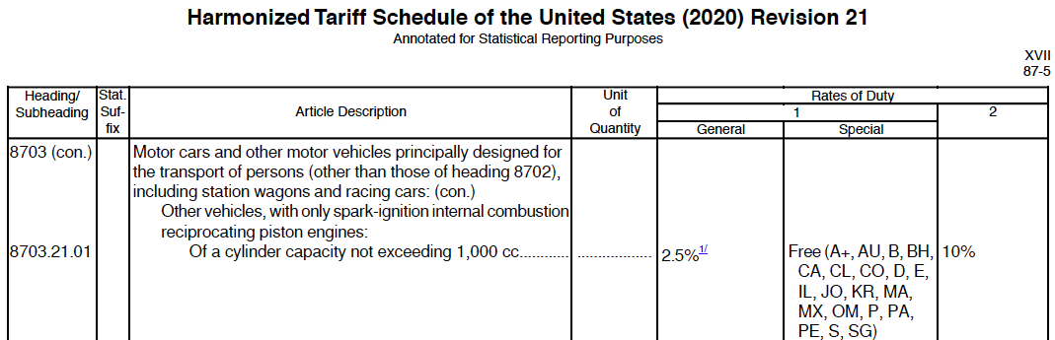

Slide 21
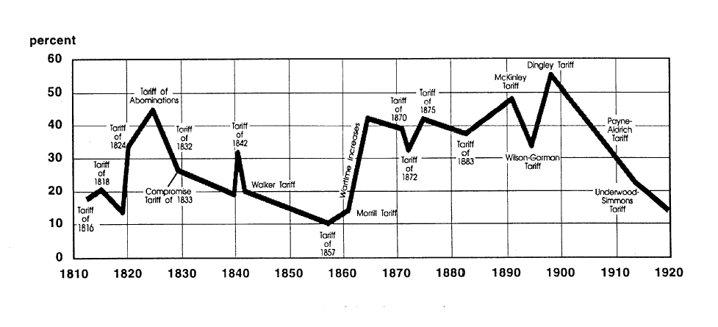
US tariff history: 1810-1920
Today
Notes:
Source: Don’t know

Slide 22
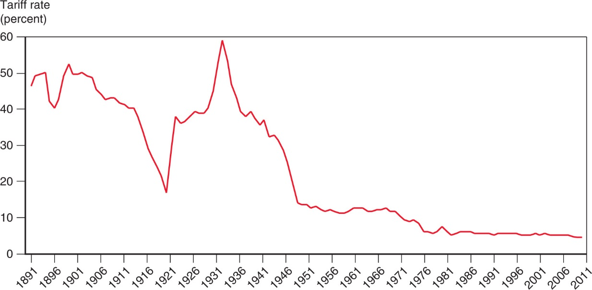
Figure 10.5 The U.S. Tariff Rate
Smoot-Hawley Tariff
1934 Reciprocal Trade Agreements Act
1947 GATT
1995 WTO
After rising sharply at the beginning of the 1930s, the average tariff rate of the United States has steadily declined.

Slide 23
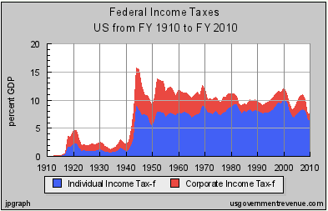
Features of US Trade Policies
Why the decline in tariffs? Partly due to revenues from income tax:
Notes:
Source: Irwin, Doug, “Trade Restrictiveness and Deadweight Losses from U.S. Tariffs,” 22 December 2008, Figure 1.

Slide 24
Features of US Trade Policies
Tariffs, quotas, etc.
  We still have high tariffs on a few products
    Textiles, apparel
      Men’s cotton shirts: 19.7%
      Women’s blouses: 26.9%
        See optional reading by Rampell
Notes:
https://www.wto.org/english/res_e/statis_e/daily_update_e/tariff_profiles/US_e.pdf

Slide 25
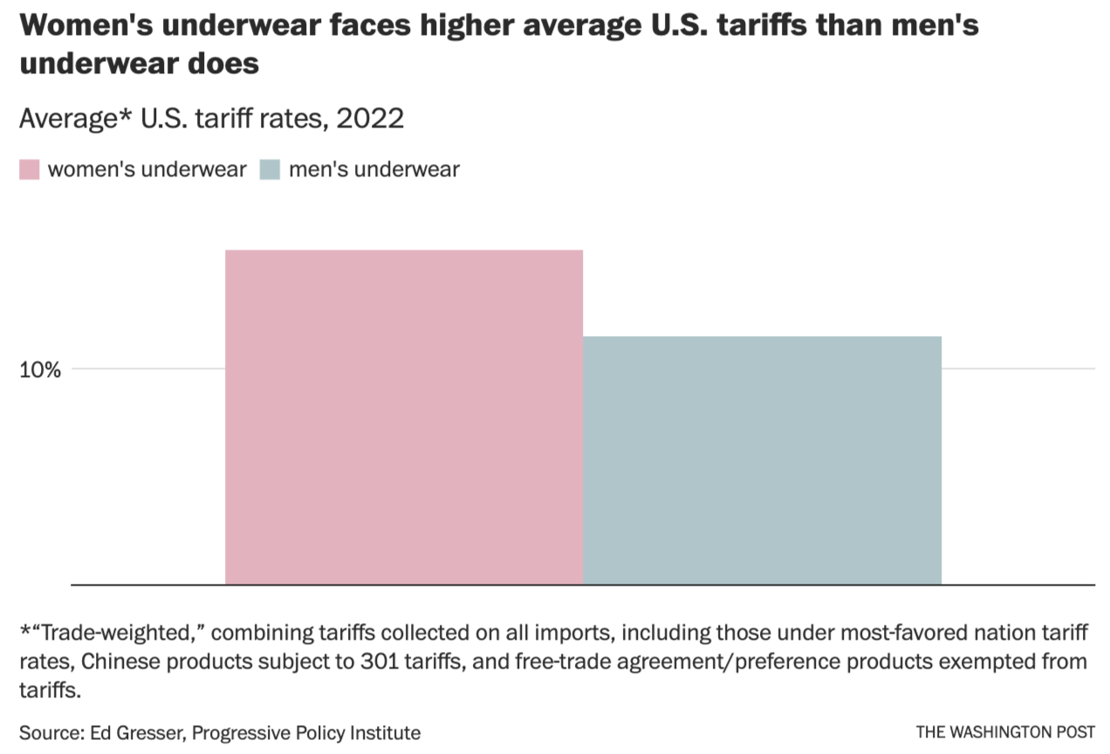
Notes:
https://www.washingtonpost.com/opinions/2023/02/09/women-underwear-tariffs-equality-valentines-day/

Slide 26
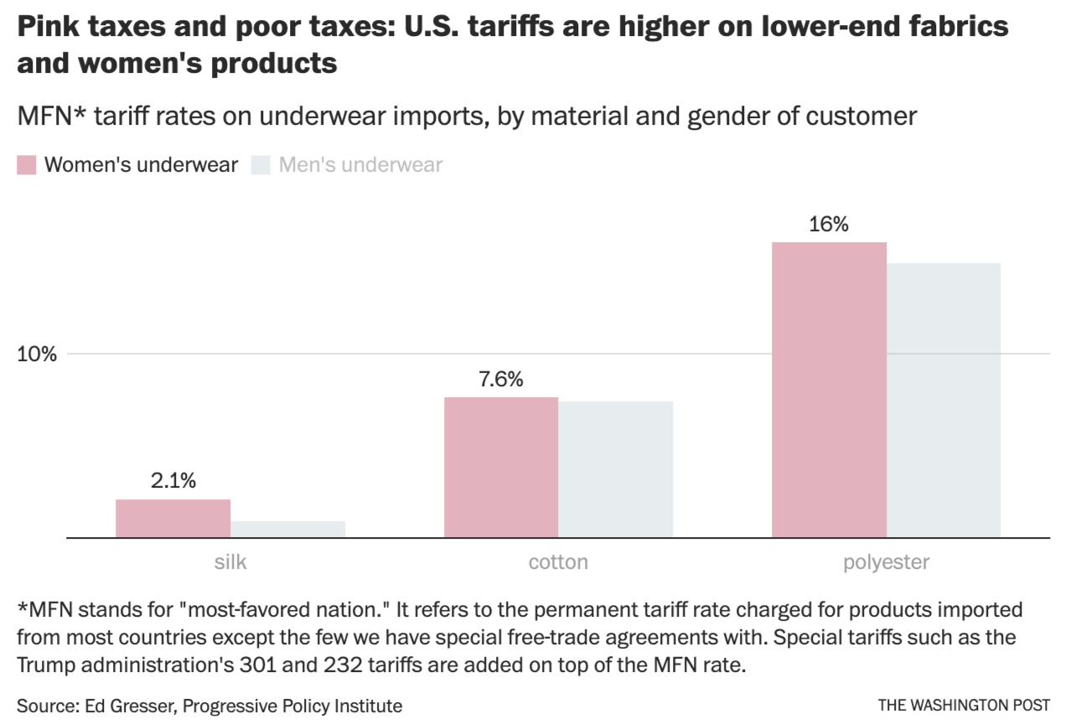
Notes:
https://www.washingtonpost.com/opinions/2023/02/09/women-underwear-tariffs-equality-valentines-day/

Slide 27
Features of US Trade Policies
Tariffs, quotas, etc.
  We still have high tariffs on a few products
    Textiles, apparel
      Men’s cotton shirts: 19.7%
      Women’s blouses: 26.9%
    Agriculture
Product | AVG % | MAX %
Dairy | 17.6 | 118
Coffee, tea | 3.2 | 54
Sugars | 13.3 | 66
Bev & Tobac | 15.0 | 350
Notes:
https://www.wto.org/english/res_e/statis_e/daily_update_e/tariff_profiles/US_e.pdf

Slide 28
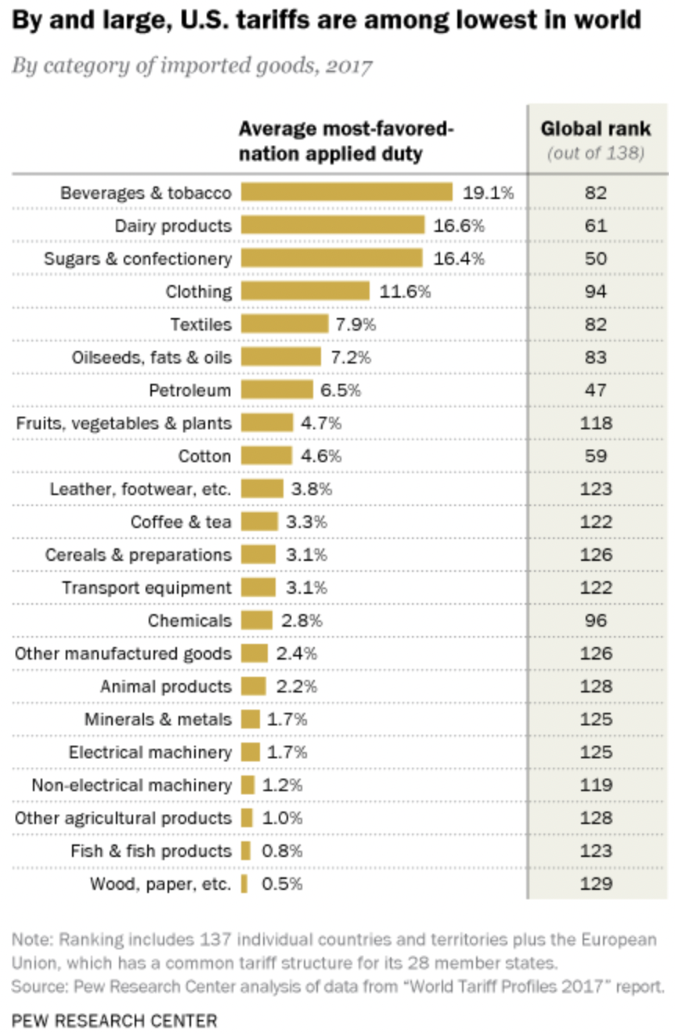
Source: Pew Research Center, 2018
Notes:
Desilver, Drew, “U.S. tariffs vary a lot, but the highest duties tend to be on imported clothing,” Pew Research Center, March 28, 2018.
https://www.pewresearch.org/fact-tank/2018/03/28/u-s-tariffs-vary-a-lot-but-the-highest-duties-tend-to-be-on-imported-clothing/

Slide 29
Features of US Trade Policies
De Minimus
  As we saw earlier, US levies tariffs on imports only if they are worth more than $800
  This is allowing increasing amounts of US imports to enter tariff-free
  See optional reading by Zumbrun

Slide 30
Features of US Trade Policies
Tariffs, quotas, etc.
  Quotas are still common in agriculture
  VERs: Voluntary Export Restraints
    No longer
    But Trump has negotiated something like VERs
  With Trump we got more high tariffs, and Biden has not removed them

Slide 31
Features of US Trade Policies
Escape Clause = Section 201
  Called “Safeguards” in WTO
  Permits temporary protection from injurious imports
    Does NOT allege that the imports are “unfair”
  Eligibility is decided by USITC alone
    Injury (must be “serious”)
    Causation (must be due to imports)
  Implemented by President, who may say NO.
  This was used under Trump for solar panels and washing machines (he could have said no)
  We’ll study it more on Nov 15

Slide 32
Features of US Trade Policies
Unfair Trade Laws
  Permit protection (not necessarily temporary) from “unfair” imports
    Must also be injurious, but less so than for escape clause (only “material injury”)
    “Unfair” if
      Subsidized by foreign government
      “Dumped”, i.e., priced too low by firm (more on this below)

Slide 33
Features of US Trade Policies
Unfair Trade Laws
  Fairness decided by ITA
  Injury decided by USITC
  President is NOT permitted to say NO
We’ll study these more Nov 27, Dec 4

Slide 34
Features of US Trade Policies
Section 301 of the Trade Act of 1974
  US law permitting tariffs on countries that engage in “unfair trade” (other than dumping and subsidies)
    Decided by USTR
  What is unfair trade? “acts that are ‘unjustifiable’ or ‘unreasonable’ and burden U.S. commerce.”
  Before 1995,
    used extensively by US to pressure other countries, esp. Japan;
    after that, not until Trump
  2018 applied to China by USTR:
    “practices related to technology transfer, intellectual property, and innovation are unreasonable or discriminatory, and burden or restrict U.S. commerce.”
Notes:
Andres B. Schwarzenberg, “Section 301 of the Trade Act of 1974,” Congressional Research Service, Updated Aug 31, 2020.
https://crsreports.congress.gov/product/pdf/IF/IF11346#:~:text=Overview%20of%20Section%20301&text=U.S.%20commerce.,their%20markets%20to%20U.S.%20exports.

Slide 35
Features of US Trade Policies
Section 232 Tariffs: National Defense
  Used by Trump on Steel and Aluminum
  Has basis in US law, but WTO legality in doubt
    See Fefer et al.
    WTO panel said no, but US appealed
  Biden administration insists WTO cannot question this

Slide 36
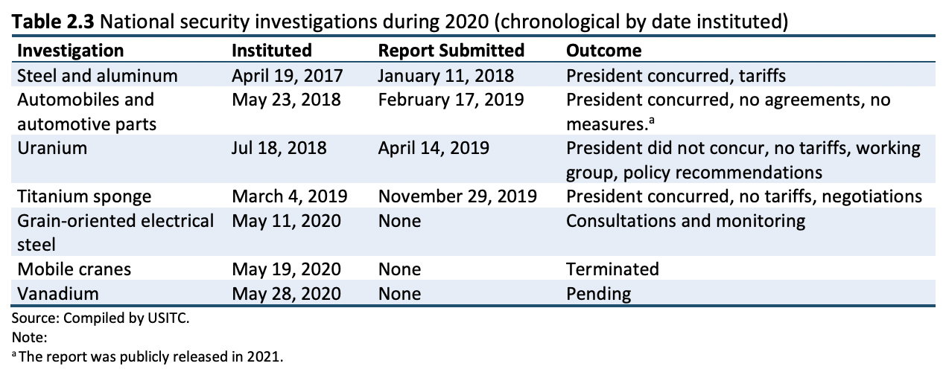
Source: USITC “The Year in Trade 2020”
Notes:
Jones, Lin, et al., “The Year in Trade 2020,” USITC, September 2021.
https://www.usitc.gov/publications/332/pub5228.pdf

Slide 37
Pause for Discussion

Slide 38
  Questions on Fefer et al.,
  “Section 232”
Under what circumstances does Section 232 of the 1962 Trade Act permit the President to levy tariffs?
Who conducts the investigation to determine if this is the case? If the answer is yes, must the President levy tariffs?
Must the tariffs apply to all imports of the product? If not, do we know why not?
Is the use of Section 232 legal under the rules of the WTO?

Slide 39
Features of US Trade Policies
Trade Adjustment Assistance (TAA)
  Provides temporary help (not tariff protection) for firms and workers hurt by imports
  Gives workers access to income support, relocation allowances, job search allowances, health coverage tax credit, and occupational training
  As of 2002, Alternative Trade Adjustment Assistance (ATAA) also provides limited “wage insurance” for trade-displaced older workers
  We’ll study more Nov 20

Slide 40
Features of US Trade Policies
Fast Track -- officially “Trade Promotion Authority” (TPA)
  Procedure, imposed by Congress on itself, requiring it to
  Relevant for approval of FTAs and some other trade deals
  Congress approved TPA in July 2015 but it expired July 1, 2021.
  Biden wants to “rethink the objectives of trade agreements before seeking the authority.”
Consider trade legislation without amendment

Slide 41
Features of US Trade Policies
Tariff Preference Programs
  GSP = Generalized System of Preferences
    Charge lower tariffs on some exports from some developing countries than we charge other countries
      Departure from MFN, permitted by WTO
    Other developed countries do this too
  AGOA = African Growth and Opportunity Act
    Zero tariffs on many goods from many sub-Saharan African countries
  CBI = Caribbean Basin Initiative
    Tariff preferences for most Caribbean countries
  NTPP = Nepal Trade Preference Program

Slide 42
Pause for Discussion

Slide 43
  Questions on Verrill
Who has "standing" under the antidumping law? Who determines whether there is dumping?
How do the injury requirements differ for antidumping and for safeguards? Do either require that the domestic firms make losses?
What can a U.S. producer do if it believes that its competitors in another country are engaging in anticompetitive conduct that is being tolerated by their government?

Slide 44
  Questions on Jackson
Why did Fast Track, or something like it, become necessary only after trade negotiations were moving on from tariffs to negotiating non-tariff measures?
Once a trade agreement is negotiated and accepted, does it automatically become part of the law of the participating countries?
What are the four requirements of the Fast Track procedure that was first approved by Congress? Under what President was this done?

Slide 45
  Questions on Economist,
  “Trade Mission: Taking Stock…”
What is AGOA?
Has it succeeded?
What interferes with its success?
Do the preferences require that inputs also be made in Africa?

Slide 46
US Trade Policies under Biden
He’s done very little, so far. Mostly waiting to study issues
  Negotiated with EU and others on steel and aluminum tariffs, and replaced with tariff-rate quotas
  Settled the Airbus-Boeing dispute
  Nuclear submarine exports to Australia
  IRA Subsidies and tax credits conditional on sourcing in US and FTA partners

Slide 47
US Trade Policies under Biden
USTR says US is pursuing a “new approach to trade policy” that
  “grows the middle class,
  addresses inequality, and
  helps solve today’s greatest challenges, including
    tackling the climate crisis and
    promoting fair competition.”

Slide 48
US Trade Policies under Biden
Key features:
  Stepping up engagement with the WTO
  Standing up for Workers’ Rights via USMCA
  Advancing environmental goals
  Supporting U.S. Agriculture
  Bolstering Supply Chain Resiliency (i.e., China)
  Ensuring China competes fairly
  Enforcing trade agreements.

Slide 49
Pause for Discussion

Slide 50
  Questions on USTR,
  “FACT SHEET”
From this, does it appear that the Biden administration is pursuing any new trade agreements?
Is there any mention of actions taken against China?

Slide 51
  Questions on Swanson,
  “Biden’s Reluctant Approach …”
What is the role of free-trade agreements in the green subsidies of the Inflation Reduction Act?
Why is this a problem?
How is the Biden administration trying to deal with this?
On what basis doe USTR Kai defend not pursuing more FTAs?
Is she right that new FTAs are not part of the world we live in?

Slide 52
  Questions on Boot,
  “Biden is making the same …”
What, according to this, did Biden do right on trade?
What was largely right, if it can be limited properly?
What has he done wrong, much like Trump?

Slide 53
  Questions on Foroohar,
  “America Is Telling …”
Why is the new policy not “America First”?
What are the “chokepoints” mentioned by USTR Tai?
What is Tai’s objection to free trade agreements?
Tai wants to help workers, here and abroad. How?

