Slide 1
Class 10
Policies and Institutions: National, Other by
Alan V. Deardorff
University of Michigan
2023
PubPol/Econ 541

Slide 2
FROM REQUIRED READINGS

Slide 3
European Commission,
“The European Union in Brief,”

Slide 4
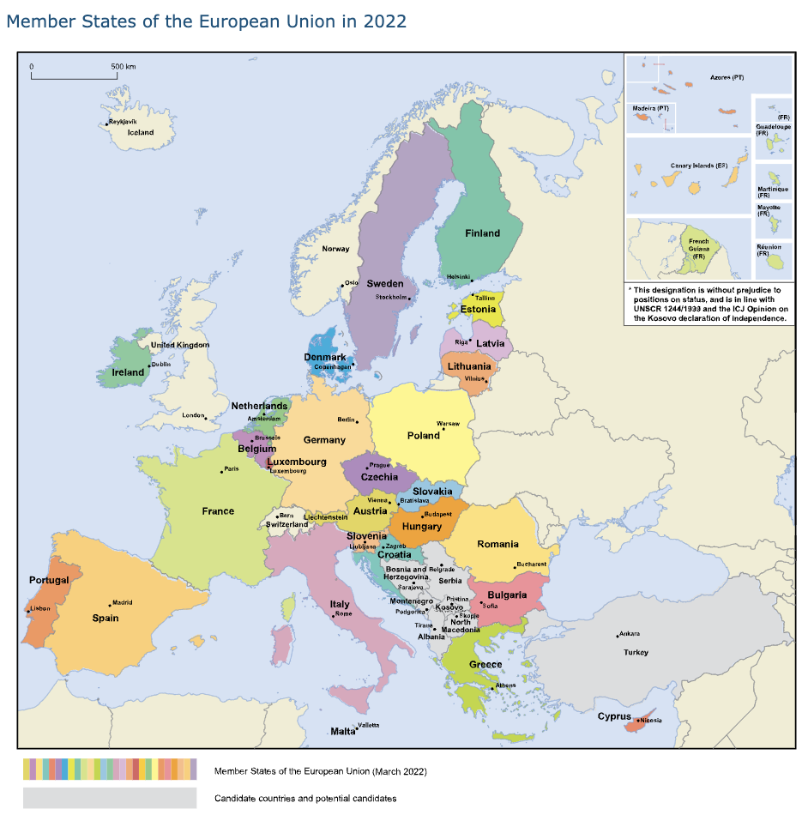
Notes:
European Commission, “The European Union in Brief,” part 1 of The European Union: What it is and what it does, [5p]
https://op.europa.eu/webpub/com/eu-what-it-is/en/#:~:text=1%20The%20European%20Union%20in,of%20the%20Second%20World%20War

