Slide 1
Class 11
Non-tariff Barriers by
Alan V. Deardorff
University of Michigan
2023
PubPol/Econ 541

Slide 2
FROM REQUIRED READINGS

Slide 3
Feenstra, Robert C., “How Costly Is Protectionism?” Journal of Economic Perspectives 6, Summer 1992, pp. 159-178

Slide 4
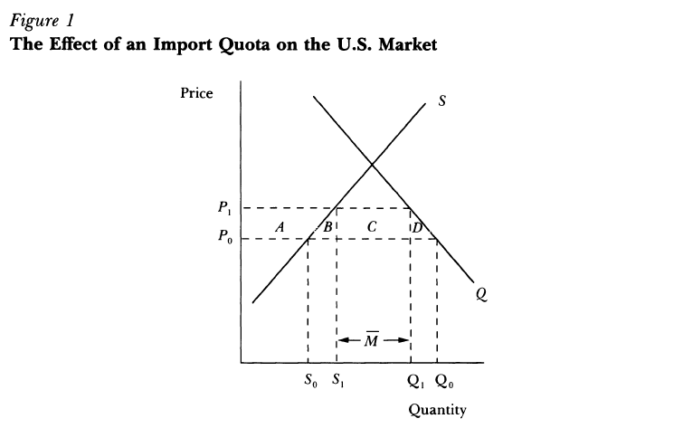
Notes:
Feenstra, Robert C., “How Costly Is Protectionism?” Journal of Economic Perspectives 6, Summer 1992, pp. 159-178

Slide 5
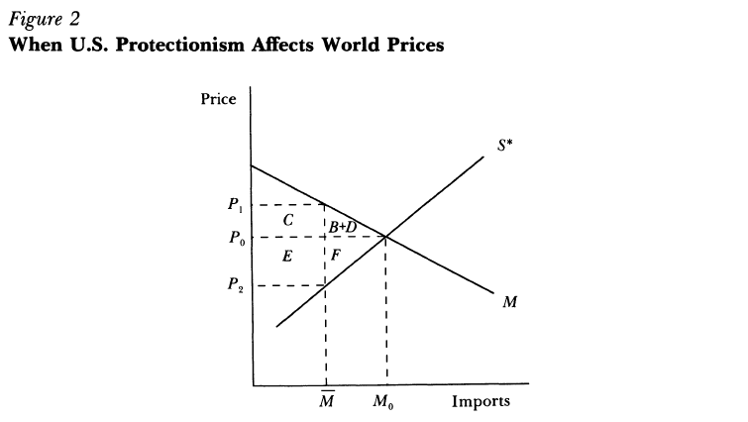
Notes:
Feenstra, Robert C., “How Costly Is Protectionism?” Journal of Economic Perspectives 6, Summer 1992, pp. 159-178

Slide 6
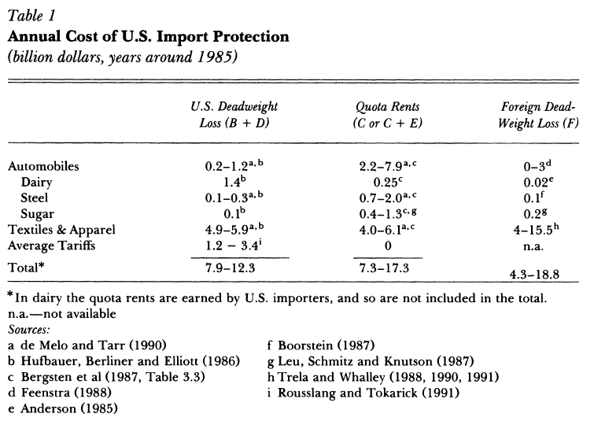
Notes:
Feenstra, Robert C., “How Costly Is Protectionism?” Journal of Economic Perspectives 6, Summer 1992, pp. 159-178

Slide 7
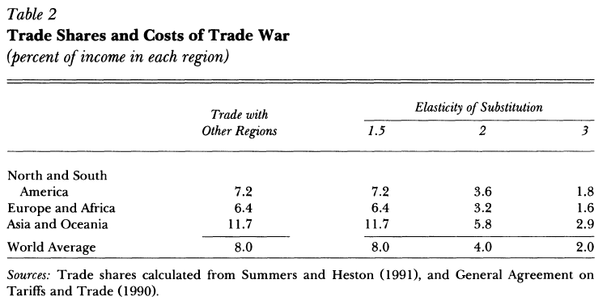
Notes:
Feenstra, Robert C., “How Costly Is Protectionism?” Journal of Economic Perspectives 6, Summer 1992, pp. 159-178

