Slide 1
Class 12
Export Policies by
Alan V. Deardorff
University of Michigan
2023
PubPol/Econ 541

Slide 2
FROM REQUIRED READINGS

Slide 3
Laborde, David, Carmen Estrades, and Antoine Bouët, “A Global Assessment of the Economic Effects of Export Taxes,” The World Economy, 36(10), October, 2013, pp. 1333–1354.

Slide 4
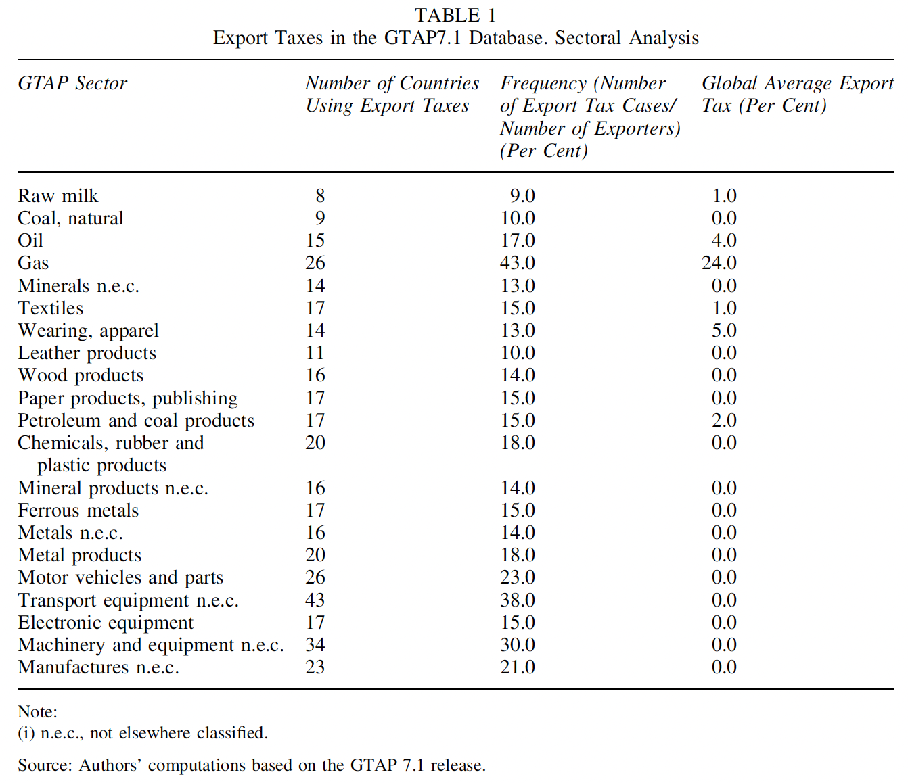
Notes:
Laborde, David, Carmen Estrades, and Antoine Bouët, “A Global Assessment of the Economic Effects of Export Taxes,” The World Economy, 36(10), October, 2013, pp. 1333–1354.

Slide 5
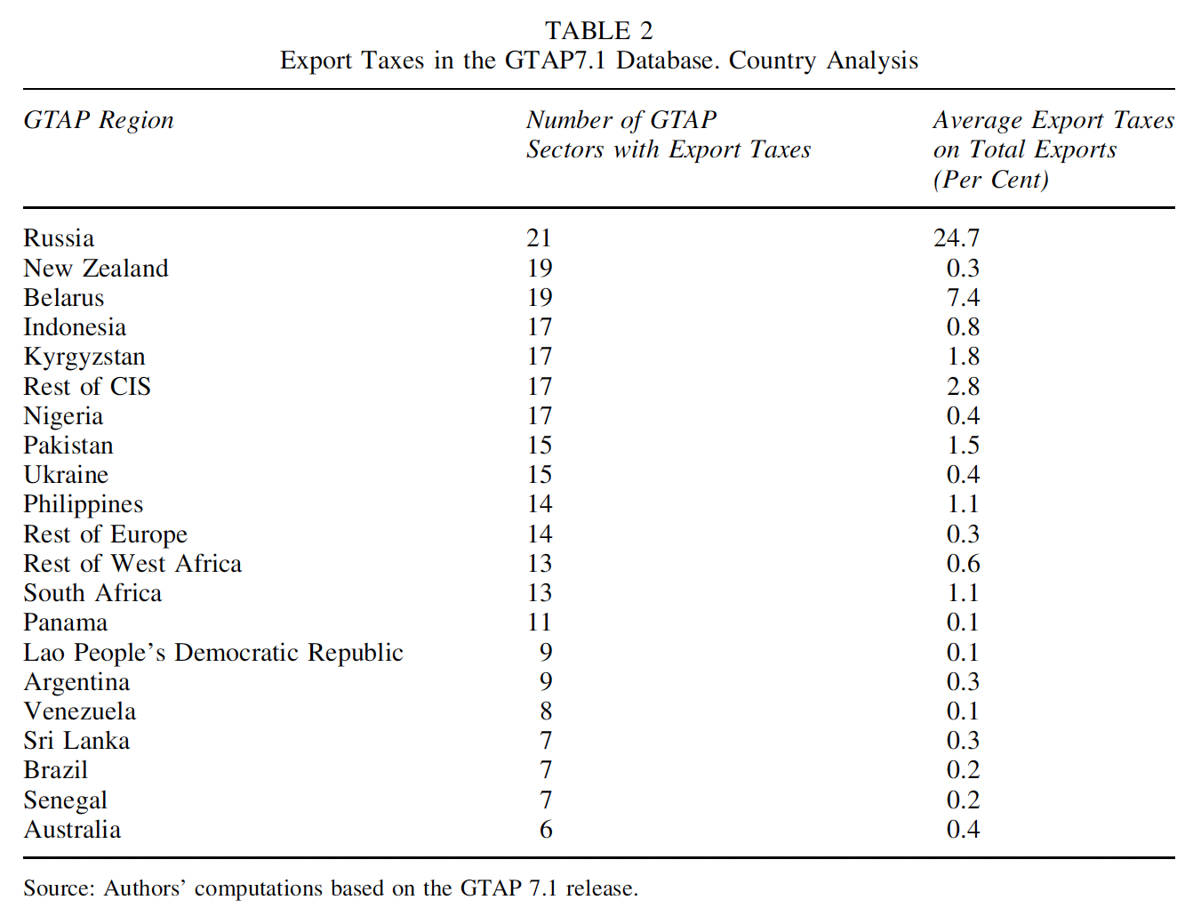
Notes:
Laborde, David, Carmen Estrades, and Antoine Bouët, “A Global Assessment of the Economic Effects of Export Taxes,” The World Economy, 36(10), October, 2013, pp. 1333–1354.

Slide 6
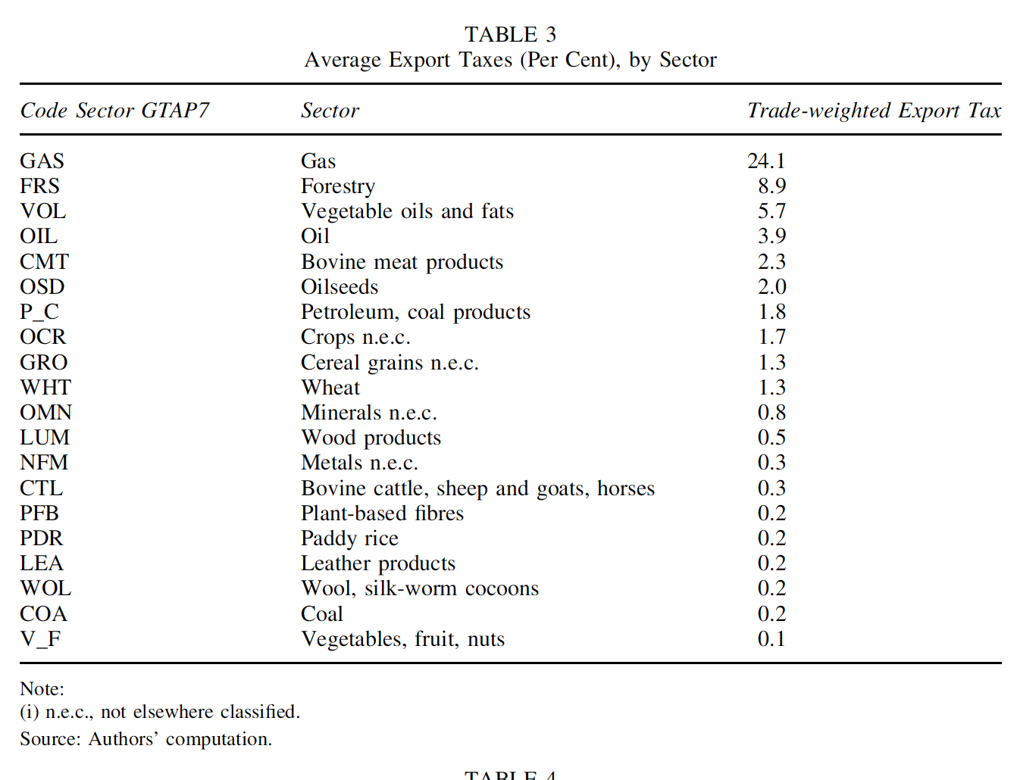
Notes:
Laborde, David, Carmen Estrades, and Antoine Bouët, “A Global Assessment of the Economic Effects of Export Taxes,” The World Economy, 36(10), October, 2013, pp. 1333–1354.

Slide 7
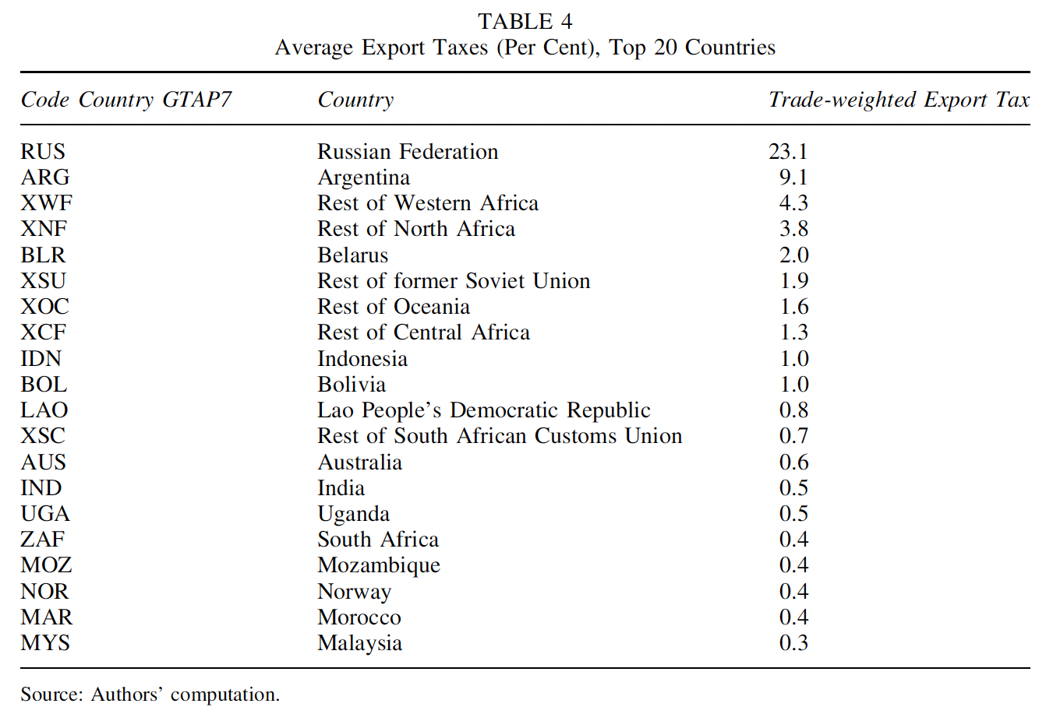
Notes:
Laborde, David, Carmen Estrades, and Antoine Bouët, “A Global Assessment of the Economic Effects of Export Taxes,” The World Economy, 36(10), October, 2013, pp. 1333–1354.

Slide 8
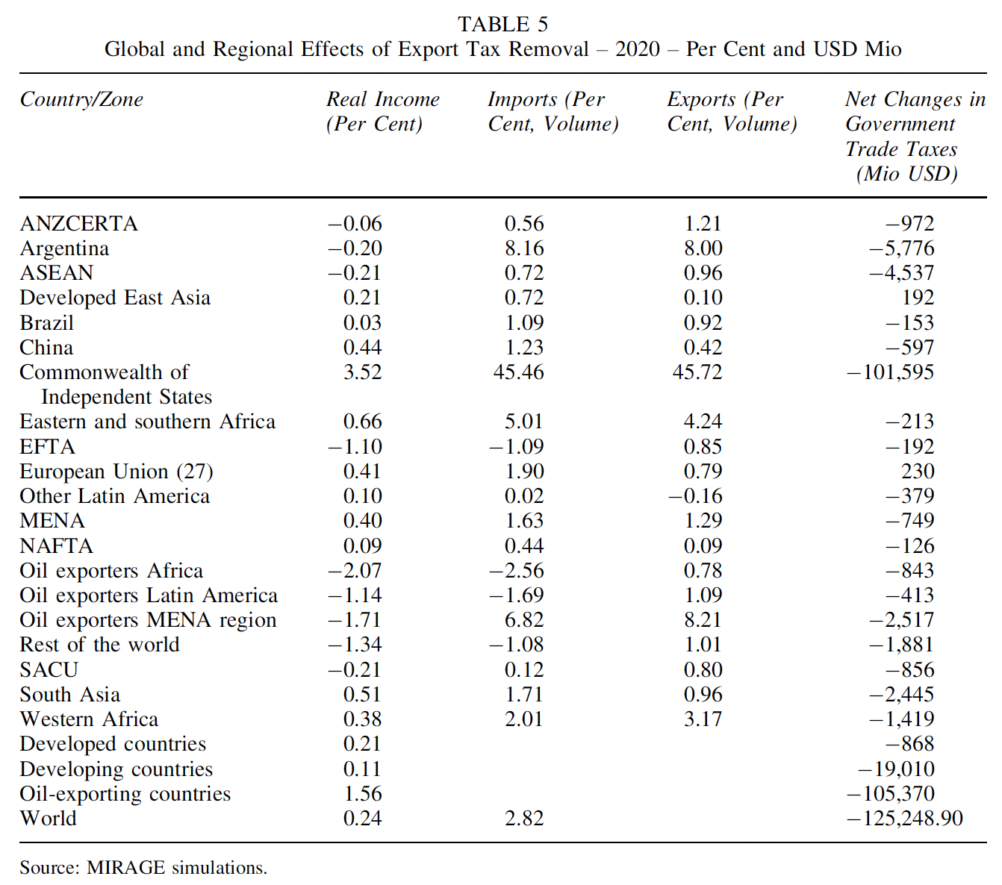
Notes:
Laborde, David, Carmen Estrades, and Antoine Bouët, “A Global Assessment of the Economic Effects of Export Taxes,” The World Economy, 36(10), October, 2013, pp. 1333–1354.

Slide 9
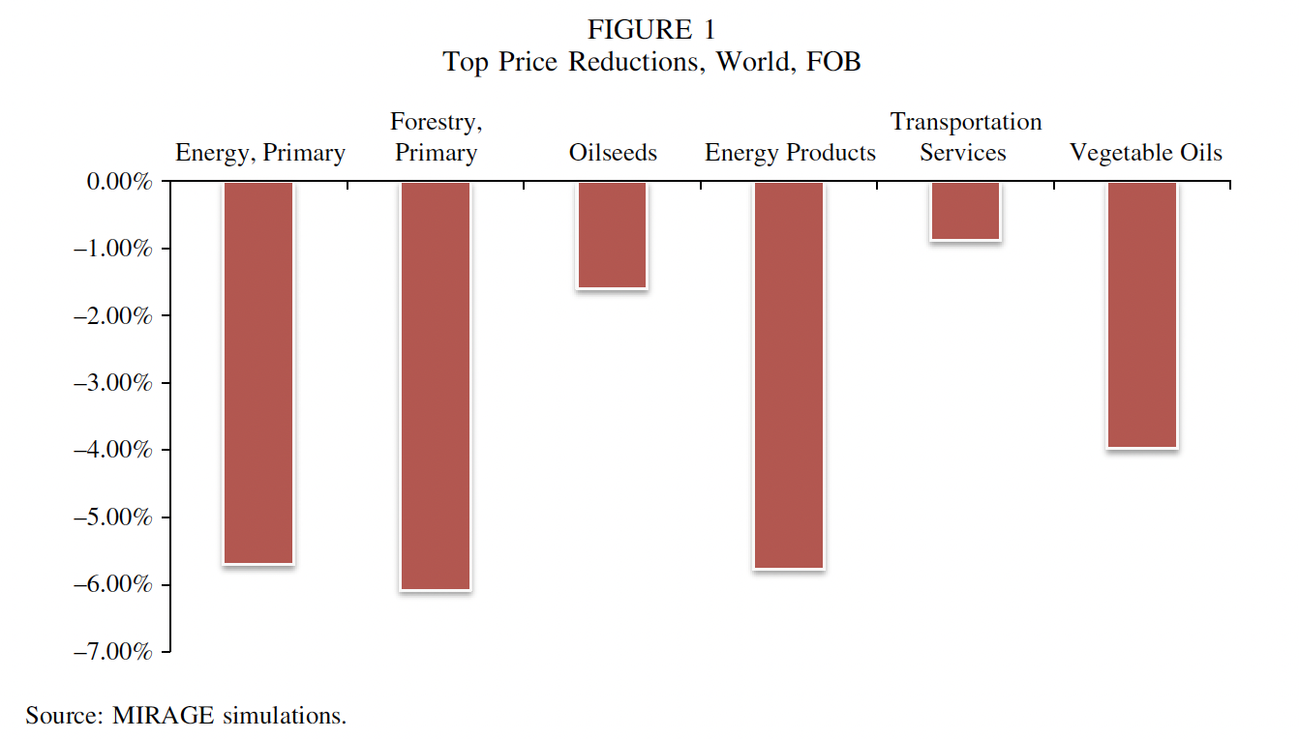
Notes:
Laborde, David, Carmen Estrades, and Antoine Bouët, “A Global Assessment of the Economic Effects of Export Taxes,” The World Economy, 36(10), October, 2013, pp. 1333–1354.

Slide 10
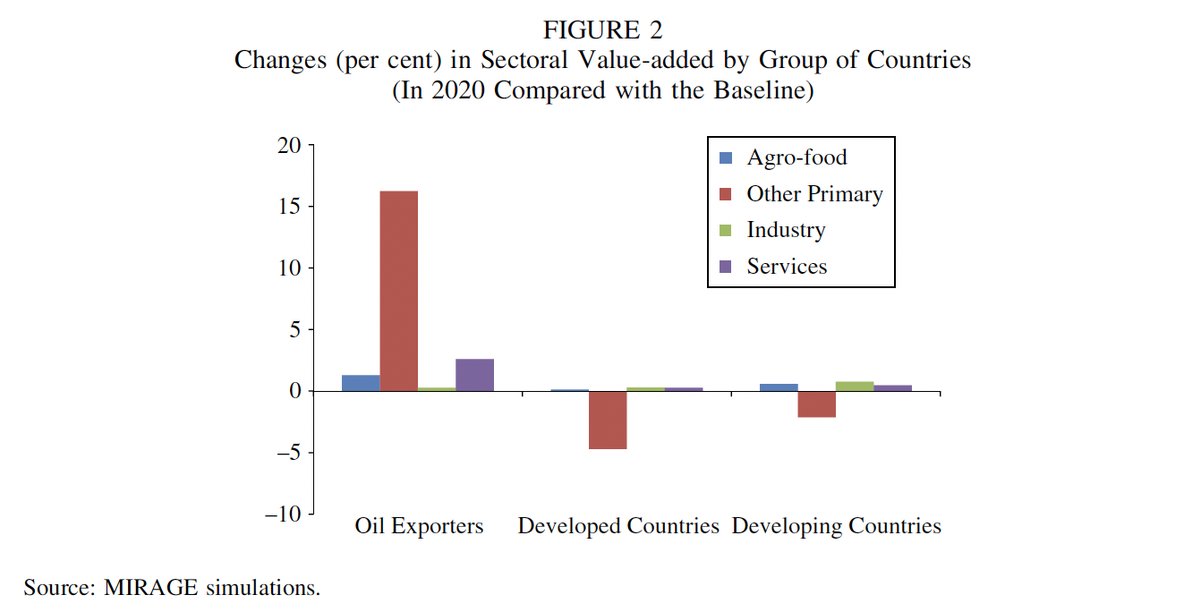
Notes:
Laborde, David, Carmen Estrades, and Antoine Bouët, “A Global Assessment of the Economic Effects of Export Taxes,” The World Economy, 36(10), October, 2013, pp. 1333–1354.

Slide 11
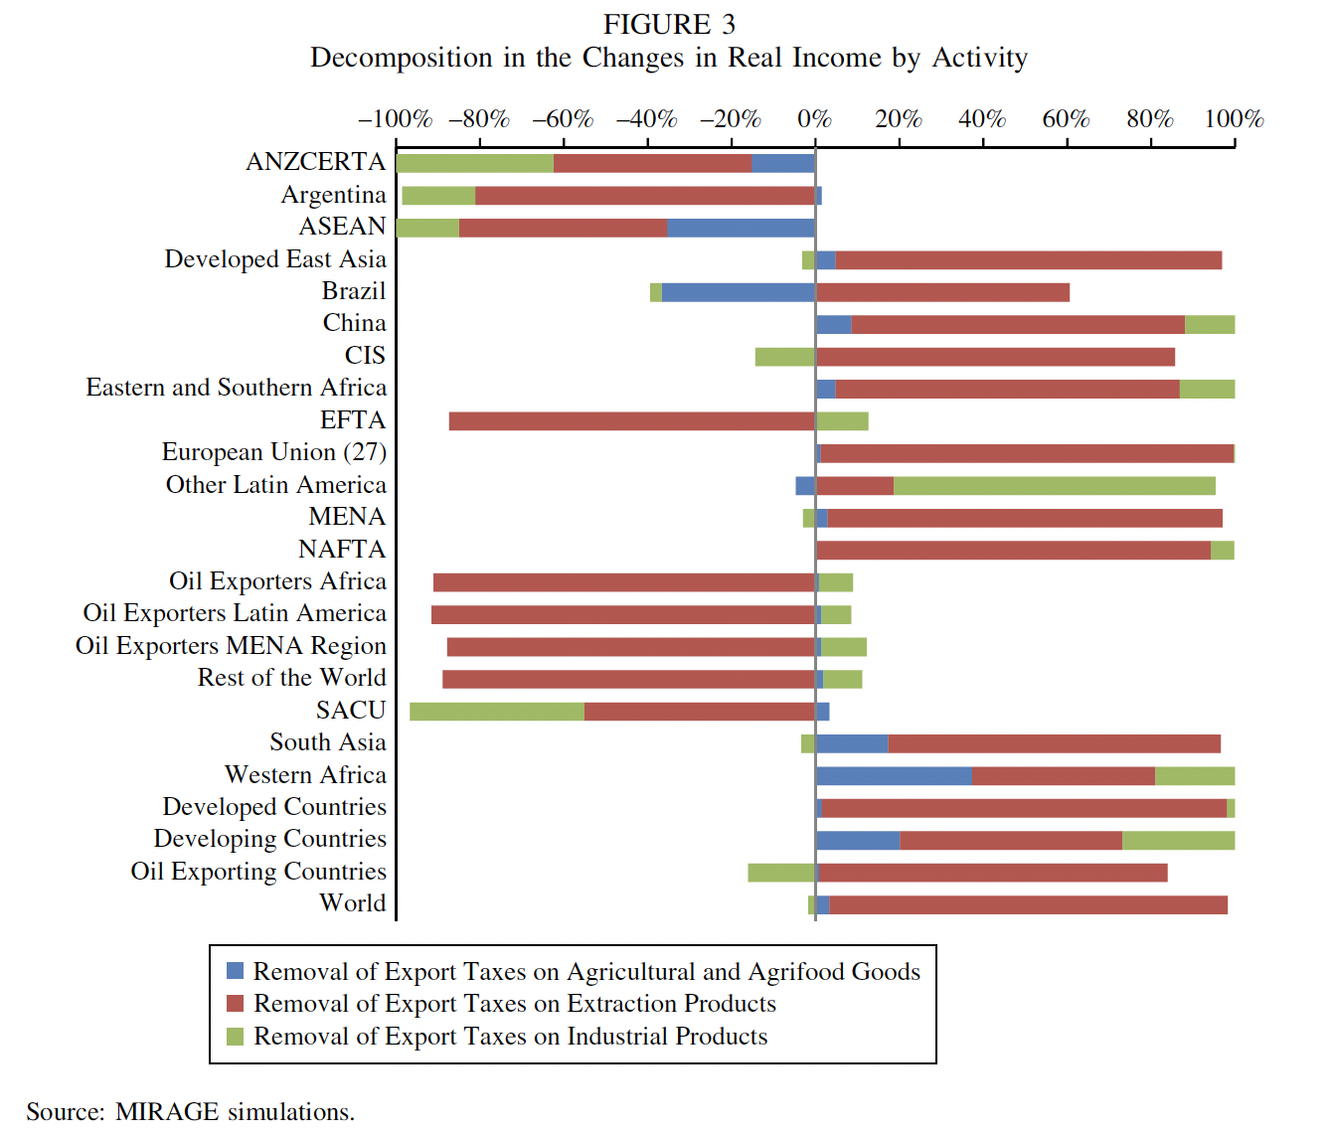
Notes:
Laborde, David, Carmen Estrades, and Antoine Bouët, “A Global Assessment of the Economic Effects of Export Taxes,” The World Economy, 36(10), October, 2013, pp. 1333–1354.

Slide 12
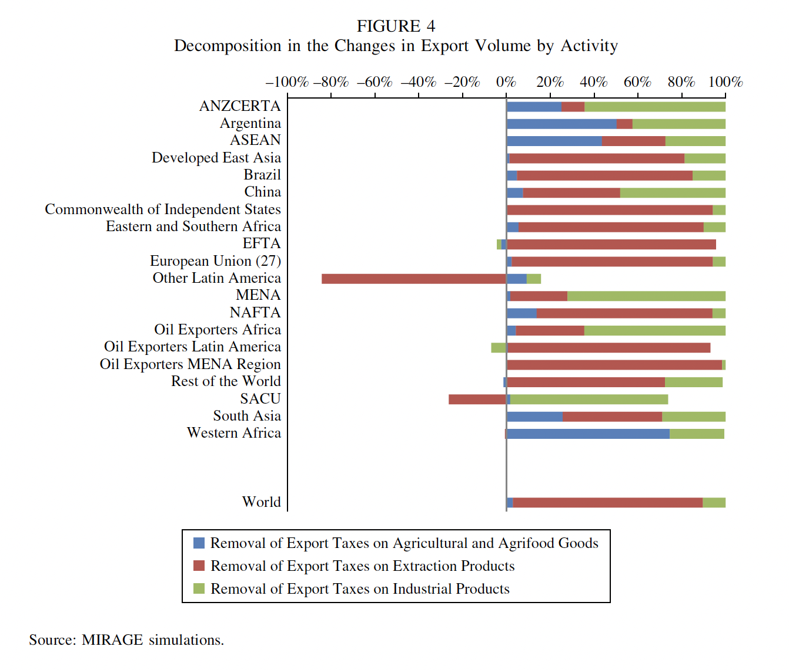
Notes:
Laborde, David, Carmen Estrades, and Antoine Bouët, “A Global Assessment of the Economic Effects of Export Taxes,” The World Economy, 36(10), October, 2013, pp. 1333–1354.

Slide 13
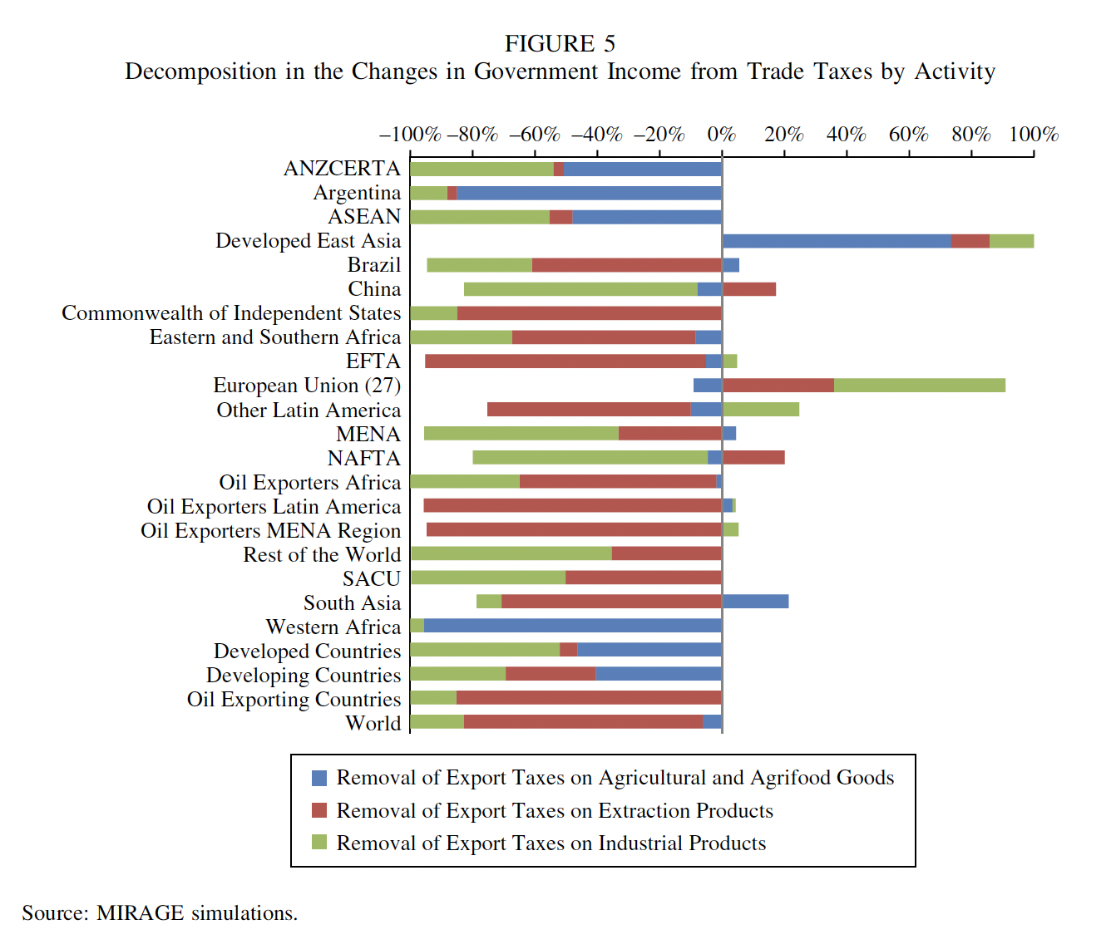
Notes:
Laborde, David, Carmen Estrades, and Antoine Bouët, “A Global Assessment of the Economic Effects of Export Taxes,” The World Economy, 36(10), October, 2013, pp. 1333–1354.

Slide 14
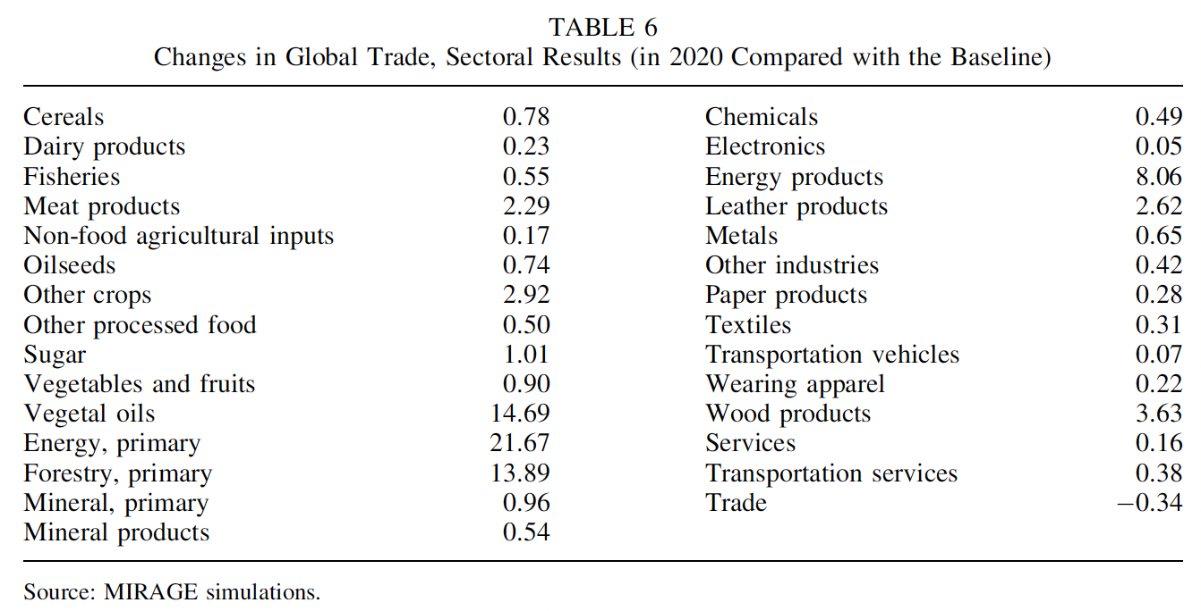
Notes:
Laborde, David, Carmen Estrades, and Antoine Bouët, “A Global Assessment of the Economic Effects of Export Taxes,” The World Economy, 36(10), October, 2013, pp. 1333–1354.

Slide 15
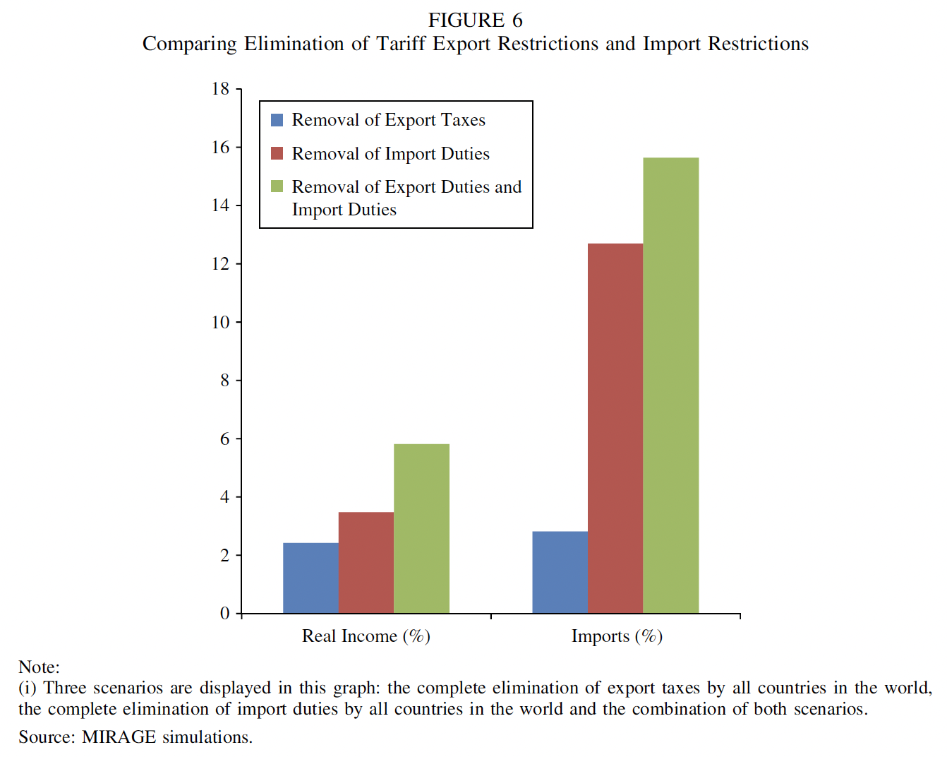
Notes:
Laborde, David, Carmen Estrades, and Antoine Bouët, “A Global Assessment of the Economic Effects of Export Taxes,” The World Economy, 36(10), October, 2013, pp. 1333–1354.

Slide 16
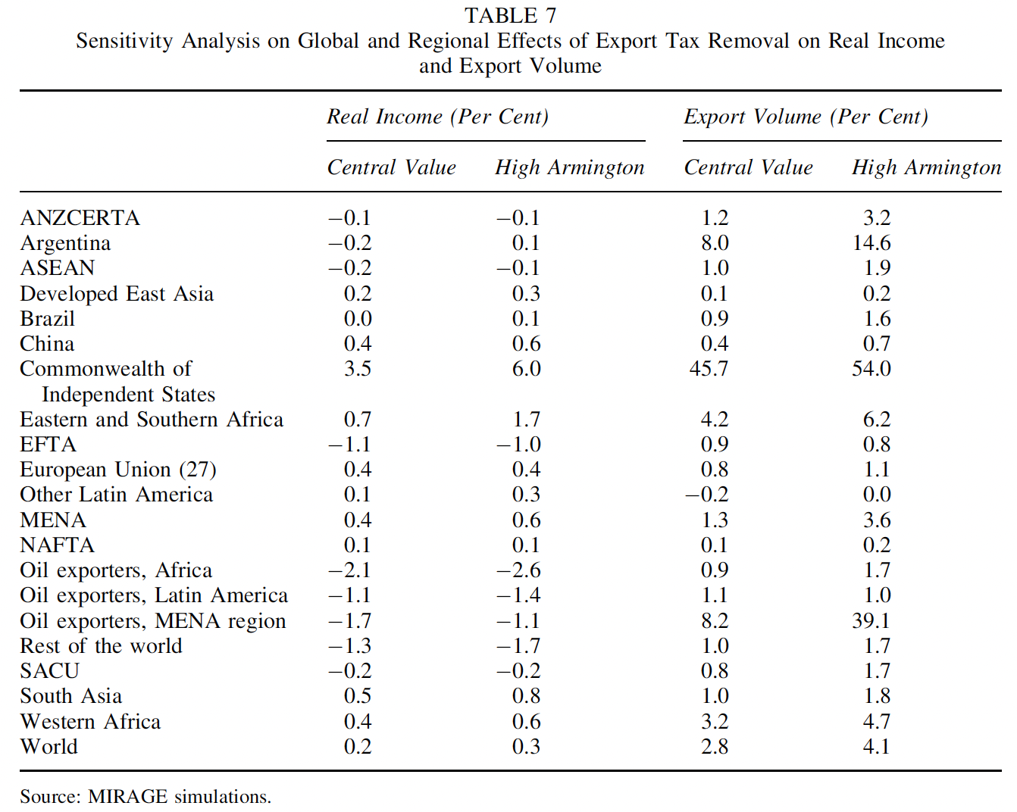
Notes:
Laborde, David, Carmen Estrades, and Antoine Bouët, “A Global Assessment of the Economic Effects of Export Taxes,” The World Economy, 36(10), October, 2013, pp. 1333–1354.

Slide 17
Beckman, Jayson, Carmen Estrades, Manuel Flores, and Angel Aguiar, “The impacts of export taxes on agricultural trade,” VOX^{EU}, CEPR Policy Portal, October 3, 2018.

Slide 18
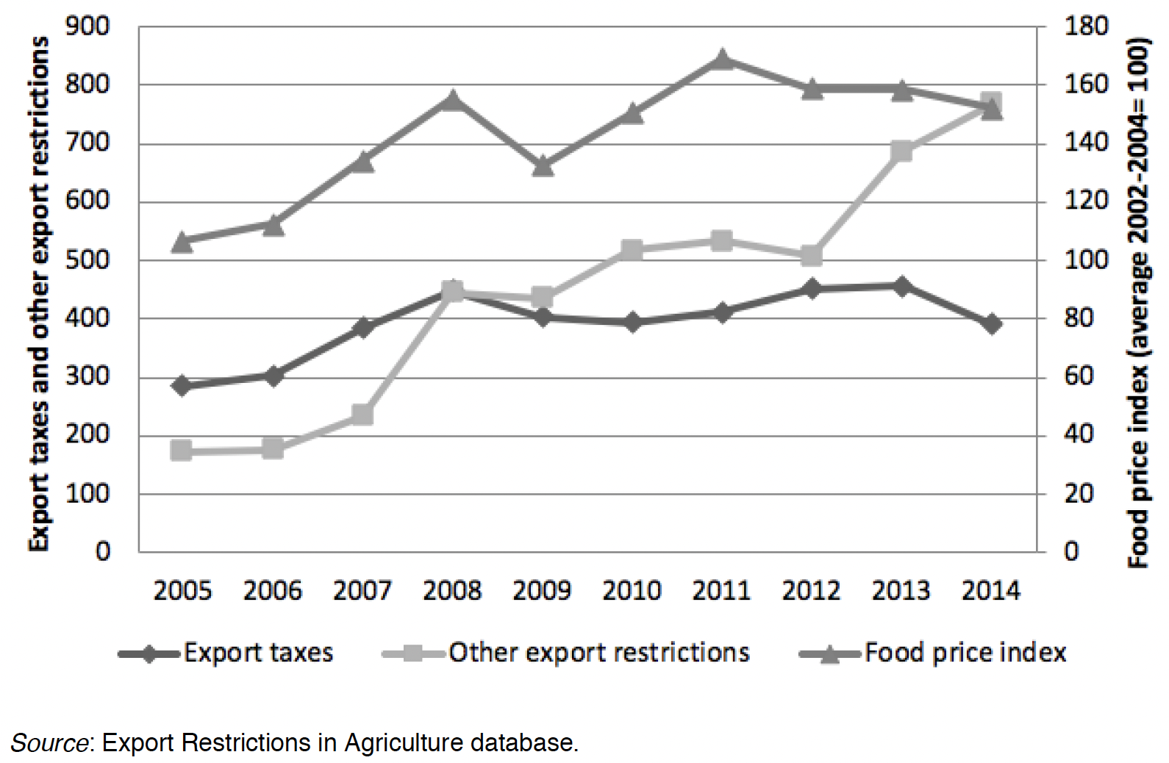
Notes:
Beckman, Jayson, Carmen Estrades, Manuel Flores, and Angel Aguiar, “The impacts of export taxes on agricultural trade,” VOX^{EU}, CEPR Policy Portal, October 3, 2018. [4p] https://voxeu.org/article/impacts-export-taxes-agricultural-trade

Slide 19
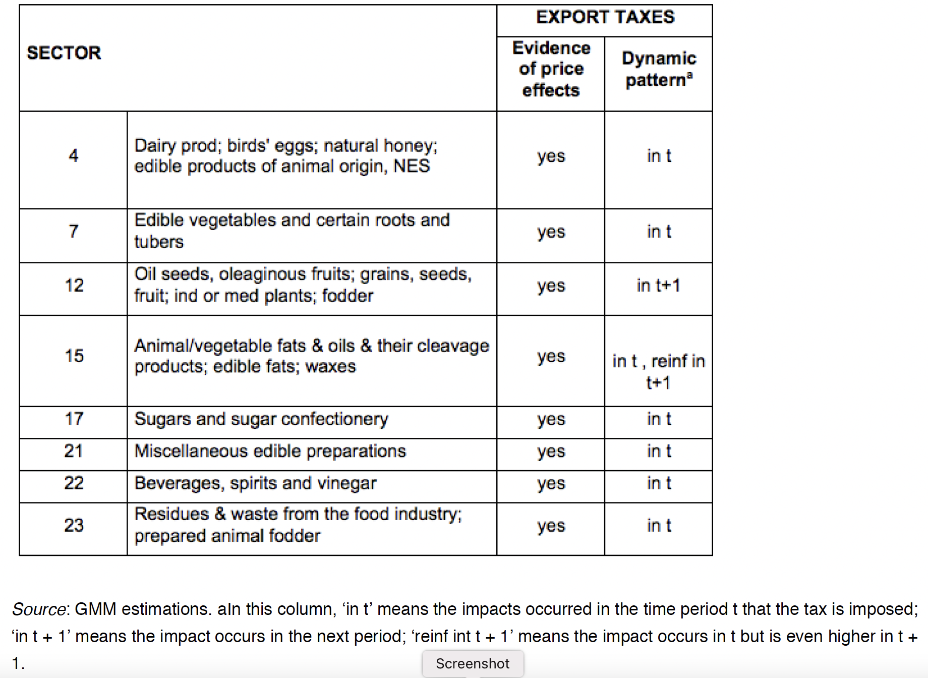
Notes:
Beckman, Jayson, Carmen Estrades, Manuel Flores, and Angel Aguiar, “The impacts of export taxes on agricultural trade,” VOX^{EU}, CEPR Policy Portal, October 3, 2018. [4p] https://voxeu.org/article/impacts-export-taxes-agricultural-trade

Slide 20
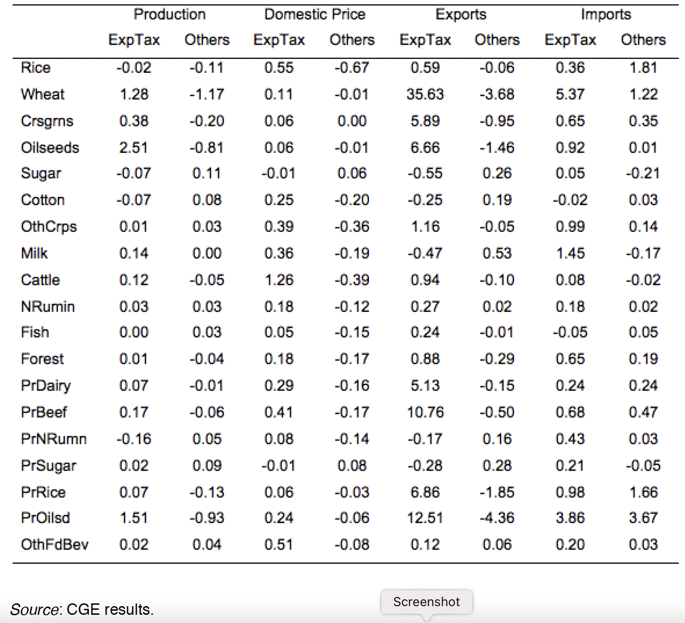
Notes:
Beckman, Jayson, Carmen Estrades, Manuel Flores, and Angel Aguiar, “The impacts of export taxes on agricultural trade,” VOX^{EU}, CEPR Policy Portal, October 3, 2018. [4p] https://voxeu.org/article/impacts-export-taxes-agricultural-trade

Slide 21
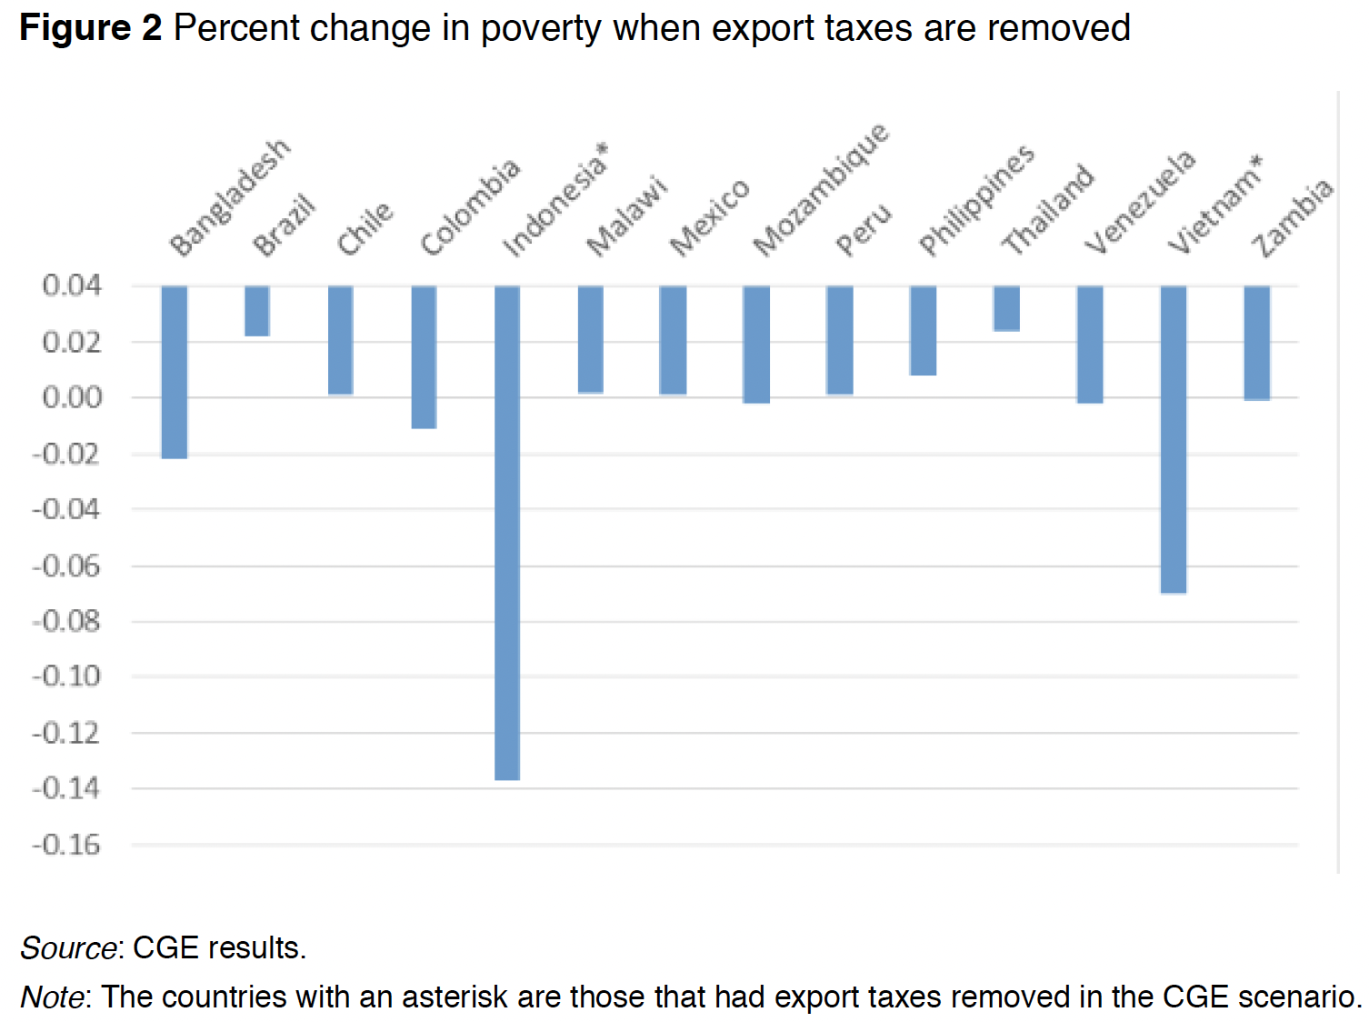
Note the zero line. This is an odd way to present results.
Notes:
Beckman, Jayson, Carmen Estrades, Manuel Flores, and Angel Aguiar, “The impacts of export taxes on agricultural trade,” VOX^{EU}, CEPR Policy Portal, October 3, 2018. [4p] https://voxeu.org/article/impacts-export-taxes-agricultural-trade

Slide 22
Fildes, "Australia Rattles Industry and Trading Partners With Energy Interventions," Financial Times,, February 19, 2023.

Slide 23
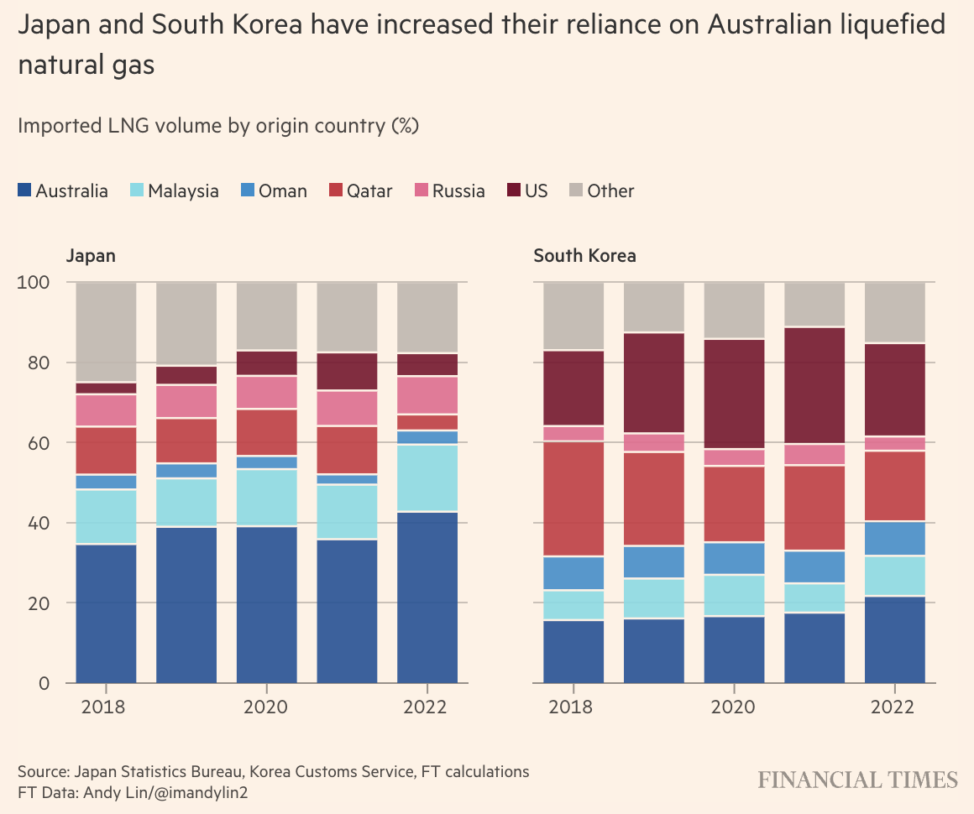
Notes:
Fildes, "Australia Rattles Industry and Trading Partners With Energy Interventions," Financial Times,, February 19, 2023. [3 Pp]
https://www.ft.com/content/c20ceba4-20d5-44de-8abd-4c48c80df28a

Slide 24
Khan, Yusuf, "Increasing Export Restrictions on Critical Minerals Threaten Energy Transition, OECD Says," Wall Street Journal, April 11, 2023.

Slide 25
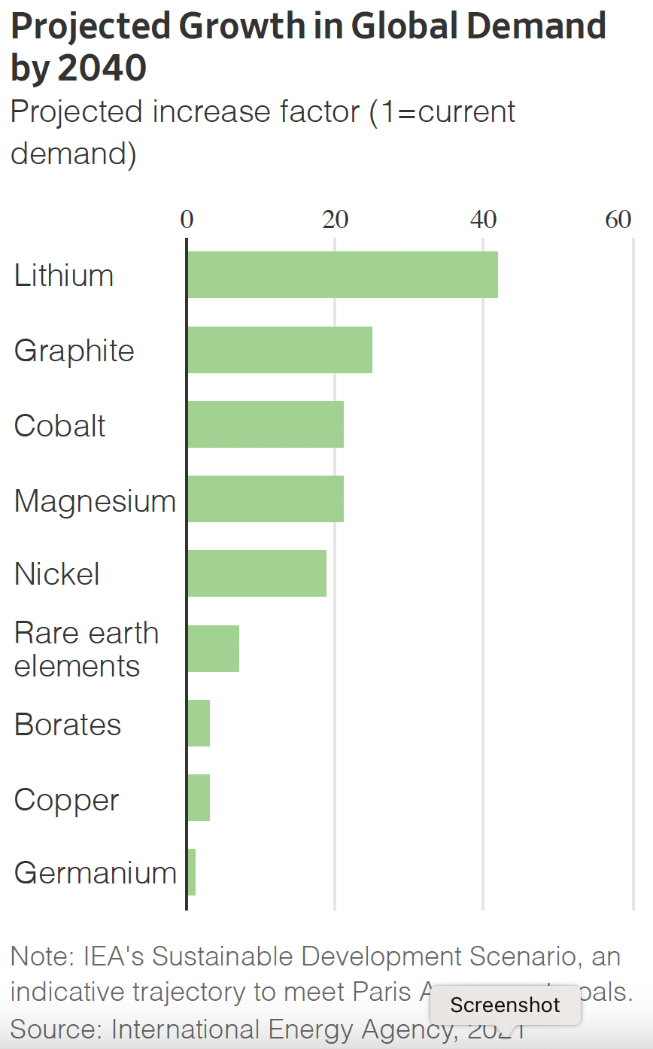
Note: This is not 40%, but 40 times!
Notes:
Kahn, Yusuf, "Increasing Export Restrictions on Critical Minerals Threaten Energy Transition, OECD Says," Wall Street Journal, April 11, 2023. [3 Pp]
https://www.wsj.com/articles/increasing-export-restrictions-on-critical-minerals-threaten-energy-transition-says-oecd-81183533#:~:text=In%20a%20new%20report%2C%20the,surged%20to%2018%2C263%20from%203%2C337.

