Slide 1
Class 12
Export Policies by
Alan V. Deardorff
University of Michigan
2023
PubPol/Econ 541

Slide 2
Announcements
Monday, 10/16: (Fall Break)
  Class not required or expected, but I’ll be here for Q&A and discussion
Quizzes
  Quiz 6 on NTBs & Export Policies this Friday Oct 13
  No quiz Oct 20
  Quiz 7 Oct 27

Slide 3
For next Monday
If you’ve time and interest,
  Optional: read and view:
    Scott and Trade Talk on trade and women
    Economist on Making trade greener: When environmental protection turns into trade protection
    Telling on developing countries
    Economist on The urge to protect: How trade restrictions are being used as a tool to protect human rights
    Swanson on black and disadvantaged workers

Slide 4
Outline
Export policies
How common are they
Economic analysis
Empirics of export restrictions
Recent uses

Slide 5
Export policies
Types of export policies
  Bans
  Taxes
  Subsidies

Slide 6
Export policies
Reasons for export policies
  Bans
    To keep products away from other countries
    To lower prices to home consumers
  Taxes
    To raise revenue
    To lower prices to home consumers
  Subsidies (see later, Dec 4. Not GATT-legal)
    To support domestic producers

Slide 7
Outline
Export policies
How common are they
Economic analysis
Empirics of export restrictions
Recent uses

Slide 8
How common are export taxes
See Laborde et al.
Note first why they’ve been neglected:
  Countries usually want to export more, not less
Export taxes are used by about 1/3 of WTO members
Average was 0.48% per cent in 2007
  This is less than half a percent. This must be an average of ones that are zero.

Slide 9
How common are export taxes
Export taxes are concentrated on
  Raw agricultural products
  Minerals
  Processed oilseeds
  Aluminum and iron
  Timber.
  Energy products (esp. Russia natural gas)

Slide 10
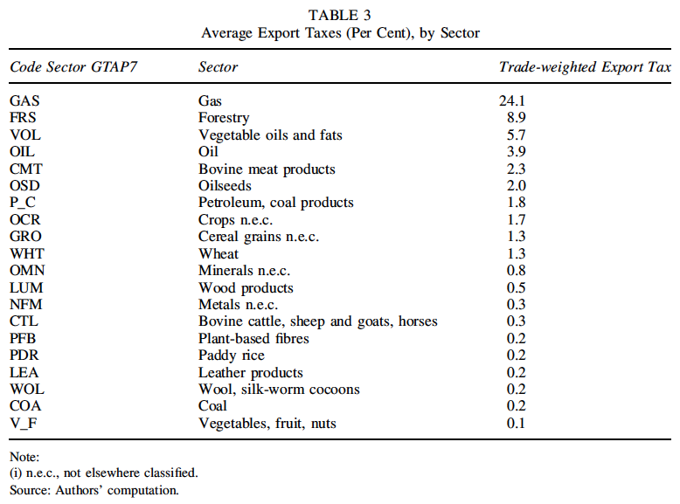
Note bias: High taxes cause less trade and lower weight.
Notes:
Laborde, David, Carmen Estrades, and Antoine Bouët, “A Global Assessment of the Economic Effects of Export Taxes,” The World Economy, 36(10), October, 2013, pp. 1333–1354.

Slide 11
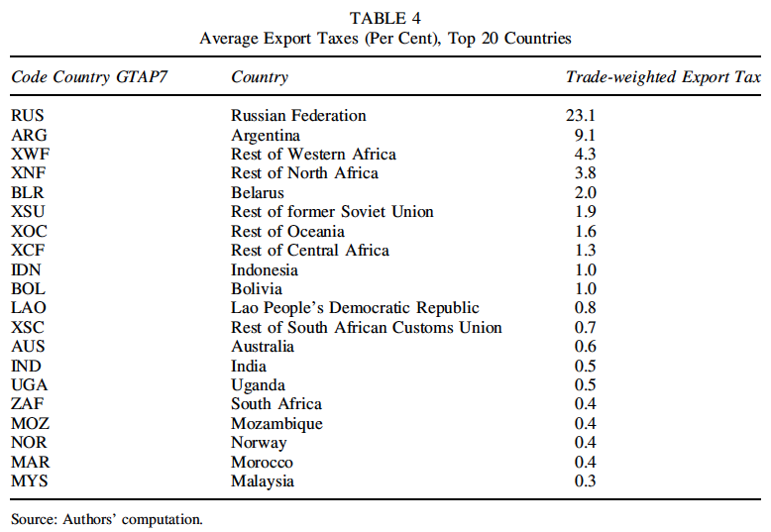
Notes:
Laborde, David, Carmen Estrades, and Antoine Bouët, “A Global Assessment of the Economic Effects of Export Taxes,” The World Economy, 36(10), October, 2013, pp. 1333–1354.

Slide 12
Pause for Discussion

Slide 13
  Questions on Laborde et al.
In 2006, what sector had the most export taxes?
What are some of the motives for export taxes mentioned?

Slide 14
Outline
Export policies
How common are they
Economic analysis
Empirics of export restrictions
Recent uses

Slide 15
Economic Analysis
Use the same tools and assumptions as for tariffs
Export tax causes domestic price to be below the world price by the amount of the tax (if country still exports)
Why? If suppliers continue to sell both at home and for export,
  They must get the same at home as for export
  And that is the world price minus the tax

Slide 16
Small country export tax
P
Effects of an export tax, starting from free trade
  Price falls
  Quantity demanded rises
  Quantity supplied falls
  Quantity of exports falls
  Tax revenue rises from zero
D
S
P₀=P_{W}
t
P₁=P_{W}–t
P_{aut}
X₀
D₀
D₁
S₁
S₀
Q
X₁
Specific Export Tax t

Slide 17
Small country export tax
P
Welfare effects of an export tax, starting from free trade
  Suppliers lose −(a+b+c+d+e)
  Demanders gain +(a+b)
  Government gains +d
  Country loses −(c+e)
D
S
P₀=P_{W}
c
e
t
a
d
b
f
P₁=P_{W}–t
P_{aut}
“Dead Weight Loss” =
X₀
D₀
D₁
S₁
S₀
Q
X₁
Specific Export Tax t

Slide 18
Small country export tax
P
Welfare effects of an export tax, starting from free trade
  Suppliers lose −(a+b+c+d+e)
  Demanders gain −(a+b)
  Government gains +d
  Country loses −(c+e)
D
S
P₀=P_{W}
c
e
t
a
d
b
f
P₁=P_{W}–t
P_{aut}
“Dead Weight Loss” =
X₀
D₀
D₁
S₁
S₀
Q
X₁
Specific Export Tax t

Slide 19
Large country, World Market
Welfare effects of a large-country tariff, starting from free trade
Home:
  Private sector (S&D) loses −(c+d)
  Government gains +(a+c)
  Country may gain or lose: +a−d
Foreign
  Private sector (S&D) loses −(a+b)
World loses −(b+d)
World Market
Home is Exporter
Foreign (*) is Importer
P
XS
P*₁
a
b
t
c
d
P₁
MD*
X₁=M*₁
X₀=M*₀
M*,X
“Dead Weight Loss” =

Slide 20
Large country, World Market
Thus large country, again, will gain from export tax if a>d
What is area a?
  The portion of the tax paid by foreign importers, who pay a higher price
  A transfer from foreign demanders to the home government
  The result, again, of improving the home country’s
  “terms of trade”
World Market
Home is Exporter
Foreign (*) is Importer
P
XS
P*₁
a
b
t
c
d
P₁
MD*
X₁=M*₁
X₀=M*₀
M*,X
“Terms of Trade” ≡ Relative price of exports = P^{X}/P^{M}

Slide 21
Pause for Discussion

Slide 22
  Questions
  (not asked about readings)
Explain why an export tax pushes down the price at home.
Explain why an export tax pushes up the price abroad.
Who are hurt and who are helped by an export tax?
Statement above said
  “Export tax causes domestic price to be below the world price by the amount of the tax (if country still exports)”
  What happens if exports stop?

Slide 23
Outline
Export policies
How common are they
Economic analysis
Empirics of export restrictions
Recent uses

Slide 24
Empirics
Laborde et al.
  They use computer model of trade to quantify the effects of removing export taxes that existed in 2007
  (CGE Model = Computable General Equilibrium Model)

Slide 25
Empirics
Findings: Export tax removal causes
  an overall gain of 0.24 per cent in world real income
    +1.6 per cent in oil-exporting countries,
    +0.2 per cent in developed countries and
    +0.1 per cent in other developing countries.
  boosts world trade volumes by 2.8 per cent
  reduces the world price of these products.

Slide 26
Empirics
Findings on export tax removal:
  The largest winner is the CIS block (whose real income increases by 3.5 per cent)
  Other oil exporters are negatively hit
  Importing countries can benefit
  May cause deindustrialization
  Despite their much smaller size, export taxes effects on real incomes are more than half those of import taxes

Slide 27
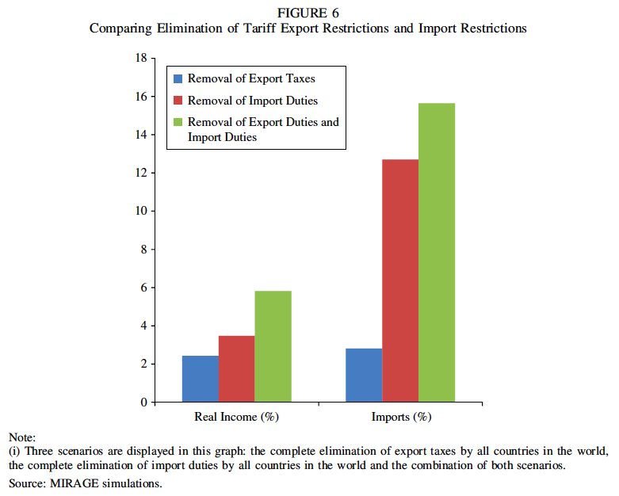
Notes:
Laborde, David, Carmen Estrades, and Antoine Bouët, “A Global Assessment of the Economic Effects of Export Taxes,” The World Economy, 36(10), October, 2013, pp. 1333–1354.

Slide 28
Empirics
Beckman et al.
  Reports effect of export taxes in agriculture, 2006-2008
  “In times of high or volatile prices, they are generally applied to guarantee domestic food supply and lower domestic prices.”
  Results from both a partial equilibrium model and a CGE model

Slide 29
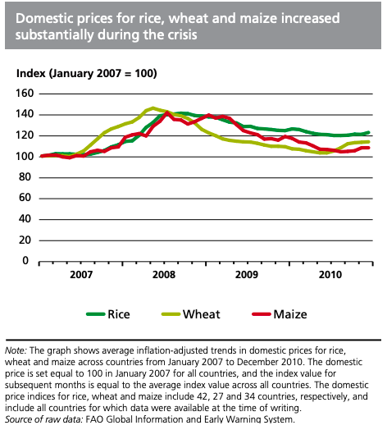
Notes:
FAO: “Lessons from the world food crisis of 2006–08”
http://www.fao.org/3/i2330e/i2330e04.pdf

Slide 30
Empirics
Effects of export taxes, Beckman et al.:
  lower domestic prices.
  increased international prices
    if exporter is large or if many exporters tax
  negative impacts on welfare
  countries that implemented these policies tended to weather the food-price crisis the best.
  countries that are dependent on food imports were not as insulated

Slide 31
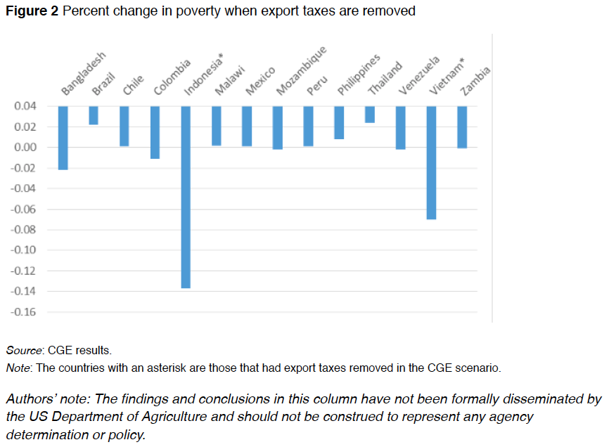
Note the zero line. This is a very odd way to present results.
Notes:
Beckman, Jayson, Carmen Estrades, Manuel Flores, and Angel Aguiar, “The impacts of export taxes on agricultural trade,” VOX^{EU}, CEPR Policy Portal, October 3, 2018.
https://voxeu.org/article/impacts-export-taxes-agricultural-trade

Slide 32
Pause for Discussion

Slide 33
  Questions on Laborde et al., “Economic Effects of Export Taxes”
What are some of the main effects of removing export taxes?
What are some of the limitations of this analysis?

Slide 34
  Questions on Beckman et al., “Export taxes on agricultural …”
What was the main reason for export taxes examined here?
Can you tell from this whether the policies have the desired effects?
Does Figure 2 show poverty falling in all the countries?

Slide 35
Outline
Export policies
How common are they
Economic analysis
Empirics of export restrictions
Recent uses

Slide 36
Recent Uses
India:
  Banned all export of onions in 2020
    Due to drought, then rain, and resulting onion shortage
    Neighboring country consumers hit hard
  Began restricting exports of rice in September 2022
    World price had risen after Russia invaded Ukraine
    Purposes
      To lower price at home
      Recover part of its “huge subsidies” on fertilizer and power
Notes:
Gettleman, Jeffrey, Julfikar Ali Manik, and Suhasini Raj, “India Isnʼt Letting a Single Onion Leave the Country,” New York Times, October 1, 2019. [2p]
https://www.nytimes.com/2019/10/01/world/asia/india-modi-onion-prices.html

Slide 37
Recent Uses
Mozambique: Cashews
  Since 2001
    Export tax of 18-22% on raw cashews
    Export tax of zero on processed cashews
  Purpose: to support processing industry
  Growers are hurt, but the processing industry has thrived
  But, quality of raw cashews became “one of the lowest in the world”
Notes:
Economist, “Of cashews and cash: Mozambique’s nut factories have made a cracking comeback,” The Economist, September 12, 2019. [2p]
https://www.economist.com/middle-east-and-africa/2019/09/12/mozambiques-nut-factories-have-made-a-cracking-comeback

Slide 38
Recent Uses
Bans on export of sand
  Several countries
    Indonesia in 2003, Vietnam in 2010, Cambodia in 2017, Malaysia in 1997-2015, and again in 2020.
  Why?
    Mining sand threatens natural habitats
    Huge amounts needed for construction and land reclamation.
    Many countries but especially
      China
      Singapore
Notes:
Bruce-Lockhart, Chelsea, “Boom in global sand trade fuels fears over conservation,” Financial Times, December 30, 2019. [7p]
https://www.ft.com/content/aa614ec6-21ae-11ea-b8a1-584213ee7b2b

Slide 39
Recent Uses
Cocoa
  In summer 2019:
    “Governments of Ghana and Ivory Coast formed a cocoa cartel that will charge an extra $400 per metric ton of the crop to give a better deal to farmers.”
  Why might this succeed?
    The two produce about 65% of the world’s cocoa.
    Smaller producers can’t serve the needs of the largest brands
Notes:
Ryan, Carol, “Cocoa Cartel Is Less Bitter for Luxury Chocolate,” Wall Street Journal, January 17, 2020. [3p]
https://www.wsj.com/articles/cocoa-cartel-is-less-bitter-for-luxury-chocolate-11579256986?mod=itp_wsj&ru=yahoo

Slide 40
Recent Uses
Rare earths from China
  In 2010, “restricted exports of rare earths to Japan following a territorial dispute”
  Announced July 3 it would “impose export restrictions on gallium and”
  It controls ~80% of world supply
  Crucial for many high-tech products
    Including American F-35 fighter jets
Notes:
Mal Nguyen, “China's rare earths dominance in focus after it limits germanium and gallium exports,” Reuters, July 5, 2023.
https://www.reuters.com/markets/commodities/chinas-rare-earths-dominance-focus-after-mineral-export-curbs-2023-07-05/

Slide 41
Recent Uses
Indonesia
  2020 banned exports of nickel
    to encourage processing of it in the country
  Added ban on exporting bauxite (used for aluminum) in June 2023
  Next may come export bans on copper, then tin and gold.
Notes:
Economist, "Full Metal Jacket: Indonesia Embraces Resource Nationalism ", the Economist, January 26, 2023.
https://www.economist.com/asia/2023/01/26/indonesia-embraces-resource-nationalism

Slide 42
Recent Uses
Australia energy policies
  New policies in 2023 on exports of LNG (liquified natural gas)
    Price caps
    Export controls
  Countries relying on Australia LNG:
    Japan 42%
    China 34.5 %
    South Korea 22%
Notes:
Fildes, "Australia Rattles Industry and Trading Partners With Energy Interventions," Financial Times,, February 19, 2023.
https://www.ft.com/content/c20ceba4-20d5-44de-8abd-4c48c80df28a

Slide 43
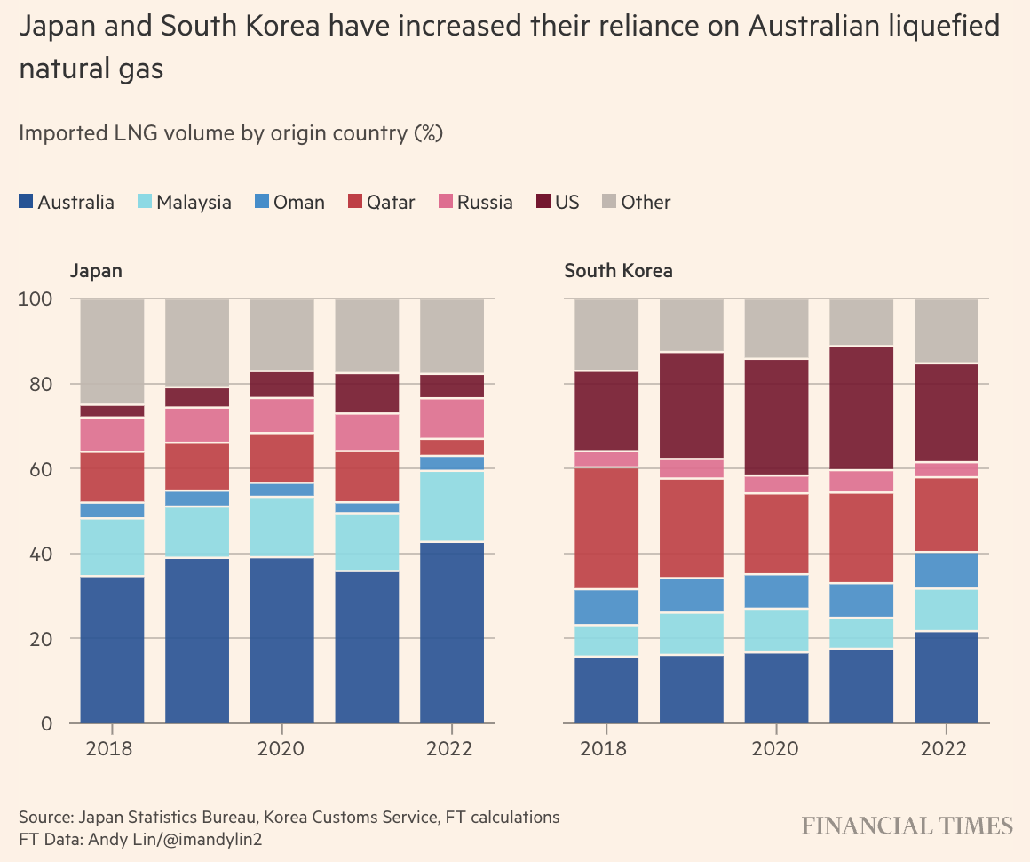
Notes:
Fildes, "Australia Rattles Industry and Trading Partners With Energy Interventions," Financial Times,, February 19, 2023.
https://www.ft.com/content/c20ceba4-20d5-44de-8abd-4c48c80df28a

Slide 44
Recent Uses
Multiple countries restricting exports of critical minerals
  New report in 2023:
    “export restrictions have increased over the last decade more than fivefold.”
  Top countries with new restrictions:
    China,
    India,
    Vietnam,
    Russia,
    Argentina and Kazakhstan.”
Notes:
Kahn, Yusuf, "Increasing Export Restrictions on Critical Minerals Threaten Energy Transition, OECD Says," Wall Street Journal, April 11, 2023. [3 Pp]
https://www.wsj.com/articles/increasing-export-restrictions-on-critical-minerals-threaten-energy-transition-says-oecd-81183533#:~:text=In%20a%20new%20report%2C%20the,surged%20to%2018%2C263%20from%203%2C337.

Slide 45
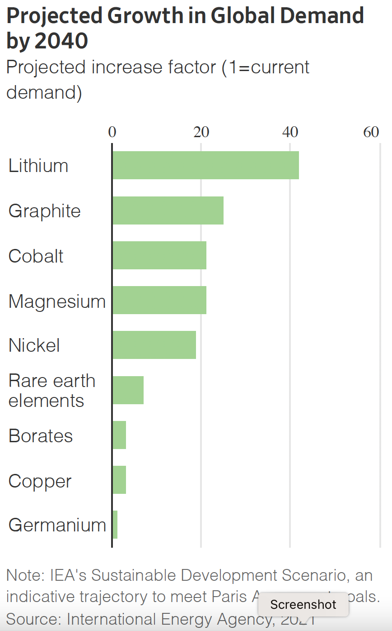
Argentina:
Country in which production is concentrated:
Congo:
Note: This is not 40%, but 40 times!
China:
Vietnam:
Notes:
Kahn, Yusuf, "Increasing Export Restrictions on Critical Minerals Threaten Energy Transition, OECD Says," Wall Street Journal, April 11, 2023. [3 Pp]
https://www.wsj.com/articles/increasing-export-restrictions-on-critical-minerals-threaten-energy-transition-says-oecd-81183533#:~:text=In%20a%20new%20report%2C%20the,surged%20to%2018%2C263%20from%203%2C337.

Slide 46
Recent Uses
China
  Restrictions on exports of gallium and germanium, critical inputs for semiconductor manufacturing
  See Godek on their effectiveness
    Earlier 2010 limits on China’s rare earth exports did less than expected
    [Godek was student iin this course last year, now works a Stimson Center in DC.]
Notes:
Kahn, Yusuf, "Increasing Export Restrictions on Critical Minerals Threaten Energy Transition, OECD Says," Wall Street Journal, April 11, 2023. [3 Pp]
https://www.wsj.com/articles/increasing-export-restrictions-on-critical-minerals-threaten-energy-transition-says-oecd-81183533#:~:text=In%20a%20new%20report%2C%20the,surged%20to%2018%2C263%20from%203%2C337.

Slide 47
Pause for Discussion

Slide 48
  Questions on Economist, “Full Metal Jacket”
Has Indonesia’s ban on export of nickel ore accomplished what it intended?
What is the main reason that expanding the ban to include other metals may work less well than the ban on nickel?
What other reasons does the article give for this being “ill-advised”?

Slide 49
  Questions on Reed & Singh, “India Restricts Rice Exports”
How is India restricting rice exports?
How important is India in the world rice market?
What role do subsidies play?
A possible “cartel” is mentioned. What’s that about?

Slide 50
  Questions on Fildes,
  “Australia Rattles Industry …”
Why is Australia limiting exports of LNG?
What, besides limiting exports, are they doing to reduce the price?
What harm will this do, according to critics?

Slide 51
  Questions on Khan,
  “Increasing Export Restrictions …”
How much have export restrictions increased over the last decade? Is this the amount of trade covered?
Does this say what having supplies concentrated might matter for the export restrictions?
What policies attempt to diversify sources for these materials?

Slide 52
  Questions on Godek,
  “Why China’s Export Controls…”
Did China meet pushback from the WTO?
What two mechanisms lessened the impact of China’s policy?
By how much did China’s exports of rare earths fall?

