Slide 1
Class 14
Why Countries Restrict Trade by
Alan V. Deardorff
University of Michigan
2023
PubPol/Econ 541

Slide 2
FROM REQUIRED READINGS

Slide 3
Baldwin, Robert E. and Christopher S. Magee, “Is trade policy for sale? Congressional voting on recent trade bills,” Public Choice 105, 2000

Slide 4
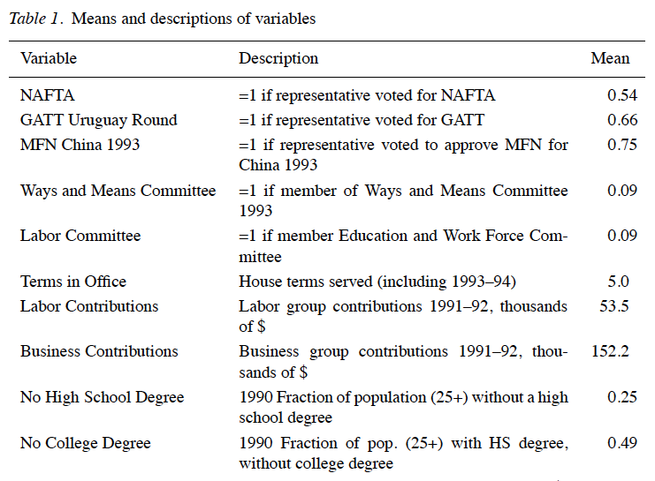
Notes:
Baldwin, Robert E. and Christopher S. Magee, “Is trade policy for sale? Congressional voting on recent trade bills,” Public Choice 105, 2000, pp. 79-101.
http://link.springer.com.proxy.lib.umich.edu/content/pdf/10.1023%2FA%3A1005121716315.pdf

Slide 5

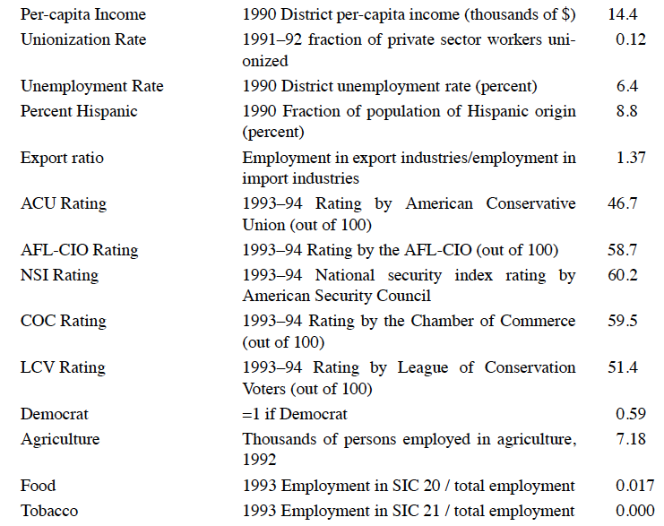
Notes:
Baldwin, Robert E. and Christopher S. Magee, “Is trade policy for sale? Congressional voting on recent trade bills,” Public Choice 105, 2000, pp. 79-101.
http://link.springer.com.proxy.lib.umich.edu/content/pdf/10.1023%2FA%3A1005121716315.pdf

Slide 6
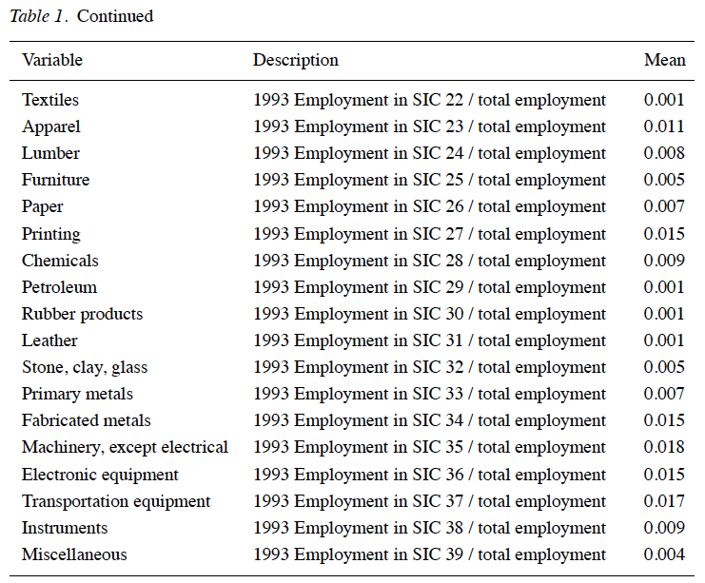
Notes:
Baldwin, Robert E. and Christopher S. Magee, “Is trade policy for sale? Congressional voting on recent trade bills,” Public Choice 105, 2000, pp. 79-101.
http://link.springer.com.proxy.lib.umich.edu/content/pdf/10.1023%2FA%3A1005121716315.pdf

Slide 7
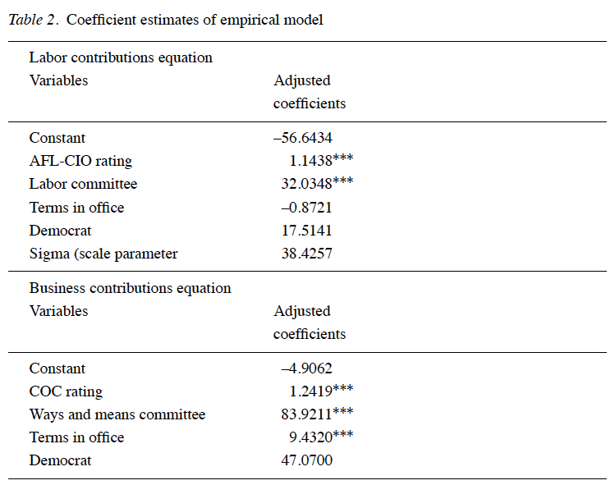
Notes:
Baldwin, Robert E. and Christopher S. Magee, “Is trade policy for sale? Congressional voting on recent trade bills,” Public Choice 105, 2000, pp. 79-101.
http://link.springer.com.proxy.lib.umich.edu/content/pdf/10.1023%2FA%3A1005121716315.pdf

Slide 8
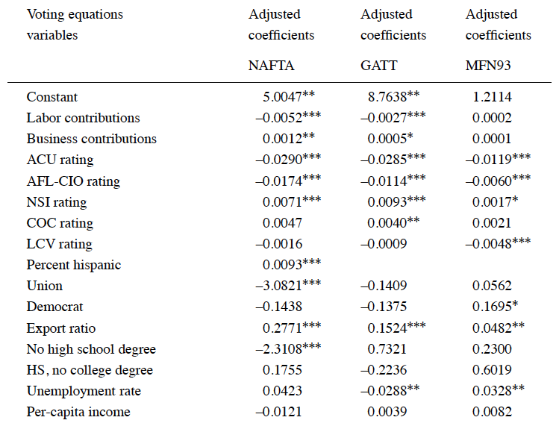
Notes:
Baldwin, Robert E. and Christopher S. Magee, “Is trade policy for sale? Congressional voting on recent trade bills,” Public Choice 105, 2000, pp. 79-101.
http://link.springer.com.proxy.lib.umich.edu/content/pdf/10.1023%2FA%3A1005121716315.pdf

Slide 9
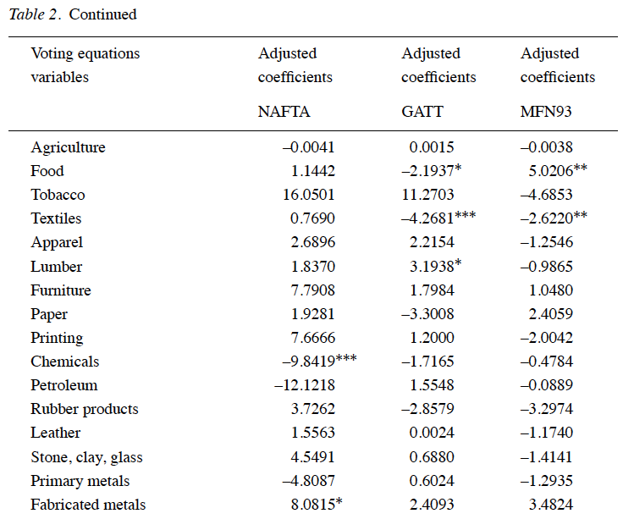
Notes:
Baldwin, Robert E. and Christopher S. Magee, “Is trade policy for sale? Congressional voting on recent trade bills,” Public Choice 105, 2000, pp. 79-101.
http://link.springer.com.proxy.lib.umich.edu/content/pdf/10.1023%2FA%3A1005121716315.pdf

Slide 10
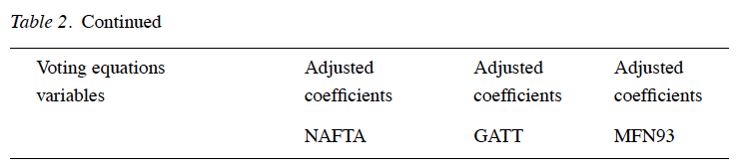
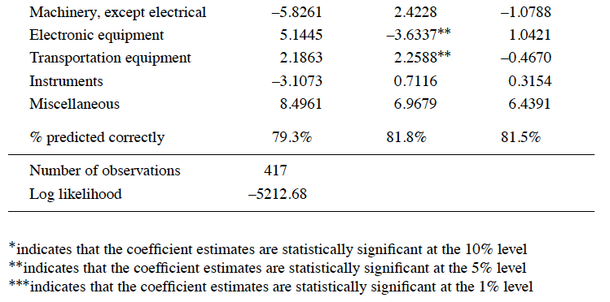
Notes:
Baldwin, Robert E. and Christopher S. Magee, “Is trade policy for sale? Congressional voting on recent trade bills,” Public Choice 105, 2000, pp. 79-101.
http://link.springer.com.proxy.lib.umich.edu/content/pdf/10.1023%2FA%3A1005121716315.pdf

Slide 11
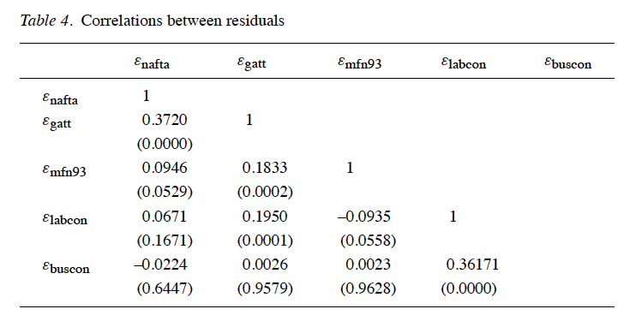
Notes:
Baldwin, Robert E. and Christopher S. Magee, “Is trade policy for sale? Congressional voting on recent trade bills,” Public Choice 105, 2000, pp. 79-101.
http://link.springer.com.proxy.lib.umich.edu/content/pdf/10.1023%2FA%3A1005121716315.pdf

Slide 12
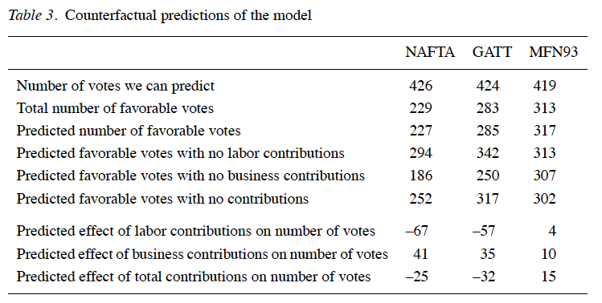
Notes:
Baldwin, Robert E. and Christopher S. Magee, “Is trade policy for sale? Congressional voting on recent trade bills,” Public Choice 105, 2000, pp. 79-101.
http://link.springer.com.proxy.lib.umich.edu/content/pdf/10.1023%2FA%3A1005121716315.pdf

Slide 13
Magee, Christopher S. P., “Why Are Trade Barriers So Low?” Economic Affairs 31(3), October 2011, pp. 12-17.

Slide 14
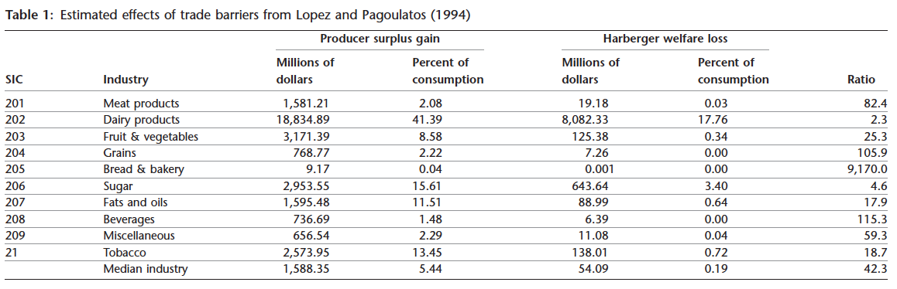
Notes:
Magee, Christopher S. P., “Why Are Trade Barriers So Low?” Economic Affairs 31(3), October 2011, pp. 12-17.
http://onlinelibrary.wiley.com.proxy.lib.umich.edu/doi/10.1111/j.1468-0270.2011.02118.x/pdf

