Slide 1
Class 17
Behind the Standard Model by
Alan V. Deardorff
University of Michigan
2023
PubPol/Econ 541

Slide 2
Announcements
Paper 2
  Due in a week: Nov 8
  Some points:
    I don’t have “correct” numbers this time
      Use your judgement on what numbers to use
    Do assume Canada a small country
    Report results for all three years
    Supply elasticity: Your guess is good as mine (1)
    Do sensitivity analysis, especially on supply elasticity

Slide 3
Announcements
Office hour
  I will not be holding my regular office hour tomorrow, Thursday.
  If you or your group need to see me, email for an appointment

Slide 4
Purpose Today
To look behind the Production Possibilities of the Standard Model:
    Q_{F}
    Q_{C}

Slide 5
Purposes
Why?
To see what determines Comparative Advantage and thus trade
To see how trade has affects inside economies, especially wages

Slide 6
Pause for Discussion

Slide 7
  Questions on KOM
“To produce more of one good, the economy must sacrifice some production of another good.”
  Is this always true?
  What if there is unemployment?

Slide 8
Outline
Ricardian Model
Comparative Advantage
Heckscher-Ohlin Model
Trade and Wages

Slide 9
Outline
Ricardian Model
Comparative Advantage
Heckscher-Ohlin Model
Trade and Wages

Slide 10
The Ricardian Model
Implies that factors earn the same in both.
Assumes
  Two goods: cloth C and food F
    Outputs: Q_{F}, Q_{C}
    Prices: P_{F}, P_{C}
  One factor: labor L
    Perfectly mobile between sectors
  Two countries: Home and Foreign (*)
  Takes as given
    Unit labor requirements:
    Fixed (they do not vary with output)
Very important!
a_{C}, a_{F}, a_{C}*, a_{F}*

Slide 11
Ricardian Technology
Unit labor requirements
  a_{i}, a_{i}* = amount of labor needed to produce one unit of output of good i = C,F
  Assume (so that Home will end up exporting C, as we’ll see below):
  i.e., Home (without *) needs relatively less labor to produce cloth than food, compared to foreign (*)
a_{C}
a_{C}*
<
a_{F}
a_{F}*

Slide 12
Ricardian PPF
    Q_{F}
Full employment requires
L = a_{C}Q_{C} + a_{F}Q_{F}
and thus, solving for Q_{F}:
Q_{F} = L/a_{F} – (a_{C}/a_{F})Q_{C}
L/a_{F}
–a_{C}/a_{F}
L/a_{C}
    Q_{C}

Slide 13
2-Countries’ PPFs
    Q_{F}
    Q_{F}*
Assumes
a_{C}
a_{C}*
L*/a_{F}*
<
a_{F}
a_{F}*
L/a_{F}
–a_{C}/a_{F}
–a_{C}*/a_{F}*
L/a_{C}
    Q_{C}
L*/a_{C}*
    Q_{C}*

Slide 14
NOT equilibrium: RP < a_{C}/a_{F}
    Q_{F}
    Q_{F}*
    Q_{F}*
Both would produce only F
RP < a_{C}/a_{F}
L*/a_{F}*
L*/a_{F}*
L/a_{F}
–a_{C}/a_{F}
–a_{C}*/a_{F}*
L/a_{C}
    Q_{C}
L*/a_{C}*
    Q_{C}*

Slide 15
NOT equilibrium: RP > a_{C}*/a_{F}*
    Q_{F}
RP > a_{C}*/a_{F}*
    Q_{F}*
Both would produce only C
L*/a_{F}*
L/a_{F}
–a_{C}/a_{F}
–a_{C}*/a_{F}*
L/a_{C}
    Q_{C}
L*/a_{C}*
    Q_{C}*

Slide 16
Specialized Equilibrium: a_{C}/a_{F} < RP < a_{C}*/a_{F}*
    Q_{F}
    Q_{F}*
    Q_{F}*
Both specialize:
Home in C,
Foreign in F
Trade
a_{C}/a_{F} < RP < a_{C}*/a_{F}*
S*
L*/a_{F}*
L*/a_{F}*
RP
L/a_{F}
D
D*
RP
–a_{C}/a_{F}
S
–a_{C}*/a_{F}*
L/a_{C}
    Q_{C}
L*/a_{C}*
    Q_{C}*

Slide 17
Specialized Equilibrium: a_{C}/a_{F} < RP < a_{C}*/a_{F}*
    Q_{F}
    Q_{F}*
    Q_{F}*
Gains from Trade
a_{C}/a_{F} < RP < a_{C}*/a_{F}*
S*
L*/a_{F}*
L*/a_{F}*
RP
L/a_{F}
D
D*
S^{A}*=D^{A}*
S^{A}=D^{A}
RP
–a_{C}/a_{F}
S
–a_{C}*/a_{F}*
L/a_{C}
    Q_{C}
L*/a_{C}*
    Q_{C}*

Slide 18
Home-Diversified Equilibrium: a_{C}/a_{F} = RP < a_{C}*/a_{F}*
    Q_{F}
    Q_{F}*
    Q_{F}*
Only Foreign specializes:
Trade
a_{C}/a_{F} = RP < a_{C}*/a_{F}*
S*
L*/a_{F}*
L*/a_{F}*
D*
L/a_{F}
S^{A}=D^{A}=D
S^{A}*
=D^{A}*
RP
RP
S
–a_{C}/a_{F}
–a_{C}*/a_{F}*
L/a_{C}
    Q_{C}
L*/a_{C}*
    Q_{C}*

Slide 19
Home Diversified Equilibrium: a_{C}/a_{F} = RP < a_{C}*/a_{F}*
    Q_{F}
    Q_{F}*
    Q_{F}*
Only Foreign gains from trade
a_{C}/a_{F} = RP < a_{C}*/a_{F}*
S*
L*/a_{F}*
L*/a_{F}*
D*
L/a_{F}
S^{A}=D^{A}=D
S^{A}*
=D^{A}*
RP
RP
S
–a_{C}/a_{F}
–a_{C}*/a_{F}*
L/a_{C}
    Q_{C}
L*/a_{C}*
    Q_{C}*

Slide 20
Effects of Trade in Ricardian Model
Labor moves – wholly or partially – out of import-competing sector
All labor paid the same wage (due to perfect mobility), so all share any gains from trade
Real wage rises as price of import falls
Note that transition, not modelled, could be painful

Slide 21
Pause for Discussion

Slide 22
  Questions on KOM
In the Ricardian Model, do both countries necessarily gain from trade? Is it possible for a country to lose from trade?
What do the relative supply and demand curves of a country look like in the Ricardian Model, and why? What do they look like for the world of two countries?

Slide 23
    Q_{F}
Home
    Q_{F}*
Foreign
L*/a_{F}*
L/a_{F}
–a_{C}/a_{F}
–a_{C}*/a_{F}*
L/a_{C}
L*/a_{C}*
    RP = P_{C}/P_{F}
    RP = P_{C}/P_{F}
    RP = P_{C}/P_{F}
Home
Foreign
World
    RS*
    RS ^{W}
a_{C}*/a_{F}*
    RS
a_{C}/a_{F}
    RQ= Q_{C}/Q_{F}
    RQ= Q_{C}/Q_{F}
(L/a_{C} )/(L*/a_{F}*)
    RQ

Slide 24
  More Questions on KOM
Suppose that preferences change so that, at given prices, demanders everywhere increase their preferred consumption of one good and decrease it for the other. In most models, such a change will cause both the price and the quantity of the preferred good to increase. Is that true in the Ricardian Model, of a closed economy and/or of a two-country world?

Slide 25
Outline
Ricardian Model
Comparative Advantage
Heckscher-Ohlin Model
Trade and Wages

Slide 26
Comparative Advantage
Before Ricardo, we knew that
  if each country had “absolute advantage” in one good
  (Meaning they were better at producing it)
  Then they would export it
But it was thought that,
  if one country had absolute advantage in both goods,
  then trade might be impossible

Slide 27
Comparative Advantage
Ricardo showed that this was wrong.
What matters is “comparative advantage”
A less productive country can gain by exporting the good in which its disadvantage is relatively smaller

Slide 28
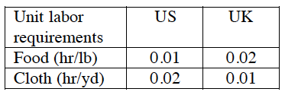
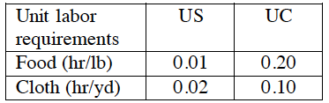
Comparative Advantage
Ricardo used numerical examples like the following, with unit labor requirements:
Absolute advantage:
Comparative advantage:

Slide 29
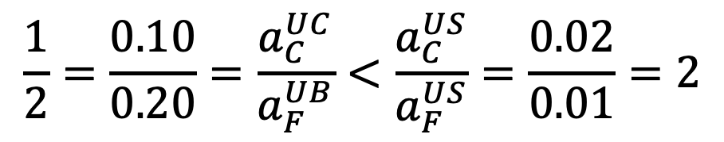
Comparative Advantage
By assigning amounts of labor to the countries, one can show that each can consume more of both goods if
  US exports Food
  Other (UK or UC) exports Cloth
UC has comparative advantage in Cloth because its relative labor cost is lower:
$$\frac{1}{2}=\frac{0.10}{0.20}=\frac{a_{C}^{UC}}{a_{F}^{UB}}<\frac{a_{C}^{US}}{a_{F}^{US}}=\frac{0.02}{0.01}=2$$

Slide 30
Comparative Advantage
Recall from Ricardian Model:
    Q_{F}
    Q_{F}*
Assumes
Thus Home has comparative advantage in C
a_{C}
a_{C}*
L*/a_{F}*
<
a_{F}
a_{F}*
L/a_{F}
–a_{C}/a_{F}
–a_{C}*/a_{F}*
L/a_{C}
    Q_{C}
L*/a_{C}*
    Q_{C}*

Slide 31
Comparative Advantage
In a much more general context than the Ricardian model, comparative advantage needs to be defined in terms of relative autarky prices.
Why? Because costs vary along production possibility curve:
    Q_{F}
    Q_{C}

Slide 32
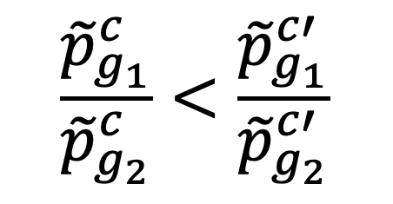
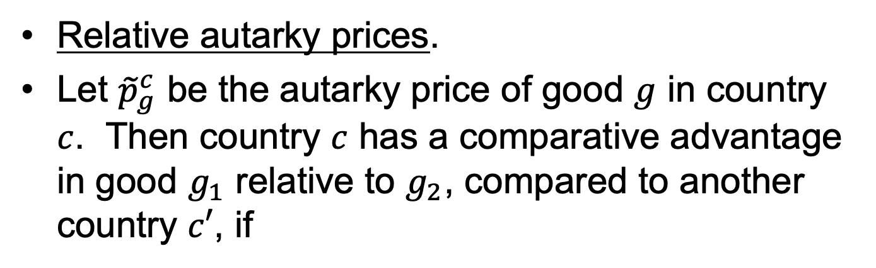
Comparative Advantage
Relative autarky prices.
Let ${\tilde{p}}_{g}^{c}$ be the autarky price of good $g$ in country $c$. Then country $c$ has a comparative advantage in good $g_{1}$ relative to $g_{2}$, compared to another country $c′$, if
$$\frac{{\tilde{p}}_{g_{1}}^{c}}{{\tilde{p}}_{g_{2}}^{c}}<\frac{{\tilde{p}}_{g_{1}}^{c′}}{{\tilde{p}}_{g_{2}}^{c′}}$$

Slide 33
Pause for Discussion

Slide 34
  Questions on KOM
Does comparative advantage imply absolute advantage? Does absolute advantage imply comparative advantage?

Slide 35
  Questions on Deardorff
How can one identify comparative advantage in terms of
  Unit labor requirements for producing goods?
  Output per worker in producing the goods?
  Opportunity cost?
Why is comparative advantage a relative concept in two senses simultaneously?

Slide 36
  Questions on Deardorff
When a high-wage country trades with a low-wage country in the Ricardian model, who is hurt, or hurt more: The high-wage workers or the low-wage workers?

Slide 37
Outline
Ricardian Model
Comparative Advantage
Heckscher-Ohlin Model
Trade and Wages

Slide 38
The Heckscher-Ohlin (H-O) Model
Assumes
  Two goods: cloth C and food F
    Outputs: Q_{F}, Q_{C}
    Prices: P_{F}, P_{C}

Slide 39
The Heckscher-Ohlin (H-O) Model
Assumes
  Two factors: labor L, land T
    Endowments: L, T, L*, T*
  Both assumed perfectly mobile between industries
  Thus a single
    wage, w, paid to labor, and
    rental, r, paid to land
Again, very important!

Slide 40
The Heckscher-Ohlin (H-O) Model
Assumes
  Two countries: Home and Foreign (*)
    Differ (only) in relative factor endowments

Slide 41
The Heckscher-Ohlin (H-O) Model
Assumptions:
  Takes as given
    Constant-returns-to-scale production functions
    Same in both countries
  Homothetic preferences are also the same in both countries, as in the Standard Model

Slide 42
H-O Technology
Unit factor requirements
  a_{ij} = a_{ij}* = amount of factor i = L, T needed to produce one unit of output of good j = C,F
    (Usually, but not here, these are taken to be variable, depending on factor prices.)
  Assume (so that Home will end up exporting C, as we’ll see below):
  That is, production of cloth is “labor-intensive” relative to land, compared to production of food
a_{LC}
a_{LF}
>
a_{TC}
a_{TF}

Slide 43
H-O Endowments
Factor endowments
  H-O takes as given the countries’ “endowments” of the two factors
  Assume (again so that Home will end up exporting C, as we’ll see below):
  That is, Home is relatively well-endowed with labor (relative to land, compared to Foreign)
L
L*
>
T
T*

Slide 44
H-O PPFs
With these assumptions, it can be shown that PPFs are curved, as in the Standard Model.
Home, because it is relatively well endowed with labor, is better able to produce the labor-intensive good C.
PPFs therefore look as we saw them in the Standard Model.

Slide 45
H-O Trade Equilibrium
    Q_{F}
Home
    Q_{F}*
Foreign
Trade
S*
D
D*
S^{A}*=D^{A}*
S^{A}=D^{A}
S
    Q_{C}
    Q_{C}*

Slide 46
H-O Gains from Trade
    Q_{F}
Home
    Q_{F}*
Foreign
Gains from Trade
S*
D
D*
S^{A}*=D^{A}*
S^{A}=D^{A}
S
    Q_{C}
    Q_{C}*

Slide 47
H-O Production Changes
Due to Trade
    Q_{F}
Home
    Q_{F}*
Foreign
Home shifts towards C
Foreign shifts towards F
RP^{W}
S*
RP^{A}
D*
D
S^{A}*=D^{A}*
S^{A}=D^{A}
RP^{W}
S
RP^{A}*
    Q_{C}
    Q_{C}*

Slide 48
H-O Price Changes
Due to Trade
    Q_{F}
Home
    Q_{F}*
Foreign
RP rises in Home and falls in Foreign
RP^{W}
S*
RP^{A}
D*
D
S^{A}*=D^{A}*
S^{A}=D^{A}
RP^{W}
S
RP^{A}*
    Q_{C}
    Q_{C}*
Labor and land move from F to C
Labor and land move from C to F

Slide 49
H-O Effects on Factor Prices
Can’t be seen in these pictures, but
  Factor Price Equalization (FPE)
    Equality of goods prices (due to free trade) causes equality of factor prices (wage of labor and rent of land)
  Stolper-Samuelson Theorem (SS)
    As price rises for good using intensively the abundant factor,
      Real wage or rent of that factor rises
      Real wage or rent of other (“scarce”) factor falls

Slide 50
Factor Price Equalization
Simple analytics
  P_{C} = wa_{LC}+ ra_{TC}
  P_{F} = wa_{LF}+ ra_{TF}
  => w = (a_{TF}P_{C} – a_{TC}P_{F})/Δ
  r = (a_{LF}P_{C} – a_{LC}P_{F})/Δ
  where Δ = a_{LC}a_{TF} – a_{LF}a_{TC}
Thus (FPE): If P_{C}=P_{C}* & P_{F}=P_{F}*
Then w=w* & r=r*

Slide 51
Stolper-Samuelson Theorem
Recall
a_{LC}
a_{LF}
It can also be shown that
  If %ΔP_{C} > %ΔP_{F} , so that Δ(P_{C}/P_{F}) > 0
  Then %Δw > %ΔP_{C} > %ΔP_{F} > %Δr
So that
  w rises relative to both prices, and
  r falls relative to both prices
  That is (SS): if Δ(P_{C}/P_{F}) > 0, then
real wage rises, and
real rent falls
<
a_{TC}
a_{TF}

Slide 52
SS Interpretations
A rise in relative price of a good increases the real return to the factor used intensively in its production and lowers the real return to the other factor.
Free trade benefits the abundant factor and hurts the scarce factor
Protection benefits the scarce factor and hurts the abundant factor

Slide 53
Pause for Discussion

Slide 54
  Questions on KOM
If one country has more of both land and labor than the other country, what will it export?
Is the Heckscher-Ohlin Theorem, as a theory of trade, an alternative to the theory of comparative advantage?
Who gains and who loses from trade, in the two-factor model?

Slide 55
Outline
Ricardian Model
Comparative Advantage
Heckscher-Ohlin Model
Trade and Wages

Slide 56
Trade and Wages
Starting in about 1980
  Wages of more educated labor rose
  Wages of less educated labor
    Rose less rapidly, or
    Fell
  Thus there was a rise in the
    Return to education
    “Skill Premium”

Slide 57

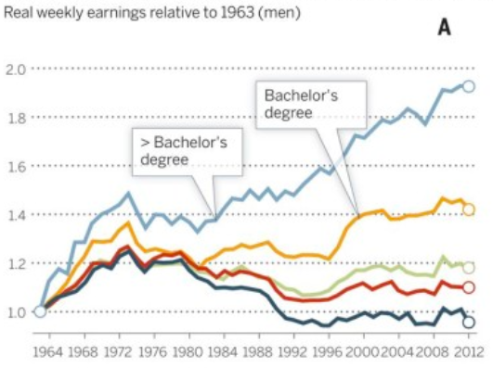
Changes in real wage levels of full-time U.S. workers by sex and education, 1963-2012
Source: Roser & Nagdy, 2013
Notes:
Max Roser and Mohamed Nagdy, “Returns to Education,” Our World in Data, 2013.
https://ourworldindata.org/returns-to-education

Slide 58
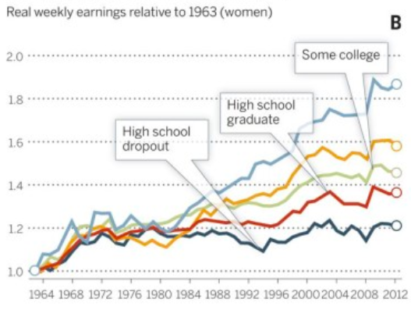
Changes in real wage levels of full-time U.S. workers by sex and education, 1963-2012
Source: Roser & Nagdy, 2013
Notes:
Max Roser and Mohamed Nagdy, “Returns to Education,” Our World in Data, 2013.
https://ourworldindata.org/returns-to-education

Slide 59
Trade and Wages
Why did this happen? Several possible causes were studied
  Immigration
  Scarcity of education
  Decline of unions
  Globalization
  Technological change

Slide 60
Trade and Wages
Why did this happen? Several possible causes were studied
  Immigration
  Scarcity of education
  Decline of unions
  Globalization
  Technological change
Of these, only the last two found empirical support

Slide 61
Trade and Wages
How could globalization cause this?
  If countries lowered tariffs, this is exactly what is predicted by the Stolper-Samuelson Theorem
    In the US less educated labor is the scarce factor
      Not because there are few of them absolutely
      But because there are fewer compared to more educated
  Also, if the portion of the world with more low-educated workers grows
    This too will push down low-educated wages
    Note the opening and growth of China

Slide 62
Trade and Wages
How could technology cause this?
  Increased use of computers and other information technology
    Increases demand for educated labor

Slide 63
Trade and Wages
What the empirical studies found (see Freeman)
  “…trade matters, but it is neither all that matters nor the primary cause of observed changes.”
  My recollection of the literature
    Trade accounted for 30-40%
    The rest was technology

Slide 64
Pause for Discussion

Slide 65
  Questions on KOM
How have the wages of skilled and unskilled labor in the US changed since the 1970s? Could this change be due to trade? Is it in fact due primarily to trade?
In what sense can trade in goods be regarded as equivalent to trade in (or international movement of) factors?
What are some of the reasons why the prediction of international factor price equalization does not hold in the real world?

Slide 66
  Questions on Freeman
Contrast the changes in skilled and unskilled wages and employment in the U.S. and Europe.
Two empirical approaches to studying the effects of globalization are described by Freeman, one looking at the “factor content of trade” and the other looking at prices. What is the reasoning behind each?

