Slide 1
Class 19
Preferential Trading Arrangements by
Alan V. Deardorff
University of Michigan
2023
PubPol/Econ 541

Slide 2
FROM REQUIRED READINGS

Slide 3
World Trade Organization, “Causes and Effects of PTAs: Is It All about Preferences?” Chapter C in World Trade Report 2011,

Slide 4
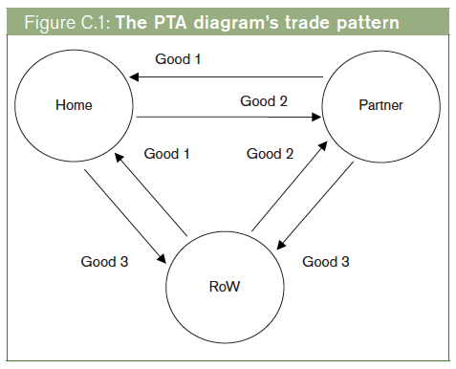
Notes:
World Trade Organization, “Causes and Effects of PTAs: Is It All about Preferences?” Chapter C in World Trade Report 2011, pp. 92-121.
http://www.wto.org/english/res_e/booksp_e/anrep_e/wtr11-2c_e.pdf

Slide 5
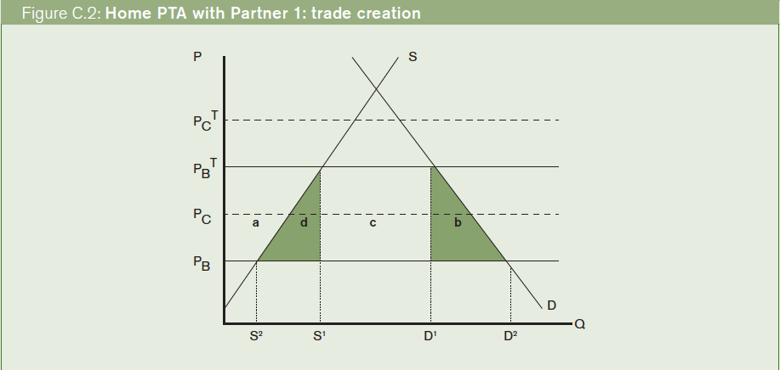
Notes:
World Trade Organization, “Causes and Effects of PTAs: Is It All about Preferences?” Chapter C in World Trade Report 2011, pp. 92-121.
http://www.wto.org/english/res_e/booksp_e/anrep_e/wtr11-2c_e.pdf

Slide 6
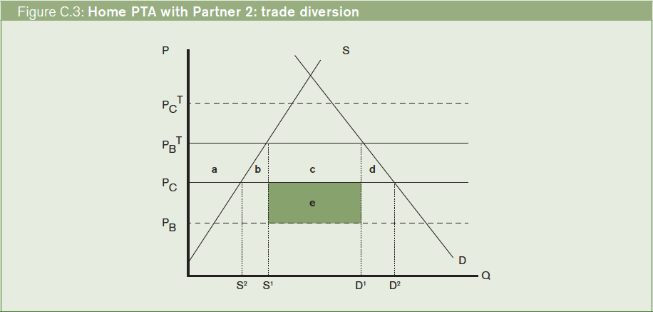
Notes:
World Trade Organization, “Causes and Effects of PTAs: Is It All about Preferences?” Chapter C in World Trade Report 2011, pp. 92-121.
http://www.wto.org/english/res_e/booksp_e/anrep_e/wtr11-2c_e.pdf

Slide 7
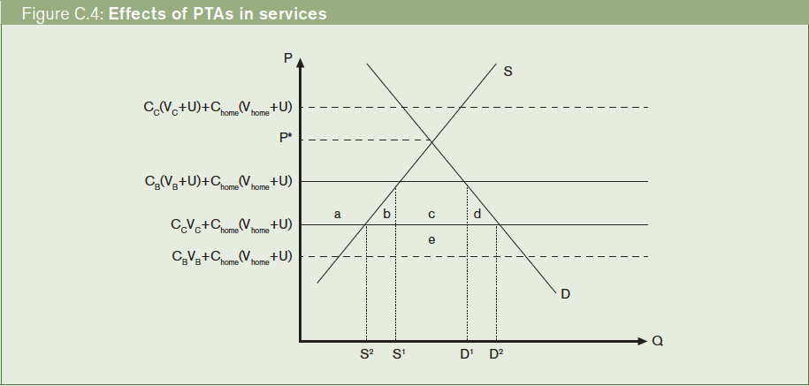
Notes:
World Trade Organization, “Causes and Effects of PTAs: Is It All about Preferences?” Chapter C in World Trade Report 2011, pp. 92-121.
http://www.wto.org/english/res_e/booksp_e/anrep_e/wtr11-2c_e.pdf

Slide 8
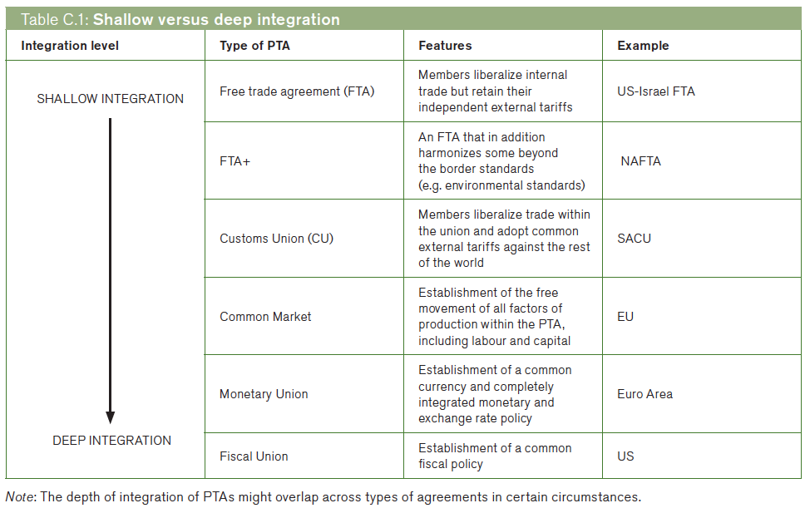
Notes:
World Trade Organization, “Causes and Effects of PTAs: Is It All about Preferences?” Chapter C in World Trade Report 2011, pp. 92-121.
http://www.wto.org/english/res_e/booksp_e/anrep_e/wtr11-2c_e.pdf

Slide 9
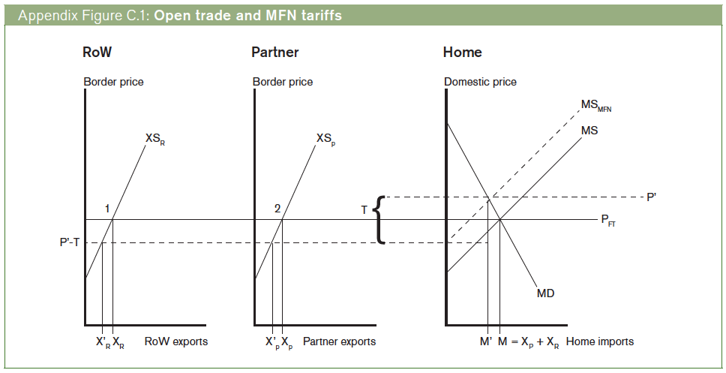
Notes:
World Trade Organization, “Causes and Effects of PTAs: Is It All about Preferences?” Chapter C in World Trade Report 2011, pp. 92-121.
http://www.wto.org/english/res_e/booksp_e/anrep_e/wtr11-2c_e.pdf

Slide 10
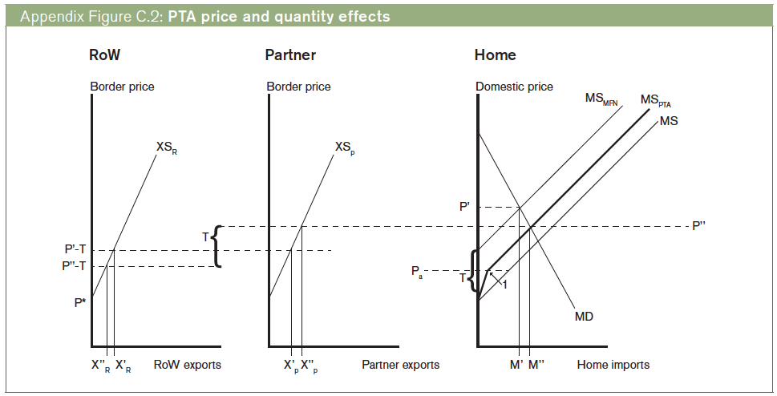
Notes:
World Trade Organization, “Causes and Effects of PTAs: Is It All about Preferences?” Chapter C in World Trade Report 2011, pp. 92-121.
http://www.wto.org/english/res_e/booksp_e/anrep_e/wtr11-2c_e.pdf

Slide 11
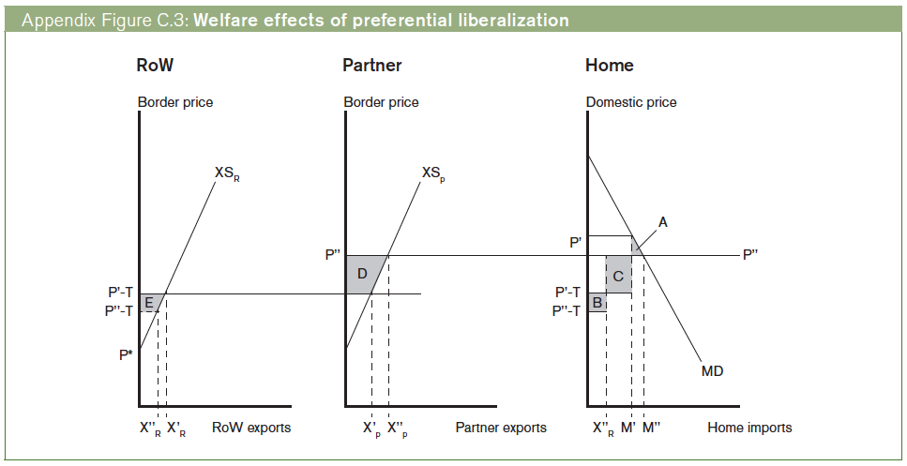
Notes:
World Trade Organization, “Causes and Effects of PTAs: Is It All about Preferences?” Chapter C in World Trade Report 2011, pp. 92-121.
http://www.wto.org/english/res_e/booksp_e/anrep_e/wtr11-2c_e.pdf

Slide 12
FROM OPTIONAL READINGS

