Slide 1
Class 20
FTAs and Other Trade Deals by
Alan V. Deardorff
University of Michigan
2023
PubPol/Econ 541

Slide 2
FROM REQUIRED READINGS

Slide 3
Reading

Slide 4
Kirby, Jen, "USMCA, Trump's New NAFTA Deal, Explained in 600 Words," VOX, July 1, 2020

Slide 5
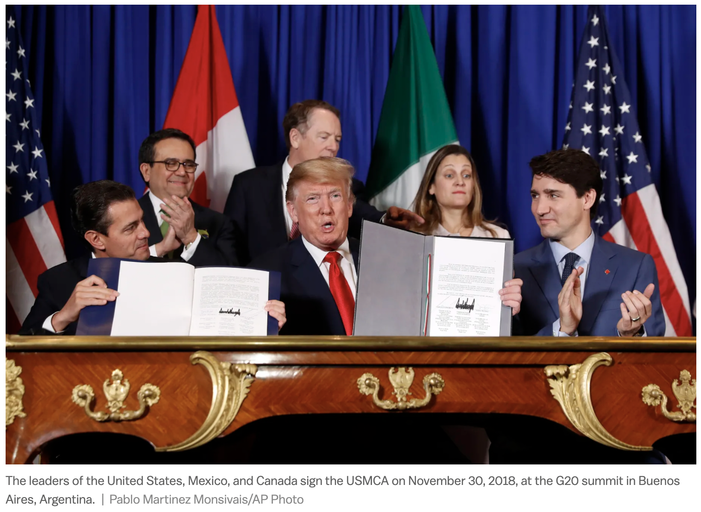
Notes:
Kirby, Jen, "USMCA, Trump's New NAFTA Deal, Explained in 600 Words," VOX, July 1, 2020.
https://www.vox.com/2018/10/3/17930092/usmca-mexico-nafta-trump-trade-deal-explained

Slide 6
Hayashi, Yuka, “U.S. on Sidelines as China and Other Asia-Pacific Nations Launch Trade Pact,” Wall Street Journal, January 1, 2022

Slide 7
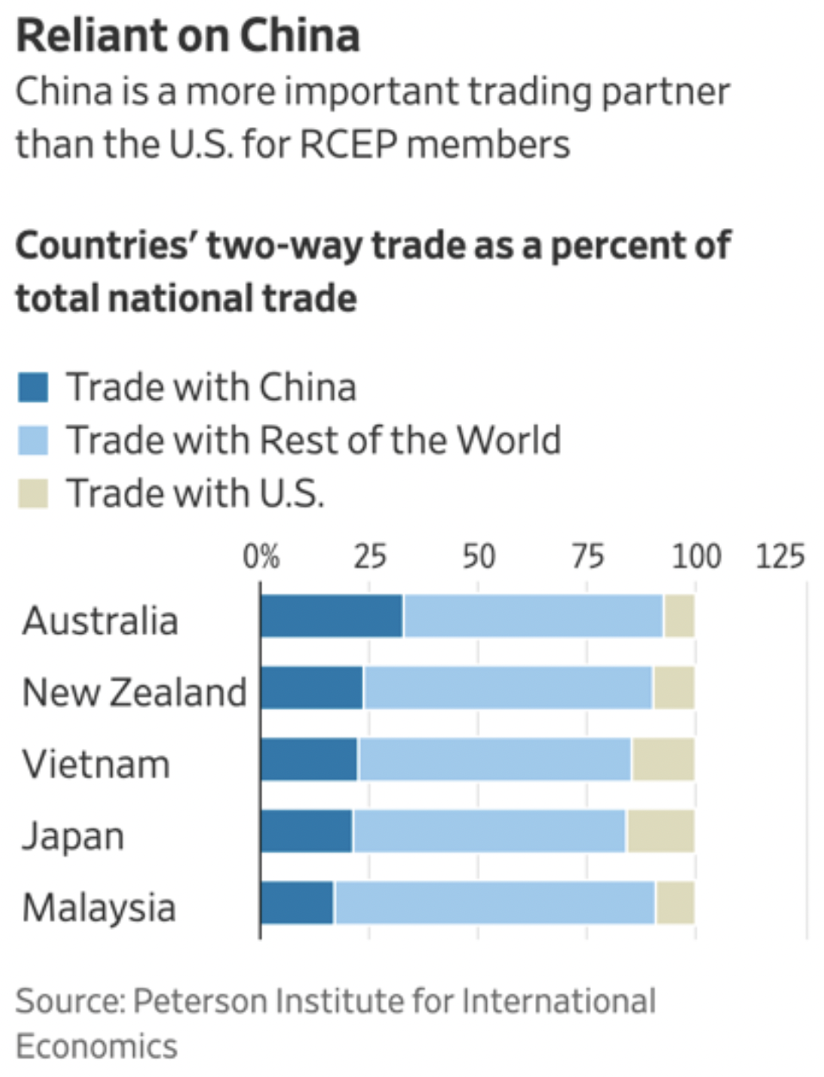
Notes:
Hayashi, Yuka, “U.S. on Sidelines as China and Other Asia-Pacific Nations Launch Trade Pact,” Wall Street Journal, January 1, 2022. [3p].
https://www.wsj.com/articles/u-s-on-sidelines-as-china-and-other-asia-pacific-nations-launch-trade-pact-11641038401?mod=Searchresults_pos1&page=1

Slide 8
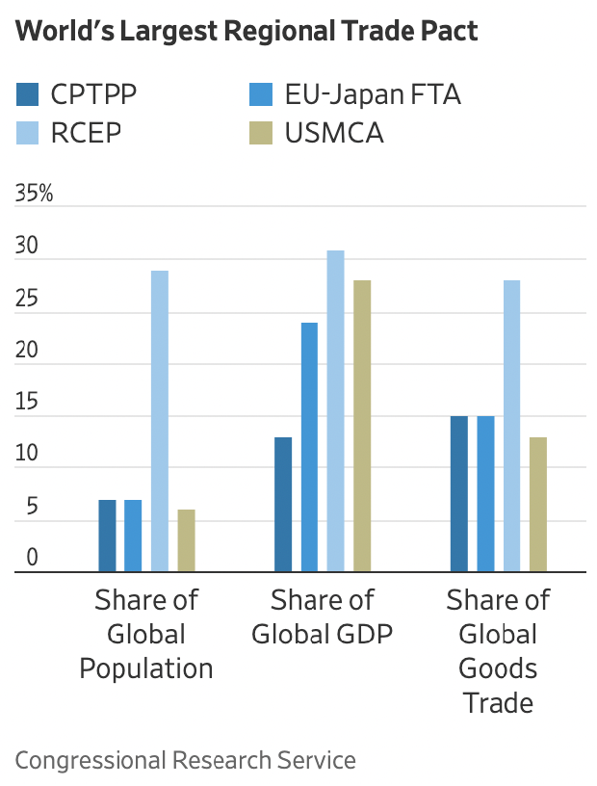
Notes:
Hayashi, Yuka, “U.S. on Sidelines as China and Other Asia-Pacific Nations Launch Trade Pact,” Wall Street Journal, January 1, 2022. [3p].
https://www.wsj.com/articles/u-s-on-sidelines-as-china-and-other-asia-pacific-nations-launch-trade-pact-11641038401?mod=Searchresults_pos1&page=1

Slide 9
Edmond, Charlotte, "The United Kingdom Is Set to Join the Trans-Pacific Free Trade Pact. Here's What You Need to Know," World Economic Forum, April 3, 2023.

Slide 10
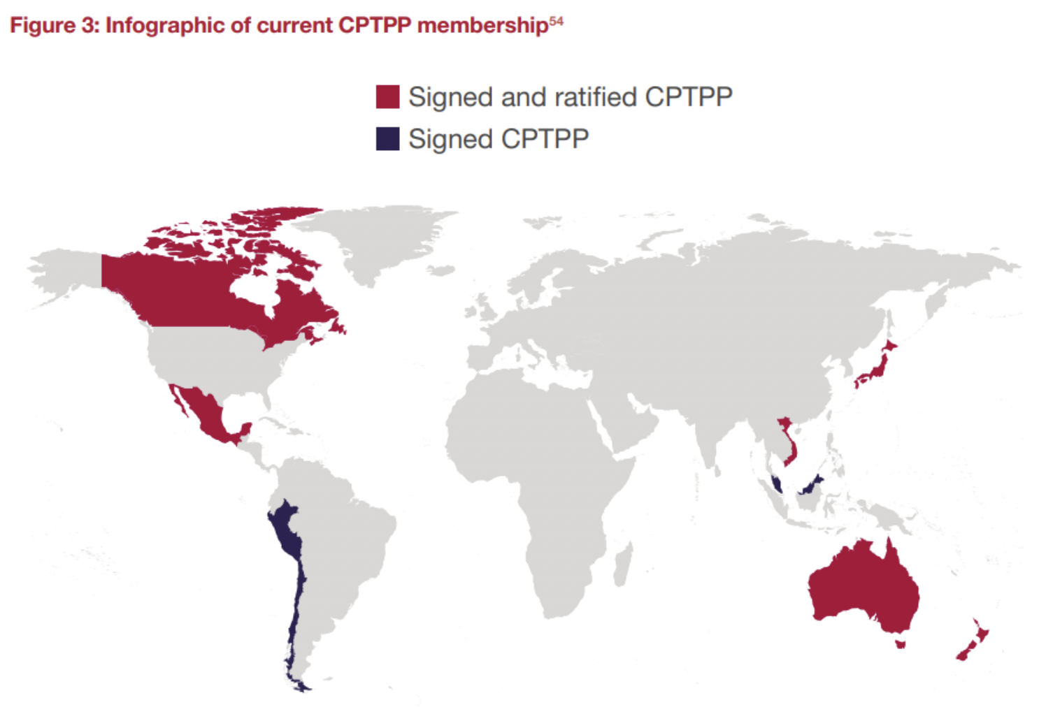
There are 11 CPTPP members currently, accounting for 14% of global GDP.
Notes:
Edmond, Charlotte, "The United Kingdom Is Set to Join the Trans-Pacific Free Trade Pact. Here's What You Need to Know," World Economic Forum, April 3, 2023. [4p]
https://www.weforum.org/agenda/2023/04/cptpp-trade-tariff-brexit-uk/

Slide 11
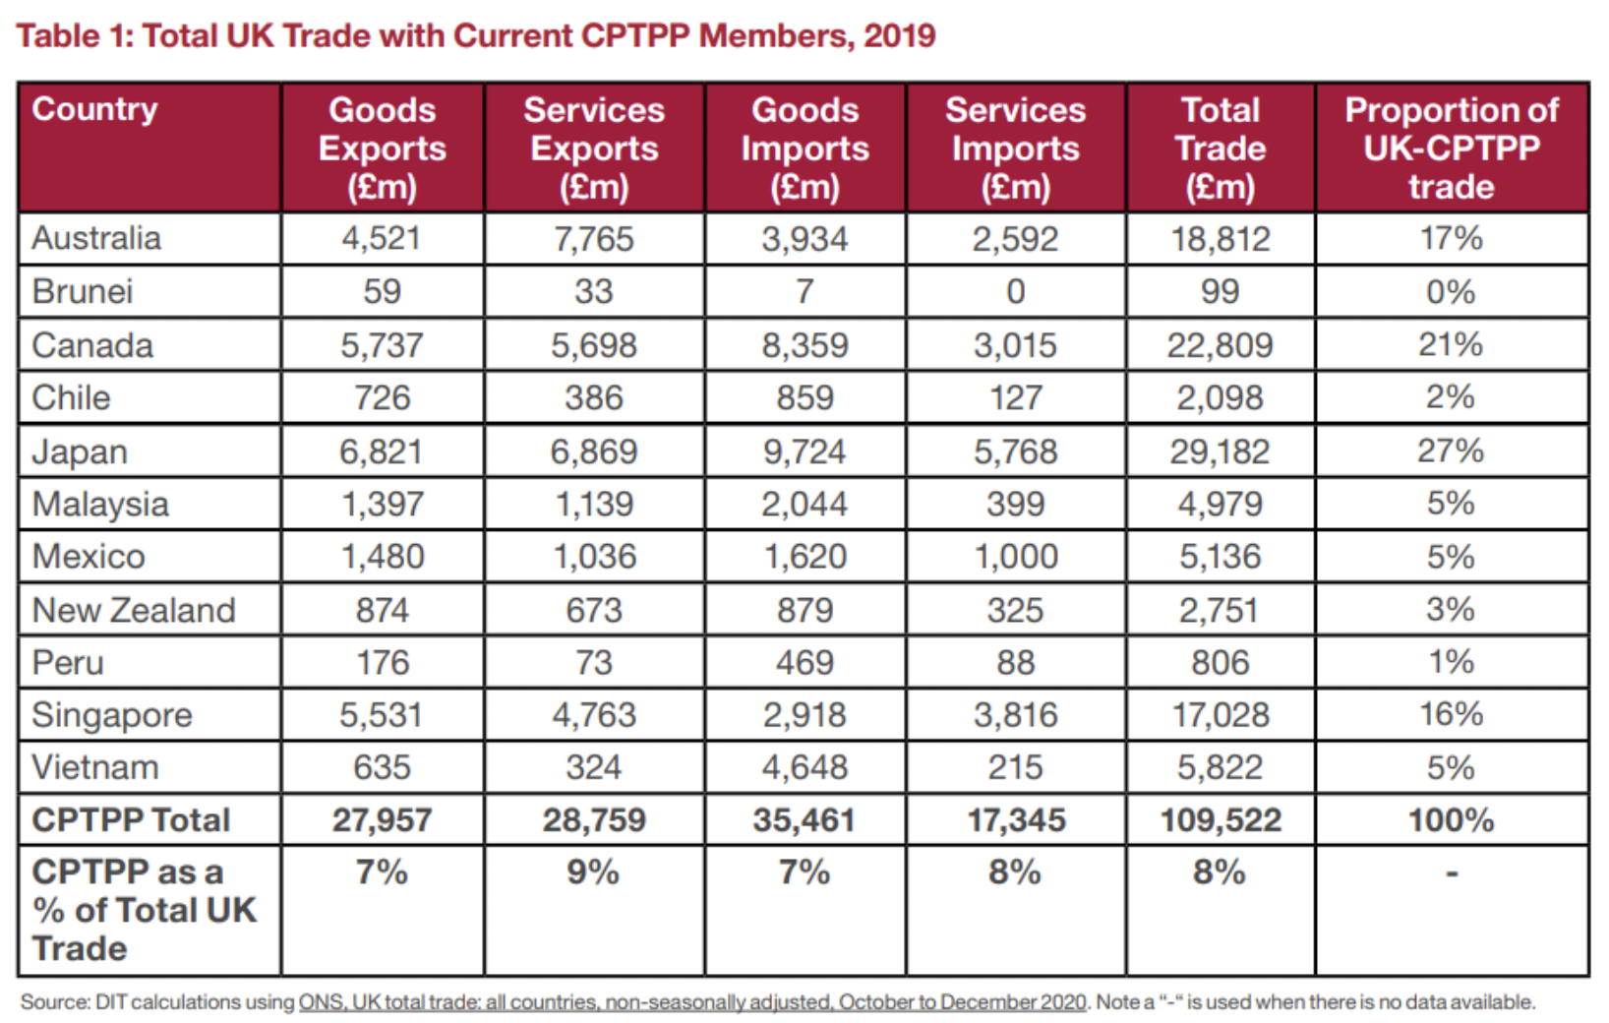
In 2019, CPTPP-UK trade represented around 8% of total UK trade.
Notes:
Edmond, Charlotte, "The United Kingdom Is Set to Join the Trans-Pacific Free Trade Pact. Here's What You Need to Know," World Economic Forum, April 3, 2023. [4p]
https://www.weforum.org/agenda/2023/04/cptpp-trade-tariff-brexit-uk/

Slide 12
FROM OPTIONAL READINGS

Slide 13
Reading

