Slide 1
Class 22
Trade Adjustment Assistance by
Alan V. Deardorff
University of Michigan
2023
PubPol/Econ 541

Slide 2
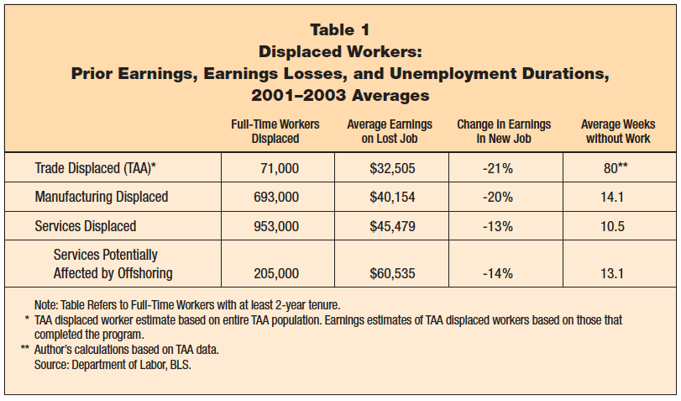
Notes:
Brainard, Lael, Robert E. Litan, and Nicholas Warren, “Insuring America’s Workers in a New Era of Offshoring,” Policy Brief #143, The Brookings Institution, July 2005.
http://www.brookings.edu/~/media/Files/rc/papers/2005/07macroeconomics_brainard/pb143.pdf

Slide 3
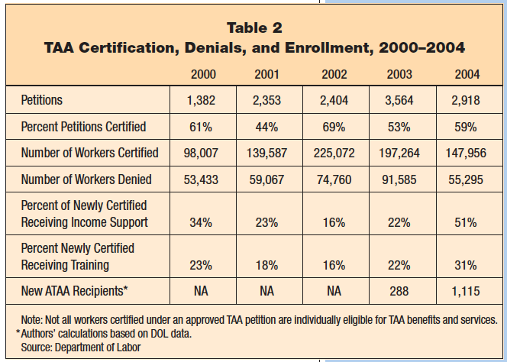
Notes:
Brainard, Lael, Robert E. Litan, and Nicholas Warren, “Insuring America’s Workers in a New Era of Offshoring,” Policy Brief #143, The Brookings Institution, July 2005.
http://www.brookings.edu/~/media/Files/rc/papers/2005/07macroeconomics_brainard/pb143.pdf

Slide 4
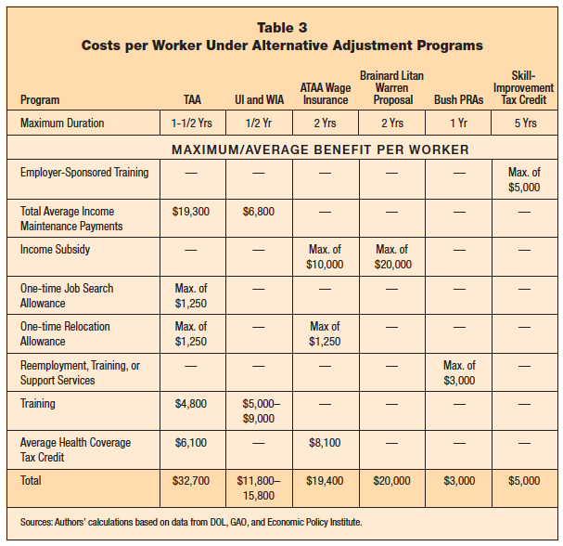
Notes:
Brainard, Lael, Robert E. Litan, and Nicholas Warren, “Insuring America’s Workers in a New Era of Offshoring,” Policy Brief #143, The Brookings Institution, July 2005.
http://www.brookings.edu/~/media/Files/rc/papers/2005/07macroeconomics_brainard/pb143.pdf

Slide 5
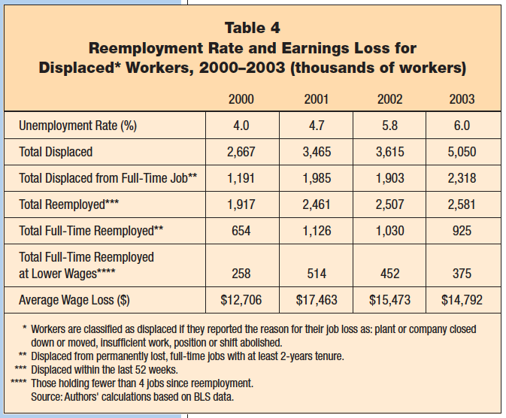
Notes:
Brainard, Lael, Robert E. Litan, and Nicholas Warren, “Insuring America’s Workers in a New Era of Offshoring,” Policy Brief #143, The Brookings Institution, July 2005.
http://www.brookings.edu/~/media/Files/rc/papers/2005/07macroeconomics_brainard/pb143.pdf

Slide 6
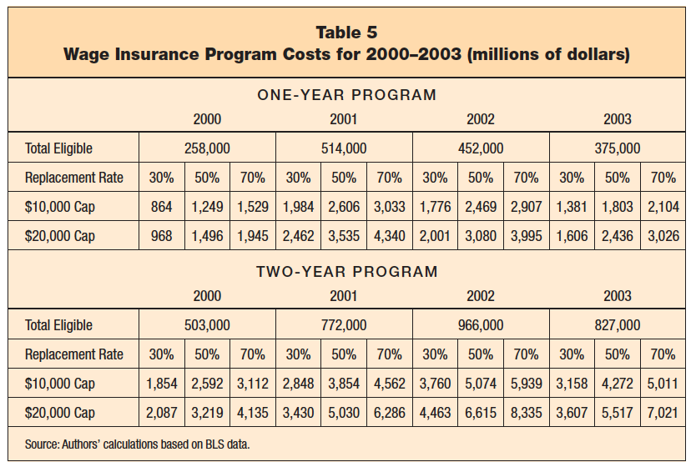
Notes:
Brainard, Lael, Robert E. Litan, and Nicholas Warren, “Insuring America’s Workers in a New Era of Offshoring,” Policy Brief #143, The Brookings Institution, July 2005.
http://www.brookings.edu/~/media/Files/rc/papers/2005/07macroeconomics_brainard/pb143.pdf

Slide 7
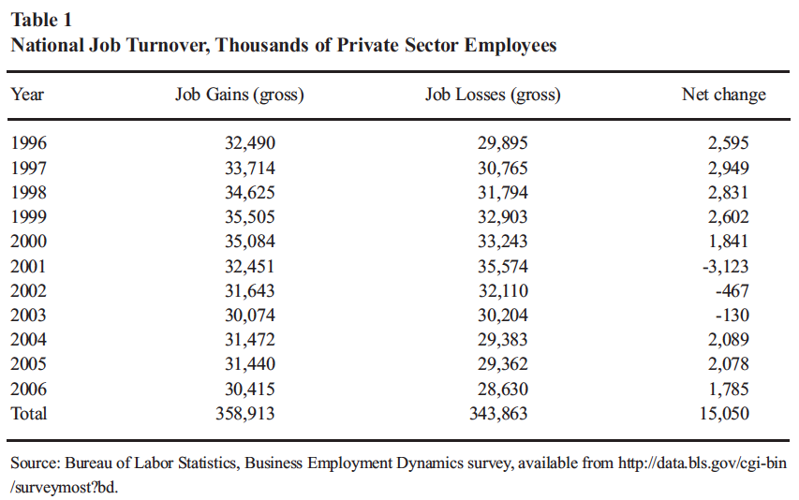
Notes:
James, Sallie, “Maladjusted: The Misguided Policy of ‘Trade Adjustment Assistance’,” Briefing Paper No. 26, Center for Trade Policy Studies, Cato Institute, November 8, 2007.
http://www.freetrade.org/pubs/briefs/tbp-026.pdf

Slide 8
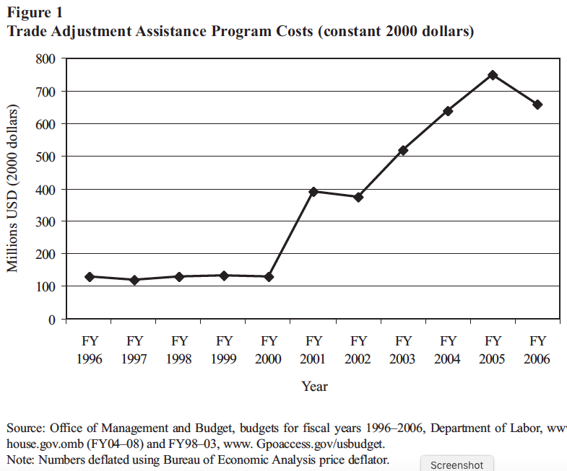
Notes:
James, Sallie, “Maladjusted: The Misguided Policy of ‘Trade Adjustment Assistance’,” Briefing Paper No. 26, Center for Trade Policy Studies, Cato Institute, November 8, 2007.
http://www.freetrade.org/pubs/briefs/tbp-026.pdf

Slide 9
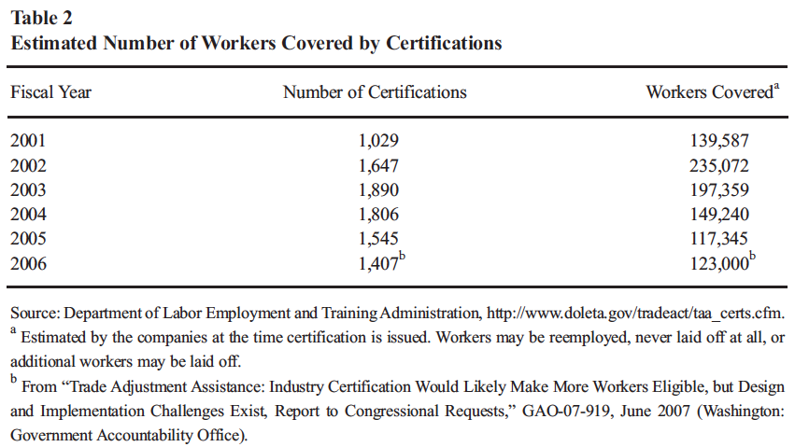
Notes:
James, Sallie, “Maladjusted: The Misguided Policy of ‘Trade Adjustment Assistance’,” Briefing Paper No. 26, Center for Trade Policy Studies, Cato Institute, November 8, 2007.
http://www.freetrade.org/pubs/briefs/tbp-026.pdf

Slide 10
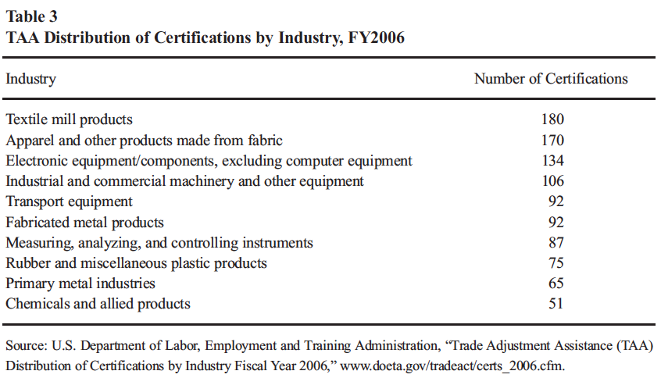
Notes:
James, Sallie, “Maladjusted: The Misguided Policy of ‘Trade Adjustment Assistance’,” Briefing Paper No. 26, Center for Trade Policy Studies, Cato Institute, November 8, 2007.
http://www.freetrade.org/pubs/briefs/tbp-026.pdf

Slide 11
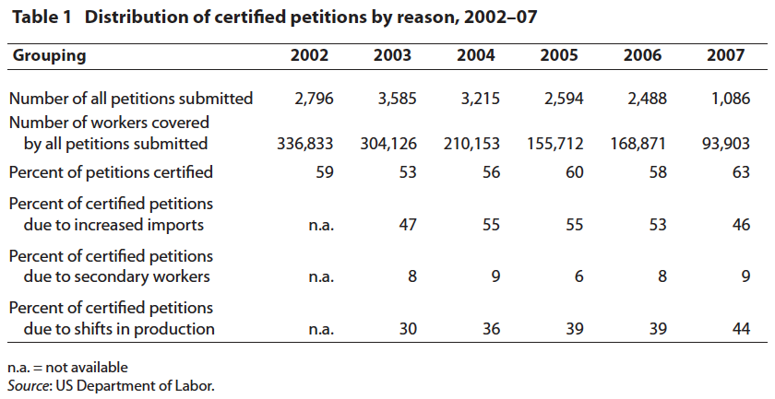
Notes:
Rosen, Howard F., “Strengthening Trade Adjustment Assistance,” Policy Brief No. PB08-2, Peterson Institute for International Economics, January 2008.
https://piie.com/publications/policy-briefs/strengthening-trade-adjustment-assistance

Slide 12
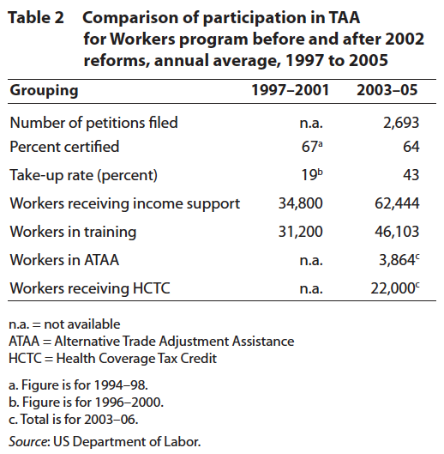
Notes:
Rosen, Howard F., “Strengthening Trade Adjustment Assistance,” Policy Brief No. PB08-2, Peterson Institute for International Economics, January 2008.
https://piie.com/publications/policy-briefs/strengthening-trade-adjustment-assistance

Slide 13
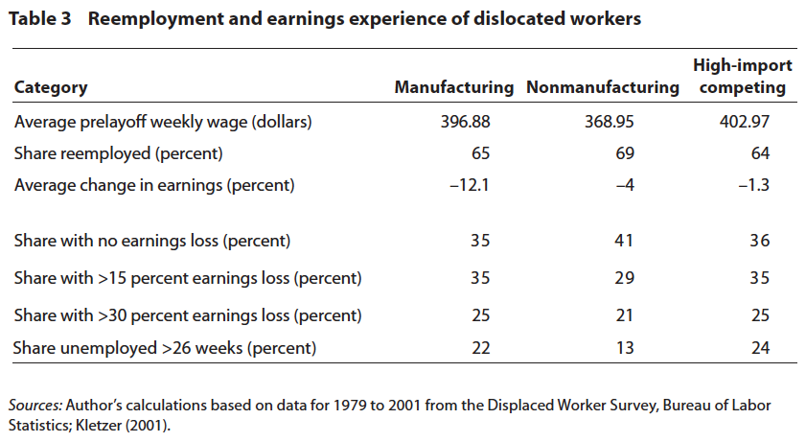
Notes:
Rosen, Howard F., “Strengthening Trade Adjustment Assistance,” Policy Brief No. PB08-2, Peterson Institute for International Economics, January 2008.
https://piie.com/publications/policy-briefs/strengthening-trade-adjustment-assistance

Slide 14
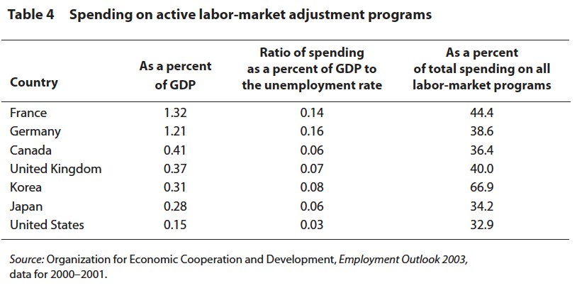
Notes:
Rosen, Howard F., “Strengthening Trade Adjustment Assistance,” Policy Brief No. PB08-2, Peterson Institute for International Economics, January 2008.
https://piie.com/publications/policy-briefs/strengthening-trade-adjustment-assistance

