Slide 1
Class 24
Economic Sanctions by
Alan V. Deardorff
University of Michigan
2023
PubPol/Econ 541

Slide 2
FROM REQUIRED READINGS

Slide 3
Masters, Jonathan, “What Are Economic Sanctions?” Backgrounder, Council on Foreign Relations, August 12, 2019.

Slide 4
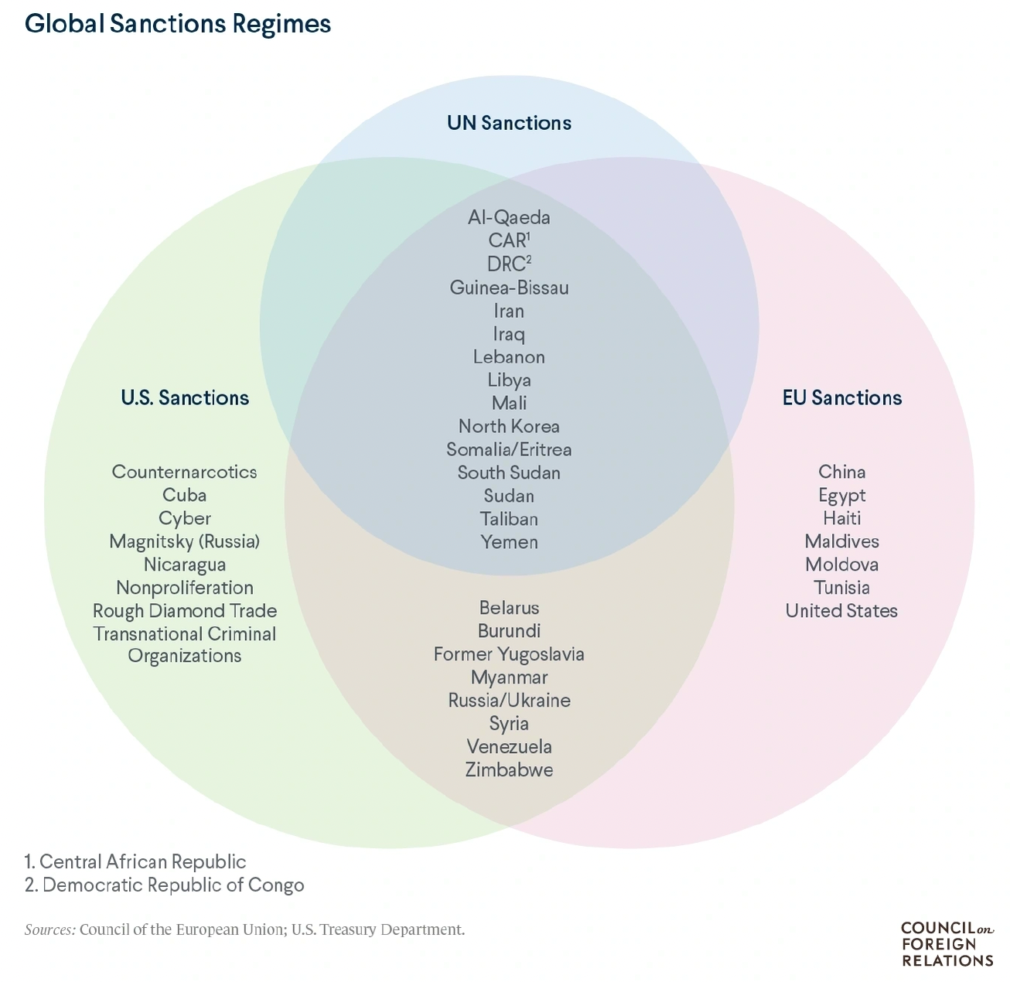
Notes:
Masters, Jonathan, “What Are Economic Sanctions?” Backgrounder, Council on Foreign Relations, August 12, 2019. 12 pp.
https://www.cfr.org/backgrounder/what-are-economic-sanctions

Slide 5
Mulder, Nicholas, “The Sanctions Weapon,” Finance and Development, June 2022, pp. 20-23.

Slide 6
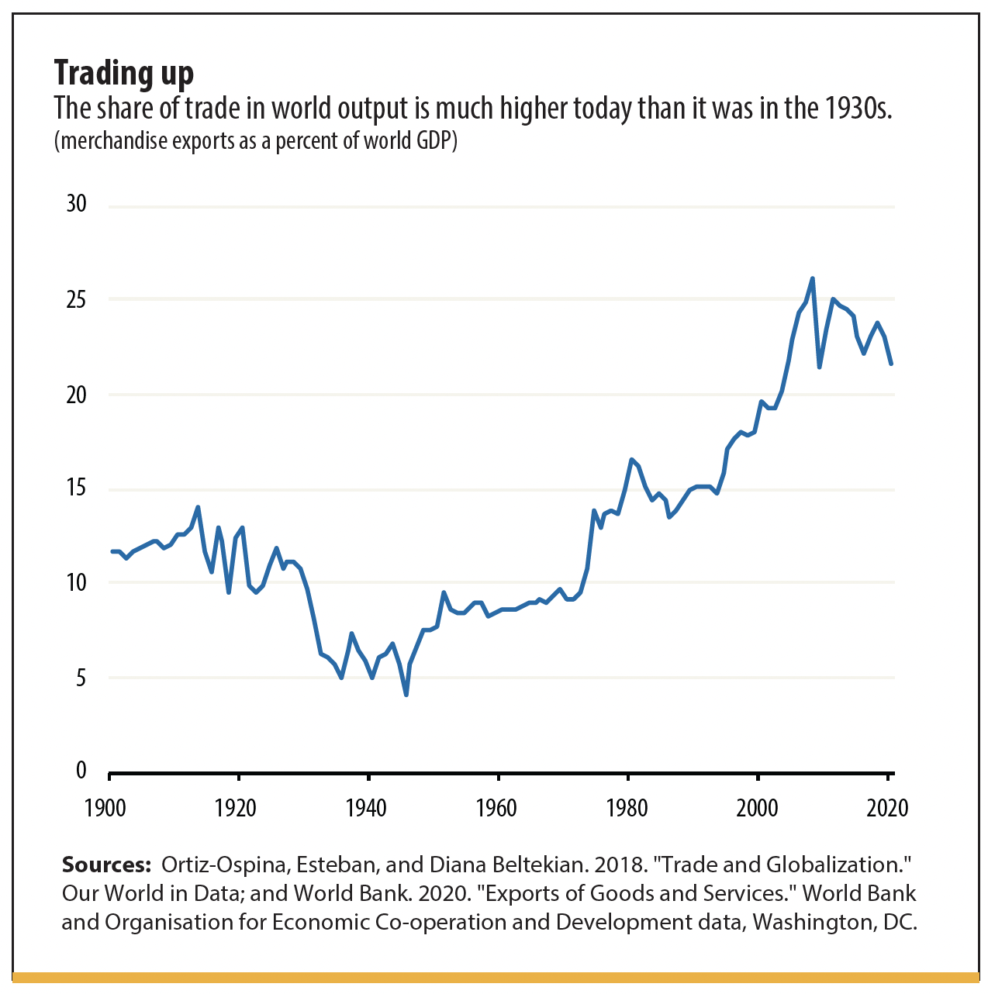
Notes:
Mulder, Nicholas, “The Sanctions Weapon,” Finance and Development, June 2022, pp. 20-23. 4 pp.
https://www.imf.org/en/Publications/fandd/issues/2022/06/the-sanctions-weapon-mulder

Slide 7
Kantchev, Georgi, Paul Hannon, and Laurence Norman, "How Sanctioned Western Goods Are Still Flowing Into Russia," Wall Street Journal, May 14, 2023.
Notes:
Kantchev, Georgi, Paul Hannon, and Laurence Norman, "How Sanctioned Western Goods Are Still Flowing Into Russia," Wall Street Journal, May 14, 2023. [7 Pp]
https://www.wsj.com/articles/how-sanctioned-western-goods-are-still-flowing-into-russia-916db262

Slide 8
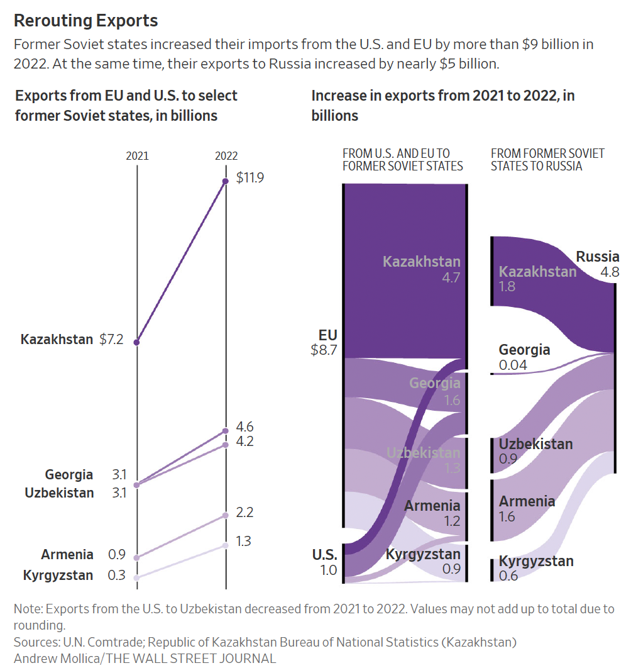
Notes:
Kantchev, Georgi, Paul Hannon, and Laurence Norman, "How Sanctioned Western Goods Are Still Flowing Into Russia," Wall Street Journal, May 14, 2023. [7 Pp]
https://www.wsj.com/articles/how-sanctioned-western-goods-are-still-flowing-into-russia-916db262

Slide 9
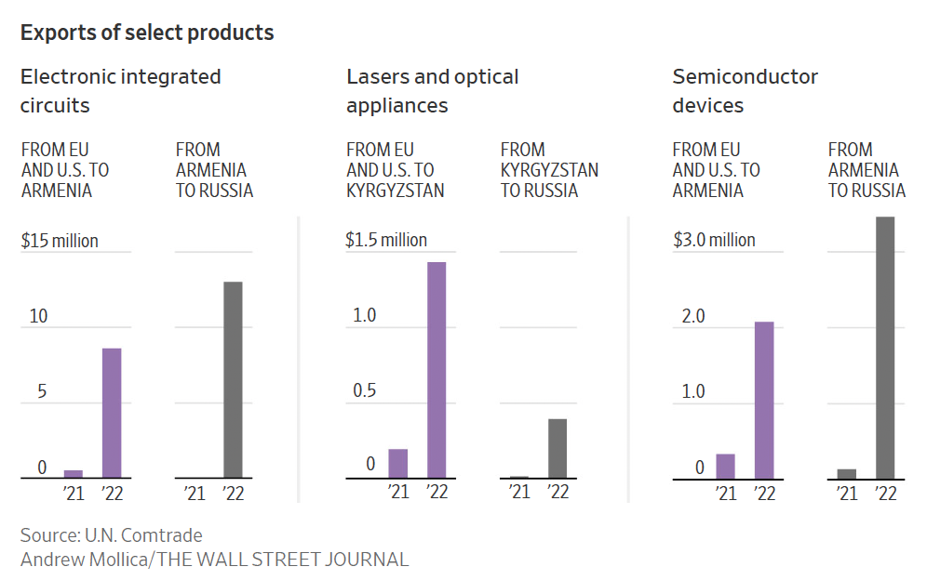
Notes:
Kantchev, Georgi, Paul Hannon, and Laurence Norman, "How Sanctioned Western Goods Are Still Flowing Into Russia," Wall Street Journal, May 14, 2023. [7 Pp]
https://www.wsj.com/articles/how-sanctioned-western-goods-are-still-flowing-into-russia-916db262

Slide 10
FROM OPTIONAL READINGS

Slide 11
Elliott, Kimberly Ann, “Evidence on the Costs and Benefits of Economic Sanctions,” October 23, 1997,

Slide 12
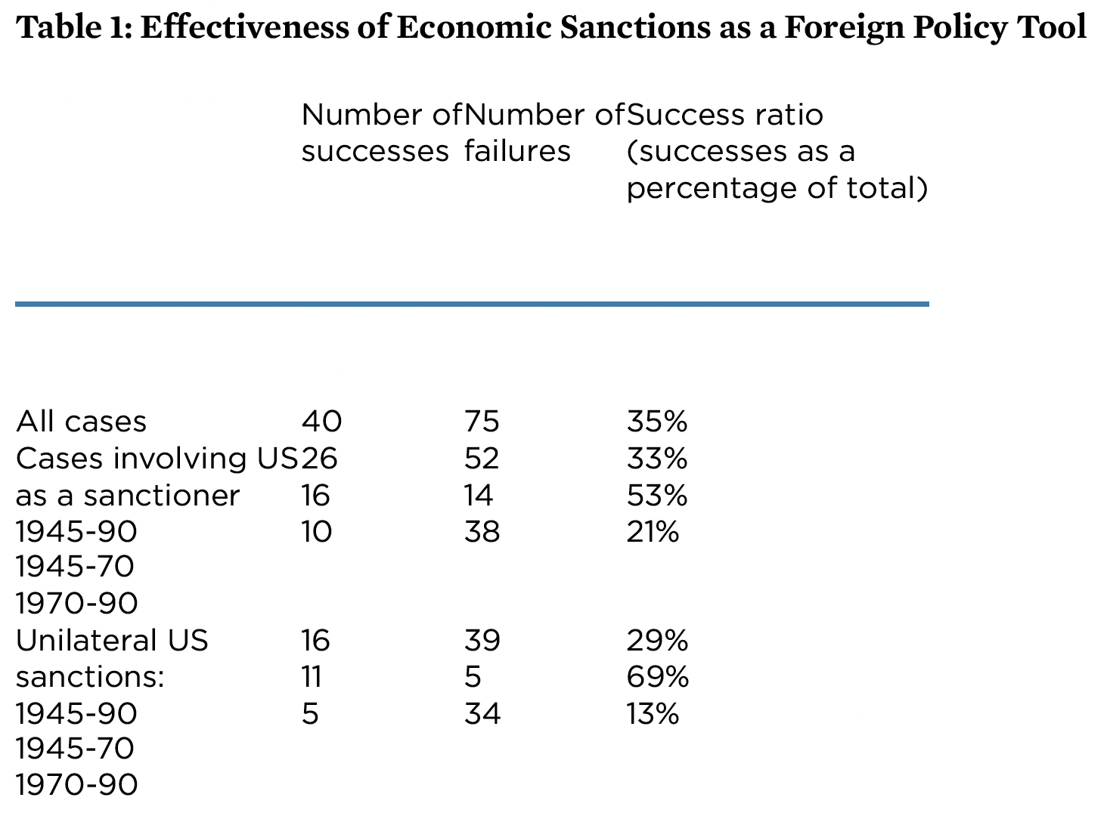
Notes:
Elliott, Kimberly Ann, “Evidence on the Costs and Benefits of Economic Sanctions,” Speech given before the Subcommittee on Trade Committee on Ways and Means United States House of Representatives Washington, DC, October 23, 1997, Peterson Institute for International Economics. 6 pp.
https://www.piie.com/commentary/testimonies/evidence-costs-and-benefits-economic-sanctions

Slide 13
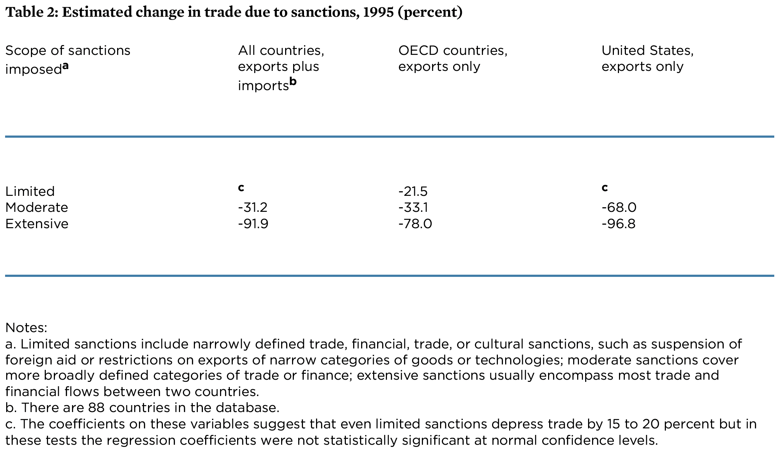
Notes:
Elliott, Kimberly Ann, “Evidence on the Costs and Benefits of Economic Sanctions,” Speech given before the Subcommittee on Trade Committee on Ways and Means United States House of Representatives Washington, DC, October 23, 1997, Peterson Institute for International Economics. 6 pp.
https://www.piie.com/commentary/testimonies/evidence-costs-and-benefits-economic-sanctions

