Slide 1
Class 25
Subsidies and Countervailing Duties by
Alan V. Deardorff
University of Michigan
2023
PubPol/Econ 541

Slide 2
FROM REQUIRED READINGS

Slide 3
Chazan, Guy, Sam Fleming, and Kana Inagaki, "A global subsidy war? Keeping up with the Americans," Financial Times, July 13, 2023.

Slide 4
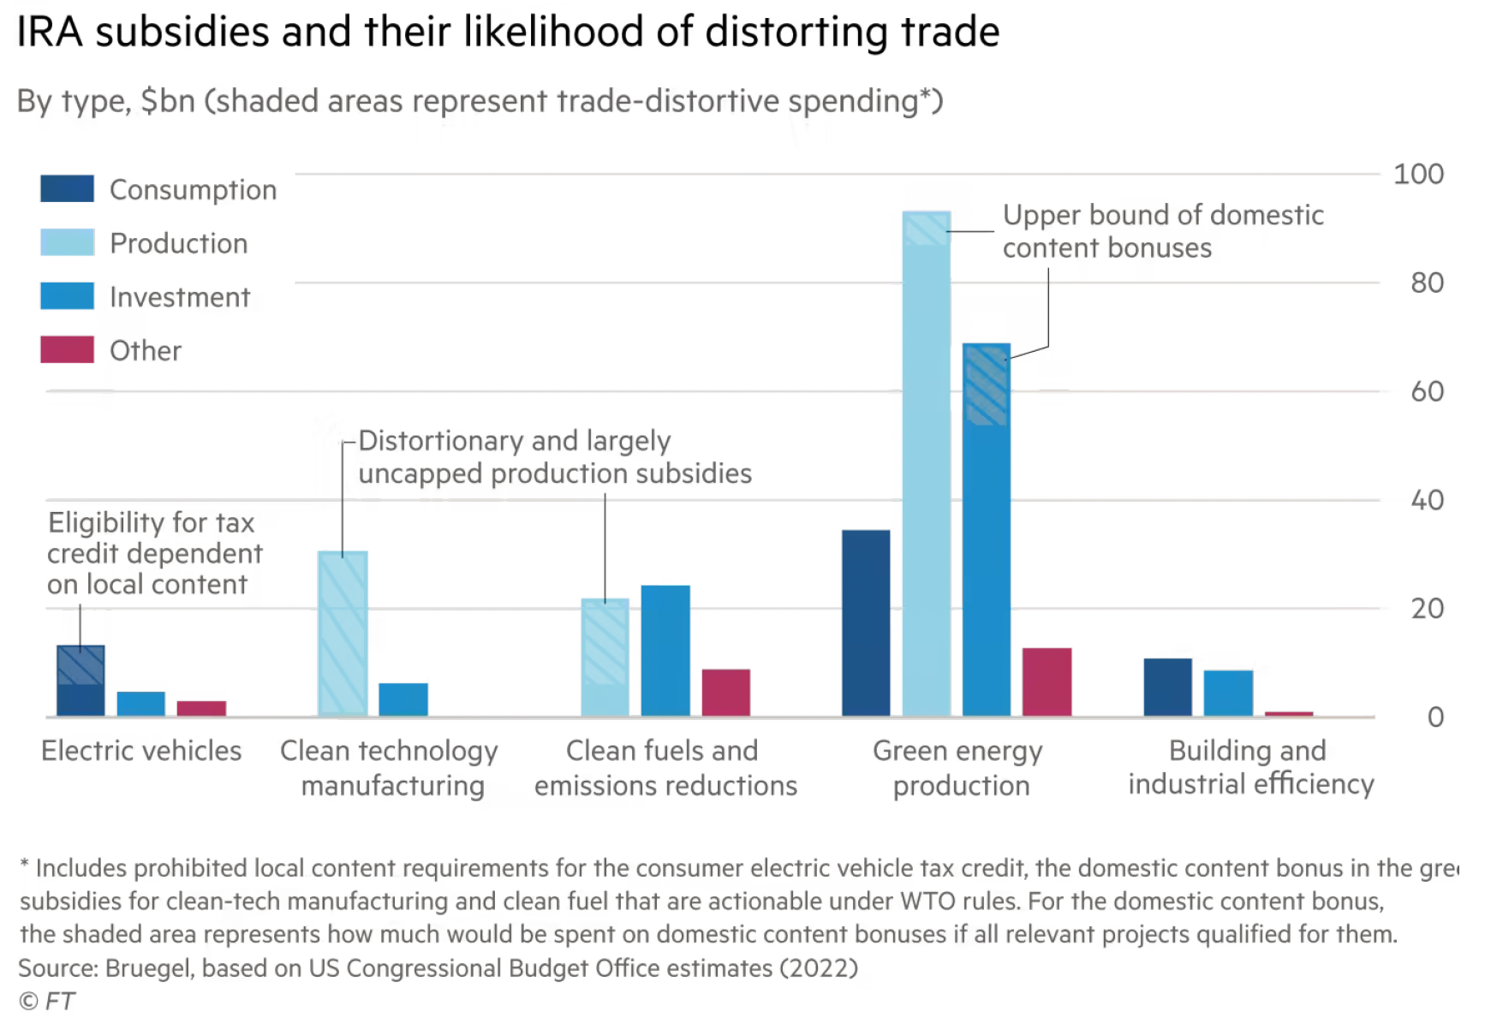
Notes:
Chazan, Guy, Sam Fleming, and Kana Inagaki, "A global subsidy war? Keeping up with the Americans," Financial Times, July 13, 2023.
https://www.ft.com/content/4bc03d4b-6984-4b24-935d-6181253ee1e0

Slide 5
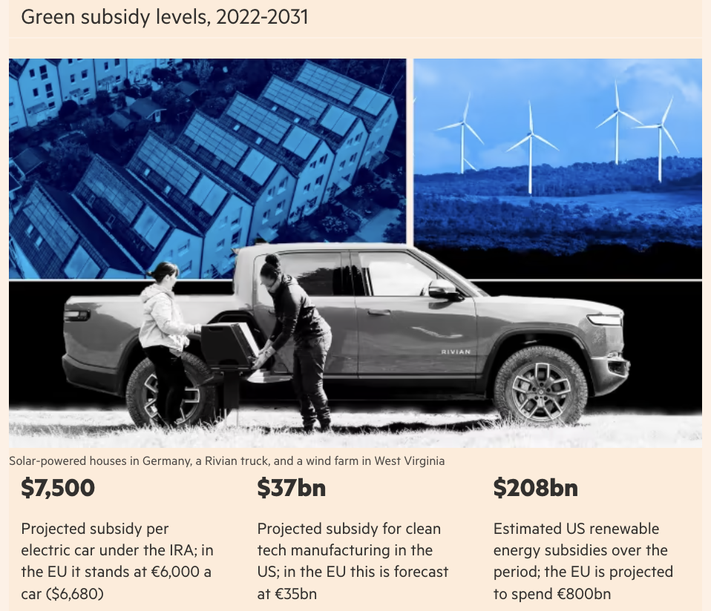
Notes:
Chazan, Guy, Sam Fleming, and Kana Inagaki, "A global subsidy war? Keeping up with the Americans," Financial Times, July 13, 2023.
https://www.ft.com/content/4bc03d4b-6984-4b24-935d-6181253ee1e0

Slide 6
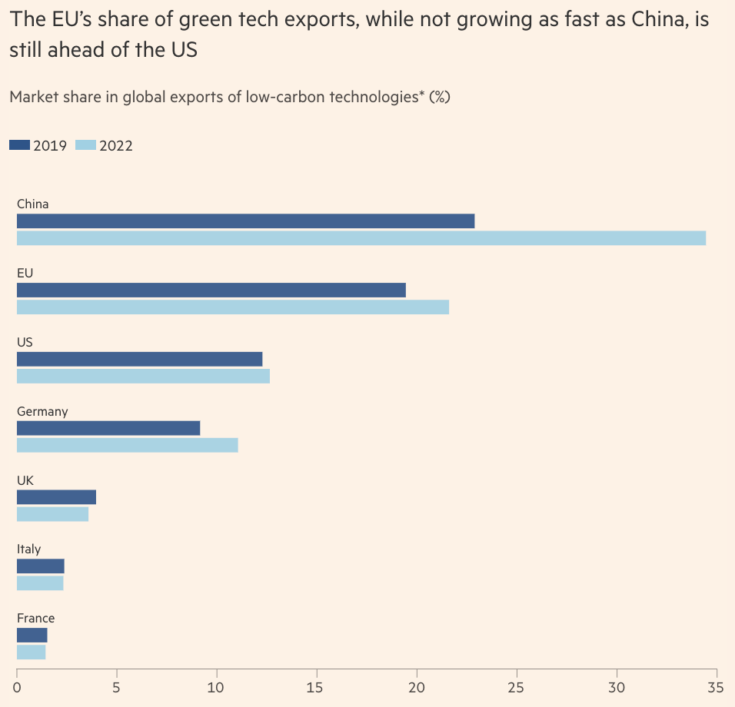
Notes:
Chazan, Guy, Sam Fleming, and Kana Inagaki, "A global subsidy war? Keeping up with the Americans," Financial Times, July 13, 2023.
https://www.ft.com/content/4bc03d4b-6984-4b24-935d-6181253ee1e0

Slide 7
Reading

Slide 8
FROM OPTIONAL READINGS

Slide 9
Evenett, Simon and Gary C. Hufbauer, "Are the IRA climate-related tax credits a trillion-dollar problem?" Zeitgeist Series, Briefing #9, Global Trade Alert, July 24, 2023

Slide 10
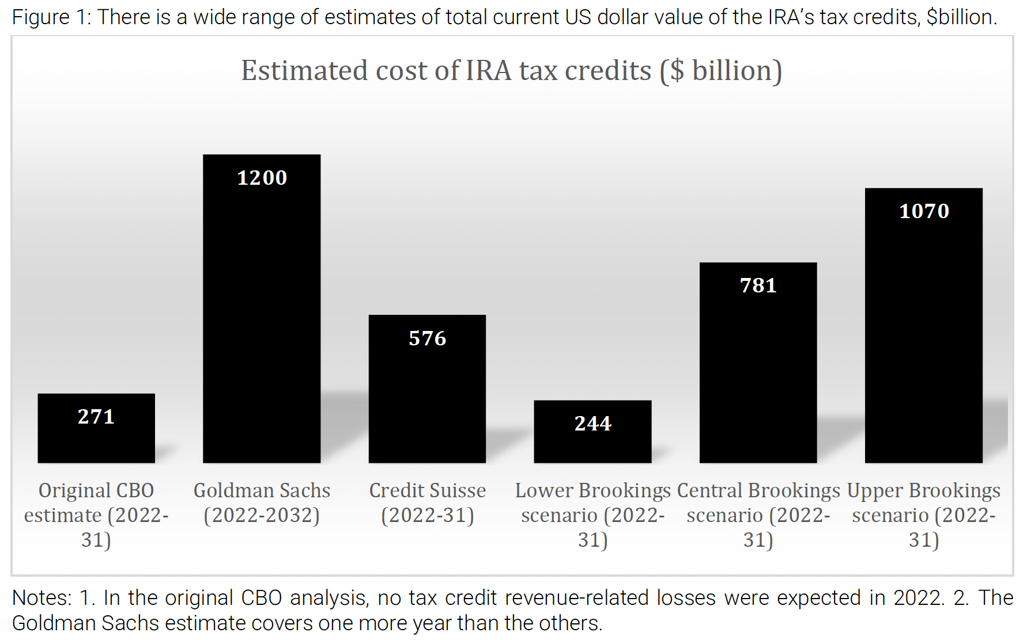
Notes:
Evenett, Simon and Gary C. Hufbauer, "Are the IRA climate-related tax credits a trillion-dollar problem?" Zeitgeist Series, Briefing #9, Global Trade Alert, July 24, 2023
https://www.globaltradealert.org/reports/download/115#:~:text=No%20surprise%2C%20then%2C%20that%20the,of%20US%20GDP%20in%202022.

Slide 11
Reading

