Slide 1
Class 25
Subsidies and Countervailing Duties by
Alan V. Deardorff
University of Michigan
2023
PubPol/Econ 541

Slide 2
Announcements
Paper #3
  Is due Wednesday at start of class, 8:30 AM, Dec 6
  I am still available to answer questions
    At today’s office hour 10-11
    By email
    Meet with your group by zoom

Slide 3
Announcements
Quiz #12
 | Q10 | Q11 | Q12
Mean | 7.63 | 8.53 | 8.57
Median | 7 | 9.5 | 9
Max | 10 | 10 | 10
Min | 3 | 4.5 | 5.5
S.D. | 2.07 | 1.73 | 1.47

Slide 4
Announcements
Quiz #13
  Available from 10:00 AM today.
  Due by Friday 12/8 midnight,
  Accepted until Saturday 12/9 midnight with 1 point penalty
  Covers material from today only (Subsidies and Countervailing Duties)

Slide 5
Announcements
This is NOT our last class together
Class this Wednesday, Dec 6:
  No required reading
  Class will be review and discussion
    What have you learned from this course?
    What would you still like to know?

Slide 6
Announcements
Course evaluations
  Please do them
  Due by Thursday, Dec 7
  Only 5 of 15 had done them as of 5:00 PM yesterday

Slide 7
Subsidies and
Countervailing Duties
Subsidies are assistance provided by government to firms or industries
Here they will take the simple form of a fixed $ payment per unit of output or per unit of export
  In practice they are seldom that simple
Countervailing duties (CVDs) are permitted by the GATT/WTO under specified circumstances

Slide 8
Pause for Discussion

Slide 9
  Questions on Jackson Ch. 11
Why does Jackson view the issue of subsidies as “perplexing”?
In what ways can a subsidy have international effects – that is, effects on other countries? (Jackson lists three.)
What is meant by the three colored “baskets” or “boxes” of subsidies?
What is the importance of “specificity” and “general availability” in the context of subsidies?

Slide 10
Outline
“Unjustified” Subsidies
  Effects of subsidies
    Export
    Production by Small Country
    Production in 2-country world
  Effects of CVDs
“Justified” Subsidies
Subsidies with Imperfect Competition
Recent subsidy issues

Slide 11
Categories of Subsidies
There are several ways of categorizing subsidies
  Export versus domestic (=production)
  Direct versus indirect
  Trade distorting versus not
  “Justified” versus “unjustified”
I’ll use the latter term:
  “Justified” means being used appropriately to correct a distortion
  “Unjustified” is any other

Slide 12
Outline
“Unjustified” Subsidies
  Effects of subsidies
    Export
    Production by Small Country
    Production in 2-country world
  Effects of CVDs
“Justified” Subsidies
Subsidies with Imperfect Competition
Recent subsidy issues

Slide 13
Export Subsidy
Export Market
P^{X}
The export subsidy, s per unit of the good exported, gives exporters price P₁^{X} which is larger than what foreign importers pay, P₁^{M}, by the amount s.
Home price (inc. subsidy) rises
Foreign price falls
Exports rise
S^{X}
P₁^{X}
a
b
P₀^{X}
c
s
f
e
d
P₁^{M}
Welfare effects
Dom. private gains +(a+b)
Dom. govt loses –(a+b+c+d+e+f)
Dom. cty loses –(c+d+e+f)
For. private gains +(d+e+f)
World loses –c
D^{X}
Q₀^{X}
Q₁^{X}
Q^{X}
=
“Dead Weight Loss”

Slide 14
Pause for Discussion

Slide 15
  Questions on KOM, Ch 9
Can an export subsidy benefit the country that uses it (in perfect competition)? If so, how? If not, why not?
Why does the text say that an export subsidy has effects that are “exactly the reverse of those of a tariff,” given that the export subsidy raises the domestic price above the world price and (if the country is large) pushes down the world price?

Slide 16
Outline
“Unjustified” Subsidies
  Effects of subsidies
    Export
    Production by Small Country
    Production in 2-country world
  Effects of CVDs
“Justified” Subsidies
Subsidies with Imperfect Competition
Recent subsidy issues

Slide 17
Production Subsidy,
Small Country Importer
b
P
The production subsidy, s per unit, gives suppliers s in addition to the world price, P^{W}. Demanders can still buy at P^{W}.
Output rises
Imports fall
S
P^{W}+s
a
s
b
P^{W}
Welfare effects
Suppliers gain +a
Demanders 0
Govt loses –(a+b)
Cty loses –b
M₁
M₀
D
S₀
S₁
D₀
=D₁
Q^{X}
“Dead Weight Loss” =

Slide 18
Production Subsidy,
Small Country Exporter
b
P
The production subsidy, s per unit, gives suppliers s in addition to the world price, P^{W}. Demanders can still buy at P^{W}.
Output rises
Exports rise
D
S
P^{W}+s
a
b
c
s
P^{W}
Welfare effects
Suppliers gain +(a+b)
Demanders 0
Govt loses –(a+b+c)
Cty loses –c
X₁
X₀
D₀
=D₁
S₀
S₁
Q^{X}
“Dead Weight Loss” =

Slide 19
Outline
“Unjustified” Subsidies
  Effects of subsidies
    Export
    Production by Small Country
    Production in 2-country world
  Effects of CVDs
“Justified” Subsidies
Subsidies with Imperfect Competition
Recent subsidy issues

Slide 20
Production Subsidy,
Large Country Importer
A
Dom Mkt
Trade
B
Dom Mkt
P^{A}
P
XS^{B}
P
s
D^{B}
S^{B}
P₀
P₀
P₀
P₁
P₁
P₁
S^{A}
S^{A}’
D^{A}
D^{B}
MD^{A}’
MD^{A}
Q
Q
Q
The subsidy, s, is here most simply thought of as reducing the cost of suppliers in A and thus shifting its supply curve down by the amount s
This causes A’s import demand curve to shift to the left.
The world price falls from P₀ to P₁.

Slide 21
Production Subsidy,
Large Country Importer
A
Dom Mkt
Trade
B
Dom Mkt
P^{A}
P
XS^{B}
P
s
D^{B}
S^{B}
P₀
P₀
P₀
P₁
P₁
P₁
S^{A}
D^{A}
S^{A}’
D^{B}
MD^{A}
Q
Q
Q
Results:
A: Supply and demand both rise
B: Demand rises; supply falls
Quantity traded – export and import – falls

Slide 22
Production Subsidy,
Large Country Importer
A
Dom Mkt
Trade
B
Dom Mkt
P^{A}
P
XS^{B}
P
s
D^{B}
S^{B}
P₀
P₀
P₀
P₁
P₁
P₁
S^{A}
D^{A}
S^{A}’
D^{B}
MD^{A}
Q
Q
Q
Welfare of Country B:
Demanders gain
Suppliers lose
So country B loses
Note that B’s loss also appears in A as

Slide 23
Production Subsidy,
Large Country Importer
A
Dom Mkt
Trade
B
Dom Mkt
P^{A}
P
XS^{B}
P
s
D^{B}
S^{B}
P₀
P₀
P₀
P₁
P₁
P₁
S^{A}
D^{A}
S^{A}’
D^{B}
MD^{A}
Q
Q
Q
Welfare of Country A:
Suppliers gain
Demanders gain
Government loses
So country A gains but loses
Result:
Large importer may (but need not) gain from subsidy
Why? Improves terms of trade

Slide 24
Production Subsidy,
Large Country Importer
“Dead Weight Loss” =
A
Dom Mkt
Trade
B
Dom Mkt
P^{A}
P
XS^{B}
P
s
D^{B}
S^{B}
P₀
P₀
P₀
P₁
P₁
P₁
S^{A}
D^{A}
S^{A}’
D^{B}
MD^{A}
Q
Q
Q
Welfare of Country A:
Suppliers gain
Demanders gain
Government loses
So country A gains but loses
Deducting the loss for Country B
World loses

Slide 25
Pause for Discussion

Slide 26
  Questions (Not asked before)
We didn’t look at a production subsidy for an exporter. (You should be able to do it yourself now.) How would you expect it to differ from the case of an importer?

Slide 27
Outline
“Unjustified” Subsidies
  Effects of subsidies
    Export
    Production by Small Country
    Production in 2-country world
  Effects of CVDs
“Justified” Subsidies
Subsidies with Imperfect Competition
Recent subsidy issues

Slide 28
CVD and Export Subsidy
Export Market
P^{W}
The export subsidy, s, shifts the export supply curve down by the amount s
This lowers the world price to P₁^{W} and increases quantity traded to Q₁
The CVD is a tariff, t, equal to the subsidy, which shifts the demand curve for imports down by t
Quantity traded returns to Q₀
World price is now below its initial level by t=s. But domestic prices in both countries are returned to P₀^{W}
Thus the only effect of the combined s&t is a transfer of s×Q₀ from the exporting government to the importing government
S^{X}
s=t
S^{X}’
P₀^{W}
s
P₁^{W}
P₂^{W}
D^{M}
D^{M}’
Q₀
Q₁
Q
Q²=Q₀

Slide 29
Pause for Discussion

Slide 30
  Questions on Jackson Ch. 11
How are export subsidies handled in the WTO? Why does Jackson suggest that perhaps importing countries should be required to levy countervailing duties against export subsidies?

Slide 31
Outline
“Unjustified” Subsidies
  Effects of subsidies
    Export
    Production by Small Country
    Production in 2-country world
  Effects of CVDs
“Justified” Subsidies
Subsidies with Imperfect Competition
Recent subsidy issues

Slide 32
“Justified” Subsidies
The only example I will consider here is a positive external economy, E, per unit of a good produced (you should try others)
It is well understood that in a closed economy the optimal policy is a production subsidy s=E
The question here will be how this affects an open economy and its trading partners

Slide 33
External Economy in Autarky
The externality means that the social cost of this good is less than the private cost by E per unit, so the marginal social cost is shown by S–E
Therefore the optimal output is Q₁
A subsidy, s=E, shifts the supply curve down to coincide with S–E and raises output to the optimum
Welfare
Demanders +(e+f+g)
Suppliers +(a+b+c)
Gov’t –(a+b+c+d+e+f+g)
Externality +(c+d+e)
Country +(c+e) = +d
Domestic Market
P
S
P₁+s
E
a
b
c
d
S–E
P₀
s
g
f
e
P₁
D
Q₀
Q₁
Q^{X}

Slide 34
External Economy & Subsidy in Small Importer
Domestic Market
P
S
Subsidy s = E shifts supply down by s to match S-E
Supply rises
Demanders still face P^{W} so demand does not change
Imports fall
E
S–E
P₁=P^{W}+s
s
a
b
P₀=P^{W}
Welfare
Demanders 0
Suppliers +a
Gov’t –(a+b)
Externality +(b+c)
Country +c
c
M₀
D
M₁
S₀
S₁
D₀
Q

Slide 35
External Economy & Subsidy in Large Importer
Domestic Market
P
S
The same figure shows what will happen for a given world price for a large country
The decline in imports means that world demand shifts down, reducing world price (not shown)
This (also not shown) causes additional gain for the importer and loss to the rest of world
E
S–E
P₁=P^{W}+s
s
a
b
P₀=P^{W}
c
M₀
D
M₁
S₀
S₁
D₀
Q

Slide 36
External Economy & Subsidy in Small Exporter
Domestic Market
P
D
S
The analysis is essentially the same for an exporter, except that now exports rise
E
=s
P₁=P^{W}+s
S–E
a
b
c
P₀=P^{W}
Welfare
Demanders 0
Suppliers +(a+b)
Gov’t –(a+b+c)
Externality +(c+d)
Country +d
d
X₀
X₁
D₀
S₀
S₁
Q

Slide 37
External Economy & Subsidy in Large Exporter
Domestic Market
P
Again, the same figure shows what will happen for a given world price for a large country
The rise in exports now means that world supply shifts out, again reducing world price
But this causes offsetting loss for the exporter and gain for the rest of world
D
S
E
=s
P₁=P^{W}+s
S–E
a
b
c
P₀=P^{W}
d
X₀
X₁
D₀
S₀
S₁
Q

Slide 38
Pause for Discussion

Slide 39
  Questions (Not asked before)
Do justified subsidies (based on the analysis here) always hurt or always help the rest of world?

Slide 40
Outline
“Unjustified” Subsidies
  Effects of subsidies
    Export
    Production by Small Country
    Production in 2-country world
  Effects of CVDs
“Justified” Subsidies
Subsidies with Imperfect Competition
Recent subsidy issues

Slide 41
Imperfect Competition
Strategic Trade Policy: Boeing-Airbus Game
P=produce, N=not produce
No subsidy,
Equil. If Boeing moves first,
since now Airbus will not enter
 |  | Airbus
 |  | P |  | N
Boeing | P |  | −5 |  | 0
 |  | −5 |  | 100
 | N |  | 100 |  | 0
 |  | 0 |  | 0
Boeing choice: depends on Airbus
Payoff Matrix

Slide 42
Imperfect Competition
Strategic Trade Policy: Boeing-Airbus Game
P=produce, N=not produce
No subsidy, Airbus Subsidy = +10
 |  | Airbus
 |  | P |  | N
Boeing | P |  | −5 (+5) |  | 0
 |  | −5 |  | 100
 | N |  | 100 (110) |  | 0
 |  | 0 |  | 0
Now Airbus choice does not depend on Boeing

Slide 43
Imperfect Competition
Strategic Trade Policy: Boeing-Airbus Game
P=produce, N=not produce
No subsidy, Airbus Subsidy = +10
Equil. With no subsidy if Boeing moves first
 |  | Airbus
 |  | P |  | N
Boeing | P |  | −5 (+5) |  | 0
 |  | −5 |  | 100
 | N |  | 100 (110) |  | 0
 |  | 0 |  | 0
Equil. with subsidy and exit

Slide 44
Imperfect Competition
Boeing-Airbus Game results
  If Boeing moves first, without subsidy Airbus will not enter
    Boeing and US gain +100
    Airbus and EU gain 0
  If EU pays subsidy, Airbus will enter and Boeing will exit
    Airbus gains 110, EU gains 100 (=100-10)
    Boeing and US gain 0
  Thus EU gains and US loses from EU subsidy

Slide 45
Imperfect Competition
But note caveats: These arguments are not likely to be usable:
    Empirical difficulties: Hard to know where to intervene
    Entry: Benefits will be dissipated by new firms
    General equilibrium: Help in some sectors hurts others
    Retaliation: Other countries may react
    Political economy: Industries lobby for help

Slide 46
Pause for Discussion

Slide 47
  Questions on KOM
In the Boeing-Airbus example, Airbus benefits from the subsidy. Is that all that is needed for the example to be a valid basis for a subsidy?
The textbook warns that correctly using the Brander-Spencer analysis as the basis for an export subsidy relies on getting the numbers right. Where would a government go to learn these numbers? Is that a problem?

Slide 48
  Questions on Hollinger, “Airbus and Boeing subsidy battle far from over”
What did Airbus and Boeing object to with regard to the other company?
Does this agreement end those actions that each objected to? If not, what does it do?
How had the WTO dealt with this dispute?
What are Airbus and Boeing probably more worried about than each other?

Slide 49
Outline
“Unjustified” Subsidies
  Effects of subsidies
    Export
    Production by Small Country
    Production in 2-country world
  Effects of CVDs
“Justified” Subsidies
Subsidies with Imperfect Competition
Recent subsidy issues

Slide 50
Recent subsidy issues
EU puts tariff on “glass fiber fabrics” from Egypt, based on China’s subsidy
EU and China reach agreement on investment, but without addressing subsidies

Slide 51
Pause for Discussion

Slide 52
  Questions on Stearns, “EU Challenges China’s Trade Expansion”
Why is this a “landmark tariff”?
What product is subject to the tariff, from where into where, and what is the size and duration of the tariff?
Might more such tariffs be used in the future?

Slide 53
Recent subsidy issues
US started a “subsidy war” with subsidies for clean energy and technology
  Especially electric vehicles
EU and others are responding with their own subsidies
US subsidies are more trade distorting than our model:
  They are conditional on firms getting inputs from US, North America, or US FTA partners

Slide 54
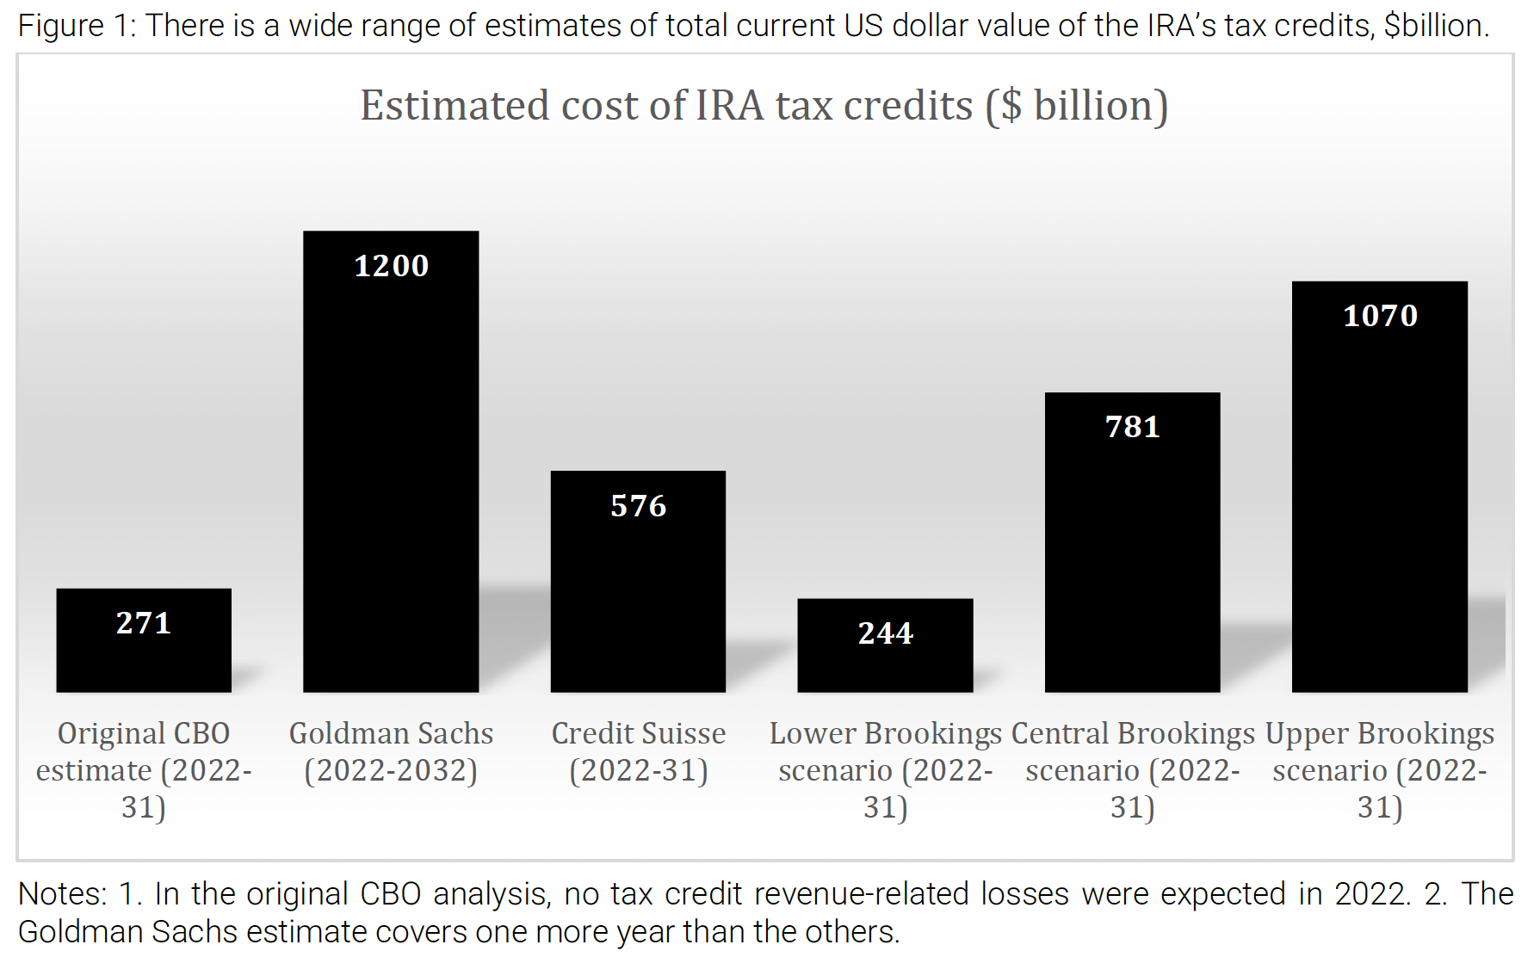
Notes:
Evenett, Simon and Gary C. Hufbauer, "Are the IRA climate-related tax credits a trillion-dollar problem?" Zeitgeist Series, Briefing #9, Global Trade Alert, July 24, 2023
https://www.globaltradealert.org/reports/download/115#:~:text=No%20surprise%2C%20then%2C%20that%20the,of%20US%20GDP%20in%202022.

Slide 55
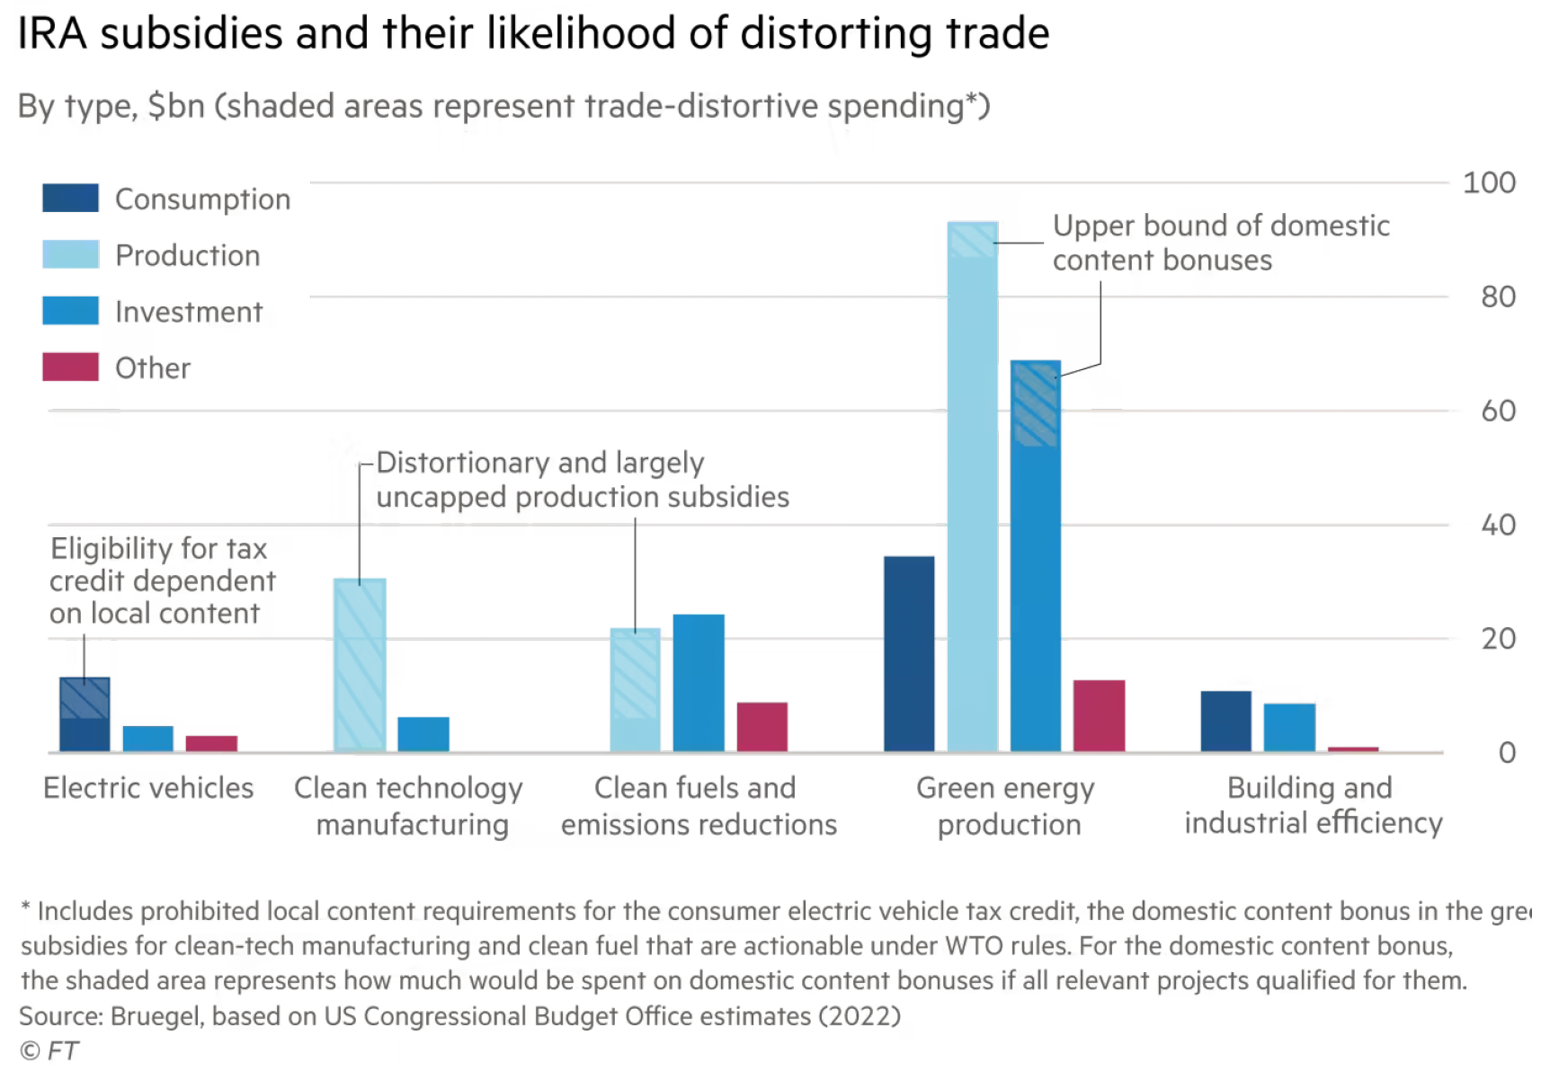
Notes:
Chazan, Guy, Sam Fleming, and Kana Inagaki, "A global subsidy war? Keeping up with the Americans," Financial Times, July 13, 2023.
https://www.ft.com/content/4bc03d4b-6984-4b24-935d-6181253ee1e0

Slide 56
Recent subsidy issues
US electric car subsidies (see optional reading by Baschuk)
  “Consumers can claim as much as $7,500 in federal tax credits if they purchase a clean-energy vehicle that satisfies certain US rules regarding critical minerals and battery components.”
  “Countries eligible for exemptions because they have FTAs with the US:
    Canada, Mexico, Japan, South Korea
    NOT EU

Slide 57
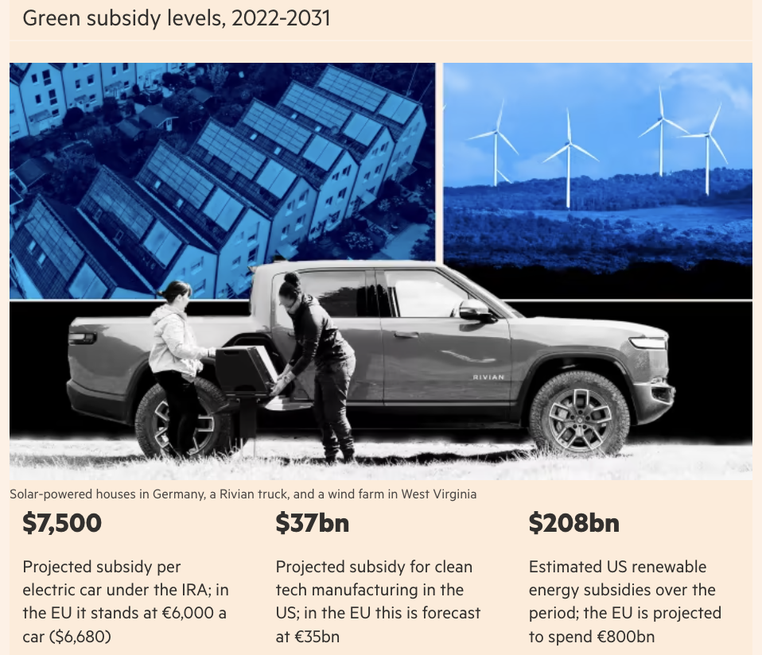
Notes:
Chazan, Guy, Sam Fleming, and Kana Inagaki, "A global subsidy war? Keeping up with the Americans," Financial Times, July 13, 2023.
https://www.ft.com/content/4bc03d4b-6984-4b24-935d-6181253ee1e0

Slide 58
Pause for Discussion

Slide 59
  Questions on Chazan et al.,
  “A global subsidy war?”
What are the two pieces of legislation in the US that are at the heart of this subsidy war?
What are the motives for these acts, according to the US and to others?
How are EU, Japan, and South Korea responding to this?

