Slide 1
Class 26
Last Class by
Alan V. Deardorff
University of Michigan
2022
PubPol/Econ 541

Slide 2
Announcements
Quiz #13
  Due by Friday 12/8 midnight,
  Accepted until Saturday 12/9 midnight with 1 point penalty
  Covers material from Monday only (Subsidies and Countervailing Duties)

Slide 3
Announcements
Course evaluations
  Please do them
  Due by tomorrow, Thursday
  So far I have
    Only 5

Slide 4
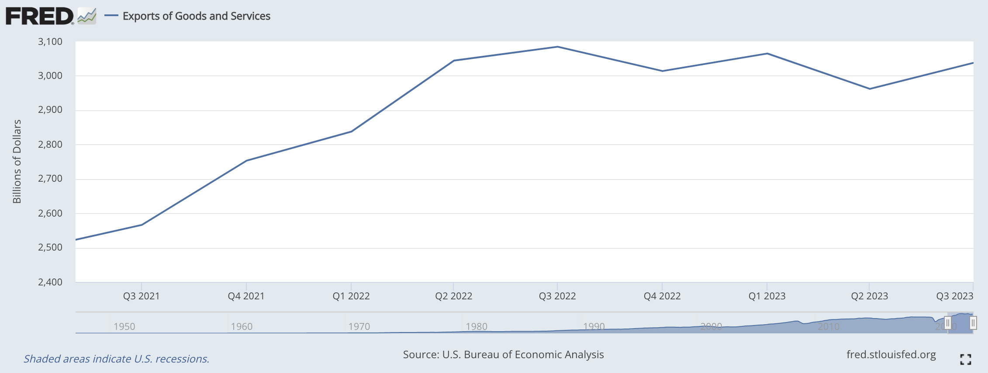
Recent Data: US Exports
Fred 12/5
Notes:
https://www.ft.com/content/b9dde56c-38c2-42c6-8cd3-49cf4c0d4735

Slide 5
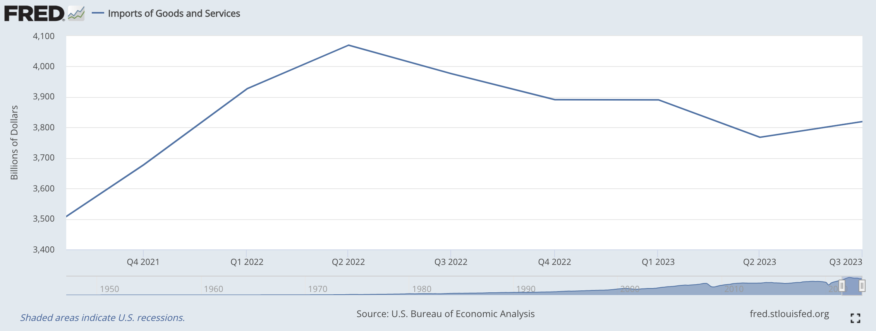
Recent Data: US Imports
Fred 12/5
Notes:
https://www.ft.com/content/b9dde56c-38c2-42c6-8cd3-49cf4c0d4735

Slide 6
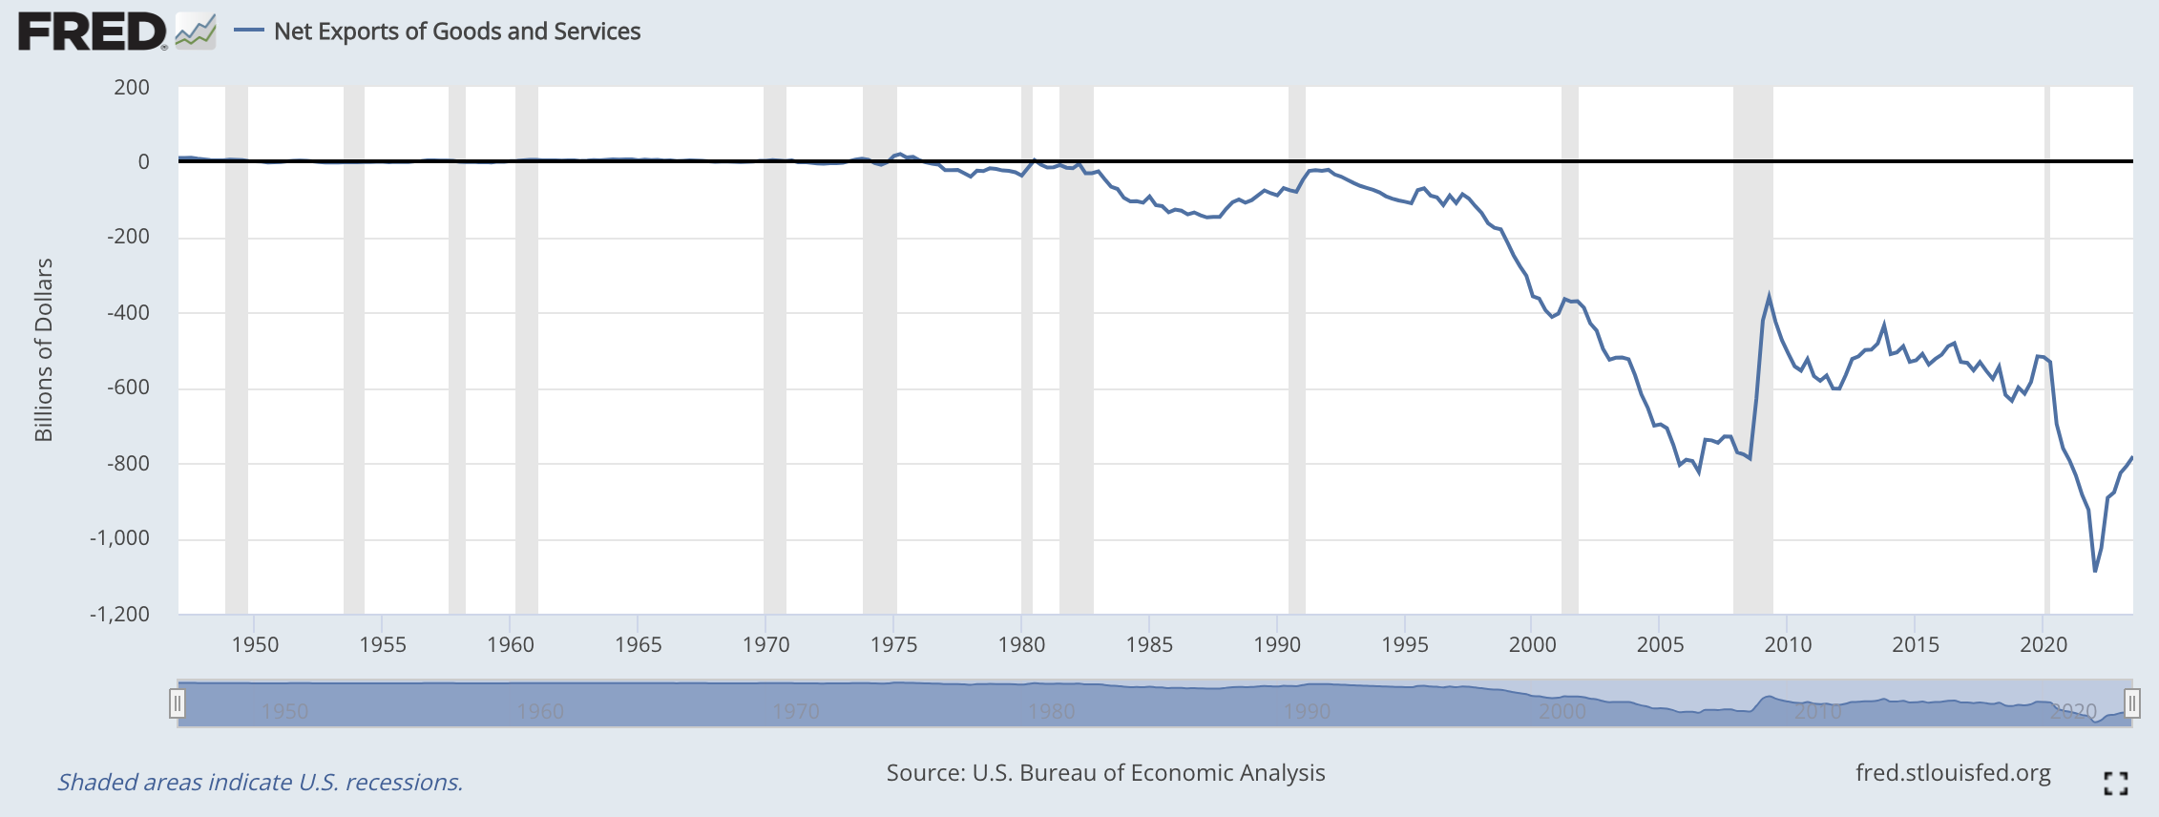
Recent Data: US Net Exports
Fred 12/5
Notes:
https://www.ft.com/content/b9dde56c-38c2-42c6-8cd3-49cf4c0d4735

Slide 7
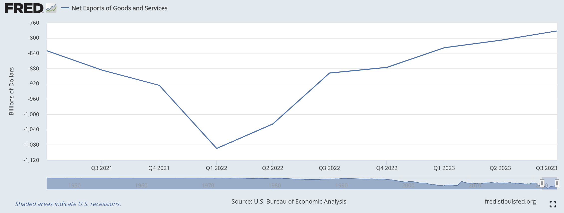
Recent Data: US Net Exports
Fred 12/5
Notes:
https://www.ft.com/content/b9dde56c-38c2-42c6-8cd3-49cf4c0d4735

Slide 8
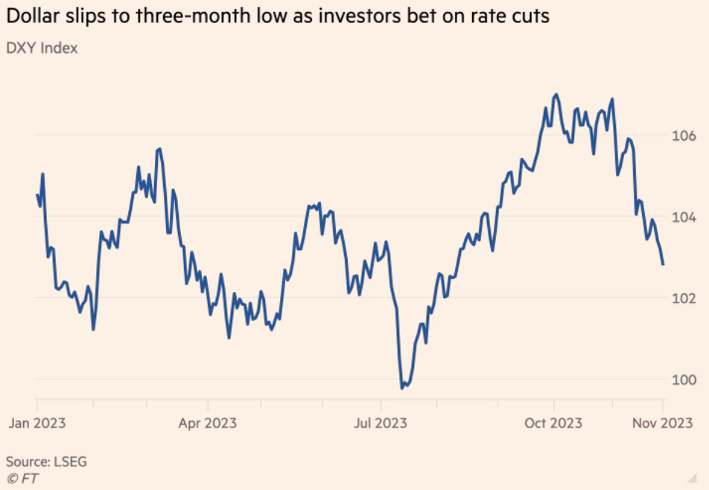
Recent Data: Dollar
FT 11/28
Notes:
https://www.ft.com/content/b9dde56c-38c2-42c6-8cd3-49cf4c0d4735

Slide 9
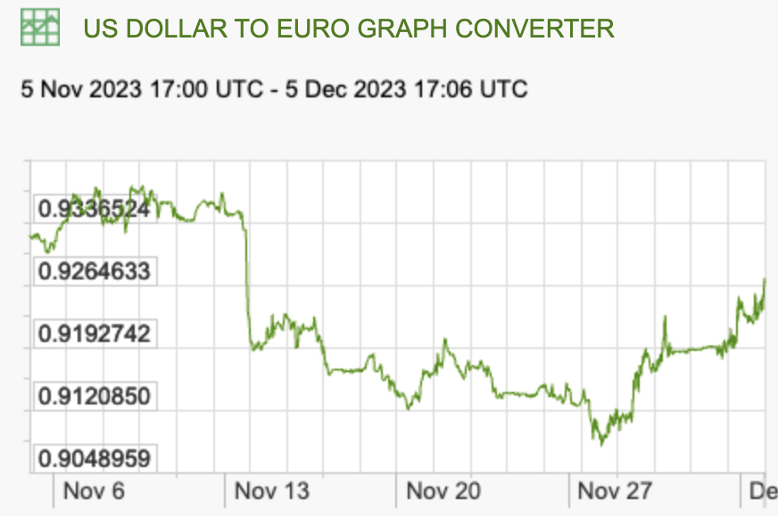
Recent Data: Euros per Dollar
X-Rates.com 12/5
Notes:
https://www.ft.com/content/b9dde56c-38c2-42c6-8cd3-49cf4c0d4735

Slide 10
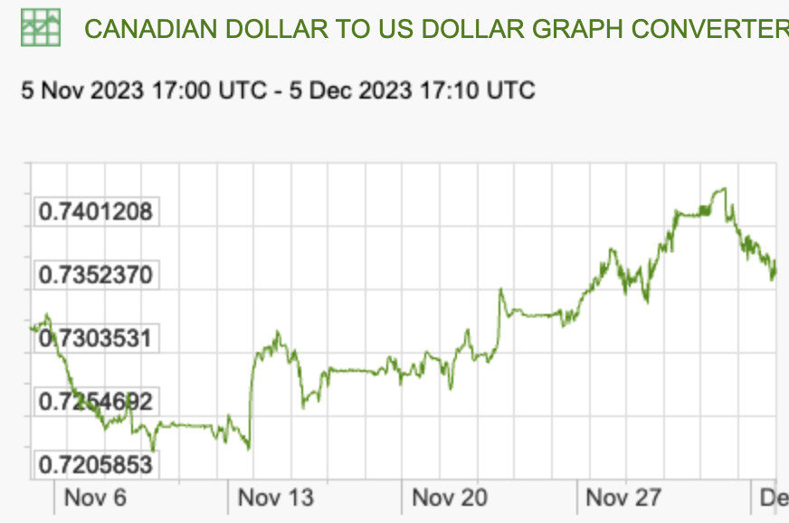
Recent Data:
Dollars per C$
X-Rates.com 12/5
Notes:
https://www.ft.com/content/b9dde56c-38c2-42c6-8cd3-49cf4c0d4735

Slide 11
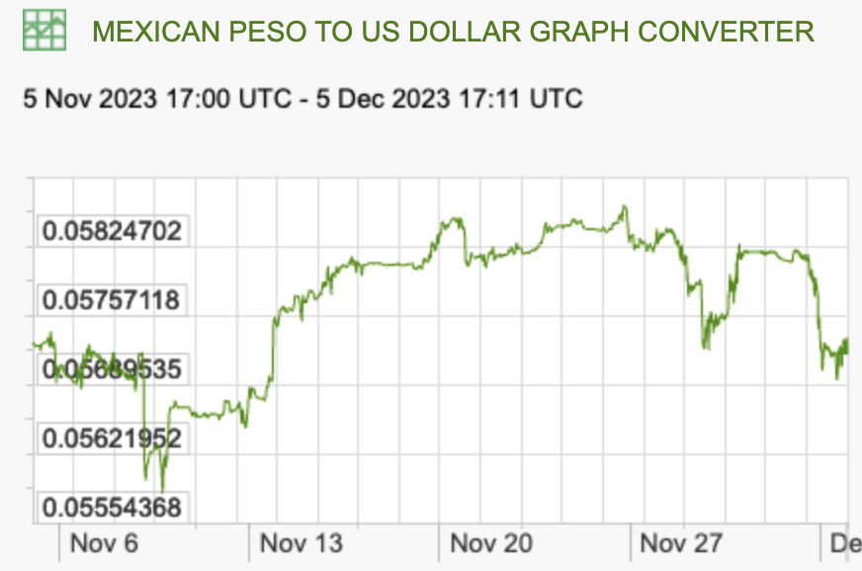
Recent Data:
Dollars per Mexican Peso
X-Rates.com 12/5
Notes:
https://www.ft.com/content/b9dde56c-38c2-42c6-8cd3-49cf4c0d4735

Slide 12
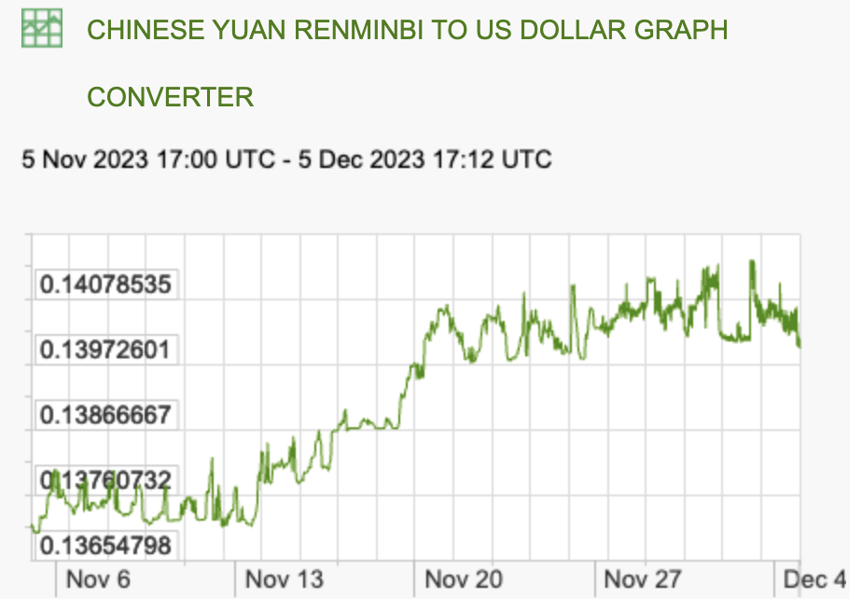
Recent Data:
Dollars per Renminbi
X-Rates.com 12/5
Notes:
https://www.ft.com/content/b9dde56c-38c2-42c6-8cd3-49cf4c0d4735

Slide 13
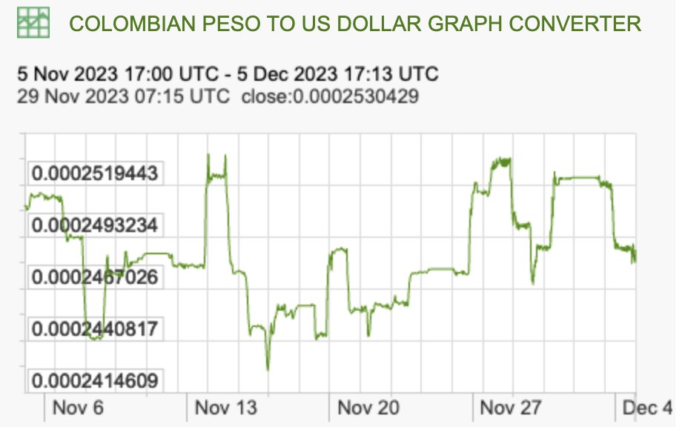
Recent Data:
Dollars per Colombian Peso
X-Rates.com 12/5
Notes:
https://www.ft.com/content/b9dde56c-38c2-42c6-8cd3-49cf4c0d4735

Slide 14
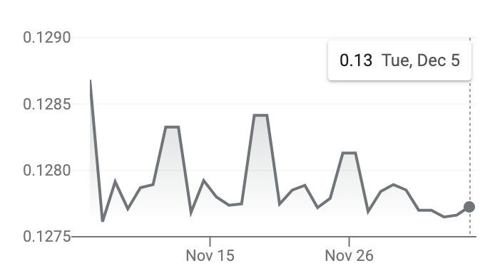
Recent Data:
Dollars per Guatemalan Quetzal
Google.com
12/5
Notes:
https://www.ft.com/content/b9dde56c-38c2-42c6-8cd3-49cf4c0d4735

Slide 15
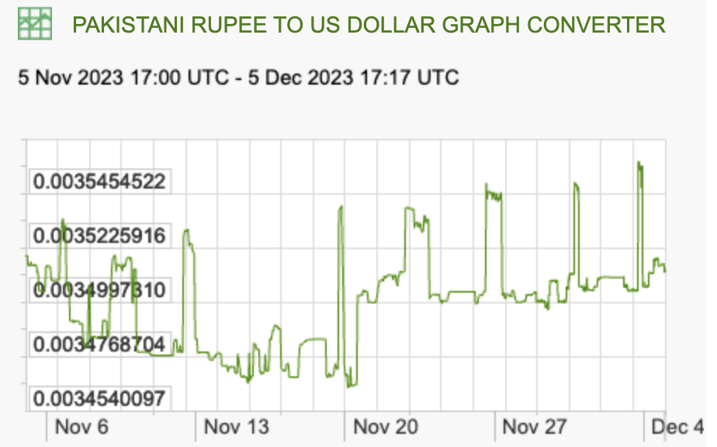
Recent Data:
Dollars per Pakistani Rupee
X-Rates.com 12/5
Notes:
https://www.ft.com/content/b9dde56c-38c2-42c6-8cd3-49cf4c0d4735

Slide 16
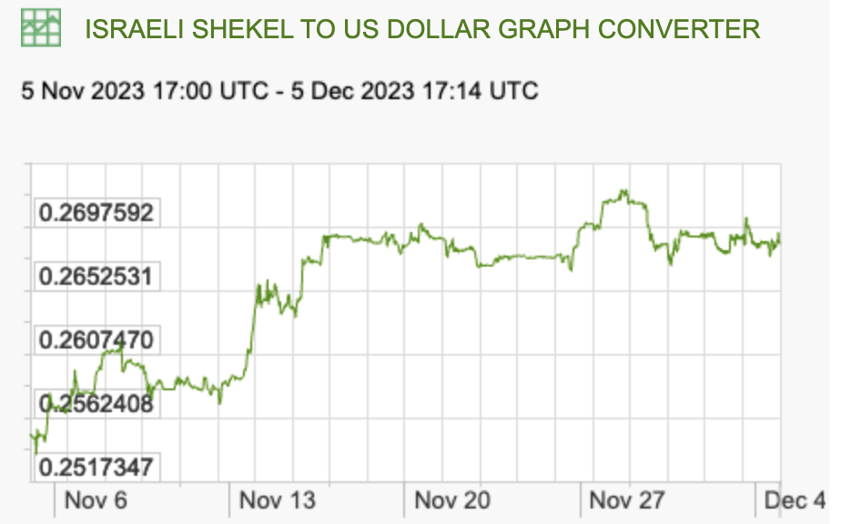
Recent Data:
Dollars per Israeli Shekel
X-Rates.com 12/5
Notes:
https://www.ft.com/content/b9dde56c-38c2-42c6-8cd3-49cf4c0d4735

Slide 17
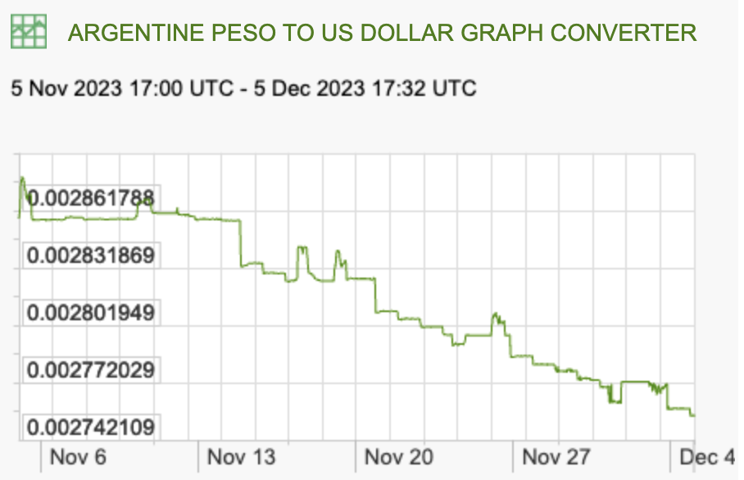
Recent Data:
Dollars per Argentine Peso
X-Rates.com 12/5
Notes:
https://www.ft.com/content/b9dde56c-38c2-42c6-8cd3-49cf4c0d4735

Slide 18
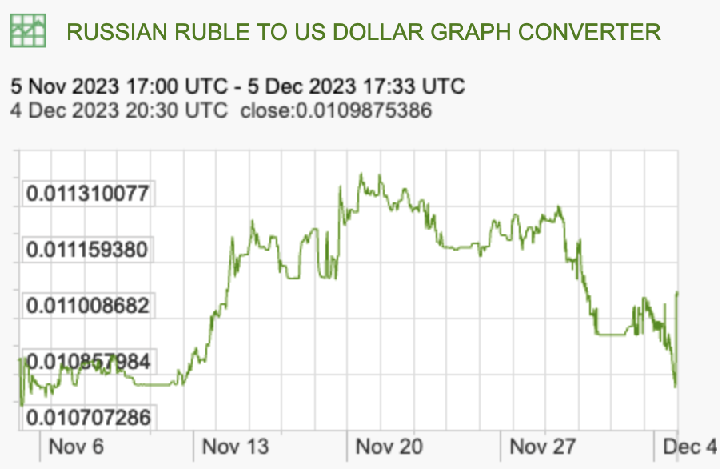
Recent Data:
Dollars per Russian Ruble
X-Rates.com 12/5
Notes:
https://www.ft.com/content/b9dde56c-38c2-42c6-8cd3-49cf4c0d4735

Slide 19
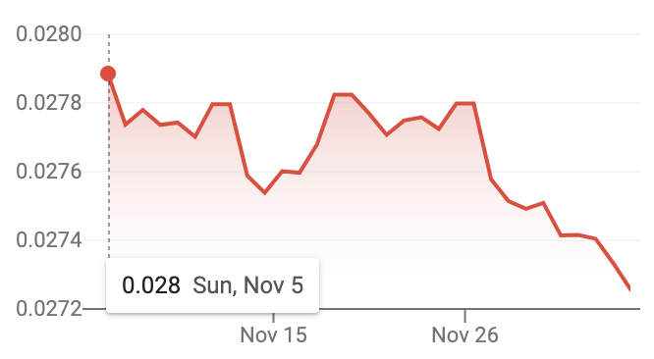
Recent Data:
Dollars per Ukraine Hryvnia
Google.com
12/5
Notes:
https://www.ft.com/content/b9dde56c-38c2-42c6-8cd3-49cf4c0d4735

Slide 20
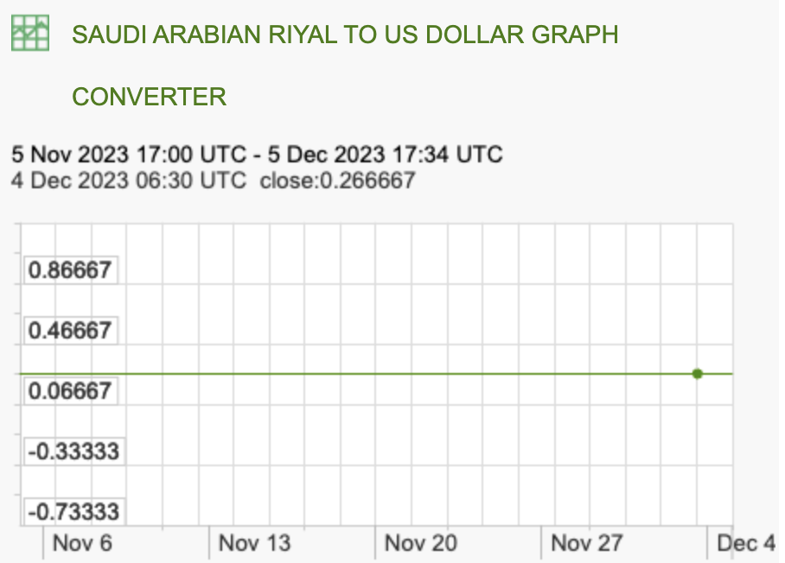
Recent Data:
Dollars per Saudi Arabian Riyal
X-Rates.com 12/5
Notes:
https://www.ft.com/content/b9dde56c-38c2-42c6-8cd3-49cf4c0d4735

Slide 21
Recent Data:
Dollars per
X-Rates.com 12/5
Notes:
https://www.ft.com/content/b9dde56c-38c2-42c6-8cd3-49cf4c0d4735

Slide 22
What have you learned?
Your list:
  NAFTA views
  Policy evaluation
  Understanding price changes
  Free trade consensus
  Economies of scale
  Dumping & subsidies
  GSP, AGOA
  General equilibrium effects

Slide 23
What have you learned?
My list:
  How trade policies have been used recently by the US especially.

Slide 24
What have you learned?
My list (cont.):
  How trade policies have been used recently by the US especially.
  The costs and benefits of tariffs, etc.

Slide 25
What have you learned?
My list (cont.):
  How trade policies have been used recently by the US especially.
  The costs and benefits of tariffs, etc.
  How effects of trade policies can be analyzed, and why that is so uncertain.

Slide 26
What have you learned?
My list (cont.):
  How trade policies have been used recently by the US especially.
  The costs and benefits of tariffs, etc.
  How effects of trade policies can be analyzed, and why that is so uncertain.
  Who are the main winners and losers from globalization.

Slide 27
What have you learned?
My list (cont.):
  What motivates uses of trade policies.

Slide 28
What have you learned?
My list (cont.):
  What motivates uses of trade policies.
  Why there is an international need to constrain the use of trade policies, and how that has or has not been successful.

Slide 29
What have you learned?
My list (cont.):
  What motivates uses of trade policies.
  Why there is an international need to constrain the use of trade policies, and how that has or has not been successful.
  How and should those who are hurt by trade or trade policies be helped?

Slide 30
What would you still like to know?
More on trade initiatives of other major powers.
  Belt and Road Initiative
  Russia?
  EU?
Trade policies for developing countries
LDC involvement in process
Supply elasticities over time, maybe a good class to end on

Slide 31
What would you still like to know?

Slide 32
From Last Year

Slide 33
What have you learned?
Your list:
That free trade benefits all (overall), both exporting and importing countries
Strategic alliances (embargoes, etc. FTA)
How we model trade and limitations
Losses concentrated, gains distributed
Trade restrictions are costly
Other perspectives, from EU, etc.

Slide 34
What have you learned?
Your list (cont.):
  Power of workers and firms
  How few jobs are saved by trade policies
  Poor job of providing transitions for those hurt by trade
  Institutions involved in trade
  Carve-outs from free trade (services, agriculture, developing countries)
    Also antidumping & CVDs

