Slide 1

Selecting Linear Mixed Models for Clustered and Longitudinal Data
Brady t. West (bwest@umich.edu)
Kathleen b. welch (kwelch@umich.edu)

Slide 2
“All models are wrong, but some are useful.”
- George E.P. Box

Slide 3
Seminar Objectives
This two-hour seminar has two parts:
Part I (12:00pm-12:50pm): Introduce the appropriate specification of linear mixed models (LMMs) for cross-sectional clustered data sets in popular statistical software (SAS, R, Stata)
Part II (1:00pm-1:50pm): Introduce the appropriate specification of LMMs for longitudinal data sets in popular statistical software
Related Objectives:
Carefully consider data management and data preparation for these two study designs
Beware of potential pitfalls when fitting these models to these types of data sets

Slide 4
Part I: LMMs for Clustered Data

Slide 5
What are Linear Mixed Models?
From West, Welch, and Galecki (2022):
“LMMs are statistical models for continuous outcome variables in which the residuals are
normally distributed but may not be independent or have constant variance.”
Key points:
LMMs are very handy and flexible models for dependent data, where correlations of the collected values arise from clustering or repeated measurement due to the study design
We will focus on models for continuous outcomes, but the basic principles that we present can also be extended to generalized linear mixed models (GLMMs) for other types of outcomes (binary, count, categorical, etc.)

Slide 6
Fixed vs. Random Effects
Fixed Effects: Unknown, constant regression parameters capturing relationships between variables that are often of interest; define the conditional mean of the DV, like in regression
Random Effects: Random variables that allow unique clusters or subjects (in a longitudinal study) to have unique, randomly varying regression coefficients in a given model
Random effects are assumed to arise from a normal distribution with mean 0 and some variance-covariance structure (depending on how many random effects are included in a given model)
The residuals that you are used to in regression models are now divided into random effects associated with clusters or subjects (which capture within-cluster or within-subject correlation of the observed values) and conditional residual errors

Slide 7
Two-Level Clustered Data
These study designs are generally characterized by a “random” sample of higher-level clusters of units of analysis (e.g., clinics, hospitals, neighborhoods, schools, etc.), with observations recorded on units within those clusters; OK if not a truly random probability sample
The observations recorded on units from the same cluster will generally have correlated residuals (same attitudes, same exposures, same…something), which means that standard OLS no longer applies and will underestimate standard errors of regression coefficients
Example Two-Level Clustered Designs:
Students within schools
Homeowners within neighborhoods
Volunteer patients within clinics

Slide 8
Appropriate Models for Two-Level Clustered Data
Example specification of an LMM for two-level clustered data (i = unit, j = cluster):
Fixed Effects
Random Effects
Conditional Residual Errors

Slide 9
Appropriate Models for Two-Level Clustered Data
At a minimum, include random effects associated with the intercept for each cluster:
  Captures the constant, within-cluster correlation of observations from the same cluster
  Enables estimation of the between-cluster variance of the random effects
  Enables explanation of the between-cluster variance of the random effects using the fixed effects of cluster-level covariates
  Example: interviewer effects in survey research
Conditional residual errors are generally independent for clustered data
Allow the coefficients for predictor variables of interest to vary across clusters if there is explicit scientific interest in estimating between-cluster variance in those coefficients
  Example: Interest in between-clinic variance in the effect of a treatment administered to a random subsample of volunteers within each clinic (where other volunteers get the placebo)

Slide 10
Managing Clustered Data
Need one row per unit of analysis
Need a cluster ID variable, with multiple rows for a given cluster ID
May have unit-specific covariates (varying across rows) or cluster-specific covariates (constant for all rows from the same cluster)
Dependent variable is measured on units of analysis, and should necessarily vary across the rows of the data set
  If you have dependent variable measured at the cluster level, just consider a more standard modeling approach for a cluster-level data set

Slide 11
Managing Clustered Data
Example Data Set (best to sort by cluster ID and unit ID):
Cluster ID | Unit ID | DV | Cluster_IV | Unit_IV
1 | 1 | 20.3 | 1 | 5
1 | 2 | 19.3 | 1 | 4
1 | 3 | 19.7 | 1 | 6
2 | 1 | 16.5 | 0 | 3
2 | 2 | 16.9 | 0 | 4
2 | 3 | 17.1 | 0 | 4
…

Slide 12
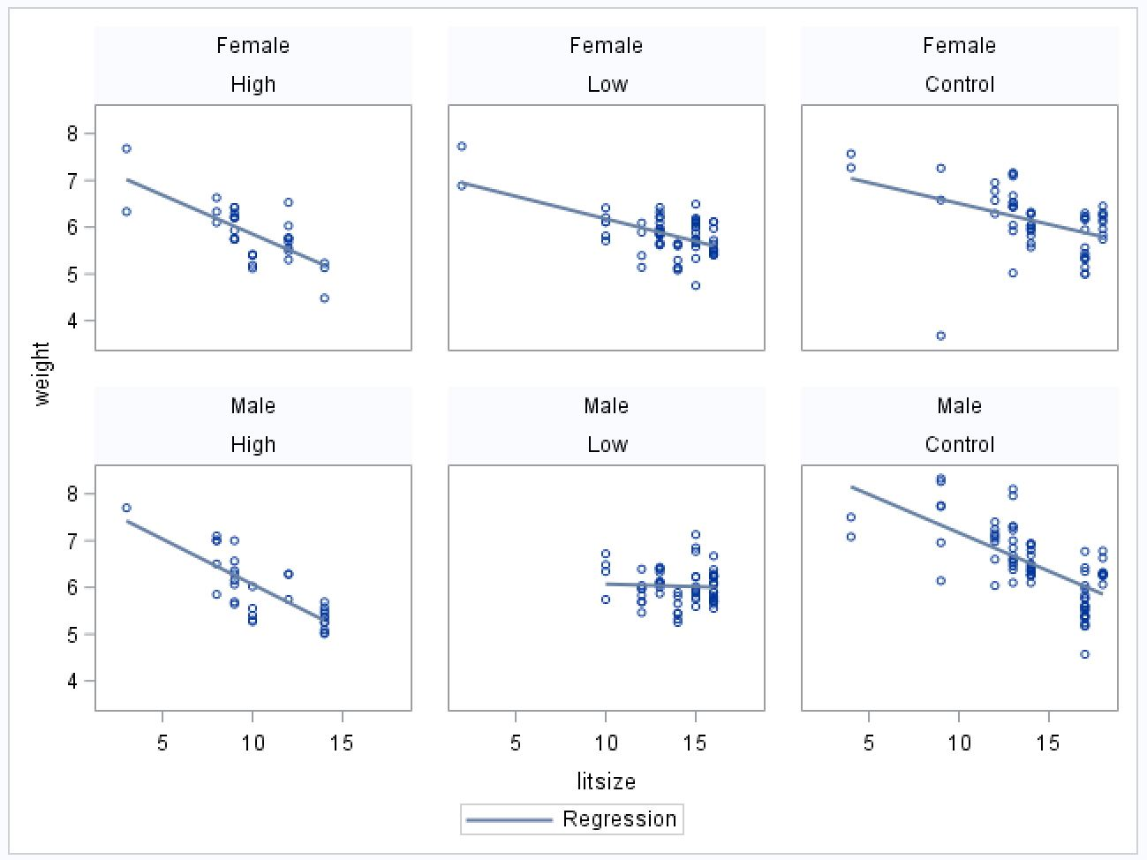
Visualization of the Rat Pup Data

Slide 13
Fitting Two-Level Models: Software
SAS Example (Litters = Clusters, Observations = Rat Pups, DV = Birthweight):
proc glimmix data = ratpup3 method = RSPL;
class treat sex litter trtgrp;
model weight = treat sex treat*sex litsize / solution ddfm = sat dist = normal;
random int / subject = litter;
random residual / group = trtgrp;
run;

Slide 14
Fitting Two-Level Models: Software
Alternative approach using proc mixed in SAS:
proc mixed data = ratpup3 method = REML;
class treat sex litter trtgrp;
model weight = treat sex treat*sex litsize / solution ddfm = sat;
random int / subject = litter;
repeated / group = trtgrp;
run;

Slide 15
Fitting Two-Level Models: Software
R Example (using the lme() function in the nlme package):
> model3.2a.fit <- lme(weight ~ treatment + sex1 + litsize + treatment:sex1,
random = ~1 | litter, ratpup, method = "REML",
weights = varIdent(form = ~1 | trtgrp))
> summary(model3.2a.fit)

Slide 16
Fitting Two-Level Models: Software
Stata Example:
. mixed weight ib1.treatment2 female litsize ib1.treatment2#c.female ///
|| litter: , covariance(identity) variance reml ///
residuals(independent, by(trtgrp)) dfmethod(kroger)

Slide 17
Interpretation of Output
We consider interpreting SAS output (proc glimmix) from the Rat Pup example here (NS interaction dropped).
Solutions for Fixed Effects
Standard
Effect sex treat Estimate Error DF t Value Pr > |t|
Intercept 8.3276 0.2741 33.35 30.38 <.0001
treat High -0.8623 0.1829 25.72 -4.71 <.0001
treat Low -0.4337 0.1523 24.29 -2.85 0.0088
treat Control 0 . . . .
sex Female -0.3434 0.04204 255.8 -8.17 <.0001
sex Male 0 . . . .
litsize -0.1307 0.01855 31.15 -7.04 <.0001

Slide 18
Interpretation of Output, cont’d
Covariance Parameter Estimates
Standard
Cov Parm Subject Group Estimate Error
Intercept litter 0.09900 0.03288
Residual (VC) trtgrp High/Low 0.09178 0.009855
Residual (VC) trtgrp Control 0.2646 0.03395
The Stata and R code will produce identical parameter estimates.

Slide 19
Summary of Output
Several significant fixed effects: the key is making sure that estimates, standard errors, and significance tests correctly account for within-cluster correlations
Between-litter variance component seems large relative to its (approximate) standard error; better to use a likelihood ratio test for formal significance testing (West et al. 2022)
Note the large difference in the within-cluster variance components (the variances of the conditional residual errors); often a feature of real world data, and an important aspect of getting the covariance structure of the data correct before significance testing!

Slide 20
Pitfalls to Avoid (Clustered Data)
Avoid adding too many random effects (so called “maximal” random effect models, e.g., every coefficient is allowed to randomly vary across clusters): this leads to convergence problems with estimation algorithms (too many variances and covariances to estimate!)
Avoid allowing the residual errors to covary: conditional residual errors will often be uncorrelated after conditioning on random effects (but they may have non-constant variance!)
Avoid using LMMs for data sets where there is a negative correlation within clusters: often leads to convergence issues, and estimates of 0 for variance components
Avoid small samples of clusters / too many clusters with only one observation: leads to very unreliable estimates of variance components (simpler models may work just fine)

Slide 21
Three-Level Clustered Data
You can also fit LMMs to three-level clustered data sets (e.g., students nested within classrooms, nested within schools)
In these studies, there could be within-cluster correlations at multiple levels of the data hierarchy, and you need to carefully model them
LMMs allow you to include random effects associated with the randomly selected clusters at each level of the data hierarchy
Simple random intercept models will often do the trick: include random coefficients at specific levels only when there is explicit scientific interest in them and their variance, and the random coefficients significantly improve model fit

Slide 22
Fitting Three-Level Models: Software
SAS Example:
proc glimmix data = classroom;
class classid schoolid;
model mathgain = mathkind sex minority ses / solution;
random intercept / subject = schoolid solution;
random intercept / subject = classid(schoolid) solution;
run;

Slide 23
Part II: LMMs for Longitudinal Data

Slide 24
Longitudinal vs.
Repeated-Measures Data
Longitudinal data come from study designs in which the DV is measured at several time points for each unit of analysis (subject).
Repeated-measures data involve multiple measures made on the same unit over time, or under changing experimental or observational conditions.
The dependent variable is measured more than once for each unit of analysis in both.
LMMs fitted to these two types of data involve the estimation of covariance parameters for random effects to capture the correlation among observations on the same subject.
In the context of fitting LMMs, the distinction between longitudinal and repeated-measures studies is not critical. We will focus on longitudinal data for this presentation.
Notes:
Repeated Measures: Rat brain example from Book (Ch 5) : 3 different Brain regions, 2 Treatments: Basal vs. Carbachol.
Note: In the context of fitting LMMs the distinction between longitudinal and repeated measures designs is not critical.

Slide 25
Some Characteristics of LMMs for Longitudinal Data
  Software for LMMs allow subjects to have missing data for some time points. This means that listwise deletion of cases for a subject with one or more missing time points (as in multivariate analysis of variance) is not necessary, making it possible to retain all available cases for a subject in the analysis.
Under the assumption that missing data are Missing at Random (MAR), inferences based on methods of ML estimation in LMMs are valid (Verbeke & Molenberghs, 2000).
Notes:
We can have differing numbers of observations for different subjects. Some subjects may even have only one observation, but if a preponderance of subjects have only one measurement, consider using a traditional GLM approach to the analysis.
MAR means Missingness cannot depend on the Missing values themselves (like missing weights too low or too high to measure) or unwilling to report if too high, but can depend on other covariates (like previous weight or illness).
-Missingness can be related to design factors like Study (Autism) some kids measured four times and others five times by design.
Not necessary to use listwise deletion for missing values (as required in a multivariate ANOVA).
Previous ABS seminar on Missing Data presented by Rod Little and Trivellore Ragunathan.

Slide 26
Some Characteristics of LMMs for Longitudinal Data (Cont.)
Time trajectories for different subjects can be allowed to vary randomly by including random effects for time or functions of time.
We can use other covariates in the model to help explain the random variability in time trajectories, and we can make inferences about the variability of these time trajectories in the larger population.
The presence of the random effects in the LMM produces correlations for observations made on the same subject. These correlations are necessarily positive, because they are derived from the variances of the random effects in the model.
Notes:
Time-varying covariates like current weight or current smoking status.

Slide 27
Longitudinal Data: Examples
Example Longitudinal Study Designs:
1. Patients’ immune response measured several times over the weeks or months after receiving an infusion of a new drug vs. standard treatment
2. Student achievement scores measured over time
3. Socialization skills measured at different ages for children with ASD (Autism Study)

Slide 28
Appropriate Models for Longitudinal Data: Levels of Data
Similar to clustered data, we can think in terms of levels of data when fitting an LMM to longitudinal data.
  Level 1: time-varying variables
    The DV is always measured at Level 1 of the data; it can change over time.
    The time variable (e.g., minutes, years, age, grade, time since drug administered)
    Other time-varying covariates (e.g., current employment, current weight, current smoking status)
    These variables can change from one time point to another.
  Level 2: time-invariant covariates
    Subject-specific characteristics such as Sex or Parent Education Level.
    All observations for the same subject get the same value for these variables.

Slide 29
Appropriate Models for Longitudinal Data: How to Handle Time
Time can be treated as continuous or categorical.
Continuous Time:
  Not all subjects need to be measured at the same time points.
  Subjects can different numbers of time points.
  We can include linear, quadratic or other functions of fixed time effects
    In a LMM we can also include random effects corresponding to the fixed effects of time, in essence generating an individual time trajectory for each subject (Autism Example).
    If there is not much variability between starting values, it may not be feasible to include a random intercept in the model, even when higher order random effects for time are included.
    Graphical analysis is often helpful when deciding how to handle the effect of time in the model

Slide 30
Appropriate Models for Longitudinal Data: How to Handle Time (cont)
Categorical Time:
  This approach is possible if there are not too many time points, and if all subjects are measured at the same time points (can still have missing time points for some subjects).
  Important to choose a reference time point that makes sense, given the goals of the study.
  Both Continuous and Categorical Time:
  In SAS, we can include continuous versions of time as covariates in the model, while also using time as a categorical variable in order to set up residual the error covariance structure (illustrated for Autism Data).

Slide 31
Appropriate Models for Longitudinal Data: Time-Varying Covariates
  Time-varying covariates potentially have both between- and within-subject effects:
Can generate two new variables for each time-varying covariate:
  Subject-Specific Mean (= Mean_{i}): gives the strictly between-subjects effect of the covariate
  Deviation from the Subject-specific mean at each time point (= Value_{ti} - Mean_{i}): gives the strictly within-subjects effect of the covariate.
These new variables are independent and can be entered into the model simultaneously. One can then test whether the “Between” and “Within” effects are equal. If their effects are not equal, both variables can be retained in the model. Otherwise, the original variable can be used in the model.
This method can be applied to both continuous and categorical covariates.
Notes:
Example: Abrevaya et al. studied a sample of moms who had two or more live singleton births between 1990 and 1998 in order to estimate the effect of mom’s smoking on babies’ birth weights.

Slide 32
LMMs for Longitudinal Data: Alternative Ways to Handle Baseline Values of the Dependent Variable
  Treat the baseline measurement of DV as another outcome:
  Elegant theoretically, because the DV is assumed to be measured with error, while covariates are assumed to be fixed.
  However, the treatment effect may need to be modeled as a treatment by time interaction, if treatment groups are similar at baseline.
  A changing effect of treatment over time may require a complex interaction between treatment and a function of time.

Slide 33
LMMs for Longitudinal Data: Alternative Ways to Handle Baseline Values of the Dependent Variable (Cont.)
Treat the baseline value of the DV as a covariate in the model:
  Baseline measurement of the DV may be considered to be inherently different from subsequent values, because measured prior to treatment
  Inclusion of baseline DV as a covariate in the model may reduce residual variance substantially, increasing the power of statistical tests.
  Values in subsequent measures of the DV may be a function of the initial values. Can easily model this by including an interaction between the baseline DV and time as a covariate.
  Conclusion: How to handle baseline values of the DV depends on the characteristics of the data and the research goals of the study.
Notes:
Summary: Both model frameworks are useful in different settings.
Method 1 is more elegant
Method 2 is often more practical.

Slide 34
Managing Longitudinal Data
Need one row of data for each time point within a subject.
Need a Subject ID variable, with multiple rows for each subject. Different subjects may have different numbers of observations, made at different time points.
Need a variable to index Time.
Best to sort by Subject ID and Time.
Dependent variable is measured at each time point, and should necessarily vary across the rows of the data set within each subject.
  If the outcome variable is only measured once for each subject, then a more traditional GLM approach (linear regression, ANOVA, or ANCOVA) should be used.

Slide 35
Example Data Set: Description of the Autism Study
Data were collected at the University of Michigan on 158 ASD children, at ages 2, 3, 5, 9 and 13 years.
Children were divided into three groups (SICDEGP), based on their expressive language score at age two.
Researchers were interested in the growth of parent-reported socialization skills (VSAE) for children in the three levels of SICDEGP. Not all children were measured at all time points. (Anderson et al., 2009).
Notes:
VSAE=Vineland Score Age Equivalent
SICDEGP=Sequenced Inventory of Communications Development Expressive Subscale Group.

Slide 36
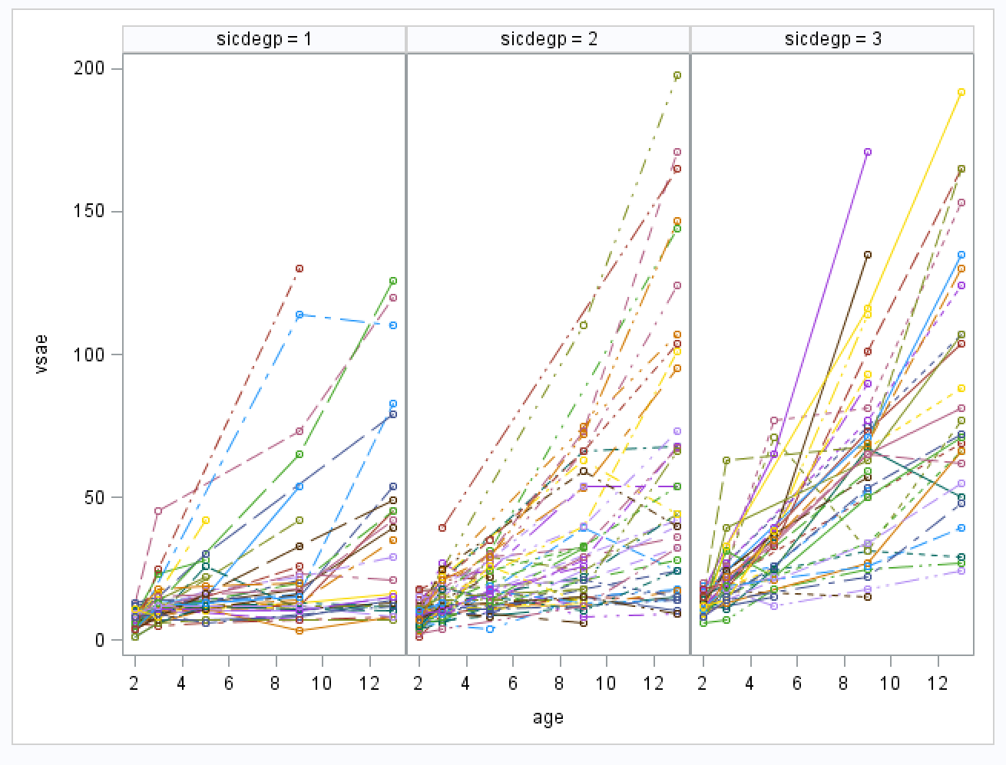
Visualization of the Autism Data
Notes:
We note two very important features of the raw data
There is not much variability at the the starting age: 2 years old
There is a tremendous amount of variability at the older ages.
There appears to be a lot of between-subject variability in the time trajectories for different children.

Slide 37
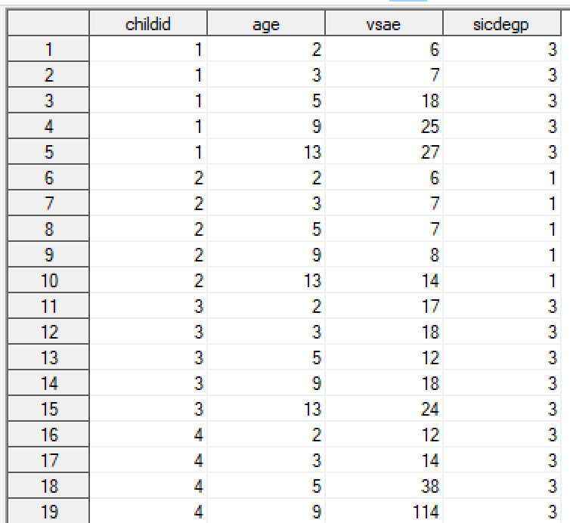
Values in the Autism Data Set for the first three subjects
Level 1 (time-varying) variables: AGE (the time variable) and the variables constructed from it, plus the Dependent Variable, VSAE.
Level 2 (time-invariant) variable is SICDEGP, which is constant for all observations on the same child.
All variables at Level 1 and at Level 2 are included in each row of data for each subject.

Slide 38
Data Manipulation for Autism Data
data autism2;
set autism;
c_age = age-2; c_agesq = c_age * c_age;
if sicdegp in (1,2) then newgp = 1;
if sicdegp = 3 then newgp = 2;
run;

Slide 39
Autism Data: Analysis Plan
All models discussed for the Autism data include the following fixed effects: Intercept, AGE and AGE², SICDEGP (two dummy variables with Level 3 as the reference group) and interactions between the SICDEGP dummy variables and the fixed effect for AGE. (Note that Age is Centered at two years.)
Model I: We first attempt to fit an LMM including random effects for the Intercept, AGE and AGE². This approach results in estimation problems (non positive-definite G matrix).
Model II: We modify the LMM, keeping the same fixed effects, but remove the random Intercept. We also add unequal conditional residual errors for levels of SICDEGP recoded into a new variable, NEWGP.
Model III: We fit the same fixed effects in this model as in Model I and II, but use a strictly marginal approach. There are no random effects in this model, so this model is no longer an LMM.
We demonstrate fitting models for this data set using SAS Proc Mixed and Proc Glimmix. See the book website for examples of similar code using Stata and R.
Notes:
We include the same fixed effects for each model, but use different covariance structures for the Random Effects, and different covariance structures for the Residual Errors.

Slide 40
LMM for a Single Observation in the Autism Study: Model I
Where t indexes time and i indexes subject.
Conditional on the Random Effects, u_{0i}, u_{1i}, u_{2i}.
Notes:
Note that the variable AGE in this model equation is centered at Age two.
We allow the intercept and the effect of AGE and AGE² to vary randomly across subjects by including Random Effects for these variables, (u_{0i}, u_{1i} and u_{2i}, respectively).
When the model lincludes a random effect for the intercept there are problems generated when fitting the model in all software packages, with different error messages.

Slide 41
LMM in Matrix Form for Subject i in the Autism Study
Correlations among the marginal residuals come from this portion of the V_{i} matrix
Default structure for R_{i} is uncorrelated residuals, with constant variance: σ²I.
Notes:
Note that there will be n_{i} observations in the vector for subject i. The value of n_{i} can change from subject-to-subject.
We can stack all observations for all subjects to set up the matrix specification for the entire data set.

Slide 42
Discussion of Variance-Covariance Matrices in an LMM: G
The G matrix is the Variance-Covariance Matrix for the Random Effects (called G-side random effects in Proc Glimmix).
We use different structures for the G matrix in the models we fit for the Autism Data:
Model I Includes 3 random effects: Intercept, Age and Age². The G matrix is 3x3.
Model II Includes 2 random effects: Age and Age². The G matrix is 2x2.
Model III Includes No random effects in the model. There is no G matrix,.
When there are more than one random effect in a model, we can impose different structures on G, including unstructured and variance components (or independence).

Slide 43
Discussion of Variance-Covariance Matrices in an LMM: R_{i}
The R_{i} matrix is the Variance-Covariance Matrix for the Conditional Residual Errors.
We note that the structure of R_{i} remains constant, but the dimension of this matrix (= n _{i}x n_{i}) can change from subject-to-subject.
We use different structures for R_{i} in the models we fit:
Model I: Default structure for R_{i} : σ²I (uncorrelated errors, with equal variance).
Model II: Unequal conditional residual variances for different groups of subjects, based on the recoded group variable: NEWGP.
Model III: Unstructured R_{i} matrix, which allows all 15 variances and covariances for the residual errors at the five ages in this study to be estimated.

Slide 44
Discussion of Variance-Covariance Matrices in an LMM: V_{i}
The V_{i} matrix is the Variance-Covariance Matrix for the Marginal Residual Errors implied by the LMM.
The dimension of this matrix (= n _{i}x n_{i}) can change from subject-to-subject due to different numbers of observations, but the structure remains the same across all subjects.
When fitting an LMM using SAS, it is often helpful to view the V_{i} matrix and the V_{i} correlation matrix, to be sure the model is adequately capturing the correlations among observations.
  NB: This may not be feasible for a study with three levels, such as a clustered-longitudinal design, because SAS may consider there to be only a single subject for the entire study, making the dimensions of V_{i} to be N x N, rather than n _{i}x n_{i}.

Slide 45
Fitting LMMs for Longitudinal Data: Proc Mixed Model I
title “Proc Mixed: Model I”;
proc mixed data=autism2 method=reml covtest ;
class childid sicdegp;
model vsae = c_age c_agesq sicdegp c_age*sicdegp / solution ddfm=sat;
random int c_ age c_ agesq / subject=childid type=un g v vcorr;
run;
This covtest Option does not have the same function as the covtest statement in proc glimmix.
The random statement is used to set up the structure of the G matrix.

Slide 46
Fitting LMMs for Longitudinal Data: Proc Glimmix Model I
title "Proc Glimmix: Model I";
proc glimmix data=autism2 method=rspl ;
class childid sicdegp;
model vsae = c_age c_agesq sicdegp c_age*sicdegp / solution ddfm=sat;
random int c_age c_agesq / subject=childid type=un g v vcorr;
run;
RSPL estimation is the same as REML estimation when the dependent variable distribution is normal.
The random statement sets up the random effects and the covariance structure for the G matrix. Same as Proc Mixed.

Slide 47
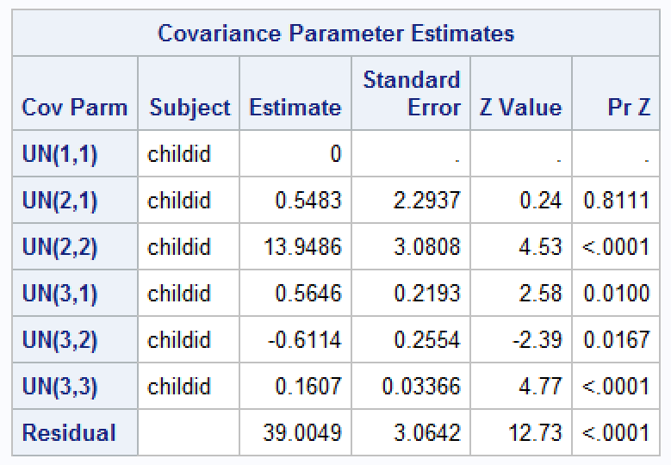
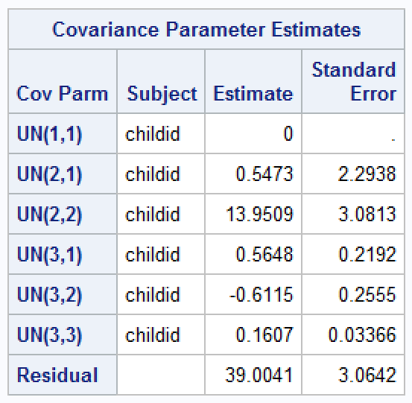
Problems Encountered in Fitting Model I for the Autism Data.
Proc Mixed
Proc glimmix
We also see the following message in the SAS Log from both procedures:
NOTE: Estimated G matrix is not positive definite.
Notes:
Can use the nobound option in Proc Mixed or Proc Glimmix to help diagnose this problem.
We should not report the results from this model, because it is the G matrix is not positive definite.
We reformulate the LMM removing the random deviations in the intercept. Now, all variance at the baseline time point is due to residual variance, with no contribution from the random effects at this time point.

Slide 48
Fitting LMMs for Longitudinal Data: Proc Mixed Code for Model II
title "Proc Mixed: Model II";
proc mixed data=autism2 covtest method=reml;
class childid sicdegp age newgp;
model vsae = c_age c_agesq sicdegp c_age*sicdegp
/ solution ddfm=sat;
random c_age c_agesq / subject=childid type=un g gcorr v vcorr;
repeated age / subject=childid group=newgp r rcorr ;
run;
Both AGE and NEWGP must be included in the Class Statement, since AGE gives the ordering of levels of the Repeated factor, and NEWGP specifies the grouping variable.
We allow the conditional residual error to differ for different levels of NEWGP.
The repeated statement is used in Proc Mixed to specify the structure of the R_{i} matrix.

Slide 49
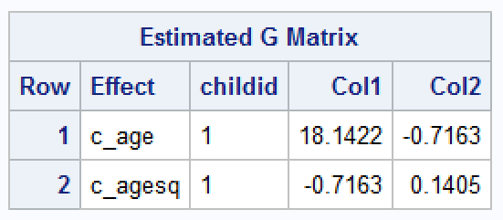
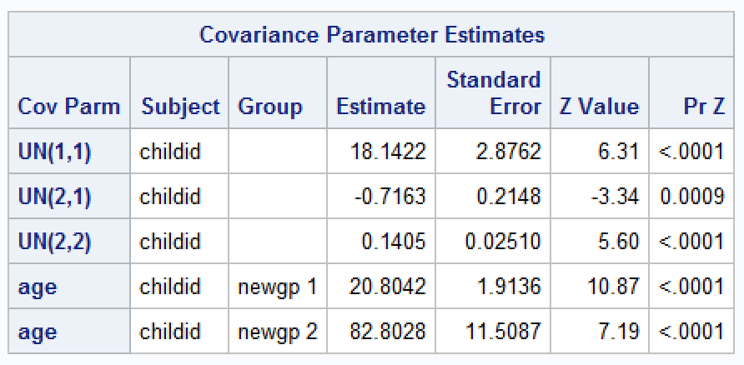
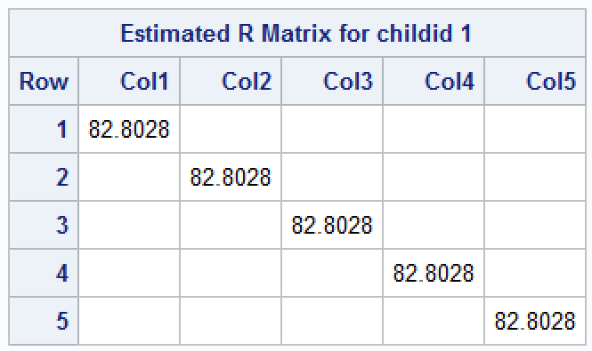
LMM Model II for Autism Data Selected Output: Covariance Parameter Estimates from Proc Mixed
We recommend using the Covtest option in Proc Mixed to get standard errors of covariance parameter estimates. However, We Do Not Recommend using the Wald tests this option generates as formal tests for covariance parameters. Instead, it is better to use LRT in Proc Glimmix or to fit reference and nested models using Proc Mixed.
Notes:
Note that the G matrix is 2 x 2. There are 5 cov. Parameters in Model II: 3 for the random effects and two different residual error variance estimates.

Slide 50
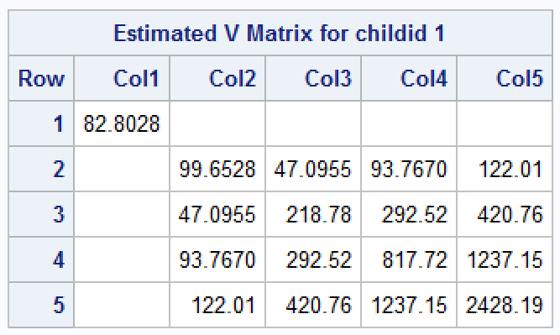
LMM Model II for Autism Data Selected Output: V_{i} Matrix Proc Mixed
The V_{i} matrix does not include any covariances between the implied marginal residuals at the first age, and those at the other time points.
This is because there is no random effect associated with the intercept in the model, so the only contribution to the marginal residual error at the first time point is from the R_{i} matrix.
We also note that the marginal residual variance increases over time, as seen in the initial graph of the data. Why? AGE and AGE² random effects.

Slide 51
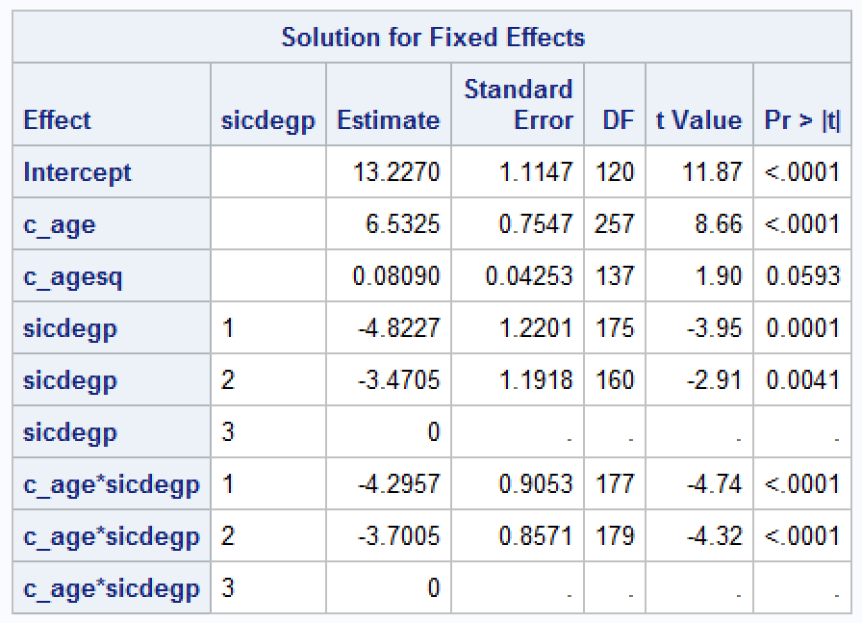
LMM Model II for Autism Data Selected Output: Fixed Effects Proc Mixed

Slide 52
Fitting LMMs for Longitudinal Data: Proc Glimmix Code for Model II
proc glimmix data=autism2 method=rspl;
class childid sicdegp age newgp;
model vsae = c_age c_agesq sicdegp c_age*sicdegp /
  solution ddfm=sat;
random c_age c_agesq / subject=childid type=un g v vcorr;
random age / subject=childid group=newgp residual ;
run;
Both AGE and NEWGP must be included in the class Statement
random Statement (with No Residual option) is used to specify structure for G in Proc Glimmix. (G-side random effects.)
random Statement with residual option is used to specify structure for R_{i} in Proc Glimmix. (R-side random effects.)
Notes:
Can’t request r, rcorr options in Proc Glimmix. Can only ask for G and V.

Slide 53
Pitfalls to Avoid: Longitudinal Data
Avoid adding too many random effects in the model: can make the model unstable. May not converge to a valid solution. May run into problems with positive-definiteness of variance-covariance matrix for covariance parameter estimates.
At times, it may be necessary to exclude a random intercept, if there is little between- subject variability at the starting point of the study.
Avoid using the v and/or vcorr options in proc mixed and proc glimmix when you have a three-level design (i.e., when SAS says there is only one subject in the data). This can produce tons of unnecessary output!

Slide 54
LMMs for Longitudinal Data: Recommendations
Graphing the data can be helpful in deciding how to set up the model and is also highly recommended for visually checking the model assumptions.
Dropouts are often a problem in longitudinal data. Consider whether the MAR assumption is valid for your data.
Examine covariance parameter estimates and their standard errors carefully during model fitting. Check for any error messages or notes in the SAS log. Make sure the model has converged.
Whenever possible, visually check the marginal variance-covariance matrix, V_{i}, for your model, to see if it makes sense.
Fit statistics can help in making modeling choices, but the biggest factor should be the study goals and hypotheses you wish to test.

Slide 55
LMMs for Longitudinal Data: Recommendations (Cont.)
Random effects should be included in the model for a valid research reason. If there is research interest in how the time trajectories of different subjects evolve, and in the variability of these trajectories in the larger population, a LMM is probably a good choice.
Other modeling choices can be made (e.g., marginal models), if the goal is simply to take correlations among residuals into account.
Having more time points per subject can help to elucidate the time trajectories for each subject.
In SAS: Use Proc Glimmix to get valid LRTs for covariance parameters. To get these same tests in Proc Mixed, need to fit a reference model and a nested model and carry out the test “by hand” using a data step.

Slide 56
References
Anderson, D., Oti, R., Lord, C., and Welch, K. (2009). Patterns of growth in adaptive social abilities among children with autism spectrum disorders. Journal of Abnormal Child Psychology, 37(7), 1019-1034.
Rabe-Hesketh, S., and Skrondal, A., Multilevel and Longitudinal Modeling Using Stata, Volume I: Continuous Responses, Fourth Edition. Stata Press, 2022.
Verbeke, G., and Molenberghs, G. (2000). Linear Mixed Models for Longitudinal Data. New York NY: Springer-Verlag.
West, B.T., Welch, K.B. and Galecki, A.T. (with Contributions from Brenda W. Gillespie) (June 2022). Linear Mixed Models: A Practical Guide using Statistical Software, Third Edition. Chapman Hall / CRC Press: Boca Raton, FL.
Website: http://www-personal.umich.edu/~bwest/almmussp.html

