Slide 1
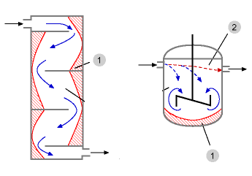
Review: Nonideal Flow in a CSTR
Ideal CSTR: uniform reactant concentration throughout the vessel
Real stirred tank
Relatively high reactant concentration at the feed entrance
Relatively low concentration in the stagnant regions, called dead zones (usually corners and behind baffles)
Short Circuiting
Dead Zone
Dead Zone

Slide 2
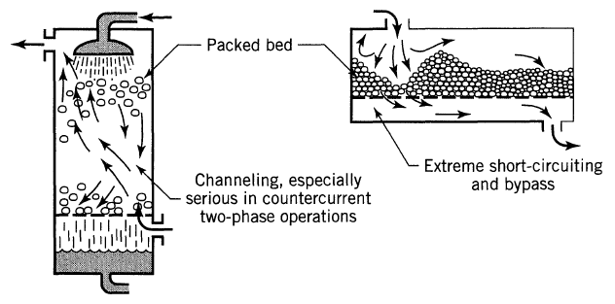
Review: Nonideal Flow in a PBR
Ideal plug flow reactor: all reactant and product molecules at any given axial position move at same rate in the direction of the bulk fluid flow
Real plug flow reactor: fluid velocity profiles, turbulent mixing, & molecular diffusion cause molecules to move with changing speeds and in different directions
channeling
Dead zones

Slide 3
Review: Residence Time Distribution
RTD ≡ E(t) ≡ “residence time distribution” function
RTD describes the amount of time molecules have spent in the reactor
RTD is experimentally determined by injecting an inert “tracer” at t=0 and measuring the tracer concentration C(t) at exit as a function of time
Measurement of RTD
C curve
Reactor
X
C(t)
↑
Pulse injection
↓
Detection
t
E(t)=0 for t<0 since no tracer can exit before it enters
E(t)≥0 for t>0 since mass fractions are always positive
Fraction of material leaving reactor that has been inside reactor for a time between t₁ & t₂

Slide 4
A pulse of tracer was injected into a reactor, and the effluent concentration as a function of time is in the graph below. Construct a figure of C(t) & E(t) and calculate the fraction of material that spent between 3 & 6 min in the reactor
t min | 0 | 1 | 2 | 3 | 4 | 5 | 6 | 7 | 8 | 9 | 10 | 12 | 14
C g/m³ | 0 | 1 | 5 | 8 | 10 | 8 | 6 | 4 | 3 | 2.2 | 1.5 | 0.6 | 0
To tabulate E(t): divide C(t) by the total area under the C(t) curve, which must be numerically evaluated as shown below:
Plot C vs time:

Slide 5
A pulse of tracer was injected into a reactor, and the effluent concentration as a function of time is in the graph below. Construct a figure of C(t) & E(t) and calculate the fraction of material that spent between 3 & 6 min in the reactor
t min | 0 | 1 | 2 | 3 | 4 | 5 | 6 | 7 | 8 | 9 | 10 | 12 | 14
C g/m³ | 0 | 1 | 5 | 8 | 10 | 8 | 6 | 4 | 3 | 2.2 | 1.5 | 0.6 | 0
E(t) | 0 | 0.02 | 0.1 | 0.16 | 0.2 | 0.16 | 0.12 | 0.08 | 0.06 | 0.044 | 0.03 | 0.012 | 0
t min | 0 | 1 | 2 | 3 | 4 | 5 | 6 | 7 | 8 | 9 | 10 | 12 | 14
C g/m³ | 0 | 1 | 5 | 8 | 10 | 8 | 6 | 4 | 3 | 2.2 | 1.5 | 0.6 | 0
Plot E(t):
Tabulate E(t): divide C(t) by the total area under the C(t) curve:

Slide 6
Review: RTD Profiles & Cum RTD Function F(t)
E(t)
E(t)
E(t)
E(t)
τ
t
t
τ
t
t
Nearly ideal PFR
Nearly ideal CSTR
PBR with channeling & dead zones
CSTR with dead zones
F(t)=fraction of effluent in the reactor less for than time t
F(t)
0.8
80% of the molecules spend 40 min or less in the reactor
t (min)
40

Slide 7
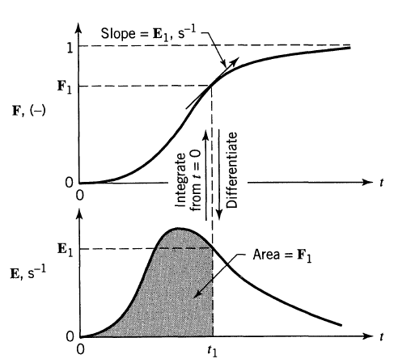
Review: Relationship between E & F
F(t) = fraction of effluent that has been in the reactor for less than time t
E(t)= Fraction of material leaving reactor that was inside for a time between t₁ & t₂

Slide 8
Review: Mean Residence Time, t_{m}
For an ideal reactor, the space time τ is defined as V/υ₀
The mean residence time t_{m} is equal toτ in either ideal or nonideal reactors
By calculating t_{m}, the reactor V can be determined from a tracer experiment
The spread of the distribution (variance):
Space time τ and mean residence time t_{m} would be equal if the following two conditions are satisfied:
No density change
No backmixing
In practical reactors the above two may not be valid, hence there will be a difference between them

Slide 9
Significance of Mixing
RTD provides information on how long material has been in the reactor
RTD does not provide information about the exchange of matter within the reactor (i.e., mixing)!
For a 1st order reaction:
Concentration does not affect the rate of conversion, so RTD is sufficient to predict conversion
But concentration does affect conversion in higher order reactions, so we need to know the degree of mixing in the reactor
Macromixing: produces a distribution of residence times without specifying how molecules of different age encounter each other and are distributed inside of the reactor
Micromixing: describes how molecules of different residence time encounter each other in the reactor

Slide 10
Quality of Mixing
RTDs alone are not sufficient to determine reactor performance
Quality of mixing is also required
Goal: use RTD and micromixing models to predict conversion in real reactors
2 Extremes of Fluid Mixing
Maximum mixedness: molecules are free to move anywhere, like a microfluid. This is the extreme case of early mixing

Slide 11
Quality of Mixing
RTDs alone are not sufficient to determine reactor performance
Quality of mixing is also required
Goal: use RTD and micromixing models to predict conversion in real reactors
2 Extremes of Fluid Mixing
Maximum mixedness: molecules are free to move anywhere, like a microfluid. This is the extreme case of early mixing
Complete segregation: molecules of a given age do not mix with other globules. This is the extreme case of late mixing

Slide 12
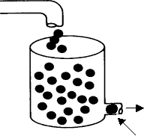
Complete Segregation Model
Mixing of different ‘age groups’ at the last possible moment
Flow is visualized in the form of globules
Each globule consists of molecules of the same residence time
Different globules have different residence times
No interaction/mixing between different globules
The mean conversion is the average conversion of the various globules in the exit stream:
Conversion achieved after spending time t_{j} in the reactor
Fraction of globules that spend between t_{j} and t_{j} + Δt in the reactor
X_{A}(t) is from the batch reactor design equation
Notes:
Can we make a model where the time in the reactor is dictated by a gaussian distribution, and the conversion follows a first order reaction?

Slide 13
Complete Segregation Example
First order reaction, A→Products
Batch reactor design equation:
To compute conversion for a reaction with a 1st order rxn and complete segregation, insert E(t) from tracer experiment and X_{A}(t) from batch reactor design equation into:
& integrate
Notes:
Can we make a model where the time in the reactor is dictated by a gaussian distribution, and the conversion follows a first order reaction?

Slide 14
Maximum Mixedness Model
In a PFR: as soon as the fluid enters the reactor, it is completely mixed radially with the other fluid already in the reactor. Like a PFR with side entrances, where each entrance port creates a new residence time:
λ →∞
λ → 0
υ₀
V = 0
λ +Δλ
λ
V = V₀
λ: time it takes for fluid to move from a particular point to end of the reactor
υ(λ): volumetric flow rate at λ, = flow that entered at λ+Δλ plus what entered through the sides
υ₀E(λ)Δλ: Volumetric flow rate of fluid fed into side ports of reactor in interval between λ + Δλ & λ
Volumetric flow rate of fluid fed to reactor at λ:
fraction of effluent in reactor for less than time t
Volume of fluid with life expectancy between λ + Δλ & λ:

Slide 15
Maximum Mixedness & Polymath
Mole balance on A gives:
residence time distribution function
fraction of effluent in reactor for less than time t
E(t) must be specified
Often it is an expression that fits the experimental data
2 curves, one on the increasing side, and a second for the decreasing side
Use the IF function to specify which E is used when
See section 13.8 in book
E
E₁
E₂
t
Also need to replace λ because Polymath cannot calculate as λ gets smaller
Note that the sign on each term changes

Slide 16
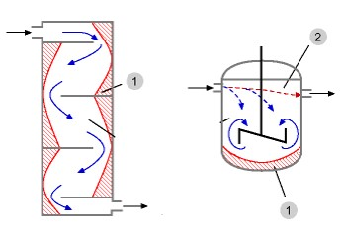
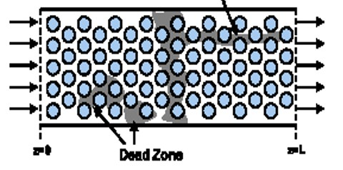
Review: Nonideal Flow & Reactor Design
Real CSTRs
Relatively high reactant conc at entrance
Relatively low conc in stagnant regions, called dead zones (corners & behind baffles)
Real PBRs
fluid velocity profiles, turbulent mixing, & molecular diffusion cause molecules to move at varying speeds & directions
Short Circuiting
channeling
Dead Zone
Dead zones
Dead Zone
Goal: mathematically describe non-ideal flow and solve design problems for reactors with nonideal flow

Slide 17
Residence Time Distribution (RTD)
RTD ≡ E(t) ≡ “residence time distribution” function
RTD describes the amount of time molecules have spent in the reactor
RTD is experimentally determined by injecting an inert “tracer” at t=0 and measuring the tracer concentration C(t) at exit as a function of time
Measurement of RTD
The C curve
Reactor
X
C(t)
↑
Pulse injection
↓
Detection
t
E(t)=0 for t<0 since no fluid can exit before it enters
E(t)≥0 for t>0 since mass fractions are always positive
Fraction of material leaving reactor that has been inside reactor for a time between t₁ & t₂

Slide 18
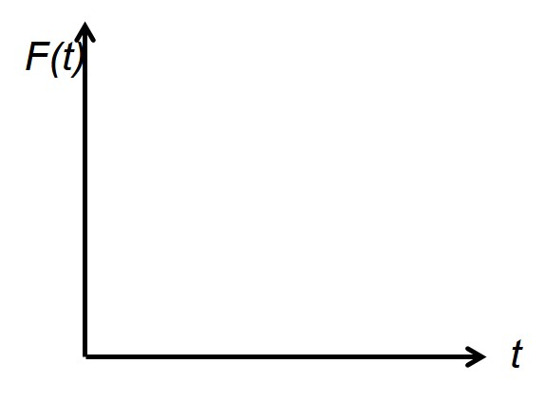
E(t)
E(t)
E(t)
E(t)
Nice multiple choice question
τ
t
t
τ
t
t
Nearly ideal PFR
Nearly ideal CSTR
PBR with dead zones
CSTR with dead zones
The fraction of the exit stream that has resided in the reactor for a period of time shorter than a given value t:
F(t) is a cumulative distribution function
0.8
80% of the molecules spend 40 min or less in the reactor
40

Slide 19
Review: Mean Residence Time, t_{m}
For an ideal reactor, the space time τ is defined as V/υ₀
The mean residence time t_{m} is equal to τ in either ideal or nonideal reactors
By calculating t_{m}, the reactor V can be determined from a tracer experiment
The spread of the distribution (variance):
Space time τ and mean residence time t_{m} would be equal if the following two conditions are satisfied:
No density change
No backmixing
In practical reactors the above two may not be valid, hence there will be a difference between them

Slide 20
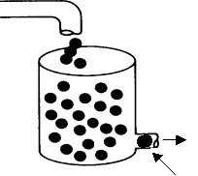
Review: Complete Segregation Model
Mixing of different ‘age groups’ at the last possible moment
Flow is visualized in the form of globules
Each globule consists of molecules of the same residence time
Different globules have different residence times
No interaction/mixing between different globules
The mean conversion is the average conversion of the various globules in the exit stream:
Conversion achieved after spending time t_{j} in the reactor
Fraction of globules that spend between t_{j} and t_{j} + Δt in the reactor
X_{A}(t) is from the batch reactor design equation

Slide 21
Review: Maximum Mixedness Model
In a PFR: as soon as the fluid enters the reactor, it is completely mixed radially with the other fluid already in the reactor. Like a PFR with side entrances, where each entrance port creates a new residence time:
λ →∞
λ → 0
υ₀
V = 0
λ +Δλ
λ
V = V₀
λ: time it takes for fluid to move from a particular point to end of the reactor
υ(λ): volumetric flow rate at λ, = flow that entered at λ+Δλ plus what entered through the sides
υ₀E(λ)Δλ: Volumetric flow rate of fluid fed into side ports of reactor in interval between λ + Δλ & λ
Volumetric flow rate of fluid fed to reactor at λ:
fraction of effluent that in reactor for less than time t
Volume of fluid with life expectancy between λ + Δλ & λ:

Slide 22
For a pulse tracer expt, the effluent concentration C(t) & RTD function E(t) are given
in the table below. The irreversible, liquid-phase, nonelementary rxn A+B→C+D, -r_{A}=kC_{A}C_{B}² will be carried out isothermally at 320K in this reactor. Calculate the conversion for (1) an ideal PFR and (2) for the complete segregation model.
C_{A0}=C_{B0}=0.0313 mol/L & k=176 L²/mol²·min at 320K
t min | 0 | 1 | 2 | 3 | 4 | 5 | 6 | 7 | 8 | 9 | 10 | 12 | 14
C g/m³ | 0 | 1 | 5 | 8 | 10 | 8 | 6 | 4 | 3 | 2.2 | 1.5 | 0.6 | 0
E(t) | 0 | 0.02 | 0.1 | 0.16 | 0.2 | 0.16 | 0.12 | 0.08 | 0.06 | 0.044 | 0.03 | 0.012 | 0

Slide 23
For a pulse tracer expt, the effluent concentration C(t) & RTD function E(t) are given
in the table below. The irreversible, liquid-phase, nonelementary rxn A+B→C+D, -r_{A}=kC_{A}C_{B}² will be carried out isothermally at 320K in this reactor. Calculate the conversion for (1) an ideal PFR and (2) for the complete segregation model.
C_{A0}=C_{B0}=0.0313 mol/L & k=176 L²/mol²·min at 320K
t min | 0 | 1 | 2 | 3 | 4 | 5 | 6 | 7 | 8 | 9 | 10 | 12 | 14
C g/m³ | 0 | 1 | 5 | 8 | 10 | 8 | 6 | 4 | 3 | 2.2 | 1.5 | 0.6 | 0
E(t) | 0 | 0.02 | 0.1 | 0.16 | 0.2 | 0.16 | 0.12 | 0.08 | 0.06 | 0.044 | 0.03 | 0.012 | 0
Start with PFR design eq & see how far can we get:
Get like terms together & integrate

Slide 24
For a pulse tracer expt, the effluent concentration C(t) & RTD function E(t) are given
in the table below. The irreversible, liquid-phase, nonelementary rxn A+B→C+D, -r_{A}=kC_{A}C_{B}² will be carried out isothermally at 320K in this reactor. Calculate the conversion for (1) an ideal PFR and (2) for the complete segregation model.
C_{A0}=C_{B0}=0.0313 mol/L & k=176 L²/mol²·min at 320K
t min | 0 | 1 | 2 | 3 | 4 | 5 | 6 | 7 | 8 | 9 | 10 | 12 | 14
C g/m³ | 0 | 1 | 5 | 8 | 10 | 8 | 6 | 4 | 3 | 2.2 | 1.5 | 0.6 | 0
E(t) | 0 | 0.02 | 0.1 | 0.16 | 0.2 | 0.16 | 0.12 | 0.08 | 0.06 | 0.044 | 0.03 | 0.012 | 0
t min | 0 | 1 | 2 | 3 | 4 | 5 | 6 | 7 | 8 | 9 | 10 | 12 | 14
C g/m³ | 0 | 1 | 5 | 8 | 10 | 8 | 6 | 4 | 3 | 2.2 | 1.5 | 0.6 | 0
E(t) | 0 | 0.02 | 0.1 | 0.16 | 0.2 | 0.16 | 0.12 | 0.08 | 0.06 | 0.044 | 0.03 | 0.012 | 0
t*E(t) | 0 | 0.02 | 0.2 | 0.48 | 0.8 | 0.8 | 0.72 | 0.56 | 0.48 | 0.396 | 0.3 | 0.144 | 0
How do we determine τ?
For an ideal reactor, τ = t_{m}
Use numerical method to determine t_{m}:

Slide 25
For a pulse tracer expt, the effluent concentration C(t) & RTD function E(t) are given
in the table below. The irreversible, liquid-phase, nonelementary rxn A+B→C+D, -r_{A}=kC_{A}C_{B}² will be carried out isothermally at 320K in this reactor. Calculate the conversion for (1) an ideal PFR and (2) for the complete segregation model.
C_{A0}=C_{B0}=0.0313 mol/L & k=176 L²/mol²·min at 320K
t min | 0 | 1 | 2 | 3 | 4 | 5 | 6 | 7 | 8 | 9 | 10 | 12 | 14
C g/m³ | 0 | 1 | 5 | 8 | 10 | 8 | 6 | 4 | 3 | 2.2 | 1.5 | 0.6 | 0
E(t) | 0 | 0.02 | 0.1 | 0.16 | 0.2 | 0.16 | 0.12 | 0.08 | 0.06 | 0.044 | 0.03 | 0.012 | 0
t min | 0 | 1 | 2 | 3 | 4 | 5 | 6 | 7 | 8 | 9 | 10 | 12 | 14
C g/m³ | 0 | 1 | 5 | 8 | 10 | 8 | 6 | 4 | 3 | 2.2 | 1.5 | 0.6 | 0
E(t) | 0 | 0.02 | 0.1 | 0.16 | 0.2 | 0.16 | 0.12 | 0.08 | 0.06 | 0.044 | 0.03 | 0.012 | 0
t*E(t) | 0 | 0.02 | 0.2 | 0.48 | 0.8 | 0.8 | 0.72 | 0.56 | 0.48 | 0.396 | 0.3 | 0.144 | 0
For an ideal PFR reactor, τ = t_{m}

Slide 26
For a pulse tracer expt, the effluent concentration C(t) & RTD function E(t) are given
in the table below. The irreversible, liquid-phase, nonelementary rxn A+B→C+D, -r_{A}=kC_{A}C_{B}² will be carried out isothermally at 320K in this reactor. Calculate the conversion for an ideal PFR, the complete segregation model and maximum mixedness model. C_{A0}=C_{B0}=0.0313 mol/L & k=176 L²/mol²·min at 320K
t min | 0 | 1 | 2 | 3 | 4 | 5 | 6 | 7 | 8 | 9 | 10 | 12 | 14
C g/m³ | 0 | 1 | 5 | 8 | 10 | 8 | 6 | 4 | 3 | 2.2 | 1.5 | 0.6 | 0
E(t) | 0 | 0.02 | 0.1 | 0.16 | 0.2 | 0.16 | 0.12 | 0.08 | 0.06 | 0.044 | 0.03 | 0.012 | 0
Segregation model:
X_{A}(t) is from batch reactor design eq
Numerical method
Solve batch reactor design equation to determine eq for X_{A}
Determine X_{A} for each time
Use numerical methods to determine ¯X _{A}
Polymath Method
Use batch reactor design equation to find eq for X_{A}
Use Polymath polynomial curve fitting to find equation for E(t)
Use Polymath to determine ¯X _{A}

Slide 27
For a pulse tracer expt, the effluent concentration C(t) & RTD function E(t) are given
in the table below. The irreversible, liquid-phase, nonelementary rxn A+B→C+D, -r_{A}=kC_{A}C_{B}² will be carried out isothermally at 320K in this reactor. Calculate the conversion for an ideal PFR, the complete segregation model and maximum mixedness model. C_{A0}=C_{B0}=0.0313 mol/L & k=176 L²/mol²·min at 320K
t min | 0 | 1 | 2 | 3 | 4 | 5 | 6 | 7 | 8 | 9 | 10 | 12 | 14
C g/m³ | 0 | 1 | 5 | 8 | 10 | 8 | 6 | 4 | 3 | 2.2 | 1.5 | 0.6 | 0
E(t) | 0 | 0.02 | 0.1 | 0.16 | 0.2 | 0.16 | 0.12 | 0.08 | 0.06 | 0.044 | 0.03 | 0.012 | 0
Segregation model:
X_{A}(t) is from batch reactor design eq
Batch design eq:
Stoichiometry:

Slide 28
For a pulse tracer expt, the effluent concentration C(t) & RTD function E(t) are given
in the table below. The irreversible, liquid-phase, nonelementary rxn A+B→C+D, -r_{A}=kC_{A}C_{B}² will be carried out isothermally at 320K in this reactor. Calculate the conversion for an ideal PFR, the complete segregation model and maximum mixedness model. C_{A0}=C_{B0}=0.0313 mol/L & k=176 L²/mol²·min at 320K
t min | 0 | 1 | 2 | 3 | 4 | 5 | 6 | 7 | 8 | 9 | 10 | 12 | 14
C g/m³ | 0 | 1 | 5 | 8 | 10 | 8 | 6 | 4 | 3 | 2.2 | 1.5 | 0.6 | 0
E(t) | 0 | 0.02 | 0.1 | 0.16 | 0.2 | 0.16 | 0.12 | 0.08 | 0.06 | 0.044 | 0.03 | 0.012 | 0
X_{A}
Segregation model:
Plug in each t & solve
Numerical method

Slide 29
For a pulse tracer expt, the effluent concentration C(t) & RTD function E(t) are given
in the table below. The irreversible, liquid-phase, nonelementary rxn A+B→C+D, -r_{A}=kC_{A}C_{B}² will be carried out isothermally at 320K in this reactor. Calculate the conversion for an ideal PFR, the complete segregation model and maximum mixedness model. C_{A0}=C_{B0}=0.0313 mol/L & k=176 L²/mol²·min at 320K
t min | 0 | 1 | 2 | 3 | 4 | 5 | 6 | 7 | 8 | 9 | 10 | 12 | 14
C g/m³ | 0 | 1 | 5 | 8 | 10 | 8 | 6 | 4 | 3 | 2.2 | 1.5 | 0.6 | 0
E(t) | 0 | 0.02 | 0.1 | 0.16 | 0.2 | 0.16 | 0.12 | 0.08 | 0.06 | 0.044 | 0.03 | 0.012 | 0
X_{A} | 0 | 0.137 | 0.23 | 0.298 | 0.35 | 0.39 | 0.428 | 0.458 | 0.483 | 0.505 | 0.525 | 0.558 | 0.585
Segregation model:
Numerical method

Slide 30
For a pulse tracer expt, the effluent concentration C(t) & RTD function E(t) are given
in the table below. The irreversible, liquid-phase, nonelementary rxn A+B→C+D, -r_{A}=kC_{A}C_{B}² will be carried out isothermally at 320K in this reactor. Calculate the conversion for an ideal PFR, the complete segregation model and maximum mixedness model. C_{A0}=C_{B0}=0.0313 mol/L & k=176 L²/mol²·min at 320K
t min | 0 | 1 | 2 | 3 | 4 | 5 | 6 | 7 | 8 | 9 | 10 | 12 | 14
C g/m³ | 0 | 1 | 5 | 8 | 10 | 8 | 6 | 4 | 3 | 2.2 | 1.5 | 0.6 | 0
E(t) | 0 | 0.02 | 0.1 | 0.16 | 0.2 | 0.16 | 0.12 | 0.08 | 0.06 | 0.044 | 0.03 | 0.012 | 0
X_{A} | 0 | 0.137 | 0.23 | 0.298 | 0.35 | 0.39 | 0.428 | 0.458 | 0.483 | 0.505 | 0.525 | 0.558 | 0.585
Segregation model:
Numerical method

Slide 31
For a pulse tracer expt, the effluent concentration C(t) & RTD function E(t) are given
in the table below. The irreversible, liquid-phase, nonelementary rxn A+B→C+D, -r_{A}=kC_{A}C_{B}² will be carried out isothermally at 320K in this reactor. Calculate the conversion for an ideal PFR, the complete segregation model and maximum mixedness model. C_{A0}=C_{B0}=0.0313 mol/L & k=176 L²/mol²·min at 320K
t min | 0 | 1 | 2 | 3 | 4 | 5 | 6 | 7 | 8 | 9 | 10 | 12 | 14
C g/m³ | 0 | 1 | 5 | 8 | 10 | 8 | 6 | 4 | 3 | 2.2 | 1.5 | 0.6 | 0
E(t) | 0 | 0.02 | 0.1 | 0.16 | 0.2 | 0.16 | 0.12 | 0.08 | 0.06 | 0.044 | 0.03 | 0.012 | 0
X_{A} | 0 | 0.137 | 0.23 | 0.298 | 0.35 | 0.39 | 0.428 | 0.458 | 0.483 | 0.505 | 0.525 | 0.558 | 0.585
Alternative approach: segregation model by Polymath:
Need an equation for E(t)
k=176
C_{B0}=0.0313
Use Polymath to fit the E(t) vs t data in the table to a polynomial

Slide 32
time
E(t)
For the irreversible, liquid-phase, nonelementary rxn A+B→C+D, -r_{A}=kC_{A}C_{B}²
Calculate the X_{A} using the complete segregation model using Polymath
Gave best fit
E(t) = 0 at t=0
Model: C02= a1*C01 + a2*C01^2 + a3*C01^3 + a4*C01^4
a1=0.0889237
a2= -0.0157181
a3= 0.0007926
a4= -8.63E-06
Final Equation: E= 0.0889237*t -0.0157181*t² + 0.0007926*t³ – 8.63E-6*t⁴

Slide 33
Complete segregation model by Polymath
A+B→C+D
-r_{A}=kC_{A}C_{B}²
Segregation model by Polymath:

Slide 34
For a pulse tracer expt, the effluent concentration C(t) & RTD function E(t) are given
in the table below. The irreversible, liquid-phase, nonelementary rxn A+B→C+D, -r_{A}=kC_{A}C_{B}² will be carried out isothermally at 320K in this reactor. Calculate the conversion for an ideal PFR, the complete segregation model and maximum mixedness model. C_{A0}=C_{B0}=0.0313 mol/L & k=176 L²/mol²·min at 320K
t min | 0 | 1 | 2 | 3 | 4 | 5 | 6 | 7 | 8 | 9 | 10 | 12 | 14
C g/m³ | 0 | 1 | 5 | 8 | 10 | 8 | 6 | 4 | 3 | 2.2 | 1.5 | 0.6 | 0
E(t) | 0 | 0.02 | 0.1 | 0.16 | 0.2 | 0.16 | 0.12 | 0.08 | 0.06 | 0.044 | 0.03 | 0.012 | 0
Maximum mixedness model:
λ=time
F(λ) is a cumulative distribution function
Polymath cannot solve because λ→0 (needs to increase)
Substitute λ for z, where z=T̅-λ where T̅=longest time interval (14 min)
E must be in terms of T̅-z. Since T̅-z=λ & λ=t, simply substitute λ for t
E(λ)= 0.0889237*λ-0.0157181*λ² + 0.0007926*λ³ – 8.63E-6*λ⁴

Slide 35
Maximum Mixedness Model, nonelementary reaction A+B→C+D
-r_{A}=kC_{A}C_{B}²
Denominator cannot = 0
Eq for E describes RTD function only on interval t= 0 to 14 minutes, otherwise E=0
X_{A, maximum mixedness} = 0.347

Slide 36
For a pulse tracer expt, C(t) & E(t) are given in the table below. The irreversible, liquid-phase, nonelementary rxn A+B→C+D, -r_{A}=kC_{A}C_{B}² will be carried out in this reactor. Calculate the conversion for the complete segregation model under adiabatic conditions with T₀= 288K, C_{A0}=C_{B0}=0.0313 mol/L, k=176 L²/mol²·min at 320K, ΔH°_{RX}=-40000 cal/mol, E/R =3600K, C_{PA}=C_{PB}=20cal/mol·K & C_{PC}=C_{PD}=30 cal/mol·K
t min | 0 | 1 | 2 | 3 | 4 | 5 | 6 | 7 | 8 | 9 | 10 | 12 | 14
C g/m³ | 0 | 1 | 5 | 8 | 10 | 8 | 6 | 4 | 3 | 2.2 | 1.5 | 0.6 | 0
E(t) | 0 | 0.02 | 0.1 | 0.16 | 0.2 | 0.16 | 0.12 | 0.08 | 0.06 | 0.044 | 0.03 | 0.012 | 0
Polymath eqs for segregation model:
E(t)= 0.0889237*t -0.0157181*t² + 0.0007926*t³ – 8.63E-6*t⁴
Express k as function of T:
Need equations from energy balance. For adiabatic operation:

Slide 37
For a pulse tracer expt, C(t) & E(t) are given in the table below. The irreversible, liquid-phase, nonelementary rxn A+B→C+D, -r_{A}=kC_{A}C_{B}² will be carried out in this reactor. Calculate the conversion for the complete segregation model under adiabatic conditions with T₀= 288K, C_{A0}=C_{B0}=0.0313 mol/L, k=176 L²/mol²·min at 320K, ΔH°_{RX}=-40000 cal/mol, E/R =3600K, C_{PA}=C_{PB}=20cal/mol·K & C_{PC}=C_{PD}=30 cal/mol·K
t min | 0 | 1 | 2 | 3 | 4 | 5 | 6 | 7 | 8 | 9 | 10 | 12 | 14
C g/m³ | 0 | 1 | 5 | 8 | 10 | 8 | 6 | 4 | 3 | 2.2 | 1.5 | 0.6 | 0
E(t) | 0 | 0.02 | 0.1 | 0.16 | 0.2 | 0.16 | 0.12 | 0.08 | 0.06 | 0.044 | 0.03 | 0.012 | 0
Energy balance for adiabatic operation:
Not zero!
E(t)= 0.0889237*t -0.0157181*t² + 0.0007926*t³ – 8.63E-6*t⁴

Slide 38
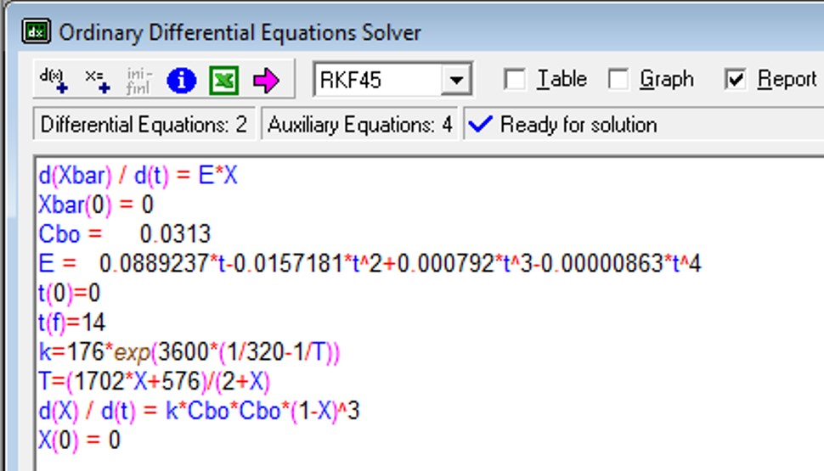
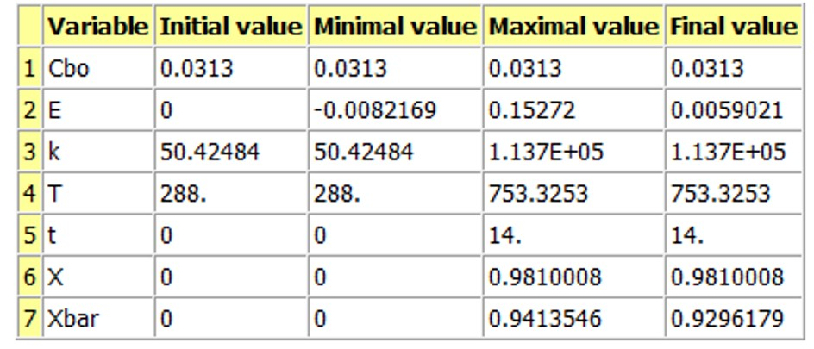
Segregation model, adiabatic operation, nonelementary reaction kinetics
A+B→C+D
-r_{A}=kC_{A}C_{B}²

Slide 39
The following slides show how the same problem would be solved and the solutions would differ if the reaction rate was still -r_{A}=kC_{A}C_{B}² but the reaction was instead elementary: A+2B→C+D
These slides may be provided as an extra example problem that the students may study on there own if time does not permit doing it in class.

Slide 40
For a pulse tracer expt, the effluent concentration C(t) & RTD function E(t) are given
in the table below. The irreversible, liquid-phase, elementary rxn A+2B→C+D, -r_{A}=kC_{A}C_{B}² will be carried out isothermally at 320K in this reactor. Calculate the conversion for an ideal PFR, the complete segregation model and maximum mixedness model. C_{A0}=C_{B0}=0.0313 mol/L & k=176 L²/mol²·min at 320K
t min | 0 | 1 | 2 | 3 | 4 | 5 | 6 | 7 | 8 | 9 | 10 | 12 | 14
C g/m³ | 0 | 1 | 5 | 8 | 10 | 8 | 6 | 4 | 3 | 2.2 | 1.5 | 0.6 | 0
E(t) | 0 | 0.02 | 0.1 | 0.16 | 0.2 | 0.16 | 0.12 | 0.08 | 0.06 | 0.044 | 0.03 | 0.012 | 0
Start with PFR design eq & see how far can we get:
C_{B0} = 0.0313
k = 0.0313
Could solve with Polymath if we knew the value of τ

Slide 41
For a pulse tracer expt, the effluent concentration C(t) & RTD function E(t) are given
in the table below. The irreversible, liquid-phase, elementary rxn A+2B→C+D, -r_{A}=kC_{A}C_{B}² will be carried out isothermally at 320K in this reactor. Calculate the conversion for an ideal PFR, the complete segregation model and maximum mixedness model. C_{A0}=C_{B0}=0.0313 mol/L & k=176 L²/mol²·min at 320K
t min | 0 | 1 | 2 | 3 | 4 | 5 | 6 | 7 | 8 | 9 | 10 | 12 | 14
C g/m³ | 0 | 1 | 5 | 8 | 10 | 8 | 6 | 4 | 3 | 2.2 | 1.5 | 0.6 | 0
E(t) | 0 | 0.02 | 0.1 | 0.16 | 0.2 | 0.16 | 0.12 | 0.08 | 0.06 | 0.044 | 0.03 | 0.012 | 0
t min | 0 | 1 | 2 | 3 | 4 | 5 | 6 | 7 | 8 | 9 | 10 | 12 | 14
C g/m³ | 0 | 1 | 5 | 8 | 10 | 8 | 6 | 4 | 3 | 2.2 | 1.5 | 0.6 | 0
E(t) | 0 | 0.02 | 0.1 | 0.16 | 0.2 | 0.16 | 0.12 | 0.08 | 0.06 | 0.044 | 0.03 | 0.012 | 0
t*E(t) | 0 | 0.02 | 0.2 | 0.48 | 0.8 | 0.8 | 0.72 | 0.56 | 0.48 | 0.396 | 0.3 | 0.144 | 0
How do we determine τ?
For an ideal reactor, τ = t_{m}
Use numerical method to determine t_{m}:

Slide 42
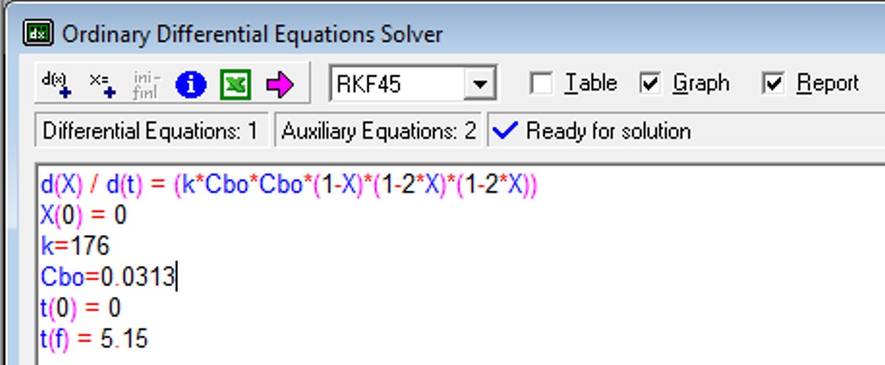
For a pulse tracer expt, the effluent concentration C(t) & RTD function E(t) are given
in the table below. The irreversible, liquid-phase, elementary rxn A+2B→C+D, -r_{A}=kC_{A}C_{B}² will be carried out isothermally at 320K in this reactor. Calculate the conversion for an ideal PFR, the complete segregation model and maximum mixedness model. C_{A0}=C_{B0}=0.0313 mol/L & k=176 L²/mol²·min at 320K
t min | 0 | 1 | 2 | 3 | 4 | 5 | 6 | 7 | 8 | 9 | 10 | 12 | 14
C g/m³ | 0 | 1 | 5 | 8 | 10 | 8 | 6 | 4 | 3 | 2.2 | 1.5 | 0.6 | 0
E(t) | 0 | 0.02 | 0.1 | 0.16 | 0.2 | 0.16 | 0.12 | 0.08 | 0.06 | 0.044 | 0.03 | 0.012 | 0
t min | 0 | 1 | 2 | 3 | 4 | 5 | 6 | 7 | 8 | 9 | 10 | 12 | 14
C g/m³ | 0 | 1 | 5 | 8 | 10 | 8 | 6 | 4 | 3 | 2.2 | 1.5 | 0.6 | 0
E(t) | 0 | 0.02 | 0.1 | 0.16 | 0.2 | 0.16 | 0.12 | 0.08 | 0.06 | 0.044 | 0.03 | 0.012 | 0
t*E(t) | 0 | 0.02 | 0.2 | 0.48 | 0.8 | 0.8 | 0.72 | 0.56 | 0.48 | 0.396 | 0.3 | 0.144 | 0
For an ideal reactor, τ = t_{m}
Final X_{A} corresponds to τ=5.15 min

Slide 43
For a pulse tracer expt, the effluent concentration C(t) & RTD function E(t) are given
in the table below. The irreversible, liquid-phase, elementary rxn A+2B→C+D, -r_{A}=kC_{A}C_{B}² will be carried out isothermally at 320K in this reactor. Calculate the conversion for an ideal PFR, the complete segregation model and maximum mixedness model. C_{A0}=C_{B0}=0.0313 mol/L & k=176 L²/mol²·min at 320K
t min | 0 | 1 | 2 | 3 | 4 | 5 | 6 | 7 | 8 | 9 | 10 | 12 | 14
C g/m³ | 0 | 1 | 5 | 8 | 10 | 8 | 6 | 4 | 3 | 2.2 | 1.5 | 0.6 | 0
E(t) | 0 | 0.02 | 0.1 | 0.16 | 0.2 | 0.16 | 0.12 | 0.08 | 0.06 | 0.044 | 0.03 | 0.012 | 0
Segregation model with Polymath:
X_{A}(t) is from batch reactor design eq
Batch reactor design eq:
Stoichiometry:
Best-fit polynomial line for E(t) vs t calculated by Polymath (slide 19)
k=176
C_{B0}=0.0313
E(t)= 0.0889237*t -0.0157181*t² + 0.0007926*t³ – 8.63E-6*t⁴

Slide 44
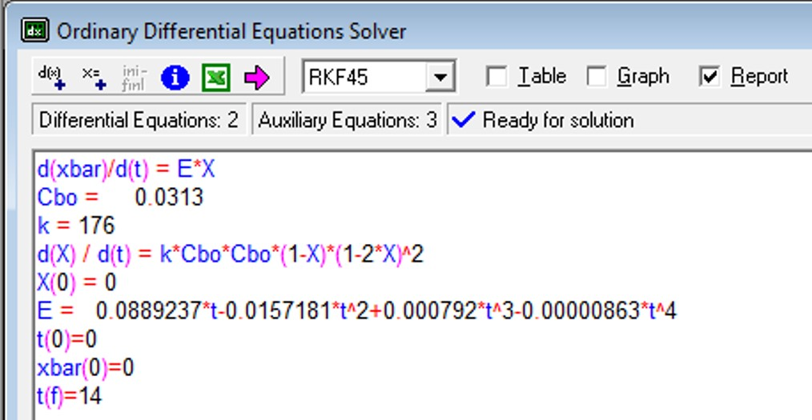
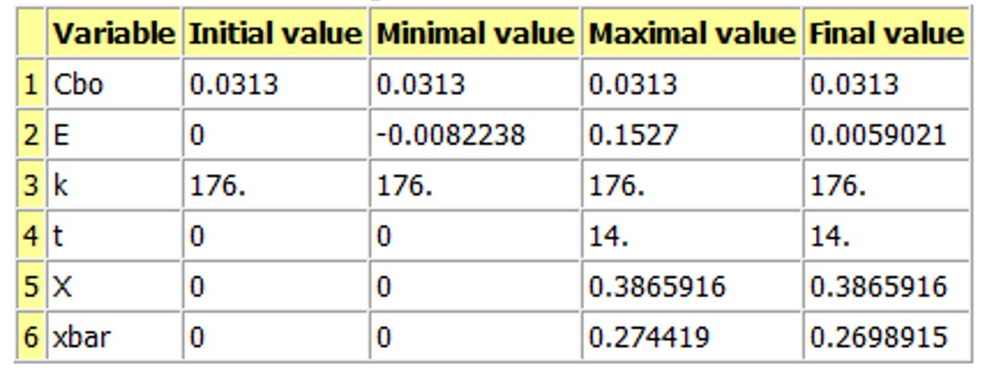
Segregation model, isothermal operation, elementary rxn: A+2B→C+D

Slide 45
For a pulse tracer expt, the effluent concentration C(t) & RTD function E(t) are given
in the table below. The irreversible, liquid-phase, elementary rxn A+2B→C+D, -r_{A}=kC_{A}C_{B}² will be carried out isothermally at 320K in this reactor. Calculate the conversion for an ideal PFR, the complete segregation model and maximum mixedness model. C_{A0}=C_{B0}=0.0313 mol/L & k=176 L²/mol²·min at 320K
t min | 0 | 1 | 2 | 3 | 4 | 5 | 6 | 7 | 8 | 9 | 10 | 12 | 14
C g/m³ | 0 | 1 | 5 | 8 | 10 | 8 | 6 | 4 | 3 | 2.2 | 1.5 | 0.6 | 0
E(t) | 0 | 0.02 | 0.1 | 0.16 | 0.2 | 0.16 | 0.12 | 0.08 | 0.06 | 0.044 | 0.03 | 0.012 | 0
Maximum mixedness model:
λ=time
Polymath cannot solve because λ→0 (must increase)
Substitute λ for z, where z=T̅-λ where T̅=longest time interval (14 min)
E must be in terms of T̅-z. Since T̅-z=λ & λ=t, simply substitute λ for t
E(λ)= 0.0889237*λ-0.0157181*λ² + 0.0007926*λ³ – 8.63E-6*λ⁴

Slide 46
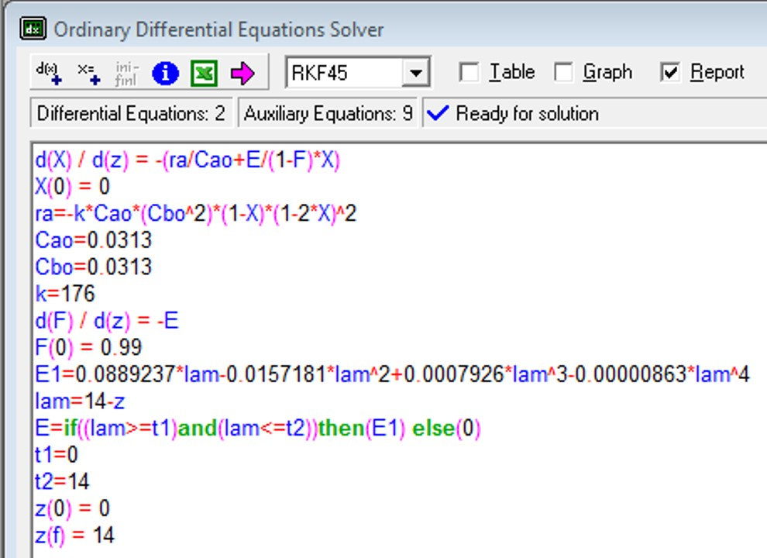
Maximum Mixedness Model, elementary reaction A+2B→C+D, -r_{A}=kC_{A}C_{B}²
Denominator cannot = 0
Eq for E describes RTD function only on interval t= 0 to 14 minutes, otherwise E=0
X_{A, maximum mixedness} = 0.25

Slide 47
For a pulse tracer expt, C(t) & E(t) are given in the table below. The irreversible, liquid-phase, elementary rxn A+2B→C+D, -r_{A}=kC_{A}C_{B}² will be carried out in this reactor. Calculate the conversion for the complete segregation model under adiabatic conditions with T₀= 288K, C_{A0}=C_{B0}=0.0313 mol/L, k=176 L²/mol²·min at 320K, ΔH°_{RX}=-40000 cal/mol, E/R =3600K, C_{PA}=C_{PB}=20cal/mol·K & C_{PC}=C_{PD}=30 cal/mol·K
t min | 0 | 1 | 2 | 3 | 4 | 5 | 6 | 7 | 8 | 9 | 10 | 12 | 14
C g/m³ | 0 | 1 | 5 | 8 | 10 | 8 | 6 | 4 | 3 | 2.2 | 1.5 | 0.6 | 0
E(t) | 0 | 0.02 | 0.1 | 0.16 | 0.2 | 0.16 | 0.12 | 0.08 | 0.06 | 0.044 | 0.03 | 0.012 | 0
Polymath eqs for segregation model:
E(t)= 0.0889237*t -0.0157181*t² + 0.0007926*t³ – 8.63E-6*t⁴
Express k as function of T:
Need equations from energy balance. For adiabatic operation:

Slide 48
For a pulse tracer expt, C(t) & E(t) are given in the table below. The irreversible, liquid-phase, elementary rxn A+2B→C+D, -r_{A}=kC_{A}C_{B}² will be carried out in this reactor. Calculate the conversion for the complete segregation model under adiabatic conditions with T₀= 288K, C_{A0}=C_{B0}=0.0313 mol/L, k=176 L²/mol²·min at 320K, ΔH°_{RX}=-40000 cal/mol, E/R =3600K, C_{PA}=C_{PB}=20cal/mol·K & C_{PC}=C_{PD}=30 cal/mol·K
t min | 0 | 1 | 2 | 3 | 4 | 5 | 6 | 7 | 8 | 9 | 10 | 12 | 14
C g/m³ | 0 | 1 | 5 | 8 | 10 | 8 | 6 | 4 | 3 | 2.2 | 1.5 | 0.6 | 0
E(t) | 0 | 0.02 | 0.1 | 0.16 | 0.2 | 0.16 | 0.12 | 0.08 | 0.06 | 0.044 | 0.03 | 0.012 | 0
Adiabatic EB:
E(t)= 0.0889237*t -0.0157181*t² + 0.0007926*t³ – 8.63E-6*t⁴

Slide 49
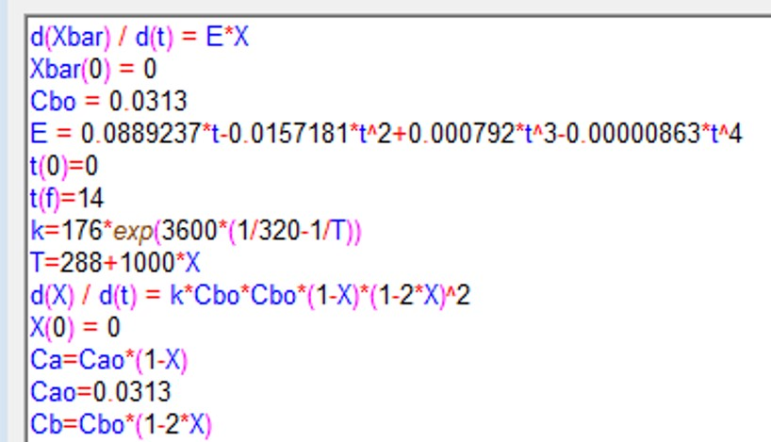
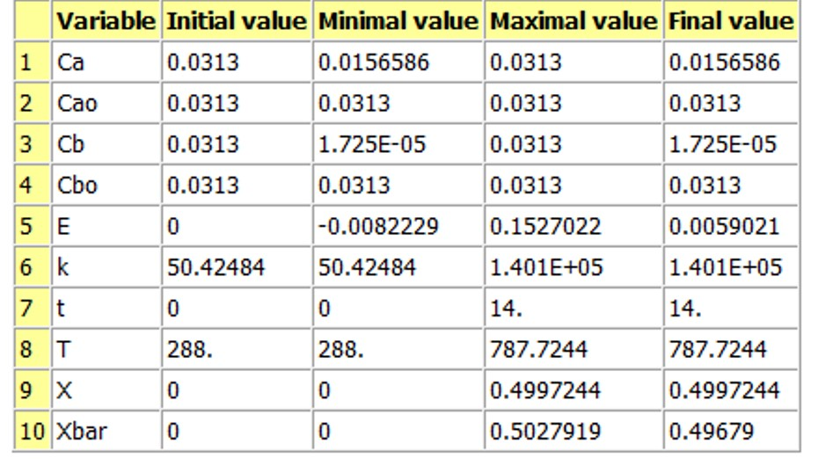
Segregation model, adiabatic operation, elementary reaction kinetics
A+2B→C+D
-r_{A}=kC_{A}C_{B}²
Because B is completely consumed by X_{A}=0.5
X̅_{A} = 0.50
Why so much lower than before?

