Slide 1
Lecture 27
Chemical Reaction Engineering (CRE) is the field that studies the rates and mechanisms of chemical reactions and the design of the reactors in which they take place.

Slide 2
Web Lecture 27 Class Lecture 23
How Reaction Rate Varies with:
Temperature
Catalyst Particle Size
Eternal Flow Rate
For
Reaction Rate Limited Reactors
Internal Diffusion Limited Reactions
External Rate Limited Reactions
And all 9 combinations of numbers and letters, Eq. 1A, 1B, 1C, 2A, 2B, 2C and 3A, 3B and 3C.

Slide 3
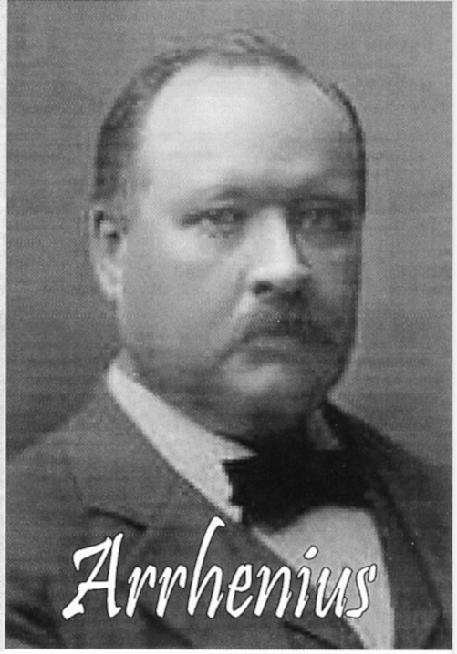
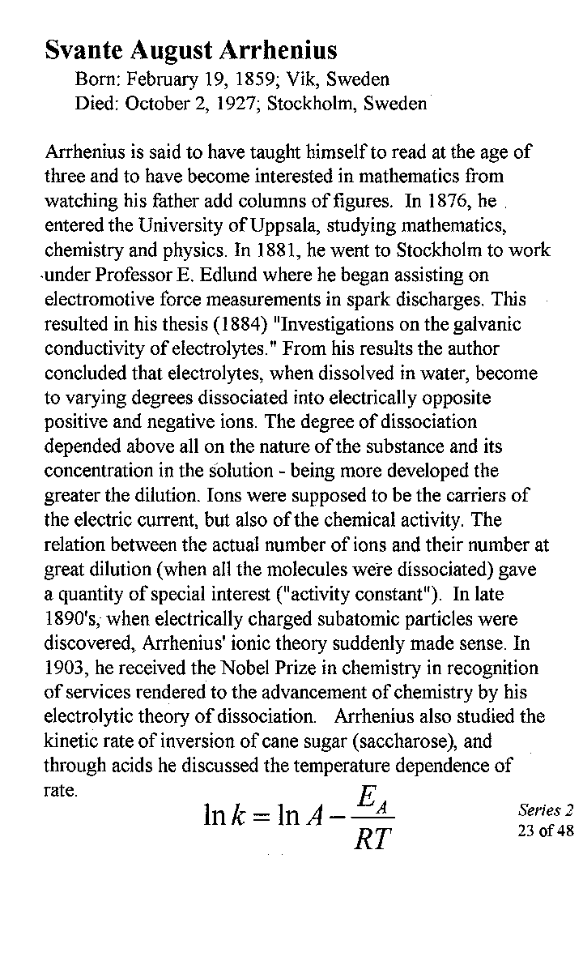

Slide 4
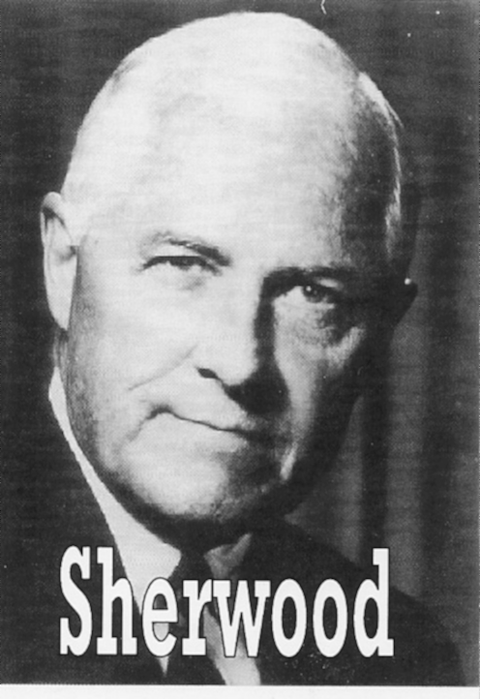
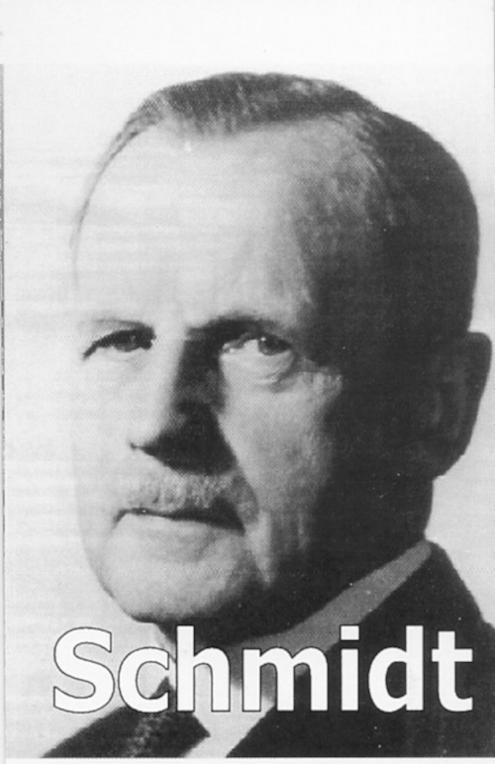
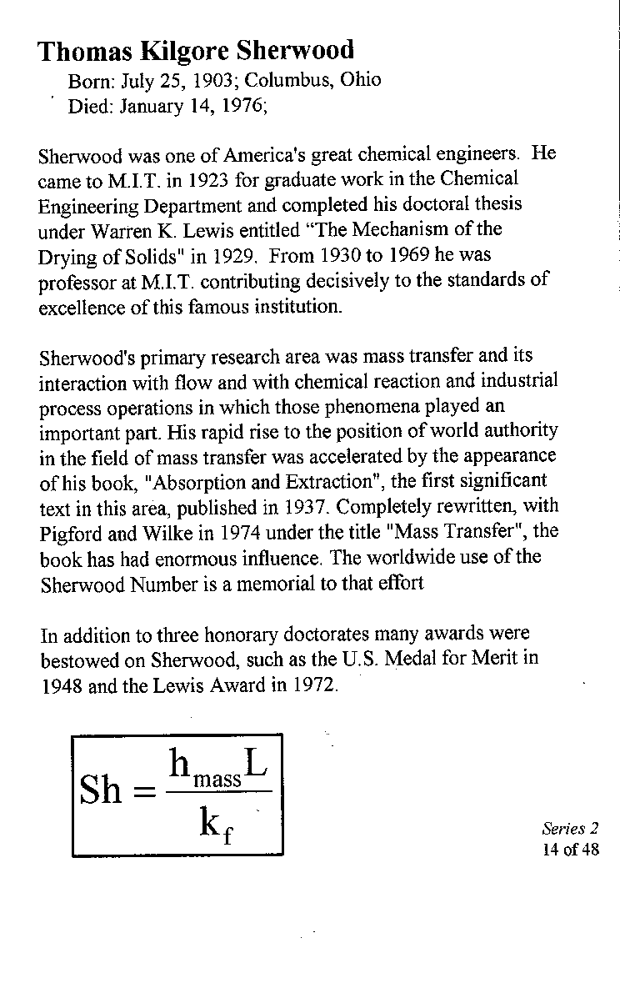
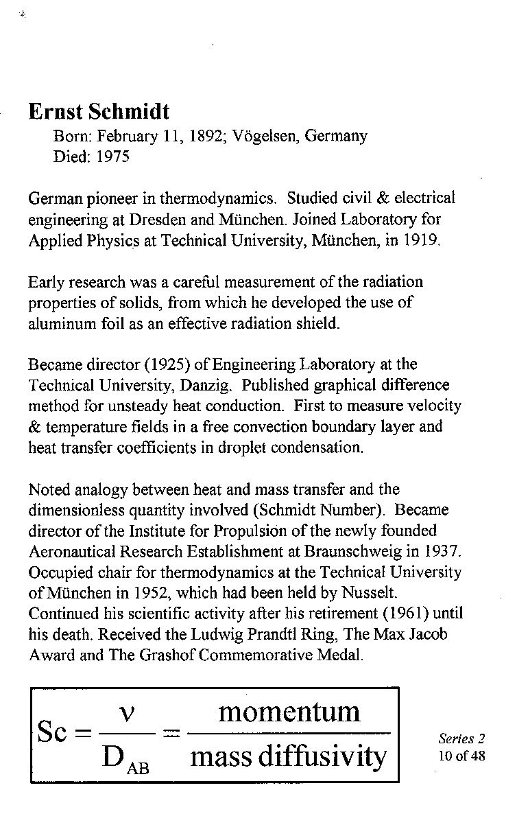

Slide 5
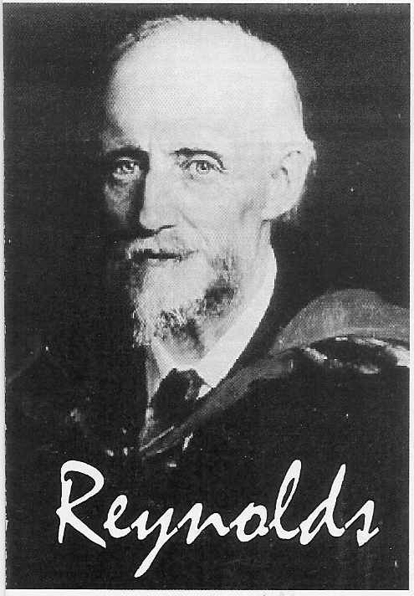
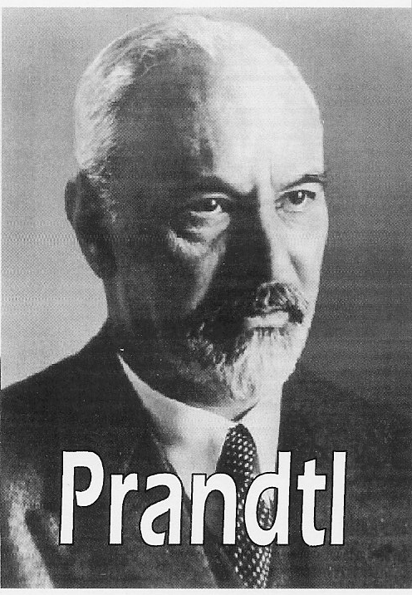
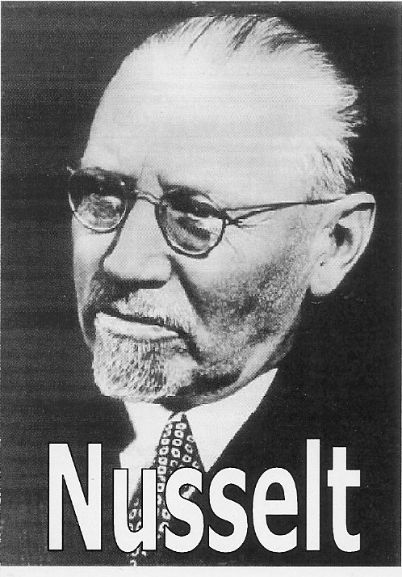
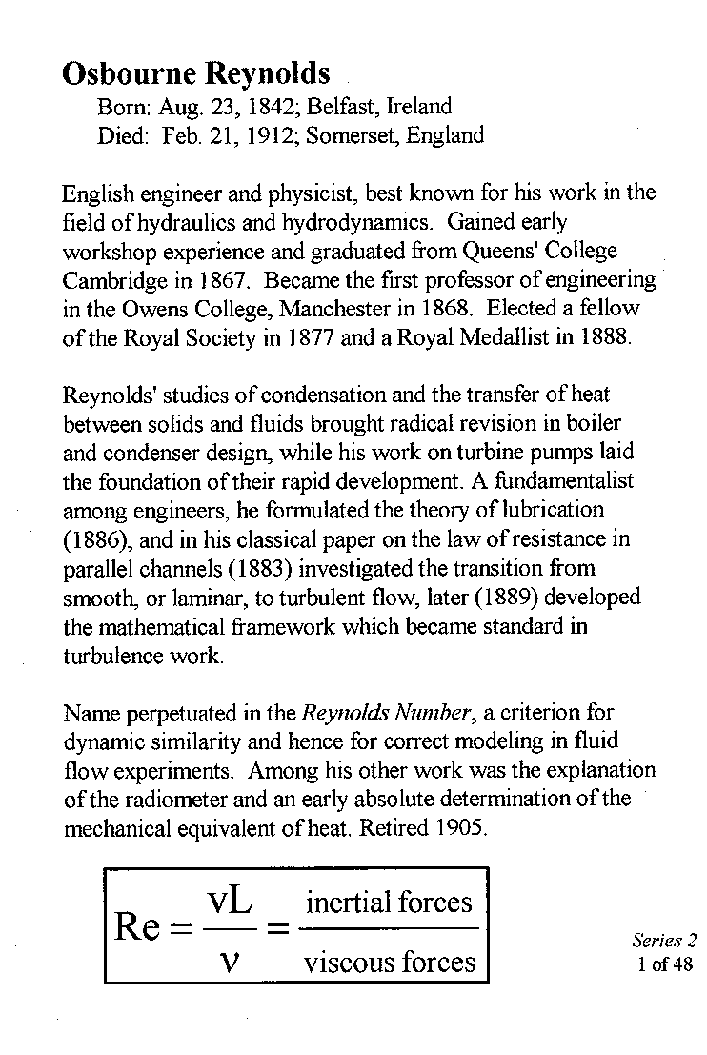
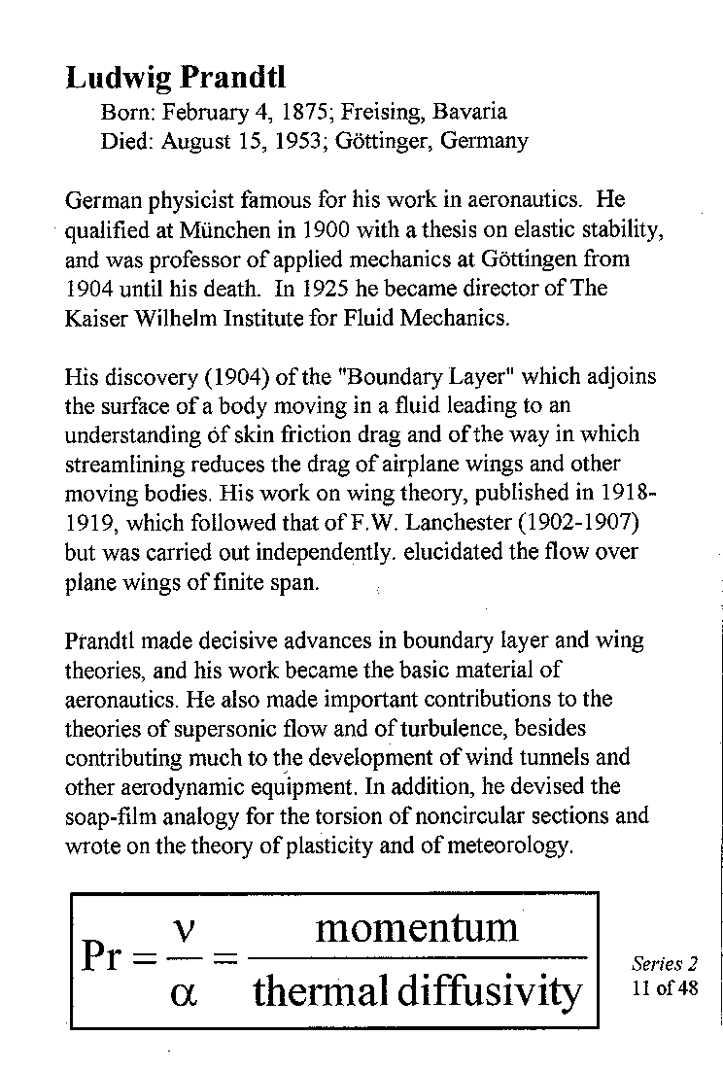
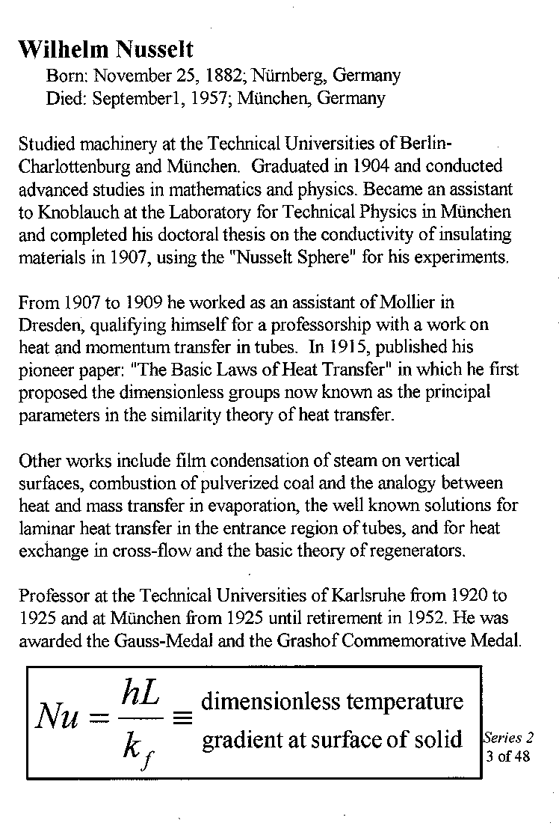

Slide 6
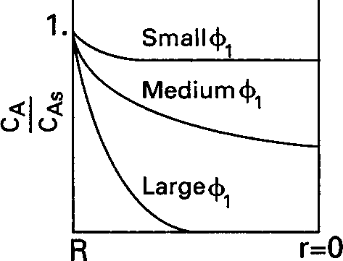
Internal Diffusion
How will we know these trends discussed in the last slide:
Solve the diffusion and reaction equation for catalyst particle for concentration gradient

Slide 7
2. Find the true rate of reaction as a function of the external and internal surface reactions.

Slide 8
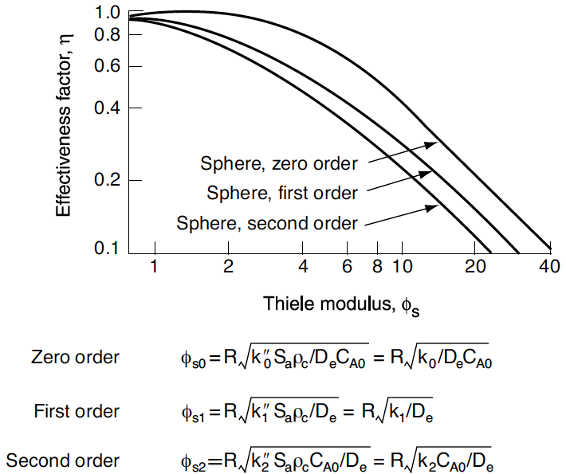

Slide 9
Internal Diffusion
=

Slide 10
Surface Reaction

Slide 11
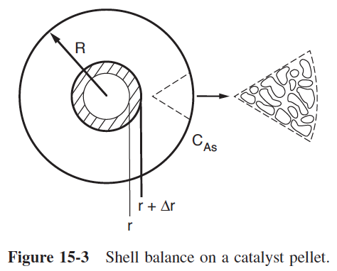

Slide 12
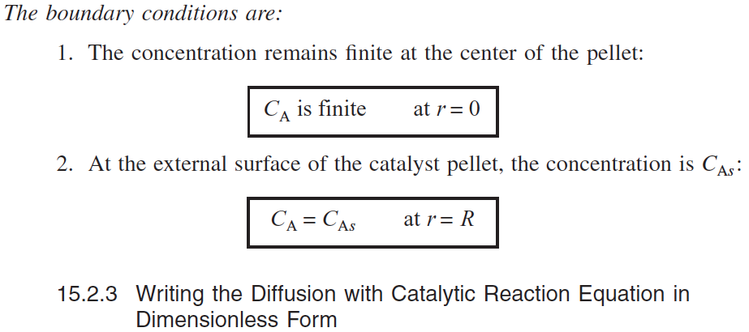
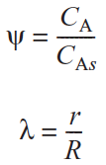

Slide 13
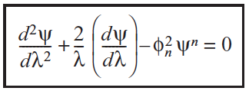

Slide 14
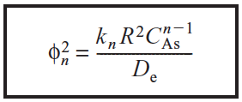

Slide 15
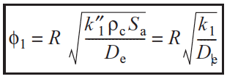
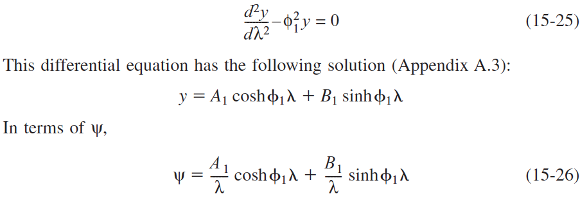
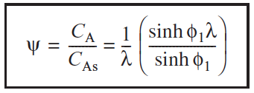
For a first-order reaction, Equation (15-19) becomes
The Thiele modulus for this first order reaction is

Slide 16
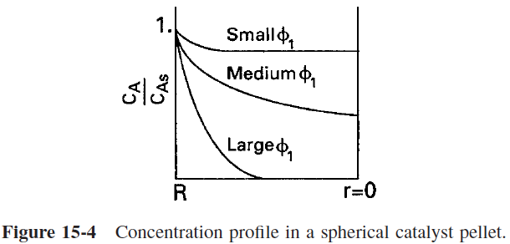

Slide 18
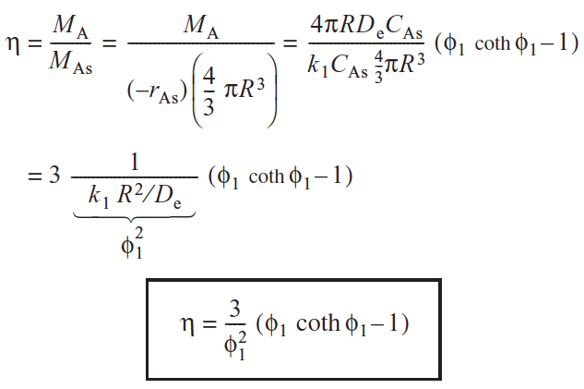

Slide 19
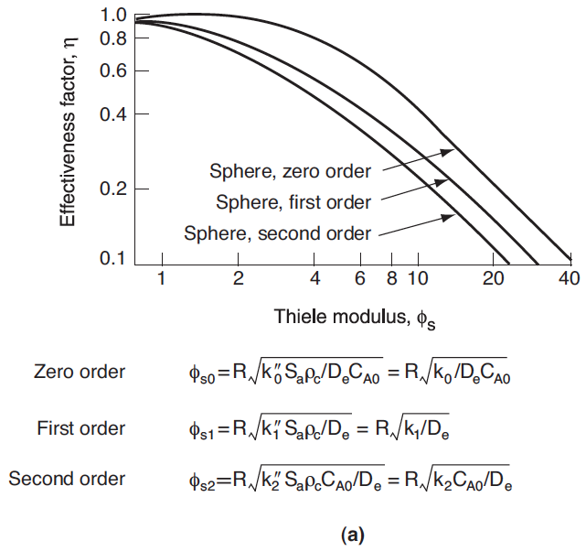

Slide 20
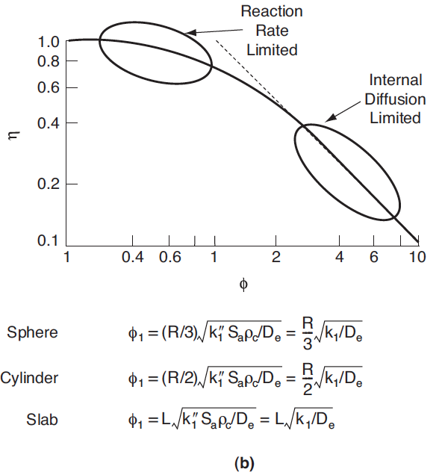

Slide 21
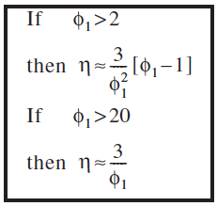

Slide 22
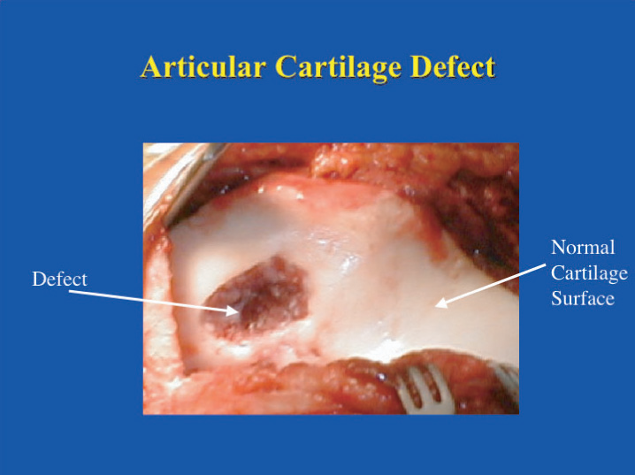
Figure E15-1.1 Damaged cartilage. (Figure courtesy of Newsweek,
September 3, 2001.)

Slide 23
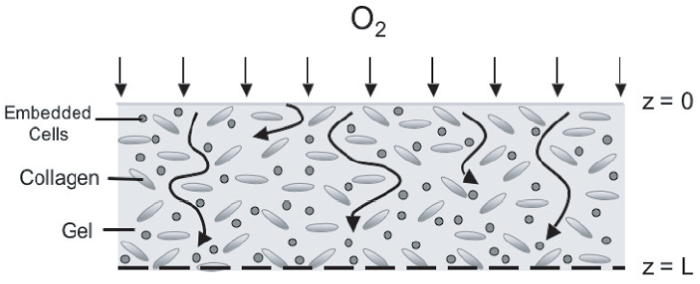
Diffusion of O₂ around collagen

Slide 24
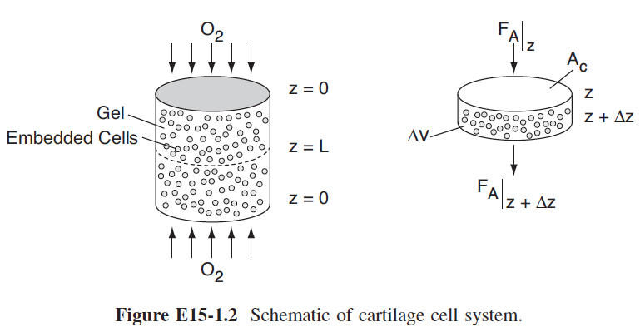

Slide 25
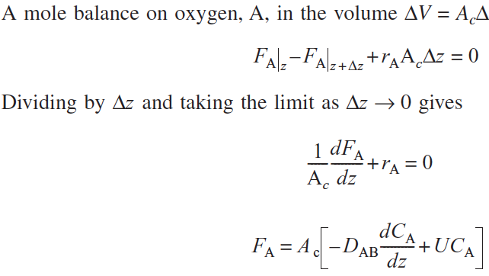

Slide 26
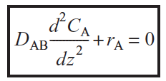

Slide 27
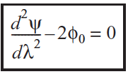

Slide 28
