Slide 1
Lecture 18
Chemical Reaction Engineering (CRE) is the field that studies the rates and mechanisms of chemical reactions and the design of the reactors in which they take place.

Slide 2
Web Lecture 18
Class Lecture 23–Tuesday
Catalytic Mechanisms
Data Analysis
Chemical Vapor Deposition (CVD)

Slide 3
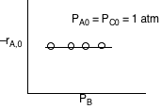
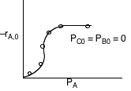
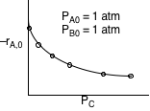
Catalytic Mechanisms
(a) The initial rate of reaction is shown below
(A) (B)
(C)

Slide 4
Catalytic Mechanisms

Slide 5
Catalytic Mechanisms

Slide 6
Catalytic Mechanisms

Slide 7
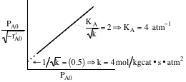
Catalytic Mechanisms

Slide 8
Catalytic Mechanisms
Where K_{A} = 4 atm^{–1} and K_{C} = 6 atm^{–1}
1) At what is the ratio of sites with A adsorbed to those sites with C adsorbed when the conversion is 50%?
2) What is the conversion when the sites with A adsorbed are equal to those with C adsorbed?

Slide 9
Catalytic Mechanisms

Slide 10
Catalytic Mechanisms
1) At X = 0.5
2) At an equal concentrations of A and C sites, the conversion will be

Slide 11
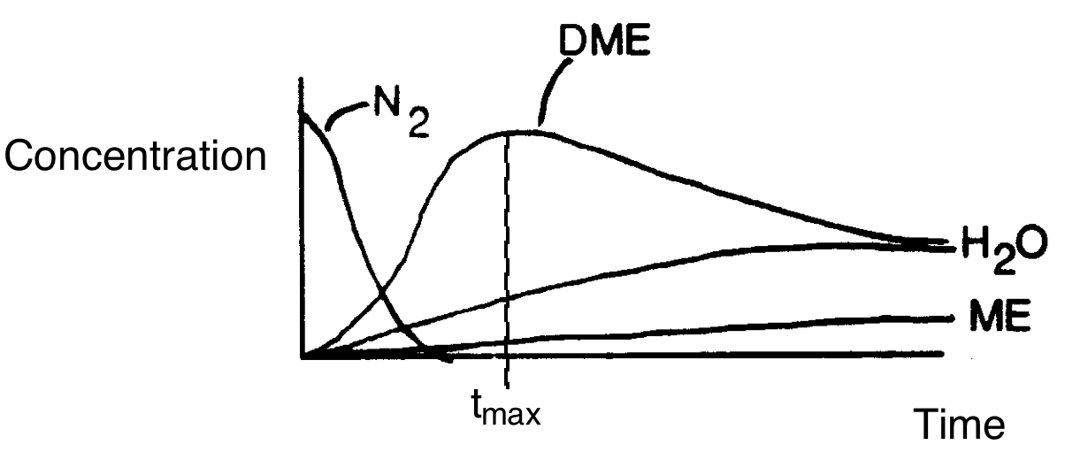
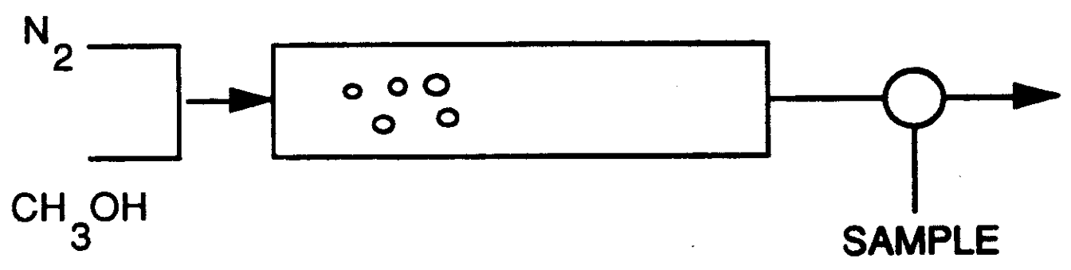
Dimethyl Either
Initially water does not exit the reactor the same as DME because
Which of the following best describes the data
A There is more DME than water.
B Steady state has been reached.
C Water reacts with ME.
D Water is adsorbed on the surface.

Slide 12
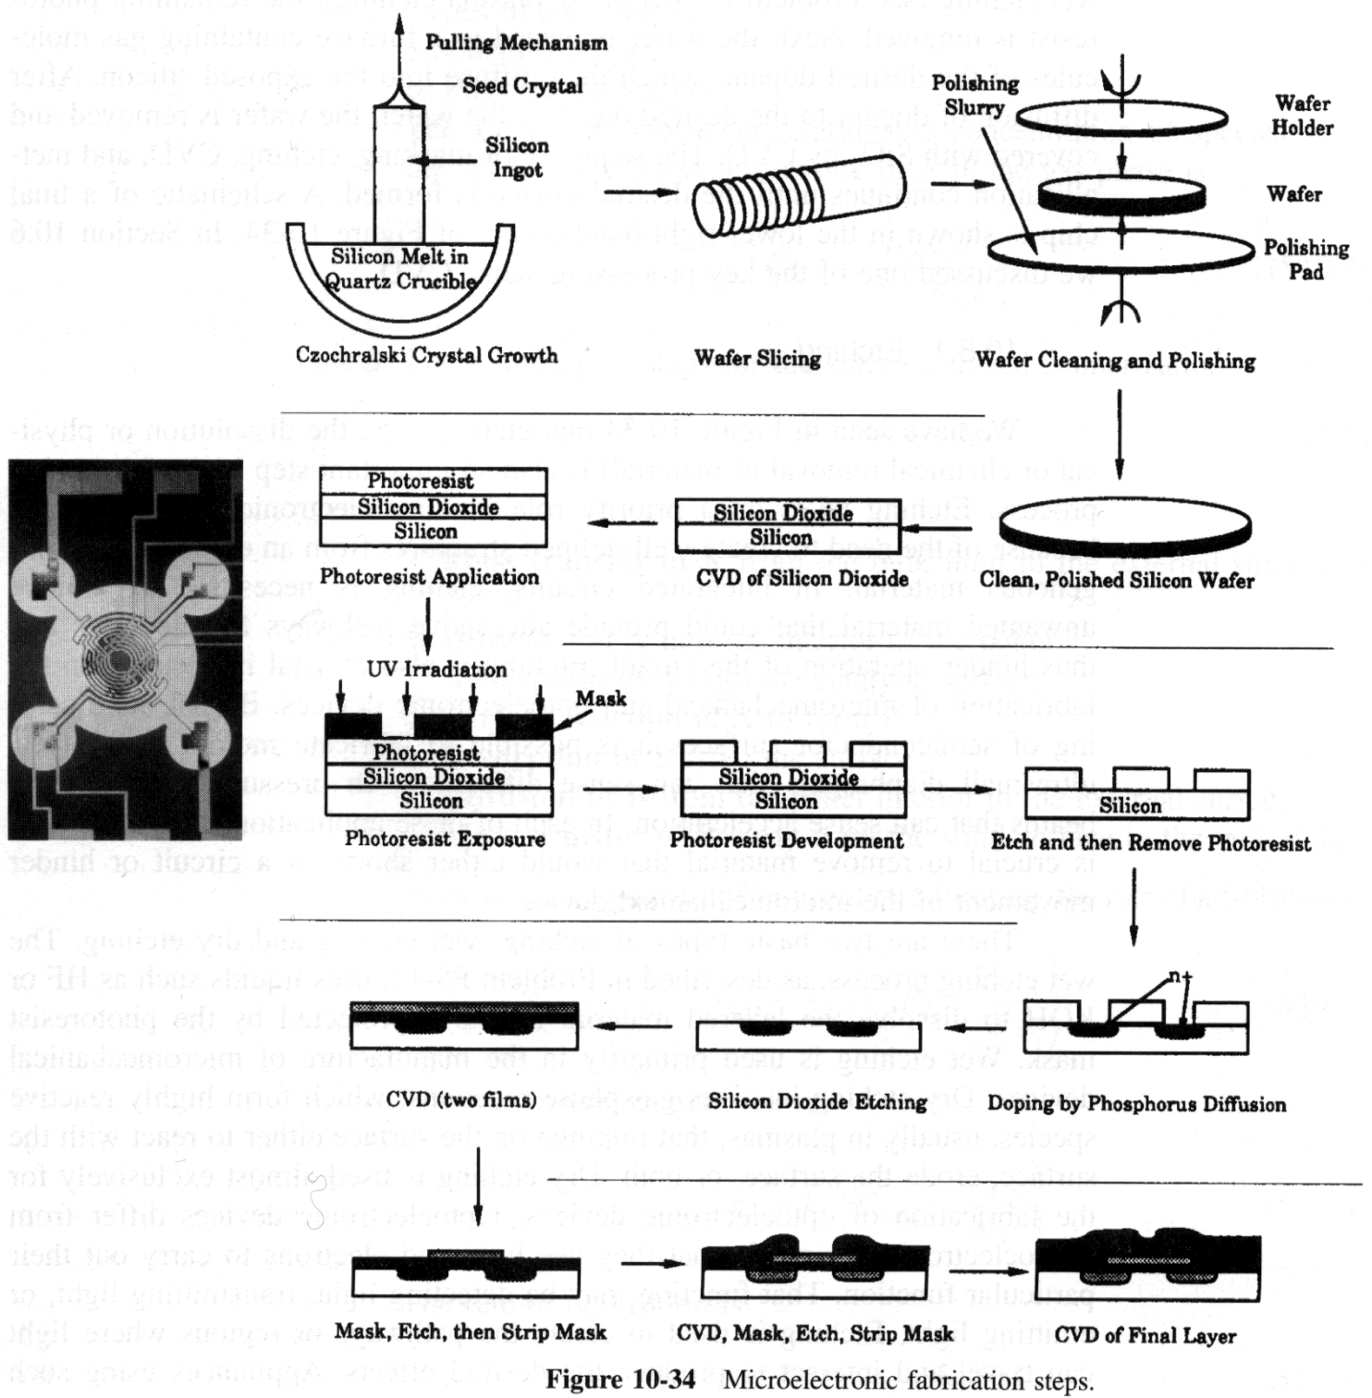
Chemical Reaction Engineering in the Electronics Industry

Slide 13
Chemical Reaction Engineering in the Electronics Industry
ChE 342
Czochralski Crystal Growth – Heat Transfer
Doping of n/p junction – Diffusion
ChE 344
Chemical Vapor Deposition (Catalysis Analogy)
Photo Resist Formation
Photo Resist Dissolution
Etching
The 5 steps
1. Postulate Mechanism
(sometimes first includes a gas phase reaction (then
adsorption, surface reaction and desorption)
2. Postulate Rate Limiting Step
3. Evaluate Parameters in Terms of Measured Variables
4. Surface Area Balance
5. Evaluate Rate Law Parameters

Slide 14
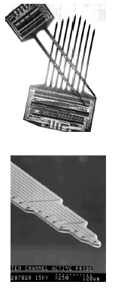
Chemical Reaction Engineering in the Electronics Industry

Slide 15
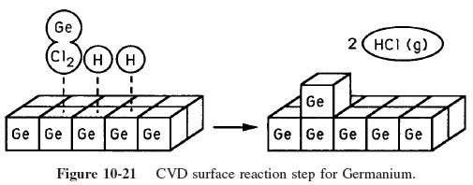
Chemical Vapor Deposition

Slide 16
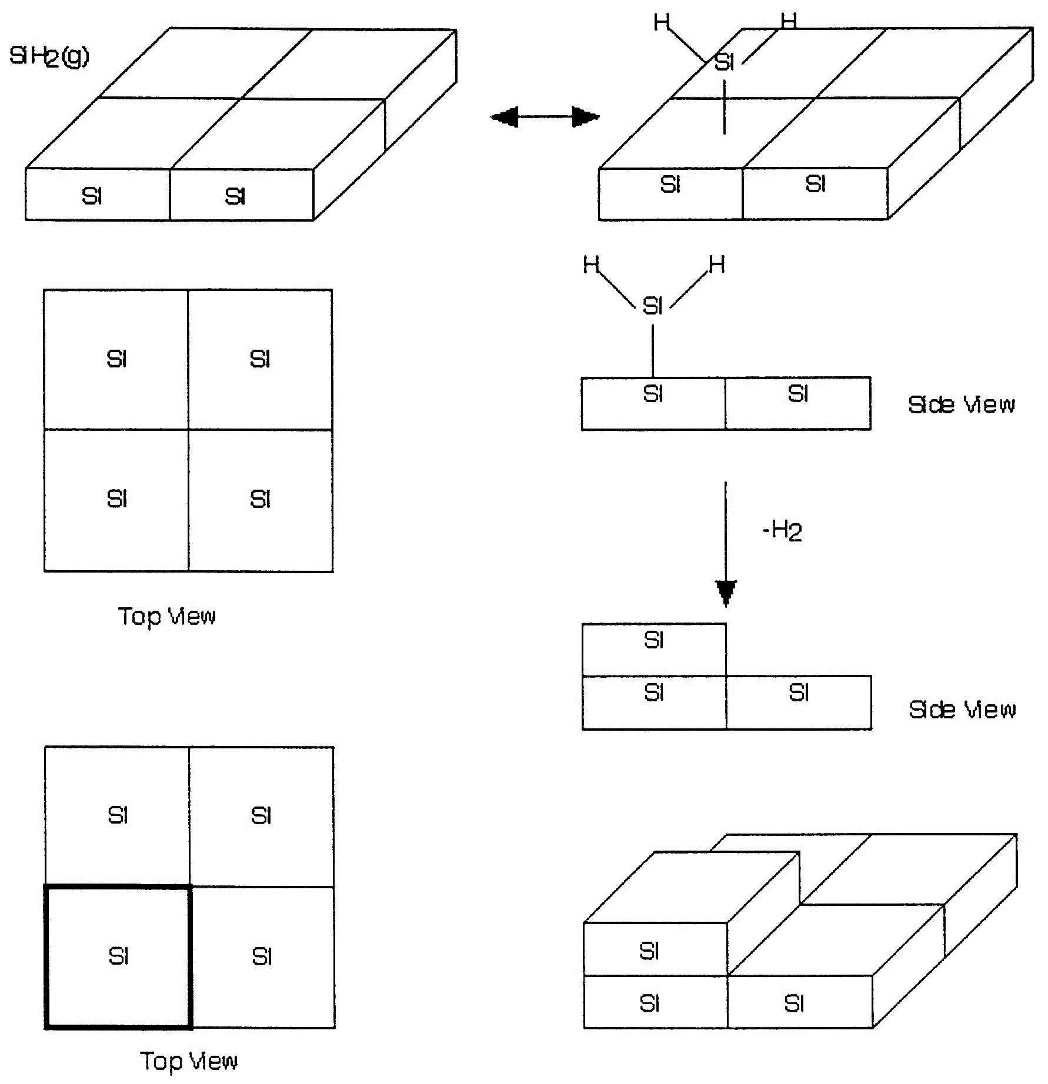
Chemical Vapor Deposition

Slide 17
Chemical Vapor Deposition
1) Mechanism
Gas Phase
Homogeneous
Heterogeneous

Slide 18
Chemical Vapor Deposition
2) Rate Limiting Step
3) Express f_{i} in terms of P_{i}
4) Area Balance

Slide 19
Chemical Vapor Deposition
4) Area Balance
5) Combine

Slide 20
Homogeneous Reaction

Slide 21
End of Web Lecture 18
End of Class Lecture 23

