Slide 1
Lecture 19
Chemical Reaction Engineering (CRE) is the field that studies the rates and mechanisms of chemical reactions and the design of the reactors in which they take place.

Slide 2
Web Lecture 19
Class Lecture 17–Tuesday
Energy Balance Fundamentals
  Adiabatic reactors

Slide 3
Today’s Lecture
Energy Balance, Rationale and Overview
Let’s calculate the volume necessary to achieve a conversion, X, in a PFR for a first-order, exothermic and adiabatic reaction.
The temperature profile might look something like this:
T
k
X
V
V
V

Slide 4
Energy Balance, Rationale and Overview
Mole Balance:
Rate Law:
Stoichiometry:
Combine:

Slide 5
Energy Balance, Rationale and Overview
We cannot solve this equation because we don’t have X either as a function of V or T.
We need another equation. That equation is:
The Energy Balance

Slide 6
User Friendly Equations Relate T and X or F_{i}
1. Adiabatic CSTR, PFR, Batch or PBR

Slide 7
Adiabatic
Exothermic
Endothermic
T₀
T
T
T₀
0
X_{EB}
0
X_{EB}

Slide 8
User Friendly Equations Relate T and X or F_{i}
2. CSTR with heat exchange: UA(T_{a}-T) and a large coolant flow rate
T
T_{a}

Slide 9
User Friendly Equations Relate T and X or F_{i}
3. PFR/PBR with heat exchange
T_{a}
Coolant
F_{A0}
T₀
3A. PFR in terms of conversion

Slide 10
User Friendly Equations Relate T and X or F_{i}
3B. PBR in terms of conversion
3C. PBR in terms of molar flow rates

Slide 11
User Friendly Equations Relate T and X or F_{i}
3D. PFR in terms of molar flow rates
4. Batch

Slide 12
User Friendly Equations Relate T and X or F_{i}
  5. For Semibatch or unsteady CSTR
6. For multiple reactions in a PFR (q reactions and m species)
Let’s look where these User Friendly Equations came from.

Slide 13
Energy Balance
Reactor with no Spatial Variations
Reactor

Slide 14
Energy Balance
Reactor with no Spatial Variations
Reactor
Rate of flow of heat to the system from the surroundings

Slide 15
Energy Balance
Reactor with no Spatial Variations
Reactor
Rate of flow of heat to the system from the surroundings
Rate of work done by the system on the surroundings
-
-

Slide 16
Energy Balance
Reactor with no Spatial Variations
Reactor
Rate of flow of heat to the system from the surroundings
Rate of work done by the system on the surroundings
Rate of energy added to the system by mass flow into the system
-
+
-
+

Slide 17
Energy Balance
Reactor with no Spatial Variations
Reactor
Rate of flow of heat to the system from the surroundings
Rate of work done by the system on the surroundings
Rate of energy added to the system by mass flow into the system
Rate of energy leaving system by mass flow out of the system
-
+
-
-
+
-

Slide 18
Energy Balance
Reactor with no Spatial Variations
Reactor
Rate of accumulation of energy within the system
Rate of flow of heat to the system from the surroundings
Rate of work done by the system on the surroundings
Rate of energy added to the system by mass flow into the system
Rate of energy leaving system by mass flow out of the system
=
-
+
-
=
-
+
-

Slide 19
Energy Balance
Energy Balance on an open system: schematic.

Slide 20
OK folks, here is what we are going to do to put the above equation into a usable form.
1. Replace U_{i} by U_{i}=H_{i}-PV_{i}
2. Express H_{i} in terms of heat capacities
3. Express F_{i} in terms of either conversion or rates
of reaction
4. Define ΔH_{Rx}
5. Define ΔC_{P}
6. Manipulate so that the overall energy balance
is in terms of the User Friendly Equations.

Slide 21

Intro to Heat Effects
Assumptions:
=0
=0
Other energies small compared to internal
Recall:

Slide 22
Intro to Heat Effects
Substituting for
Steady State:

Slide 23
Intro to Heat Effects
General Energy Balance :
For Steady State Operation:

Slide 24
Intro to Heat Effects

Slide 25
Intro to Heat Effects
For No Phase Changes
Enthalpy of formation at temperature T_{R}
Constant Heat Capacities
Heat of reaction at temperature T

Slide 26
Intro to Heat Effects
Substituting back into the Energy Balance
Adiabatic (Q=0) and no Work

Slide 27
Intro to Heat Effects

Slide 28
Intro to Heat Effects
Substituting back into the Energy Balance

Slide 29
Adiabatic Energy Balance
Adiabatic (Q=0) and no Work
T
Exothermic
T₀
X

Slide 30
Example: Adiabatic PFR
A ↔ B
1) Mole Balance:
2) Rate Laws:

Slide 31
Example: Adiabatic PFR
A ↔ B
3) Stoichiometry:
4) Energy Balance
First need to calculate the maximum conversion which is at the adiabatic equilibrium conversion.

Slide 32
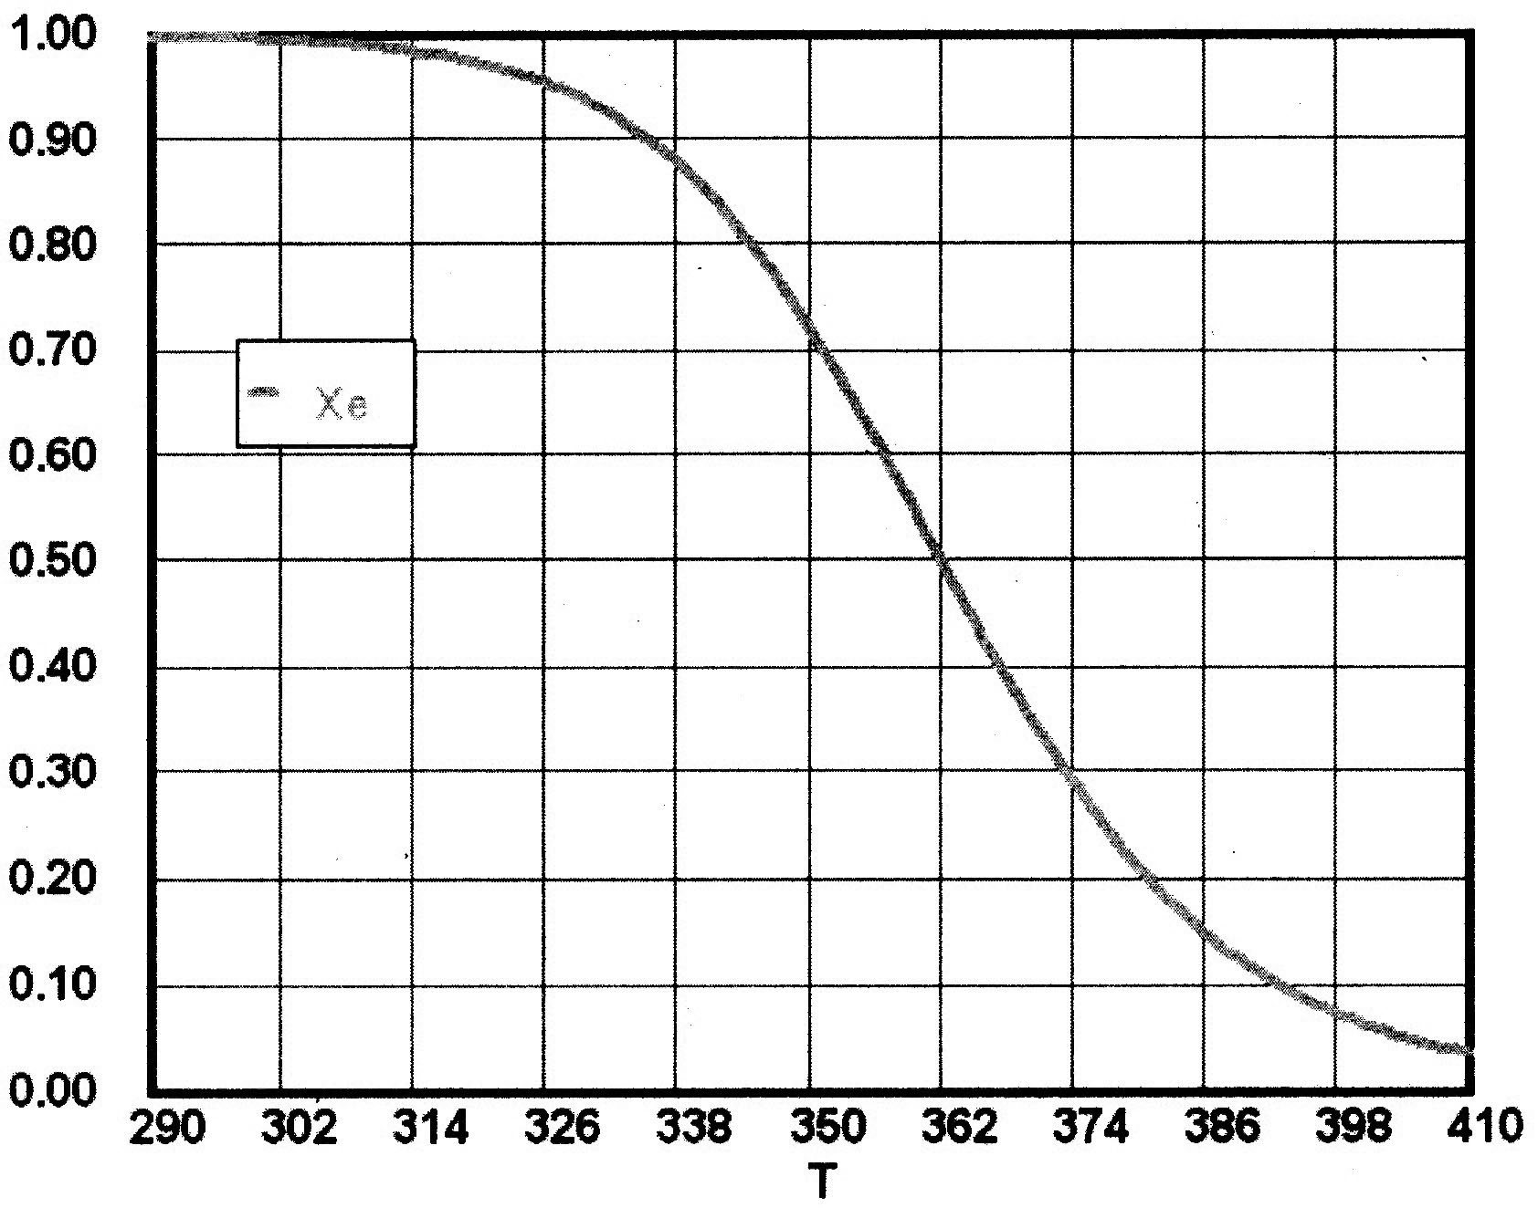
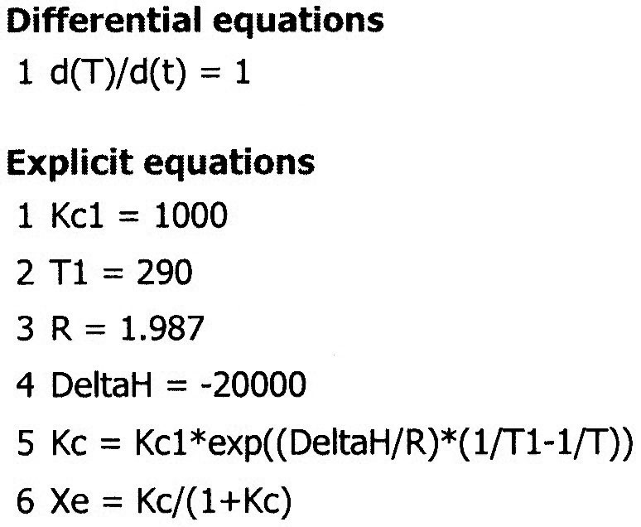
Example: Adiabatic PFR

Slide 33
Example: Adiabatic PFR
A ↔ B
X_{e}
Adiabatic equilibrium conversion and temperature
T

Slide 34
Example: Adiabatic PFR
We can now form a table. Set X, then calculate T, -V_{A},
and F_{A0}/-r_{A}, increment X, then plot F_{A0}/-r_{A} vs. X:
F_{A0}/-r_{A}
X

Slide 35
End of Web Lecture 19
Class Lecture 17

