Slide 1
Lecture 22
Chemical Reaction Engineering (CRE) is the field that studies the rates and mechanisms of chemical reactions and the design of the reactors in which they take place.

Slide 2

Web Lecture 22
Class Lecture 18-Thursday
Multiple Reactions with Heat Effects

Slide 3
Multiple Reactions with Heat Effects
PFR/PBR:
CSTR:
These equations are coupled with the mole balances and rate law equations.

Slide 4
Multiple Reactions with Heat Effects
Multiple Reactions
Make sure it is in respect to A; Subscripts must agree

Slide 5
Multiple Reactions with Heat Effects
Multiple Reactions
1) Mole Balances:– every species (no conversion!)
2) Rate Laws:
– relative rates
– net rates
3) Stoichiometry:

Slide 6
Multiple Reactions with Heat Effects
Multiple Reactions
4) Heat Effects:

Slide 7
Multiple Reactions with Heat Effects
4) Heat Effects:
5) Parameters

Slide 8
Multiple Reactions with Heat Effects
4) Heat Effects:

Slide 9
The complex gas phase reactions
take place in a 10 dm³ PFR with a heat exchanger. Plot the temperature, concentrations, molar flow rates down the length of the reactor for the following operations. E.g., Note any maximums or minimums on your plot along with how they change for the different types of operations.
(a) Adiabatic operation
(b) Heat exchange with constant T_{a}
(c) Co current heat exchange
(d) Counter current heat exchange
(e) For parts (c) and (d), plot Q_{r} and Q_{g} down the length of the reactor. What do you observe?
Additional Information

Slide 10
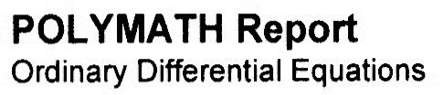
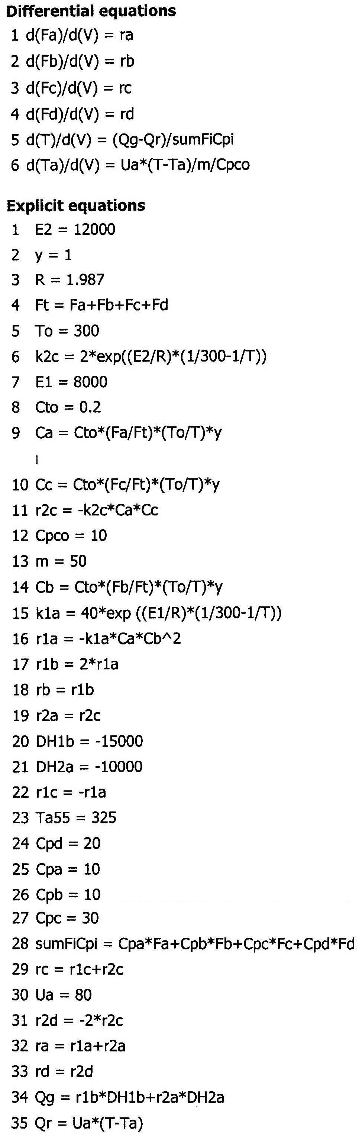
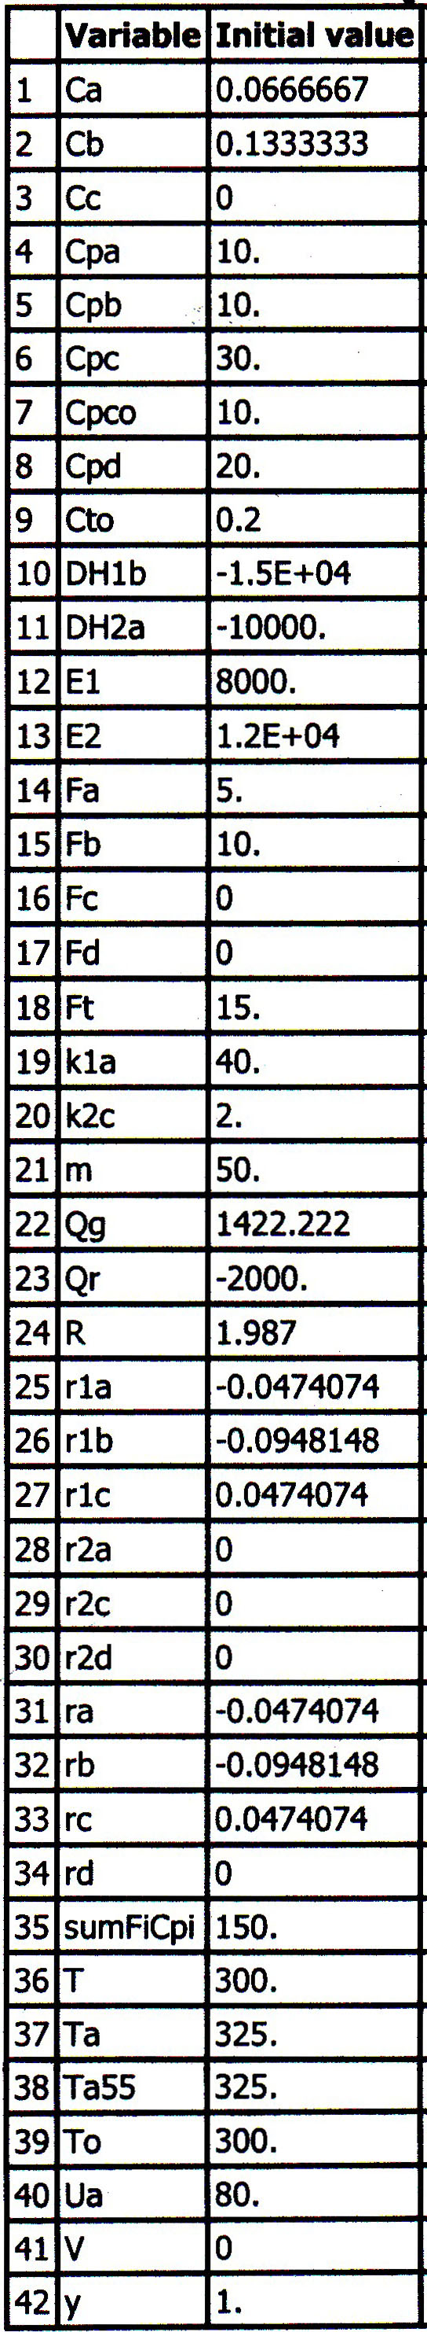

Slide 11
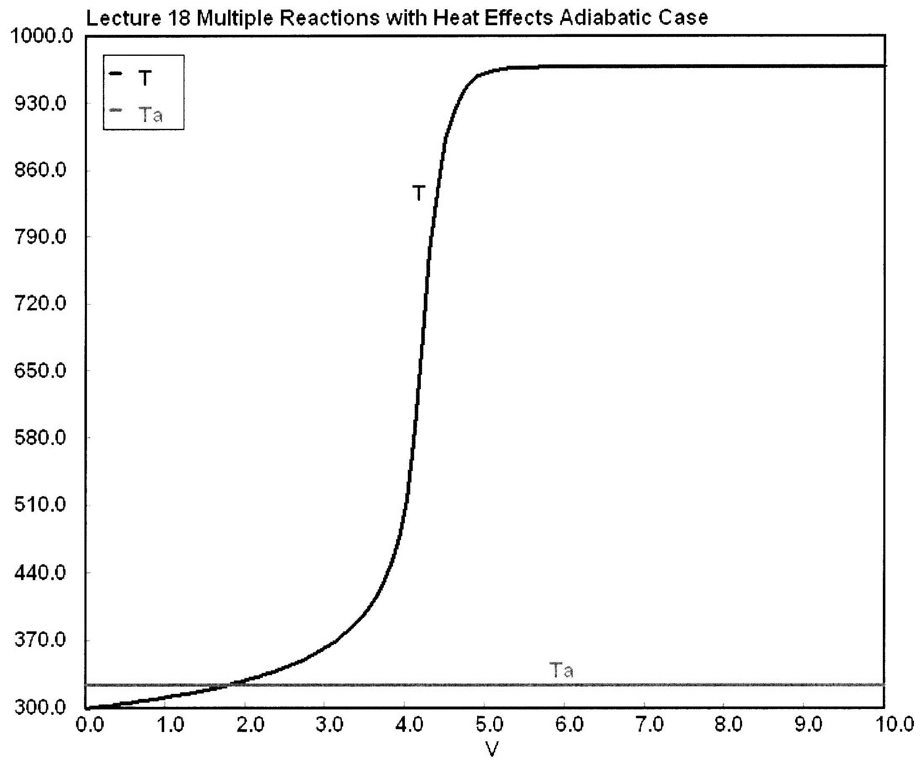
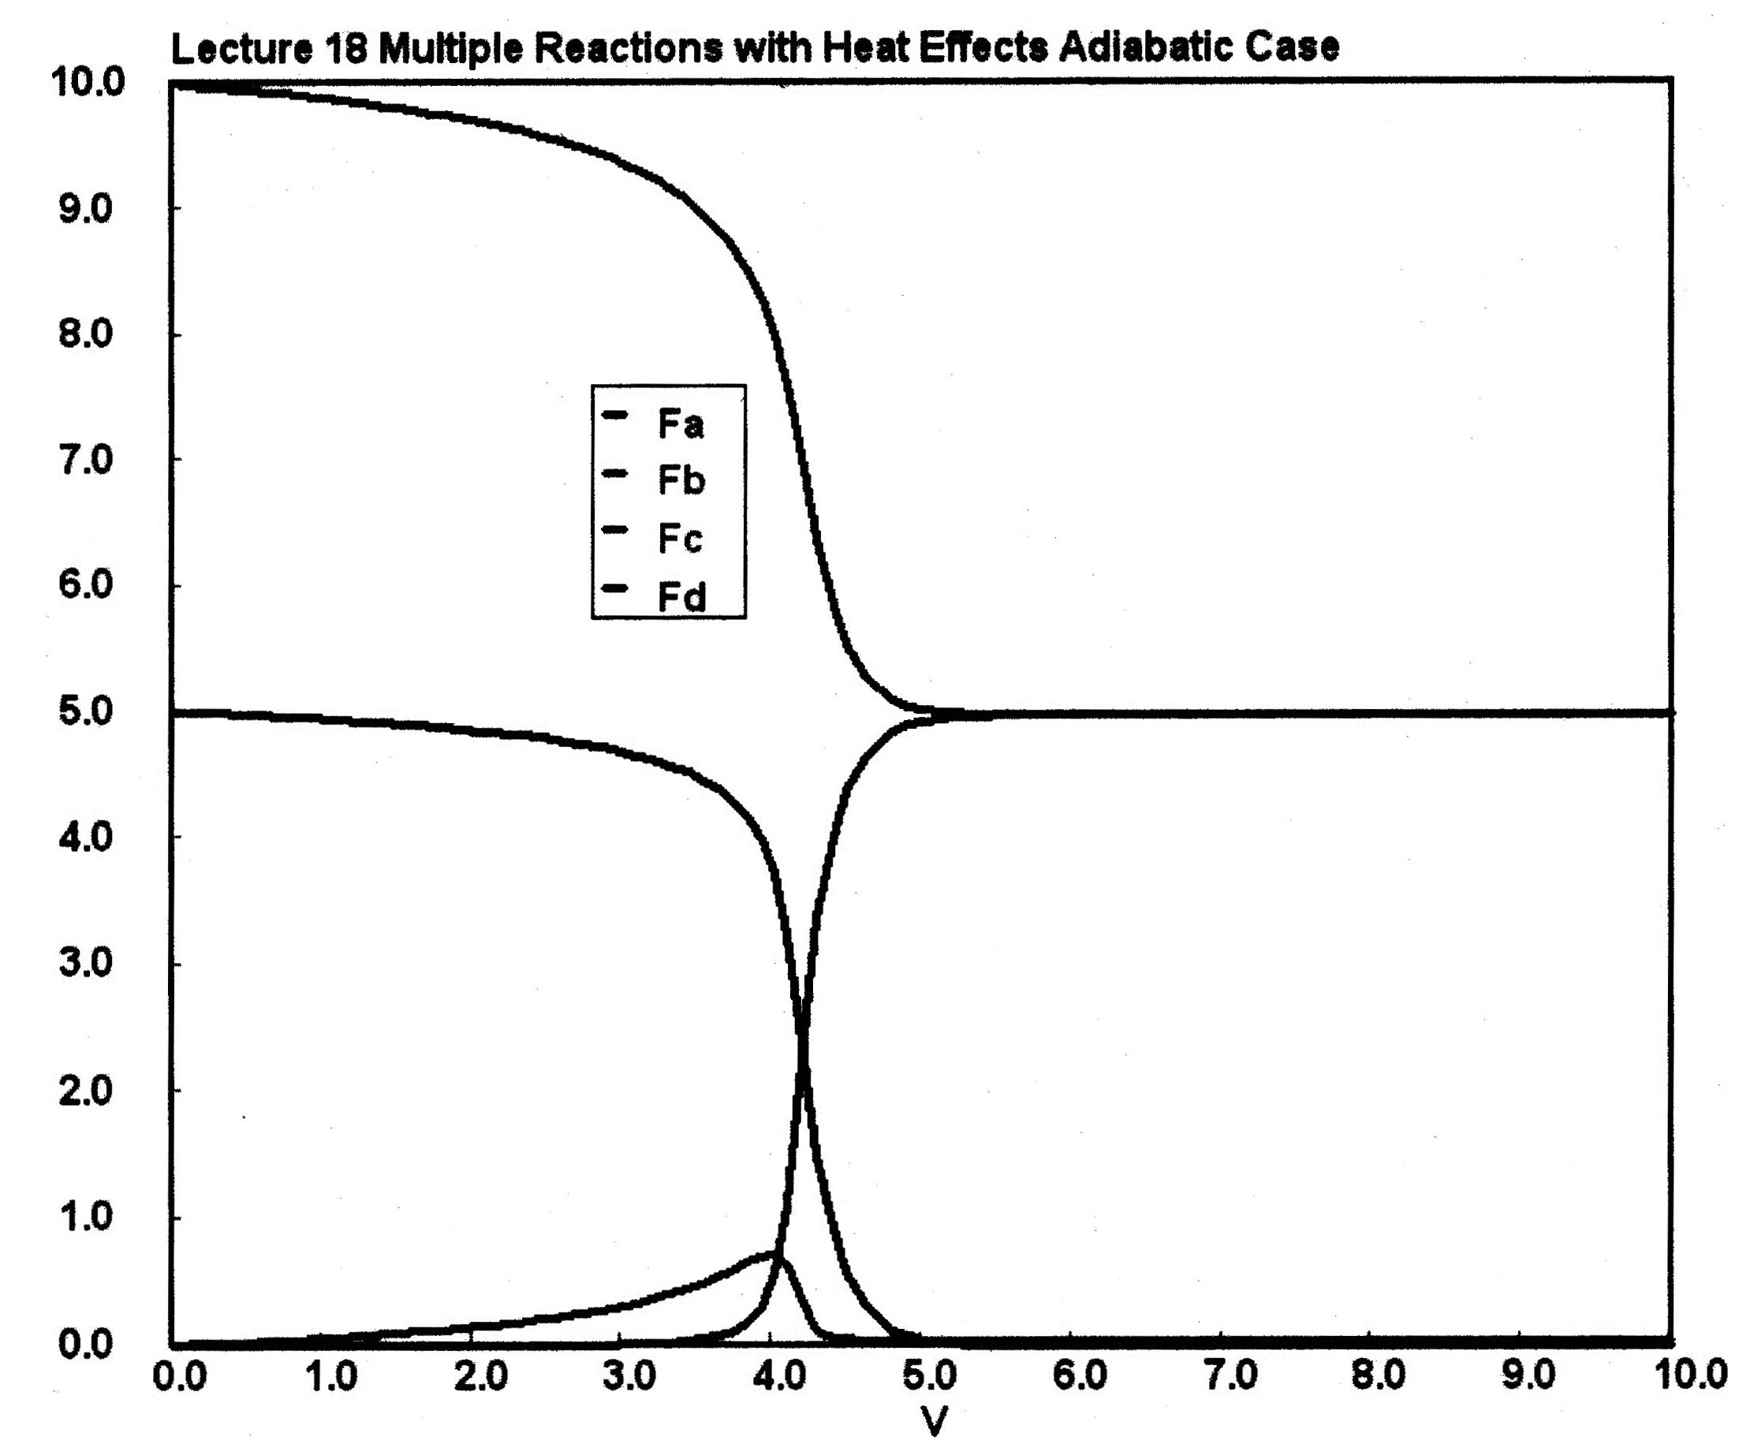
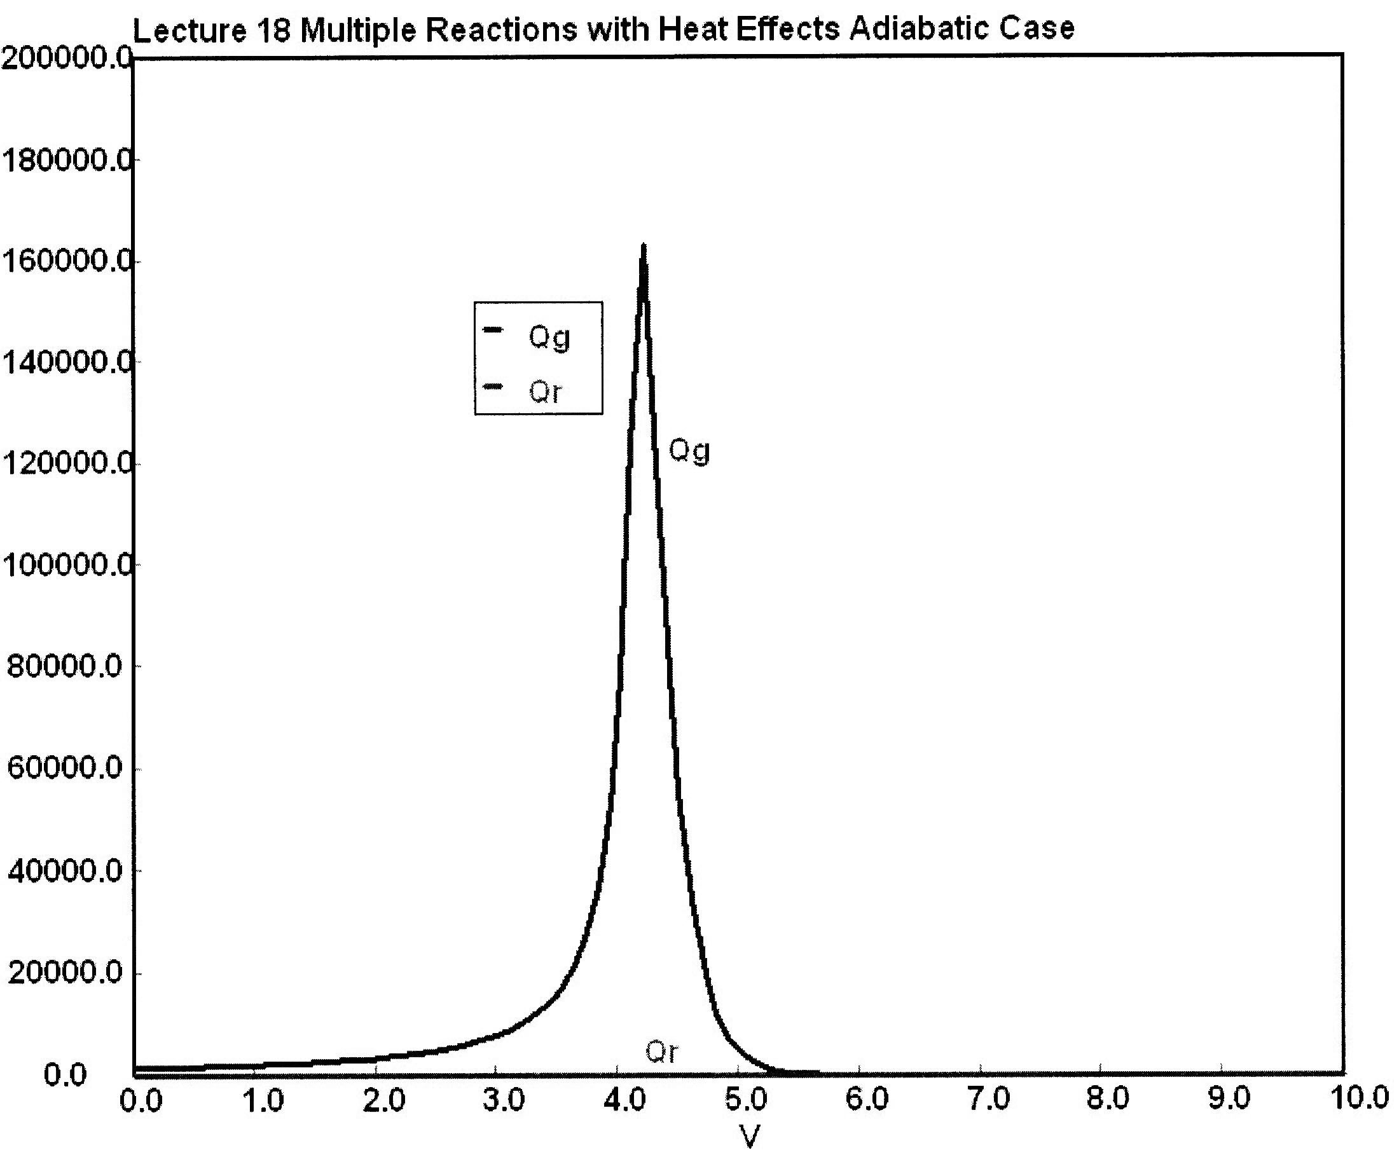

Slide 12
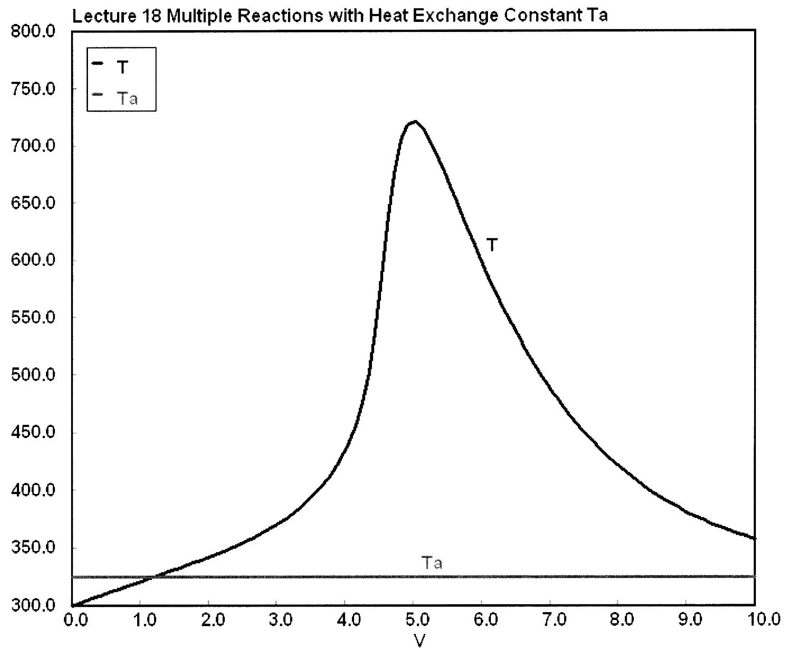
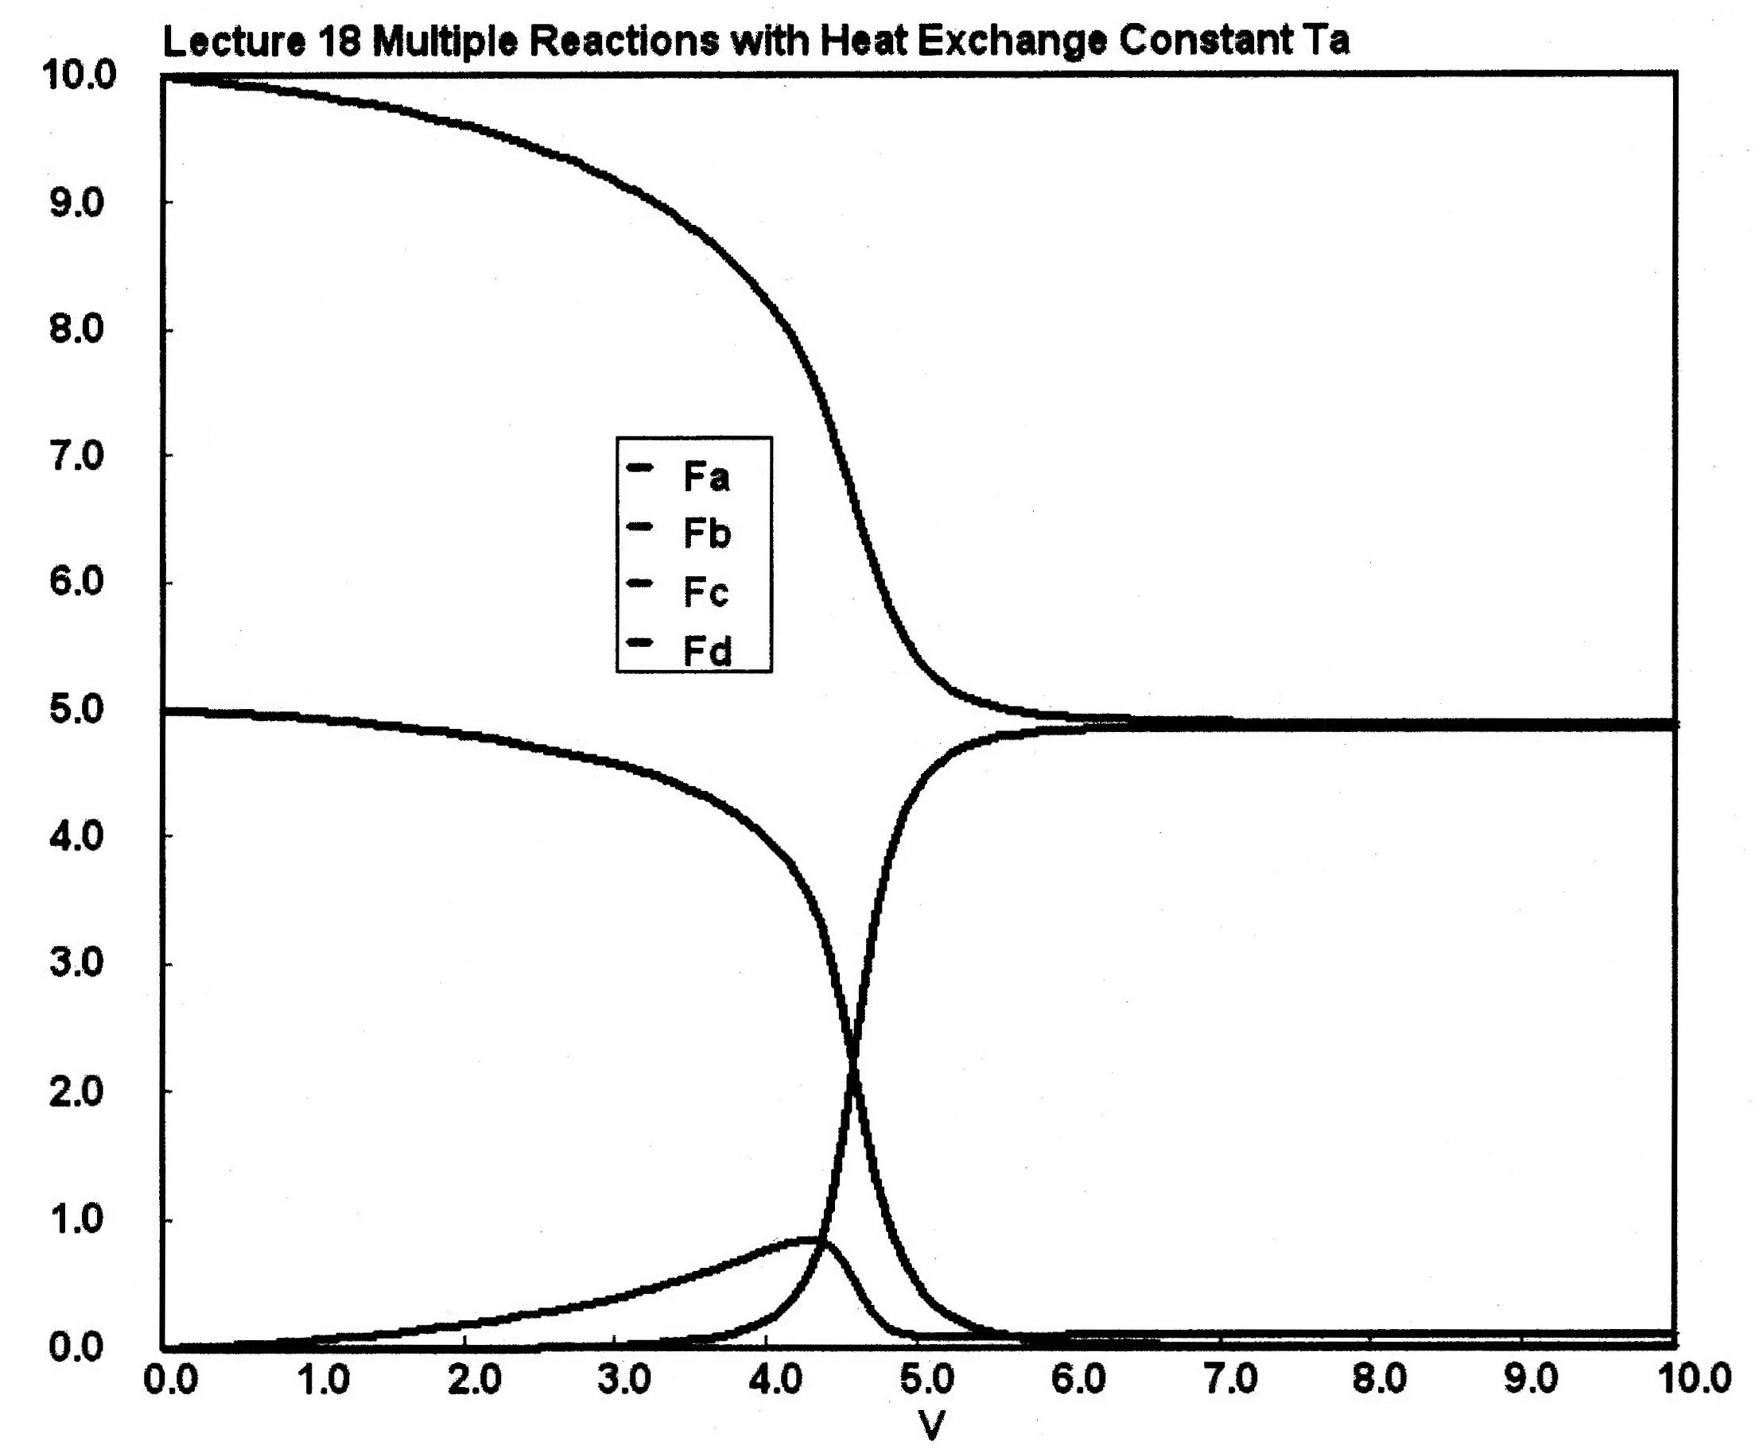
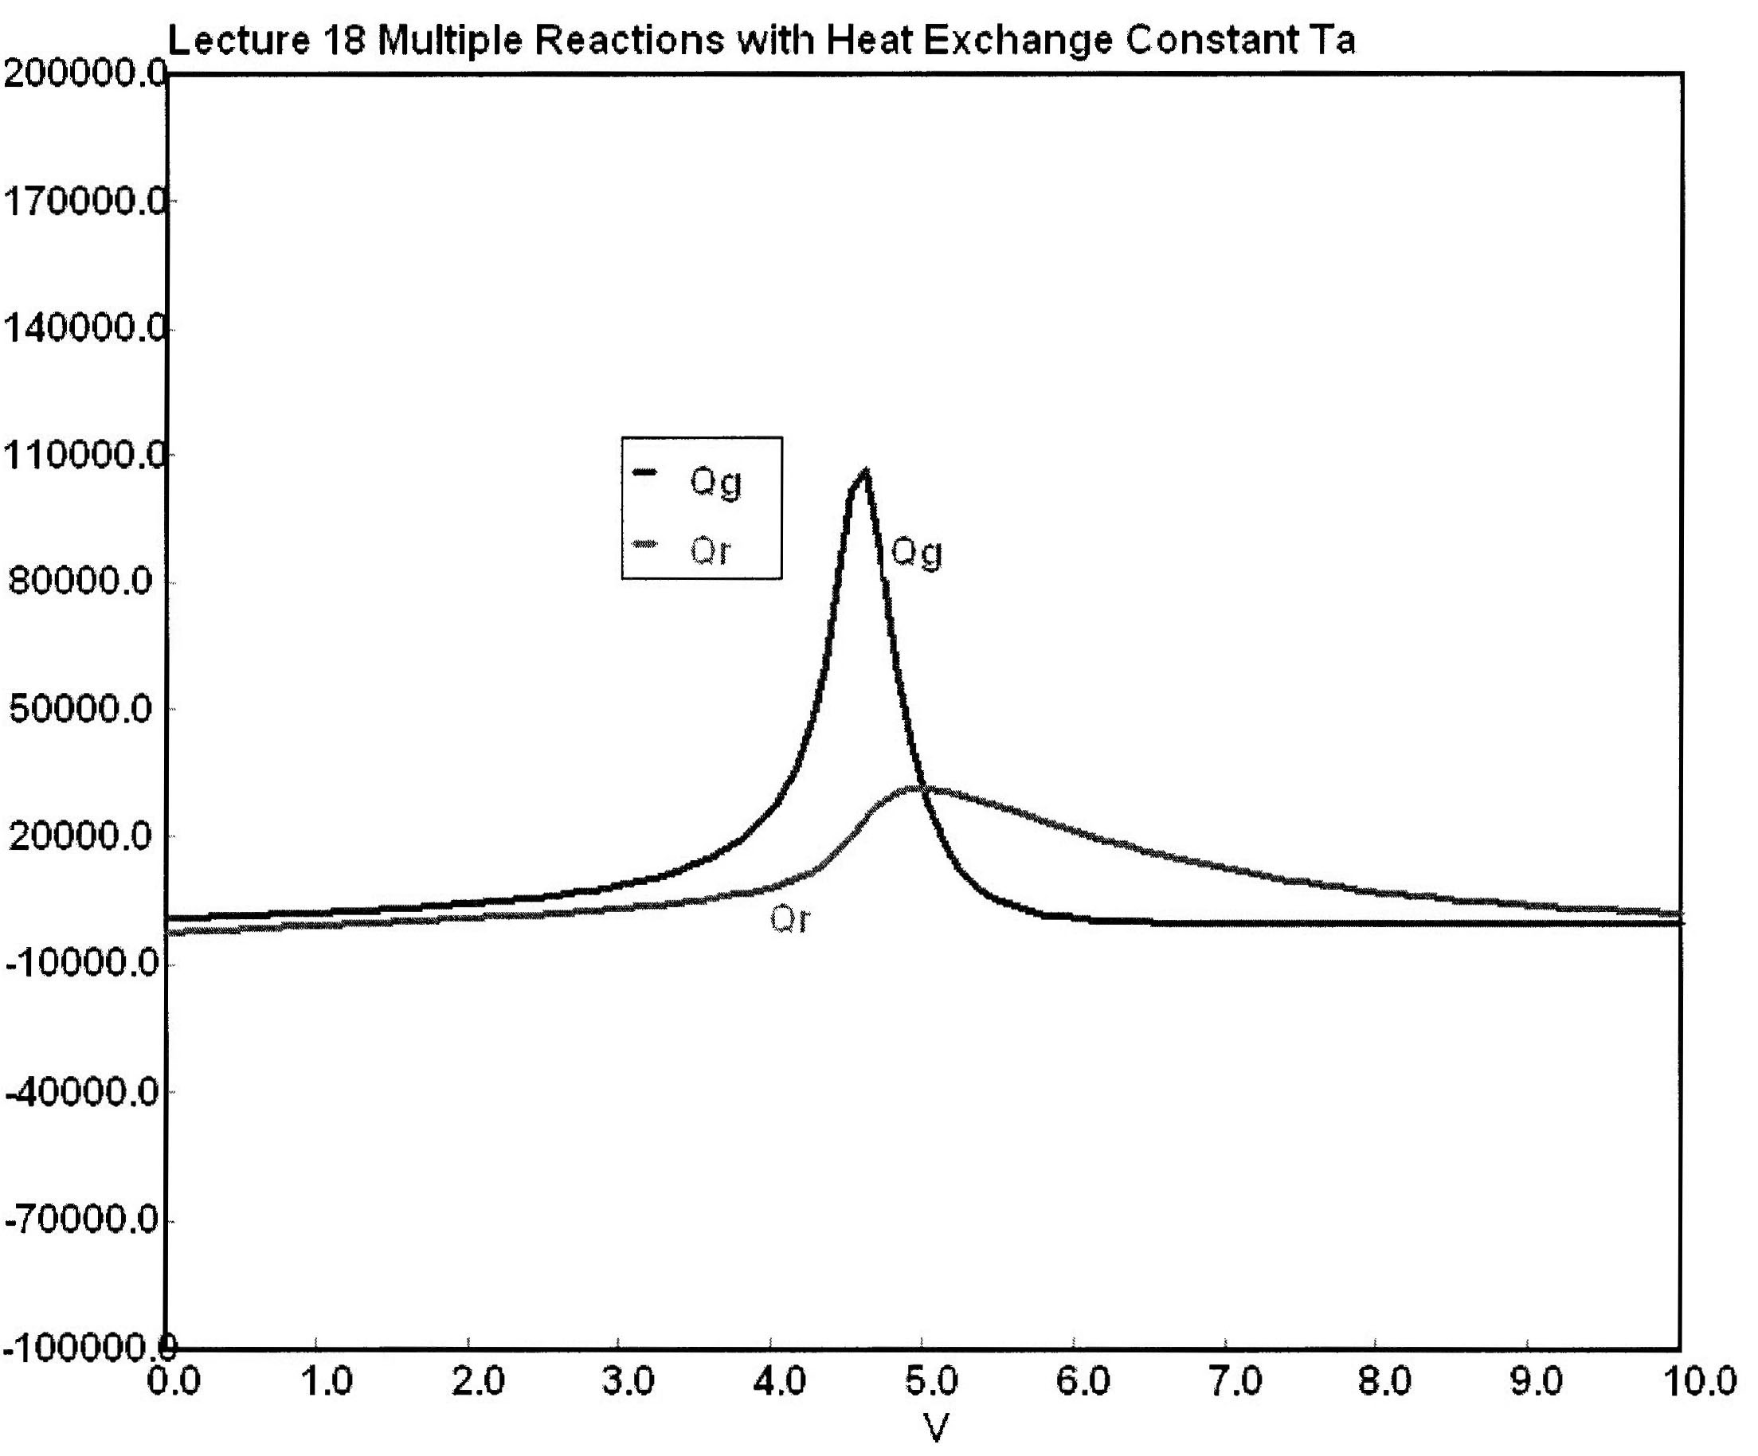

Slide 13
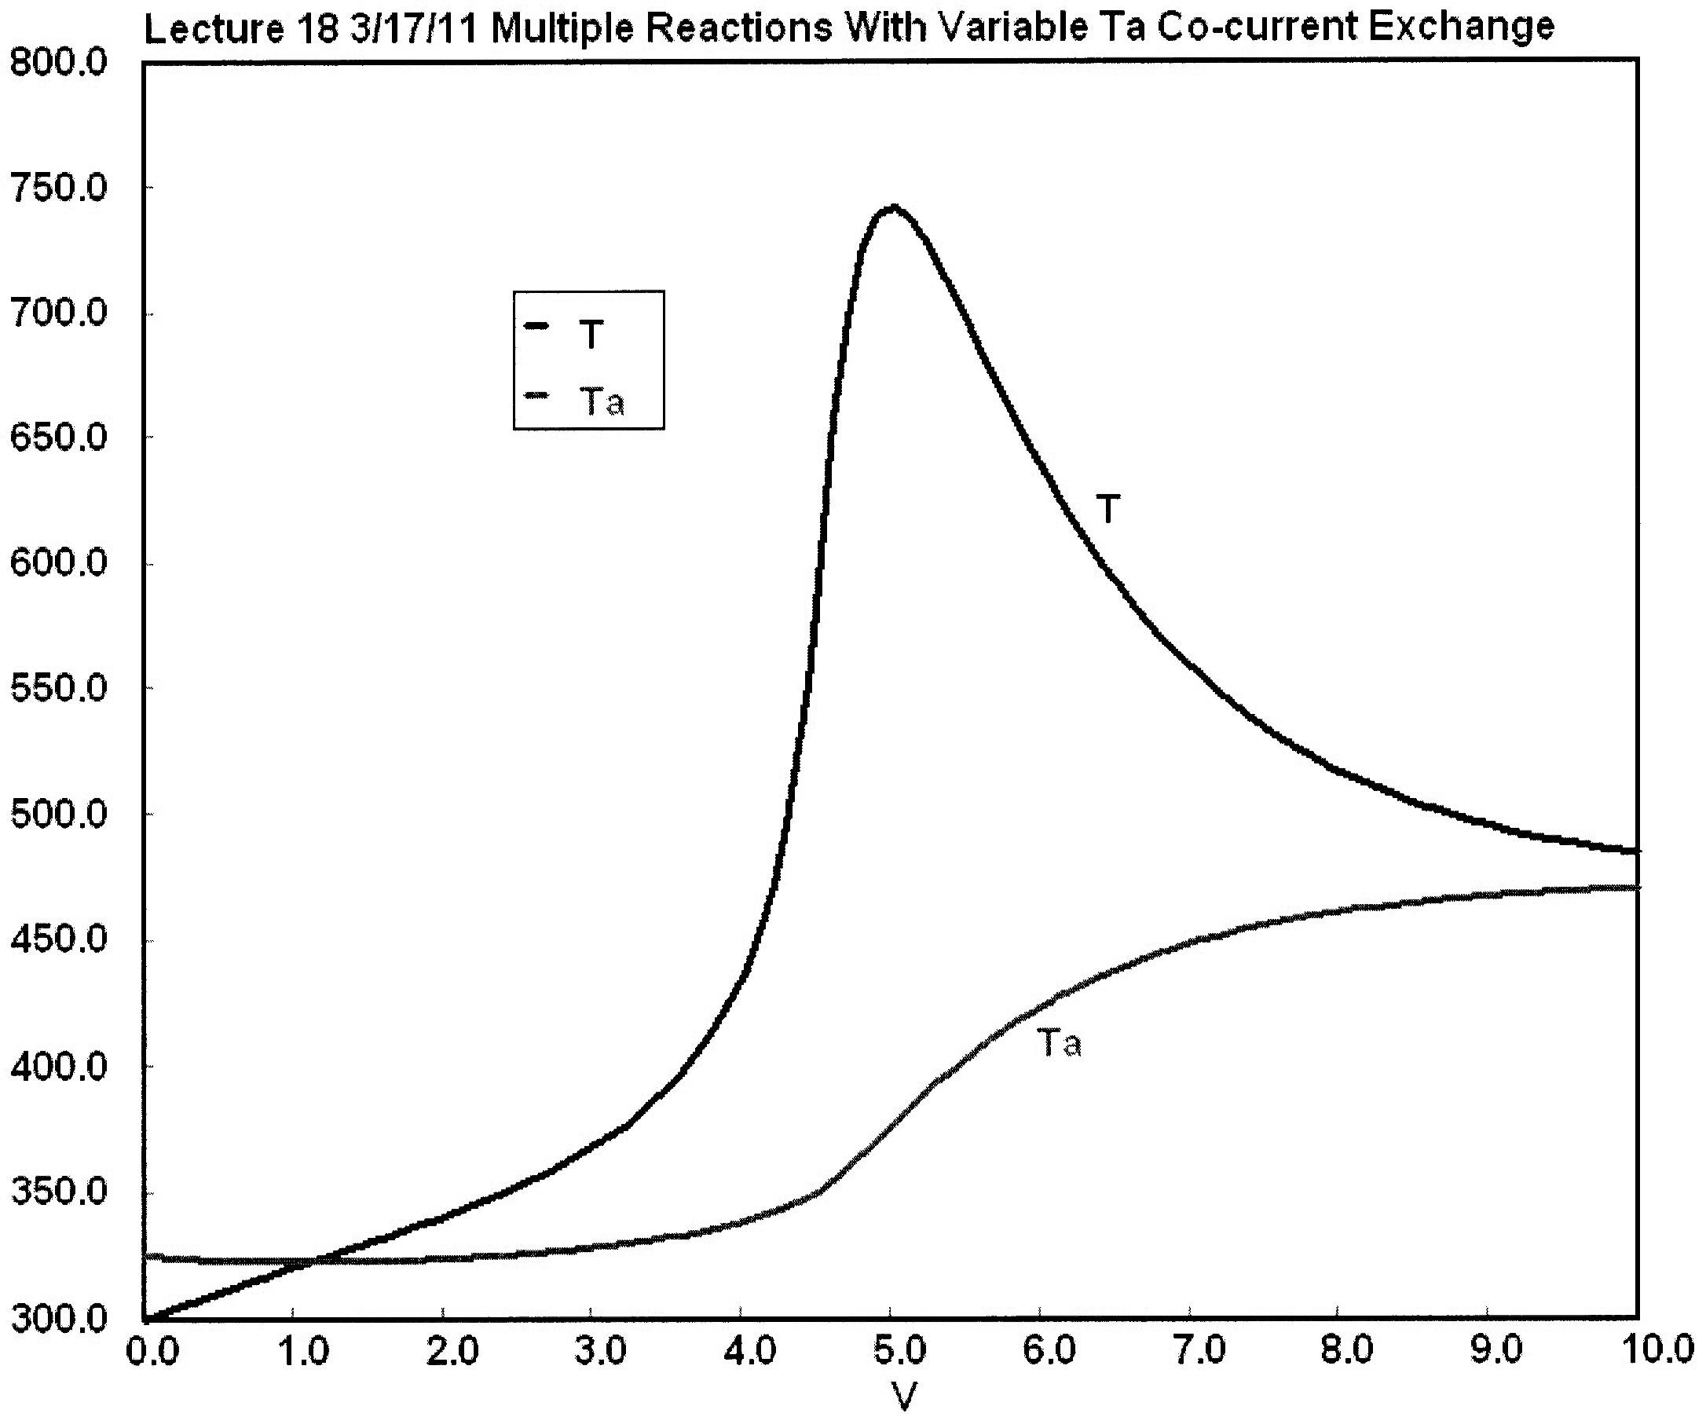
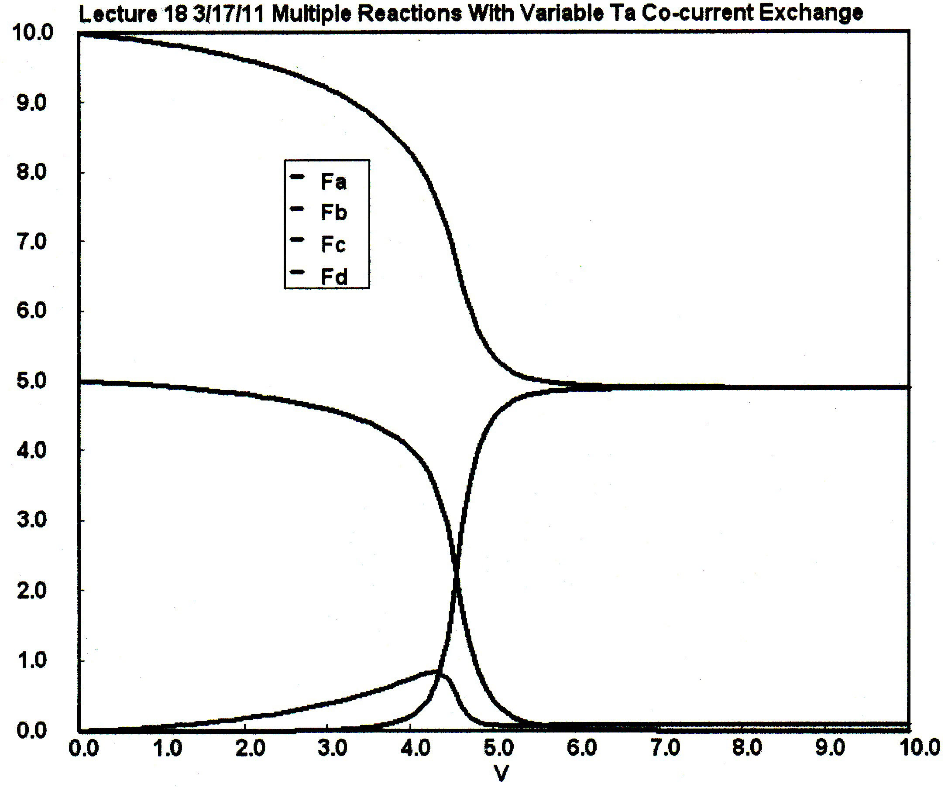
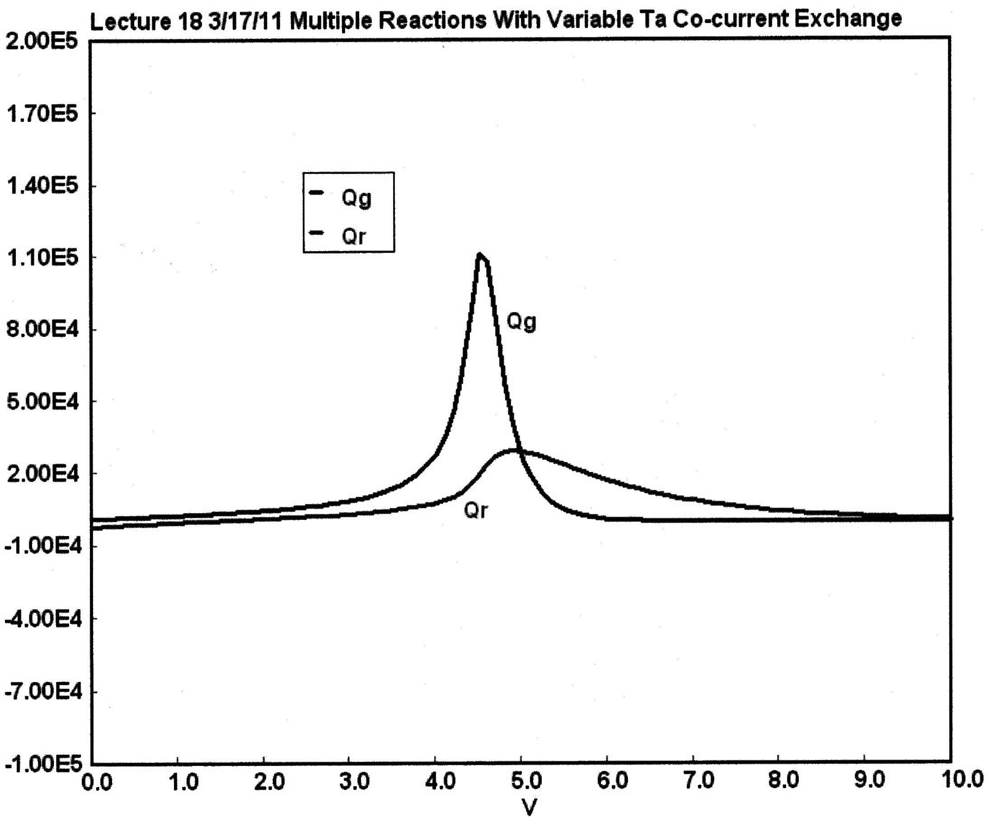

Slide 14
Multiple Reactions with Heat Effects
Multiple Reactions
4) Heat Effects:

Slide 15
Multiple Reactions with Heat Effects in a PFR and CSTR
Examples:
and
and

Slide 16
Example A: Liquid Phase CSTR
NOTE: The specific reaction rate k_{1A} is defined with respect to species A.
NOTE: The specific reaction rate k_{2C} is defined with respect to species C.

Slide 17
Example A: Liquid Phase CSTR
The complex liquid phase reactions take place in a 2,500 dm³ CSTR. The feed is equal molar in A and B with F_{A0}=200 mol/min, the volumetric flow rate is 100 dm³/min and the reation volume is 50 dm³.
Find the concentrations of A, B, C and D existing in the reactor along with the existing selectivity.
Plot F_{A}, F_{B}, F_{C}, F_{D} and S_{C/D} as a function of V

Slide 18
Example A: Liquid Phase CSTR
Solution
Liquid Phase CSTR
1) Mole Balances:
(1)
(2)
(3)
(4)
2) Net Rates:
(5)

Slide 19
Example A: Liquid Phase CSTR
3) Stoichiometry:
(16)
(17)
(18)
(19)
4) Parameters:
(20)
(21)
(22)

Slide 20
Example B: Liquid Phase PFR
Takes place in a PFR. The feed is equal molar in A and B and F_{A0}=200 mol/min and the volumetric flow rate is 100 dm³/min. The reaction volume is 50 dm³ and the rate constants are:
Rate laws are the same as Example A.
Plot F_{A}, F_{B}, F_{C}, F_{D} and S_{C/D} as a function of V.

Slide 21
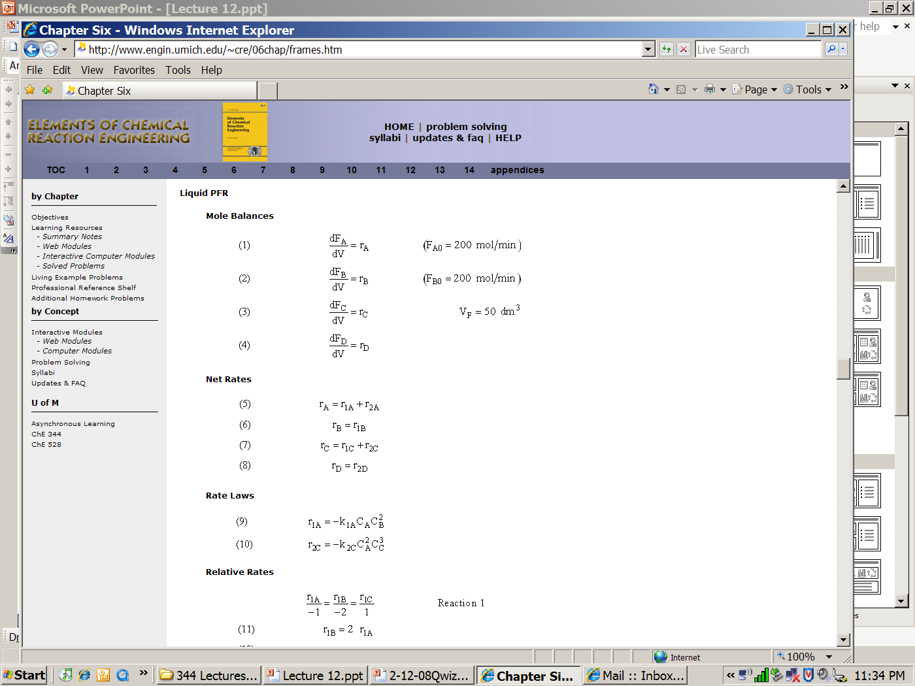
Example B: Liquid Phase PFR
1) Mole Balances:

Slide 22
Example B: Liquid Phase PFR
2) Net Rates:
(5)
(6)
(7)
(8)
2) Rate Laws:
(9)
(10)

Slide 23
Example B: Liquid Phase PFR
2) Relative Rates:
Reaction 1
(11)
(12)
Reaction 2
(13)
(14)

Slide 24
Example B: Liquid Phase PFR
2) Rate Laws:

Slide 25
Example B: Liquid Phase PFR
3) Stoichiometry:

Slide 26
Multiple Reactions with Heat Effects
4) Heat Effects:
Parameters:

Slide 27
Selectivity
If one were to write S_{C/D}=F_{C}/F_{D} in the Polymath program, Polymath would not execute because at V=0, F_{C}=0 resulting in an undefined volume (infinity) at V=0. To get around this problem we start the calculation 10⁻⁴ dm³ from the reactor entrance where F_{D} will not be zero and use the following IF statement.
(15)

Slide 28
Selectivity
3) Stoichiometry:
(16)
(17)
(18)
(19)
Parameters:
(20)
(21)
(22)

Slide 29
End of Web Lecture 22
Class Lecture 18

