Slide 1
Lecture 23
Chemical Reaction Engineering (CRE) is the field that studies the rates and mechanisms of chemical reactions and the design of the reactors in which they take place.

Slide 2
Web Lecture 23
Class Lecture 19 - Tuesday
CSTR With Heat Effects
  Multiple Steady States
  Ignition and Extinction Temperatures

Slide 3
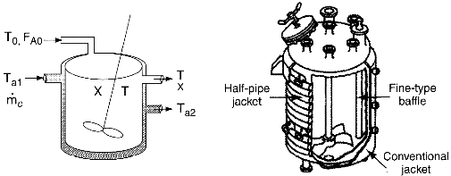
CSTR with Heat Effects
Courtesy of Pfaudler, Inc.

Slide 4
Unsteady State Energy Balance
Neglect
Using

Slide 5
Unsteady State Energy Balance
We obtain after some manipulation:
Collecting terms with and high coolant flow rates, and

Slide 6
Unsteady State Energy Balance

Slide 7
Unsteady State Energy Balance

Slide 8
Unsteady State Energy Balance
If G(T) > R(T) Temperature Increases
If R(T) > G(T) Temperature Decreases

Slide 9
Steady State Energy Balance for CSTRs
At Steady State
Solving for X.

Slide 10
Steady State Energy Balance for CSTRs
Solving for X:
Solving for T:

Slide 11
Steady State Energy Balance for CSTRs

Slide 12
Steady State Energy Balance for CSTRs

Slide 13
Steady State Energy Balance for CSTRs
R(T)
Increasing T₀
T
Variation of heat removal line with inlet temperature.

Slide 14
Steady State Energy Balance for CSTRs
κ=∞
κ=0
R(T)
Increasing κ
T_{a}
T₀
T
Variation of heat removal line with κ (κ=UA/C_{P0}F_{A0})

Slide 15
1) Mole Balances:
2) Rate Laws:

Slide 16
3) Stoichiometry:
4) Combine:

Slide 17
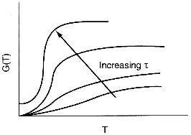
Multiple Steady States (MSS)
Variation of heat generation curve with space-time.

Slide 18
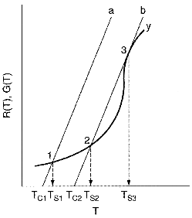
Multiple Steady States (MSS)
Finding Multiple Steady States with T₀ varied

Slide 19
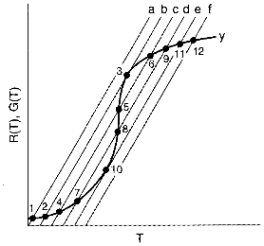
Multiple Steady States (MSS)
Finding Multiple Steady States with T₀ varied

Slide 20
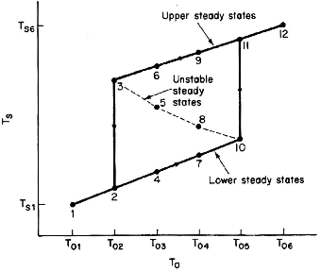
Multiple Steady States (MSS)
Temperature ignition-extinction curve

Slide 21
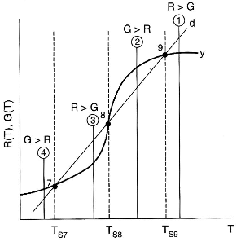
Multiple Steady States (MSS)
Stability of multiple state temperatures

Slide 22
MSS - Generating G(T) and R(T)
Need to solve for X after combining mole balance, rate law, and stoichiometry.

Slide 23
MSS - Generating G(T) and R(T)
For a first order irreversible reaction
Parameters
Then plot G and R as a function of T.

Slide 24
End of Web Lecture 23
Class Lecture 19

