Slide 1
Lecture 3
Chemical Reaction Engineering (CRE) is the field that studies the rates and mechanisms of chemical reactions and the design of the reactors in which they take place.

Slide 2
Lecture 3 – Thursday
Review of Lectures 1 and 2
Building Block 1
  Mole Balances (Review)
  Size CSTRs and PFRs given –r_{A}= f(X)
  Conversion for Reactors in Series
Building Block 2
  Rate Laws
  Reaction Orders
  Arrhenius Equation
  Activation Energy
  Effect of Temperature

Slide 3
Reactor Mole Balances Summary
The GMBE applied to the four major reactor types
(and the general reaction A→B)
Reactor | Differential | Algebraic | Integral
N_{A}
Batch
t
CSTR
F_{A}
PFR
V
F_{A}
PBR
W

Slide 5
Reactor Mole Balances Summary
In terms of Conversion
Reactor | Differential | Algebraic | Integral
X
Batch
t
CSTR
PFR
X
PBR
W

Slide 6
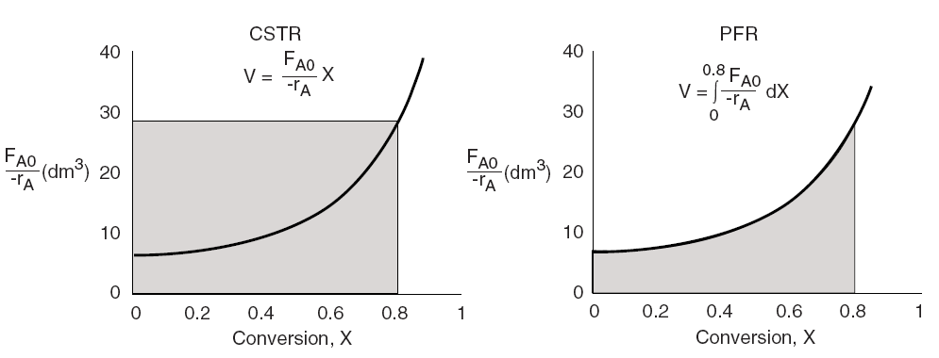
Levenspiel Plots

Slide 7
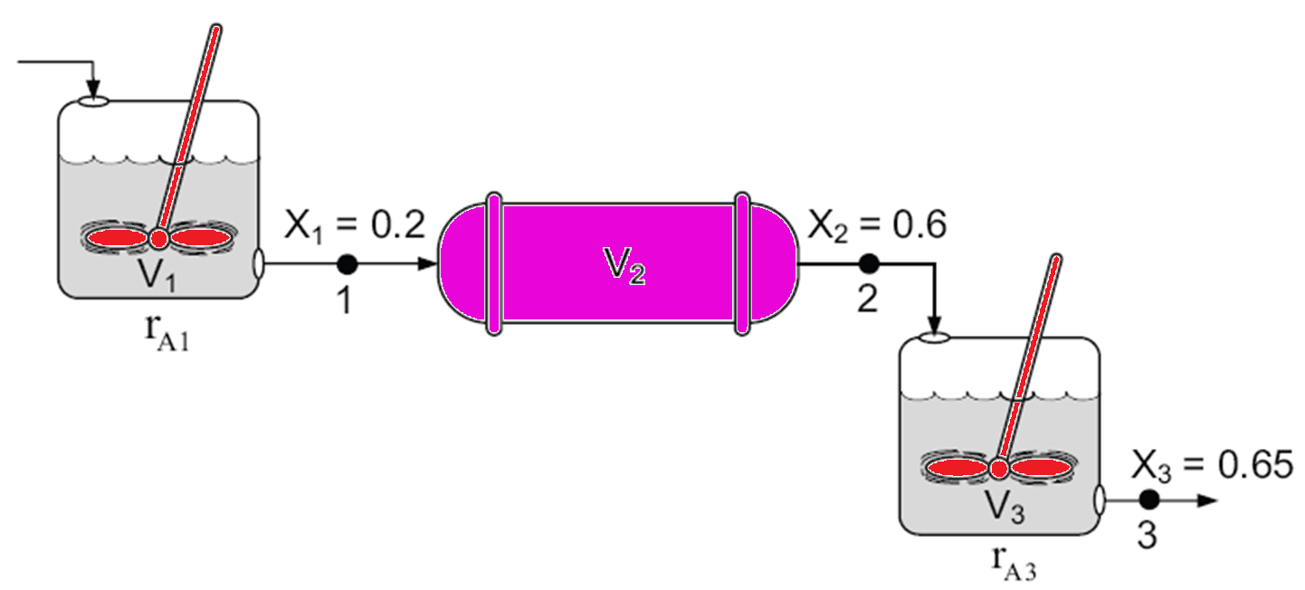
Reactors in Series
Only valid if there are no side streams

Slide 8
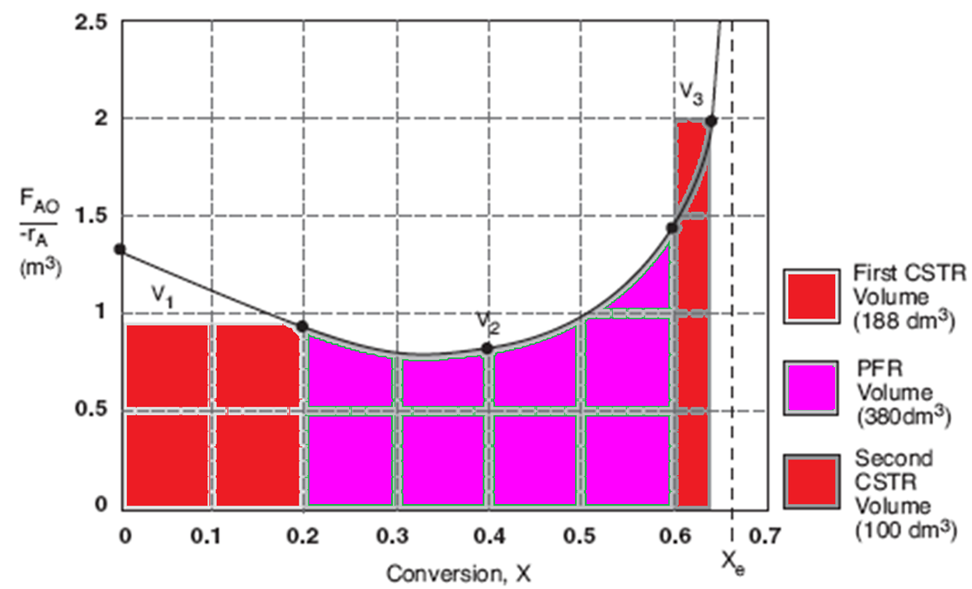
Reactors in Series

Slide 9

Building Block 2: Rate Laws
Power Law Model:

Slide 10
Building Block 2: Rate Laws
A reactor follows an elementary rate law if the reaction orders just happens to agree with the stoichiometric coefficients for the reaction as written.
e.g. If the above reaction follows an elementary rate law
2nd order in A, 1st order in B, overall third order

Slide 11
Building Block 2: Rate Laws
Rate Laws are found from Experiments
Rate Laws could be non-elementary. For example, reaction could be:
Second Order in A
Zero Order in B
Overall Second Order
2A+B→3C

Slide 12
Relative Rates of Reaction

Slide 13
Relative Rates of Reaction
Given
Then

Slide 14
Reversible Elementary Reaction
k_{A}
A+2B 3C
k_{-A}

Slide 15
Reversible Elementary Reaction
k_{A}
A+2B 3C
Reaction is: First Order in A
Second Order in B
Overall third Order
k_{-A}

Slide 16
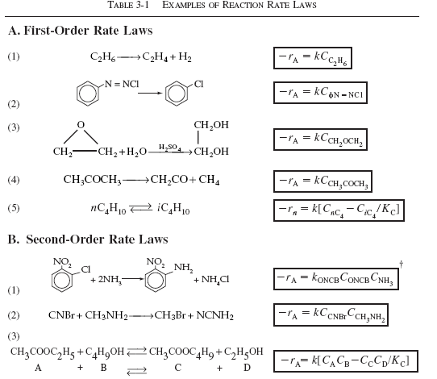
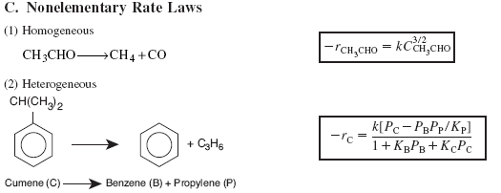

Slide 17
Algorithm
How to find
Step 1: Rate Law
Step 2: Stoichiometry
Step 3: Combine to get

Slide 18
Arrhenius Equation
k is the specific reaction rate (constant) and is given by the Arrhenius Equation.
where:
k
T

Slide 19
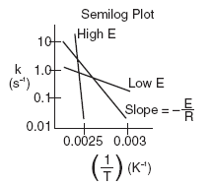

Arrhenius Equation
where:
E = Activation energy (cal/mol)
R = Gas constant (cal/mol*K)
T = Temperature (K)
A = Frequency factor (same units as rate constant k)
(units of A, and k, depend on overall reaction order)

Slide 20
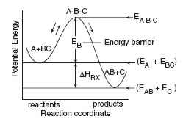
Reaction Coordinate
The activation energy can be thought of as a barrier to the reaction. One way to view the barrier to a reaction is through the reaction coordinates. These coordinates denote the energy of the system as a function of progress along the reaction path. For the reaction:
The reaction coordinate is:

Slide 21
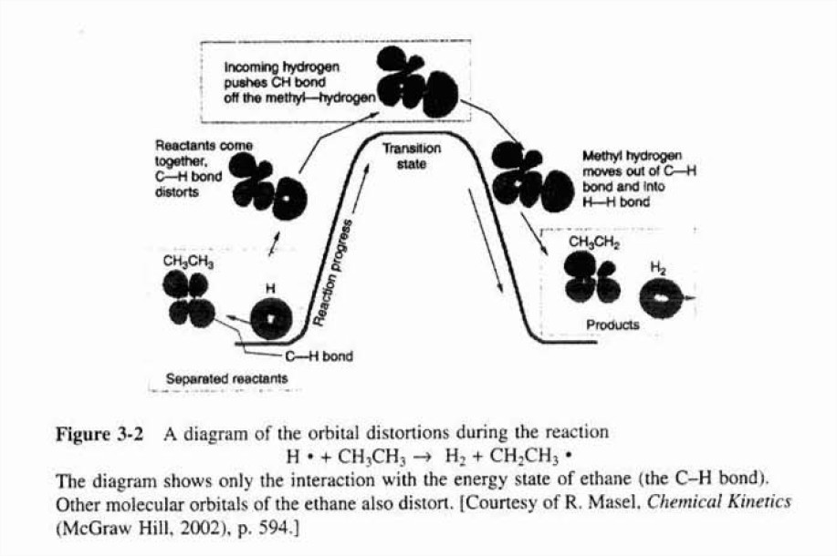

Slide 22
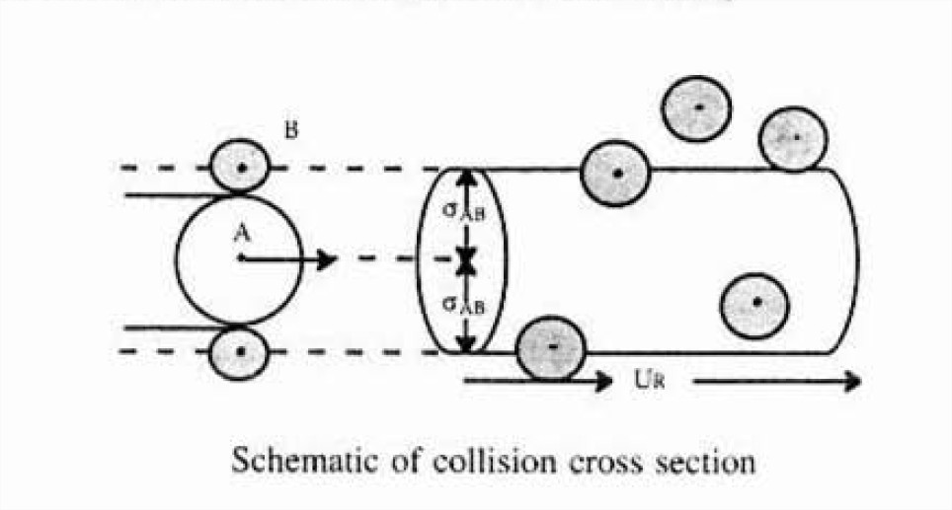
Collision Theory

Slide 23
Why is there an Activation Energy?
We see that for the reaction to occur, the reactants must overcome an energy barrier or activation energy E_{A}. The energy to overcome their barrier comes from the transfer of the kinetic energy from molecular collisions to internal energy (e.g. Vibrational Energy).
The molecules need energy to disort or stretch their bonds in order to break them and thus form new bonds
As the reacting molecules come close together they must overcome both stearic and electron repulsion forces in order to react.

Slide 24
Distribution of Velocities
We will use the Maxwell-Boltzmann Distribution of Molecular Velocities. For a species af mass m, the Maxwell distribution of velocities (relative velocities) is:
f(U,T)dU represents the fraction of velocities between U and (U+dU).

Slide 25

Distribution of Velocities
A plot of the distribution function, f(U,T), is shown as a function of U:
T₁
T₂
T₂>T₁
$$f\left(U,T\right)$$
U
Maxwell-Boltzmann Distribution of velocities.

Slide 26
Distribution of Velocities
Given
Let
f(E,T)dE represents the fraction of collisions that have energy between E and (E+dE)

Slide 27
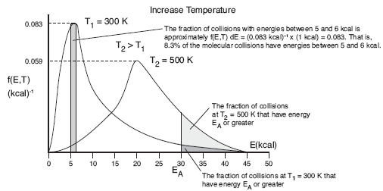
f(E,T)dE=fraction of molecules with energies between E+dE
One such distribution of energies is in the following figure:

Slide 28
End of Lecture 3

Slide 29
Supplementary Material
BC
AB
V_{BC}
V_{AB}
kJ/
Molecule
kJ/
Molecule
r₀
r_{BC}
r₀
r_{AB}
Potentials (Morse or Lennard-Jones)

Slide 30
Supplementary Material
One can also view the reaction coordinate as variation of the BC distance for a fixed AC distance:
For a fixed AC distance as B moves away from C the distance of separation of B from C, r_{BC} increases as N moves closer to A. As r_{BC} increases r_{AB} decreases and the AB energy first decreases then increases as the AB molecules become close. Likewise as B moves away from A and towards C similar energy relationships are found. E.g., as B moves towards C from A, the energy first decreases due to attraction then increases due to repulsion of the AB molecules as they come closer together. We now superimpose the potentials for AB and BC to form the following figure:

Slide 31
Supplementary Material
Reference
AB
S₂
S₁
BC
Energy
E*
E_{a}
E_{1P}
E_{2P}
r
∆H_{Rx}=E_{2P}-E_{1P}

