Slide 1
Lecture 4
Chemical Reaction Engineering (CRE) is the field that studies the rates and mechanisms of chemical reactions and the design of the reactors in which they take place.

Slide 2
Lecture 4 – Tuesday
Block 1
  Mole Balances
  Size CSTRs and PFRs given –r_{A}=f(X)
Block 2
  Rate Laws
  Reaction Orders
  Arrhenius Equation
Block 3
  Stoichiometry
  Stoichiometric Table
  Definitions of Concentration
  Calculate the Equilibrium Conversion, X_{e}

Slide 3
Reactor Mole Balances Summary
Review Lecture 2
_{in terms of conversion, X}
Reactor | Differential | Algebraic | Integral
X
Batch
t
CSTR
PFR
X
PBR
W

Slide 4
Levenspiel Plots
Review Lecture 2

Slide 5
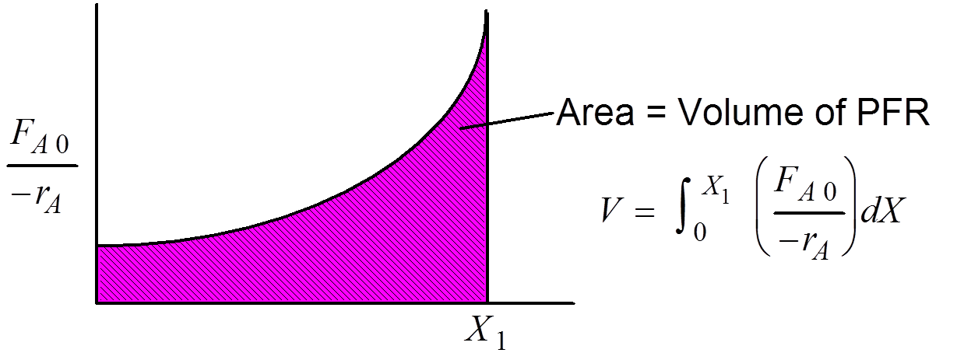
PFR
Review Lecture 2

Slide 6
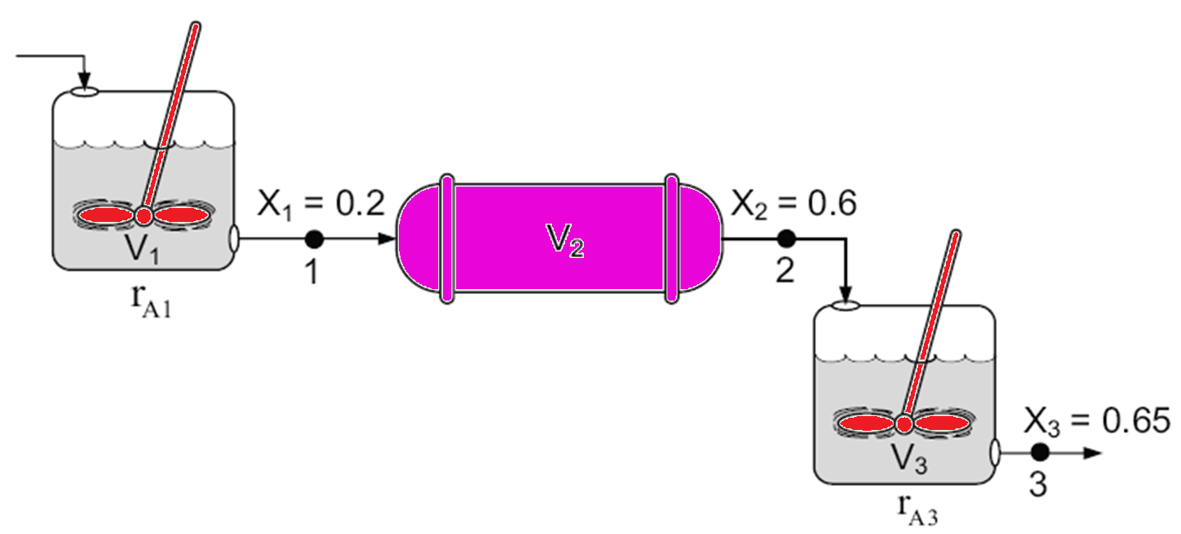
Reactors in Series
Review Lecture 2
Only valid if there are no side streams

Slide 7
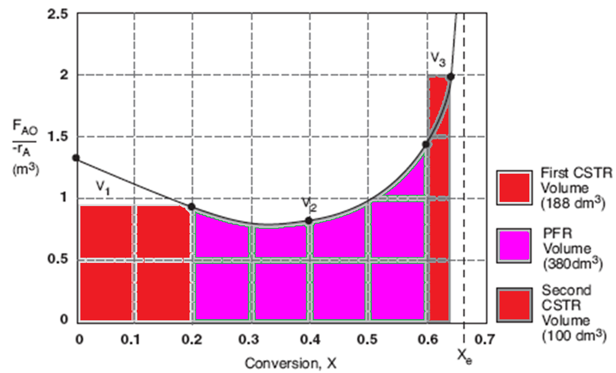
Reactors in Series
Review Lecture 2

Slide 8
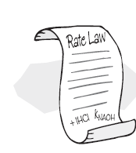
Two steps to get
Review Lecture 2
Step 1: Rate Law
Step 2: Stoichiometry
Step 3: Combine to get

Slide 9
Building Block 2: Rate Laws
Review Lecture 3
Power Law Model:
A reactor follows an elementary rate law if the reaction orders just happens to agree with the stoichiometric coefficients for the reaction as written.
e.g. If the above reaction follows an elementary rate law
2nd order in A, 1st order in B, overall third order

Slide 10
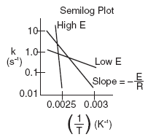

Arrhenius Equation
Review Lecture 3
k
E = Activation energy (cal/mol)
R = Gas constant (cal/mol*K)
T = Temperature (K)
A = Frequency factor (same units as rate constant k)
(units of A, and k, depend on overall reaction order)
T

Slide 11
Reaction Engineering
Review Lecture 3
Mole Balance
Rate Laws
Stoichiometry
These topics build upon one another

Slide 12
Algorithm
Review Lecture 3
How to find
Step 1: Rate Law
Step 2: Stoichiometry
Step 3: Combine to get

Slide 13
Building Block 3: Stoichiometry
We shall set up Stoichiometry Tables using species A as our basis of calculation in the following reaction. We will use the stoichiometric tables to express the concentration as a function of conversion. We will combine C_{i} = f(X) with the appropriate rate law to obtain -r_{A} = f(X).
A is the limiting reactant.

Slide 14
Stoichiometry
For every mole of A that reacts, b/a moles of B react. Therefore moles of B remaining:
Let Θ_{B} = N_{B0}/N_{A0}
Then:

Slide 15
Batch System - Stoichiometry Table
Species | Symbol | Initial | Change | Remaining
A | A | N_{A0} | -N_{A0}X | N_{A}=N_{A0}(1-X)
B | B | N_{B0}=N_{A0}Θ_{B} | -b/aN_{A0}X | N_{B}=N_{A0}(Θ_{B}-b/aX)
C | C | N_{C0}=N_{A0}Θ_{C} | +c/aN_{A0}X | N_{C}=N_{A0}(Θ_{C}+c/aX)
D | D | N_{D0}=N_{A0}Θ_{D} | +d/aN_{A0}X | N_{D}=N_{A0}(Θ_{D}+d/aX)
Inert | I | N_{I0}=N_{A0}Θ_{I} | ---------- | N_{I}=N_{A0}Θ_{I}
 |  | F_{T0} |  | N_{T}=N_{T0}+δN_{A0}X
Where:
and
δ = change in total number of mol per mol A reacted

Slide 16
Stoichiometry Constant Volume Batch
Note: If the reaction occurs in the liquid phase
or
if a gas phase reaction occurs in a rigid (e.g. steel) batch reactor
Then
etc.

Slide 17
Stoichiometry Constant Volume Batch
Suppose
Batch:
Equimolar feed:
Stoichiometric feed:

Slide 18
Stoichiometry Constant Volume Batch
If
, then
Constant Volume Batch
and we have

Slide 19
Batch Reactor - Example
Calculate the equilibrium conversion for gas phase reaction, X_{e} .
Consider the following elementary reaction with
K_{C}=20 dm³/mol and C_{A0}=0.2 mol/dm³.
Find X_{e} for both a batch reactor and a flow reactor.

Slide 20
Batch Reactor - Example
Calculate X_{e}
Step 1:
Step 2: rate law:

Slide 21
Batch Reactor - Example
Symbol | Initial | Change | Remaining
A | N_{A0} | -N_{A0}X | N_{A0}(1-X)
B | 0 | ½ N_{A0}X | N_{A0} X/2
Totals:
N_{T0}=N_{A0}
N_{T}=N_{A0} -N_{A0} X/2
@ equilibrium: -r_{A}=0

Slide 22
Batch Reactor - Example
Solution:
At equilibrium
Stoichiometry:
Constant Volume:
Batch
Species | Initial | Change | Remaining
A | N_{A0} | -N_{A0}X | N_{A}=N_{A0}(1-X)
B | 0 | +N_{A0}X/2 | N_{B}=N_{A0}X/2
 | N_{T0}=N_{A0} |  | N_{T}=N_{A0}-N_{A0}X/2

Slide 23
Batch Reactor - Example

Slide 24
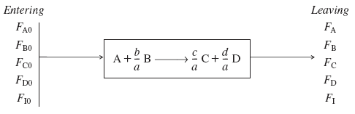
Flow System – Stoichiometry Table
Species | Symbol | Reactor Feed | Change | Reactor Effluent
A | A | F_{A0} | -F_{A0}X | F_{A}=F_{A0}(1-X)
B | B | F_{B0}=F_{A0}Θ_{B} | -b/aF_{A0}X | F_{B}=F_{A0}(Θ_{B}-b/aX)
Where:

Slide 25
Flow System – Stoichiometry Table
Species | Symbol | Reactor Feed | Change | Reactor Effluent
C | C | F_{C0}=F_{A0}Θ_{C} | +c/aF_{A0}X | F_{C}=F_{A0}(Θ_{C}+c/aX)
D | D | F_{D0}=F_{A0}Θ_{D} | +d/aF_{A0}X | F_{D}=F_{A0}(Θ_{D}+d/aX)
Inert | I | F_{I0}=_{A0}Θ_{I} | ---------- | F_{I}=F_{A0}Θ_{I}
 |  | F_{T0} |  | F_{T}=F_{T0}+δF_{A0}X
Where:
and
Concentration – Flow System

Slide 26
Flow System – Stoichiometry Table
Species | Symbol | Reactor Feed | Change | Reactor Effluent
A | A | F_{A0} | -F_{A0}X | F_{A}=F_{A0}(1-X)
B | B | F_{B0}=F_{A0}Θ_{B} | -b/aF_{A0}X | F_{B}=F_{A0}(Θ_{B}-b/aX)
C | C | F_{C0}=F_{A0}Θ_{C} | +c/aF_{A0}X | F_{C}=F_{A0}(Θ_{C}+c/aX)
D | D | F_{D0}=F_{A0}Θ_{D} | +d/aF_{A0}X | F_{D}=F_{A0}(Θ_{D}+d/aX)
Inert | I | F_{I0}=F_{A0}Θ_{I} | ---------- | F_{I}=F_{A0}Θ_{I}
 |  | F_{T0} |  | F_{T}=F_{T0}+δF_{A0}X
Where:
and
Concentration – Flow System

Slide 27
Stoichiometry
Concentration Flow System:
Liquid Phase Flow System:
Flow Liquid Phase
etc.
We will consider C_{A} and C_{B} for gas phase reactions in the next lecture

Slide 28
Heat Effects
Isothermal Design
Stoichiometry
Rate Laws
Mole Balance

Slide 29
End of Lecture 4

