Slide 1
Lecture 10
Chemical Reaction Engineering (CRE) is the field that studies the rates and mechanisms of chemical reactions and the design of the reactors in which they take place.

Slide 2
Lecture 10 – Tuesday 2/12/2013
Block 1: Mole Balances
Block 2: Rate Laws
Block 3: Stoichiometry
Block 4: Combine
Definition of Selectivity
Semibatch Reactors

Slide 3
Selectivity in Multiple Reactions
 | Selectivity | Yield
Instantaneous | S_{D/U} = r_{D}/r_{U}
Overall | Ŝ_{D/U} = F_{D}/F_{U}
Keep C_{A} high and C_{B} low.

Slide 4
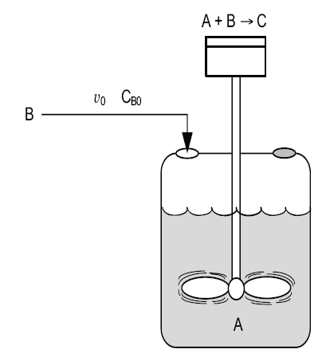
  Semibatch Reactors
Semibatch reactors can be very effective in maximizing selectivity in liquid phase reactions.
The reactant that starts in the reactor is always the limiting reactant.

Slide 5
  Semibatch Reactors
Semibatch reactors
A + B → C + D
B, v₀
Initial V
A
Liquid level and volume increase

Slide 6
  Semibatch Reactors
1) Mass Balance:

Slide 7
  Semibatch Reactors
1) Mole Balance on Species A:
[in] – [out] + [gen] = [acc]

Slide 8
  Semibatch Reactors
1) Mole Balance on Species B:

Slide 9
  Semibatch Reactors
1) Mass and Mole Balance Summary

Slide 10
Semibatch Reactors
2) Rate Laws
3) Stoichiometry
4) Parameters

Slide 11
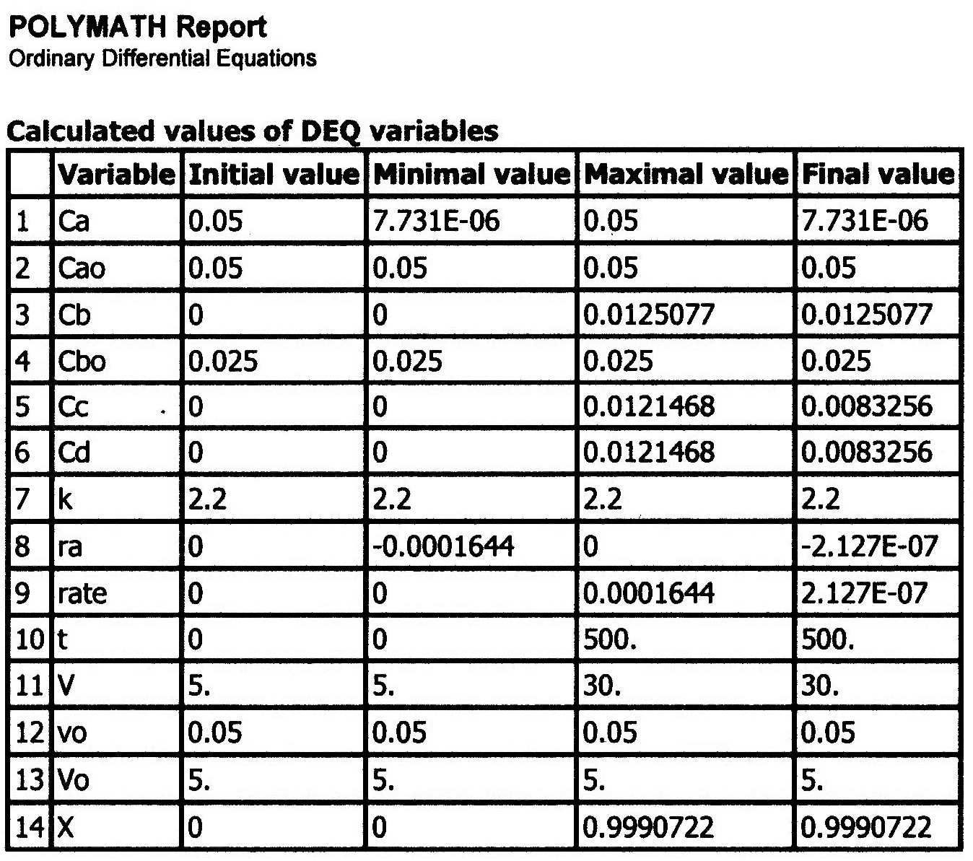
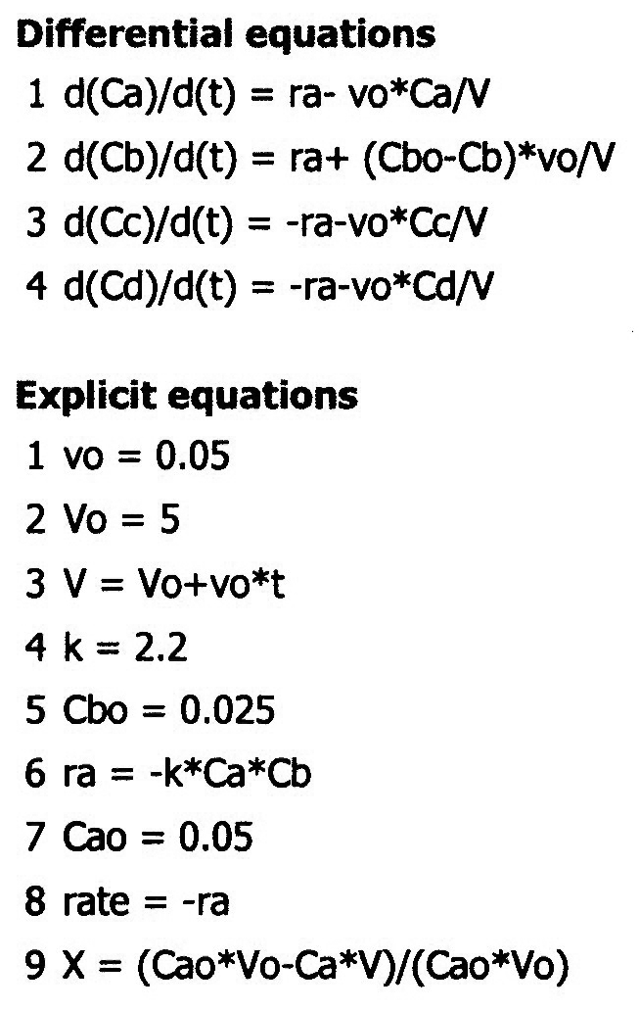
Semibatch Reactors

Slide 12
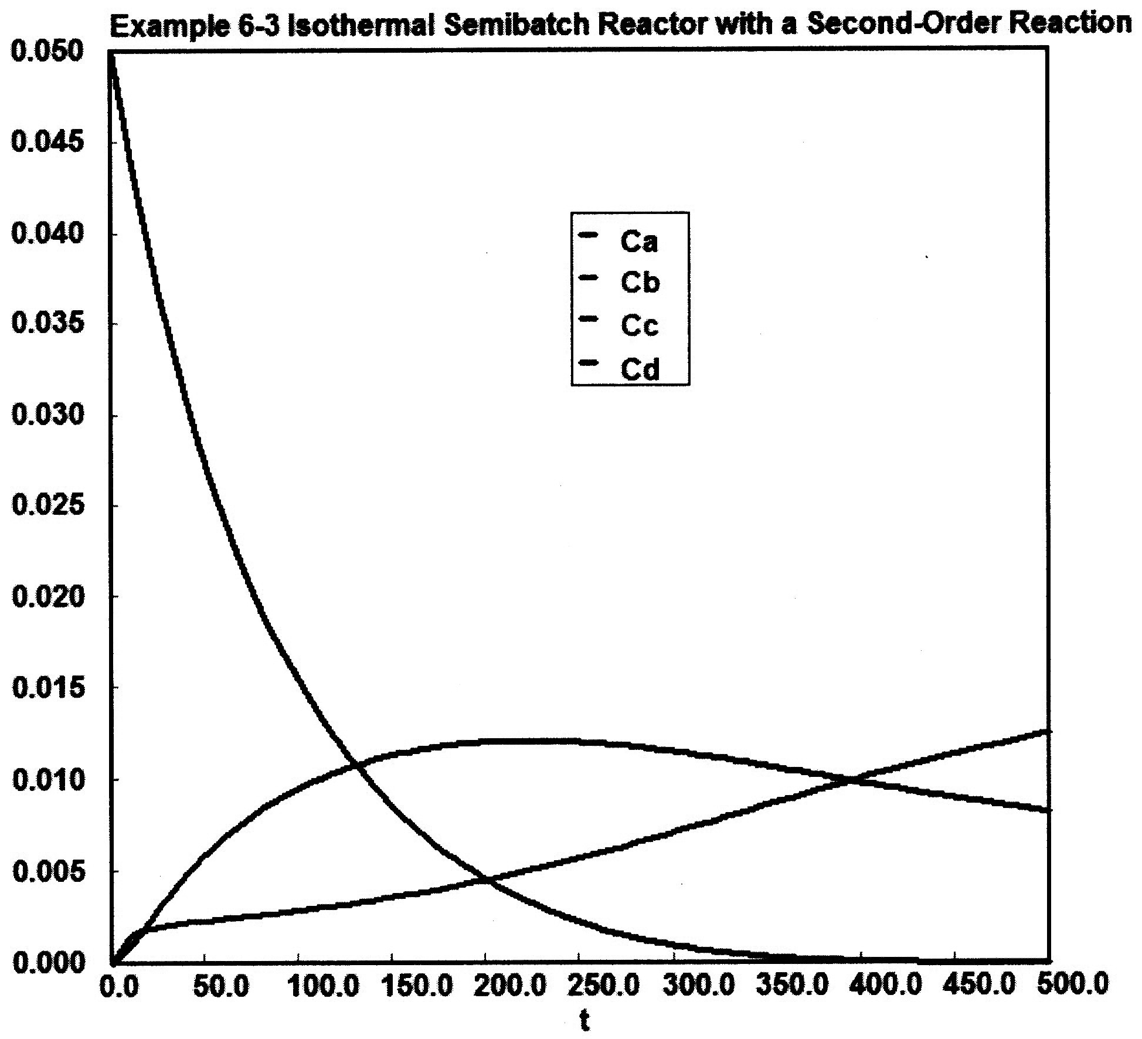
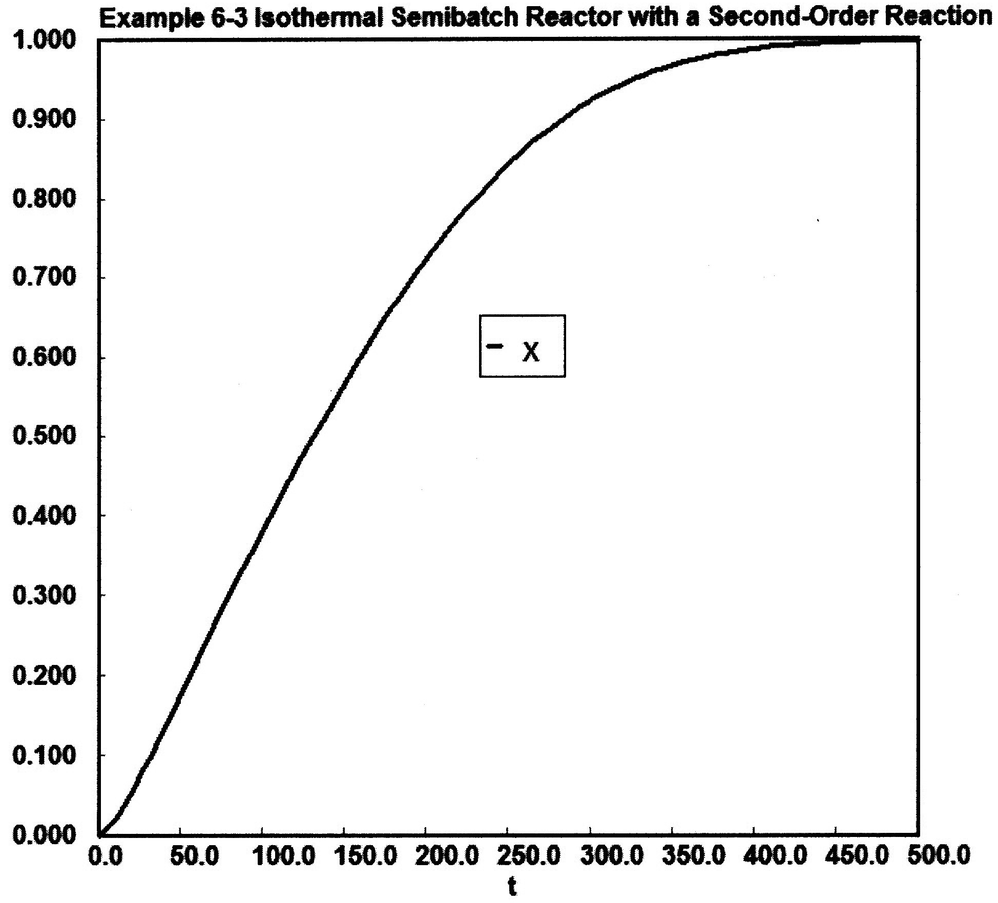
Semibatch Reactors

Slide 13
Equilibrium Conversion in Semibatch Reactors with Reversible Reactions
Consider the following reaction:
Everything is the same as for the irreversible case, except for the rate law:

Slide 14
Equilibrium Conversion in Semibatch Reactors with Reversible Reactions
Where:
At equilibrium, then
X_{e} changes with time.

Slide 15
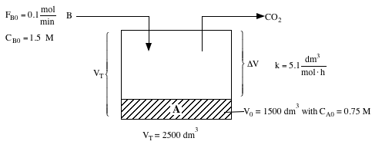
P6-6_{B} - Semibatch Reactors
Sodium Bicarbonate + Ethylene Chlorohydrin → Ethylene Glycol + NaCl + CO₂↑
NaCHO₃ + CH₂OHCH₂Cl → (CH₂OH)₂ + NaCl + CO₂ ↑
A + B → C + D + CO₂ ↑

Slide 16
P6-6_{B} - Semibatch Reactors
Semibatch Reactors in terms of Moles
A + B → C + D + CO₂
Mole Balances
Stoichiometry

Slide 17
Rate Laws
Rest of the Polymath Statements
Similar to Concentration Program

Slide 18
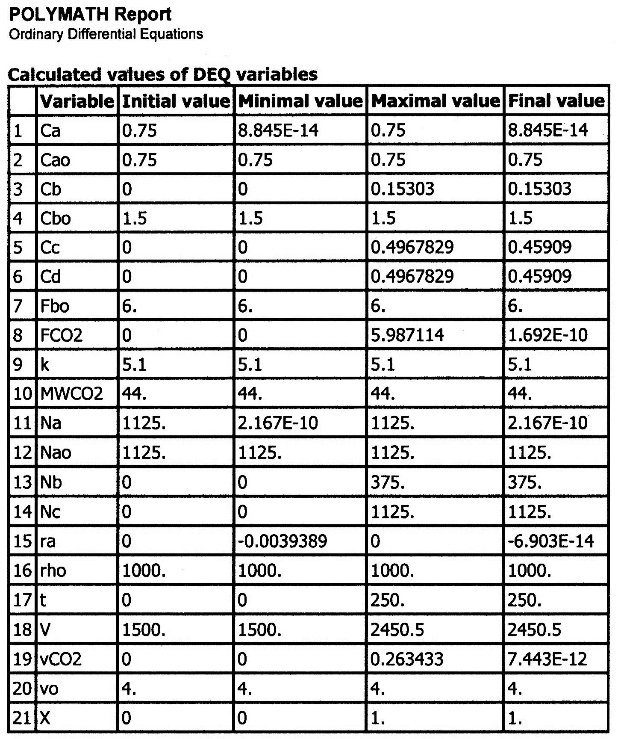
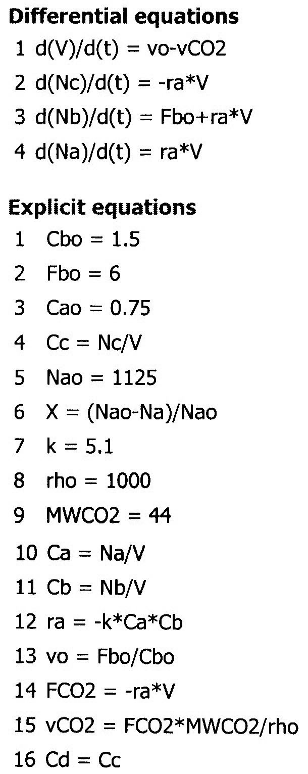
P6-6 Semibatch: Moles, N_{a}, N_{b}, etc.

Slide 19
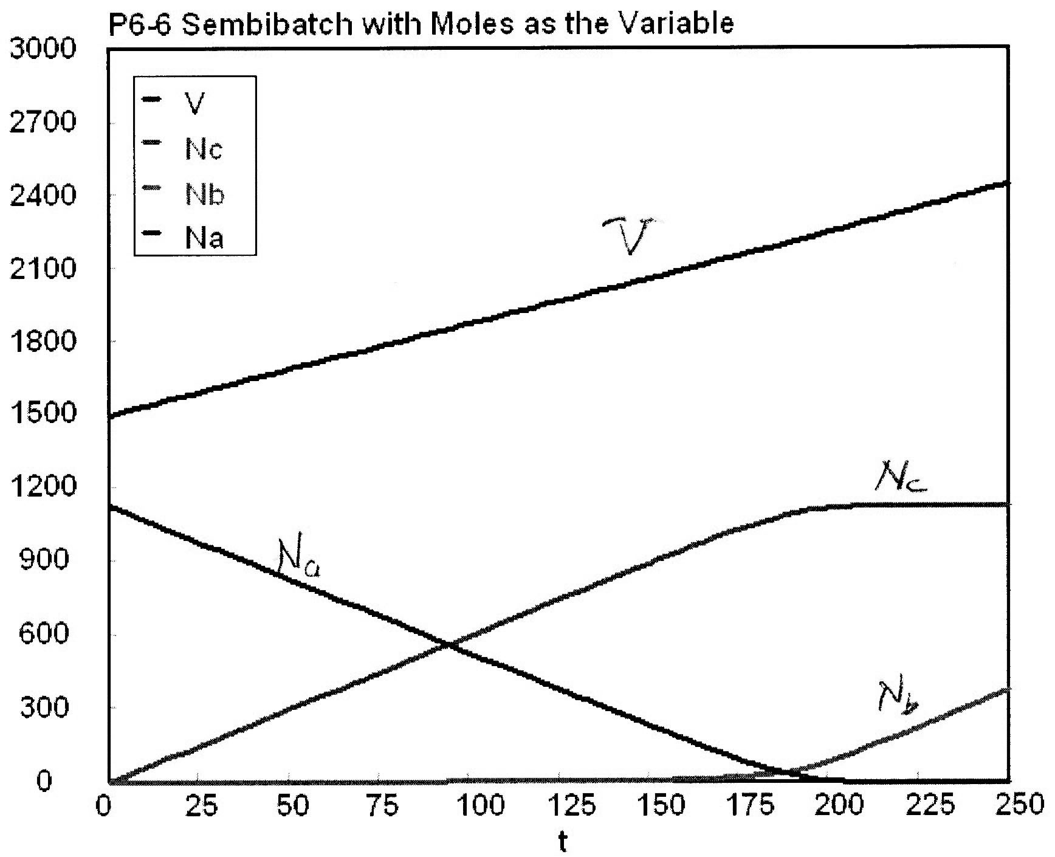

Slide 20
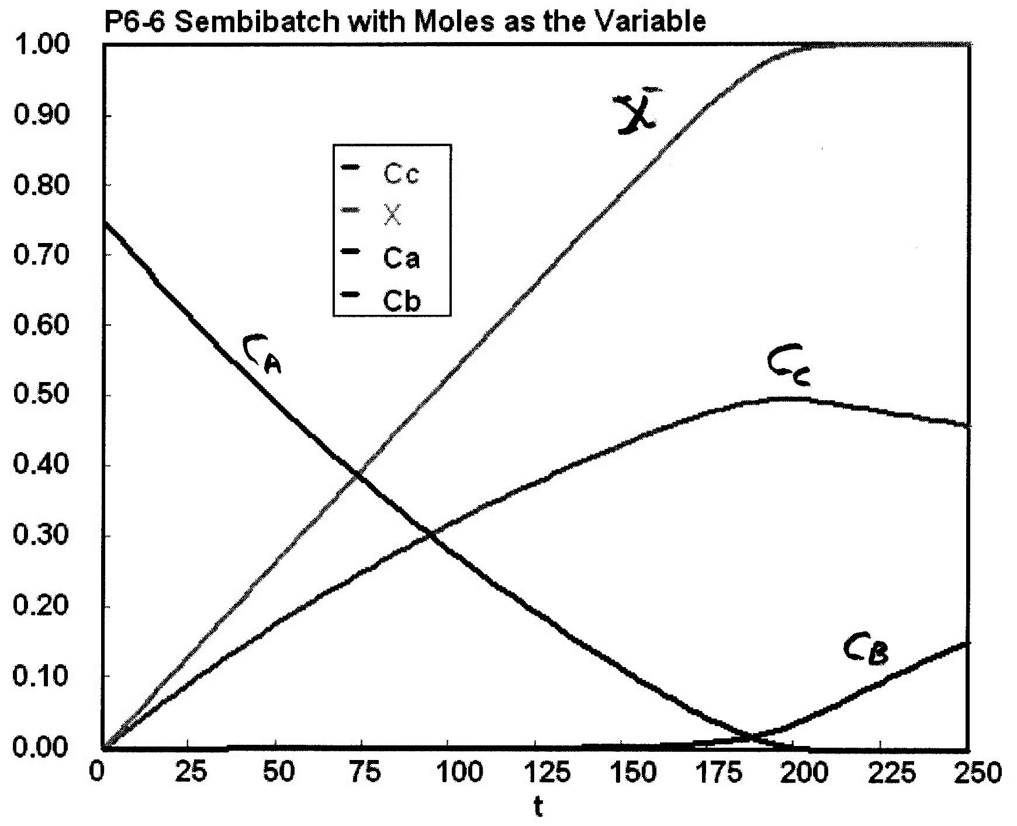

Slide 21
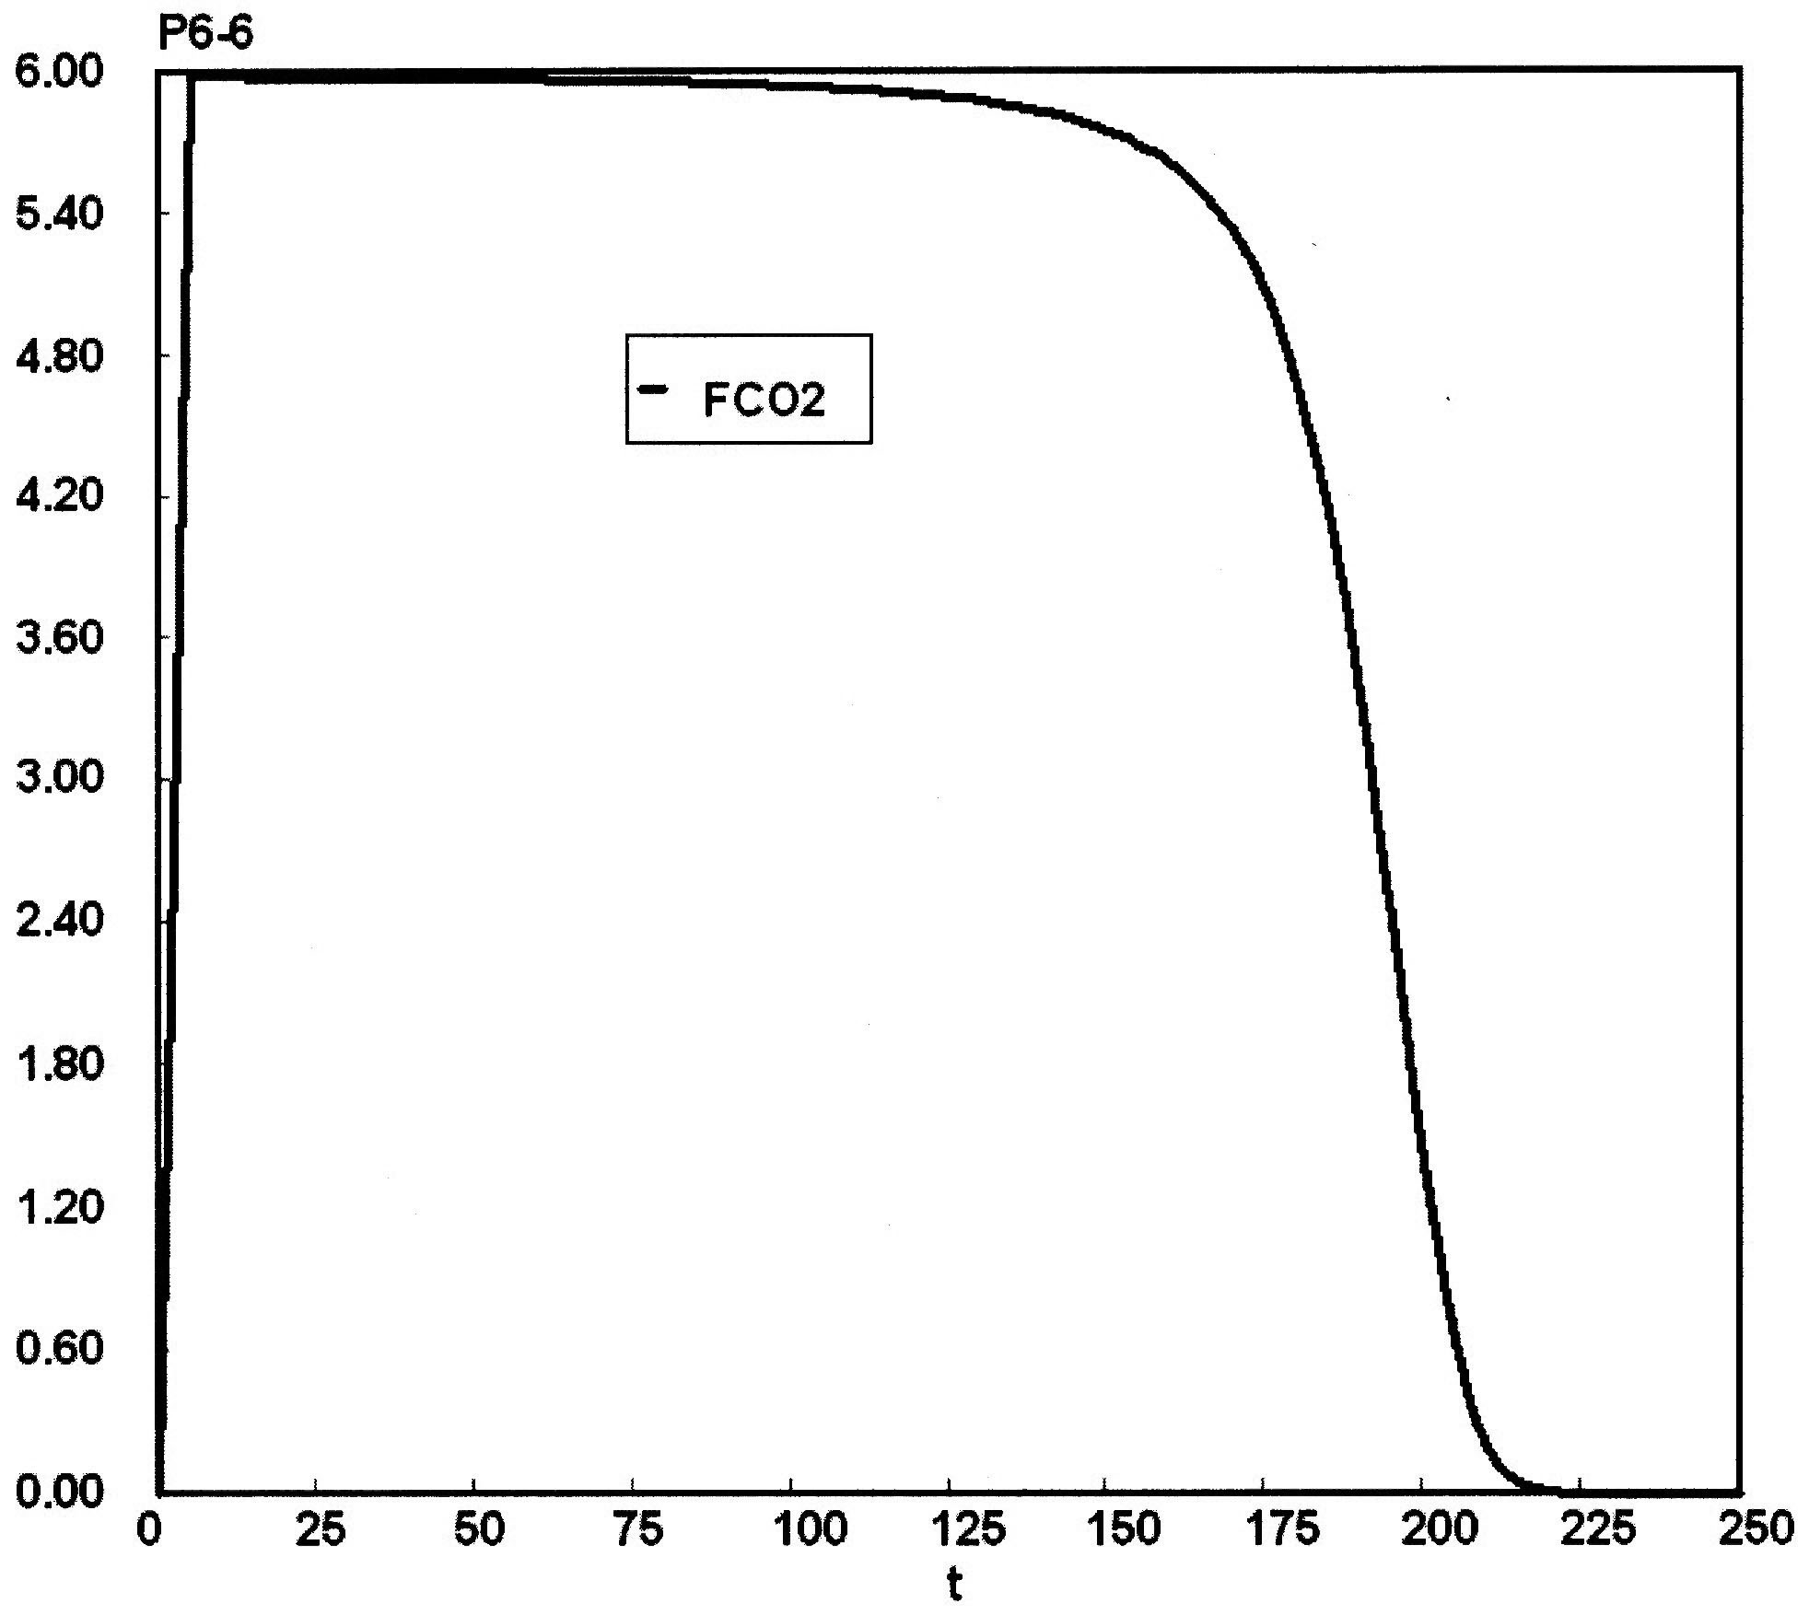

Slide 22
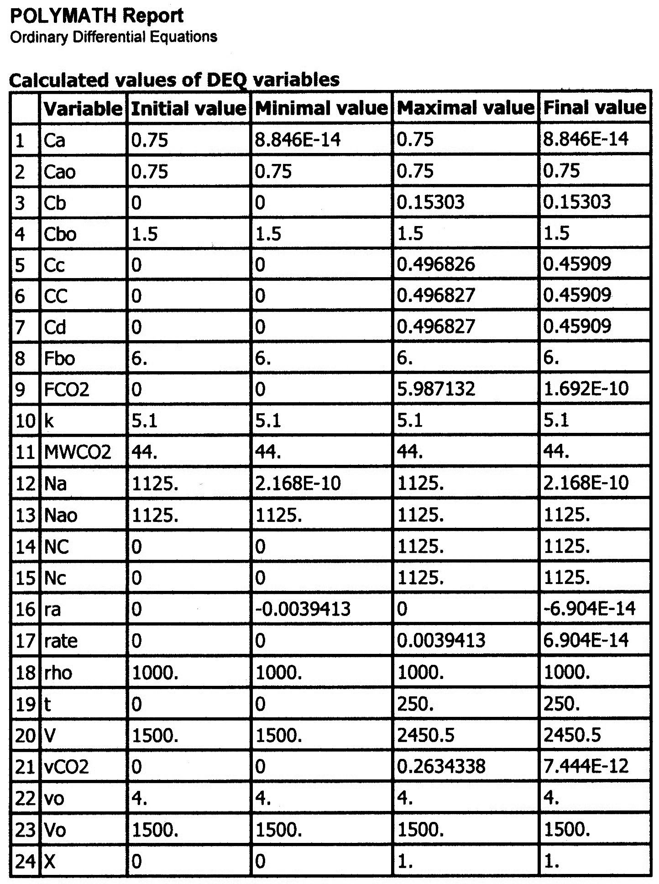
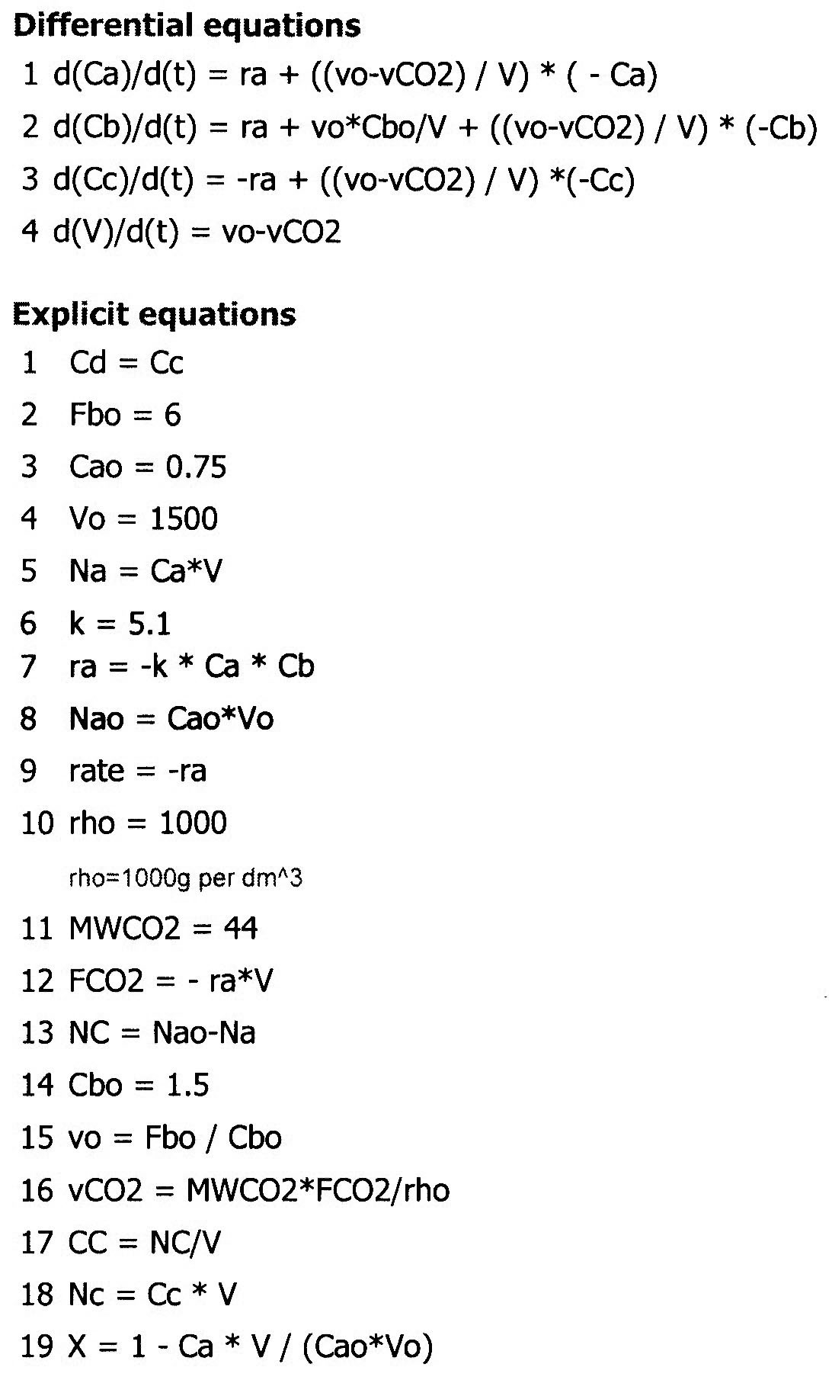
P6-6 Semibatch: Concentrations C_{A}, C_{B}, C_{C}

Slide 23
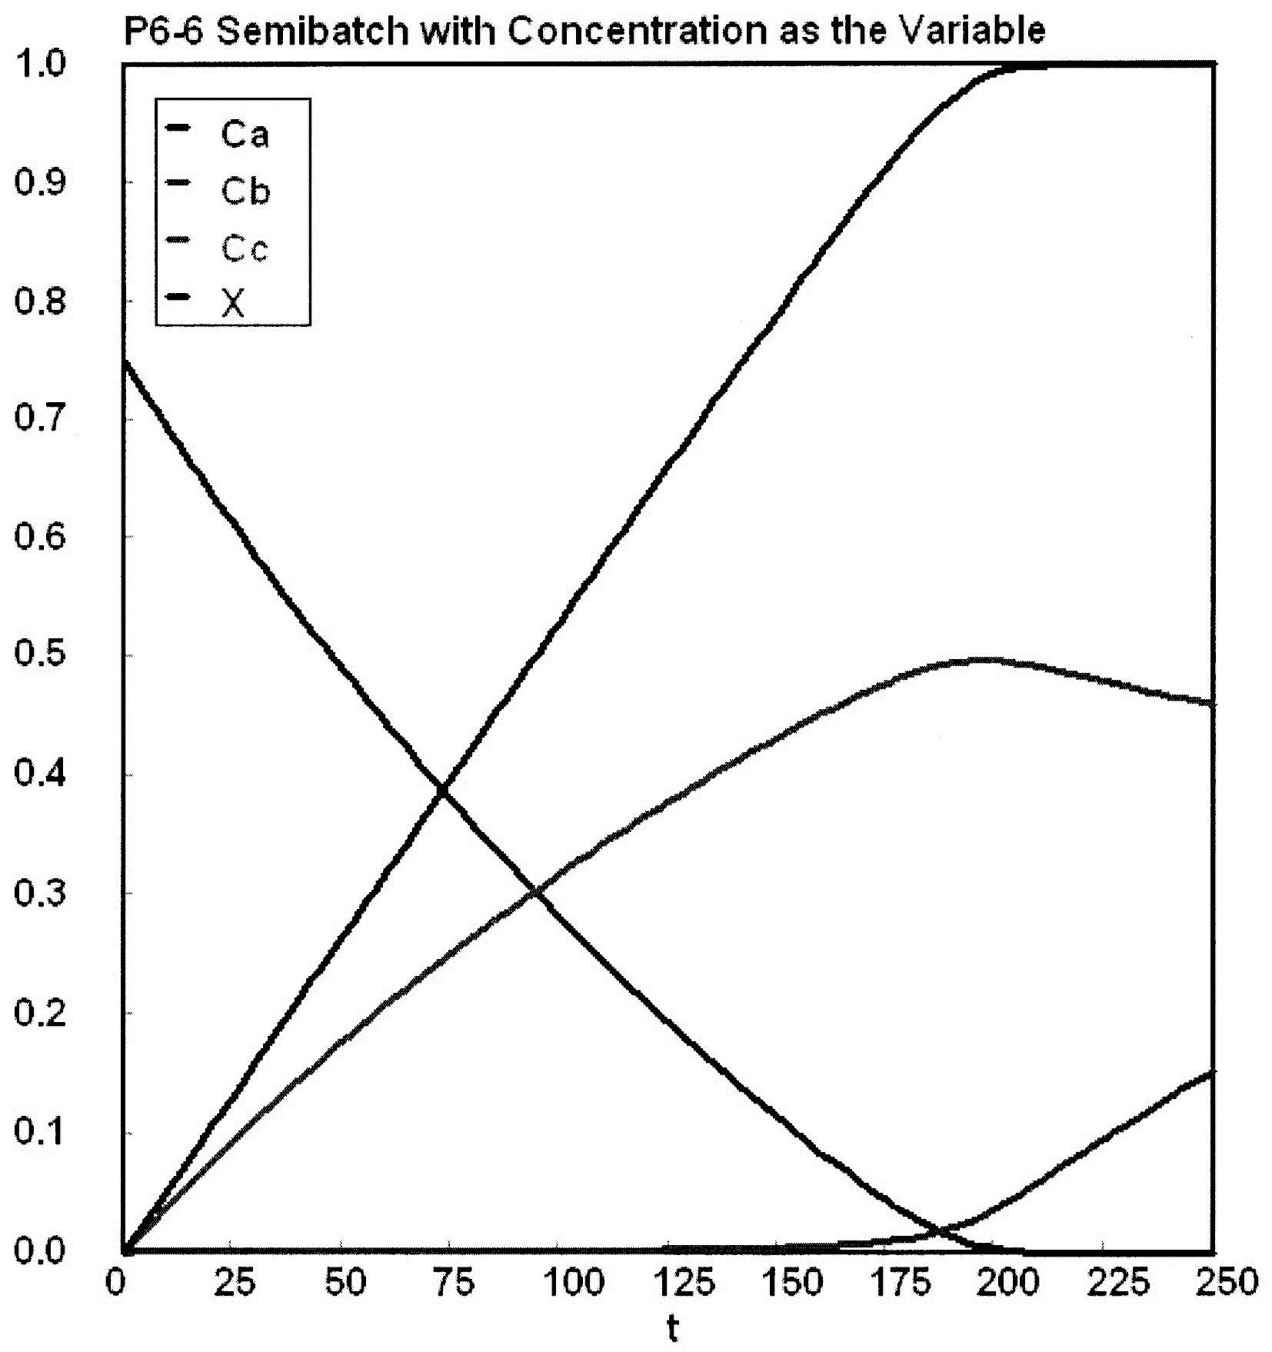

Slide 24
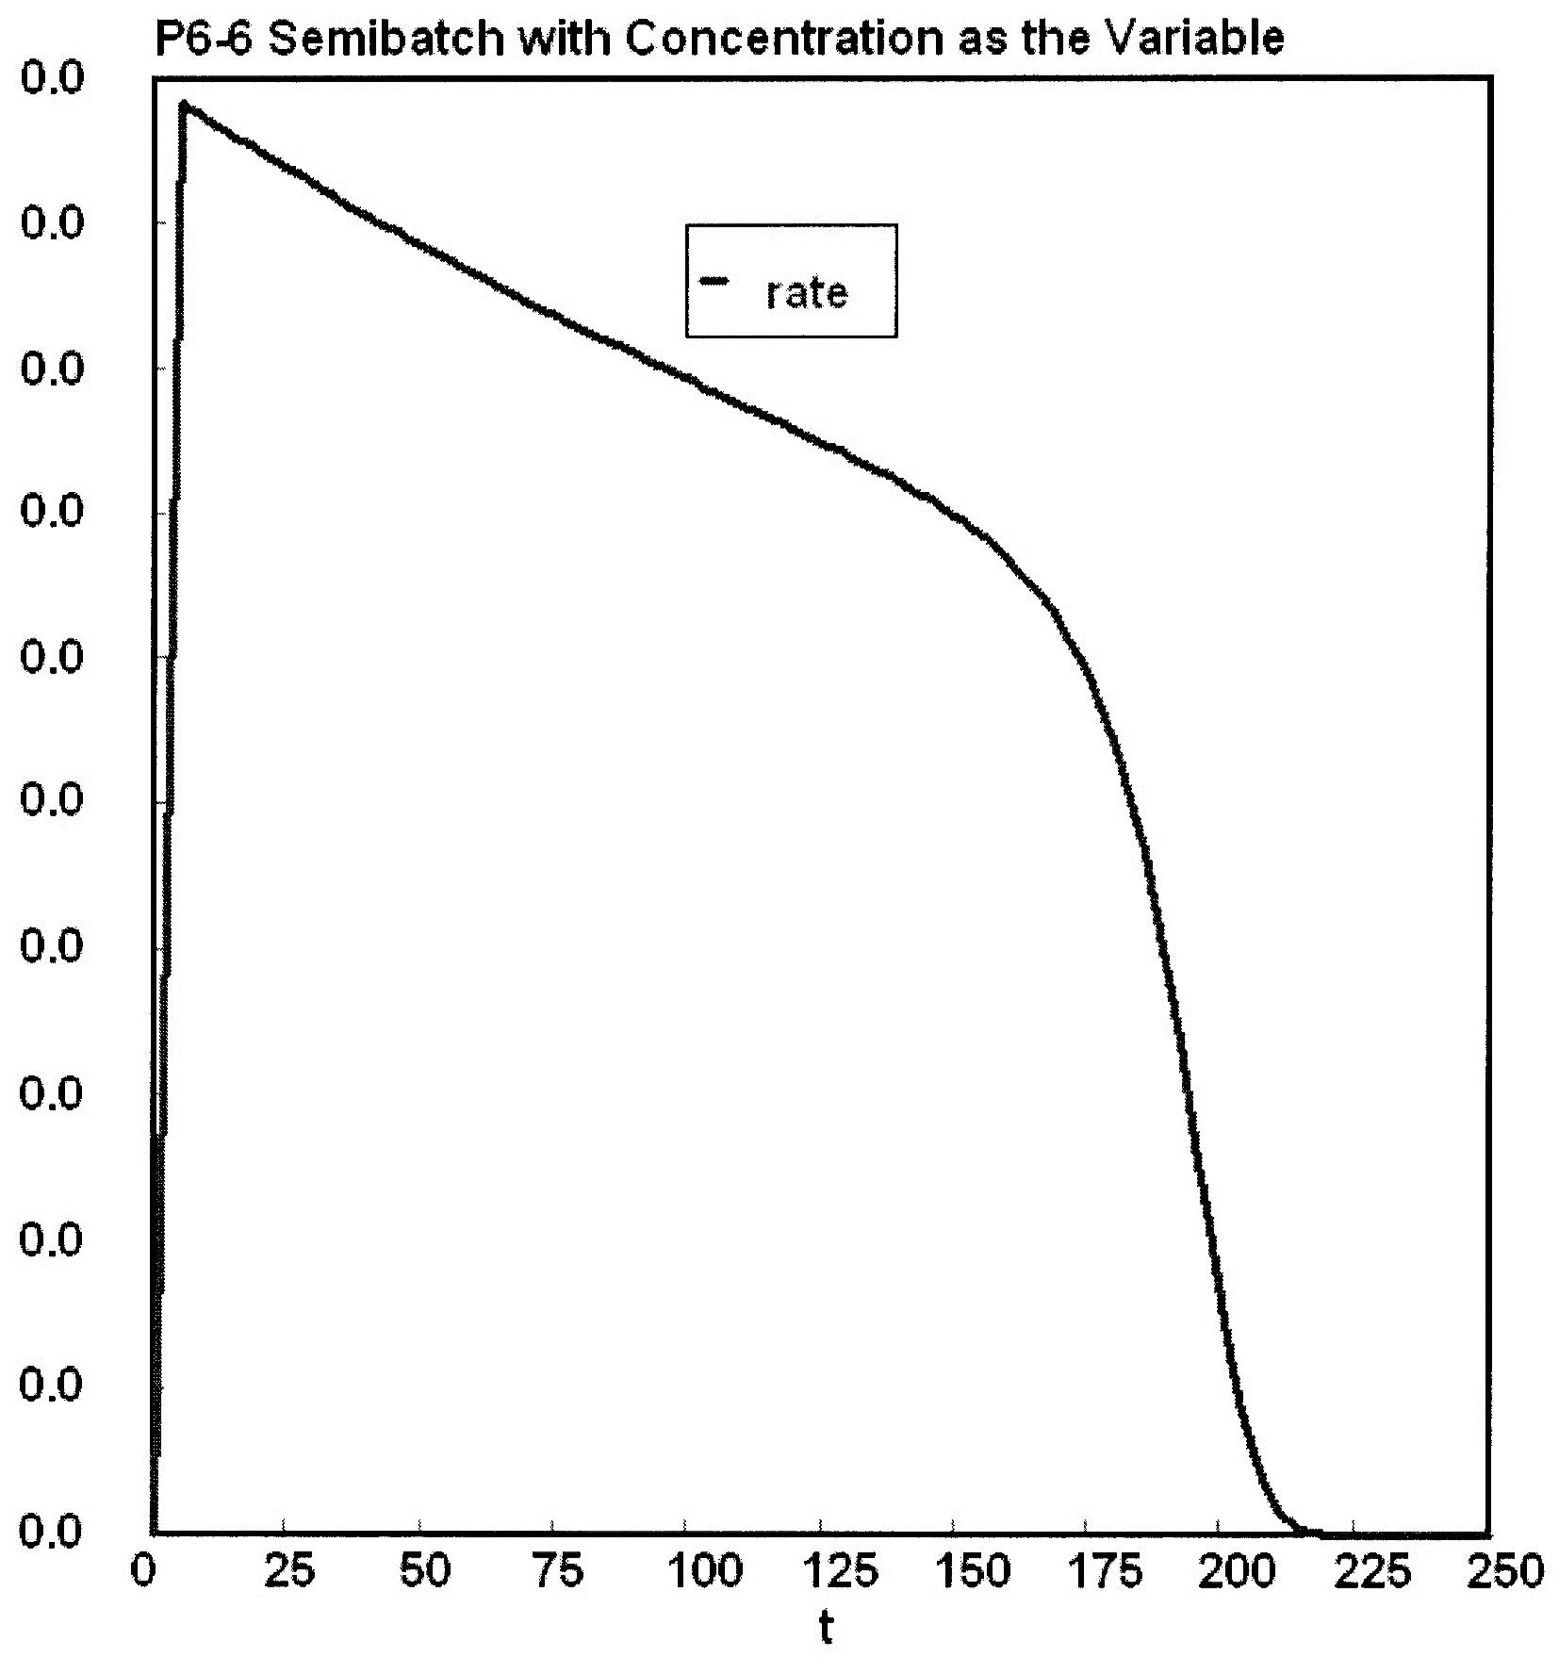

Slide 25
Semibatch Reactors
Three Forms of the Mole Balances applied to Semibatch Reactors:
Molar Basis
Concentration Basis
Conversion

Slide 26
Semibatch Reactors
Consider the following elementary reaction:
A+B → C+D
-r_{A}=kC_{A}C_{B}
The combined Mole Balance, Rate Law, and Stoichiometry may be written in terms of number of moles, conversion, and/or concentration:
Conversion | Concentration | No. of Moles

Slide 27
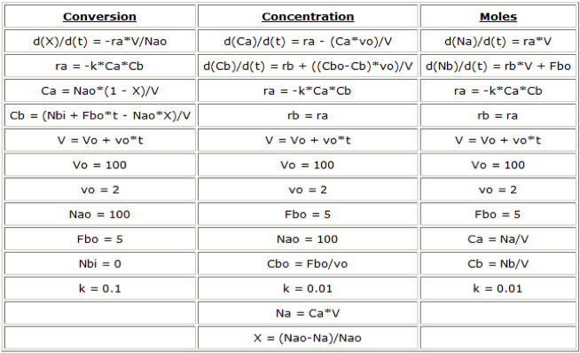
Polymath Equations

Slide 28
End of Lecture 10

