Slide 1
Lecture 14
Chemical Reaction Engineering (CRE) is the field that studies the rates and mechanisms of chemical reactions and the design of the reactors in which they take place.

Slide 2
Lecture 14 – Thursday 2/28/2013
Pseudo Steady State Hypothesis (PSSH)
  Net rate of reaction of active intermediates is zero
  Hall of Fame Reaction: 2NO +O₂→ 2NO₂
  Introduction to Enzyme Kinetics
  Begin non-Isothermal reactor design

Slide 3
Active Intermediates and PSSH
An active intermediate is a molecule that is in a highly energetic and reactive state It is short lived as it disappears virtually as fast as it is formed. That is, the net rate of reaction of an active intermediate, A*, is zero.
The assumption that the net rate of reaction is zero is called the Pseudo Steady State Hypothesis (PSSH)

Slide 4
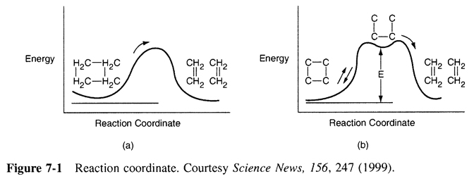
Active Intermediates and PSSH

Slide 5
Example
The rate law for the reaction
is found from experiment to be
How did this rate law come about? Suggest a mechanism consistent with the rate law.

Slide 6
Example
For reactions with active intermediates, the reaction coordinated now has trough in it and the active intermediate, A*, sits in this trough

Slide 7
Example - Solution

Slide 8
Rate Laws:
k₃ is defined w.r.t. A*
Reaction (1) (1)
Reaction (2) (2)
Reaction (3) (3)
But C*_{A} cannot be measured since it is so small
Relative Rates:

Slide 9
Net Rates: Rate of Formation of Product
(4)
Pseudo Steady State Hypothesis r*_{A} = 0
(5)
(6)
Solving for

Slide 10
Substituting for in Equation (4) the rate of formation of B is
(8)
Relative rates overall
(9)

Slide 11
For high concentrations of A, we can neglect in the denominator with respect to
and the rate law becomes
(10)
(apparent first order)

Slide 12
For low concentrations of A, we can neglect in the denominator with respect to k₃.
and the rate law becomes
(11)
(apparent second order)
Dividing by k₃ and letting k’=k₂/k₃ and k=k₁ we have the rate law we were asked to derive
(12)

Slide 13
Active Intermediates
Why do so many reactions follow elementary rate laws?
What about

Slide 14
Active Intermediates/Free Radicals and PSSH
Hall of Fame Reaction
The reaction: 2NO +O₂→ 2NO₂
has an elementary rate law
However… Look what happens to the rate as the temperature increases:
-r_{NO2}
T

Slide 15
Why does the rate law decrease with increasing temperature?
Mechanism:
(1)
(2)
(3)
Write rate of formation of product r_{NO2}
Note: k₃ is defined w.r.t. NO₃*

Slide 16
Define k with respect to NO₃*
Assume that all reactions are elementary reactions, such that:

Slide 17
The net reaction rate for NO₃* is the sum of the individual reaction rates for NO₃*:

Slide 18
Pseudo Steady State Hypothesis (PSSH)
The PSSH assumes that the net rate of species A*
(in this case NO₃*) is zero.

Slide 19
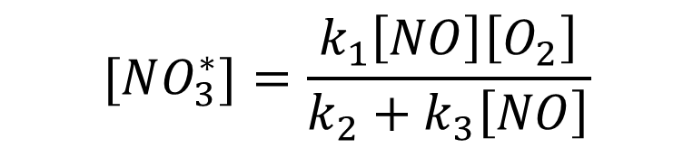
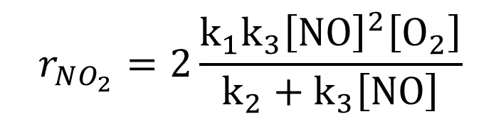
Pseudo Steady State Hypothesis (PSSH)
$$[NO_{3}^{∗}]=\frac{k_{1}\left[NO\right]\left[O_{2}\right]}{k_{2}+k_{3}\left[NO\right]}$$
$$r_{NO_{2}}=2\frac{k_{1}k_{3}{\left[NO\right]}^{2}\left[O_{2}\right]}{k_{2}+k_{3}\left[NO\right]}$$

Slide 20
Pseudo Steady State Hypothesis (PSSH)
This result shows why the rate decreases as temperature increases.
-r_{NO2}
T

Slide 21
End Lecture 14

