Slide 1
Lecture 1
Chapter 1
Chemical Reaction Engineering (CRE) is the field that studies the rates and mechanisms of chemical reactions and the design of the reactors in which they take place.

Slide 2
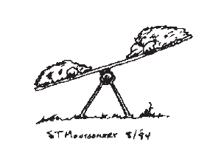
Lecture 1
Introduction
Definitions
General Mole Balance Equation
  Batch (BR)
  Continuously Stirred Tank Reactor (CSTR)
  Plug Flow Reactor (PFR)
  Packed Bed Reactor (PBR)

Slide 3
Chemical Reaction Engineering
Chapter 1
Chemical reaction engineering is at the heart of virtually every chemical process. It separates the chemical engineer from other engineers.
Industries that Draw Heavily on Chemical Reaction Engineering (CRE) are:
CPI (Chemical Process Industries)
Examples like Dow, DuPont, Amoco, Chevron

Slide 4
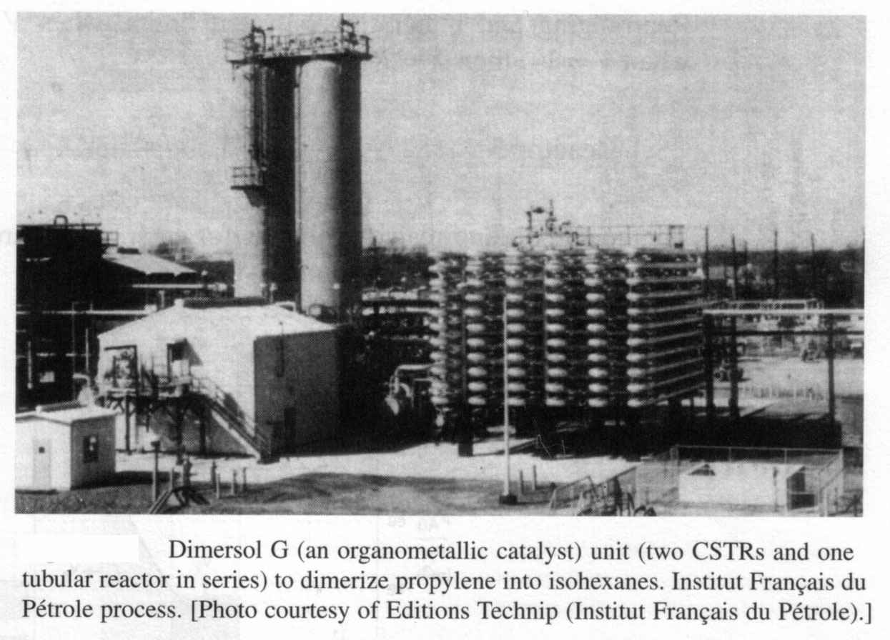
Chapter 1

Slide 5
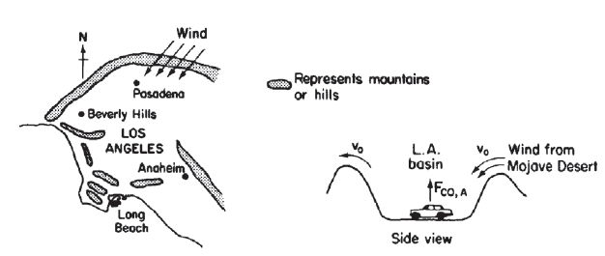
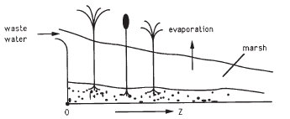

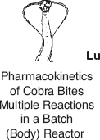
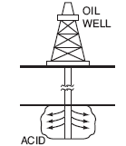
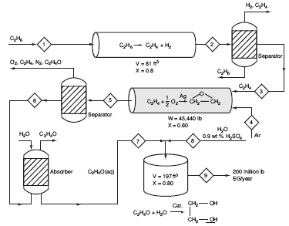
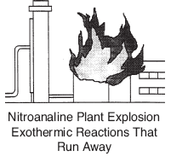
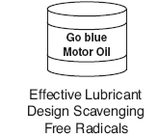
Chapter 1
Smog (Ch. 1)
Wetlands (Ch. 7 DVD-ROM)
Hippo Digestion (Ch. 2)
Oil Recovery (Ch. 7)
Cobra Bites
(Ch. 8 DVD-ROM)
Lubricant Design (Ch. 9)
Plant Safety
(Ch. 11,12,13)
Chemical Plant for Ethylene Glycol (Ch. 5)

Slide 6
Materials on the Web
http://www.umich.edu/~elements/6e/

Slide 7
Let’s Begin CRE
Chapter 1
Chemical Reaction Engineering (CRE) is the field that studies the rates and mechanisms of chemical reactions and the design of the reactors in which they take place.

Slide 8
Chemical Identity
Chapter 1
A chemical species is said to have reacted when it has lost its chemical identity.
The identity of a chemical species is determined by the kind, number, and configuration of that species’ atoms.

Slide 9
Chemical Identity
Chapter 1
A chemical species is said to have reacted when it has lost its chemical identity.
There are three ways for a species to loose its identity:
1. Decomposition CH₃CH₃ → H₂ + H₂C=CH₂
2. Combination N₂ + O₂ → 2 NO
3. Isomerization C₂H₅CH=CH₂ → CH₂=C(CH₃)₂

Slide 10
Reaction Rate
Chapter 1
The reaction rate is the rate at which a species looses its chemical identity per unit volume.
The rate of a reaction (mol/dm³/s) can be expressed as either:
  The rate of Disappearance of reactant: -r_{A}
              or as
  The rate of Formation (Generation) of product: r_{P}

Slide 11
Reaction Rate
Consider the isomerization
A → B
r_{A} = the rate of formation of species A per unit volume
-r_{A} = the rate of a disappearance of species A per unit volume
r_{B} = the rate of formation of species B per unit volume

Slide 12
Reaction Rate
Chapter 1
EXAMPLE: A→B
  If Species B is being formed at a rate of
  0.2 moles per decimeter cubed per second, i.e.,
  r_{B} = 0.2 mole/dm³/s
Then A is disappearing at the same rate:
-r_{A}= 0.2 mole/dm³/s
The rate of formation (generation of A) is:
  r_{A}= -0.2 mole/dm³/s

Slide 13
Reaction Rate
Chapter 1
For a catalytic reaction we refer to –r_{A}’ , which is the rate of disappearance of species A on a per mass of catalyst basis. (mol/gcat/s)
NOTE: dC_{A}/dt is not the rate of reaction

Slide 14
Reaction Rate
Chapter 1
Consider species j:
r_{j} is the rate of formation of species j per unit volume [e.g. mol/dm³s]
r_{j} is a function of concentration, temperature, pressure, and the type of catalyst (if any)
r_{j} is independent of the type of reaction system (batch, plug flow, etc.)
r_{j} is an algebraic equation, not a differential equation
(e.g. -r_{A} = kC_{A} or -r_{A} = kC_{A}²)

Slide 15
General Mole Balances
Chapter 1
Building Block 1:
System Volume, V
F_{j0}
G_{j}
F_{j}

Slide 16
General Mole Balances
Chapter 1
Building Block 1:
If spatially uniform:
If NOT spatially uniform:

Slide 17
General Mole Balances
Chapter 1
Building Block 1:
Take limit

Slide 18
General Mole Balances
Chapter 1
Building Block 1:
System Volume, V
F_{A0}
G_{A}
F_{A}
General Mole Balance on System Volume V

Slide 19
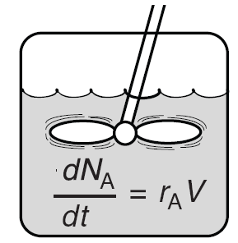
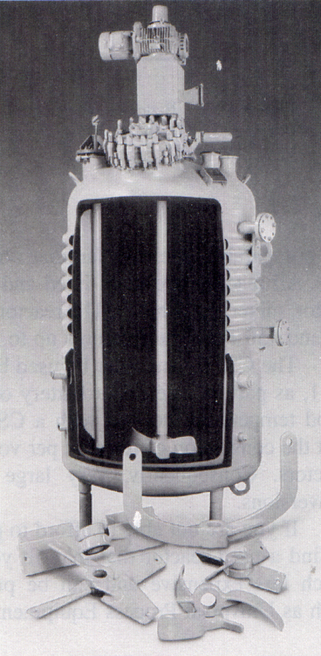
Batch Reactor - Mole Balances
Chapter 1
Batch
Well-Mixed
19

Slide 20
Batch Reactor - Mole Balances
Chapter 1
Integrating
when
Time necessary to reduce the number of moles of A from N_{A0} to N_{A}.

Slide 21
Batch Reactor - Mole Balances
Chapter 1
N_{A}
t

Slide 22
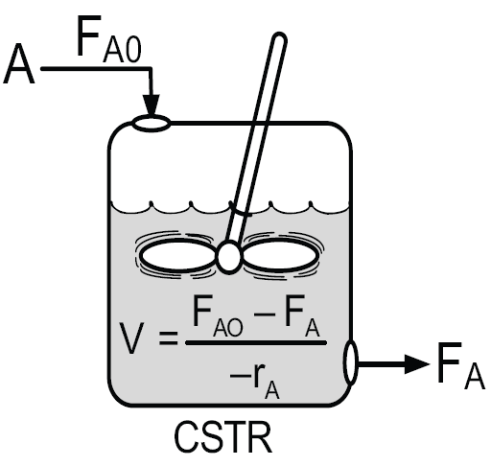
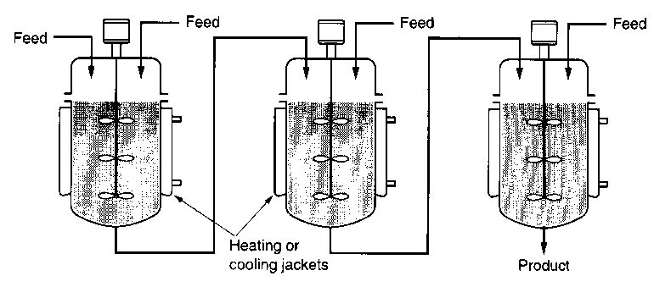
CSTR - Mole Balances
Chapter 1
CSTR
Steady State

Slide 23
CSTR - Mole Balances
Chapter 1
Well Mixed
CSTR volume necessary to reduce the molar flow rate from F_{A0} to F_{A}.

Slide 24
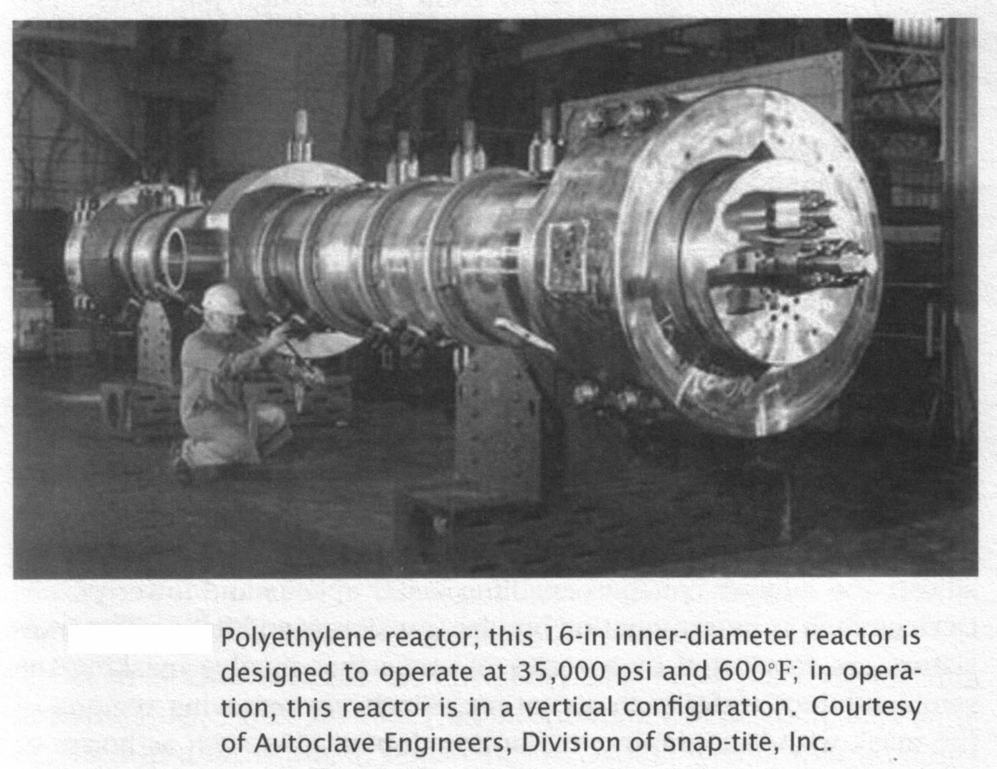
Plug Flow Reactor - Mole Balances
Chapter 1

Slide 25
Plug Flow Reactor - Mole Balances
Chapter 1

Slide 26
Plug Flow Reactor - Mole Balances
Chapter 1
Rearrange and take limit as ΔV→0
This is the volume necessary to reduce the entering molar flow rate (mol/s) from F_{A0} to the exit molar flow rate of F_{A}.

Slide 27
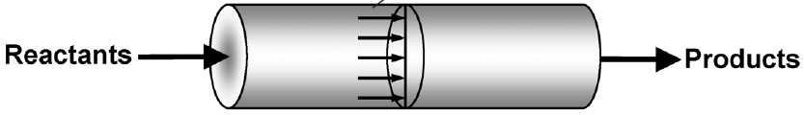
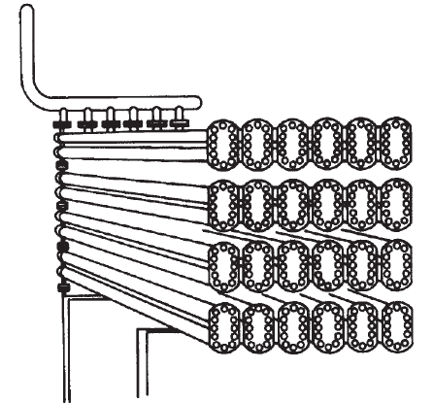
Plug Flow Reactor - Mole Balances
Chapter 1
PFR
Steady State

Slide 28
Plug Flow Reactor - Mole Balances
Chapter 1
Alternative Derivation
Differientiate with respect to V
The integral form is:
This is the volume necessary to reduce the entering molar flow rate (mol/s) from F_{A0} to the exit molar flow rate of F_{A}.

Slide 29
Packed Bed Reactor - Mole Balances
Chapter 1
PBR
Steady State

Slide 30
Packed Bed Reactor - Mole Balances
Chapter 1
Rearrange:
The integral form to find the catalyst weight is:
PBR catalyst weight necessary to reduce the entering molar flow rate F_{A0} to molar flow rate F_{A}.

Slide 31
Reactor Mole Balances Summary
Chapter 1
The GMBE applied to the four major reactor types
(and the general reaction A→B)
Reactor | Differential | Algebraic | Integral
N_{A}
Batch
t
CSTR
F_{A}
PFR
V
F_{A}
PBR
W

Slide 32

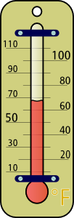
Reactors with Heat Effects
Fast Forward to the 10th Week of the Course
Chapter 11
EXAMPLE: Production of Propylene Glycol in an Adiabatic CSTR
Propylene glycol is produced by the hydrolysis of propylene oxide:

Slide 33
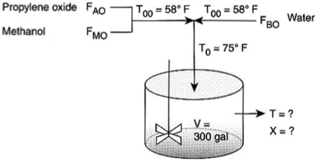
Fast Forward to the 10th Week of the Course
Chapter 11
v₀
Propylene Glycol
What are the exit conversion X and exit temperature T?
Solution
Let the reaction be represented by
A+B→C

Slide 34
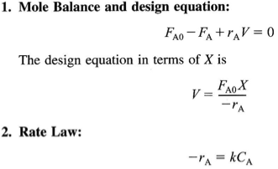
Chapter 11

Slide 35
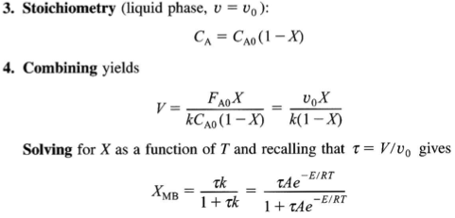
Chapter 11

Slide 36
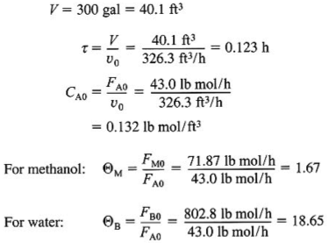
Chapter 11

Slide 37

Chapter 11

Slide 38

Chapter 11

Slide 39
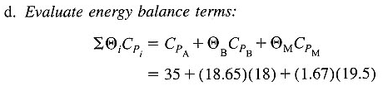



Chapter 11
Evaluate energy balance terms

Slide 40

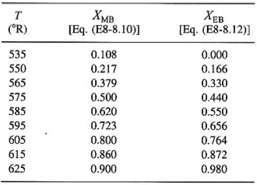
Chapter 11

Slide 41
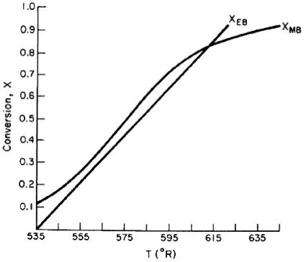
Chapter 11

Slide 42
Analysis
Chapter 11
We have applied our CRE algorithm to calculate the Conversion (X=0.84) and Temperature (T=614 °R) in a 300 gallon CSTR operated adiabatically.
T=535 °R
X=0.84
A+B→C
T=614 °R

Slide 43
Keeping Up
Algorithm

Slide 44
Separations
Algorithm
Filtration
Distillation
Adsorption
These topics do not build upon one another.

Slide 45
Reaction Engineering
Algorithm
Mole Balance
Rate Laws
Stoichiometry
These topics build upon one another.

Slide 46
Algorithm
Heat Effects
Isothermal Design
Stoichiometry
Rate Laws
Mole Balance
CRE Algorithm

Slide 47
Algorithm
Rate Laws
Mole Balance
Be careful not to cut corners on any of the
CRE building blocks while learning this material!

Slide 48
Algorithm
Isothermal Design
Heat Effects
Rate Laws
Stoichiometry
Mole Balance
Otherwise, your Algorithm becomes unstable.

Slide 49
End of Lecture 1

Slide 50
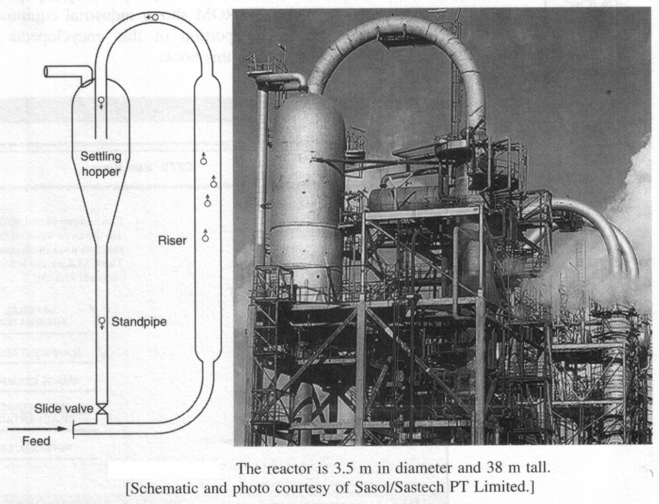
Supplemental Slides
Additional Applications of CRE

Slide 51
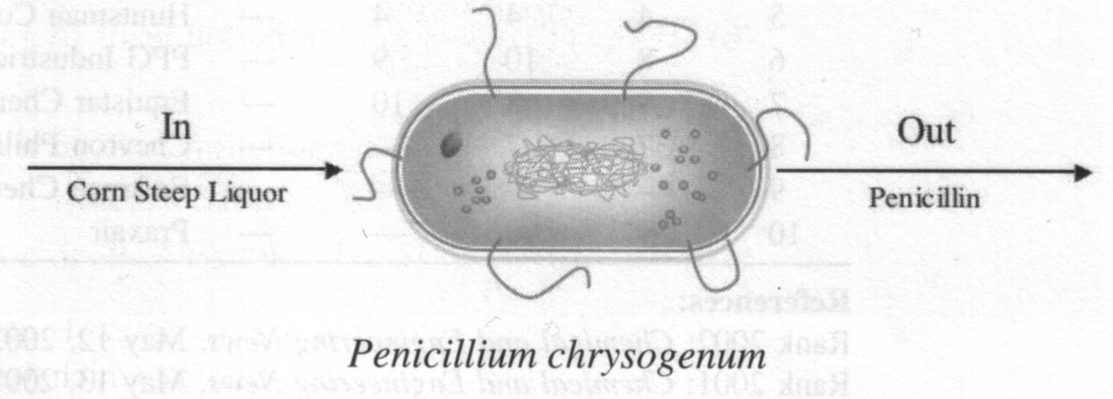
Supplemental Slides
Additional Applications of CRE

Slide 52
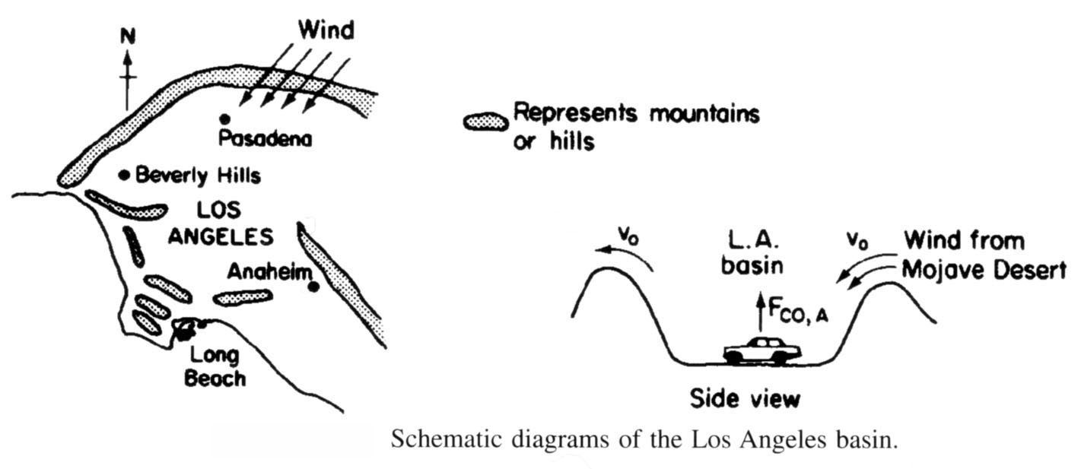
Supplemental Slides
Additional Applications of CRE

Slide 53
Supplemental Slides
Additional Applications of CRE
Hippo Digestion (Ch. 2)

Slide 54
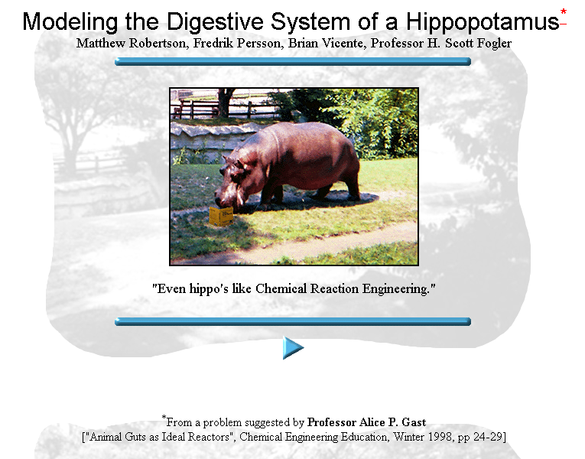
Supplemental Slides
Additional Applications of CRE

Slide 55
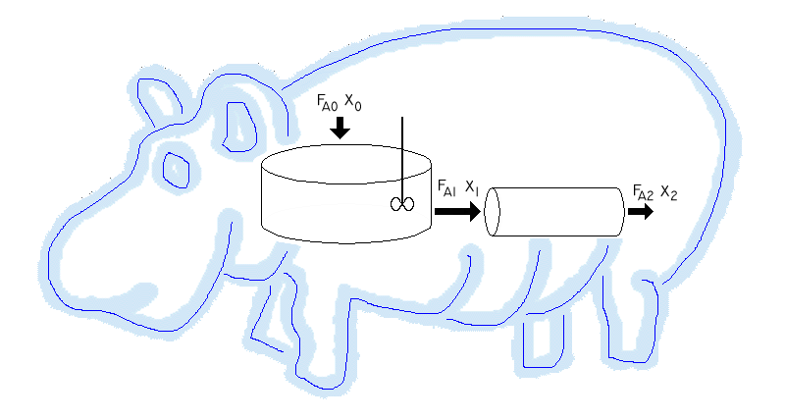
Supplemental Slides
Additional Applications of CRE

Slide 56
Supplemental Slides
Additional Applications of CRE
Smog (Ch. 1)

Slide 57
Supplemental Slides
Additional Applications of CRE
Chemical Plant for Ethylene Glycol (Ch. 5)

Slide 58
Supplemental Slides
Additional Applications of CRE
Wetlands (Ch. 7 DVD-ROM)
Oil Recovery (Ch. 7)

Slide 59
Supplemental Slides
Additional Applications of CRE
Cobra Bites
(Ch. 8 DVD-ROM)

Slide 60
Supplemental Slides
Additional Applications of CRE
Lubricant Design (Ch. 9)

Slide 61
Supplemental Slides
Additional Applications of CRE
Plant Safety
(Ch. 11,12,13)

