Slide 1
Lecture 20
Chemical Reaction Engineering (CRE) is the field that studies the rates and mechanisms of chemical reactions and the design of the reactors in which they take place.

Slide 2
Last Lecture
Energy Balance Fundamentals
Substituting for

Slide 3
Web Lecture 20
Class Lecture 16-Thursday 3/14/2013
Reactors with Heat Exchange
User friendly Energy Balance Derivations
  Adiabatic
  Heat Exchange Constant T_{a}
  Heat Exchange Variable T_{a} Co-current
  Heat Exchange Variable T_{a} Counter Current

Slide 4
Adiabatic Operation CSTR
Elementary liquid phase reaction carried out in a CSTR
The feed consists of both - Inerts I and Species A with the ratio of inerts I to the species A being 2 to 1.

Slide 5
Adiabatic Operation CSTR
Assuming the reaction is irreversible for CSTR,
A → B, (K_{C} = 0) what reactor volume is necessary to achieve 80% conversion?
If the exiting temperature to the reactor is 360K, what is the corresponding reactor volume?
Make a Levenspiel Plot and then determine the PFR reactor volume for 60% conversion and 95% conversion. Compare with the CSTR volumes at these conversions.
Now assume the reaction is reversible, make a plot of the equilibrium conversion as a function of temperature between 290K and 400K.

Slide 6
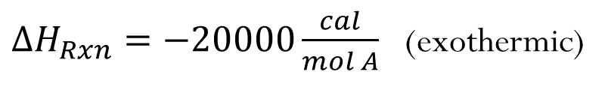
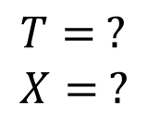
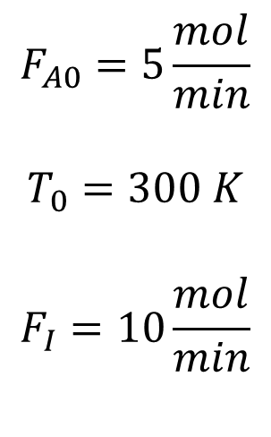
CSTR: Adiabatic Example
$$F_{A0}=5\frac{mol}{min}$$
$$T_{0}=300 K$$
$$F_{I}=10\frac{mol}{min}$$
$ΔH_{Rxn}=−20000\frac{cal}{mol A}$ (exothermic)
$$T= ? \\ X= ?$$
1) Mole Balances:

Slide 7
CSTR: Adiabatic Example
2) Rate Laws:
3) Stoichiometry:

Slide 8
CSTR: Adiabatic Example
4) Energy Balance
Adiabatic, ∆C_{p}=0

Slide 9
CSTR: Adiabatic Example
Irreversible for Parts (a) through (c)
(a) Given X = 0.8, find T and V
(if reversible)

Slide 10
CSTR: Adiabatic Example
Given X, Calculate T and V

Slide 11
CSTR: Adiabatic Example
Given T, Calculate X and V
(b)
(if reversible)

Slide 12
CSTR: Adiabatic Example
(c) Levenspiel Plot

Slide 13
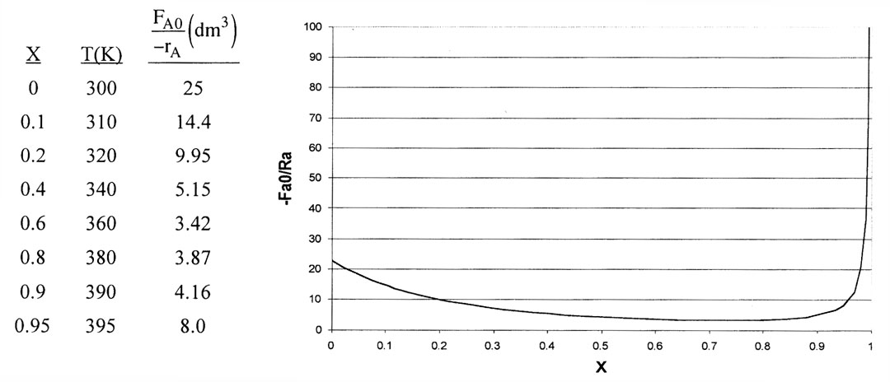
CSTR: Adiabatic Example
(c) Levenspiel Plot

Slide 14
CSTR: Adiabatic Example
CSTR X = 0.6 T = 360 K
CSTR X = 0.95 T = 395 K

Slide 15
CSTR: Adiabatic Example
PFR X = 0.6
PFR X = 0.95

Slide 16
CSTR: Adiabatic Example - Summary
CSTR | X = 0.6 | T = 360 | V = 2.05 dm³
PFR | X = 0.6 | T_{exit} = 360 | V = 5.28 dm³
CSTR | X = 0.95 | T = 395 | V = 7.59 dm³
PFR | X = 0.95 | T_{exit} = 395 | V = 6.62 dm³

Slide 17
Energy Balance in terms of Enthalpy

Slide 18
PFR Heat Effects

Slide 19
PFR Heat Effects
Need to determine T_{a}

Slide 20
Heat Exchange:
Need to determine T_{a}

Slide 21
Heat Exchange Example:
Case 1 - Adiabatic
Energy Balance:
Adiabatic (Ua=0) and ΔC_{P}=0

Slide 22
User Friendly Equations
Constant Ta e.g., Ta = 300K
B. Variable T_{a} Co-Current
C. Variable T_{a} Counter Current
Guess T_{a} at V = 0 to match T_{a0} = T_{a0} at exit, i.e., V = V_{f}

Slide 23
Heat Exchanger Energy Balance
Variable T_{a} Co-current
Coolant Balance:
In - Out + Heat Added = 0

Slide 24
Heat Exchanger Energy Balance
Variable T_{a} Counter-current
In - Out + Heat Added = 0

Slide 25
Heat Exchanger – Example
Case 1 – Constant T_{a}
Elementary liquid phase reaction carried out in a PFR
Heat Exchange Fluid
T_{a}
F_{A0}
F_{I}
T
The feed consists of both inerts I and species A with the ratio of inerts to the species A being 2 to 1.

Slide 26
Heat Exchanger – Example
Case 1 – Constant T_{a}
1) Mole Balance:
2) Rate Laws:

Slide 27
Heat Exchanger – Example
Case 1 – Constant T_{a}
3) Stoichiometry:
4) Heat Effects:

Slide 28
Heat Exchanger – Example
Case 1 – Constant T_{a}
Parameters:

Slide 29
PFR Heat Effects
Heat generated
Heat removed

Slide 30
Heat Exchanger – Example
Case 2 – Adiabatic
Mole Balance:
Energy Balance:
Adiabatic and ΔC_{P}=0
Ua=0
Additional Parameters (17A) & (17B)

Slide 31
Adiabatic PFR

Slide 32
Example: Adiabatic
Find conversion, X_{eq} and T as a function of reactor volume
X_{eq}
X
T
rate
X
V
V
V

Slide 33
Heat Exchange
Need to determine T_{a}

Slide 34
User Friendly Equations
A. Constant Ta (17B) Ta = 300K
Additional Parameters (18B – (20B):
B. Variable T_{a} Co-Current
C. Variable T_{a} Countercurrent
Guess T_{a} at V = 0 to match T_{a0} = T_{a0} at exit, i.e., V = V_{f}

Slide 35
Heat Exchange Energy Balance
Variable T_{a} Counter-current
Coolant balance:
In - Out + Heat Added = 0
All equations can be used from before except T_{a} parameter, use differential T_{a} instead, adding m_{C} and C_{PC}

Slide 36
Heat Exchange Energy Balance
Variable T_{a} Co-current
In - Out + Heat Added = 0
All equations can be used from before except dT_{a}/dV which must be changed to a negative. To arrive at the correct integration we must guess the T_{a} value at V=0, integrate and see if T_{a0} matches; if not, re-guess the value for T_{a} at V=0

Slide 37
Derive the user-friendly Energy Balance for a PBR
Differentiating with respect to W:

Slide 38
Derive the user-friendly Energy Balance for a PBR
Mole Balance on species i:
Enthalpy for species i:

Slide 39
Derive the user-friendly Energy Balance for a PBR
Differentiating with respect to W:

Slide 40
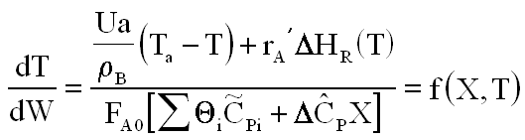
Derive the user-friendly Energy Balance for a PBR
Final Form of the Differential Equations in Terms of Conversion:
A:

Slide 41
Derive the user-friendly Energy Balance for a PBR
Final form of terms of Molar Flow Rate:
B:

Slide 42
Reversible Reactions
The rate law for this reaction will follow an elementary rate law.
Where K_{e} is the concentration equilibrium constant. We know from Le Chaltlier’s law that if the reaction is exothermic, K_{e} will decrease as the temperature is increased and the reaction will be shifted back to the left. If the reaction is endothermic and the temperature is increased, K_{e} will increase and the reaction will shift to the right.

Slide 43
Reversible Reactions
Van’t Hoff Equation:

Slide 44
Reversible Reactions
For the special case of ΔC_{P}=0
Integrating the Van’t Hoff Equation gives:

Slide 45
Reversible Reactions
X_{e}
K_{P}
endothermic reaction
endothermic reaction
exothermic reaction
exothermic reaction
T
T

Slide 46
End of Lecture 20

