Slide 1
Lecture 21
Chemical Reaction Engineering (CRE) is the field that studies the rates and mechanisms of chemical reactions and the design of the reactors in which they take place.

Slide 2
Web Lecture 21
Class Lecture 17 – Tuesday 3/19/2013
Gas Phase Reactions
Trends and Optimums

Slide 3
User Friendly Equations relate T, X, or F_{i}
Review Last Lecture
1. Adiabatic CSTR, PFR, Batch, PBR achieve this:

Slide 4
User Friendly Equations relate T, X, or F_{i}
2. CSTR with heat exchanger, UA(T_{a}-T) and a large coolant flow rate:
T
T_{a}

Slide 5
User Friendly Equations relate T, X, or F_{i}
3. PFR/PBR with heat exchange:
Coolant
F_{A0}
T₀
T_{a}
3A. In terms of conversion, X

Slide 6
User Friendly Equations relate T, X, or F_{i}
3B. In terms of molar flow rates, F_{i}
4. For multiple reactions
5. Coolant Balance

Slide 7
Reversible Reactions
X_{e}
K_{P}
endothermic reaction
endothermic reaction
exothermic reaction
exothermic reaction
T
T

Slide 8
Heat Exchange
Example: Elementary liquid phase reaction carried out in a PFR
T_{a}
Heat Exchange Fluid
F_{A0}
F_{I}
The feed consists of both inerts I and Species A with the ratio of inerts to the species A being 2 to 1.

Slide 9
Heat Exchange
Adiabatic. Plot X, X_{e}, T and the rate of disappearance as a function of V up to V = 40 dm³.
Constant T_{a}. Plot X, X_{e}, T, T_{a} and rate of disappearance of A when there is a heat loss to the coolant and the coolant temperature is constant at 300 K for V = 40 dm³. How do these curves differ from the adiabatic case.

Slide 10
Heat Exchange
Variable T_{a} Co-Current. Plot X, X_{e}, T, T_{a} and rate of disappearance of A when there is a heat loss to the coolant and the coolant temperature varies along the length of the reactor for V = 40 dm³. The coolant enters at 300 K. How do these curves differ from those in the adiabatic case and part (a) and (b)?
Variable T_{a} Countercurrent. Plot X, X_{e}, T, T_{a} and rate of disappearance of A when there is a heat loss to the coolant and the coolant temperature varies along the length of the reactor for V = 20 dm³. The coolant enters at 300 K. How do these curves differ from those in the adiabatic case and part (a) and (b)?

Slide 11
Heat Exchange
Example: PBR A ↔ B
5) Parameters
For adiabatic:
Constant T_{a}:
Co-current: Equations as is
Counter-current:

Slide 12
Reversible Reactions
1) Mole Balances

Slide 13
Reversible Reactions
2) Rate Laws

Slide 14
Reversible Reactions
3) Stoichiometry
Note: Nomenclature change for 5th edition p ≡ y

Slide 15
Reversible Reactions
Parameters

Slide 16
Reversible Reactions
Gas Phase Heat Effects
Example: PBR A ↔ B
3) Stoichiometry:
Gas Phase

Slide 17
Reversible Reactions
Gas Phase Heat Effects
Example: PBR A ↔ B

Slide 18
Reversible Reactions
Gas Phase Heat Effects
Example: PBR A ↔ B
Exothermic Case:
K_{C}
X_{e}
T
T
Endothermic Case:
~1
K_{C}
X_{e}
T
T

Slide 19
Reversible Reactions
Gas Phase Heat Effects
Case 1: Adiabatic and ΔC_{P}=0
Additional Parameters (17A) & (17B)

Slide 20
Reversible Reactions
Gas Phase Heat Effects
Case 2: Heat Exchange – Constant T_{a}
Heat effects:

Slide 21
Reversible Reactions
Gas Phase Heat Effects
Case 3. Variable T_{a} Co-Current
Case 4. Variable T_{a} Countercurrent
Guess T_{a} at V = 0 to match T_{a0} = T_{a0} at exit, i.e., V = V_{f}

Slide 28
Adiabatic Equilibrium
Conversion on temperature
Exothermic ΔH is negative
Adiabatic Equilibrium temperature (T_{adia}) and conversion (Xe_{adia})
X
X_{eadia}
T_{adia}
T

Slide 29
Q₁
Q₂
F_{A0}
F_{A1}
F_{A2}
F_{A3}
T₀
X₁
T₀
X₂
T₀
X₃

Slide 30
X
X_{e}
X₃
X₂
X₁
T₀
T

Slide 31
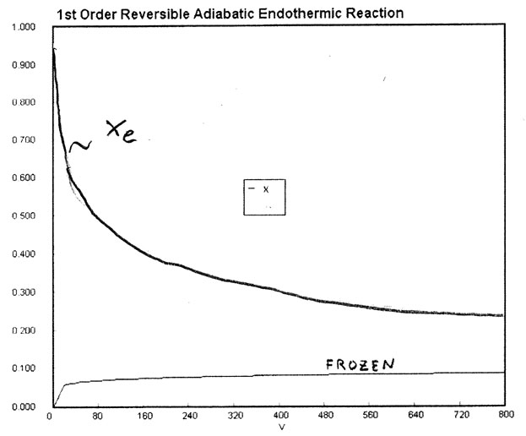

Slide 32
Gas Flow Heat Effects
Trends:
Adiabatic
exothermic
endothermic
X
X
Adiabatic
T and X_{e}
T
T
T₀
T₀

Slide 33
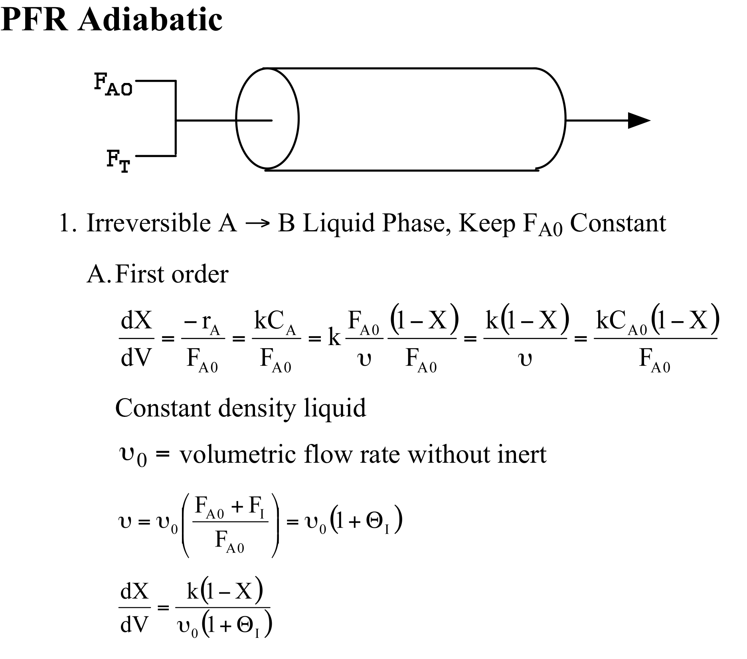
Effects of Inerts in the Feed

Slide 34
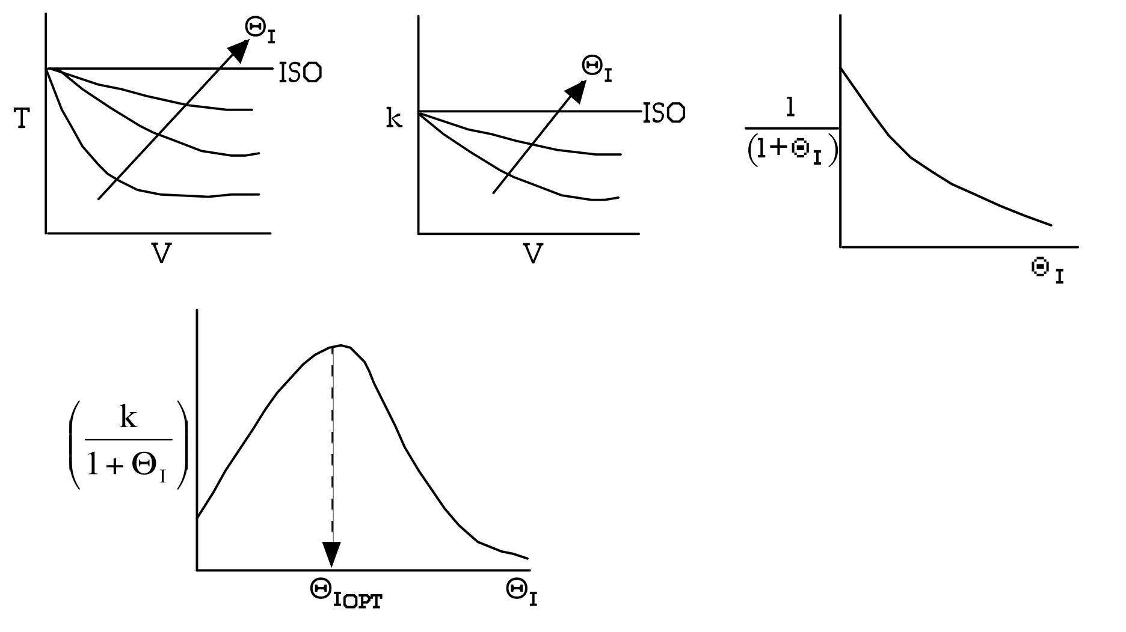
Endothermic
First Order Irreversible
As inert flow increases the conversion will increase. However as inerts increase, reactant concentration decreases, slowing down the reaction. Therefore there is an optimal inert flow rate to maximize X.

Slide 35
Gas Phase Heat Effects
Adiabatic:
As T₀ decreases the conversion X will increase, however the reaction will progress slower to equilibrium conversion and may not make it in the volume of reactor that you have.
Therefore, for exothermic reactions there is an optimum inlet temperature, where X reaches X_{eq} right at the end of V. However, for endothermic reactions there is no temperature maximum and the X will continue to increase as T increases.
X
X_{e}
X
X
T
T₀
T
T

Slide 36
Gas Phase Heat Effects
Effect of adding inerts
Adiabatic:
X_{e}
X
X
V₁
V₂
X
T
T
T₀

Slide 37
Exothermic Adiabatic
k
θ_{I}
As θ_{I} increase, T decrease and

Slide 38
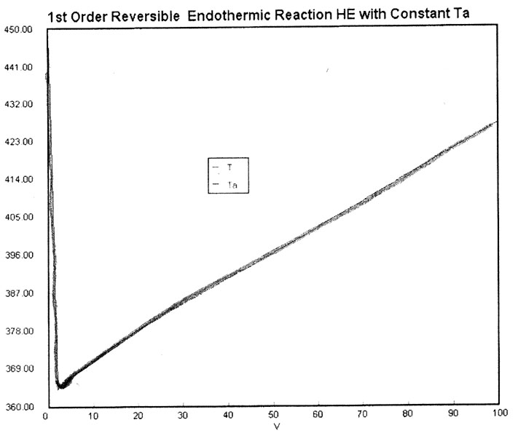

Slide 39
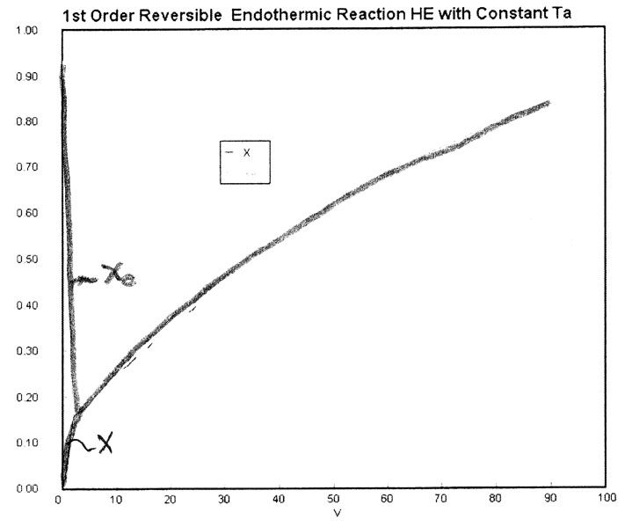

Slide 40
Adiabatic
Exothermic
Endothermic

Slide 41
Heat Exchange
Exothermic
Endothermic

Slide 42
End of Web Lecture 21
End of Class Lecture 17

